Slide 1
Tshepo Makgoba Data Scientist|Developer 10 March 2021
distinguish between different types of fruits

Slide 2
MEETING OBJECTIVES
Project background and Overview
Exploratory Data Analysis
Modeling & Results
Solution & Production architecture

Slide 3
Background & Problem statement
This is a supervised classification machine learning problem. It is supervised because there is labelled features and the target that will be used for prediction. During training the model is fed the features and target to learn how to map the data to a prediction. Moreover, this is a classification task because the target value is discrete classes (as opposed to continuous values in regression)
The fruits dataset was created by Dr. Iain Murray from University of Edinburgh. He bought a few dozen oranges, lemons and apples of different varieties, and recorded their measurements in a table. And then the professors at University of Michigan formatted the fruits data slightly and it can be downloaded at the link available in the Reference Documents section above.

Slide 4
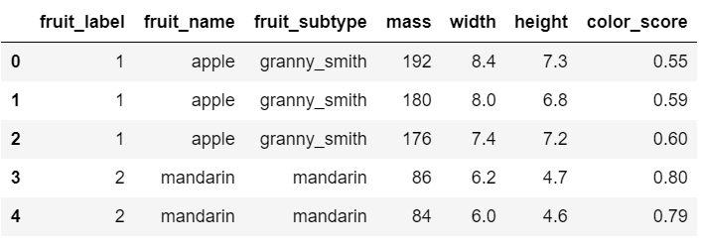
Exploratory Data Analysis
Data view & Key features overview
WHEN | WHAT | WHO | WHERE | HOW
 | Fruit_name
 | Fruit_label
 | Height
 | Fruit_subtype
 | mass
 | width
 | Color_score

Slide 5
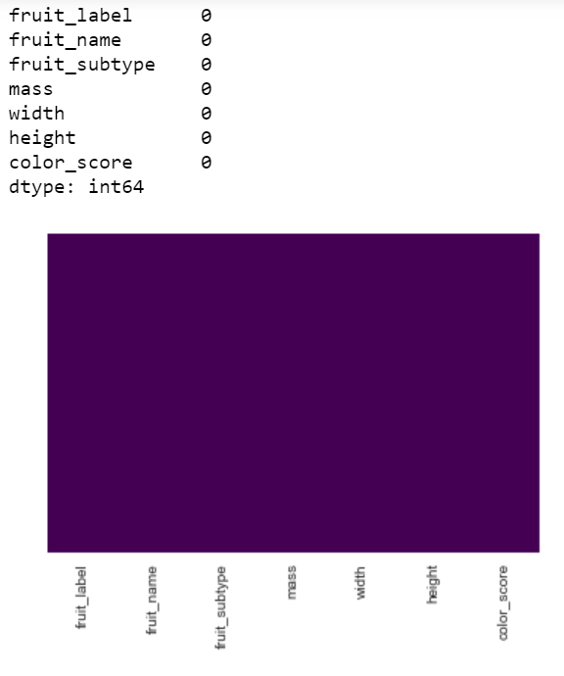
Missing values
Exploratory Data Analysis
No Missing values
Approach to impute for future reference
Categorical base imputer
Mean imputer
Median imputer
Drop na

Slide 6
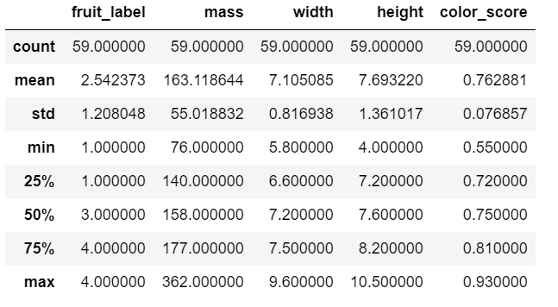
Exploratory Data Analysis
Descriptive Statistics
The numerical values do not have the same scale. Scaling is required for this dataset. There are no data points that immediately appear as anomalous and no zeros in any of the measurement columns.

Slide 7
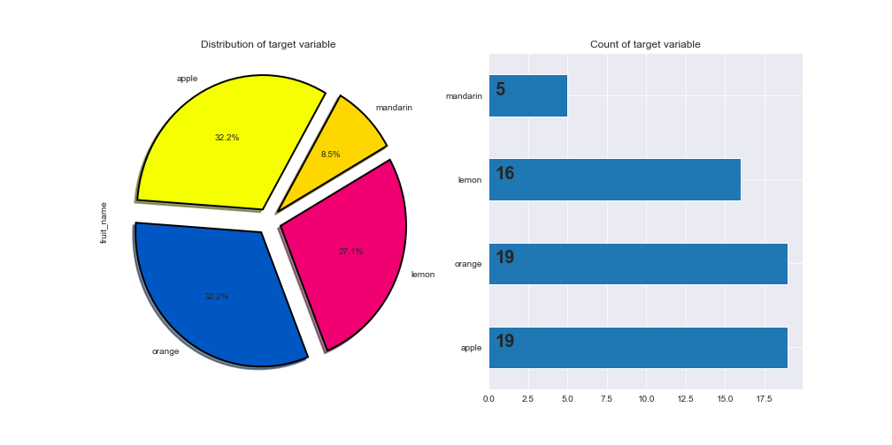
Exploratory Data Analysis
Data balance
The data is pretty much balanced except mandarin
To also improve the model performance. The target variable must be balanced

Slide 8
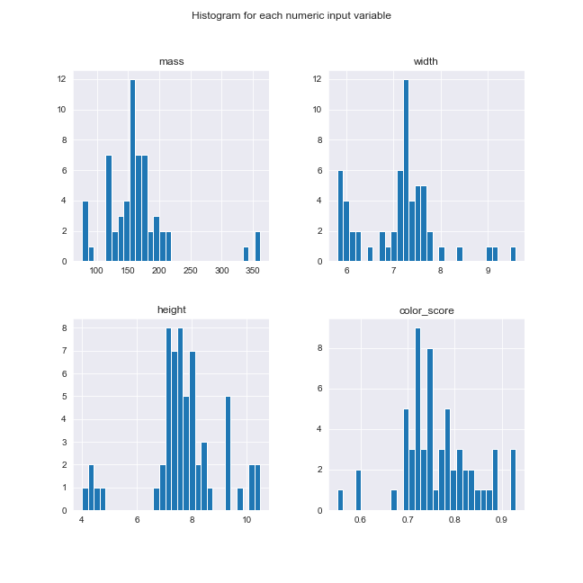
Exploratory Data Analysis
Feature distribution
Some pairs of attributes are correlated (mass and width). This suggests a high correlation and a predictable relationship. Thus a presence of multicollinearity

Slide 9
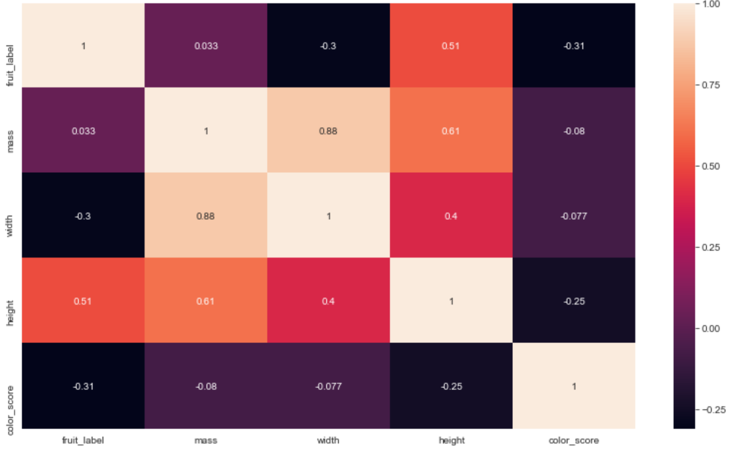
Exploratory Data Analysis
Feature correlation

Slide 10
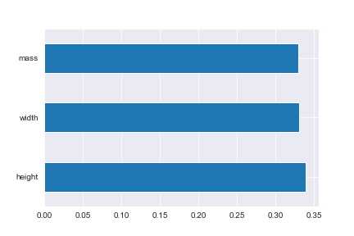
Exploratory Data Analysis
Feature importance

Slide 11
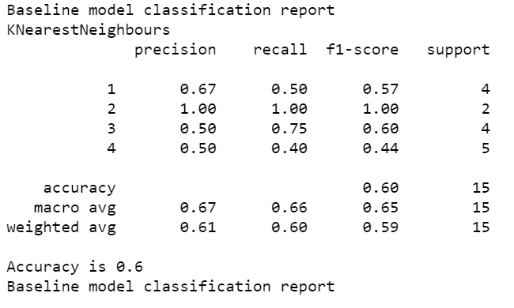
Modeling
Baseline Classifier
The baseline model accuracy is 60%. Which will act as a baseline to all models

Slide 12
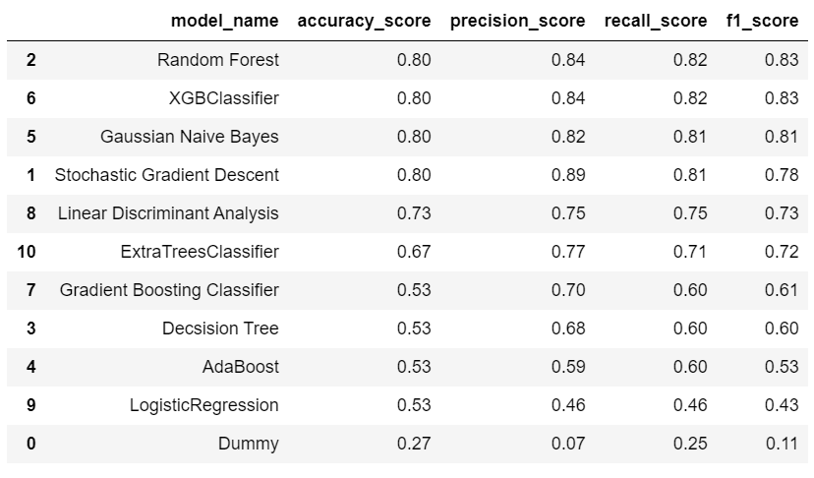
Modeling
Classifiers
Performance of all the classifier models before parameter tunning

Slide 13
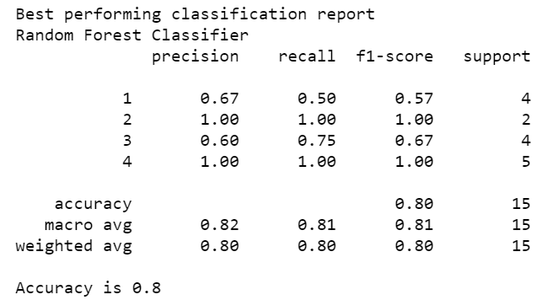
Modeling
Best performing Classifier
The best performing model after parameter tuning. The accuracy is 80%
And can still be improved.
It was obtained through grid search

Slide 14
Modeling
Parameter tuning
Used grid search
For Random Forest Classifier

Slide 15
Solution & Production architecture
End to end pipeline for fruits classification model
Model evaluation
& validation
Model deployment
Data Analysis
Data Transformation
Feature engineering
Model training
Data Collection
SLA understanding
Model monitoring
Data Visualization
Model explanation
Data Understanding
Business understanding
APIs or Dashboard or Report
Problem definition

