Slide 1

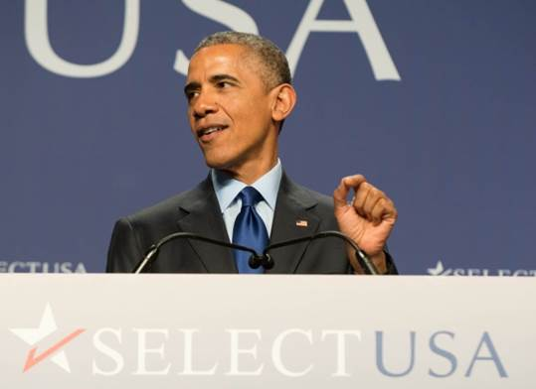

Hannover Messe 2016 Partner Country – United States
HANNOVER FAIR 2016 PARTNER COUNTRY – UNITED STATES
April 24-29, 2016
Hannover, Germany
The Investment Pavilion is almost sold out!
Act now to reserve your spot!
President Obama is attending!
Click HERE to read the White House Announcement
Click Here to Watch USA Partner Country Video!

Slide 2
Top-Line Points
2
Please Join Us in Hall 2 or Hall 3!
#1 show for Industrial Technology, Products, R&D (“Digital Factory”)
Huge: 200,000 attendees (68% decision-makers), 6,500 exhibitors
Global: 70 countries (China: 800. India: 400. Turkey: 300. W. Europe)
U.S. Partner Country = prime location + exposure, huge media (2,500)
Hall 2: Centerpiece U.S Investment Pavilion (24,000 sq. ft.) for EDOs
Hall 3: Research + Technology (colleges/universities, start-ups, labs)
High-Level Administration presence at the Investment Pavilion
Investment Services: Preparation + Promotion (slide #9)
Your Next Steps
Register your interest @ http://tinyurl.com/zp55vf2
(If EDO, select ”Economy” for “Select Your Industry”)
Review Investment Booth options (slides #9-10)
Submit contract to German-American Chambers of Commerce (slide #18)
Review Research + Technology Pavilion (slides #13-14)
Contact me if questions: david.campbell@trade.gov. Tel. (202) 482-4750
Source: U.S. Bureau of Economic Analysis. FDIUS Data. http://www.bea.gov/international/di1fdibal.htm

Slide 3
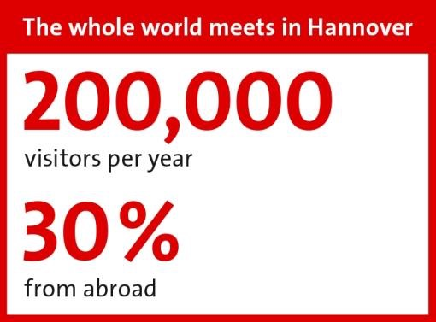
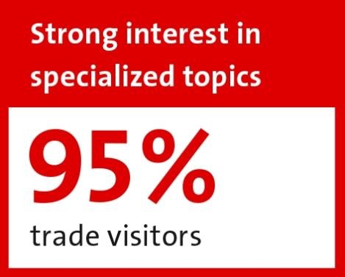
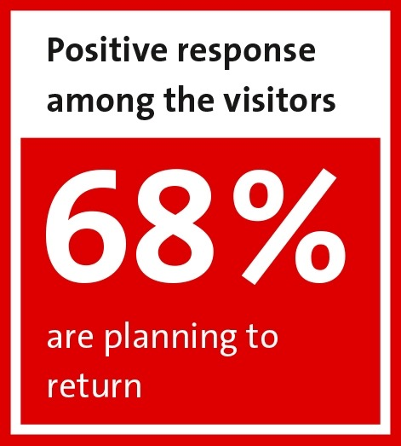
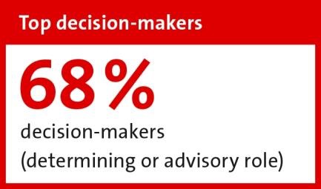
the world’s LARGEST TRADE SHOW FOR INDUSTRIAL GOODS & TECHNOLOGY
3
The United States will be Partner Country at the 2016 Hannover Fair!
http://trade.gov/events/hannovermesse/
5.5 million
business contacts in 5 days
6,500 exhibitors
from 70 countries
150 business delegations
from across the globe
2,500 journalists from 42 countries
16 Halls & Pavilions
(5.3 million sq. ft.)

Slide 4
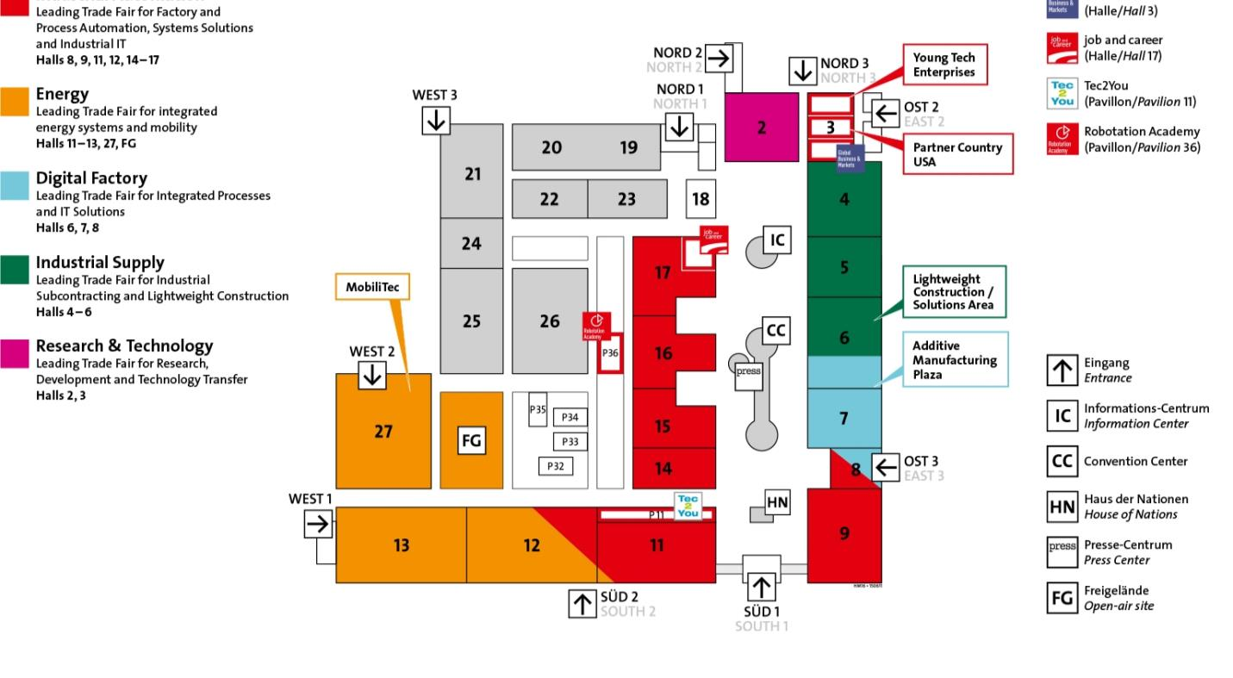
EXHIBITION HALLS
4
The Research & Technology Hall (Hall 2) is for Colleges/Universities, Research Labs, Start-ups, etc.
Partner Country USA is
located in Hall 3
16 Total Halls
7 U.S. Industry Pavilions and a National Investment Pavilion
SME Exhibitors in the Industry Pavilions. EDOs in the National Investment Pavilion

Slide 5
U.S. investment pavilion & 8 industry PAVILIONS
5
U.S. Investment
50 U.S. EDOs
Instrumentation, Sensors
and Controls
Safety and Security Technology
Process and Production Automation
Industrial Supply
Assembly/ machine construction
Steel & non-ferrous materials
Room for Related Organizations (Chambers , Service Providers)
Exhibitor booths start at ~ $9,000 (4 options)
Smart Factory Components
Microelectronics and hybrid technology
Exhibitor booths start at $7,560
Automated engineering
Motor components
Ventilators and fans for electrical devices
Cable and wire equipment
Fastener systems
Lightweight construction products
Learn More
Learn More
Learn More
Learn More
Energy
Smart Grids
Research & Technology
Start-up Companies
Automation Technology and IT
MobiliTec
3D Printing
Alternative Fuel
Environmental Tech
Power Systems
Pipeline Tech
R&D Labs
Universities
Life Science and Nano Tech
Industry Software and Engineering
Open Source data associations
Software solutions
Hybrid drive tech
Technical publications
Learn More
Learn More
Learn More
Learn More
U.S. Materials
Intelligent Surfaces
Nanotechnologies
Lightweight Materials and Composites
Learn More
A great opportunity for Economic Development Organizations, U.S. Companies, Academia, and Research & Technology Organizations
For more information about the Industry Pavilions, please contact
Juanita Harthun. Tel. (704) 333-4886 x224. hannovermesse@trade.gov

Slide 6
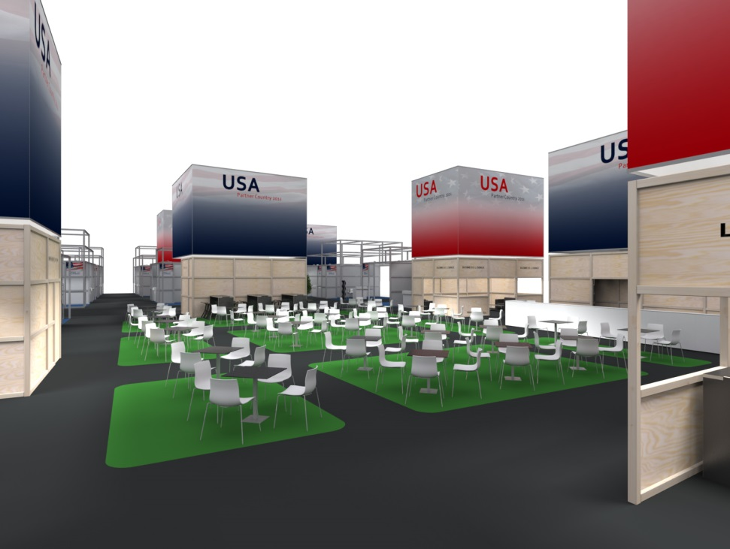
U.S. NATIONAL INVESTMENT PAVILION
6
Less Than 15 Booth Left: Act Now to Reserve Yours!
Meet one-on-one with potential investors, government officials, and other interested parties
Emphasize why your U.S. jurisdiction is a prime location for business investment
Easy access to the Research & Technology Pavilion (next to Hall 3)
Refer investors with federal questions to the SelectUSA booth
Exhibitors have access to on-site support, on-demand interpretation, and additional meeting and lounge space in the pavilion
Increased visibility, signage, TV and press coverage, accompanying seminars, substantive discussions
For more information about Investment Services (pre-show/on-site): David Campbell. Tel. (202) 482-4750. david.campbell@trade.gov

Slide 7
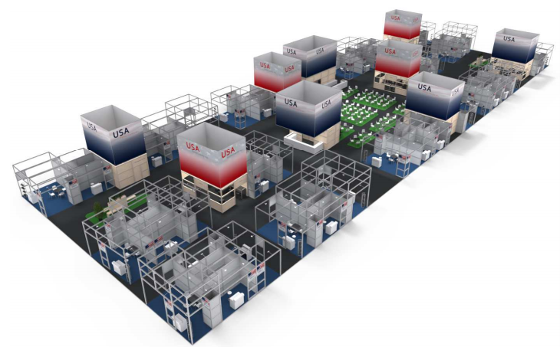
U.S. NATIONAL INVESTMENT PAVILION
7
Did your State receive a STEP grant for FY2016? You may be able to apply STEP $ to facilitate attendance at HM16. See slide #17
U.S. Partner Country spotlight
Hall 3 (“Global Business & Markets Exhibition Hall for Investment, Economic Development and Joint Ventures”)
Focal Point for Partner Country Activities: Ribbon Cutting by Heads
of State. Partner Country Reception
For U.S. EDOs (state, regional, etc.)
Open Networking Area
Private Meeting Space
SelectUSA Investment Services including Promotion + Preparation
Will attract companies, investors, foreign officials and media
4 options: packages start at ~ $9,010
Goal: 50 EDO Exhibitors + SelectUSA
http://tinyurl.com/o8nb232
X
24,000 sq. ft.
The Pavilion was increased to 36,000 sf
to meet overwhelming demand!!
We are contacting EDOs with the German-American Chambers of Commerce (GACC).
Their contact information is on slide #18
For more information about the Investment Pavilion, contact
David Campbell. Tel. (202) 482-4750. david.campbell@trade.gov

Slide 8
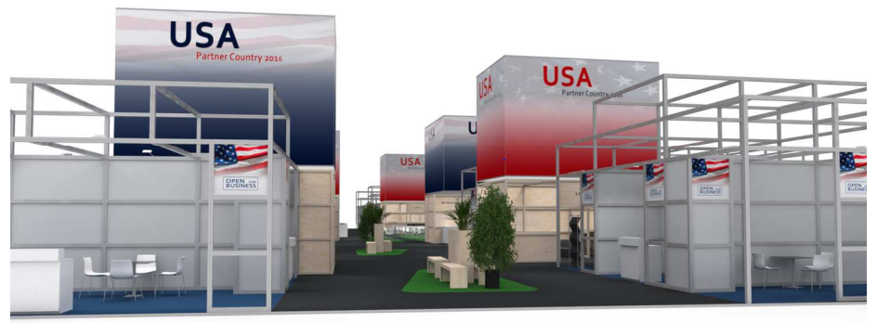
U.S. NATIONAL INVESTMENT PAVILION
8
Payment Terms
Purchasing EDO (main exhibitor) pays processing fee (~ $400) when contract is received
Basic rent (e.g. ~ $9,000 for Bronze booth) is due by January 10, 2016
Each EDO co-exhibitor (Platinum booths only) pay nominal registration fee (~ $400)
The U.S. Investment Pavilion will have unified logo, messaging & colors
Branding will be consistent to the 8 U.S. Industry Pavilions
Enhanced marketing and promotional to potential investors, partners, and international media before and during the show help you to connect to 200,000 attendees

Slide 9
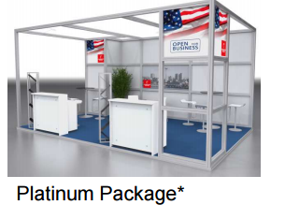
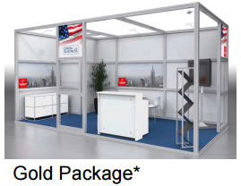
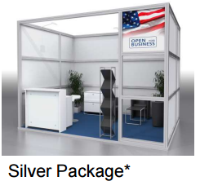
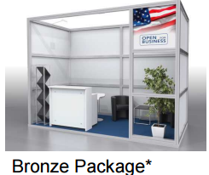
U.S. NATIONAL INVESTMENT PAVILION
9
EDOs purchasing Platinum booths can add up to 3 additional EDOs to join their booth
Each co-exhibiting EDO pays a nominal registration fee of ~ $400
This may be your best value!
FDI Investment Services
Preparation: webinars + guidance to maximize your time on-site
Promotion: making sure Exhibitors + Attendees know you are coming!
EDO profiles to 25 target markets
Exhibitor information to EDOs
DMAG emails to Attendees
On-Site: recording investor contact information (in-take booth); on-site counseling and conversations
€24,500
(~ $27,000)
260 sq. ft.
€18,500
(~ $20,000)
194 sq. ft.
€12,500
(~ $14,000)
130 sq. ft.
€8,500
(~ $9,000)
87 sq. ft.
* Illustration contains optional fixtures / furnishings

Slide 10
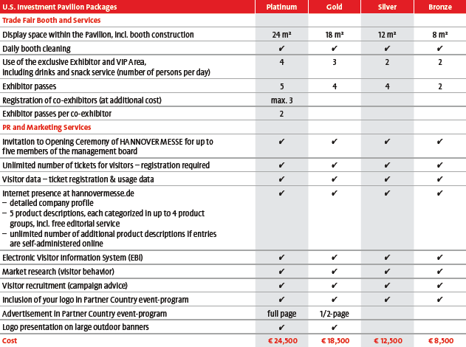
U.S. NATIONAL INVESTMENT PAVILION PACKAGES
10
Booths awarded on “first-come”, “first-serve” basis
EDOs can select
4 booth packages (incl. multiples)
Contracts processed by German-American Chambers of Commerce (GACC) for
Deutsche Messe AG
GACC contact information on slide #18
For more information about booth contracts and packages, please contact
Marco Siebert. Tel. +011 49 511 89-31619. Marco.Siebert@messe.de
Kathrin Schmidt. Tel. +011 49 511 89-31106. Kathrin.Schmidt@messe.de

Slide 11
U.S. INDUSTRY PAVILIONS
11
Intended primarily for U.S. small- & medium-sized companies (SMEs)
Turnkey packages make it easy U.S. companies to secure space
Hannover Fairs USA (HFUSA) manages logistics
Packages start at $7,560 for 9 sq. meters (10’ x 10’) in a row booth
NOTE: advertised exhibiting rates independent of the pavilion are for raw space only, do not include amenities like carpeting, internet, etc., and would require significant coordination by our clients.
Exhibitors have access to on-site support, on-demand interpretation, and additional meeting and lounge space in the pavilion
Increased visibility, signage, TV and press coverage, seminars, discussions
Enhanced marketing and promotional efforts to potential buyers, partners, international media before and during the show help you to connect directly to 200,000+ attendees
Turnkey Packages include:
Booth for 9 square meters (10’ x 10’) in a row booth with wall elements and carpeting
Overhead company name sign and company logo
Furniture package – 1 table, 3 chairs, 1 lockable info counter, 1 barstool, 1 literature rack, 1 waste bin
Overhead spotlights
Electrical receptacle with 2 KW service
Internet connection
1 company profile listing and 5 product descriptions in online catalog
2 exhibitor entrance tickets
Unlimited complimentary visitor tickets
Multilingual Pavilion Concierge
Interpreter service by appointment
Pavilion Office
Shared meeting lounge
Nightly Cleaning and security
For more information about the Industry Pavilions:
Juanita Harthun. Tel. (704) 333-4886 x224 hannovermesse@trade.gov

Slide 12
U.S. EXHIBITOR SUPPORT
12
PRE-MESSE
Industry-specific counseling utilizing market intelligence and expertise from across the DOC
“Know Before You Go” educational webinars
Internet Presence on ITA & Hannover Messe Website
Exposure to Potential International Buyers via Worldwide Commercial Service promotional efforts
AT-MESSE
Executive Market Counseling Program: Receive insights into global industry trends and identify best market opportunities for your product/service through personalized counseling with Commercial Service industry experts
International Partner Promotion Program: Facilitated introductions to international buyers, distributors and investors
Numerous networking events are designed to feature the United States, including invitations for U.S. exhibitors to attend the prestigious Opening Ceremony Networking Event and Business Summit
Whether you are an experienced exhibitor or attending for the first, our team of international trade specialists are available to help maximize your exposure at the show
POST-MESSE
Follow up support on market entry strategies
Assistance in developing relationships with leads from the show
Customized matchmaking services in markets of interest*
Background checks or vetting potential partners*
For more information about U.S. Company recruitment & export services:
Debora Sykes. Tel. (609) 896-2734. debora.sykes@trade.gov
Ryan Russell. Tel. (412) 644-2817. ryan.russell@trade.gov
* Commercial Service fee based programs

Slide 13
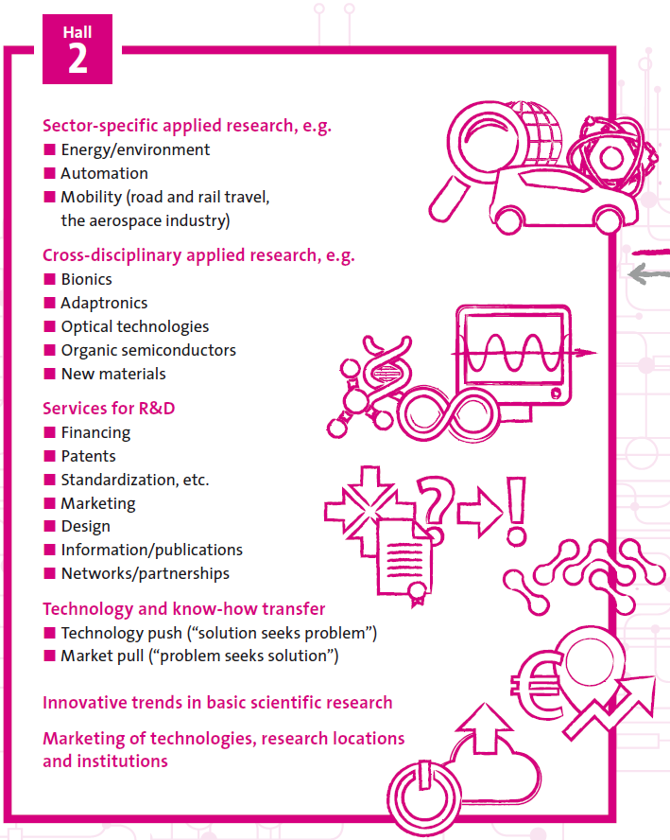
research & technology Hall
13
Intersecting with all the key industries
Innovation to drive the global economy
Research & Technology attracts more visitors than any other trade show of its kind world-wide, and covers more areas.
Featuring high-caliber speakers and themed parks, Hall 2 is the Fair’s innovations hub.
Decision-makers and investors from 70 nations come here seeking new ideas to gain advantage over their global competitors.
Topics : Industry 4.0, smart energy, robotics, lightweight construction, nano-technology, organic electronics, plus more!
Hall 2 Events:
“Night of Innovation” – Hall 2 bedazzles on the Fair’s first evening. R+T exhibitors remain on-site for Q+A. Exciting shows, displays and live music set the tone.
“Tech Transfer” Initiative – fact-finding contact platform for thinkers and businesses to search for new ideas.
“Day for Ideas” – with a matchmaking stand and online exchange forum.
The cream of applied research ~All the key technologies ~The most important buyer industries
All under one roof : only at Hannover Fair!

Slide 14
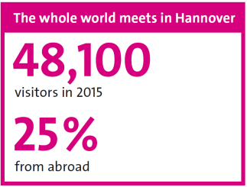
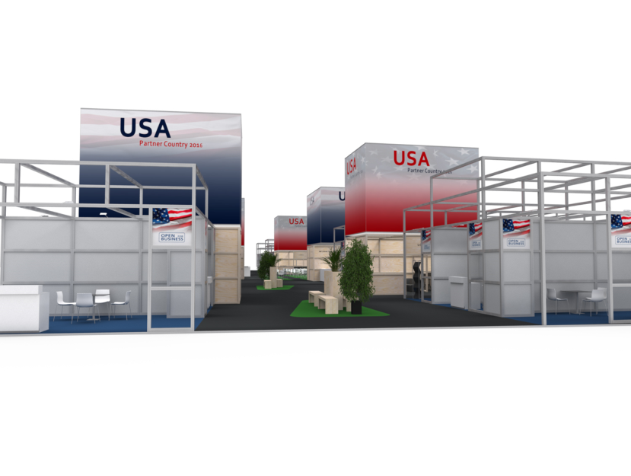
U.S. Research & technology PAVILION
14
Intended primarily for U.S. academia, labs, start-ups, R&D organizations
Hall 2
Topics
Sector-Specific Applied Research: Energy/Environment, Automation,
Mobility (Road & Railroad Travel, Aerospace )
Cross-Disciplinary Applied Research: Bionics, Adaptronics, Optical Technologies, Organic Semiconductors, and New Materials
Services for R&T: Financing, Patents, Standardizations, Marketing, Design, Information/Publications, and Networks/Partnerships
Technology and Know-How Transfer: Technology Push (“Solution seeks Problem”) and Market Pull (“Problem seeks Solution”)
Innovation Trends in Basic Scientific Research
Marketing of Technologies, Research Locations, and Institutions
Innovations on a global scale – Innovative solutions, cutting-edge technology, and new product launches attract highly-qualified professionals from your target sectors worldwide
New networks – Over 200, 000 attendees and 150 delegations from industry, business, academia, and government offer huge potential for developing new partnerships
Promising new contacts – Senior decision-makers with firm project commitments come to Hannover from every continent to invest in new technology
Maximum media exposure – International press conferences, preview events, and over 2,500 journalists from 42 countries in attendance
For more information:
Carla Menendez. carla.menendez@trade.gov
Christina Sharkey. christina.sharkey@trade.gov

Slide 15
Manufacturing supports local communities
15
FDI contributes to trade: foreign-owned affiliates in the U.S. account for 21% of all U.S. goods exports
Foreign-owned affiliates in the U.S. are closely tied to manufacturing. Multinationals (foreign-owned affiliates) that export are typically goods producers
Manufacturers are major employers. Workers in manufacturing industries make up 10% of U.S. private industry employment
FDI-supported jobs are concentrated in manufacturing. Foreign-owned affiliates in manufacturing account for 18% of all U.S. manufacturing workers.
Manufacturing is the largest contributor to U.S. FDI: 36% of total FDI stock ($1.05 trillion) was invested in manufacturing at the end of 2014. Over 37% of total FDI-supported jobs (5.8 million) are in manufacturing
Manufacturing FDI has grown faster than FDI in all other industries since 2009
The U.S. workforce is among the most productive in the world: output per hour is 25% above the average of the world’s mature economies
Manufacturing industries are growth industries: by 20215, it is estimated there will be 2 million jobs available in manufacturing sectors
For every $1 in goods produced, the U.S. manufacturing industry returns $1.37 to the economy. That adds up to $2.09 trillion dollars
Sources: U.S. Bureau of Economic Analysis, The Conference Board Total Economy Database

Slide 16
Fdi stock in u.s. manufacturing industries (2014)
16
Total Stock: $1.05 Trillion
(36% of total U.S. FDI)
Source: U.S. Bureau of Economic Analysis. FDIUS Data. http://www.bea.gov/international/di1fdibal.htm

Slide 17
Fiscal year 2016 step grants
17
SBA announces 40 awards from the State Trade and Export Promotion (STEP) program to states and territories to support increased exporting by small businesses.
If you [EDO] identified Hannover Messe in your STEP application, you can apply that $ to HM16.
If not, If you have an approved Stipend Program, you may be able to allocate part of your FY16 STEP grant to HM16.
Contact your local SBA office for details: http://tinyurl.com/ndzg4r4
State | Award | State | Award
Alabama | $115,251 | Nebraska | $300,570
Arkansas | $207,535 | Nevada | $300,000
California | $747,781 | New Hampshire | $199,878
Colorado | $195,938 | New Jersey | $498,000
Connecticut | $350,000 | New Mexico | $193,700
Delaware | $276,741 | New York | $663,893
Hawaii | $750,000 | North Carolina | $746,800
Idaho | $346,708 | North Dakota | $287,694
Illinois | $685,855 | Ohio | $700,000
Iowa | $190,000 | Oregon | $450,000
Kansas | $296,533 | Pennsylvania | $698,613
Kentucky | $400,000 | Puerto Rico | $288,650
Maine | $161,048 | Rhode Island | $373,000
Maryland | $518,413 | South Carolina | $349,218
Massachusetts | $500,000 | Utah | $395,000
Michigan | $750,000 | Vermont | $174,461
Minnesota | $564,132 | Virginia | $578,500
Mississippi | $540,100 | Washington | $747,300
Missouri | $599,000 | West Virginia | $200,000
Montana | $347,688 | Wisconsin | $712,000
The FY16 awards help states to assist small businesses with export related activities or other export initiatives that are in line with the objectives of the program.
These objectives include participation in foreign trade missions.
http://www.sba.gov/news

Slide 18
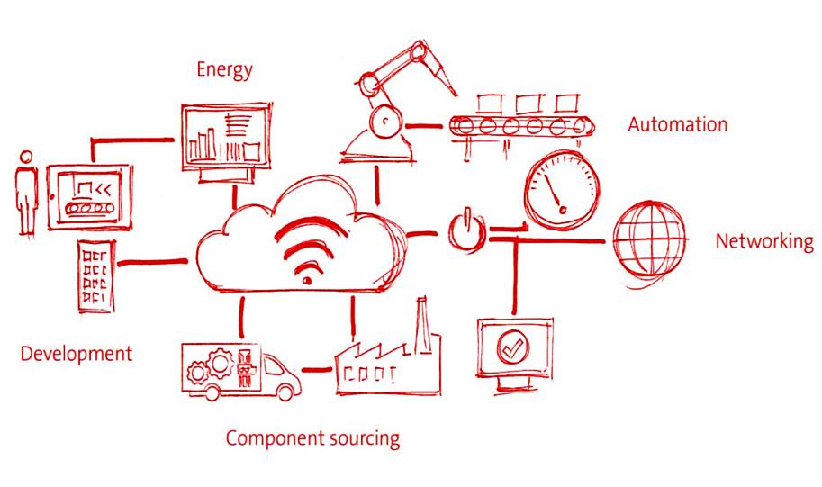
Key Dates Facts & Figures
18
Click Here for Hannover Fair Promotional Videos
EVENT DATES + Locatoin
April 24-29, 2016. Hannover, Germany
PARTICIPATION FEE
U.S. Industry Pavilion Prices Start at $7,560
Investment Pavilion Prices Start at ~ $9,000
WEBSITE
http://trade.gov/events/hannovermesse/
CONTACT DETAILS
Industry Pavilions:
Email juanita.harthun@trade.gov or call (704) 333-4886 x224
U.S. Investment Pavilion:
Email david.campbell@trade.gov or call (202) 482-4750
GACC Contact Information:
Virginia Rounds @ rounds@gaccmidwest.org. Tel. (312) 494-2163
Will Middlebrooks @ wmiddlebrooks@gaccsouth.com. Tel. (404) 586-6819
Susanne Rehse @ srehse@gaccny.com. Tel. (212) 974-8836
U.S. Company Recruitment / Export Services: U.S. Research & Technology Pavilion:
Email debora.sykes@trade.gov or call (609) 896-2734 Email carla.menendez@trade.gov or call (410) 962-4534
Email ryan.russell@trade.gov or call (412) 644-2817 Email christina.sharkey@trade.gov
Email bernhard.spitzenberg@messe.de or call +49 511 89 31 319

