Slide 1
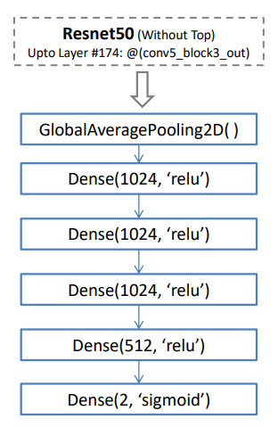
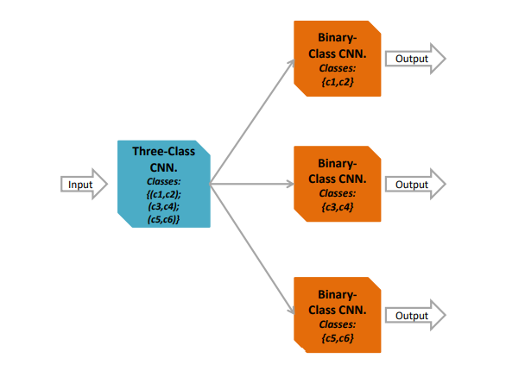
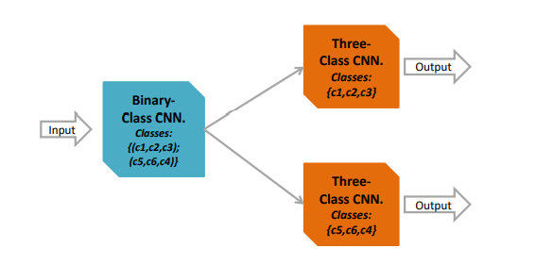

Architecture
Four-Class Classification using Proposed Technique
Ensemble Structure #1 for Six-Class Classification. using Proposed Technique

Slide 2
Dataset details
Natural Images https://www.kaggle.com/datasets/prasunroy/natural-images
Samples:
It includes 4338 files for (Training, Validation & Testing)
Number of Classes and their labels:
6 classes
Labels:
(Airplane, Car, Dog, Flower, Motorbike, Person)
Monkey Species
https://www.kaggle.com/datasets/slothkong/10-monkey-species?resource=download
Samples:
It includes 2488 files for (Training, Validation & Testing)
Number of Classes and their labels:
6 classes
Labels:
(“patas_monkey”, “bald_uakari”, “japanese_macaque”, “white_headed_capuchin”, “silvery_marmoset”, “black_headed_night_monkey”)

Slide 3
Implementation Details
Resizing to 224 images
In All the CNNs we use Adam Optimizer for training, with mini-batch size of 32 for larger image categories and of 16 for smaller ones,
The CNNs are trained using early stopping. We use loss function in binary cross-entropy for binary-class CNNs and categorical cross-entropy for multiclass CNNs.
We divide the experiments into two sets based on the number of classes used for classification : ( four and six, respectively )

Slide 4
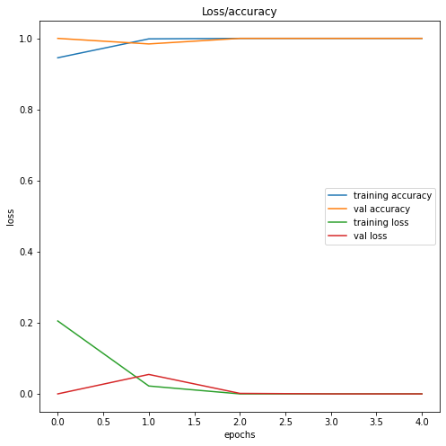
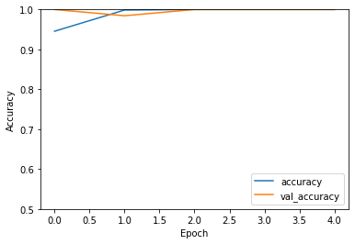
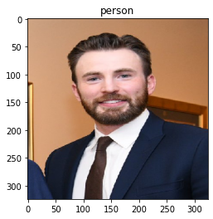
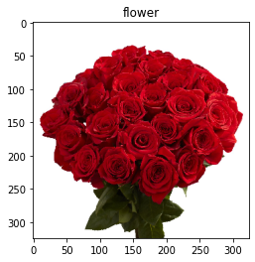
Results & Visualizations

