Slide 1
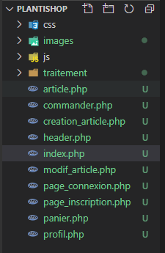
Plantishop
Linux Ubuntu 20.04
Apache 2.4
php7.2
JavaScript (ES5)
HTML5
CSS3

Slide 2


Slide 3


Slide 4


Slide 5
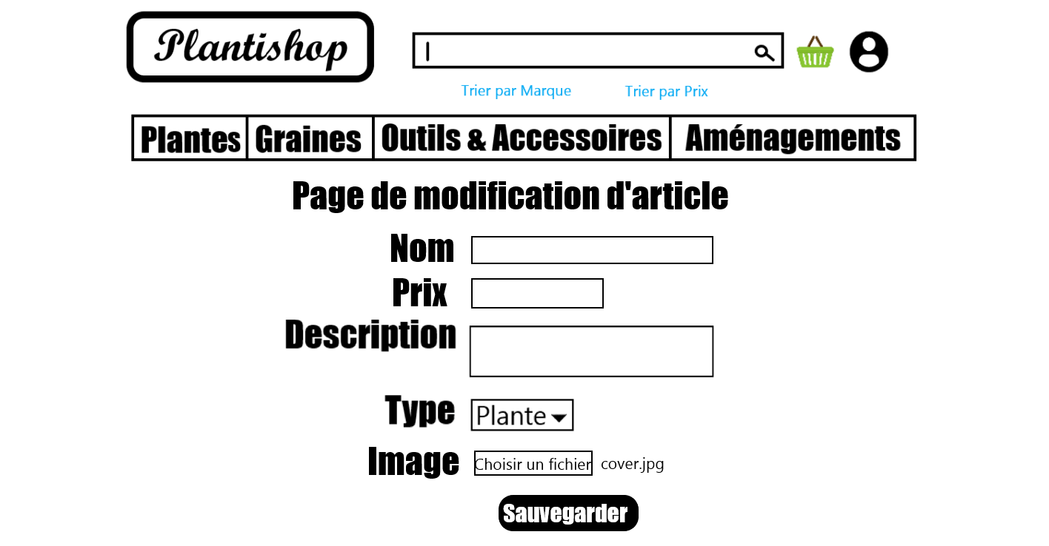

Slide 6
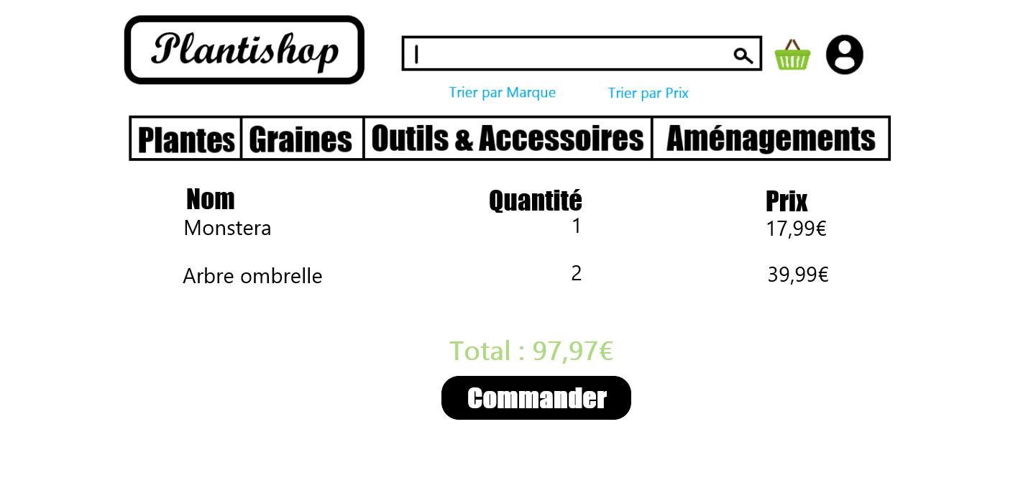

Slide 7
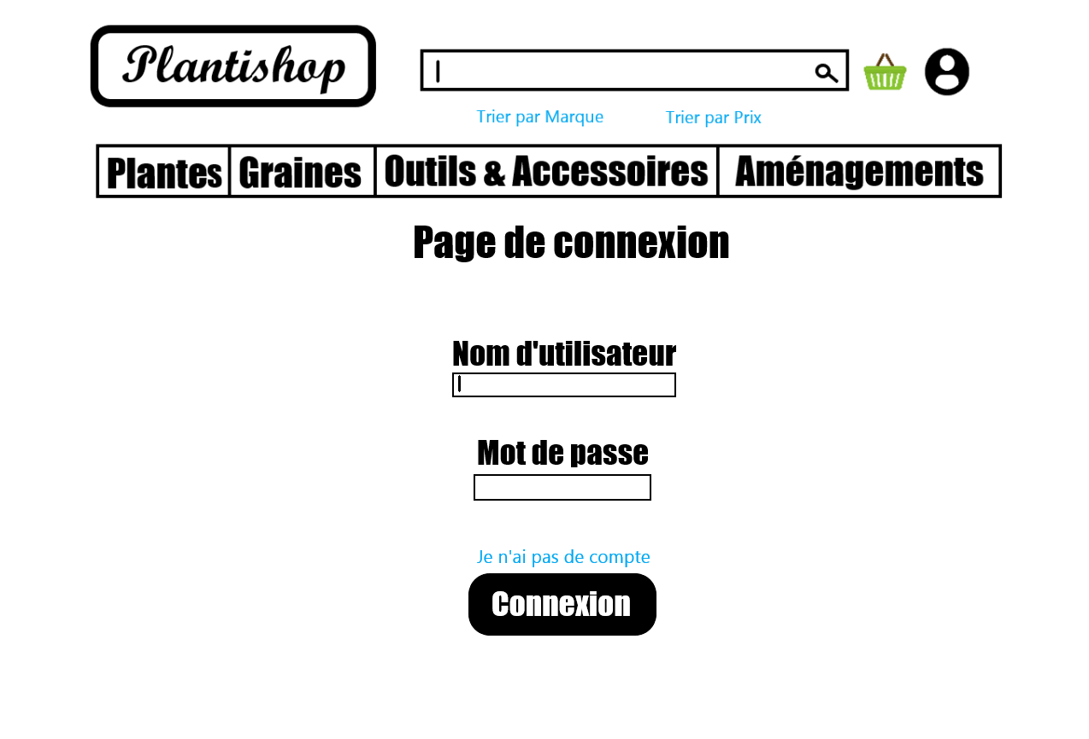

Slide 8
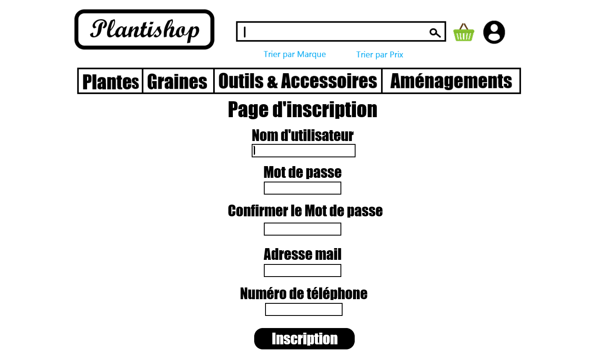

Slide 9
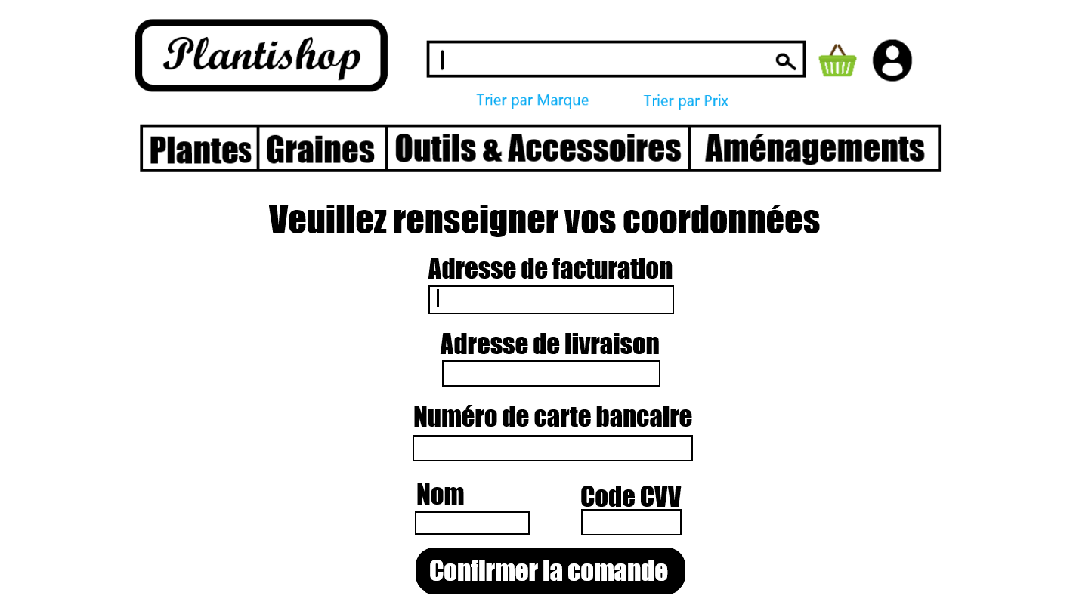

Slide 10
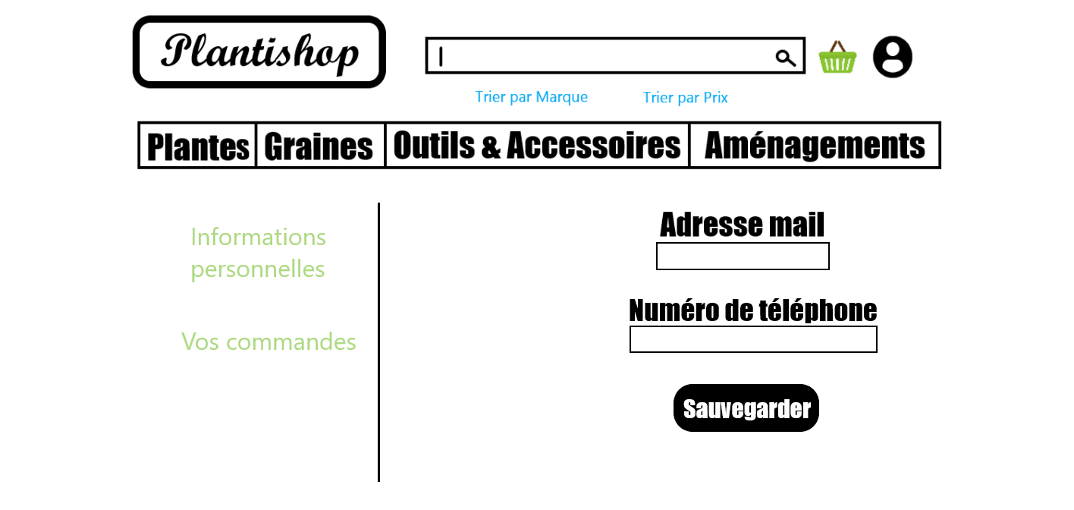

Slide 11
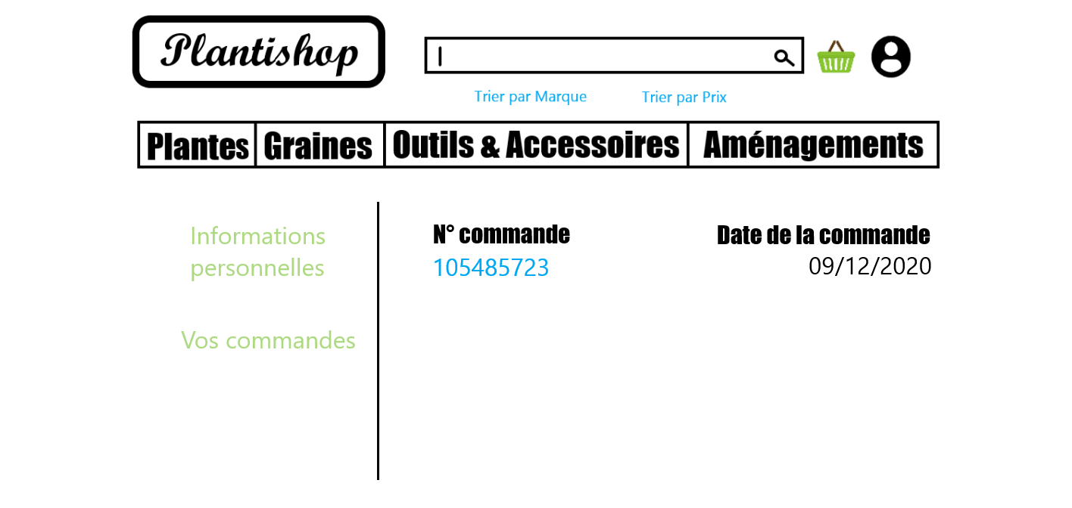

Slide 12
