Slide 1
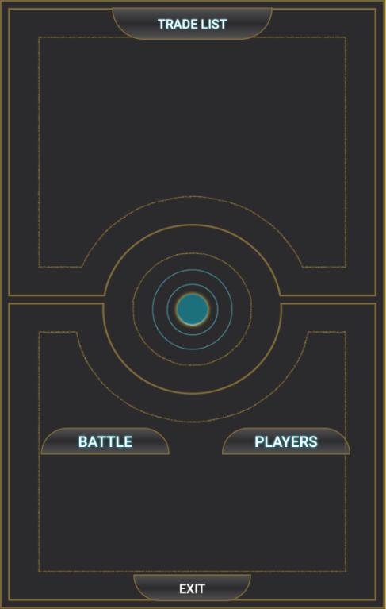
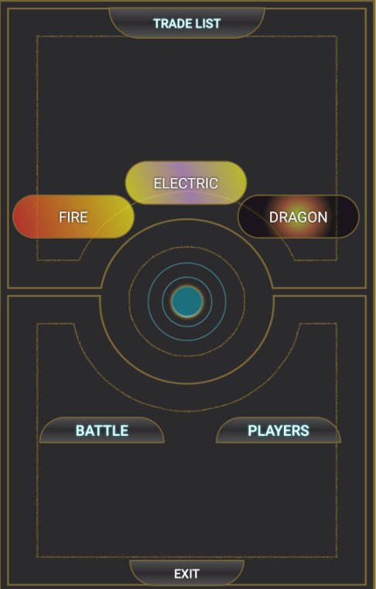
Generates Random style and text for TextViews
Change to Activity
pokemon_list.class
Hide Buttons and TextViews
Change to Activity
playerList.class
Exit the App

Slide 2
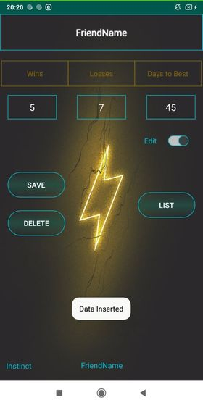

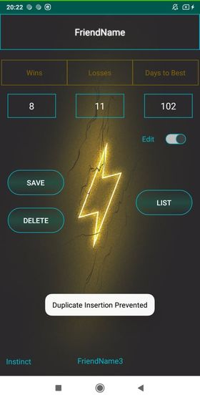
Updating Database while EditText field and Spinner position align
Preventing Insertion if the name already exists while the EditText field and Spinner position do not align

Slide 3
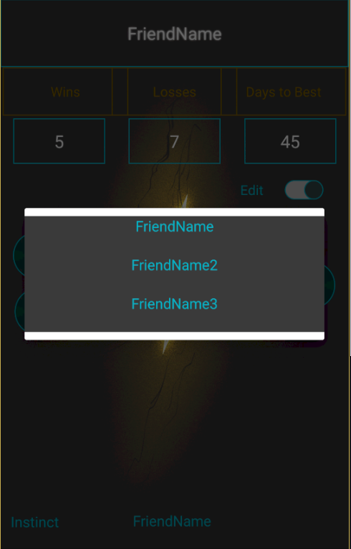
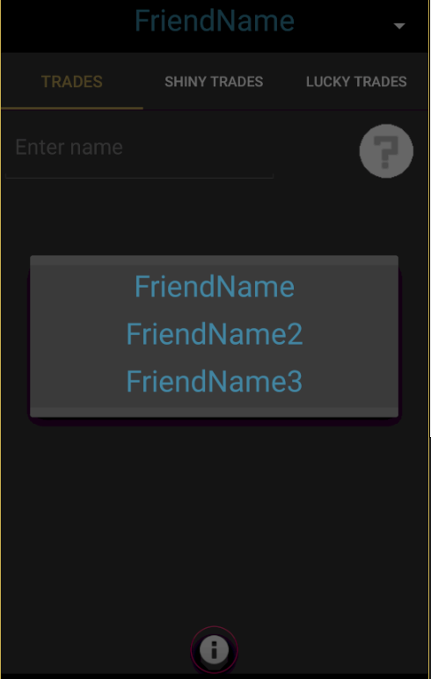
Spinner population from Rows
Spinner population from Tables
Class: playerList.java
Layout: activity_player_list.xml
Database: PlayerList.db
Class: pokemon_list.java
Layout: activity_pokemon_list.xm
Database: PlayerImageDB.db

Slide 4
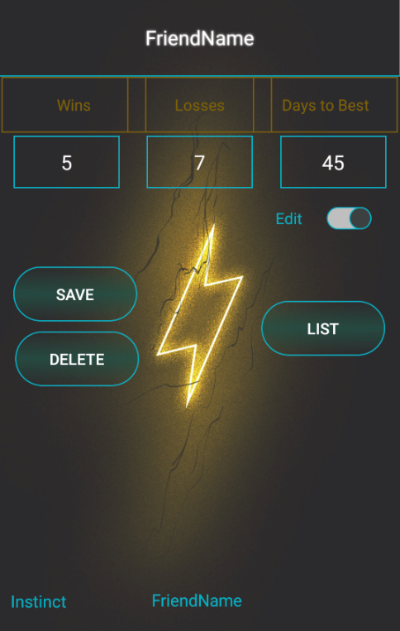
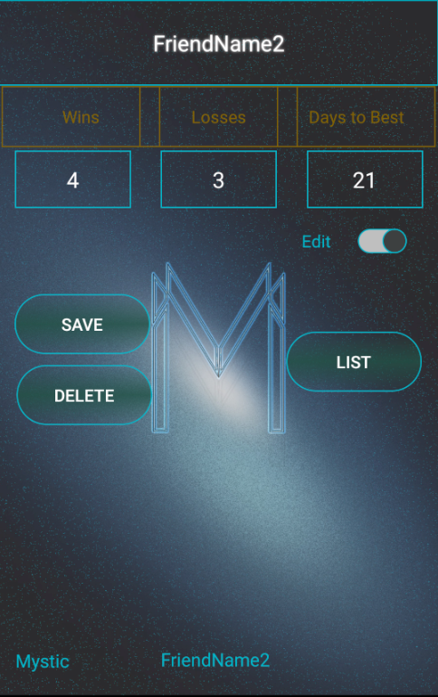
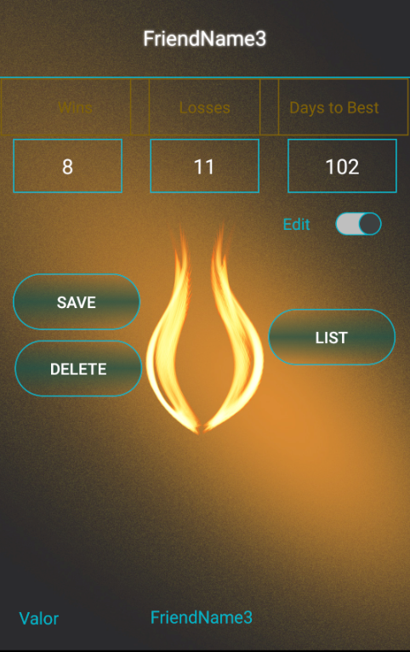

Slide 5
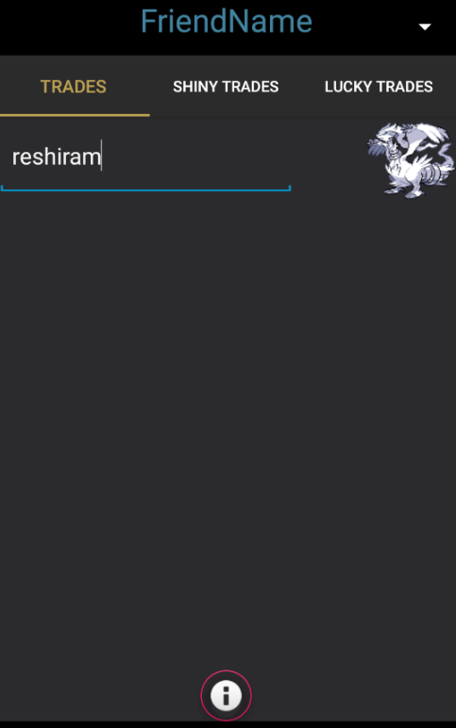
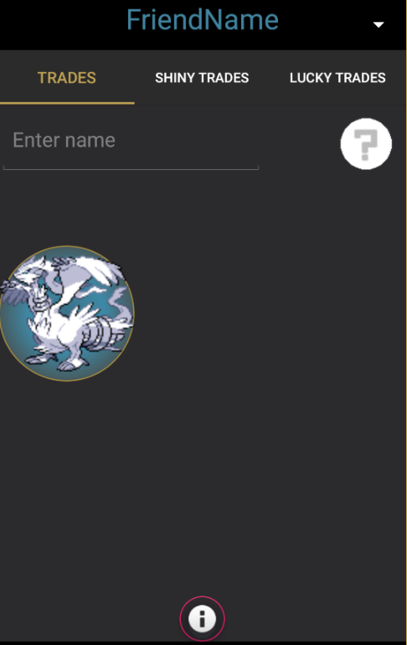
Search for the Image
in the Internal Folder of the Project
Tap the Icon to add to the Grid
After the text is changed the code compares the string in order to find the matching image

