Slide 1
CREDIT RISK / MANAGEMENT BRIEFING
Credit Risk Strategy
Where to focus, what to change,
and how to test it.
Management recommendation | Portfolio analysis and lending-review strategy
Selena Cha
A more selective review process—not broader approvals or blanket restrictions.
Presented by Selena Cha
October 2026
Notes:
Good morning. I reviewed where credit risk is concentrated and how well the current model identifies it. I want to recommend where I would focus lending reviews—and where I would avoid making the process harder for qualified borrowers.
The clearest comparison is New Car and Small Appliance: almost the same number of borrowers, but 23 more high-risk classifications in New Car. The model also misses 16 of the 42 high-risk cases in its holdout test.
I don't think the answer is to approve more applications indiscriminately or tighten every rule. I'll show which areas deserve attention, how a differentiated review process could work, and what evidence management should require before making a policy change.

Slide 2
CREDIT RISK / MANAGEMENT PROPOSAL
I recommend testing a better review process
before changing who gets credit.
The opportunity is to direct underwriting effort where it matters—and avoid extra friction for qualified borrowers.
425
Historical borrowers
211
Classified high risk
90 days
Proposed shadow pilot
Portfolio analyzed
49.6% of the portfolio
No immediate policy change
DECISION REQUEST
Approve validation and shadow-testing—not automatic lending decisions.
Notes:
I’m recommending a change to how applications are reviewed, not a blanket increase or decrease in approvals. Of 425 historical borrowers, 211 were classified high risk. That is enough to investigate where review effort may be most valuable, but it does not tell me which loans would have been profitable or which borrowers actually defaulted. I want management to approve a 90-day validation and shadow pilot. Existing underwriting decisions would stay in place while I evaluate where targeted reviews could help the lender and where qualified applicants may be facing unnecessary delays.

Slide 3
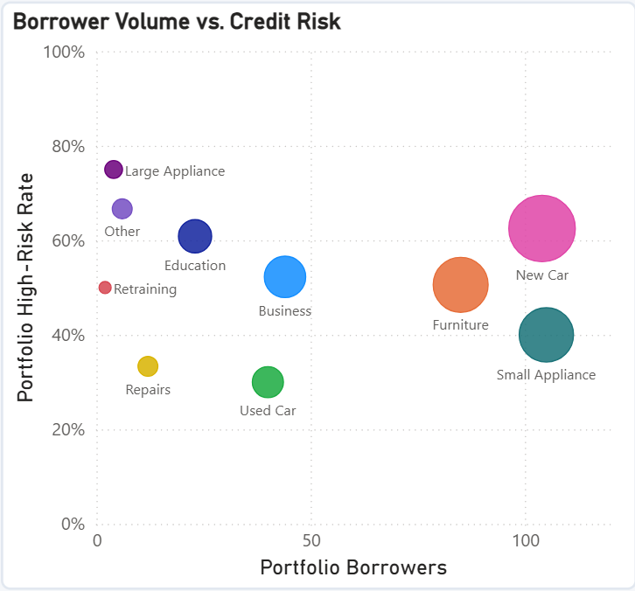
PORTFOLIO PRIORITIES
03 / 07
Similar volumes. 23 more high-risk classifications.
New Car warrants closer investigation because the risk concentration is material—not merely because its rate is high.
THE COMPARISON THAT MATTERS
104
New Car
borrowers
105
Small Appliance
borrowers
65 vs. 42
High-risk classifications at nearly identical volume
My priority:
Investigate New Car first. Evaluate responsible growth in lower-rate segments.
Selena Cha | Credit Risk Decision Brief
Historical risk labels are not observed defaults
Notes:
I would focus management on the New Car versus Small Appliance comparison. These segments are nearly the same size: 104 versus 105 borrowers. Yet New Car has 65 borrowers classified high risk, compared with 42 in Small Appliance. That is 23 more high-risk cases at effectively the same volume. Their risk rates are 62.5 percent and 40 percent. That difference is a stronger signal than simply pointing to the category with the highest percentage. Large Appliance is at 75 percent, but that is just four borrowers. I would investigate New Car underwriting characteristics first, then test opportunities for more efficient processing among qualified applicants in Small Appliance. Used Car is also promising at 30 percent high-risk classifications, but the sample is 40, so I would validate it further. These results identify priorities; they do not prove that any segment is profitable or that loan purpose causes risk.

Slide 4
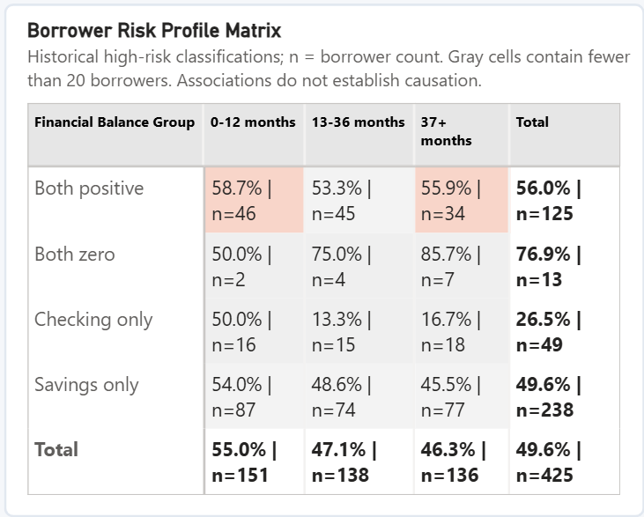
BORROWER STRATEGY
04 / 07
One financial indicator cannot reliably set a lending rule.
Combined profiles reveal differences that a one-variable cutoff would conceal.
AN UNEXPECTED PATTERN
26.5%
Checking only positive
49 borrowers
56.0%
Both balances positive
125 borrowers
My recommendation:
Check multiple indicators and ability to repay.
The 76.9% both-zero result is based on only 13 borrowers.
Selena Cha | Credit Risk Decision Brief
Historical risk labels are not observed defaults
Notes:
This matrix is why I would avoid writing lending rules around a single financial balance. The group with only a positive checking balance has a high-risk classification rate of 26.5 percent across 49 borrowers. The group with positive balances in both accounts is at 56 percent across 125 borrowers. That is not a reason to conclude savings create risk. It shows that other borrower characteristics probably matter, and these categories should be examined together. The both-zero group reaches 76.9 percent, but only 13 borrowers are in that group, so it is too small for a broad rule. I would evaluate combinations of relevant indicators and require repayment-capacity information before considering any change to who qualifies for credit. The data show association, not causation or affordability.

Slide 5
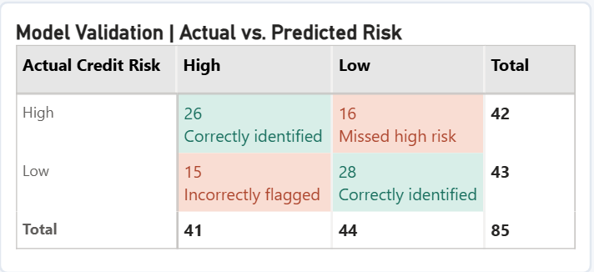
MODEL VALIDATION
05 / 07
63.5% accuracy hides two very different types of error.
The model is a candidate for supervised review support—not automated lending decisions.
85 HOLDOUT TEST CASES
16
High-risk cases missed
15
Lower-risk cases incorrectly flagged
The management trade-off: missed risk versus unnecessary review. I would not automate decisions.
Selena Cha | Credit Risk Decision Brief
Historical risk labels are not observed defaults
Notes:
I selected Logistic Regression because it outperformed the two Random Forest configurations in cross-validation, but I would not lead a policy recommendation with accuracy alone. On 85 holdout borrowers, the model correctly classified 54, or 63.5 percent. The confusion matrix shows what that misses: it classified 16 actually high-risk borrowers as low risk, and flagged 15 lower-risk borrowers as high risk. The first error could leave concerning cases without enough attention; the second could add work and friction for qualified people. High-risk recall was 61.9 percent, and the false-positive rate was 34.9 percent. That is not a sufficient basis for automatic credit decisions. I would first improve validation, assess calibration and fairness, and test the scores only as a human-supervised review aid. The class labels are not actual defaults.

Slide 6
OPERATING DECISION
06 / 07
A five-point threshold change moves one borrower into a different queue.
The simulator shows how review workload changes—not whether a policy is safe.
10 NEW BORROWERS / REVIEW QUEUE
PROPOSED REVIEW PATHWAYS
45%
5 flagged
Streamlined
Qualified and affordable → fewer duplicate checks.
50%
4 flagged
Individualized
Borderline → verify repayment capacity; consider terms.
60%
3 flagged
Enhanced
Elevated indicators → more verification + human review.
At 45%, borrower #2 (score 48.4%) gets extra review.
At 50%, the same borrower does not.
A lower threshold adds reviews. No observed outcomes are available to establish the best threshold.
Selena Cha | Credit Risk Decision Brief
Historical risk labels are not observed defaults
Notes:
This simulator answers an operational question, not a credit-approval question. For the ten new borrowers, a 45 percent score cutoff flags five for additional review. At 50 percent, four are flagged. Borrower number two, whose score is 48.4 percent, crosses from additional review to standard review even though nothing about that application changed. That illustrates why the threshold is a management choice about review capacity and missed-risk trade-offs, not a proven default probability. My proposed workflow is streamlined processing for applicants already meeting credit and affordability standards, individualized review for borderline cases, and enhanced verification for stronger risk indicators. I would shadow-test those routes before any live change.

Slide 7
IMPLEMENTATION REQUEST
07 / 07
Approve 90 days to test the decision—not to change lending policy.
A short validation cycle with a clear continue, revise, or stop decision.
Days 1–30
Days 31–60
Days 61–90
Validate
Shadow-test
Evaluate
Analytics + Compliance
Underwriting + Operations
Risk Management
Check scores, model errors,
data quality, and fairness.
Record proposed review routes
and workload; decisions stay put.
Compare errors, workload, and
borrower impacts.
Pilot criteria
Operational evidence
Continue / revise / stop
HOW I WOULD JUDGE IT
MANAGEMENT DECISION
61.9% high-risk recall · 34.9% false-positive rate
Authorize a supervised shadow pilot.
Plus review time, affordability, fairness and eventual repayment data.
Current files do not establish actual defaults, loan profitability, or the effect of alternative loan terms.
Selena Cha | Credit Risk Decision Brief
Historical risk labels are not observed defaults
Notes:
My request is specific: authorize a 90-day shadow pilot, not a live lending-policy change. In the first month I would work with Analytics and Compliance to confirm the model’s reliability, score calibration, data quality, and fair-lending safeguards. In the second month Underwriting and Operations would record which cases would go through each proposed review route while keeping actual credit decisions unchanged. In the final month Risk Management would use comparable labeled validation cases to assess whether high-risk recall and false-positive rates improve against the current 61.9 percent and 34.9 percent results, along with review volume and processing time. I would also require income, debt, loan economics, and eventual repayment outcomes before making profitability or affordability claims. Management could then continue, revise, or stop based on evidence.

