Slide 1
RAW AUDIO → ON-DEVICE ML → ANDROID
AudioClassifier
A React Native audio app built around a custom Java native module,
on-device machine learning, and local persistence.
React Native
Java
AudioRecord
TensorFlow Lite
SQLite
Prepared for review · github.com/SelenaG4/AudioClassifier

Slide 2
THE BRIEF
Built to match a specific skills gap
A role calling for Android audio work named the exact API, the exact buffer behavior, and the exact reason it's needed.
“Microphone access, raw PCM buffer
management, sample rate configuration.
Specific API:”
What this project demonstrates
✓
Microphone access
Runtime RECORD_AUDIO permission via PermissionsAndroid
✓
Raw PCM buffer management
android.media.AudioRecord
getMinBufferSize(), background capture thread, WAV export
✓
Sample rate configuration
— target job posting, Android Audio APIs row
44.1 kHz capture, decimated to 16 kHz for the ML model
Ideal level: “built a production audio app.”
✓
A production shell around it
React Native UI, SQLite logging, JS-to-native bridge
AudioClassifier
02

Slide 3
ARCHITECTURE
Why a native module?
React Native's JS thread can't keep up with continuous audio. AudioRecord.read() blocks until a buffer fills — so capture, resampling, and inference run entirely in Java on their own threads.
JAVASCRIPT (REACT)
JAVA NATIVE MODULES
initialize()
1
AudioRecord setup
44.1kHz mono PCM · buffer sized 4× minimum
start()
Capture thread
2
background loop, volatile stop flag
stop()
3
Resample → YAMNet
16kHz decimation feeds the classifier
EVENTS RECEIVED
4
WAV + SQLite
← onAmplitude ~20×/sec
thread joins, header written, event logged
← onClassification ~1×/sec
AudioClassifier
03

Slide 4
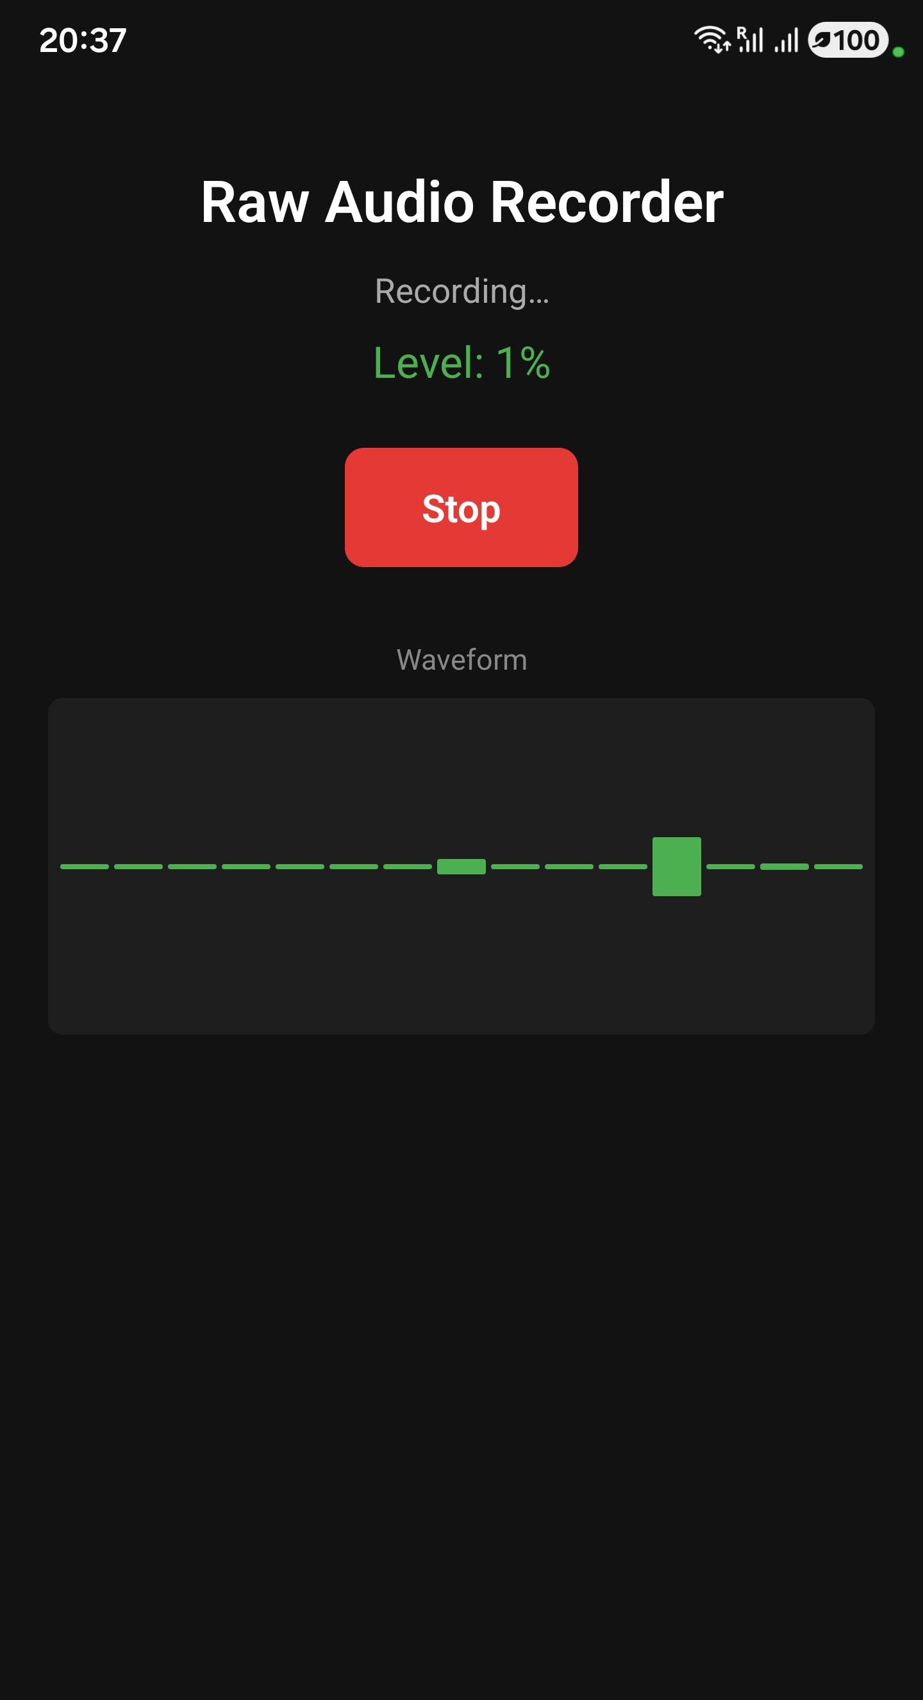
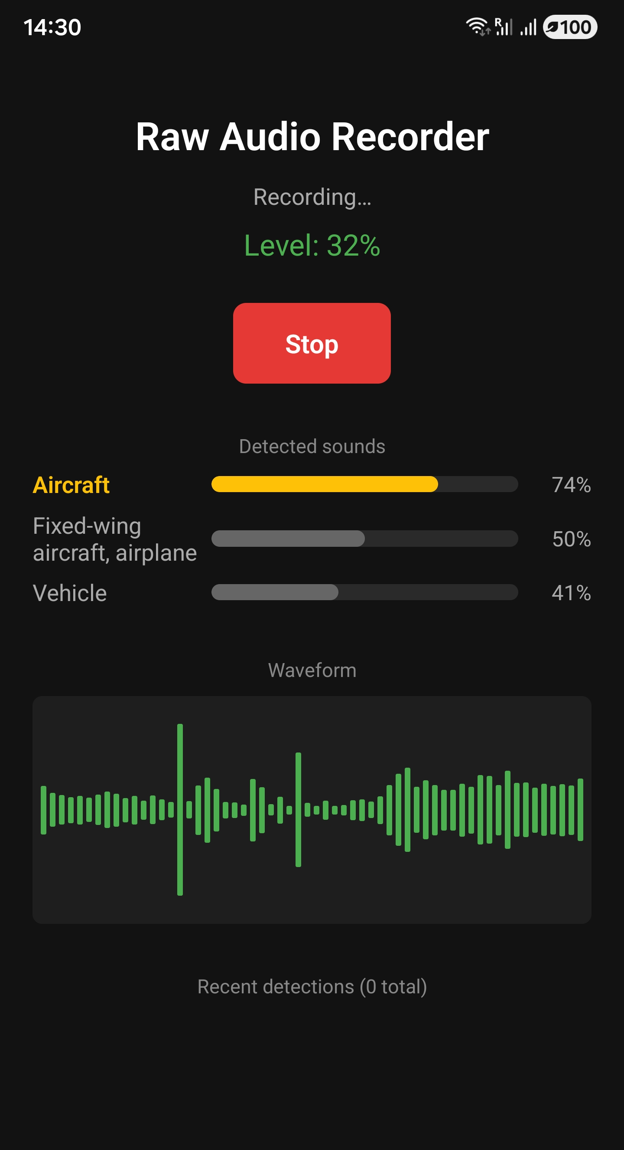
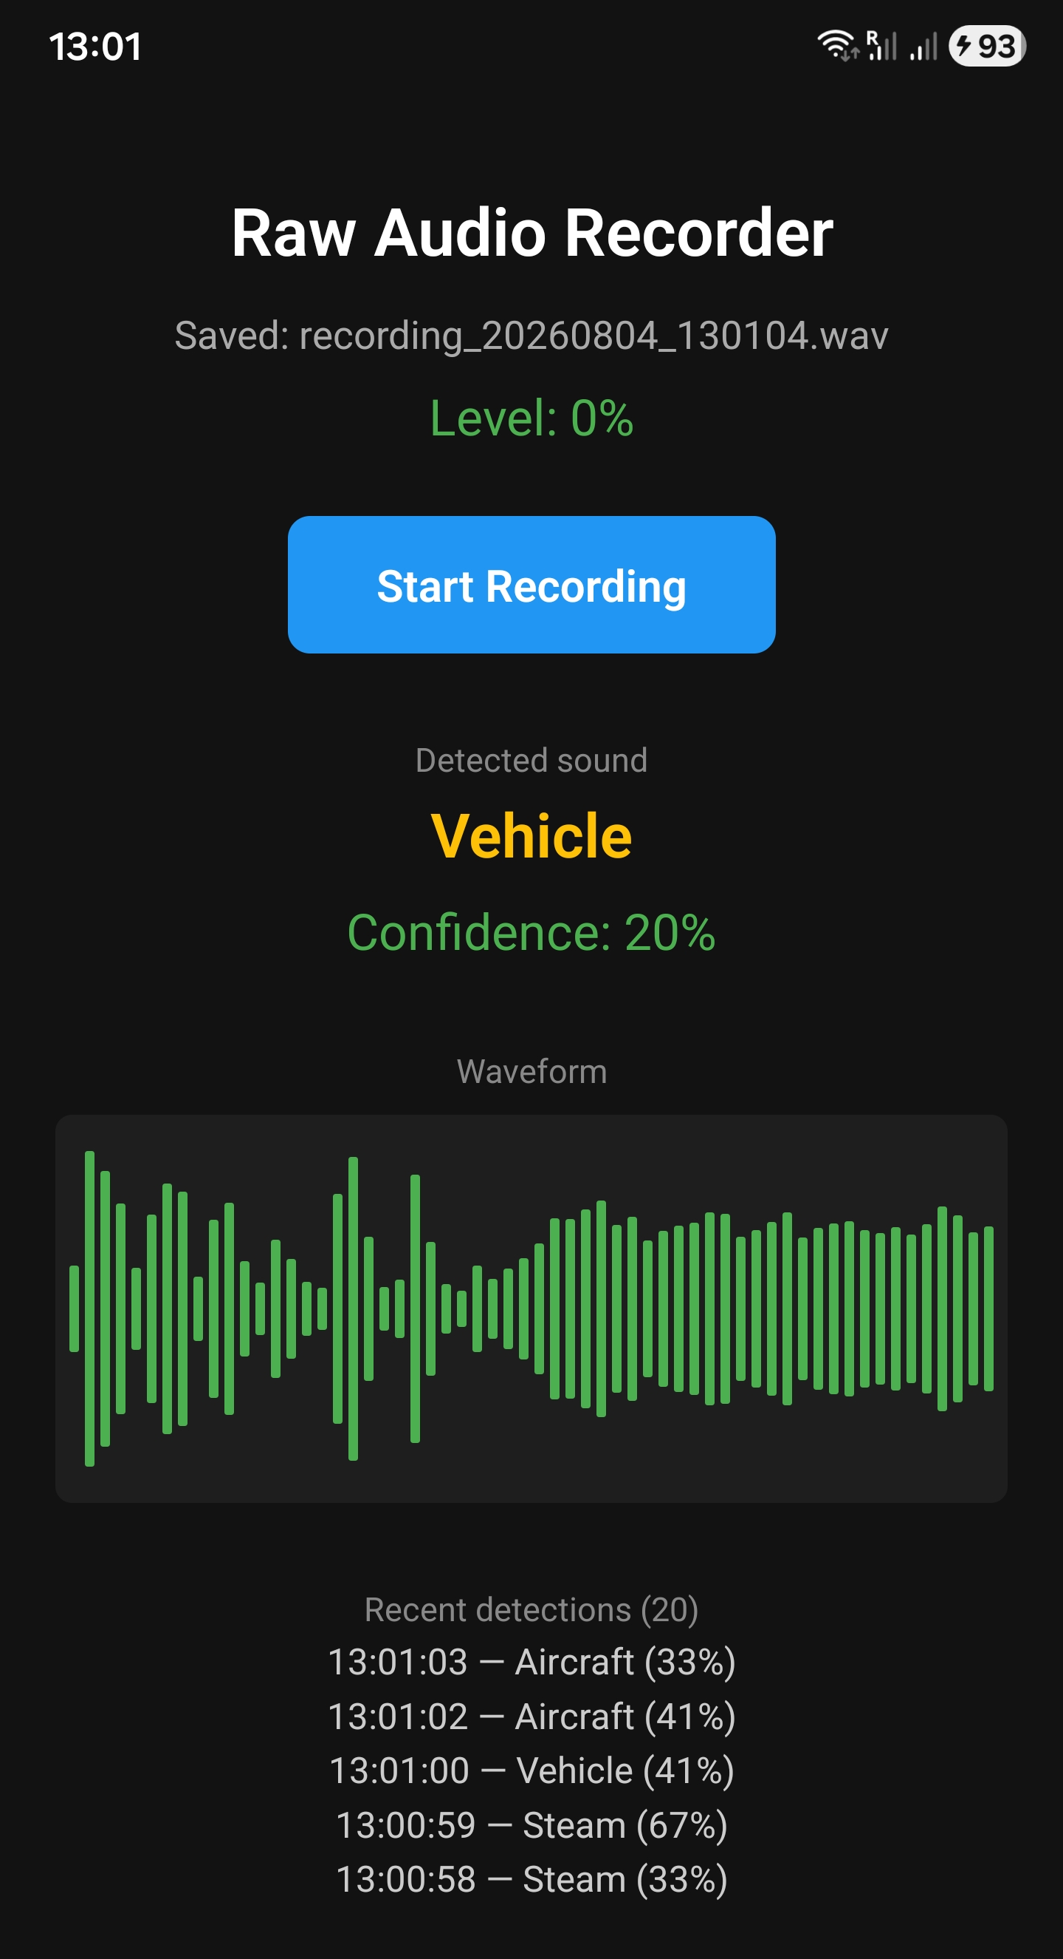
THE APP
From tap to on-device detection
1 · Capture
2 · Classify
3 · Persist
Mic starts, live level meter and waveform update ~20×/sec
Top-3 YAMNet predictions with confidence bars, ~1×/sec
Every confident detection logged to SQLite, survives restarts
AudioClassifier
04

Slide 5
UNDER THE HOOD
One buffer, two consumers
Every PCM buffer read from the microphone feeds a WAV writer and a live amplitude signal; roughly once a second, an accumulated window also feeds the classifier.
1
2
3
4
5
Permission
Init
Capture
Resample
Infer + log
PermissionsAndroid requests RECORD_AUDIO before any native call
getMinBufferSize() sizes the buffer 4× over; model loads and reports 16kHz
Background thread loops on audioRecord.read(), no allocations mid-loop
44.1kHz → 16kHz via fractional decimation, normalized to −1…1
YAMNet window → top-3 sorted → emitted to JS → SQLite insert
AudioClassifier
05

Slide 6
OFFLINE TOOLING
Fine-tuning YAMNet on ESC-50
Transfer learning on frozen embeddings, kept as a separate Python notebook — the app ships stock YAMNet, per the role's own scoping of ML work as offline tooling.
88.0%
50
2,000
CLIP-LEVEL ACCURACY
ENVIRONMENTAL CLASSES
ESC-50 AUDIO CLIPS
ACCURACY BY ITERATION
Final: 88.0% clip-level · 73.1% frame-level
AudioClassifier
06

Slide 7
COVERAGE
Mapped against the role, row by row
React Native
Custom Java native module, event bridge, top-3 UI
✓
Android Native (Java)
AudioCaptureModule, AudioClassifierModule, package wiring
✓
Android Audio APIs — AudioRecord
44.1kHz PCM capture, manual buffer sizing, WAV export
✓
TensorFlow Lite
On-device YAMNet inference via Task Audio library
✓
Audio Signal Processing
Resampling, windowing, peak-amplitude, temporal context
✓
SQLite / local storage
Persistent event log, parameterized queries, aggregate count
✓
Git / version control
Two public repos, commit history, documented decisions
✓
Python ML pipeline
ESC-50 fine-tuning notebook — offline tooling, as scoped
✓
AudioClassifier
07

Slide 8
JUDGMENT CALLS
Decisions worth explaining, not just code
Swapped the SQLite library
Kept the trained model out of the app
Chose temporal-context windowing
react-native-sqlite-storage still declares the retired jcenter() repository and fails outright under Gradle 9. Moved to react-native-nitro-sqlite, built for the New Architecture.
The fine-tuned YAMNet needs the Flex delegate (SELECT_TF_OPS) — 20-40MB and a lower-level API. Scoped as offline tooling, exactly as the role described it.
Frame-level accuracy stalled at ~65% because single frames lack context. Concatenating 3 consecutive embeddings pushed it to 73% — the single largest gain.
AudioClassifier
08

Slide 9
Thank you
Two repositories, fully documented, ready to walk through in detail.
github.com/SelenaG4/AudioClassifier
React Native app · native module · SQLite · ML notebook
github.com/SelenaG4/RawAudioRecorder
Native Kotlin app · FFT spectrum · foreground service
09

