Slide 1
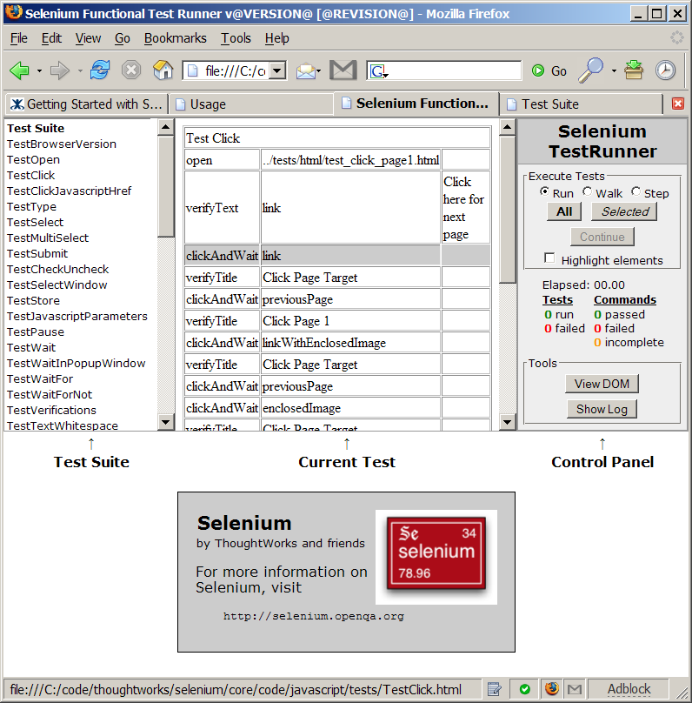
Click a testcase name to view and run single test.
Click single line to add or remove break point
Your application page will display here

Slide 2
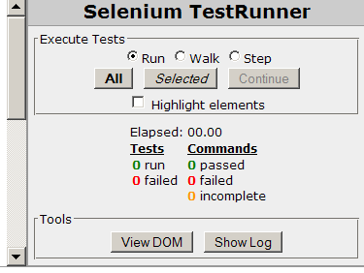
Run fast,
Walk slowly,
or Step by step
Run all tests in test suite
Resume test when it paused
Check this to highlight elements under processing when test run
Find elements by viewing your page structure
Click to see any errors, infos

