Slide 1
CLASSIFICATION

Slide 2
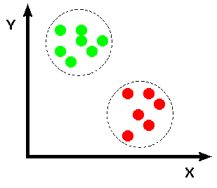
Defınıton of Classıfıcatıon
Machine learning and the simple classification problem, which of a set of categories a new observation belongs to, has been fulfilled using an execution set from basic observations and known categories. The data for the observations of the category membership is known.

Slide 3
"Wolf" is a positive class.
"No wolf" is a negative class.
We can summarize our "wolf-prediction" model using a 2x2 confusion matrix that depicts all four possible outcomes:
TP
True Positive (TP):):
True Negative (TN):
Reality: A wolf threatened.
Shepherd said: "Wolf."
Outcome: Shepherd is a hero.
Reality: No wolf threatened.
Shepherd said: "No wolf."
Outcome: Everyone is fine.
False Positive (FP):
False Negative (FN):
Reality: No wolf threatened.
Shepherd said: "Wolf."
Outcome: Villagers are angry at shepherd for waking them up.
Reality: A wolf threatened.
Shepherd said: "No wolf."
Outcome: The wolf ate all the sheep.
Precision =
TP+FP
TP
Recall =
TP+FN

Slide 4
Accuracy
Accuracy is one metric for evaluating classification models. Informally, accuracy is the fraction of predictions our model got right. Formally, accuracy has the following definition:
Number of correct predictions
Accurarcy =
Total number of predictions
For binary classification, accuracy can also be calculated in terms of positives and negatives as follows:
TP + TN
Accurarcy =
TP + TN + FP + FN
Where TP = True Positives, TN = True Negatives, FP = False Positives, and FN = False Negatives.

Slide 5
Decısıon tree
A decision tree is a flowchart-like structure in which each internal node represents a "test" on an attribute (e.g. whether a coin flip comes up heads or tails), each branch represents the outcome of the test, and each leaf node represents a class label (decision taken after computing all attributes).
Has feathers ?
True
False
Can fly ?
Has finns ?
True
False
True
False
Hawk
Penguin
Dolphin
Bear

Slide 6
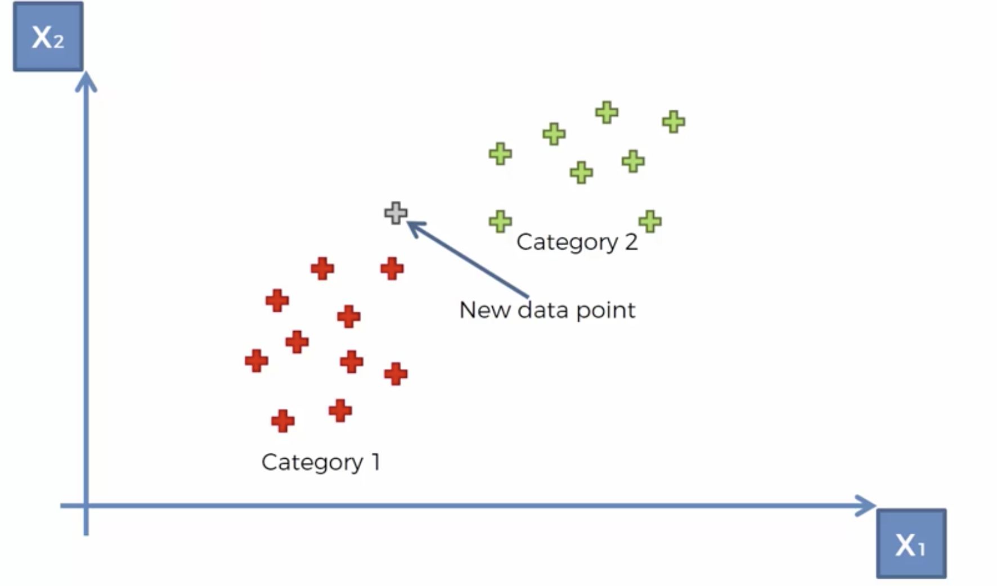
K NEAREST NEIGHBORS
In pattern recognition, the k-nearest neighbors algorithm (k-NN) is a non-parametric method proposed by Thomas Cover used for classification and regression. In both cases, the input consists of the k closest training examples in the feature space. ... In k-NN classification, the output is a class membership.

Slide 7
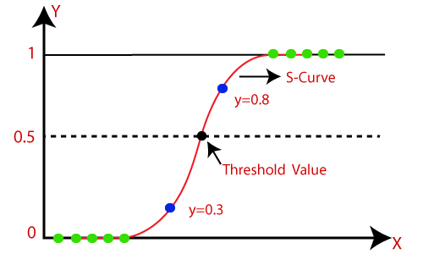

LOGISTIC REGRESSION
Status(1:Pass,0:Fail)
In statistics, the logistic model is used to model the probability of a certain class or event existing such as pass/fail, win/lose, alive/dead or healthy/sick. This can be extended to model several classes of events such as determining whether an image contains a cat, dog, lion, etc.
Hours studied
Sigmoid Probability: The probability in the logistic regression is often represented by the Sigmoid function.
Threshold represents in a binary classification the probability that the prediction is true. It represents the tradeoff between false positives and false negatives.

Slide 8
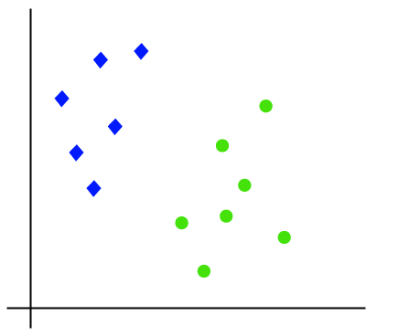
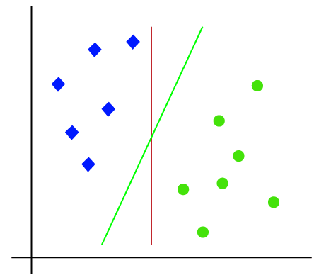
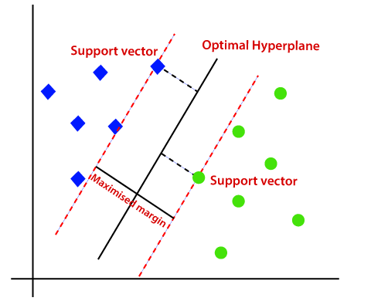
SUPPORT VECTOR MACHINES
A support vector machine (SVM) is machine learning algorithm that analyzes data for classification and regression analysis. SVM is a supervised learning method that looks at data and sorts it into one of two categories. An SVM outputs a map of the sorted data with the margins between the two as far apart as possible. SVMs are used in text categorization, image classification, handwriting recognition and in the sciences.

Slide 9
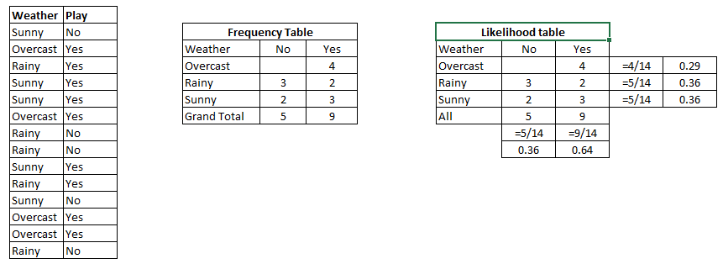
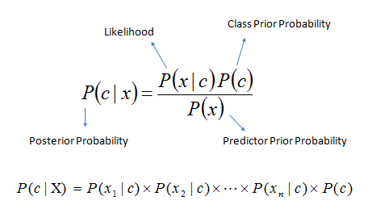
NAIVE BAYES
A naive Bayes classifier is an algorithm that uses Bayes' theorem to classify objects. Naive Bayes classifiers assume strong, or naive, independence between attributes of data points. Popular uses of naive Bayes classifiers include spam filters, text analysis and medical diagnosis. These classifiers are widely used for machine learning because they are simple to implement.
P(Yes | Sunny) = P( Sunny | Yes) * P(Yes) / P (Sunny)
Here we have P (Sunny |Yes) = 3/9 = 0.33, P(Sunny) = 5/14 = 0.36, P( Yes)= 9/14 = 0.64
Now, P (Yes | Sunny) = 0.33 * 0.64 / 0.36 = 0.60, which has higher probability.

