Slide 1
CG_TEAM_IGZYD
Artificial intelligence
Code Gladiators 2019
Srinivas

Slide 2
Executive Summary
In this hackathon, your mission, if you choose to accept is to solve a very critical problem in the overall Smart Parking solution - "Identify available parking spots from parking lot camera images".
1

Slide 3
Problem Description
With the rise of Autonomous Vehicles, better utilization of roads and vehicle becomes a reality, but identifying parking lots for these is being a serious problem in this world.
To solve that problem I am developing a system that can detect the availability of a parking in the from the given image
2

Slide 4
Solution
I combined the models of image classification with object detection to solve this problem.
Mathematical models like Visual Geometry group is used to solve this problem
Note: The Github link for the implementation is provided at the end
3

Slide 5
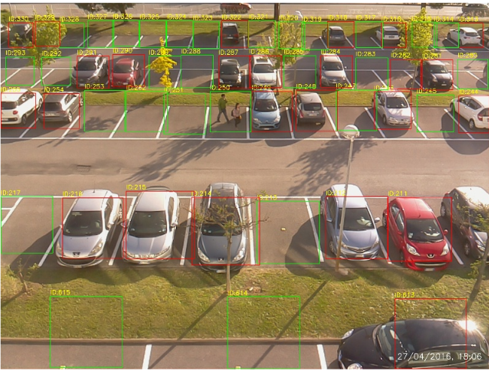
ProtoType
Due to lack of proper hardware I am unable triain my model but the result after training my model will look similar to this
4

Slide 6
Approach
Used Transfer Learning on the pretrained VGG16 model
Trained my model using Binary classifier and Sigmoid as the activation
Used this trained model to classify each patch and show the result in a complete image
5

Slide 7
Technology Stack
Keras
VGG
OpenCv for labelling
Convolutional Neural Networks
6

Slide 8
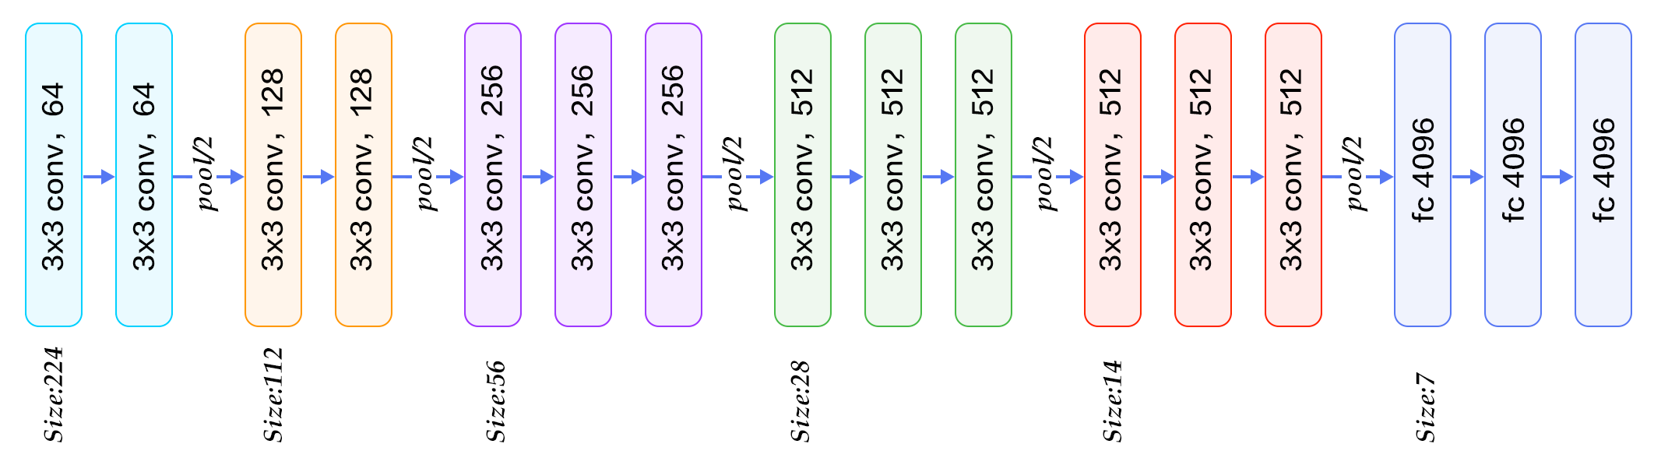
VGG Architecture
7

Slide 9
Why our team is the best!
Used the cutting edge technology like VGG and transfer learning
This model is developed from the mathematical concepts which is the heart of Artificial Intelligence
Apart from trying to win it, my main aim to participate in a hackathon is to do knowledge sharing based on the models developed by other participants
8

Slide 10
Associated attachments/ files
GitHub Link
https://github.com/srinivasmachiraju/Car-Parking-Guide
9

Slide 11
Challenges
Developing a perfect mathematical equation to solve this problem
Studied research papers and other online resources which helped me a lot
10

Slide 12
Possible improvements
I did this on images so if it's implemented on a live stream video which is collection of images then this project would work on real time.
11

Slide 13
Thank you
Any Queries
?

