Slide 1
SELF-IMPROVING LLM FRAMEWORK
Our self-improving LLM framework implements an autonomous learning cycle where the model continuously evaluates its own outputs, identifies weaknesses through structured feedback mechanisms, and refines its responses using iterative self-correction techniques. This framework enables dynamic knowledge enhancement and adaptive reasoning capabilities, allowing the LLM to progressively improve accuracy and performance without requiring constant human supervision.
GitHub repo: RK0297/Intune
Members | ID
Radhakrishna Bharuka | 24bds063
Abhang Pawar | 24bds054
Nilesh Dwivedi | 24bds048
Rushikesh Masalkar | 24bds040
IIIT DHARWAD
COURSE: ARTIFICIAL INTELLIGENCE
COURSE INSTRUCTOR: DR. ANIMESH CHATURVEDI

Slide 2

Outline
1
Introduction & Motivation
2
Related Work
Problem Statement
Research Gap
Project Objectives
Literature Review
State-of-the-Art
3
Methodology
4
Evaluation & Results
Framework Design
Technical Approach
Implementation
Evaluation & Metrics
Results & Analysis
5
Conclusion
Discussion
Contributions

Slide 3




Introduction & Motivation
Current challenges in LLM deployment
Research Gap
Project Objectives
Static models require manual retraining with expert oversight.
No automated quality assessment mechanisms in typical workflows.
Limited feedback integration from production usage.
High cost of continuous human evaluation for quality assurance.
Develop autonomous evaluation pipeline.
Implement self-correcting feedback loops.
Achieve measurable quality improvements without manual intervention
Lack of autonomous improvement frameworks.
Manual metric computation creates scaling bottlenecks.
Inability to leverage user interactions for iterative LLM refinement.

Slide 4
Literature Review
Early self-improving frameworks leaned on expert-in-the-loop or feedback loops, enhancing model reliability without manual fine-tuning (e.g., CriteriaLLM for clinical data, PubMed 2025).​
The concept of self-correction through LLMs acting as their own evaluators has gained traction: “STaR” (Self-Taught Reasoner) and chain-of-thought prompting showed models enhance their reasoning by learning from generated intermediate steps, progressively reducing complexity and error.​
Reinforcement learning frameworks (e.g., OpenAI o1, DeepSeek-R1) enable iterative self-correction with minimal human intervention, refining outputs on progressively challenging tasks.​
Combination methods (mixing intrinsic and external self-correction) improve accuracy but may reduce efficiency; still, diverse correction strategies continue to outperform traditional static approaches.​
Emerging theoretical work, like “Sharpening Mechanisms,” analyzes the internal dynamics of LLM self-improvement to optimize improvements without retraining.​
State-of-the-Art (2025)
LADDER: Uses recursive problem decomposition—LLMs generate easier variants of hard problems, learn through self-verification and reinforcement, achieving >80% improvement on math tasks without extra supervision.​
CorrectBench: Benchmarks self-correction methods, showing that flexible frameworks—combining intrinsic, external, and fine-tuned modules—significantly improve LLM reasoning, especially for complex cognitive tasks.​
GPT-4.5/GPT-4o and DeepSeek-R1: Industry-leading models employing self-improvement pipelines, often using internal feedback, dynamic test-time adaptation, and advanced CoT reasoning for “live” model improvement.​
SLD (Self-correcting LLM-controlled Diffusion): Closed-loop architectures using detectors and LLMs to repeatedly auto-correct outputs (especially in generative and image-aligned tasks).

Slide 5
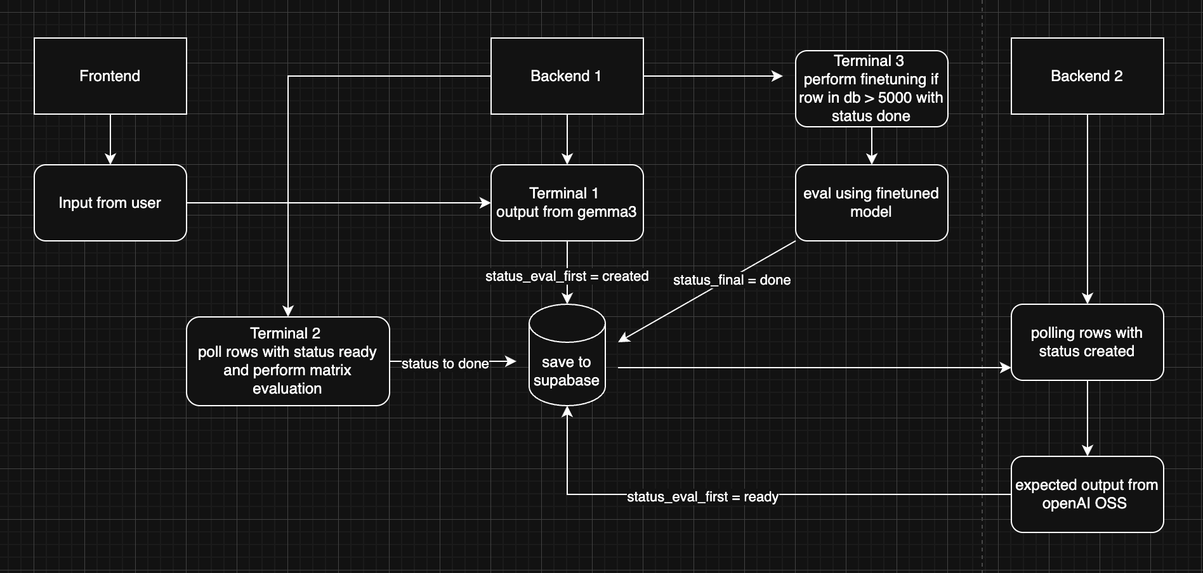
System Architecture
## Tech Stack
Backend
Python 3.10+
FastAPI (API framework)
PyTorch (Deep learning)
Transformers (Model architectures)
Unsloth (Efficient training)
Frontend
React / Vue.js
Tailwind CSS (Styling)
Database
PostgreSQL (Supabase)
JSONB (Flexible data storage)
Infrastructure
Ollama (LLM serving)
Git (Version control)

Slide 6
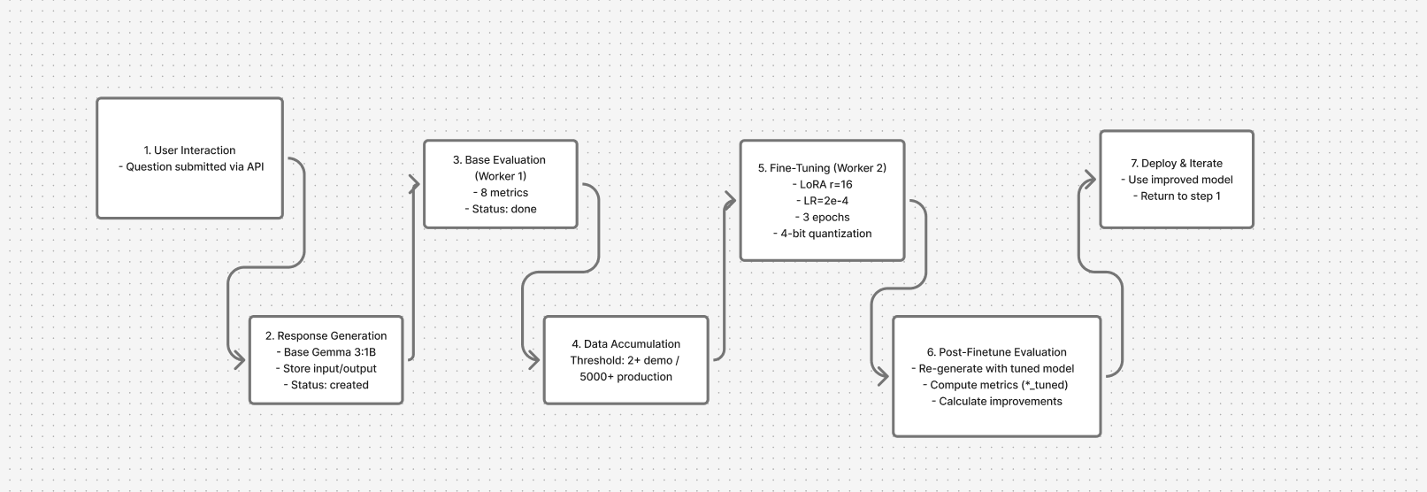
Autonomous Learning Cycle

Slide 7
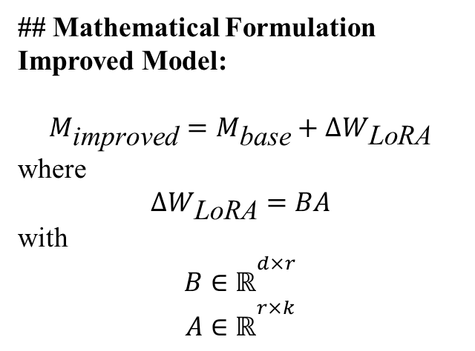
Training Pipeline -
Fine Tuning Configuration
Data Preparation → Model Loading → LoRA Application → Training Loop → Merging → Deployment
## Key Code Implementation (finetune.py)
Uses Unsloth for faster training
BitsAndBytes for 4-bit quantization
PEFT library for LoRA adapters
Gemma-style chat template formatting
Parameter | Value | Justification
Base Model | Gemma 3:1B Instruct | Efficient instruction-tuned base
Quantization | 4-bit (NF4) | Reduces VRAM from 4GB to 1GB
LoRA Rank (r) | 16 | Balance between capacity and efficiency
LoRA Alpha | 32 | Scaling factor = 2 × rank
Target Modules | q_proj, k_proj, v_proj, o_proj, gate_proj, up_proj, down_proj | All attention and FFN layers
Learning Rate | 2×10⁻⁴ | Stable for LoRA fine-tuning
Batch Size | 2 | Fits in 8GB VRAM
Grad Accumulation | 4 steps | Effective batch size = 8
Epochs | 3 | Prevents overfitting
Max Sequence Length | 2048 tokens | Standard for instruction tuning
## Mathematical Formulation
Improved Model:
$$M_{\text{improved}}=M_{\text{base}}+ΔW_{\text{LoRA}}$$
where
$$ΔW_{\text{LoRA}}=BA$$
with
$$B∈ℝ^{d×r}$$
$$A∈ℝ^{r×k}$$

Slide 8
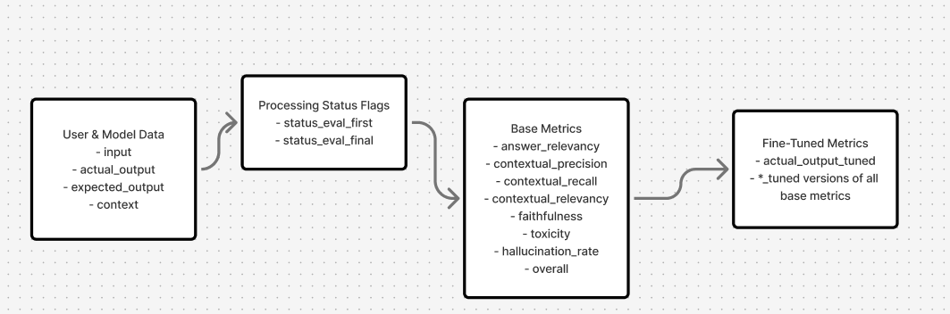
Data Pipeline -
## Data Flow Architecture User Input → Supabase (intune_db) → Worker Processing → Metrics Storage
Database Schema
## Worker Responsibilities
Worker 1 — Base Evaluation • Computes base metrics • Updates status_eval_first
## Pipeline Summary
• Supabase acts as the central data hub • Workers continuously read → process → update records • Data accumulates until threshold → fine-tuning triggers • Enables continuous self-improvement of the model
Worker 2 — Fine-Tuning • Runs LoRA fine-tuning • Generates tuned outputs • Stores tuned metrics • Updates status_eval_final

Slide 9
Metrics Specifications Table-
# | Metric | Type | Formula | Range | Interpretation
1 | Answer Relevancy | Positive | cos(Q, A) | [0, 1] | Semantic similarity to question
2 | Contextual Precision | Positive | |A ∩ C| / |A| | [0, 1] | % of answer supported by context
3 | Contextual Recall | Positive | |A ∩ C| / |C| | [0, 1] | % of context covered in answer
4 | Contextual Relevancy | Positive | cos(C, A) | [0, 1] | Semantic similarity to context
5 | Faithfulness | Positive | 0.6·cos(A, E) + 0.4·cos(A, C) | [0, 1] | Agreement with reference + context
6 | Toxicity | Negative | toxic_tokens / total_tokens | [0, 1] | Harmful language presence
7 | Hallucination Rate | Negative | 1 − Contextual Precision | [0, 1] | Fabricated or unsupported info
8 | Overall Score | Aggregate | P̄ × (1 − N̄) | [0, 1] | Combined weighted score

Slide 10

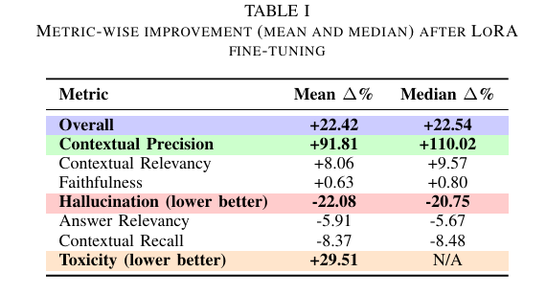
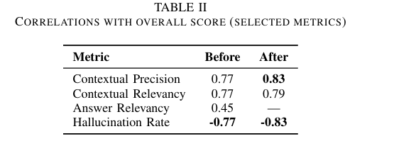
Results and Analysis
Contextual Precision: Major Win - Massive +92-110% improvement; strongest correlation (0.83) with overall performance; primary success driver
Hallucination: Successfully Reduced - Decreased by ~22% (lower is better); strong negative correlation (-0.83) confirms reduced hallucinations boost overall performance
Toxicity: Safety Risk - Degraded +29.51%, indicating potential weakening of safety guardrails during fine-tuning
Relevance & Faithfulness: Marginal Gains - Modest improvements (8-9% and <1% respectively); minor contributors to overall +22% performance boost
Win-Win on Accuracy - Model improved both contextual precision AND factual correctness (reduced hallucinations)—achieving better structure and truthfulness simultaneously

Slide 11
Discussion
• Fine-tuning significantly improved context-grounded reasoning, precision, and factual correctness. • Reduced hallucination to demonstrate more reliable model behavior. • Minor drops in recall and answer relevancy indicate a precision-over-breadth trade-off typical of tightly grounded models. • Even with a relatively small dataset (~4K samples), the system achieved strong improvements, showing efficiency and stability of the training loop.
Takeaways
• Autonomous LLM self-improvement is feasible, efficient, and scalable. • Offline evaluation pipelines can replace costly human-in-the-loop validation. • Lightweight LoRA tuning provides meaningful gains even on limited hardware. • As more data is added to the system, the model is expected to scale further, improving accuracy, robustness, and generalization.

Slide 12

Conclusion
• Built and validated a fully autonomous, self-improving LLM pipeline. • Achieved clear gains in overall quality (+22%), contextual precision (+92–110%), and reduced hallucination (−22%). • Demonstrated that the modular architecture is efficient, scalable, and deployable. • Strong improvements were achieved with only ~4K samples, indicating high data efficiency and strong scaling potential. • The framework establishes a practical foundation for continuous, automated LLM refinement.

