Slide 1















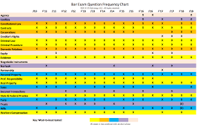




















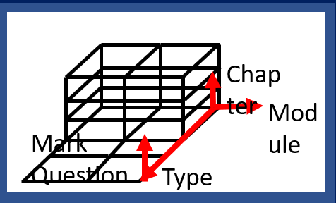








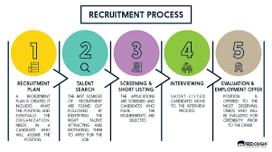


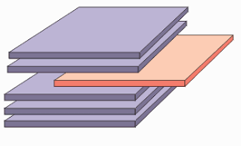
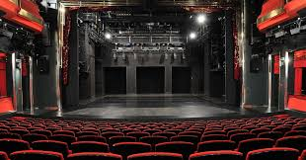














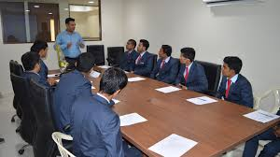




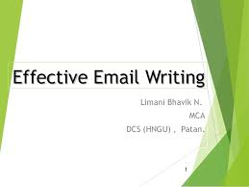
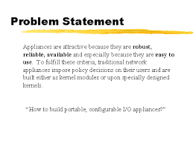


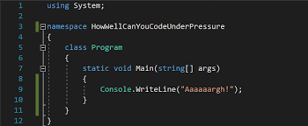
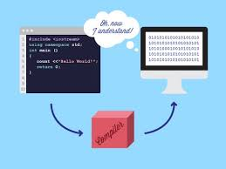







World job rack
Region-1
Region-1
Region-2
Region-2
Region-3
IT
CAMPUS DRIVE
VLSI
Job Type | Objective | Exams | Requirement | Status
Govt Jobs | Powerful | UPSC ( IAS, IPS, IES, IFS)
 |  | Staff Selection of Commission ( CGL, CHSL, Police, Junior Engineer, Technical and non-Technical Jobs)
 | Techful | DRDO (Scientist, Engineer, Programmer)
 |  | BSNL ( Junior engineer, Programmer, Technician)
 |  | DSSSB (clerk, Technician, lab assistant, Junior engineer)
 |  | PSU
 | Banker | IBPS(Probationary officer, clerk, Engineer, Programmer)
 | Defence | Indian Army
 |  | Indian Navy jobs
 |  | Indian Airforce jobs
 |  | BSF (Border security Force jobs)
 | Transoprataion | Railway Recruitment Board (Ticket collector,clerks,pharmacist,police departments,Station Master, Technicians, ALP, NTPC)
 | Agricultural | Agricultural Jobs
 | Hospitality | NHAI (National Highways Authority of India) These are the various departments that have various kind of jobs for every aspirants. if you want to know more the latest government jobs then you may visit the official website of Sarkari Results - India’s most trusted Web Portal.
Region-3
Information Source
MARKETING
Region-3.3
Registration
Region-3.2
Information
Model
EMBEDDED
Region-3.3
Information
COMMUNICATION
Verbal/Written
Quant
Logic
Verbal
Verbal/Written
Verbal/Written
Offline
Offline
Online
Verbal/Written
Past
Model
Future
Online
Company
Present
Internal
Place
Employee, Work Culture
Product
News
External
Eligibility,Skills,Job Outcome
Subject
Subject
Process-Stages
Stage
Creator
Section
Creator
Previous Appearance
Preparation
Region-4
Action
Region-5
Stage Break Down
Section1
Section2
Section3
Pre-Action
Action
Region-4.1
Pre Action
Logical Information
Model
Info→Log Info
Region-4.1
Pre Action
Others
Stage Information Resource
Information
Time+Work
Constraint
Stage Creator
Time-Stage
Work-All stage Info
Section Creator
Time-Sec Time
Work-Syllabus Info
Question Setter
Time-
Work-Type of Question
Evaluator/
Result Announcer
Time-
Work-How to evaluate
Breakdown Machine
My Work
All Stage Breakdown
My Work
Syllabus Breakdown
My Work
All Prev Year Question
Breakdown
My Work
All Result Breakdown
Log Info
Time
Log Info
Work
Table/Blueprint/Model
Stage Creator
Time-Stage
Work-All stage Info
Section Creator
Time-Sec Time
Work-Syllabus Logical
Model
Question Setter
Time-
Work-
1.Weitage of Subject
2.Weitage of Topics
3.Type of Question
Evaluator/
Result Announcer
Time-
Work-
1.Cutoff
2.Marking Style
3.How to evaluate
Strategy Machine
Logical Analysis
Machine
Strategy Machine
Logical Analysis
Machine
Strategy Machine
Logical Analysis
Machine
Strategy Machine
Logical Analysis
Machine
Strategy Machine
Logical Analysis
Machine
Preparation-1
Blueprint
How much times
T=0
Sub1
Sub2
T=End
Topics1-n
Topics1-n
Topics1-n
Work In Series or Parallel
When to Do
What to Do
How to Do Work

Slide 2





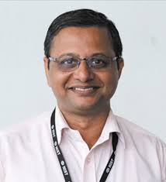

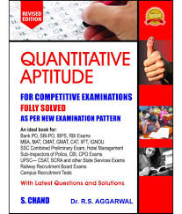
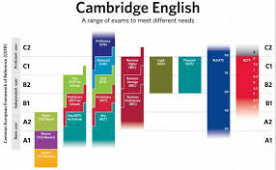




World Stage
Region-4
Region-4
Region-4.1
Pre-Preparation
Region-4.2
Preparation
Region-4.2
Execution
Region-4.2
Post Execution
Phase-1
Self Liner
Work Start
Work End
Phase-2
Phase-2.2
Time Table
Phase-2.3
Preparation
Phase-2.4
Revision
Phase-2.5
Test Series
Phase-2.6
Previous Day
Phase-2.7
Previous Hall
Phase-2.7
On Hall
Phase-2.1
Astra For War
Layer1
Syllabus Mukhasta
Layer2
Question Mukhasta
Layer3
Study
Evaluate
Improved
Guidance
Training
Sec
Quant
Logic
Verbal
GD
Online
Practice
Level
College
Own
Deep Zone
Upper Part
Brain
Universe
Open Zone
Lower Part
Fitness
Body Universe
Energy
Mental
Memory
Personality
Abhishek
90% Weightage Of Work
(Mostly Emotion Part)
Soul
90% Weightage Of Work
(Mostly Time & Work)
CM
90% Weightage Of Work
(Mostly Time & Work)
SCM
90% Weightage Of Work
(Mostly Time & Work)
1.Govinda Memory
Universal Fact
2.Toppers Guidelines
External
Internal
Core
Time
Work
Core
Internal
Core
Internal Emotion
Embrace Solitude
Comments
Environment
Noise/Distraction
Factor Management
Emotion
1.Art of Examination
2.Art of Communication
3.Skills
4.Sacrifise
5.Tools
6.Update Fuschia
1.Time Dilation
1.Procastination
2.Mision/Vision
3.Motivation
4.Mind Set
5.Confidence
1.Spirituality
2.Self Management
3.Decion Making
4.Update Fuschia
Discipline Will Power
Extra Push
Speed
Presence of Mind
1.Anxierty,Stress
2.Motivation,Depression
3.Extrapush,Pressure
4.Success,Failure
5.Happy,Angry/Frustration
6.White,Black Region
7.Sucess,Failure

