Slide 1
Bayesian Hierarchical Logistic Regression for 30-Day Hospital Readmission
The Role of Medical Specialty Among Diabetic Patients
Selina You, Zhouhan Qian
Introduction to Applied Bayesian Analysis | March 2026
Notes:
Hi everyone. Our project is on Bayesian Hierarchical Logistic Regression for 30-Day Hospital Readmission. Specifically, we're looking at the role of medical specialty among diabetic patients. My name is Selina, and this is my partner Zhouhan.

Slide 2
Part 1
Motivation & Research Question
Notes:
First, I’ll introduce the motivation and research question.

Slide 3
Why care about hospital readmissions?
Under the Centers for Medicare & Medicaid Services Hospital Readmissions Reduction Program, hospitals face financial penalties for excess readmissions
As a result, the 30-day readmission rate has become a central quality metric tied to Medicare reimbursement
Among all patient populations, diabetes Mellitus patients represent a particularly high-risk population, characterized by complex comorbidities, frequent hospitalizations, and care spanning multiple specialties
$26B+
Annual cost of unplanned
readmissions in the US
How much specialty-level heterogeneity exists in 30-day readmission risk, and can we reliably estimate it despite severe group imbalance?
Notes:
So why do we care about hospital readmissions? In the US, unplanned readmissions cost over 26 billion dollars annually. This is a huge burden on the healthcare system.
Under the Centers for Medicare & Medicaid Services Hospital Readmissions Reduction Program, hospitals face financial penalties for excess readmissions. As a result, the 30-day readmission rate has become a central quality metric tied to Medicare reimbursement. Among all patient populations, Diabetes Mellitus patients represent a particularly high-risk population, characterized by complex comorbidities, frequent hospitalizations, and care spanning multiple specialties
Among all patient populations, diabetic patients are particularly high-risk. They tend to have multiple comorbidities, require frequent hospitalizations, and their care often spans multiple medical specialties.
This cross-specialty nature of diabetic care is what motivated our central question: does the admitting specialty itself affect whether a patient gets readmitted?

Slide 4
Why a Bayesian Hierarchical Approach?
Partial Pooling
Small-sample specialties (e.g., PMR, n=288) borrow strength from larger groups through shared hyperparameter τ, yielding more stable estimates than fixed effects or complete pooling.
Coherent Uncertainty
Posterior credible intervals for τ directly quantify uncertainty about between-specialty variation, rather than reducing to a single p-value.
Principled Comparison
DIC and posterior predictive checks provide model assessment tools native to the Bayesian framework.
Notes:
We use a Bayesian hierarchical model for three main reasons:
Partial pooling stabilizes estimates for small specialties. It provides coherent uncertainty via posterior intervals. And also it enables principled model evaluation.

Slide 5
Part 2
Overall Analysis Framework

Slide 6
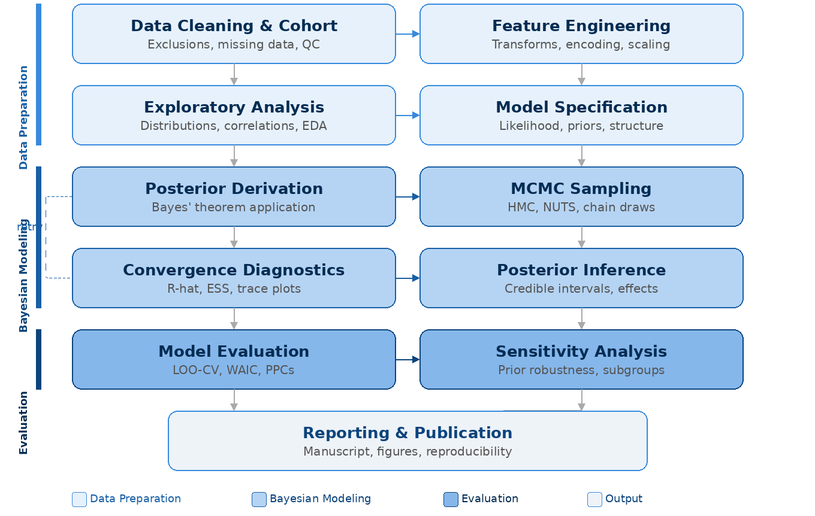
Analysis Pipeline Overview
Notes:
This slide gives you the big picture of our entire analysis pipeline — from data cleaning through feature engineering, EDA, model specification, posterior derivation, MCMC sampling, diagnostics, inference, model evaluation, and finally sensitivity analysis. We'll walk through each of these in the following sections.

Slide 7
Cohort Construction
Raw Data
N = 101,766
Dataset: UCI Diabetes 130 Hospitals dataset
Time period: 1999–2008
Population: Patients with Diabetes Mellitus
Remove duplicates
−30,248
Exclude expired/hospice
−1,545
37,964
−32,008
encounters
Exclude unknown and very small specialty
19
Analytic Cohort
N = 37,964
specialty groups (J)
Drop or handling High-Missing Vars
9.60%
readmission rate
Feature Engineering 10 continuous + 33 binary/categorical
Specialty Regrouping 73 raw specialties -> 19 groups
43
covariates (K)
Notes:
Our data comes from the UCI Diabetes 130-US Hospitals dataset, covering encounters from 1999 to 2008 across 130 hospitals.
Let me quickly walk through our data processing pipeline. We started with about 102,000 raw encounters. We removed duplicate encounter IDs, excluded patients who were discharged to hospice or expired, and excluded encounters with unknown specialty — that was about 45 percent of the data, which is a limitation we'll discuss later. We also dropped variables with very high missingness, like weight which was missing 97 percent of the time. For specialty regrouping, we consolidated 73 raw specialties into 19 groups using a threshold of at least 250 encounters per group. For feature engineering, we standardized 10 continuous variables to z-scores and created 33 binary and categorical features from demographics, ICD-9 diagnosis codes, and medication indicators.
After cleaning, our analytic cohort has about 38,000 encounters, spread across 19 medical specialties, with 43 covariates. The overall 30-day readmission rate is around 9.6 percent.

Slide 8
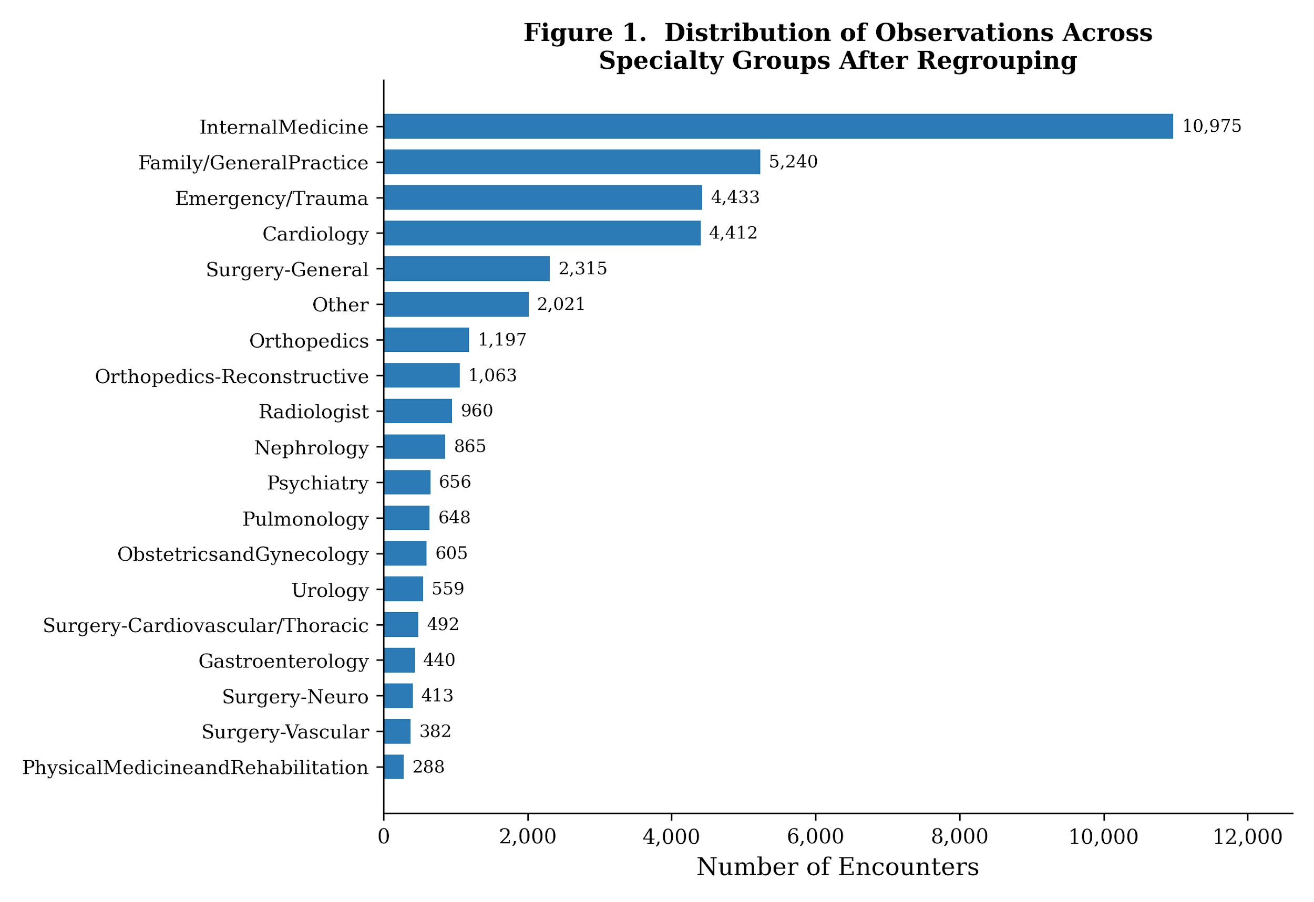
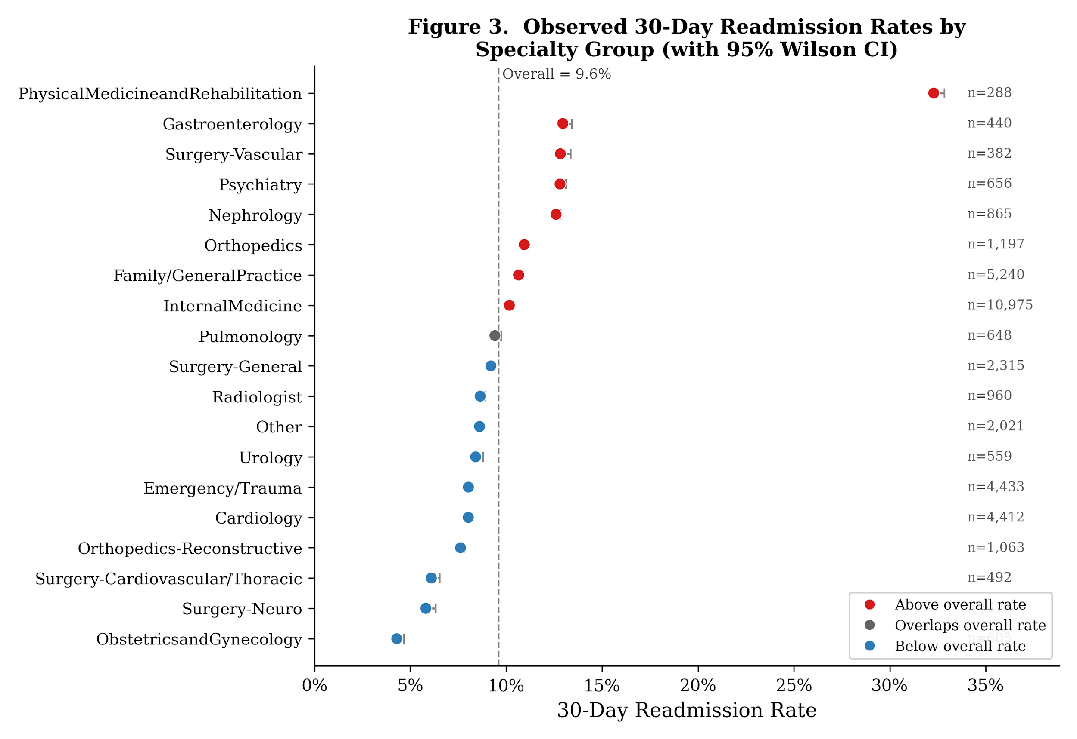
Data Overview
Key observations driving this question: Raw readmission rates vary widely across specialties 4.3% to 32.3%, but sample sizes are highly imbalanced
Notes:
A key observation is that readmission rates vary widely across specialties, but sample sizes are highly imbalanced. This motivates the use of a hierarchical model.
Direct comparison of raw rates is unreliable under such imbalance
We need a framework that borrows strength across groups while quantifying uncertainty

Slide 9
Part 3
Model Structure

Slide 10




Model Specification — Likelihood
where:
alpha = global intercept | beta = K=43 fixed effects | u_j = J=19 specialty random intercepts

Slide 11




Prior Specification
Weakly informative on log-odds scale; covers plausible baseline readmission rates
Allows OR up to exp(5) ~ 150; prevents extreme inflation without over-constraining
Exchangeable random intercepts; enables partial pooling across specialties
Hyperprior on between-group SD; controls degree of shrinkage
The key mechanism: u_j | tau ~ N(0, tau^2) induces partial pooling. Small groups are shrunk toward the population mean; tau controls shrinkage strength.

Slide 12
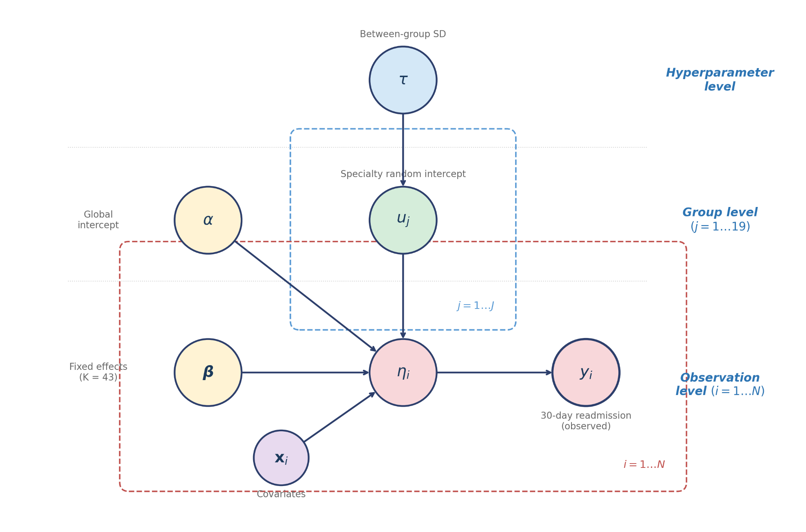
Model Hierarchy (DAG)

Slide 13

Model Assumptions
(i)
Conditional independence Given parameters, outcomes are independent across encounters:
(ii)
One observation per patient First encounter retained per patient — removes within-patient dependence.
(iii)
Specialty assignment is exogenous We do not model the specialty assignment mechanism. Specialty effects should be interpreted as residual heterogeneity, not causal effects.
(iv)
Random intercepts only No random slopes — covariate effects are assumed constant across specialties. This keeps the parameter space manageable (64 vs. 64 + 19K).
(v)
Prior independence
α ⊥ β ⊥ τ a priori; u depends on τ only. This simplifies the joint posterior factorization.

Slide 14
Part 4
Key Derivation

Slide 15
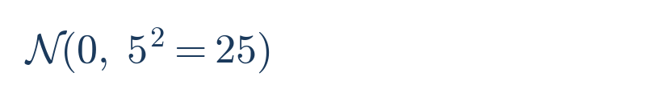
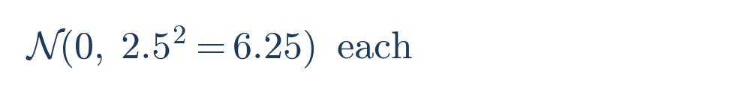
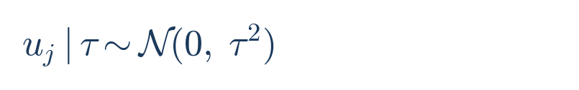

Joint Posterior Distribution
Likelihood
Logistic link, data-dependent
Intercept prior
Fixed-effect priors
Hierarchical prior
Hyperprior
The posterior is non-conjugate due to the logistic likelihood.
No closed-form solution exists → This motivates MCMC sampling.

Slide 16
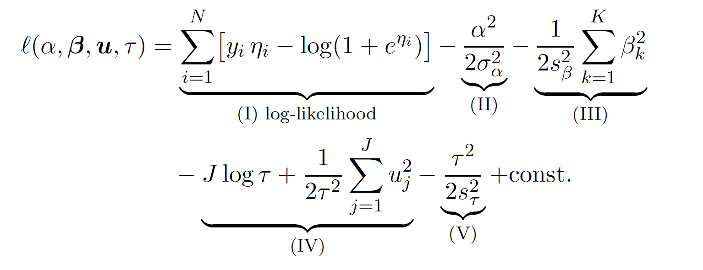
Log-Posterior Decomposition
(I) Log-likelihood
Data-dependent: logistic log-likelihood
(II) Prior on alpha
Gaussian regularization on intercept
(III) Prior on beta
Independent Gaussian on each fixed effect
(IV) Prior on u | tau
Hierarchical: tau controls shrinkage; tau only here, NOT in (I)
(V) Prior on tau
Half-Normal hyperprior on group-level SD
Key observations: tau appears ONLY in terms (IV) and (V), not in the likelihood.
tau is informed by data only indirectly through posterior draws of u_j
the tau MCMC update does NOT require likelihood evaluation --> O(J) cost.

Slide 17



Full Conditional Distributions
For each parameter block, collect terms from the log-posterior ℓ(α, β, u, τ) that depend on the parameter being updated:
Block 1: α
Block 2: βₖ (k = 1..K)
Block 3: uⱼ (j = 1..J)
Block 4: φ = log τ
Key observations:
Blocks 1–3 share the same likelihood terms — they differ only in which prior penalty is added.
Block 3 (uⱼ) sums only over group-j observations — this is a major computational saving.
Block 4 (φ) does NOT involve the likelihood at all. Data inform τ only indirectly through the posterior draws of uⱼ. None of these conditionals are available in closed form - Metropolis-Hastings required for every block.

Slide 18
Posterior Propriety & Identifiability
Posterior Propriety
Proposition. The posterior p(α, β, u, τ | y) is proper (integrates to a finite value).
Proof: (i) Bernoulli likelihood is bounded: 0 ≤ p(y | ·) ≤ 1; (ii) All priors are proper distributions.
⟹ Joint integrand bounded above by ∏(proper priors) → integrates to 1.
Identifiability
Problem: α and uⱼ are weakly non-identifiable. Shifting α → α+c and uⱼ → uⱼ−c preserves ηᵢ:
This creates a ridge in the posterior — α and mean(u) are perfectly negatively correlated.
Resolution: 1. Priors: p(α) and p(uⱼ|τ) both centered at 0 → break the shift symmetry.
2. Computation: Block 5 (joint translation move) explores along this ridge → improves mixing for α.

Slide 19

Reparameterization: phi = log(tau)
Why reparameterize?
tau > 0 constraint makes random walk on tau inefficient near boundary
phi = log(tau) maps to unconstrained R, enabling standard Gaussian proposals
Requires Jacobian correction: + phi (from |d(tau)/d(phi)| = exp(phi))
-J phi : from -J log(tau)
+ phi : Jacobian correction
exp(-2 phi) : tau^{-2} in random-effect variance
Does NOT involve the likelihood --> O(J) cost per update

Slide 20


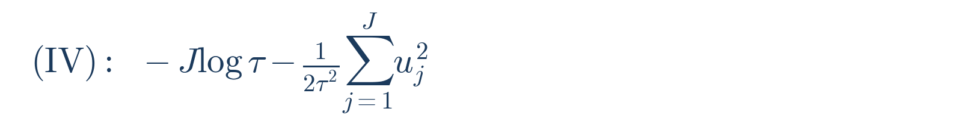
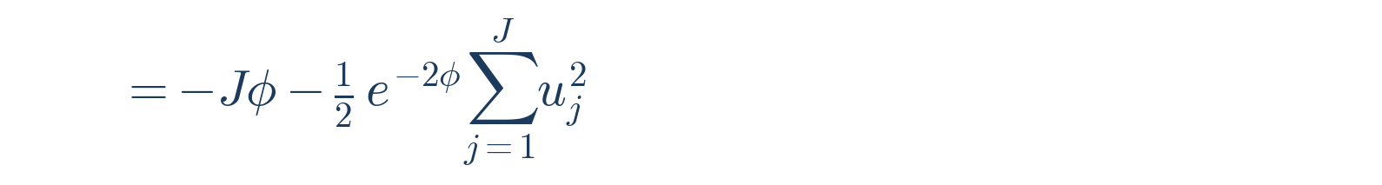
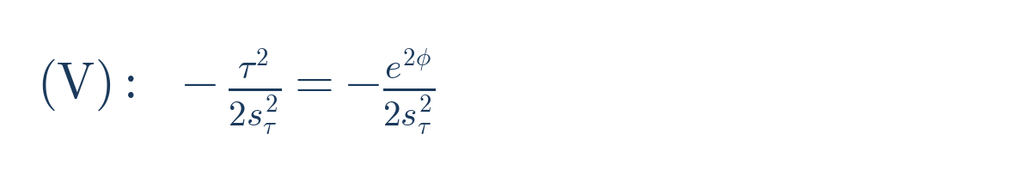

Reparameterization: φ = log(τ) — Derivation
Why reparameterize?
τ > 0 constraint makes random-walk MH inefficient near boundary (proposals τ* < 0 wasted). φ = log(τ) maps to unconstrained ℝ.
Step 1. Change of variable:
Step 2. Jacobian:
Step 3. Substitute into terms (IV) + (V) of the log-posterior:
Step 4. Combine (IV) + (V) + Jacobian:

Slide 21
Part 5
Sampling Strategy

Slide 22
Metropolis-within-Gibbs: Block Structure
Block 1: alpha
O(N)
Symmetric random walk; incremental update delta_eta = alpha* - alpha
Block 2: beta_k (k = 1..43)
O(N) each
Component-wise update; delta_eta = (beta_k* - beta_k) * X[:,k]
Block 3: u_j (j = 1..19)
O(n_j) each
Component-wise; likelihood uses only group-j observations (n_j << N)
Block 4: log(tau)
O(J)
Does not involve likelihood; only depends on current u_j draws
Block 5: Translation Move
O(J) x 10
Joint alpha-u update exploiting non-identifiability (see next slide)

Slide 23
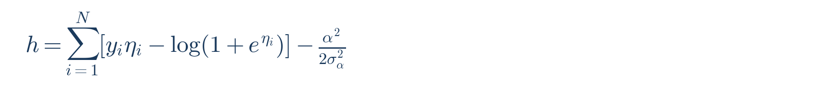
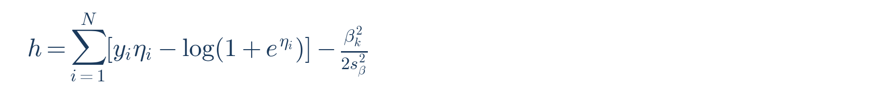
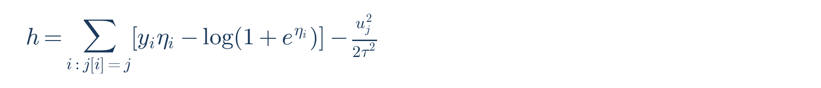
MwG: Acceptance Probability
Each block uses a symmetric random-walk proposal:
Because the proposal is symmetric — q(θ*|θ) = q(θ|θ*) — the Hastings ratio cancels:
where h(·) is the log-target (full conditional) for the block being updated.
Application to each block:
Block 1 (α):
O(N)
Block 2 (βₖ):
O(N) per k — incremental Δη
Block 3 (uⱼ):
O(nⱼ) — group-j only
Block 4 (φ):
O(J) — no likelihood!

Slide 24

Block 5: Joint α–u Translation Move
Motivation:
α and uⱼ are weakly non-identifiable. Individual MH explores the α–u ridge very slowly. The translation move directly proposes along the ridge.
Step 1. Propose:
Step 2. Show η* = η (likelihood invariance):
Likelihood cancels exactly! → Acceptance ratio depends only on priors → O(J) cost
Step 3. Log acceptance ratio (only priors remain):
Implementation: Repeated R = 10 times per iteration (cost: 10 × O(19) = O(190), negligible vs O(N) blocks). Acceptance rate: 0.45.

Slide 25
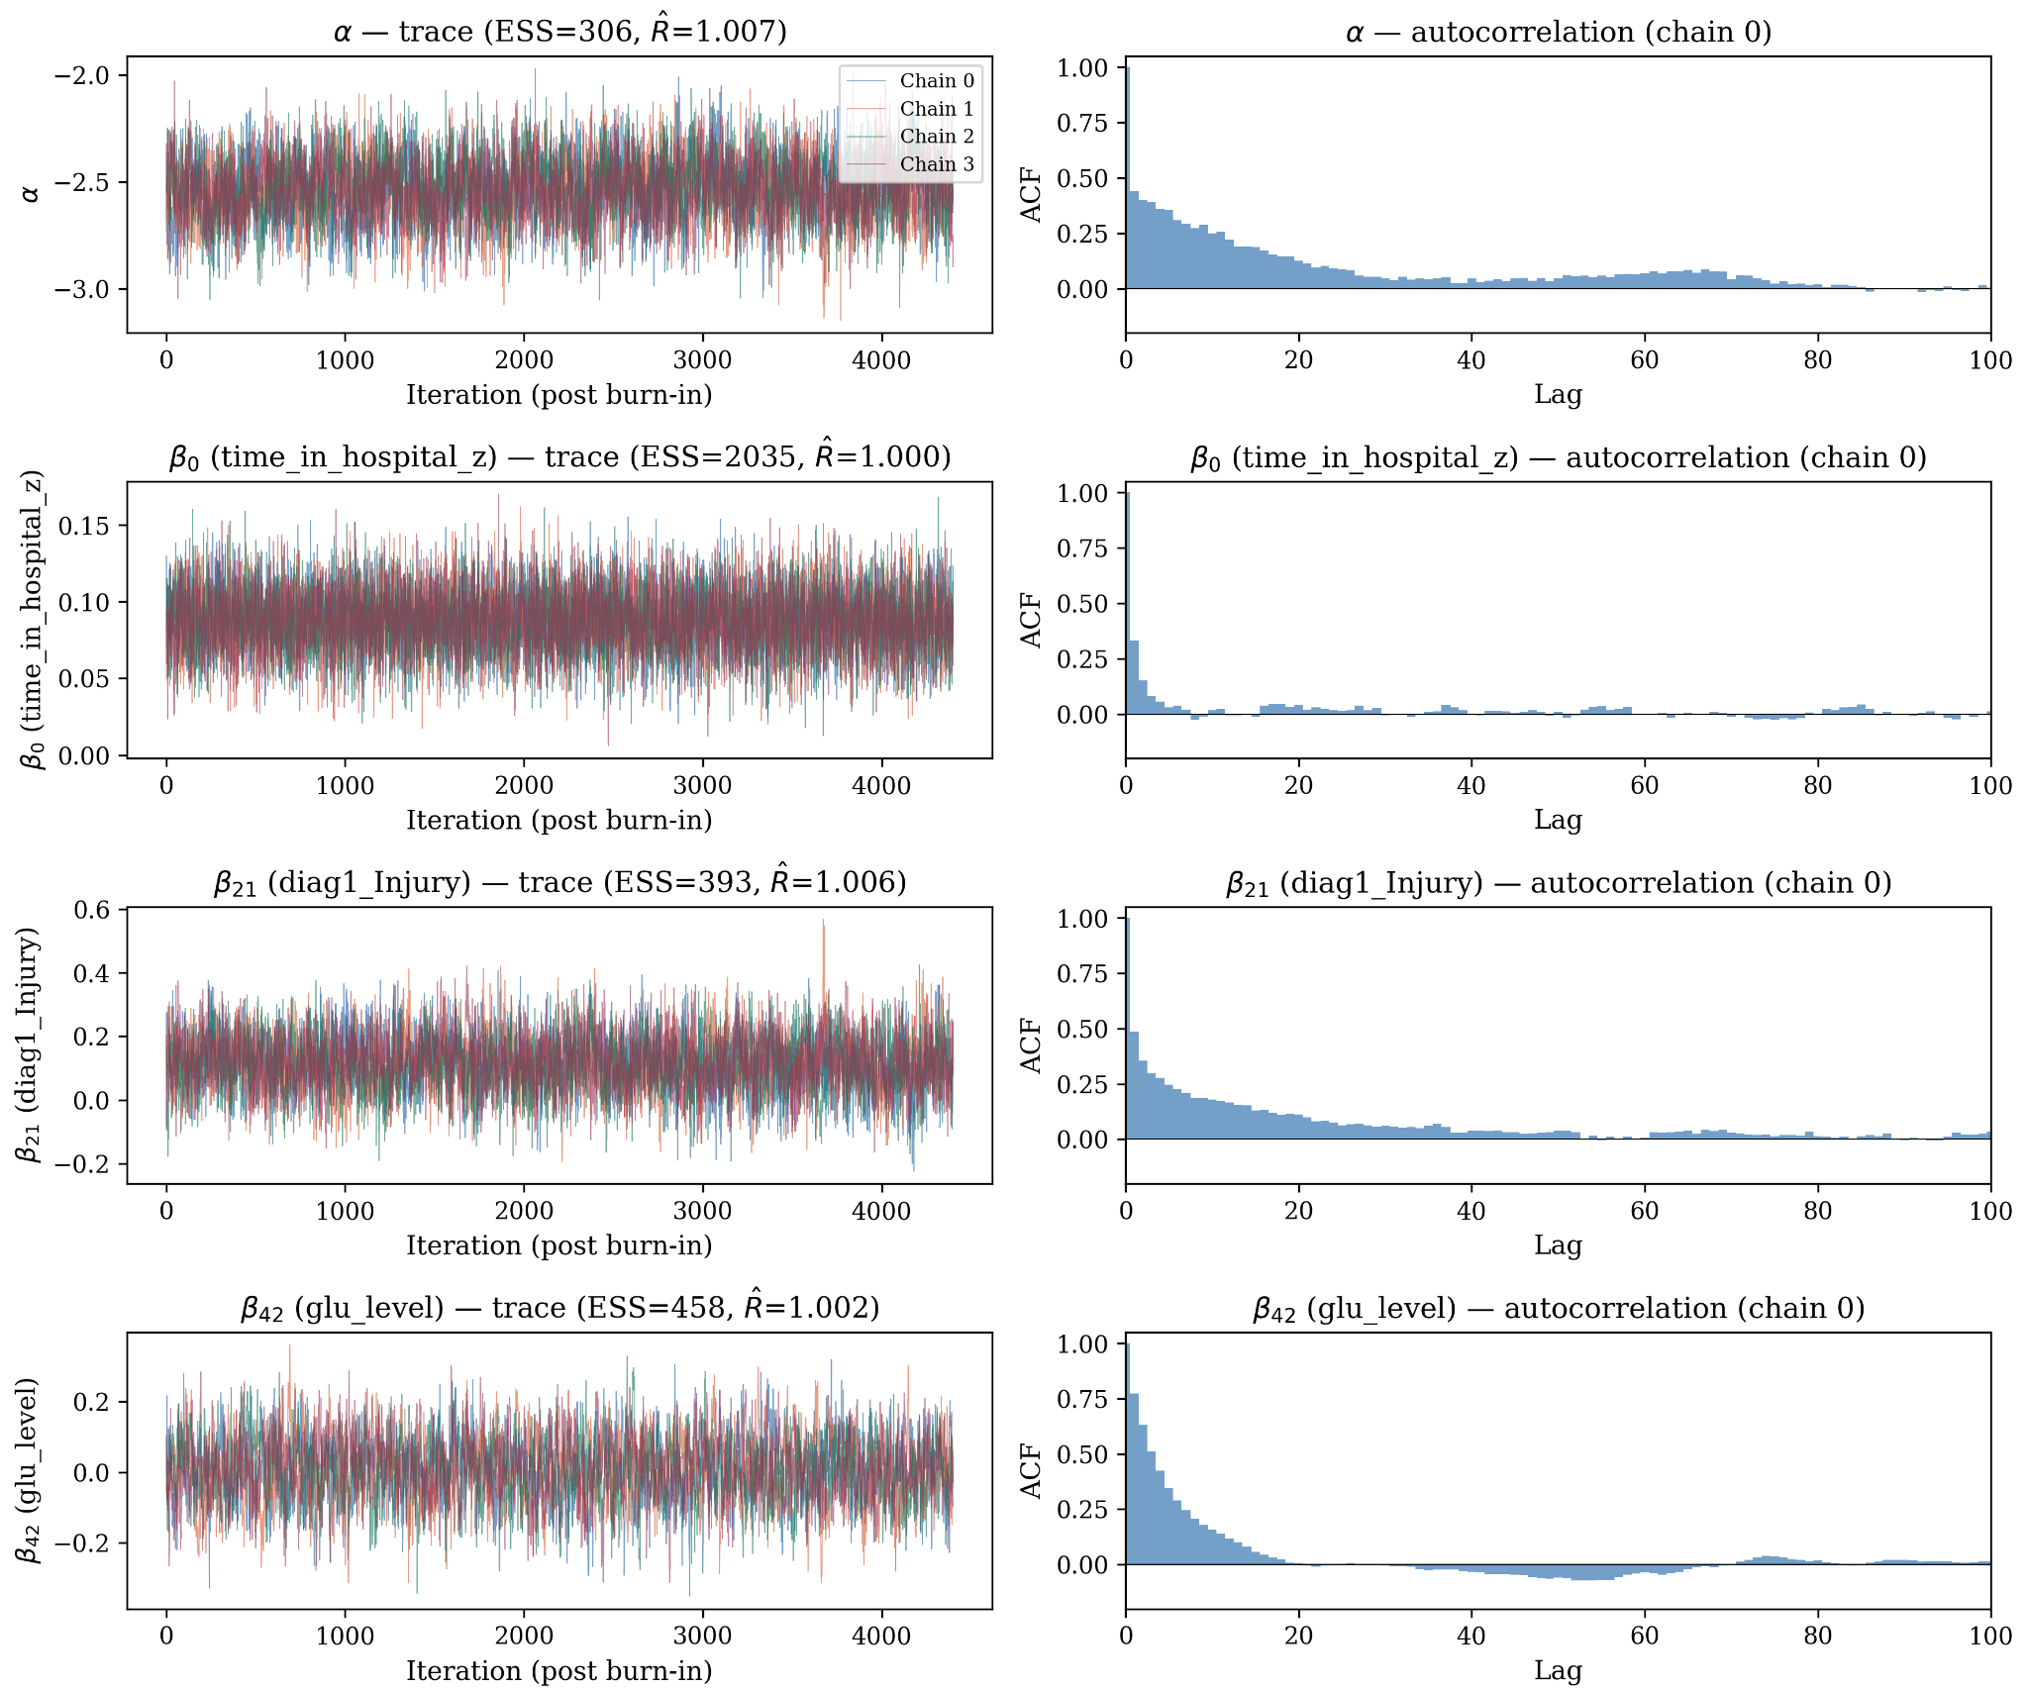
Trace Plots — Fixed Effects & Intercept
4 chains | 30,000 iter | Burn-in: 8,000 | Thin by 5 → 4,400 saved / chain | Adaptive per-coordinate tuning (target: 20%–50%)
Parameters shown:
α (intercept, ESS=306),
β₀ (time_in_hospital, ESS=2035),
β₂₁ (diag1_Injury, ESS=393),
β₄₂ (glu_level, ESS=458)

Slide 26
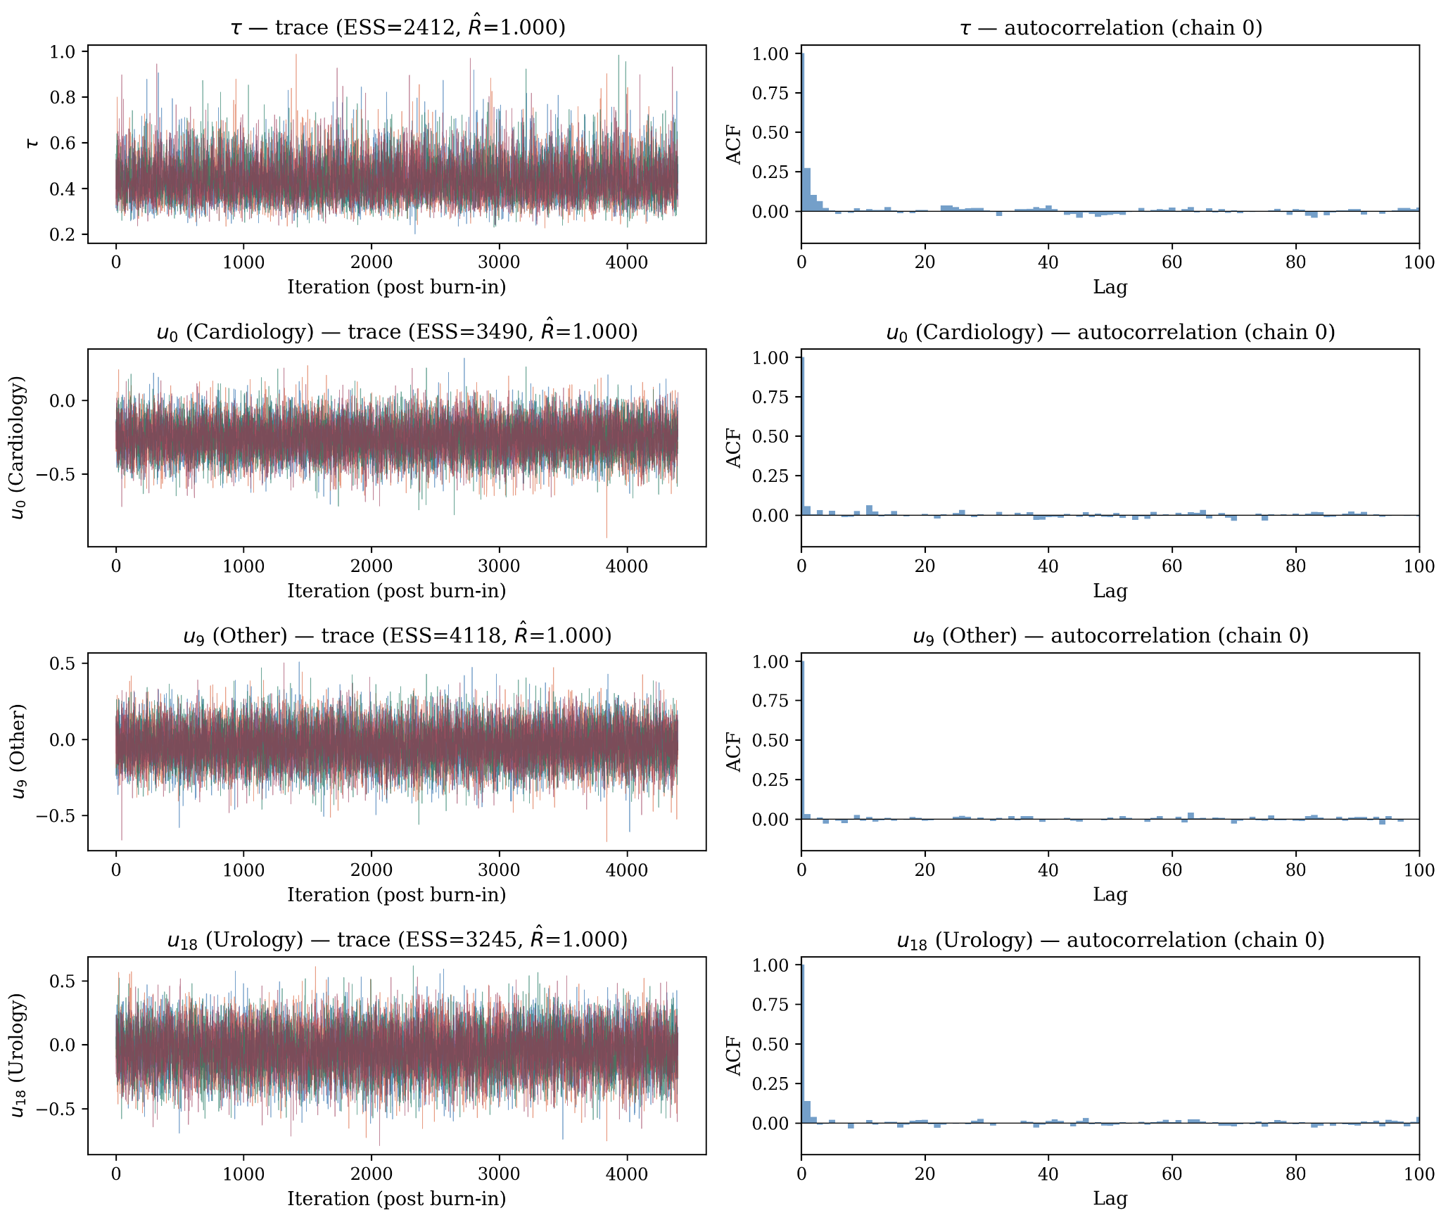
Trace Plots — Hyperparameter τ & Random Effects
All 4 chains overlap and mix well | Autocorrelation decays to near zero within 20–50 lags for most parameters
Parameters shown:
τ (ESS=2412, R̂=1.000),
u₀ Cardiology (ESS=3490),
u₉ Other (ESS=4118),
u₁₈ Urology (ESS=3245)

Slide 27
Effective Sample Size & Split-R̂
Parameter Block | Min ESS | Median ESS | Max R̂ | All R̂ < 1.05?
α (intercept) | 245 | 306 | 1.007 | ✓ Yes
β (43 fixed effects) | 118 | 866 | 1.013 | ✓ Yes
τ (between-group SD) | 2,286 | 2,412 | 1.000 | ✓ Yes
u (19 random intercepts) | 1,593 | 3,490 | 1.001 | ✓ Yes
Interpretation
All 64 parameters satisfy R̂ < 1.05 (max = 1.013 for β₂₈), well below the conventional threshold.
All parameters have ESS > 100; most exceed 500. The hyperparameter τ achieves ESS ≈ 2,412 with R̂ = 1.000, indicating excellent mixing for the key parameter of interest.
α has the lowest ESS (~306) due to the α–u ridge correlation, partially mitigated by the Block 5 translation move.

Slide 28
Part 6
Inferential Findings
Notes:
Now we move to the inferential results.

Slide 29
Fixed Effects — Key Predictors
Effects on log-odds scale
Variable | Post. Mean | 95% CrI | OR | OR 95% CrI
No. prior inpatient (z) | 0.201 | [0.175, 0.227] | 1.22 | [1.19, 1.25]
Comorbid neoplasms | 0.415 | [0.198, 0.631] | 1.51 | [1.22, 1.88]
A1C measured | 0.352 | [0.154, 0.552] | 1.42 | [1.17, 1.74]
Diabetes medication | 0.168 | [0.057, 0.277] | 1.18 | [1.06, 1.32]
Age (z) | 0.165 | [0.123, 0.208] | 1.18 | [1.13, 1.23]
Diag: Neoplasms | −0.507 | [−0.792, −0.217] | 0.60 | [0.45, 0.81]
Diag: Respiratory | −0.360 | [−0.519, −0.200] | 0.70 | [0.59, 0.82]
Interpretation
Prior inpatient visits strongest predictor (OR=1.22/SD). Comorbid neoplasms highest OR (1.51). A1C measurement reflects severity, not causal testing effect. Sex, race, insulin not significant after adjustment.
Notes:
This slide shows the key fixed effects from the hierarchical logistic model. Prior inpatient visits is the strongest predictor, with an OR of 1.22, indicating past utilization strongly predicts future readmission. Comorbid neoplasms has the largest effect (OR = 1.51), suggesting higher clinical complexity increases risk. A1C measurement and diabetes medication are also positively associated, but we interpret these as markers of disease severity rather than causal effects. Age shows a modest positive effect. In contrast, primary diagnoses of neoplasms and respiratory conditions are associated with lower readmission risk, likely reflecting differences in care pathways. Finally, sex, race, and insulin are not significant after adjustment.

Slide 30
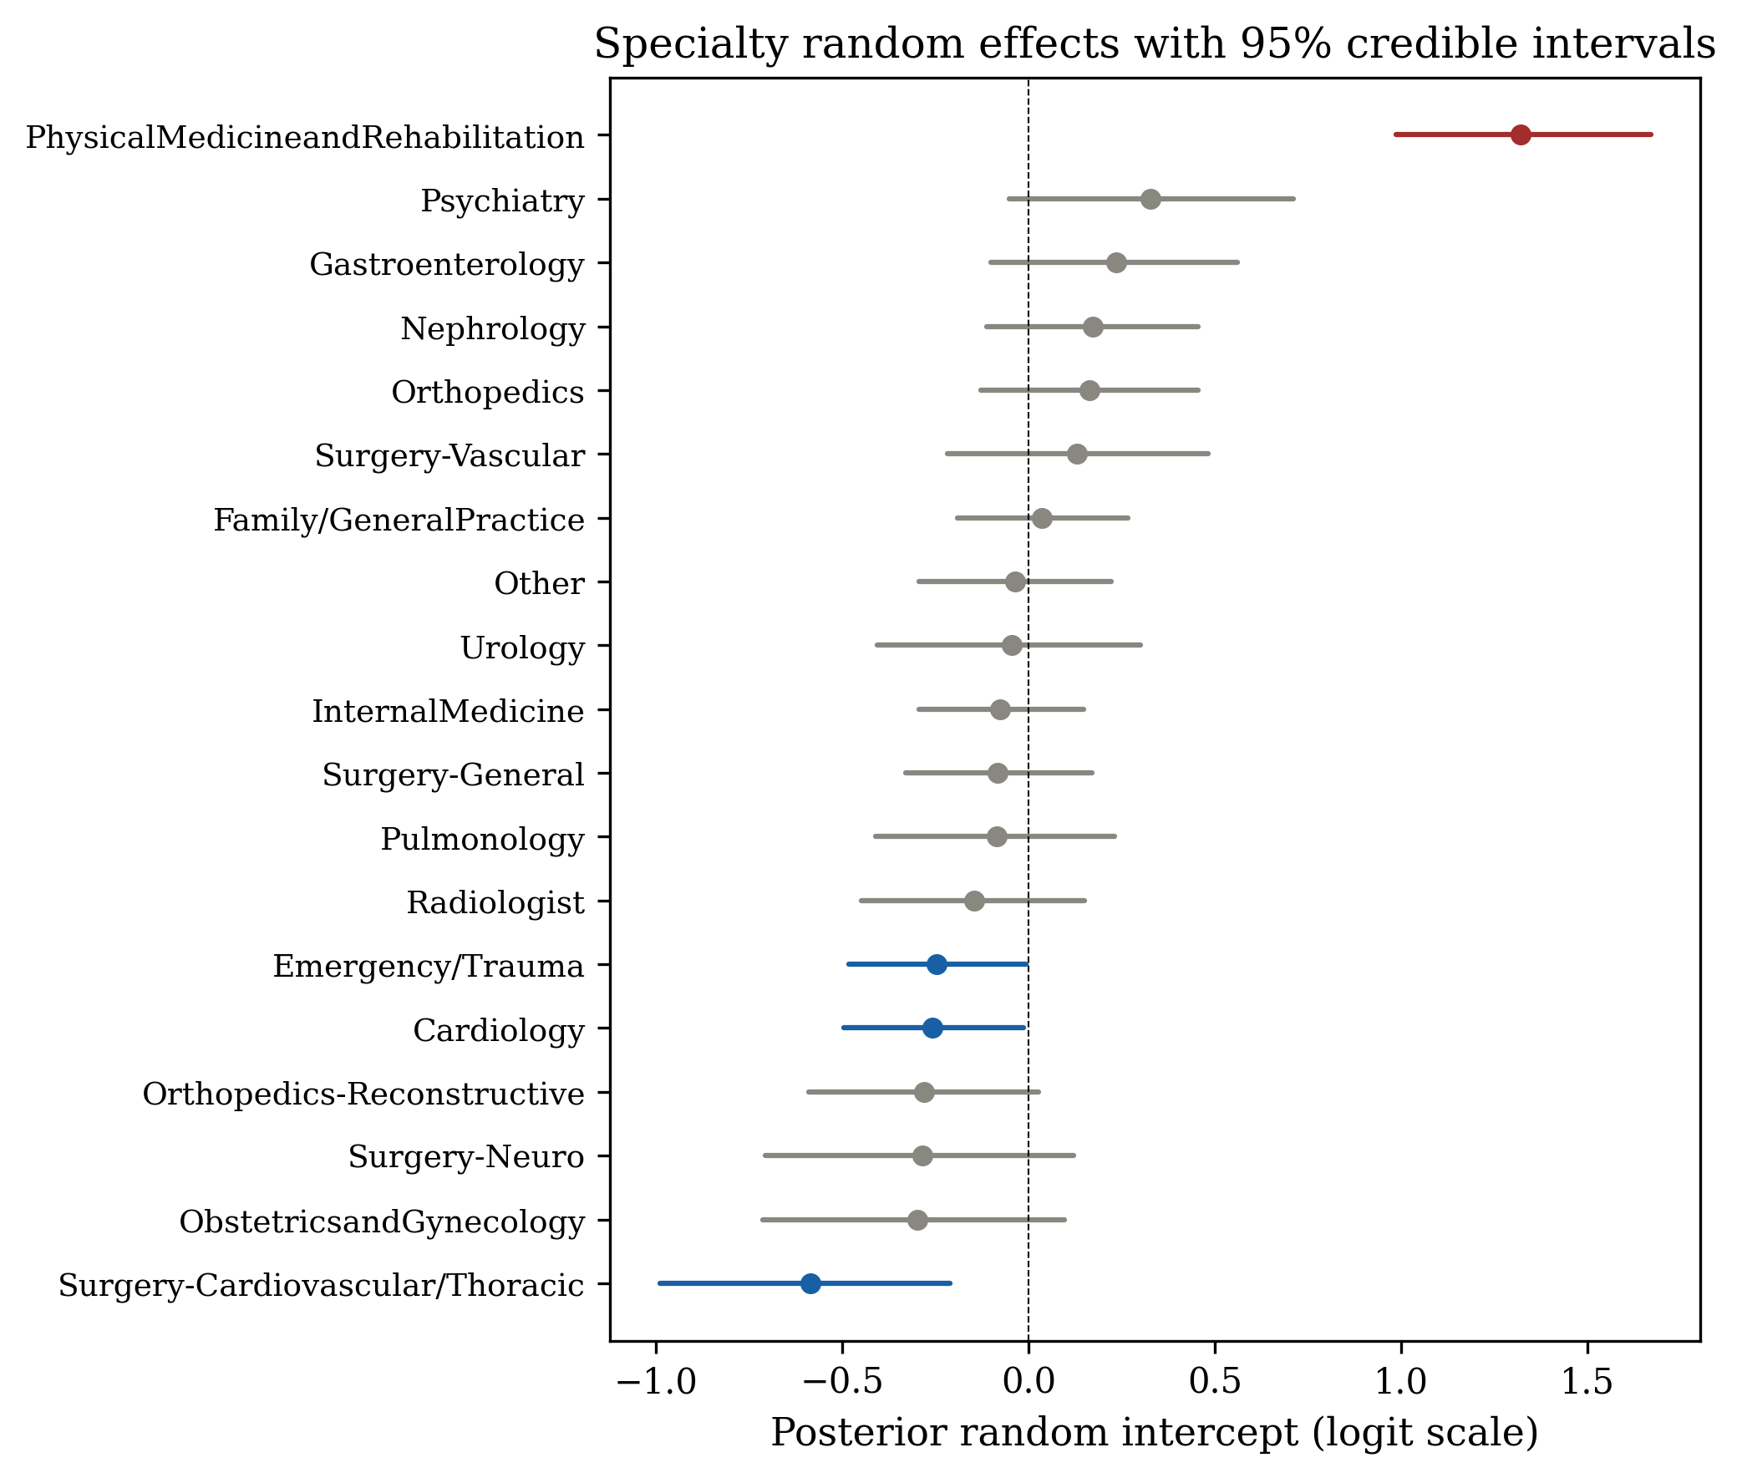
Specialty Random Effects & Shrinkage
represents the deviation from the population-average log-odds
Highest risk Physical Med & Rehab
Lowest risk Pediatrics, OB/Gyn
Shrinkage - Small-sample groups pulled toward the population mean
Key insight - Partial pooling stabilizes estimates for rare specialties
Notes:
This forest plot shows the posterior means and 95 percent credible intervals for each specialty's random intercept u_j, which represents the deviation from the population-average log-odds.
Physical Medicine and Rehabilitation has the highest random effect, around plus 1.32 on the logit scale. This means that, even after controlling for patient characteristics, patients admitted under this specialty have notably higher readmission risk. On the other end, Surgery-Cardiovascular/Thoracic and Obstetrics/Gynecology show negative random effects — lower risk, around minus 0.5 to minus 1.0.
Notice the shrinkage effect. Specialties with smaller sample sizes have wider credible intervals and their point estimates are pulled closer to zero — closer to the population mean. This is partial pooling in action. The model doesn't naively trust the noisy raw rates from small groups; instead, it borrows information from the larger groups through the hierarchical structure.

Slide 31
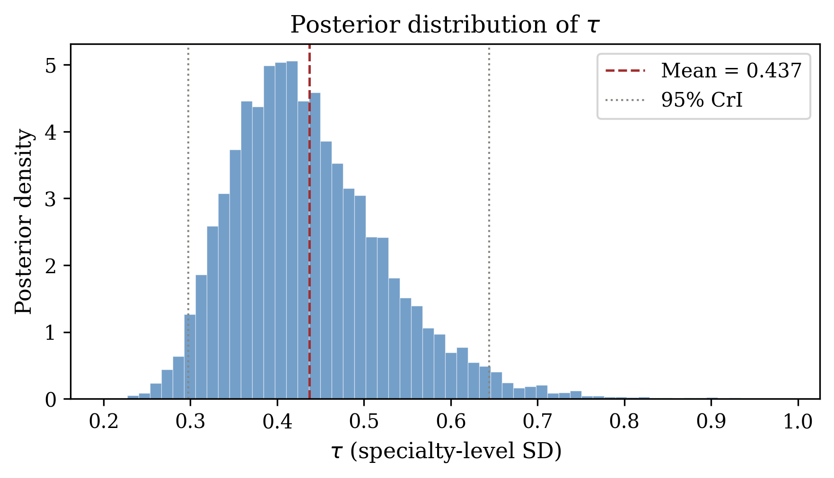
Heterogeneity Scale tau — Core Finding
τ̂ = 0.437
95% CrI [0.298, 0.644]
Interpretation
Posterior mass clearly away from zero, which means strong evidence of between-specialty heterogeneity. Specialty heterogeneity exists and is reliably estimated, but patient-level covariates remain the primary driver of readmission
Notes:
The estimated τ is 0.437, with the credible interval clearly away from zero.
This indicates strong between-specialty heterogeneity.
However, patient-level covariates remain the primary drivers.

Slide 32

Model Comparison
Model | AUC | Brier | Log-Loss | Cal. Slope
No specialty | 0.629 | 0.0852 | 0.307 | 1.003
Fixed effects | 0.641 | 0.0846 | 0.305 | 0.997
Bayesian hierarchical | 0.641 | 0.0846 | 0.305 | 1.024
DIC = 23,254 | p_D = 60.5 (< 64 nominal) confirms shrinkage from hierarchical prior
effective number of parameters
Take the average of the deviation of the posterior samples by Comorbid neoplasms
Notes:
The hierarchical model has similar predictive performance as fixed effects, but provides better interpretability.
DIC also supports the hierarchical structure.

Slide 33
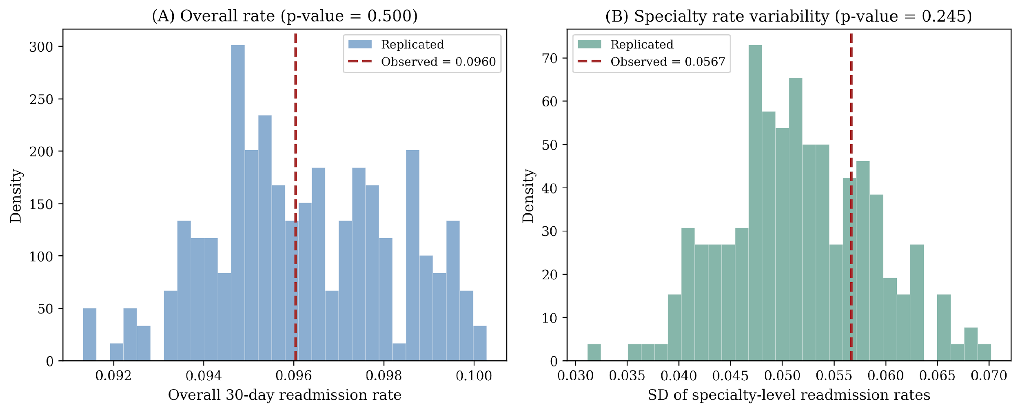
Posterior Predictive Check
Notes:
Posterior predictive checks show that the model captures both the overall rate and variability.

Slide 34
Part 7
Sensitivity & Robustness Analysis

Slide 35
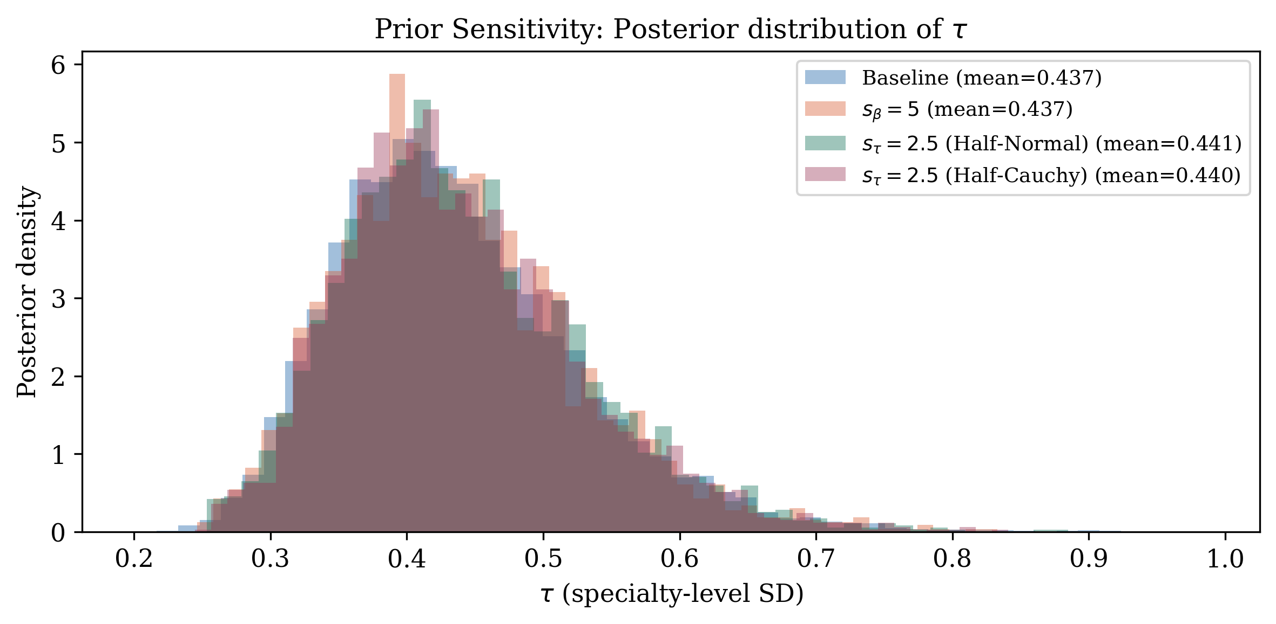
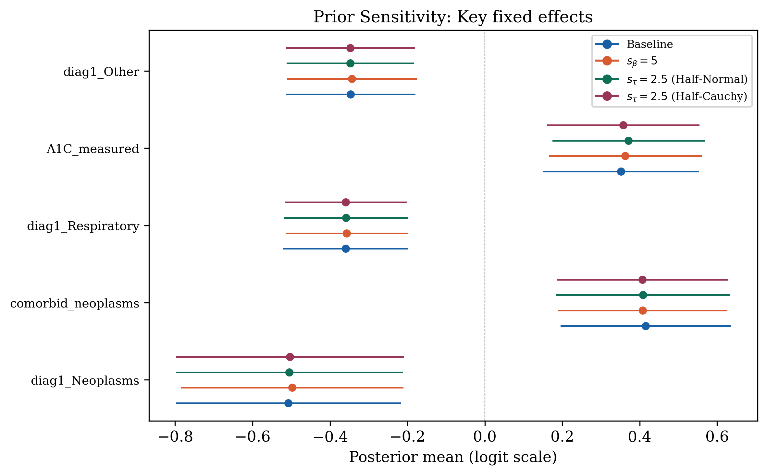
Sensitivity Analysis — Prior Robustness
Alternative Prior Configurations
Baseline
s_beta = 2.5, s_tau = 1.0 (Half-Normal)
A1
s_beta = 5.0 (fixed-effect prior standard deviation doubled)
B1
s_tau = 2.5 (widen the tau hyperprior to Half-Normal, wider)
B2
s_tau = 2.5 (switch the tau hyperprior to Half-Cauchy, heavier tails)
Notes:
For sensitivity analysis, we re-ran the sampler under three alternative prior configurations.
Our baseline uses a weakly informative prior, designed to prevent parameter divergence while avoiding overly restrictive assumptions on the data.
In A1, we doubled the fixed-effect prior standard deviation from 2.5 to 5.0, making the beta priors even more diffuse.
This allows us to assess whether the posterior is data-dominated or sensitive to prior specification; the near invariance of results suggests strong data dominance.
In B1, we widened the tau hyperprior to Half-Normal with scale 2.5 instead of 1.0, thereby allowing for greater between-group variation.
In B2, we switched the tau hyperprior to a Half-Cauchy distribution with scale 2.5, which has heavier tails and puts more prior mass on large values of tau.
From the graph, you can see the tau posterior densities under all four configurations overlaid. They are nearly identical. The range of posterior means across configurations is less than 0.05 — essentially negligible.
The key fixed-effect estimates also remain stable, with beta variation less than 0.02 across configs. And the specialty rankings — which specialty has the highest or lowest random effect — are highly consistent, with a Spearman correlation above 0.95.

Slide 36
Sensitivity Analysis — Prior Robustness
Alternative Prior Configurations
Baseline
s_beta = 2.5, s_tau = 1.0 (Half-Normal)
A1
s_beta = 5.0 (fixed-effect prior standard deviation doubled)
B1
s_tau = 2.5 (widen the tau hyperprior to Half-Normal, wider)
B2
s_tau = 2.5 (switch the tau hyperprior to Half-Cauchy, heavier tails)
Conclusion
tau range across configs: < 0.05
Beta variation: < 0.02 for top predictors
Specialty ranking: Spearman rho > 0.95
Posterior is likelihood-dominated for key parameters. Results are robust to prior choice.
Notes:
The conclusion is clear: our posterior is likelihood-dominated for all key parameters. The data, not the prior, is driving the results. Our findings are robust to the specific choice of prior.

Slide 37
Part 8
Conclusion

Slide 38
Main Findings
Specialty matters τ = 0.437 (CrI [0.298, 0.644])
meaningful heterogeneity beyond patient covariates
Medical complexity drives readmission
Prior inpatient visits, neoplasms, A1C, age, diagnoses are strongest predictors
Model adequacy
PPC confirms model captures both mean and variance structure
DIC favors hierarchical over no-specialty model
Partial pooling
Hierarchical model stabilizes estimates for small specialties via shrinkage toward the population mean
Notes:
Let me summarize our main findings.
First, specialty heterogeneity is real and reliably estimated. The posterior of tau is clearly bounded away from zero, providing strong Bayesian evidence of between-specialty variation in readmission risk.
Second, Medical complexity drives readmission— particularly prior inpatient visits, comorbid neoplasms, diabetes medication use, and number of diagnoses — remain the primary drivers of readmission.
Third, posterior predictive checks confirm that our model captures both the mean structure and the group-level variance. DIC favors the hierarchical model over the no-specialty baseline.
Fourth, the hierarchical model achieves principled partial pooling. Small specialties benefit from shrinkage toward the population mean, giving us stable estimates even for groups with fewer than 300 observations.

Slide 39
Limitations & Future Work
Limitations
Data vintage
Dataset from 1999-2008, ICD-9 has since transitioned to ICD-10
Selection bias
Excluded 45.7% of encounters with unknown specialty, which could introduce selection bias if the missing-specialty mechanism is non-random.
Model scope
assumes specialty effect is constant across patient profiles
Conclusion
A Bayesian hierarchical logistic regression provides a principled framework for modeling 30-day readmission, capturing both patient-level effects and specialty-level heterogeneity. Compared to fixed-effects models, it enables partial pooling for stable estimates in small specialties, directly quantifies between-specialty variance, and delivers coherent uncertainty. Results are robust to prior choices based on sensitivity analysis.
Notes:
We should acknowledge some limitations. The dataset is from 1999 to 2008, and clinical practices have evolved since then. The ICD-9 coding system has been replaced by ICD-10. So our specific coefficient estimates may not directly apply to current practice.
We also excluded 45 percent of encounters with unknown specialty, which could introduce selection bias if the missing-specialty mechanism is non-random.
And our model uses only random intercepts — it assumes the specialty effect is the same regardless of patient profile. A random-slopes model could capture, for example, whether age affects readmission risk differently across specialties.
Thank you! We're happy to take any questions.

