Slide 1
Beta-Testing Without Beta-Testers For Monopoly
Selim Emir Can
Stanford CS348K
June 2026
github.com/Selim-Emir-Can/CS348K-proj/tree/master

Slide 2
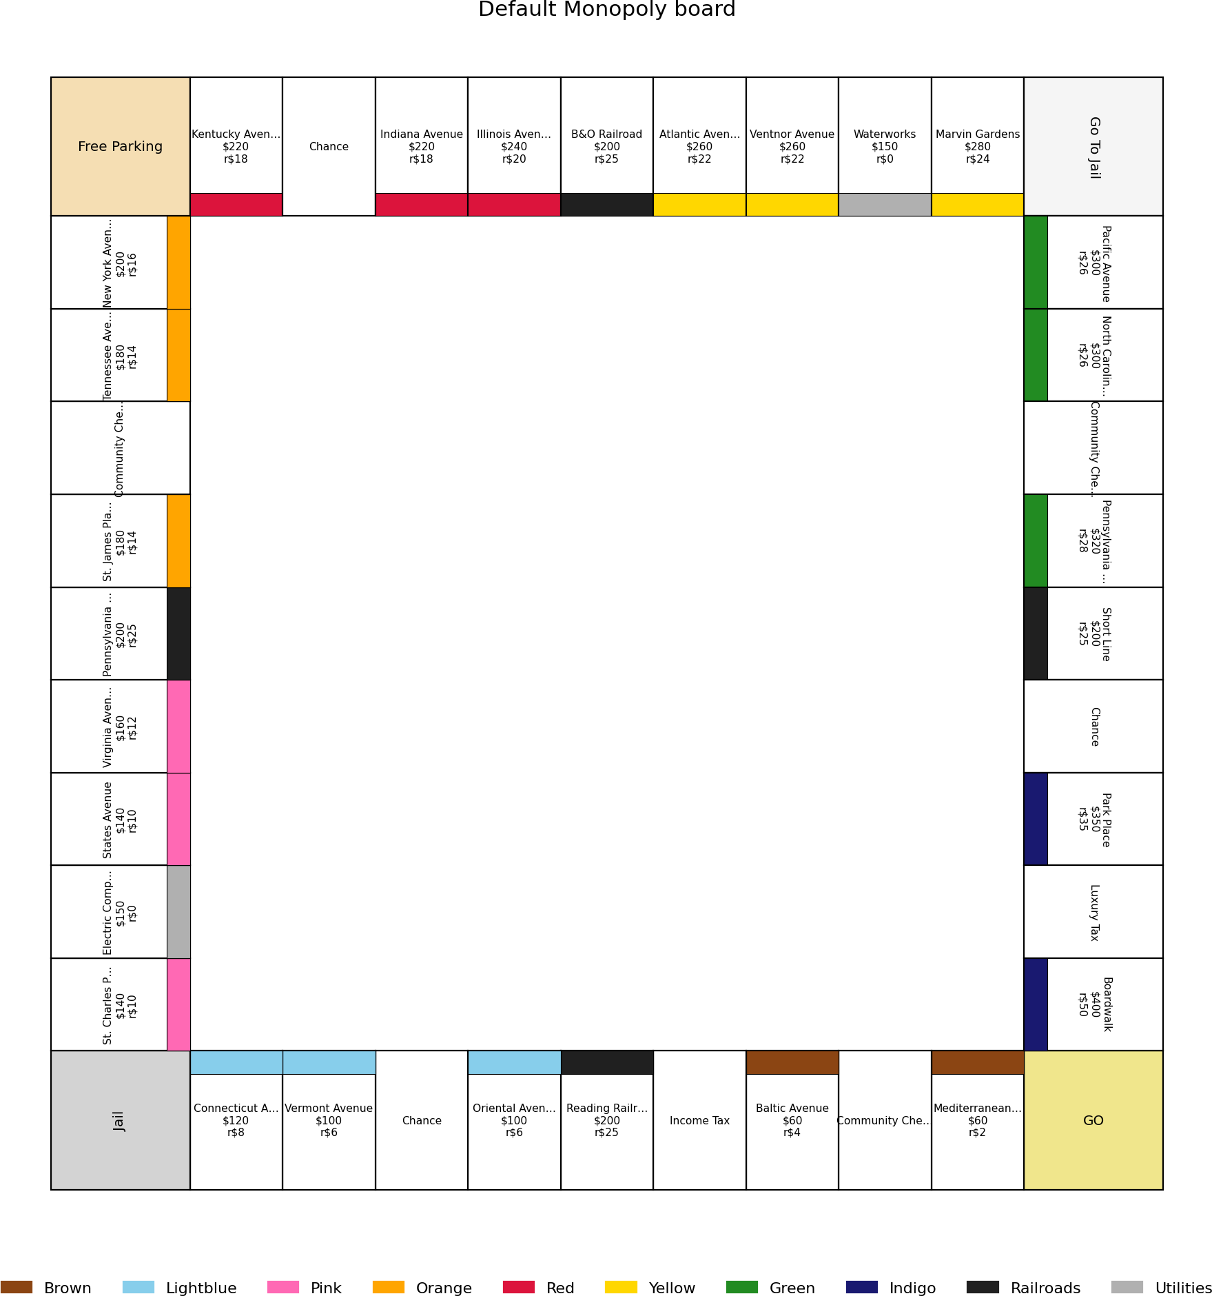
Motivation
Beta testing is resource-intensive; balance a game
→ many diverse human users over many sessions.
Combinatorial design spaces that human playtesting alone cannot cover.
We need an automated way to test each candidate design against a diverse population of simulated players.
Monopoly: our testbed

Slide 3
The strategy pool: 10 named archetypes
Strategy | Cash floor | Trades | Build | Buys | Ignores groups
AggressiveBuilder | 0 | no | max | RR+Util | none
CashHoarder | 1000 | no | slow | RR+Util | none
Trader | 300 | yes | max | RR+Util | none
RailroadKing | 100 | no | max | RR only | all colour groups
LowCostOnly | 200 | yes | max | RR+Util | 5 priciest (Or/Rd/Yl/Gn/In)
HighCostOnly | 400 | yes | max | RR only | 3 cheapest (Br/Lb/Pk)
Balanced | 300 | yes | max | RR+Util | none
Passive | 500 | no | slow | none | none
Bully | 50 | yes | max | RR+Util | none
RiskAverse | 800 | no | slow | RR only | Green, Indigo
“Cash floor” = cash kept un-spent; “Build” = max houses/turn vs. one/turn; “Buys” = railroads
/ utilities.

Slide 4
The objective: one composite, five design qualities
score(θ) = w F + w F
+ w
|R−R∗| _{+ w}
D + w
|T −T ∗|
F
Fmax
max
R _{R}∗
D
T _{T} ∗
 | Term | Measures | Goal
 | F mean fairness Fmax worst-pair fairness | win-rate spread between players (avg. over matchups) the worst matchup’s spread (robustness) | minimise minimise
 | R length | mean rounds per game | target 60
 | D draw rate | fraction of games with no winner | minimise
 | T transfer | inter-player money moved per player-turn | target 50

Slide 5
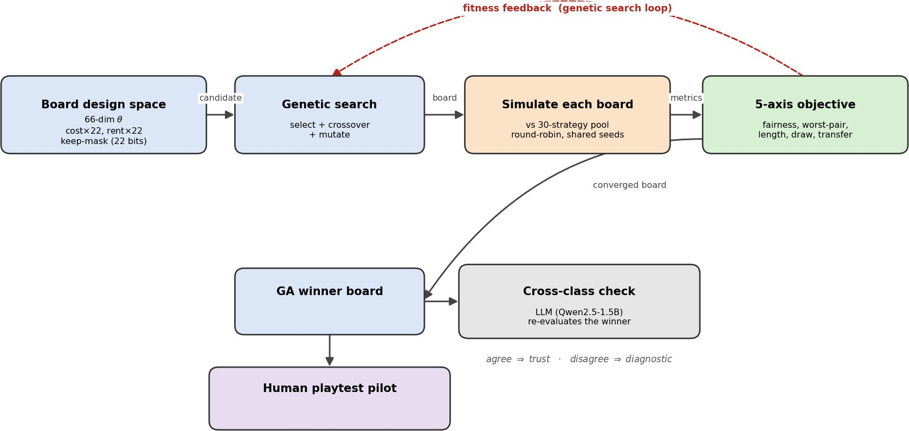
Method
How can I gain confidence that feedback from agents is *somewhat* predictive of real people?

Slide 6
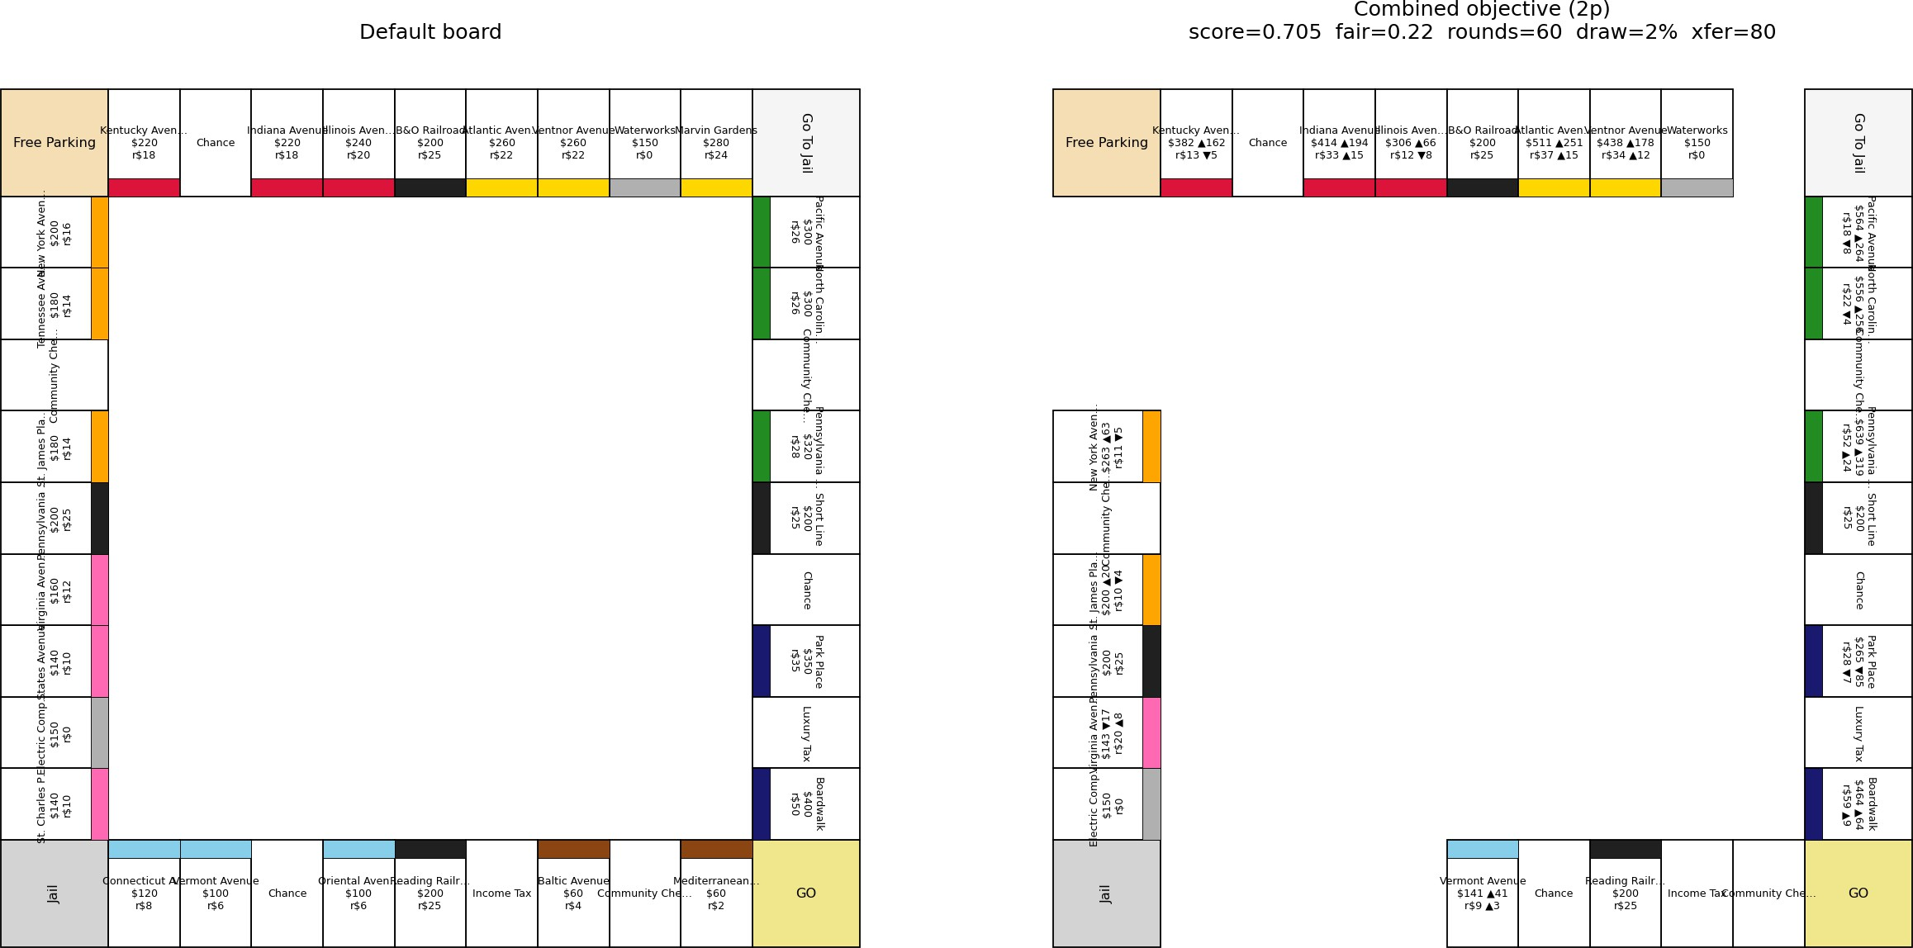
Generated boards (2p): default vs. GA winner
GA-2p winner: keeps 12 of 22 colour-group properties at ∼1.6× base cost and ∼1.3× base rent. A shorter, pricier lap that is fairer (2p), more decisive, and cashes out faster than the default.

Slide 7
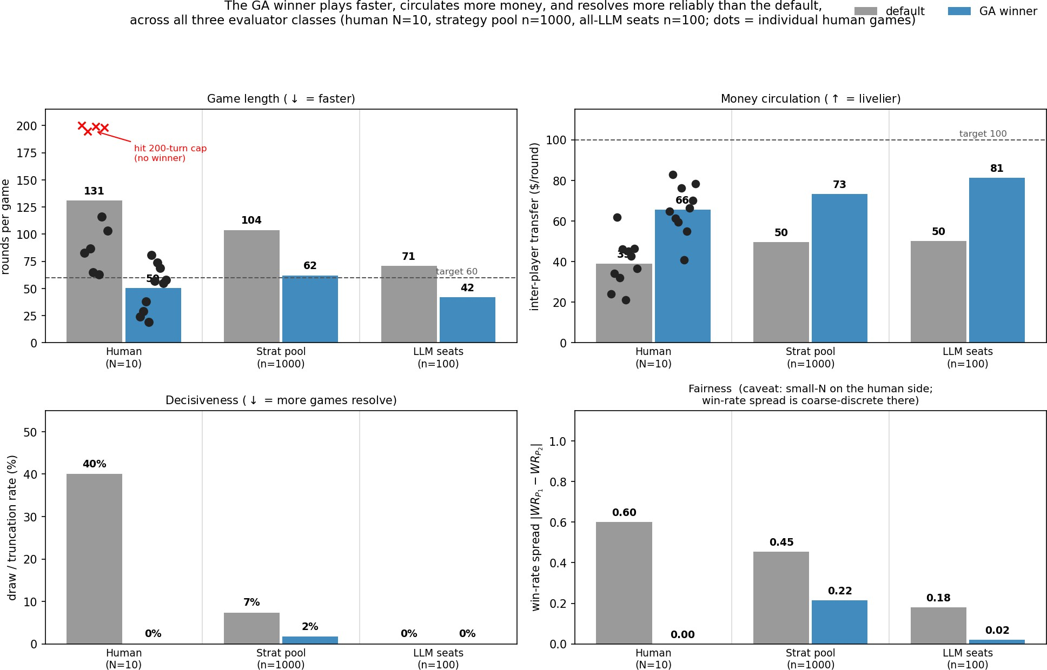
Does it hold up with a human at the controls?
Takeaway: Default board is not optimal; our strategy pool is predictive of human player experiences; all evaluators agree on direction and magnitude
Game Length: GA winner ∼50 rounds vs. 131 default.
Money + draws: $66/r vs. $39; 0% vs. 40% draws.

Slide 8
Game-design insights
Expansion → solvency: losing condition flips.
Default (long games, low rents): reward owning more.
GA winner (∼60 rounds, ∼1.3× rent, ∼1.6× cost): reward staying solvent.
One bad landing can drain a $300 reserve.
AggressiveBuilder vs. CashHoarder: 0.80 → 0.45 (WR).

Slide 9
Game-design insights
Smaller colour groups make all-in builds work.
Default: cheap 2-cell groups (Brown) can’t win; need an expensive triplet.
GA winner: 1–2 cell groups + 1.6× cost / 1.3× rent → max houses + hotel pays off.

Slide 10
Game-design insights
Blocking opponents stops working.
Default: buy one cell of opponent’s set to deny completion.
GA winner: 1–2 cell sets complete on first landing.
Higher costs (∼1.6×) prevent hoarding properties before crossing GO.
Something rent tuning alone could not do.

Slide 11
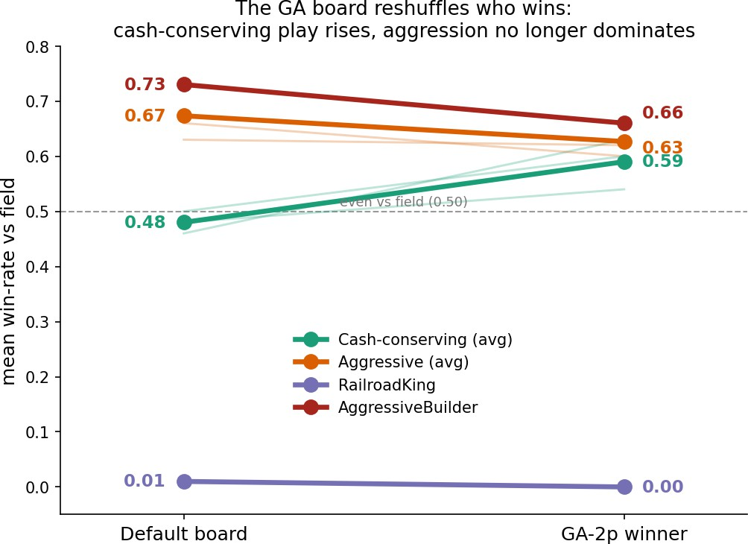
What the GA fixed: which archetypes win more (and less)?
GA winner reshuffles who wins, not just shortens:
Slow / cash-conserving (CashHoarder, RiskAverse, Passive): middling → top-tier..
Bad strategies perform the same across both boards: performance is a function of strategy and board type.
Takeaway: we can use our method to determine if a strategy is truly good.

Slide 12
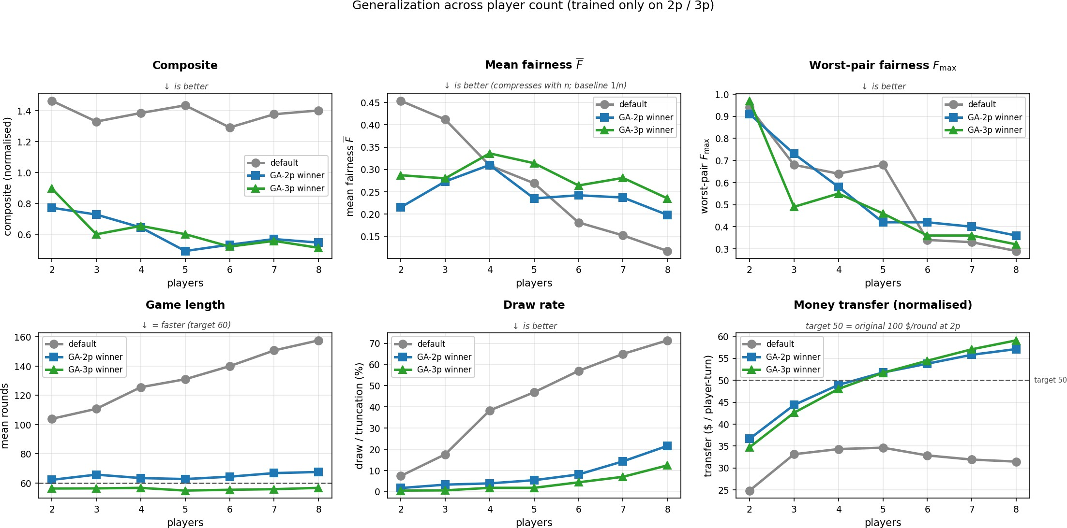
Results: generalization to 2–8 players
Takeaway: every metric except fairness generalises from training (2p / 3p) to every count from 2 to 8; fairness is strongly dependent on the number of players.
Game Length: ∼60 rounds at every count vs. 104 → 158 for the default.
Decisiveness: optimised boards finish ≥ 78% of games at 8p; the default finishes only 29%.
Fairness: winners are 30–53% fairer than default at 2p / 3p but 69–101% less fair at 7–8p

Slide 13
Conclusion
Human playtest (N=10, two players) clears the success bar
Pool + LLM evaluators agree on the rule-based GA winner.
Optimized boards play ∼2–3× faster, finish reliably at 2–8 players
We can use our framework to analyze game board characteristics and player behavior
The recipe transfers to any parameterized multi-agent system: market mechanisms, RL environments, recommendation systems.

Slide 14
Game-design insights
Game length (∼60 vs. ∼100 rounds): the 12-cell lap leaves fewer turns between rent events.
Decisiveness (draw rate 7% → 2%): ∼1.6× base cost and ∼1.3× base rent force bankruptcy before the turn cap.
Money circulation (g50 →g73/round): higher base rent on cells landed more often.
Fairness at 2p/3p (spread 0.45 → 0.22; −32% at 3p): Yellow dropped + most groups shrunk to 1–2 cells
+ per-property rent multipliers spread ∼0.6×–1.9× damp over-powered cells, the same recipe the fairness-only ablation finds.

