Slide 1
WIOT SOFTWARE ARCHITECTURE
One overview of the active Arduino STM32 node, LoRa gateway, Python server and sensor simulator
FIELD INTERFACES
ARDUINO STM32 SENSOR NODE
COMMUNICATIONS / GATEWAY
MQTT BROKER / PYTHON WEB SERVER
Power and battery monitor
Build configuration and boot
MQTT broker - company / region / node topics
Controller + converters + selected radio
ADC voltage with calibrated divider
Role / uplink; four sensor enables + addresses; pins; power modes; ACK policy
Private deployment settings and AES key remain local
wiot/{company}/{region}/{node}/data | status | cmd
wiot/{company}/{region}/broadcast
Four independently enabled sensors
Initialize and recover
Python server: decrypt and validate
TUF: flow / velocity; native day, month, year
Supmea: flow / cumulative forward totals
HNDA (Honde): moisture / temperature
Sondas: moisture / temperature / EC
Each type has its own enable and slave ID
All four can share the same RS485 bus
Safe valve output; classify reset; recover persistent reset counters
RTC, ADC, bus, selected radio, flash recovery; arm IWDG
Envelope / padding; protobuf; topic-to-payload node identity
Company / region access scope; validity and message classification
Cooperative application loop - COMMANDS FIRST
Select the compiled uplink
Route the decoded message
Pump LoRa / MQTT; validate target and request; dispatch command
Prioritize replies; advance storage; then sample / report / history / power
Direct WiFi / SIM MQTT, or LoRa to a gateway
One route is active in a node build
Status / live telemetry / command acknowledgement / flash reply
Archived readings remain separate from live consumption / charts
Sampling cycle when due
Execute accepted command
E32 / AS32 LoRa transport
Live SQLite storage
Flash archive SQLite
Poll one enabled sensor per pass
Service command traffic in idle gaps
Rates / time / valve / wake / counters
Flash clear, status, last, today, cancel
Logical frame, CRC, fragments, retries / ACKs
Network ID / source node; UART RX wake
Measurements + validity
Consumption / reset counts
Power and valve metadata
Memory status + indexed samples
History progress / generation
History ACK only after commit
Shared RS485 / Modbus RTU
Result / explicit query reply
9600 baud, 8N1; direction control
CRC / address checks; bounded timeout / retries
Complete sensor snapshot
Protobuf + AES-CBC envelope
STM32 LoRa gateway
Zero unavailable sensor groups
Attach validity, RTC, voltage, valve
and persistent reset counters
Periodic Status; requested Telemetry
Command result; flash metadata
Stored samples / history progress
Reassemble node payload -> MQTT publish
Server CMD -> Mode-1 wake probe -> command
Gateway NORMAL; sleeping nodes need WOR_TX=1
Fragment handling takes priority over MQTT work
Web dashboard, downloads and reports
Accounts / roles; company -> region -> node selection
Live readings, charts, consumption, flash archive and CSV
Latching solenoid control
Commit sample to SPI flash
Transmission cycle when due
TB6612FNG polarity pulse; bridge then OFF
Commissioned pulse times and pin checks
Telemetry is commanded state; no position sensor
S25FL064L: 8 MiB NOR journal
CRC, commit marker, recovery
Retention: 24 elapsed hours
Read latest committed sample
Explicitly marked live fallback
Keep original acquisition timestamp
Selected external IP modem
Operator command and execution tracking
ESP8266 WiFi OR SIM800L GSM / GPRS
MQTT connection / publish / receive callback
Bounded network retries and reset recovery
Validate scope / arguments; allocate request ID; queue and retry
Track broker receipt separately from node execution / rejection
Alternative test bus
RTC consumption service
Watchdog / reset recovery
Supmea forward-total differences
Day / month / year boundaries
Persist baseline / quality; TUF native
30 s IWDG; foreground progress
Stall -> reset; retained reset counters
10 retries: modem; next 10: full reset
Direct MQTT bypasses gateway
Bench sensor simulator
Radio / MQTT contract
Encode / encrypt and publish CMD
Multiple virtual sensors; unique bus addresses
Fixed / changing values; fault testing
Independent Supmea RTC comparison totals
Telemetry upstream; commands downstream
Gateway forwards the encrypted node payload
LoRa ACK != broker receipt != node execution
Execution requires a matching application reply
SRATE, STRAN, STIME, telemetry, valve, WAKE, reset-counter clears
Flash: clear / status / last / today / cancel
History persistence acknowledgement advances the node transfer
Idle / power manager
NORMAL; REMOTE_WAKE; RTC periodic / queued Standby; LoRa WOR Stop
Wake for work / commands; RTC heartbeat feeds IWDG; storage guards sleep
BLUE: measurements / transport PURPLE: commands / replies GREEN: stored data DASHED: test or supporting service
RTC schedules wakeups; IWDG expiry resets. WOR report timing uses APP_POWER_SLEEP_SECONDS; independent SRATE / STRAN applies to schedule-driven REMOTE_WAKE.
Notes:
Reviewed against final Arduino STM32 architecture, 2 November 2026. Functional architecture, not a wiring diagram or call graph. Native editable text, boxes and freeform arrows; use Selection Pane and Edit Points. Arrow endpoints must be adjusted after moving boxes.
Important distinctions: firmware roles are compiled separately. A node uses direct IP OR LoRa, not both simultaneously. The gateway has no local sensor polling/archive. RTC, not watchdog expiry, schedules normal wake. LoRa WOR uses UART RX falling-edge wake; AUX is radio readiness. Mode-1 probe may be truncated intentionally; the following command is preserved. Flash reset is 24 elapsed hours, not midnight; FLASH_TODAY filters the retained batch. TUF period totals are native; Supmea periods derive from cumulative forward-total changes. Valve ACK confirms software pulse, not physical position. Optional action ACK policy does not suppress explicit storage query responses. Sondas register map must match the purchased sensor. ESP32/CubeIDE ports are outside this active release overview.
Code references:
Node/IoT_Node_Encrypted/IoT_Node_Encrypted.ino
Node/IoT_Node_Encrypted/src/config/AppConfig.h
Node/IoT_Node_Encrypted/src/app/GatewayApp.cpp
Node/IoT_Node_Encrypted/src/app/FlowMeterManager.cpp
Node/IoT_Node_Encrypted/src/comm/MQTT.cpp
Node/IoT_Node_Encrypted/src/radio/LoraLink.cpp
Node/IoT_Node_Encrypted/src/power/PowerManager.cpp
Node/IoT_Node_Encrypted/src/platform/Watchdog.cpp
Node/IoT_Node_Encrypted/src/storage/TelemetryArchive.cpp
Node/IoT_Node_Encrypted/src/storage/TelemetryJournal.cpp
Server/WIOT-Server-Web v1.31 - Fixed Sensor Readings in Dashboard/server_web.py
Server/WIOT-Server-Web v1.31 - Fixed Sensor Readings in Dashboard/flash_archive.py
Documentation/Flowcharts/charts.py

Slide 2
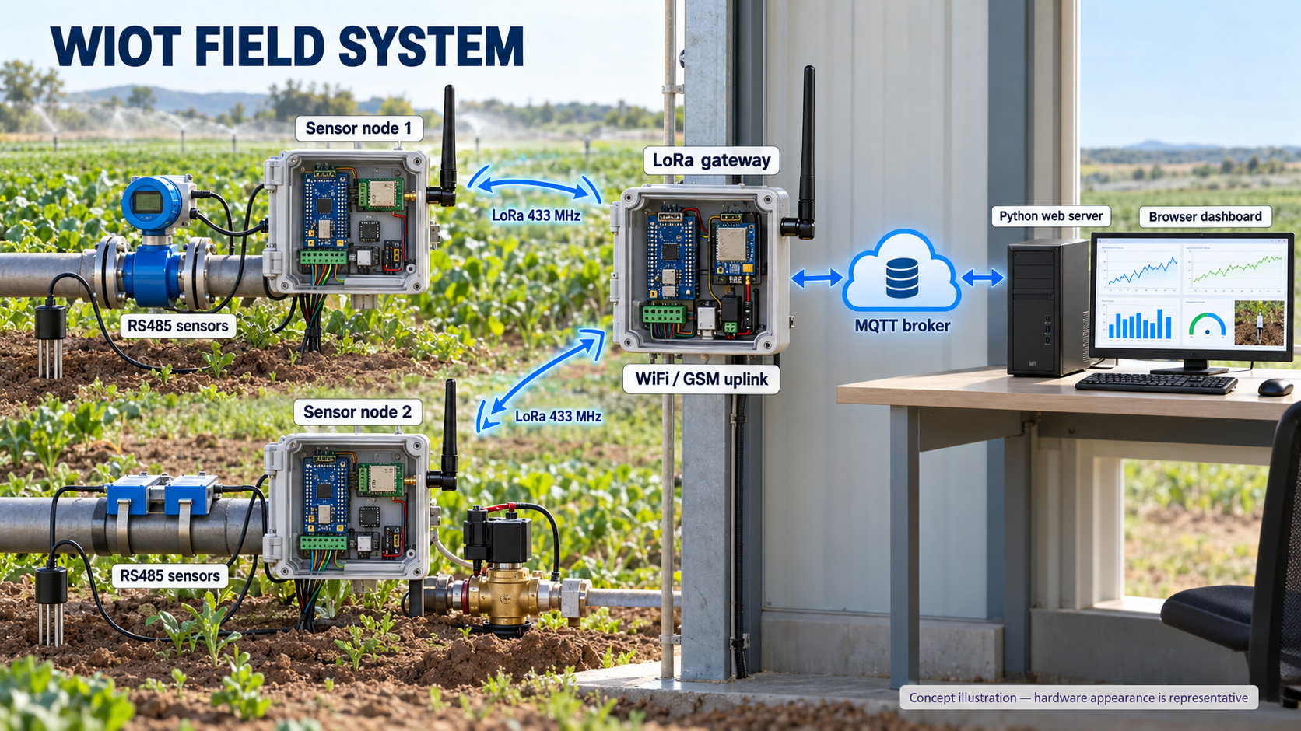
Notes:
Concept illustration generated with the built-in Image Generation tool. It represents the actual system topology, but PCB/enclosure appearance is illustrative and is not a photograph or as-built wiring reference. Each node has one selected uplink. The depicted gateway uses an external WiFi uplink; GSM is an alternative build. A server command returns through broker and gateway to the addressed node. See image_prompt.txt for the complete prompt and output provenance.

