Slide 1
How WIOT software works
Measurements go to the dashboard. Commands return to the node.
MEASUREMENTS AND REPLIES
01
02
03
04
05
Sensors
STM32 node
Connection
Python server
Dashboard
TUF / Supmea
Flow and water volume
HNDA / Sondas
Soil measurements
Read the sensors
Calculate water totals
Save the sample
Send when due
LoRa via a gateway
or WiFi / SIM directly
MQTT message exchange
Validate the message
Store readings + history
Handle commands
See live readings
Review stored samples
Control the node
Commands return through the server to the node
Settings / valve control / wake-up / flash requests
Supporting services inside the node
Measurements and time
Local storage
Automatic recovery
Power management
Validate readings. Use RTC time
for day, month and year totals.
Save samples to SPI flash.
Keep a 24-hour batch.
Watchdog and modem retry recovery.
Track watchdog and power resets.
Sleep between scheduled work.
Radio wake when supported.
The node handles commands before routine sampling and reporting.
Notes:
Simple audience overview. Source baseline c604aa6a5a49c61f86bada826a329dc600dac9f6, Arduino STM32 release.
Read the five main stages left to right. The purple return path is a conceptual route through server and the same connection, not a direct dashboard-to-radio physical link. The connection block summarizes two alternative compiled routes: node -> LoRa -> STM32 gateway -> WiFi/SIM MQTT -> broker -> Python server, OR node -> WiFi/SIM MQTT -> broker -> server. The broker is included within the connection stage to avoid a separate technical hop on this audience overview.
All four RS485 sensors are individually enabled/addressed. TUF supplies native period totals; Supmea periods derive from cumulative forward-volume changes with trusted RTC. Failed sensor groups are zeroed with invalid quality. Complete samples are committed to external S25FL064L before stored reporting when available; live fallback is explicitly marked. Flash retention is 24 elapsed hours, not midnight. Explicit flash queries return metadata or retained samples.
Commands have cooperative priority, not instantaneous preemption of in-flight operations. Automatic action ACKs are configurable. Valve replies confirm software pulse, without position feedback. LoRa WOR uses UART RX wake with a gateway Mode-1 probe; AUX remains readiness. RTC alarms schedule wake; hardware watchdog expiry resets. Timed Standby cannot receive immediate radio commands. Independent SRATE and STRAN deadlines apply in scheduled REMOTE_WAKE and default LORA_WOR. APP_LORA_WOR_USE_APP_SCHEDULE=false selects legacy WOR using APP_POWER_SLEEP_SECONDS. Stop residence ages the task clocks using RTC time. A completed sensor cycle yields to an overdue Status even when sensors failed. The gateway subscribes to direct commands and regional broadcasts. OFF, LITE and FULL diagnostics are build choices. Reviewed 7 November 2026.
Sources: Node/IoT_Node_Encrypted/IoT_Node_Encrypted.ino; src/config/AppConfig.h; src/app/FlowMeterManager.cpp; src/comm/MQTT.cpp; src/radio/LoraLink.cpp; src/power/PowerManager.cpp; src/platform/Watchdog.cpp; src/storage/TelemetryArchive.cpp; Server/WIOT-Server-Web v1.31 - Fixed Sensor Readings in Dashboard/server_web.py and flash_archive.py. Detailed workflows remain in Documentation/Flowcharts. Native editable text, blocks, icons and routed arrows; adjust endpoints after moving blocks.

Slide 2
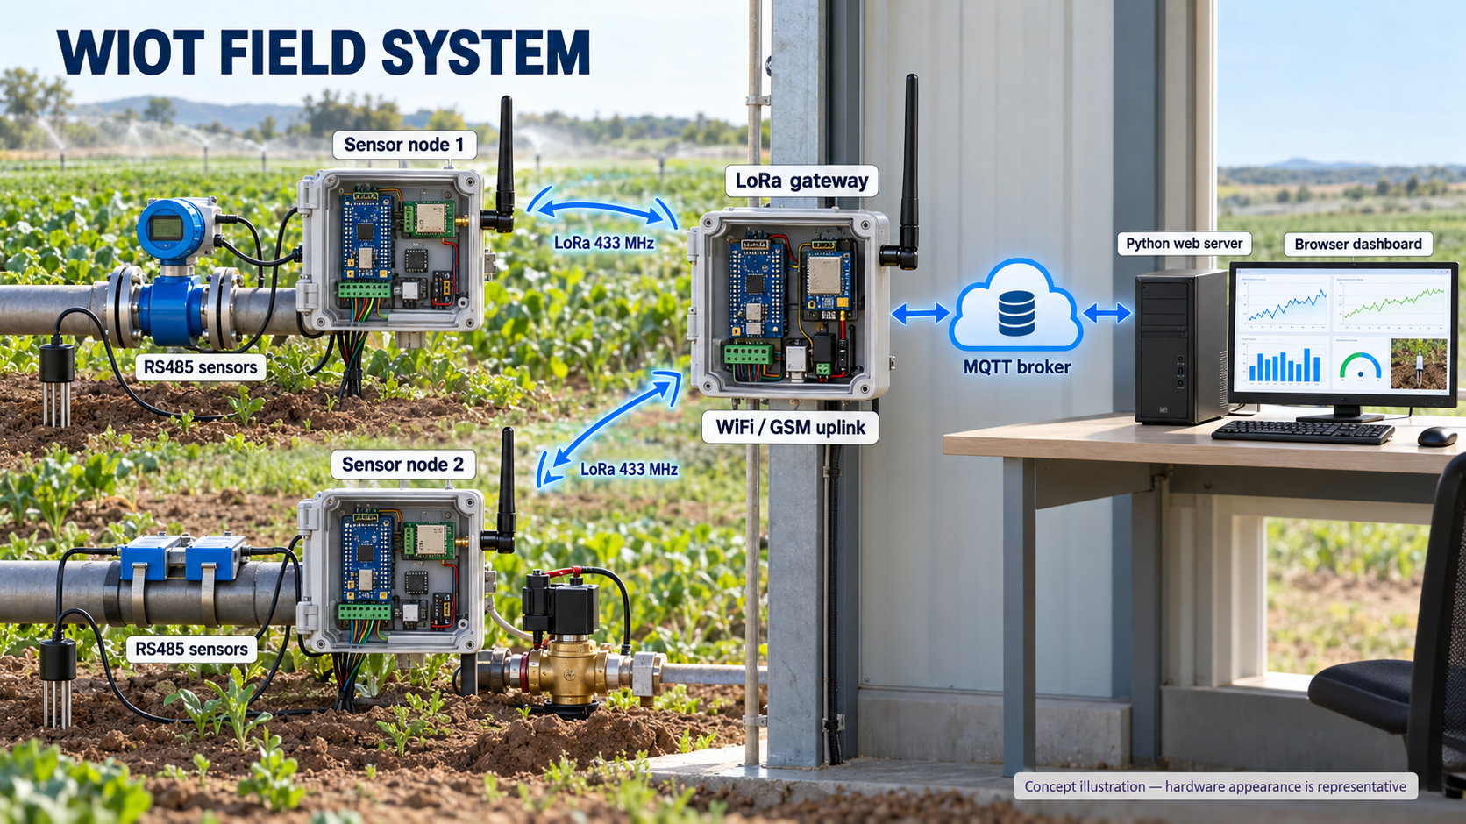
Notes:
Existing system illustration preserved from v1.0, generated with the built-in Image Generation tool. It is representative, not an as-built photograph. Complete prompt: Documentation/SystemOverview/image_prompt.txt. The flowchart on slide 1 has been simplified; software and hardware behavior are unchanged.

