Slide 1



PROJECT -1 3x3 Board Game
CME1251 Project Based Learning - I
BY
2018510074 Koray Çağlar
2017510057 Muzaffer Berşan Konal
2017510100 Mesut Selim Serbes
Izmır
26/10/2018

Slide 2
Ingredients
INTRODUCTION
PROGRESS SUMMARY
Changes in Requirements
Task Sharing and Scheduling
Completed Tasks
Incomplete Tasks: Reasons, Explanations
Additional Improvements
PROBLEMS ENCOUNTERED
ALGORITHMS AND SOLUTION STRATEGIES
SCREENSHOTS
CONCLUSION
REFERENCES

Slide 3
Introduction
Our project is to make a game played on a 3x3 board.It is a turn based game.Player’s goal is to complete the board with given random pieces with minimum turns as possible.
Every member of our team gets to create a part of the project.
We need to prepare a report, presentation and poster and complete our project in time.

Slide 4
PROGRESS SUMMARY

Slide 5
Task Sharing and Scheduling
We would think how to write the code , write the algorithm and start writing the code according to the algorithm on the first week.
Berşan would create the foundation of the algorithm and get help from Koray and Selim if needed.
Selim and Koray would start coding and show Berşan what they have done so he would learn and start coding as well.
We would finish creating the game process before the last week and work on presentation and last preparations.

Slide 6
Completed Tasks
Every member of our team wrote their own code and get help from one another time to time.
We learned new code commands and applied them in our code mostly by Koray.
Flowchart had been drawn by Berşan and transfered to computer by Selim.
Poster had been designed by all team.
We decided to use Koray’s code because it was clearer and more advanced.

Slide 7
Changes in Requirements
Koray used functions but he didn’t know it was not allowed.So he changed his function based code.
Selim didn’t know we were allowed to use loops . So he wrote 18.000 rows of code.He changed it later.

Slide 8
Incomplete Tasks: Reasons, Explanations
We didn’t wrote the code together.Because everyone thought differently.So it got complicated and we all wrote different codes and chose the best looking one.
There is no Incompleted task other than that because we planned ahead and knew what to do and what to don’t.

Slide 9
Additional Improvements
Music
Replay Option
Colored screen.
Saveable highscore table.

Slide 10
PROBLEMS ENCOUNTERED

Slide 11
We couldn’t understand how to create variables on board.So we asked our teacher and she gave us an idea
Every member of our team has written different codes and that’s a big problem for a group work.
It was hard to catch up with team for Berşan because Koray and Selim has known coding before. With Koray’s help he learnt a lot. In conclusion he managed to write his own code.

Slide 12
ALGORITHMS AND SOLUTION STRATEGIES

Slide 13
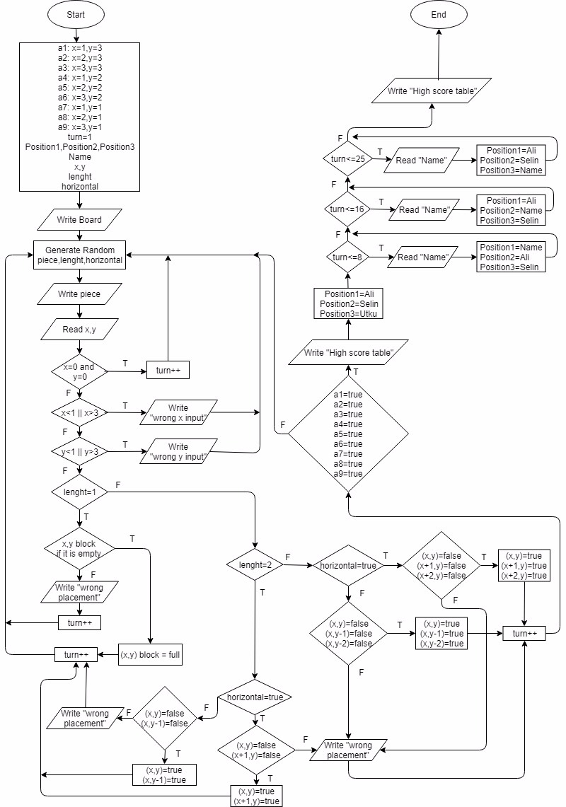

Slide 14
SCREENSHOTS

Slide 15
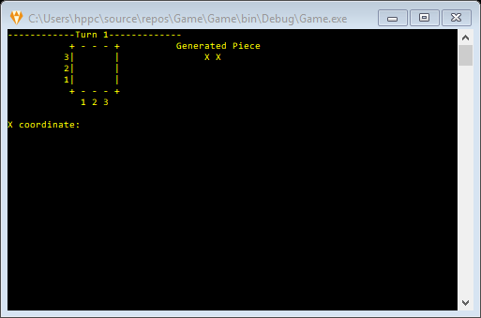

Slide 16
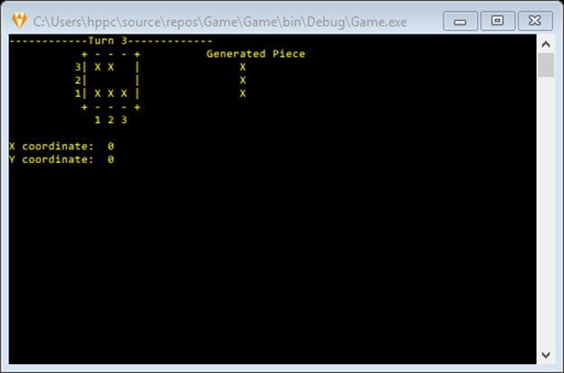

Slide 17
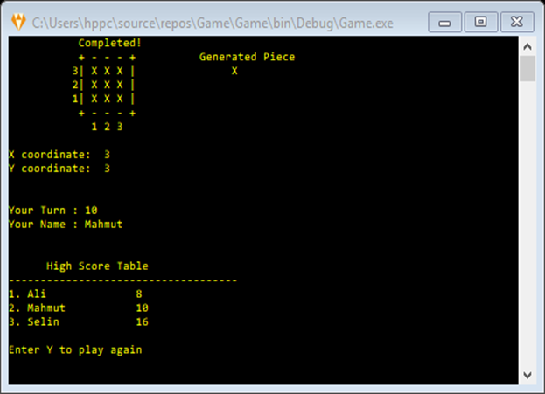

Slide 18
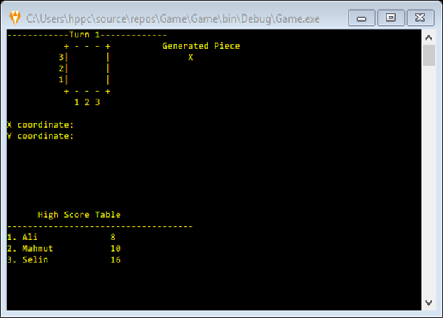

Slide 19
CONCLUSION

Slide 20
We completed the project.
We learned ;
Working as a team
A lot about coding
Designing algorithms
Drawing flowchart
We had ;
Fun

Slide 21
REFERANCES

Slide 22
Göksu Tüysüzoğlu
Derya Birant
www.stackoverflow.com
docs.microsoft.com
Youtube/Brackeys

Slide 23
Thank you for listening!
2018510074 Koray Çağlar
2017510057 Muzaffer Berşan Konal
2017510100 Mesut Selim Serbes

