Slide 1


CME 1252 PROJECT BASED LEARNING II
PROJECT: DERE
BY
______________________________________
2017510020-Emirhan Bilge BULUT
2017510100-Mesut Selim SERBES
2018510020-Ferhat DOĞAN

Slide 2
OUTLINE
INTRODUCTION
PROJECT DESCRIPTION
PROGRESS SUMMARY
Task Sharing and Scheduling
Completed Tasks
ALGORITHMS AND SOLUTION STRATEGIES
PROBLEMS ENCOUNTERED / CHANGES IN REQUIREMENTS
SCREENSHOTS
QUESTIONS
CONCLUSION

Slide 3
INTRODUCTION
The subject of the project is to develop a real estate management software
for the Dokuz Eylul Real Estate company.
The software has to include some entities to handle the records of agencies, real estates, customers,
employees, contracts etc.
Bu Fotoğraf, Bilinmeyen Yazar, CC BY-SA altında lisanslanmıştır

Slide 4


PROJECT DESCRIPTION
Company
DERE is a real estate company operating in many cities. The company is represented by different agencies in these cities. Each agency has its own employees and deals with the real estate market in its region.

Slide 5


PROJECT DESCRIPTION
Agency
The company has four agencies in the cities Izmir, Istanbul, Ankara and Antalya. New agencies can join the system over time. Each agency has some attributes including id, name, address, and phone.

Slide 6

PROJECT DESCRIPTION
Real Estate
The types of real estates that the company rents or sells can be classified as flat, villa, summer villa, farmhouse and office. The system should store the information for each real estate, including its id, type, status (for rent or for sale), availability (is it sold/rented or not), address, surface area, price and number of rooms.

Slide 7


PROJECT DESCRIPTION
Customer
System stores the customer information such as id, name, birthdate, address, phone, gender etc.

Slide 8
PROJECT DESCRIPTION
Contract
When a customer arrives to an agency, if the customer will rent or purchase a real estate, he/she has to fill a form about him/her and then an agent enters the customer information to the system.
When a customer rents or purchases a real estate, the system keeps the contract details into the system, such as related customer, rented/sold real estate, agent who performs operation, contract date, etc. The company gains 15‰ commissions from each sale or it charges 80% of rental price.

Slide 9
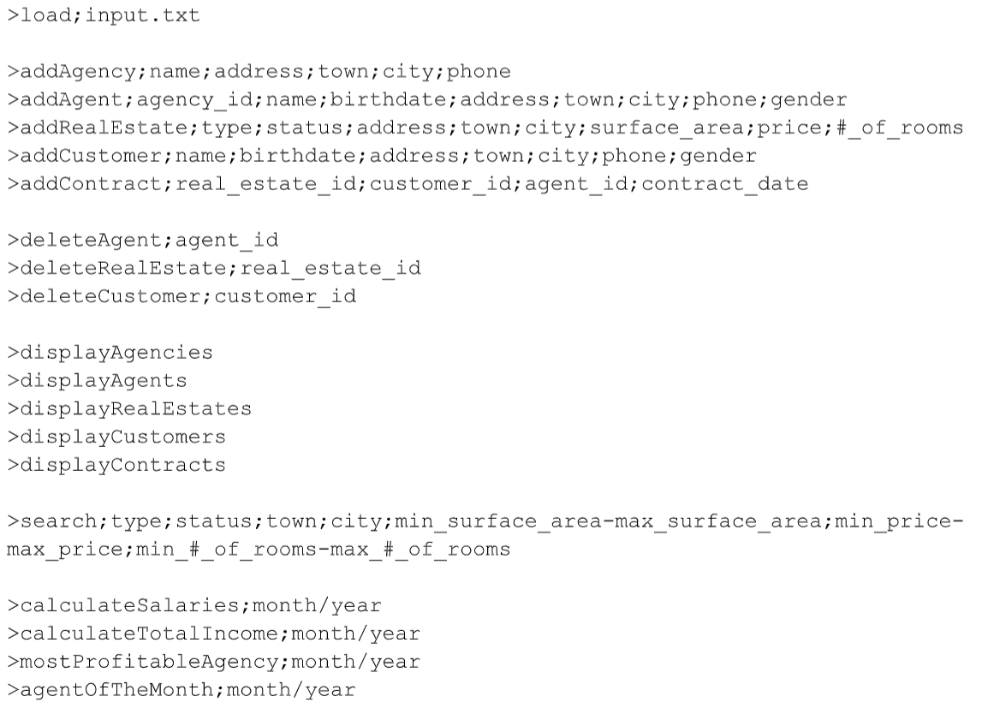
PROJECT DESCRIPTION
Commands

Slide 10
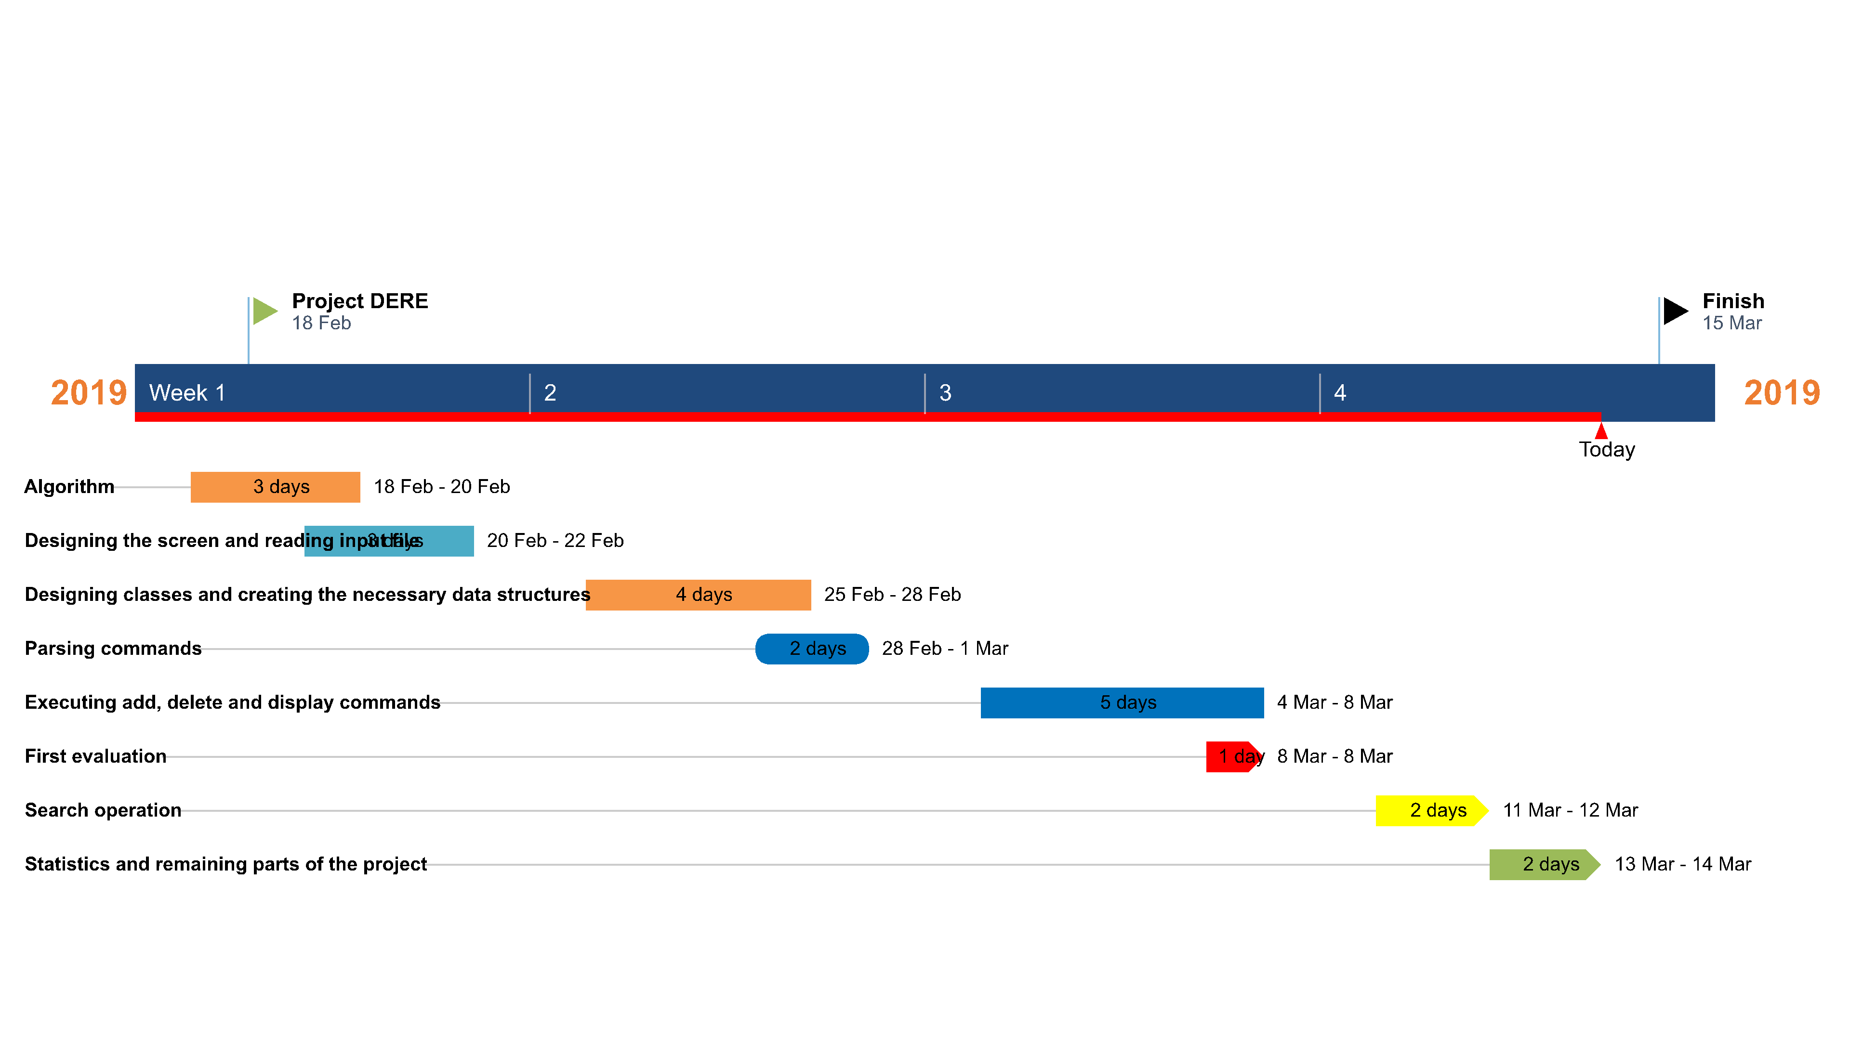
PROGRESS ACCORDING TO WEEKS

Slide 11

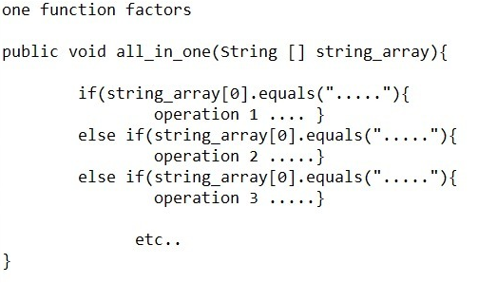
ALGORITHMS AND SOLUTION STRATEGIES

Slide 12
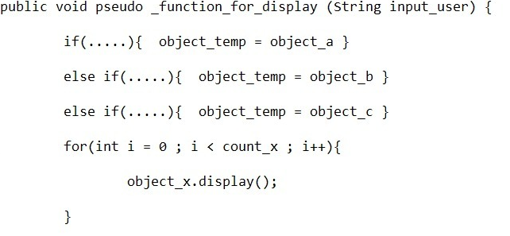
ALGORITHMS AND SOLUTION STRATEGIES

Slide 13
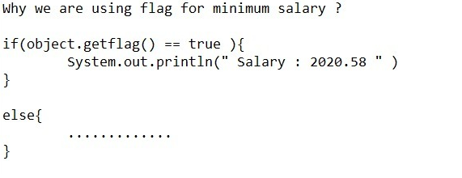
ALGORITHMS AND SOLUTION STRATEGIES

Slide 14
PROBLEMS ENCOUNTERED
Checking date uncertainty
We’ve never had much trouble

Slide 15
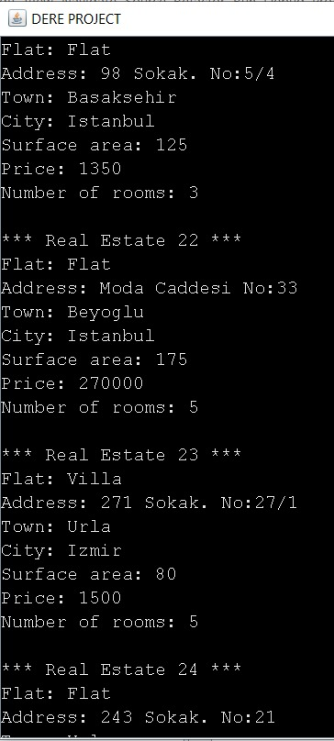
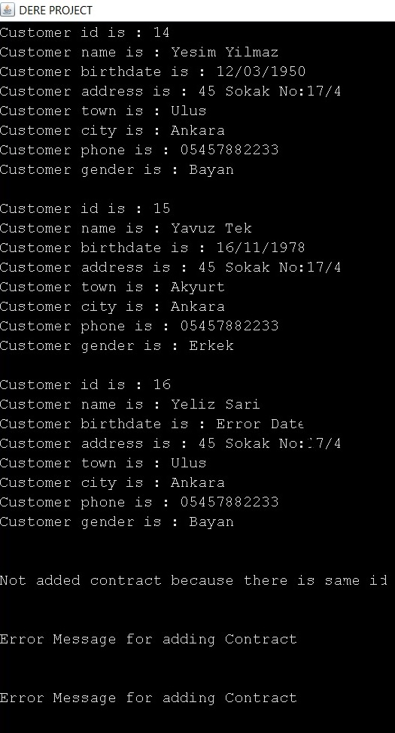
SCREENSHOTS

Slide 16

CONCLUSİON
As a conclusion, we understood the logic of object oriented programming (OOP) with Java PL and discussed the most effective ways to use it, and we successfully completed our project by applying it to our project.

Slide 17
ANY QUESTIONS ?

Slide 18

THANKS FOR LISTENING US

