Slide 1



CME 1252 PROJECT BASED LEARNING - II
PROJECT-III :
HELIX SNAKE
2017510100 - Mesut Selim Serbes
2017510012 - Muhammed Buğra Ateş
24.05.2019
Izmir

Slide 2
OUTLINE
•INTRODUCTION
•PROGRESS SUMMARY
•Scheduling and Completed Tasks
•Task Sharing
•ALGORITHMS AND SOLUTION STRATEGIES
•PROBLEMS ENCOUNTERED
•SCREENSHOTS
•CONCLUSION
•REFERENCES

Slide 3
1.
INTRODUCTION

Slide 4
INTRODUCTION
Snake game
Limited Game Area
Wall Challenge
Baits and Points
Score Table
The game is played controlling a moving snake in 25*60 area. There are four letters which are A (Adenine), C (Cytosine), G (Guanine) and T (Thymine) in the game area. The snake starts with 3 letters assigned randomly out of four letter (A, C, G, T). When the snake eats these letters, it becomes longer. If the snake bumps into a wall or its own body the game is over.

Slide 5
2.
PROGRESS SUMMARY

Slide 6
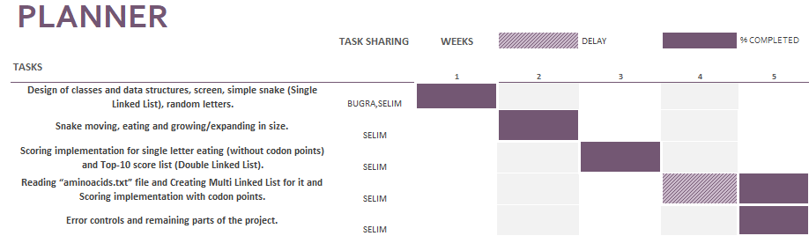

Slide 7
3.
ALGORITHM AND SOLUTION STRATEGIES

Slide 8
ALGORITHM AND SOLUTION STRATEGIES
CLASSES
MANAGEMENT
SINGLELINKEDLIST
DOUBLELINKEDLIST
MULTILINKEDLIST
MAIN
MENU
SNAKE
NODES OF LINKEDLISTS

Slide 9
ALGORITHM AND SOLUTION STRATEGIES
Eating function adds the bait to the snake's head when the coordinates of the snake's head equal the coordinates of the bait on the field. (A backup array was created for feeds).
When the coordinates increases or decreases according to the direction keys coordinates are updated of the snake's nodes by the direction function.
After sending the snake to the Reverse function, it is scanned in the Multi linked list and added the score to the player.
The collision function is activated when the head coordinates of the snake are equal to the coordinates of their parts.

Slide 10
4.
PROBLEMS ENCOUNTERED

Slide 11
PROBLEMS ENCOUNTERED
The array structure was used the in the project because of incorrect using nodes at the first weeks.
Except this,not plenty problems have been encountered during the project.

Slide 12
Additional Improvements
Menu
Sound Effects
Pause

Slide 13
5.
SCREENSHOTS

Slide 14
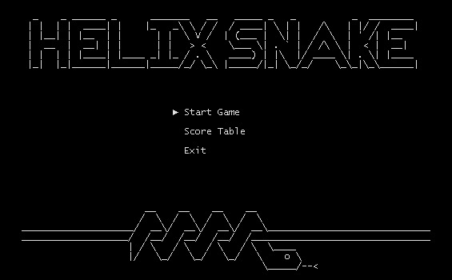
SCREEN
SHOTS

Slide 15
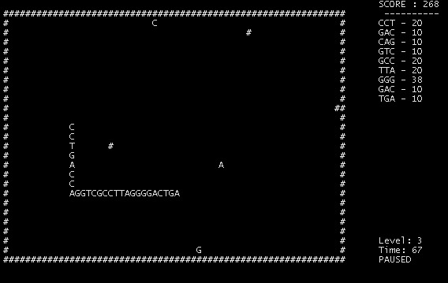
SCREEN
SHOTS

Slide 16

SCREEN
SHOTS

Slide 17
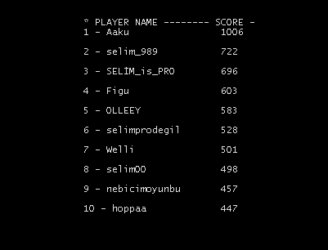
SCREEN
SHOTS

Slide 18
6.
CONCLUSION

Slide 19
CONCLUSION
Thanks to this project, we learned how to use linked list structure in Java.

Slide 20
REFERENCES
Classroom(Single Linked List)
https://drive.google.com/a/ceng.deu.edu.tr/file/d/1Q3w0Hon0bl3UcsaK-LRDcJ1ViH6j44tz/view?usp=drive_open
Classroom(Double Linked List)
https://drive.google.com/file/d/1pr7reqm2oCdW5uR44opkvNubv-d2OTfL/view
Classroom(Multi Linked list)
https://drive.google.com/file/d/1drXwBk3gLd-zdJTA_G4mhZVElLeT32-H/view

Slide 21
THANKS FOR LISTENING!
QUESTIONS?

