Slide 1



PROJECT – II NUMBERS
CME1251 Project Based Learning - II
by
2017510030 Ahmet Efendioğlu
2017510100 Mesut Selim Serbes
2017510014 Burcu Ağdar
IZMIR

Slide 2
Outline
INTRODUCTION
PROGRESS SUMMARY
Scheduling and Completed Tasks
Task Sharing
ALGORITHMS AND SOLUTION STRATEGIES
PROBLEMS ENCOUNTERED
SCREENSHOTS
conclusıon
REFERENCES

Slide 3
INTRODUCTION
The aim of the project is to develop a game in which players try to reach the target number in limited time.
Game is played with two players: human player and computer. A random target number between 100-999 is determined initially. Players will try to reach this target number in 30 seconds. Players use five random small numbers between 1-9, and one big random number (25, 50, 75 or 100) and 4 basic operations (* / + -) to reach this target.

Slide 4
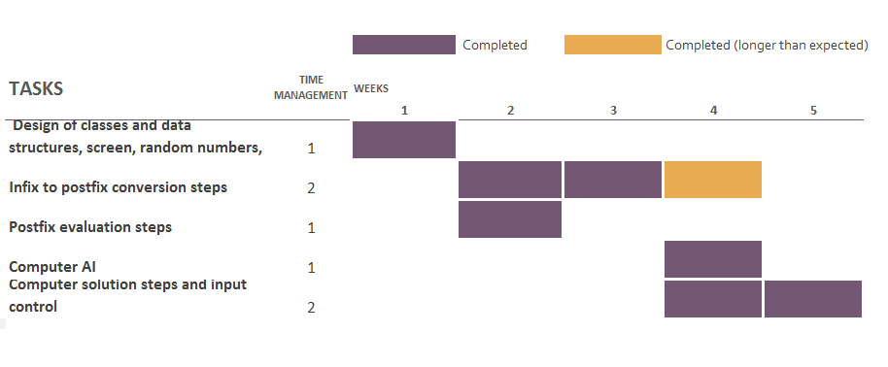
SCHEDULING AND COMPLETED TASKS

Slide 5
TASK SHARING
Burcu
Infix to postfix conversion steps
Computer AI and
solution steps.
Design of classes and data structures, screen, random numbers, timing.
Postfix evaluation
steps
Selim
Ahmet
Input control

Slide 6
ALGORITHM AND SOLUTION STRATEGIES
CLASSES
STACK
CIRCULAR QUEUE
COMPUTER
ROUND
OPERATIONS
MAIN

Slide 7
ALGORITHM AND SOLUTION STRATEGIES
COMPUTER

Slide 8
ALGORITHM AND SOLUTION STRATEGIES
OPERATIONS

Slide 9

ALGORITHM AND SOLUTION STRATEGIES
ROUND

Slide 10

PROBLEMS ENCOUNTERED
Due to the faulties in infix to postfix conversion we fell behind our schedule.

Slide 11
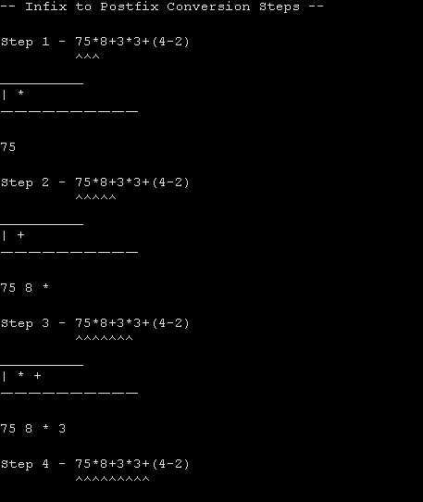
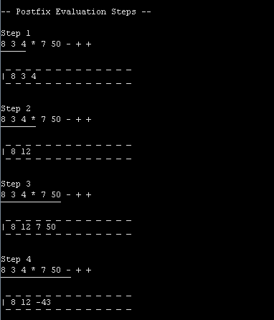
SCREENSHOTS
Infix to Postfix Conversion
Postfix Evaluation Steps

Slide 12
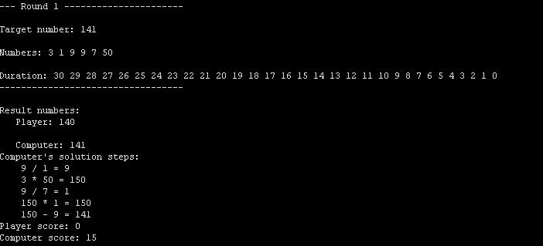
SCREENSHOTS

Slide 13
CONCLUSION
As a consequence, all of the tasks were completed in five weeks. Our Project has been submitted succesfully with report and poster.

Slide 14
REFERENCES

