Slide 1


TREASURE hunt
ASDDS
CREATED BY
ALPER TEMEL_2017510073
MESUT SELIM SERBES_2017510100
ANIL ORHAN ARSLAN_2017510009
CME 1251 PROJECT BASED LEARNING

Slide 2

contents
- TASK PLANNING AND SHARING
- COMPLETED TASKS
- INCOMPLETED TASKS
- PROBLEMS ENCOUNTERED
- SOLUTION STRATEGIES
- GAME SCREEN AND FLOWCHART PHOTOS
- CONCLUSION
- REFERENCES

Slide 3
TASK PLANNING AND SHARING
Alper TEMEL : Creating the game screen , adding the necessary variables that will be used in now and later . Filling the game screen with special pieces , designing turn system correctly and retouch.
Mesut Selim SERBES : Writing an algorithm to automatically fill the game screen array and also synchronize these arrays by writing them on top of each other . Developing the gamers final destination.
Anıl Orhan ARSLAN : Defining and filling the arrays for player and computer individual movements , special parts , game screen places . Writing the necessary random functions.

Slide 4
COMPLETED TASKS
- The game screen and board working without any error or bug.
- All rewards and penalties placing correctly and randomly.
- All rewards and penalties working on the game screen correctly.
- Turn system working perfect.
- Overlap and overflow problems are removed.
- The game movements and finishing game work successfully

Slide 5
INCOMPLETED TASKS
1) We could not add graphical refresh especially in the menu .
2) We could not add more features or game music
Reasons :
1) We had not time to do these things
2) We had not time to do these things

Slide 6
PROBLEMS ENCOUNTERED
- We had problems about where are the places of shapes and where are the places of the computer and player .
- We had a problem about updating the game screen in every turn.
- We had a bug about computer icon , sometimes computer icon was not seeing.
- We could not move the player and computer because we did not know the player and computer locations.
- Overlap and overflow had a problem , especially when the game comes to finish and using the rewards and penalties on computer and player.

Slide 7
SOLUTION STRATEGIES
- For overflow problem , we used limit on movements
- For overlap , location , rewards , penalties and every movement , we created the different 1d and 2d arrays
- For computer icon problem , we changed the code processing .
- For updating game screen problem , we used endless loop thus it fixed

Slide 8
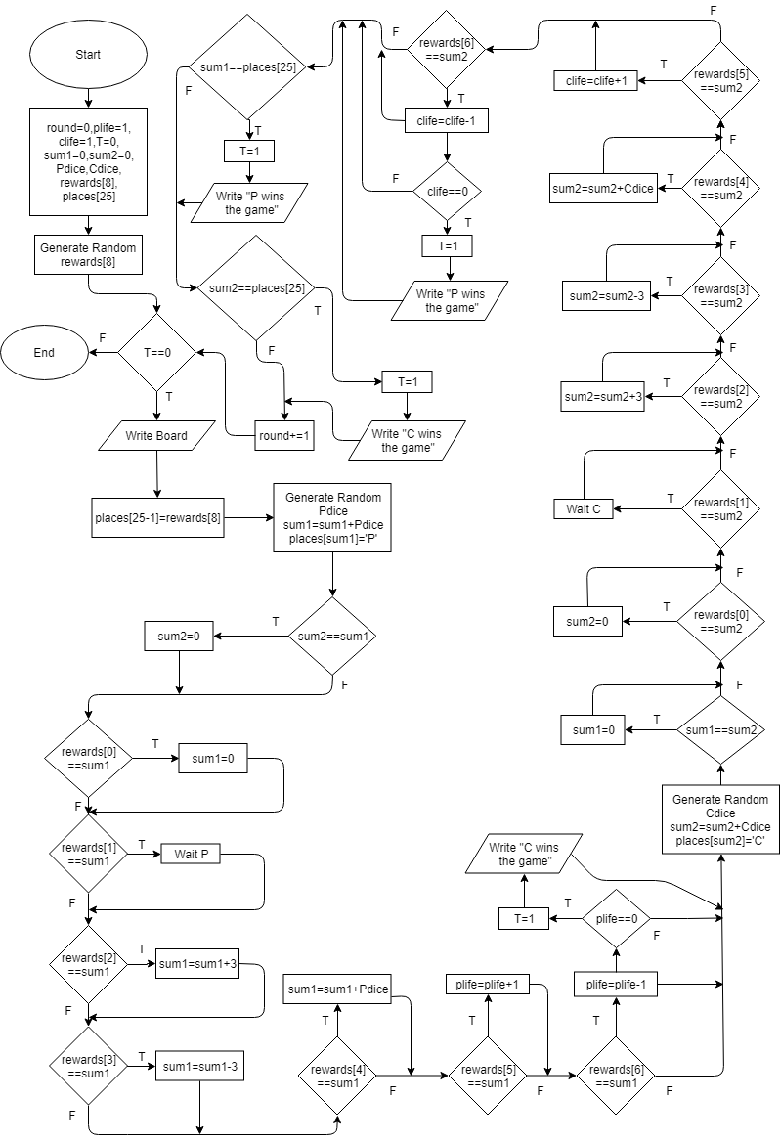
FLOWCHARt
simple algorithm logic for our project

Slide 9

MENU SCREEN and rules
Different playgrounds option and rules
Game rules simply

Slide 10

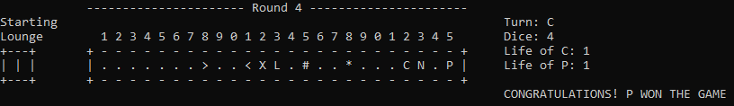
1D PLAYGROUND
In-game screen
1D game finish screen

Slide 11
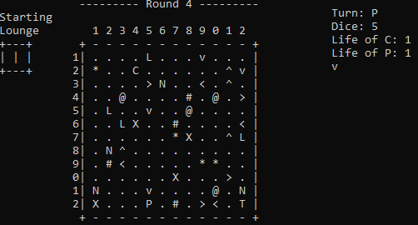
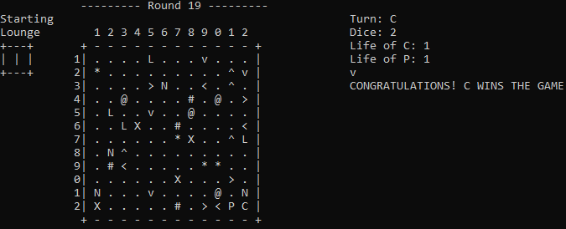
2d playground
Max 4 rewards and penalties in each column and row
2D game finish screen

Slide 12
Conclusıon
At the beginning of process we had predicted what to do but we did not have idea about how to do . After that we thought about problems and solutions and how to code it .We shared our tasks. Each member of group contributed with his solution strategies. We shared and discussed about problems and solutions . Thus we fixed problems and completed the project on time.

Slide 13
REFERENCES
https://onedrive.live.com
https://office.live.com
https://stackoverflow.com
https://docs.microsoft.com

