Slide 1



Project – ııI WORD PUZZLE CME1251 Project Based Learning - 1
By
2018510052
İrem OKUR
2017510013
Berhan Türkü AY
2017510100
Mesut Selim SERBES
1/21

Slide 2
INTRODUCTION
Our Project is to place each
Word into the proper place.
Player have to press «enter» button to play.
2/21

Slide 3
PROGRESS SUMMARY
Changes in Requirements
Task Sharing and Scheduling
Completed Tasks
Incomplete Tasks: Reasons, Explanations
Additional Improvements
3/21

Slide 4
Changes in Requirements
In the beginning
we did not know much about
«functions and procedures» .
So we wrote the code in the main
4/21

Slide 5
Task Sharing
İrem OKUR
*Read Board
*Scan Horizontal & Vertical
Berhan Türkü AY
*Read Wordlist
*Print Word Horizontal & Vertical
Mesut Selim SERBES
*Sort Wordlist
*Write Board
*Find Word
5/21

Slide 6
SCHEDULING
We obeyed our task sharıng
and suggested weekly program.
6/21

Slide 7
Completed tasks
7/21

Slide 8
İrem OKUR
I managed to get the board
read by the computer.
Also i scaned the puzzle board
horizontal and vertical.
8/21

Slide 9
Berhan Türkü AY
I completed the reading of words.
Furthermore, I printed words
vertically and horizontally
into the puzzle board.
9/21

Slide 10
Mesut Selim SERBES
I accomplished the part of sorted the words.
Moreover, i found the proper words
and the final board was written to the
«solution.txt» file by me .
10/21

Slide 11
Incomplete Tasks:
Reasons, Explanations
There is no incomplete task that
we could not
find the solution
11/21

Slide 12
Additional Improvements
We added menu section.Menu section includes 2 option.
(play and exit)
Also we changed the console’s «font».
12/21

Slide 13
PROBLEMS ENCOUNTERED
*First we had a problem
About writing the final board on the «solution.txt» file.
*Second we did not count the columns and rows. But after
That we count them for the dynamism.
*Third , we struggled finding proper word. Also if there is
Same word on the same area
the game was printing the word again.
13/21

Slide 14
ALGORITHMS AND SOLUTION
STRATEGIES
The board was read by the computer by using
«StreamReader» command. We scaned the puzzle board
horizontal and vertical by using «if/else if/else» statements.
We accomplished the part of sorted the words by using
«bubble sort». We found the proper words. Board was written
To the «solution.txt» file by using «StreamWritter» command.
14/21

Slide 15
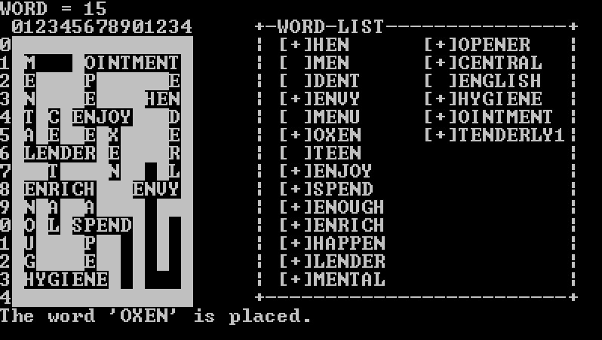
SCREENSHOTS
15/21

Slide 16

16/21

Slide 17
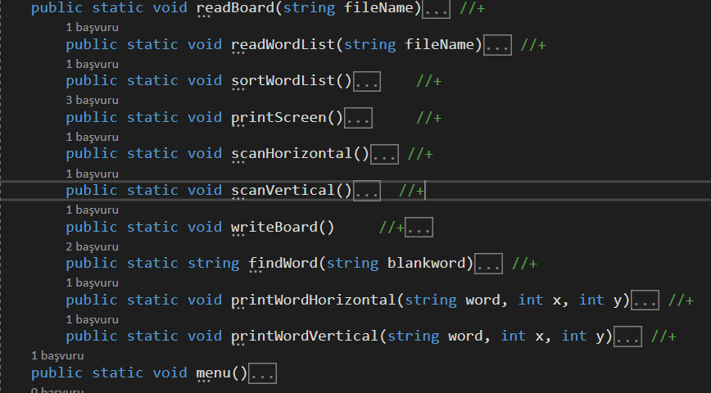
17/21

Slide 18
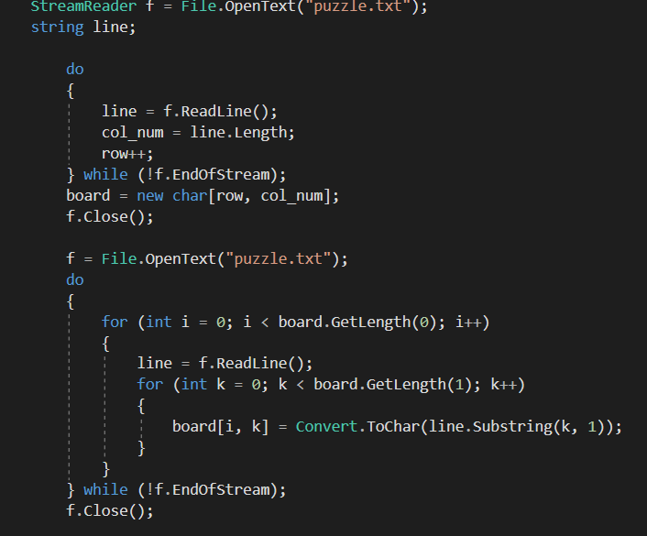
18/21

Slide 19
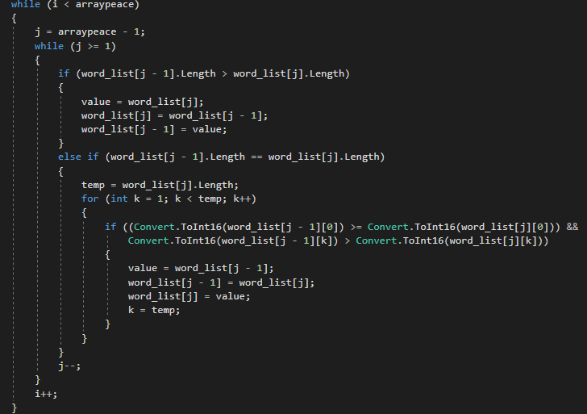
19/21

Slide 20
CONCLUSION
Despite all the difficulties, we submited the
Project exactly the right time.
Our game is working perfectly .
20/21

Slide 21
REFERENCES
1.https://stackoverflow.com/questions/10175357/c-sharp-creating-and-using-functions
2. https://csharp.net-tutorials.com/basics/functions/
21/21

