Slide 1
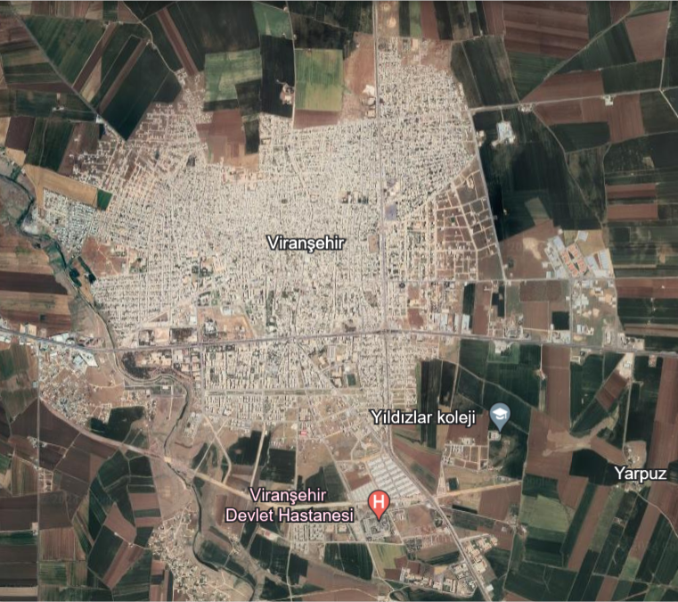
PISTACHIO ORCHARD
URFA,VİRANŞEHİR

Slide 2
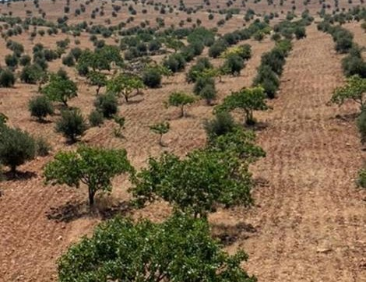
PISTACHIO ORCHARD
This garden is located on the banks of the Euphrates River. It covers an area of approximately 2,500 acres.

Slide 3
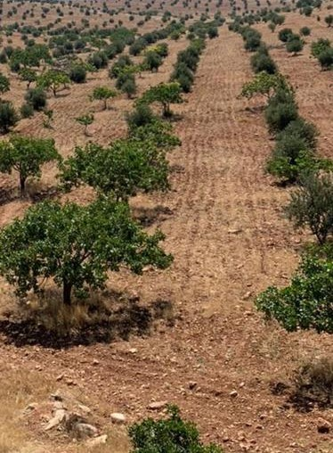
PISTACHIO ORCHARD
High-quality pistachio products known as Antep pistachios are available in the market. The trees in the pistachio orchard consist of plantations established at different dates ranging from 1990 to 2015.

Slide 4
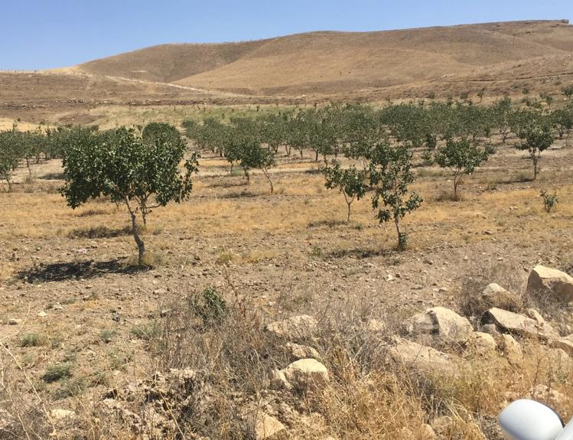
PISTACHIO ORCHARD
It is calculated to have 40 trees per hectare. The trees yield between 40 kg and 80 kg of product, depending on their age.

Slide 5
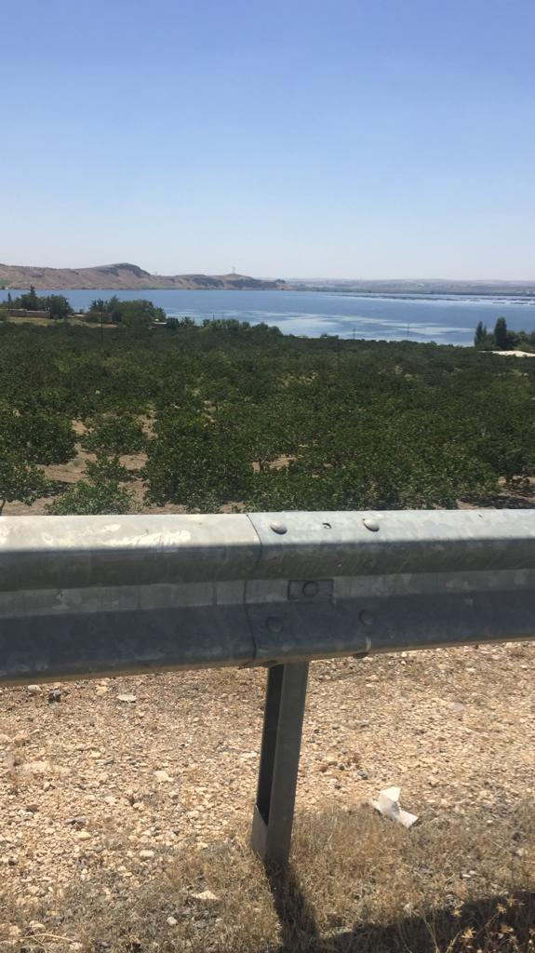
PISTACHIO ORCHARD
The annual product yield from this orchard is directly related to the annual maintenance of the orchard. When these trees are well taken care of, high production is achieved, whereas inadequate care results in low production.

Slide 6
ATTRIBUTE INFORMATION
Property Identification Number | 76123071
Province | Şanlıurfa
District | Birecik
Neighborhood/Village | Çiçekalan
Parcel | 138
Land Area on Deed | 887.016,89
Characteristic | Tarla
Location | Çeloğlu
Ground Type | Ana Taşınmaz
Map Sheet | O40.A 12.A

Slide 7
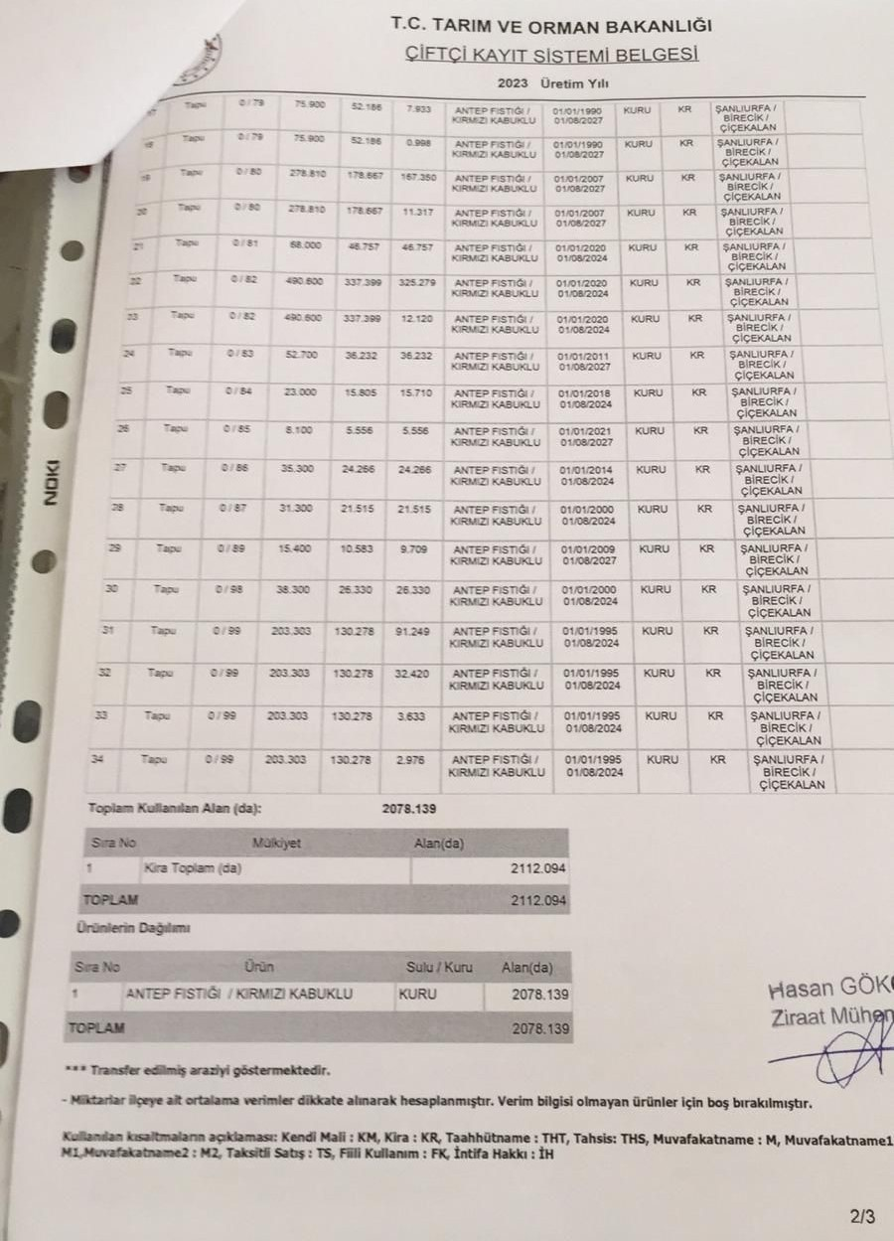
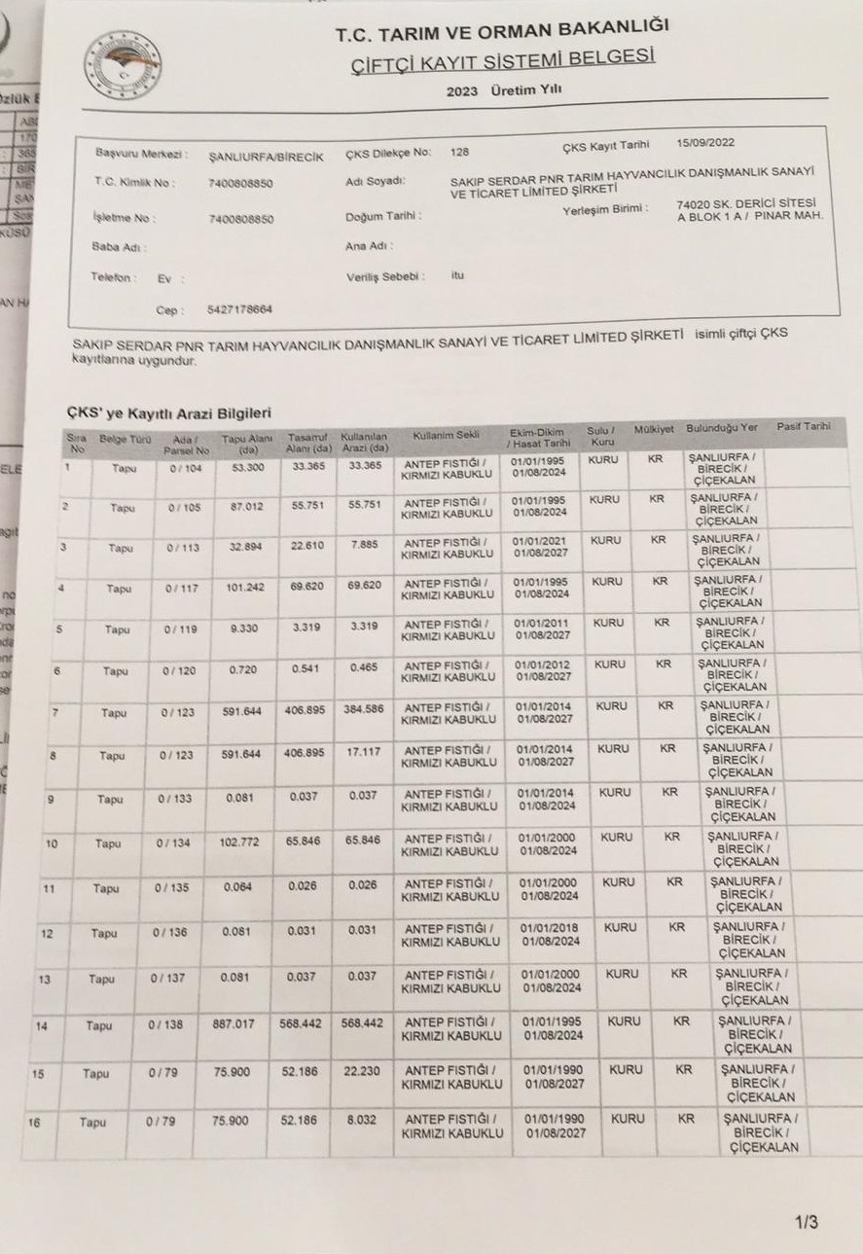
FARMER REGISTRATION SYSTEM DOCUMENT

