Slide 1
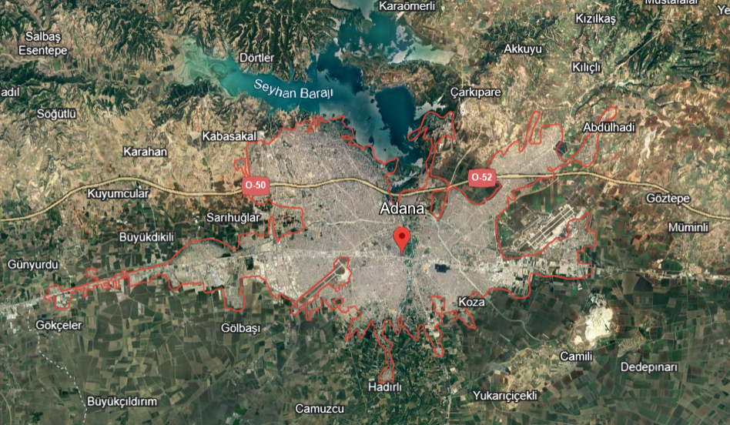
APPLE-PEACH-NECTARINE ORCHARD
ADANA BÖLGESİ

Slide 2
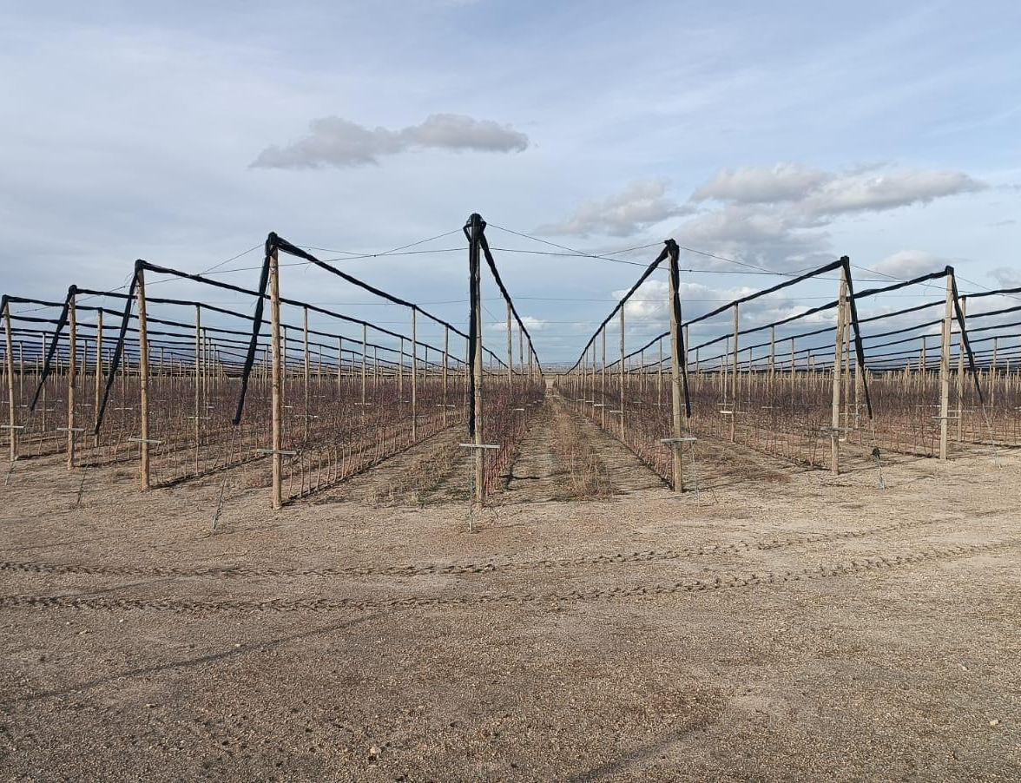
APPLE-PEACH-NECTARINE ORCHARD
Out of the 1000-acre land, 250 acres consist of apples, and 500 acres consist of peaches and nectarines. There is also an opportunity to establish a new orchard of around 250 acres.

Slide 3
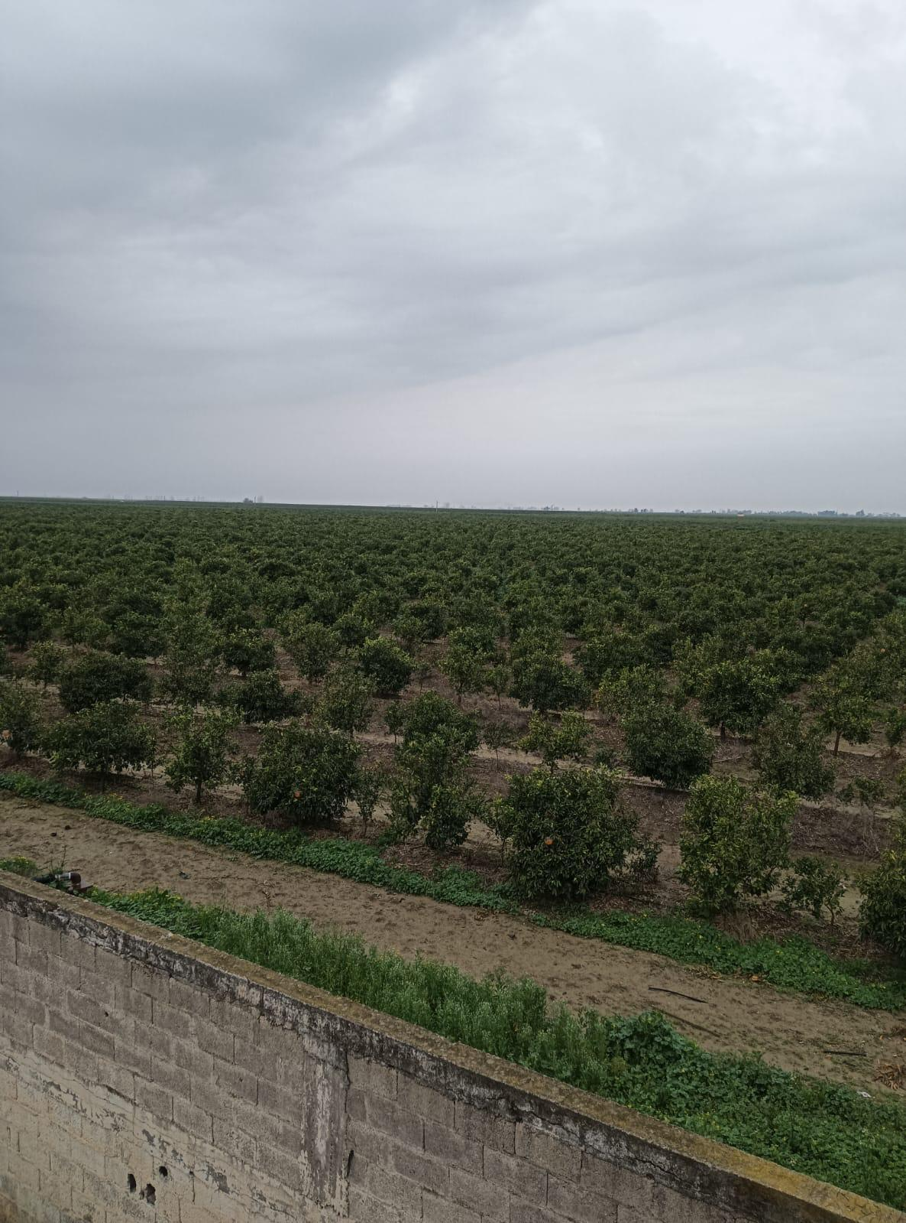
APPLE-PEACH-NECTARINE ORCHARD
The fruits of apples, peaches, and nectarines in this orchard are of valuable early varieties.

Slide 4
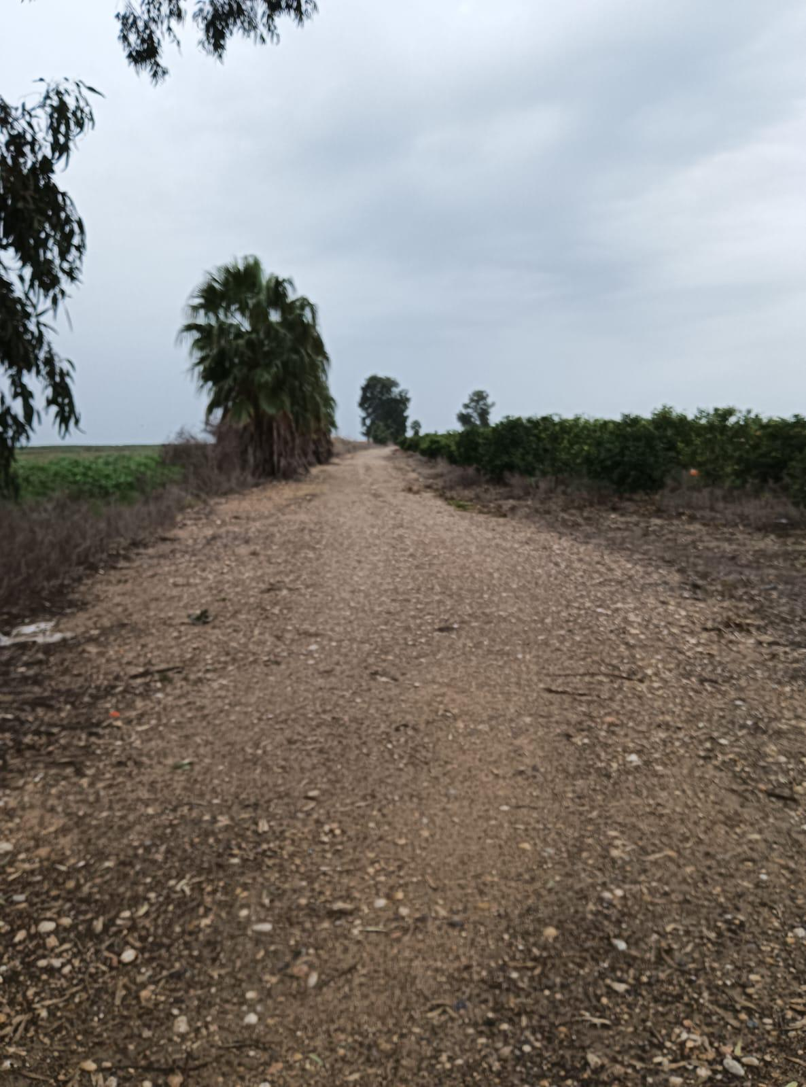
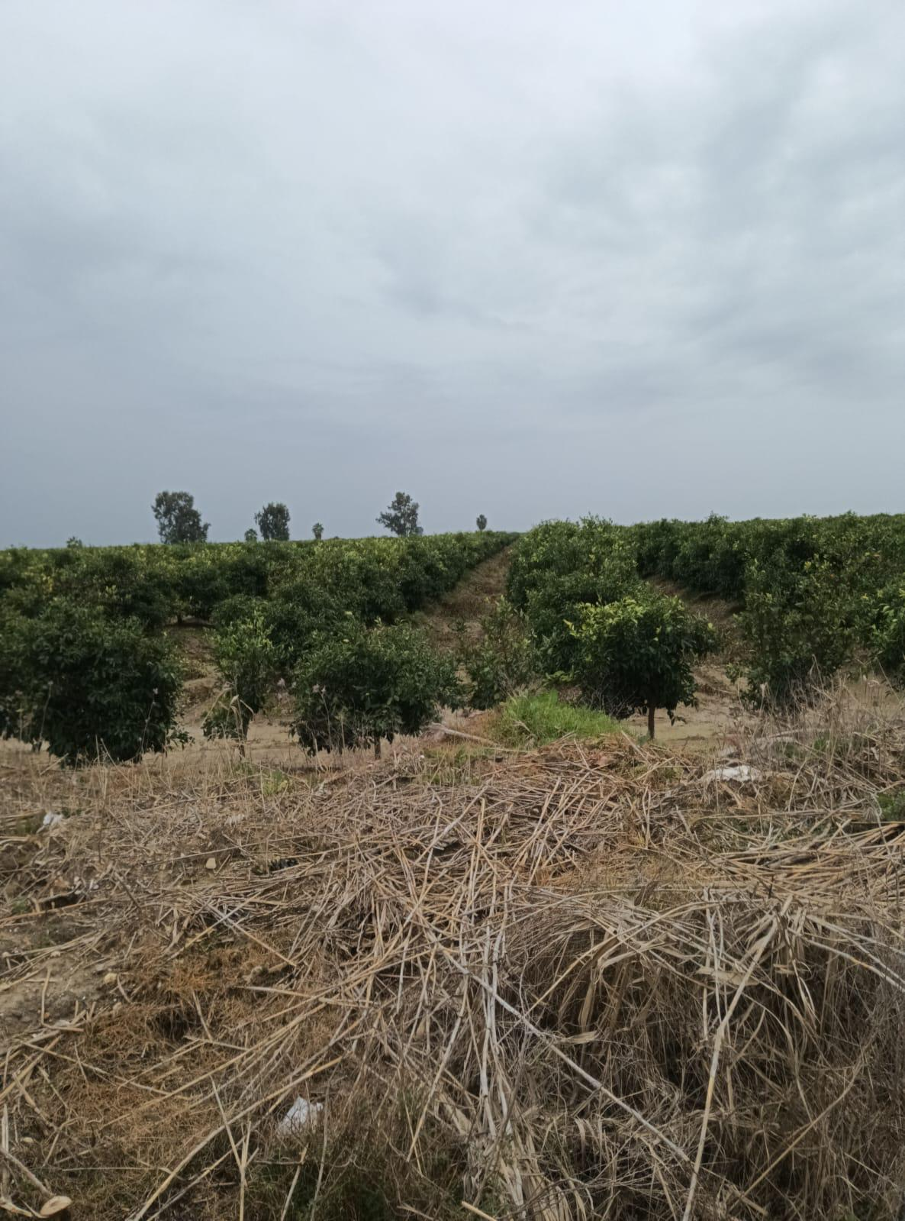

Slide 5
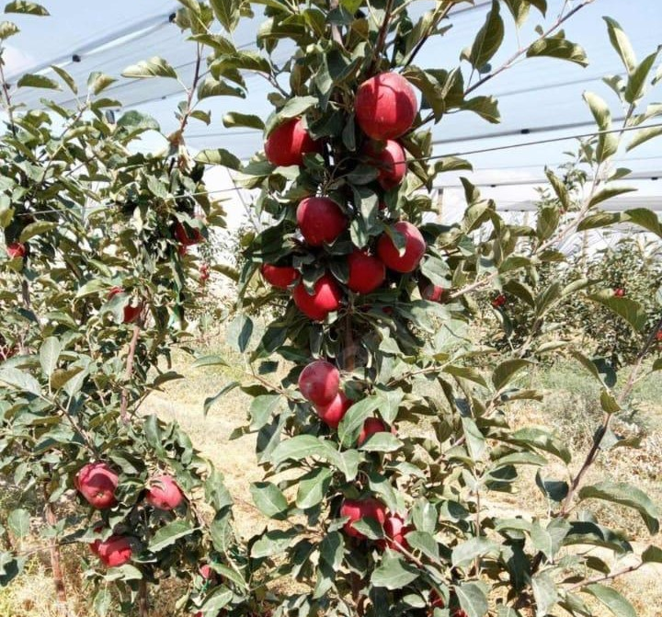
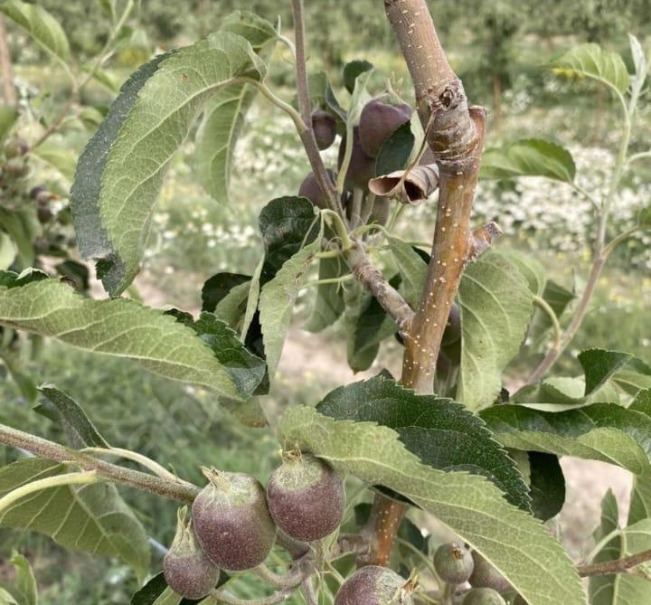
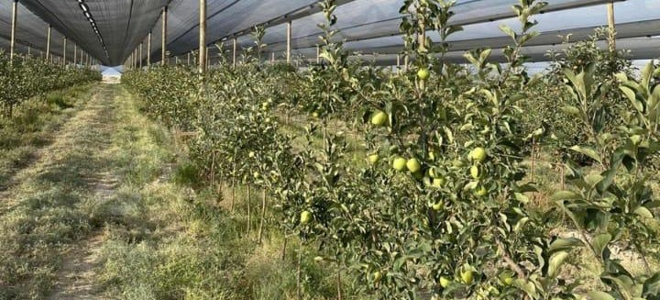
THE FRUITS GROWN IN OUR ORCHARD

