Slide 1

LEPROSY
Group members :
Sherifetu Ngozi Habib
Rackel Nyuyuni
Gwan Blessing Mbah
Catherine Kimbong
Muma Sylvian Akemengwa

Slide 2
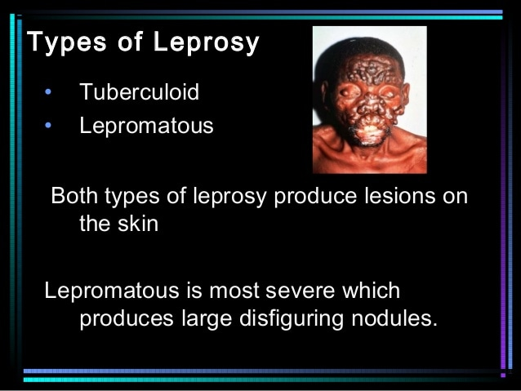
L E P R O S Y
INTRODUTION
Leprosy is a chronic infection caused by the acid-fast , rod-shaped bacillus Mycobacterium leprae ,It is a gram positive bacteria.It was discovered by Gerhard Armauer Hansen in 1873 .Leprosy can be considered to be connected to diseases that primarily affect superficial tissues , especially the skin ,peripheral nerve , mucosa of the upper respiratory tract and the eyes .Initially, a mycobacterial infection causes a wide array of cellular immune responses. These immunologic events then elicit the second part of the disease, peripheral neuropathy with potentially long-term consequences.
Types of leprosy
There are 2 main type of leprosy
Lepromatous leprosy :A more severe form of leprosy. It brings widespread skin bumps and rashes(multibacillary leprosy)
Tuberculoid leprosy :A mild , less severe form of leprosy. People with this type have only one or few patches of flat , pale-colored skin (paucibacillary leprosy).

Slide 3
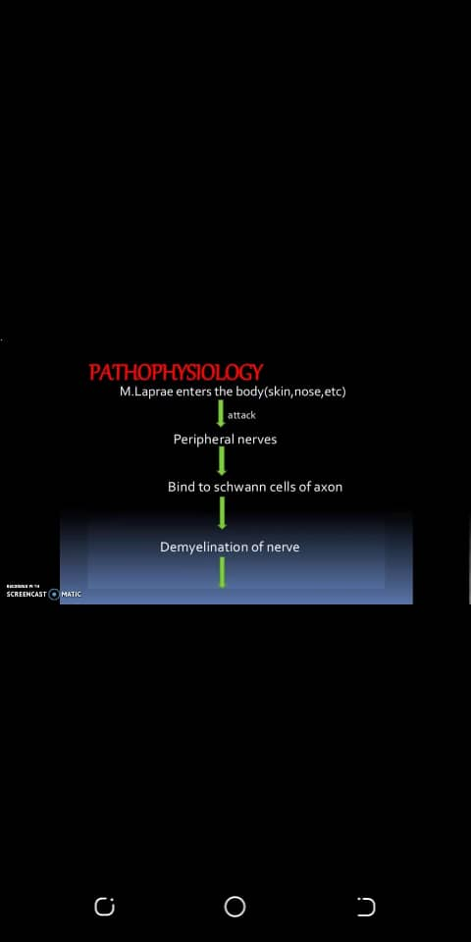
Other types
Borderline :People with this type of leprosy have symptoms of both the tuberculoid and lepromatous forms.They include ;
Borderline Lepromatous leprosy
Borderline Tuberculoid leprosy
Indeterminate leprosy
Midborderline leprosy
PHYSOPATHOLOGY OF LEPROSY
Leprosy affects the peripheral nerve by sensory nerve damage . When the sensory nerves are damaged the cannot register pain due to lack of sensation in the hands and feet so repeated injuries go unnoticed due to lack of sensation which can lead to re-absorption of affected fingers and toes resulting to the shortening or loss of digits .
The moist tissues that has body openings such as the eyelids and the inside of the nose and mouth can also be affected which can lead to vision loss, destruction of nasal tissue.

Slide 4
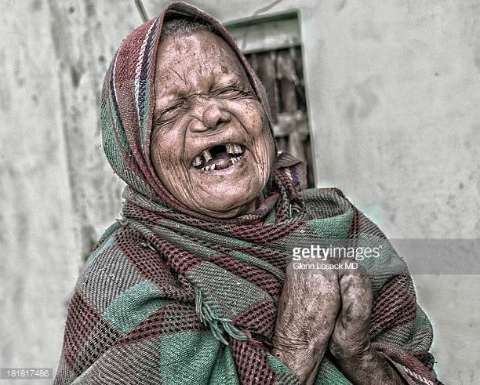
Incubation period : The disease incubation period is 5 year but symptoms may occur within 1 year and it can also take as long as 20 years or even more.
Mode of transmission
Leprosy bacteria can survive in soil : The smallest host a leprosy bacteria could infect is a common soil amoeba found worldwide which can keep it alive for months in a lab.
Red squirrels can be carriers of leprosy : Possibly because they spend time with their noses in the ground rummaging for their food .
Through open wounds of infected person.
Through droplets of moisture passing the air (coughing and sneezing) from an infected person.

Slide 5
Signs and symptoms
Discolored patches of skin , usually flat , that maybe numb and look faded (lighter than the skin around)
Growths (nodules ) on the skin
Thick ,stiff or dry skin
Painless ulcers on the soles of feet
Painless swelling or lumps on the face or earlobes
Loss of eyebrows or eyelashes
Complications of Leprosy
Kidney failure
Infertility
Erectile dysfunction and infertility in men
Dis-figuration of face
Hair loss
Iritis

Slide 6
Clinical diagnose of leprosy
Painless pale or red skin lesions without loss of sensation.
Lesions become raised as the disease progresses.
Thickening of peripheral nerves with diminished sensation and burning or tingling sensations .
Extensive sensory loss over a longer period.
Biological diagnose of leprosy
To confirm the diagnose, the doctor will take a sample of your skin or nerve biopsy to look for the bacteria under microscope and may also do test to rule out other skin diseases.
Also the presence of acid-fast bacilli confirms the presence of leprosy . the acid-fast stain the photomicrograph of a tissue sample extracted from the patient with leprosy shows a chronic inflammatory lesion know as granuloma which red-colored M.leprea are visible .
The lepromin skin test is used to determine what type of leprosy a person has. If you’ve tested positive for leprosy during a biopsy but don’t have a skin reaction , you may have lepromatous leprosy.

Slide 7
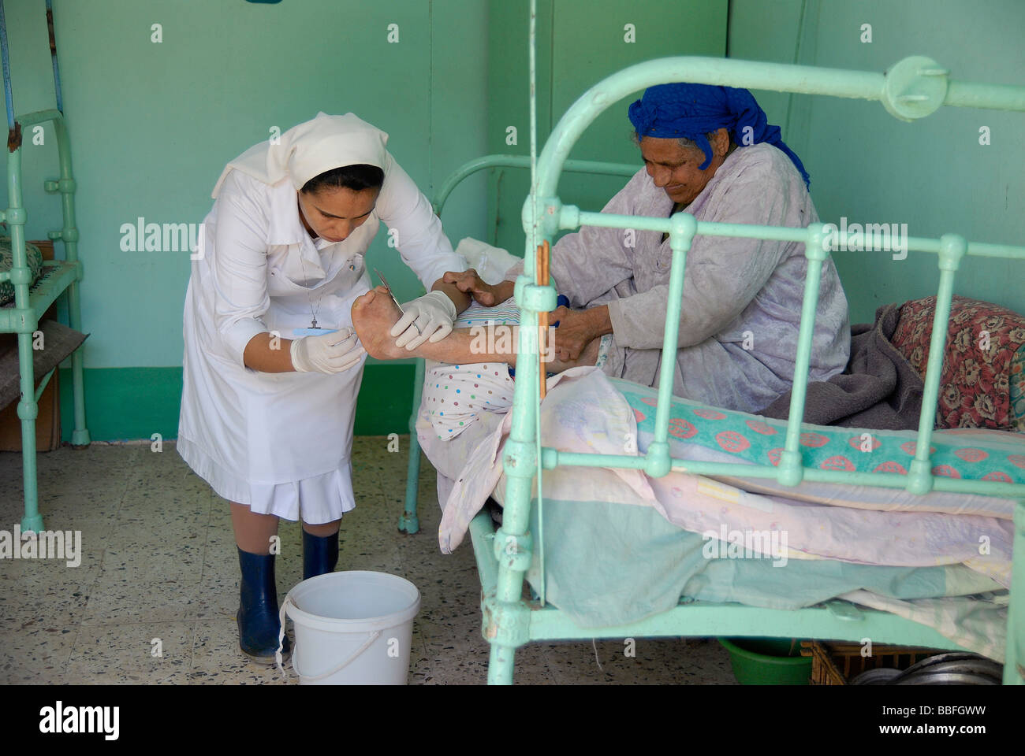
NURSING CARE
Diagnose the impaired tissue integrity and monitor the characteristics of the lesion such as color ,size,odour, and drainage .
Clean the wounds with saline or nontoxic substances as indicated
Apply a sterile bandage to cover the wounds and maintain an aseptic technique.
Examine the wound damage daily during each dressing change.
Encourage the affected people to maintain regular medical care with multi drug therapy (MTD)
Follow up the patient and monitor and signs of adverse effects regarding medications and take proper action
Protects hands and feet to avoid inadvertent injury and prevent chronic disability
Keep skin moist to prevent dryness and fissring and avoid ulceration or infection of the skin
Ensure proper rest and nutrition of the affected leprosy patient

Slide 8
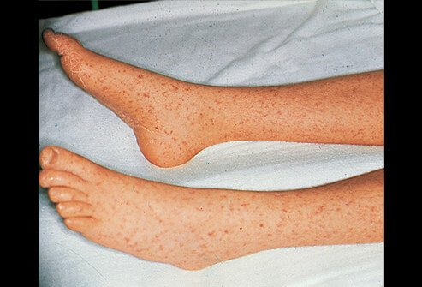
Prevention and control
Chemotherapy of patients and family BCG ( bacillus Calmette-Guerin ) vaccination
Health education and counseling must stress on the availability of effective therapy , the absence of infectivity of patients under treatment and prevention of physical and social disabilities .
In general the best way to prevent the spread of leprosy is the early diagnosis and treatment of people who are infected. for household contacts, immediate and annual
Examinations are recommended for at least 5 years after last contact with a person who is infected.
Treatment of patient with appropriate antibiotic stops the person from spreading the disease.
Prevention of contact with droplets from nasal and other secretion from patients with untreated M.leprea infection is currently the most effective way of avoiding the disease

Slide 9
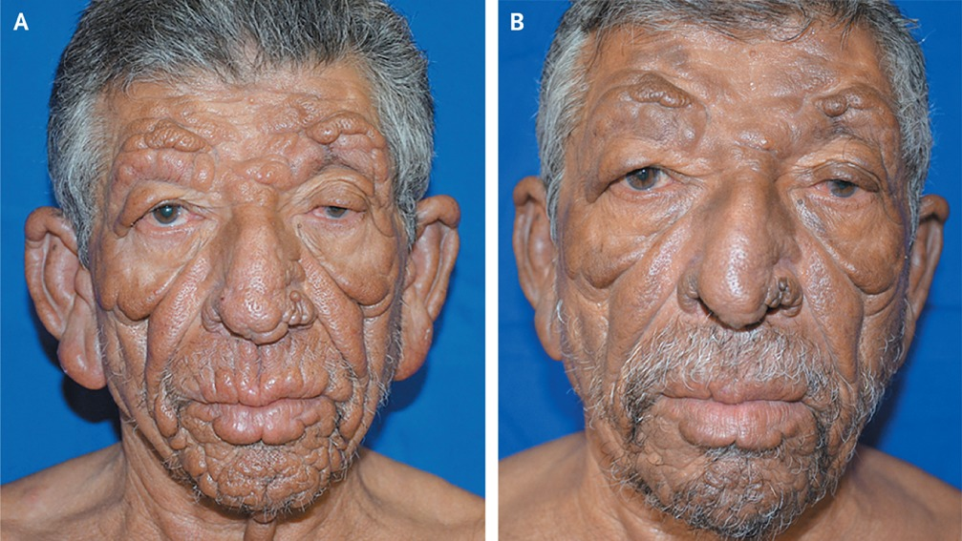
TREAMENT OF LEPROSY
Leprosy is treated with a combination of antibiotic. Typically 2 or 3 antibiotic are used at the same time. These are Dapsone with rifampicin, and clofazimine is added for some types of the disease . This is called multidrug therapy.

Slide 10
CONCLUSION
We can conclude that the causative organism is Mycobaterium leprea .
The bacteria is contagious as well and can be transmitted through coughing or sneezing.
Not all symptoms of the leprosy disease are visible such as muscle atrophy and articular deformities or paralysis of the limb or an early stage of blindness.
Finally, leprosy can be treated by multi drugs therapy , antibiotics such as Rifapicine, Dapson and Clofazimins and can be prevented by early diagnose of the disease.
NB: You can’t get leprosy from casual contact with a person who Hansen’s disease like :
Shaking hands or hugging.
Sitting next to each other on the bus or anywhere.
Sitting together at a meal.

Slide 11
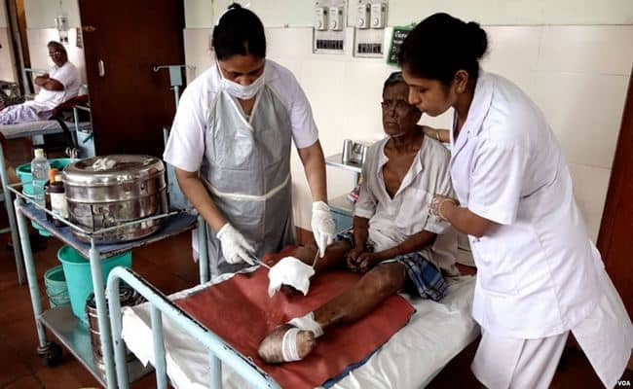
References
WWW.webmd.com (14-12-2021 at 8:12pm)
WWW.who.int (14-12-2021 at 9:20pm)
nursingexercise.com (15-12-2021 at 3:29pm)
WWW.medicinenet.com (15-12-2021 at 6:09pm)
WWW.healthline.com (15-12-2021at 6:30pm)
WWW.cdc.gov (15-12-2021 at 7:30 )
WWW.ncbi.nlm.nih.gov (18-12-2021 at 9:56am)

Slide 12
THANKS FOR LISTENING

