Slide 1
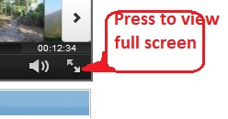
jMeter tutorial – Multiple value RegEx Extractor
How to use regex extractor to extract multiple values from response body
View full screen by pressing bottom right icon as shown below

Slide 2
Clone the scripts from https://github.com/msapariya/jmeter-recipes

