Slide 1
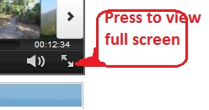
jMeter tutorial – RegEx Extractor
How to use regex extractor to extract single value from response body
View full screen by pressing bottom right icon as shown below

Slide 2
Clone the scripts from https://github.com/msapariya/jmeter-recipes

