Slide 1
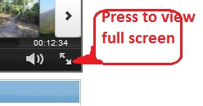
jMeter tutorial – RegEx extract two variables
How to use regex extractor to extract two variables from JSON arrays
View full screen by pressing bottom right icon as shown below
LETS SEE IT IN ACTION. ☺

Slide 2
subtle issues while creating this tutorial
The javascript in the while controller throws excetption if there is space in last round and curly bracket. Check the jmeter log for exception, if your while condition is not existing/entering.
The javascript in while controller did not like the loopcount and finalcount, when exported as integer from the beanshell. I had to convert them to string in beanshell, and again back to integer in the javascript comparision. ☹

Slide 3
Clone the scripts from https://github.com/msapariya/jmeter-recipes

