Slide 1

Global Terrorism Exploratory &
Predictive
Analysis
CSSM-502
Selin SUSEM

Slide 2
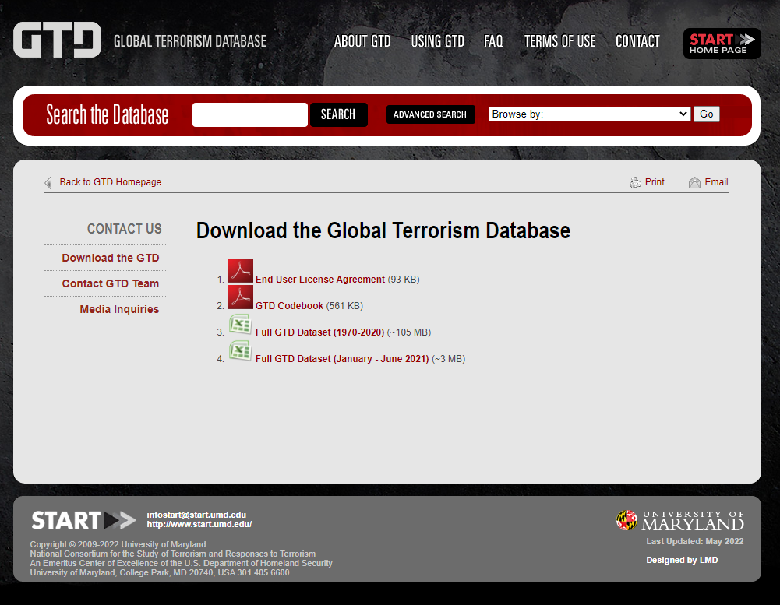
Data
GTD - The Global Terrorism Database™
GTD is an open-source database including information on terrorist events around the world from 1970 through 2017 with annual updates.
The dataset can be download from https://www.start.umd.edu/ gtd/contact/download
The original data used for this Project: 135 columns * 181.691 rows

Slide 3
Outline
1.) Reading the Data
2.) Cleaning the Data
data1, data2, data3, data4, data5
Renaming
Missing and outlier treatment
Lower case transformation
Taking relevant variables from the data and create new ones for intended purpose (e.g. casualties, check_casualties)
Double-check by exporting to Excel
3.) Exploratory Analysis
How does the number of terrorist acts vary around the world (countries, regions) and how has it changed over time? Increased during recent years? How have casualties evolved throughout the years? Where are there the most casualties? Are certain nationalities more targeted? Is this related with freedom schedules?
What is the percentage of successful attacks? (at total and based on regions over years)
Which weapon/attack types are popular? What are the casualties by weapon type? Who are the targets?
4.) Predictive Analysis
Can casualties be predicted from GTD-exclusive features (our dataset)? – Random Forest?
Whether a terrorist attack is expected to succeed or fail?

Slide 4
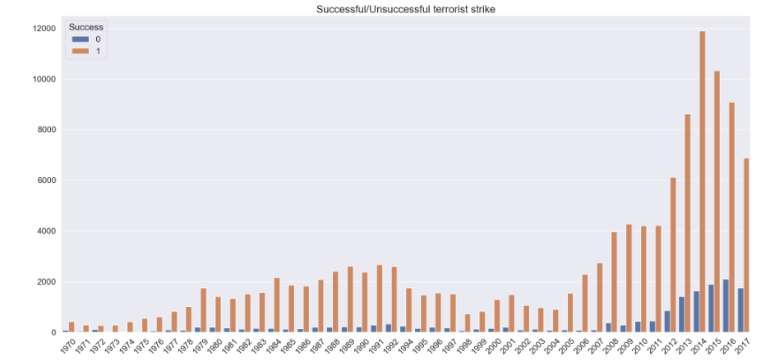
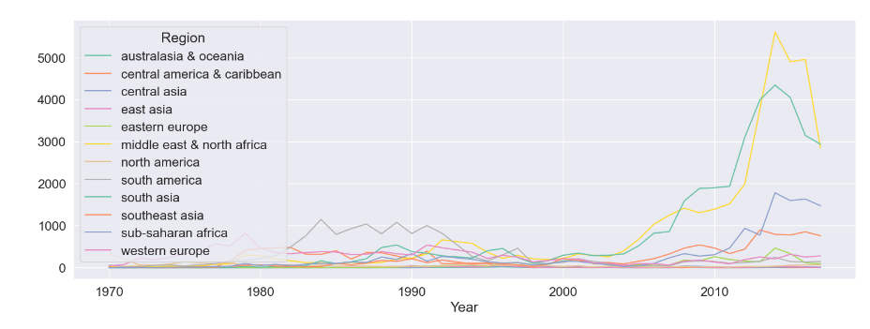
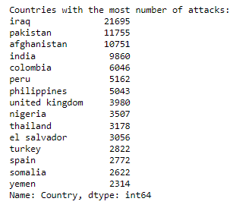
Exploratory Analysis
Amount of terrorist attacks has increased during the last five years (after 2013). However, one should take into account the effictiveness of data collection.
88.3% of attacks were successful over 50 years so only 11.7% of the attacks were unsuccessful.
There is a noticable is the drop in both successfull and failed attacks in 1998. This is a phenomon shared by all regions.
The most known country with terror attacks is Iraq totalled at 21.695 so city Baghdad.
Increase in Middle East & Africa and South Asia during the latest years. However, in regions like Southern Asia, Easter Europe there is no decline actually, rathet their rate is low and constant.

Slide 5
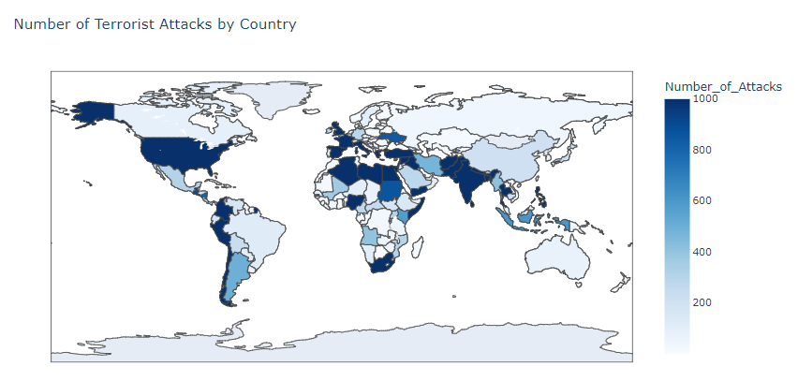
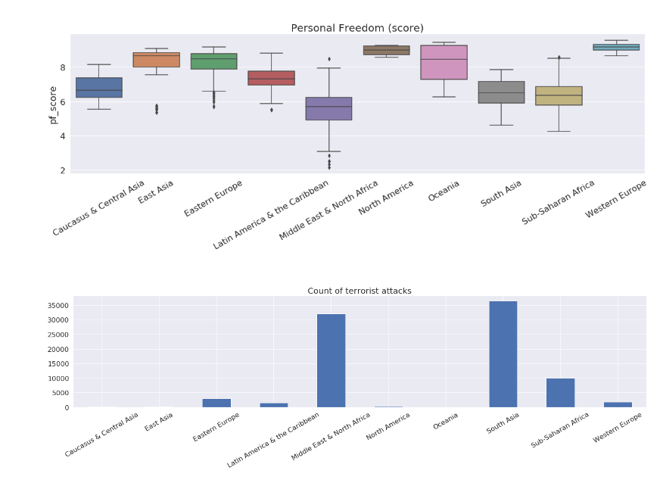
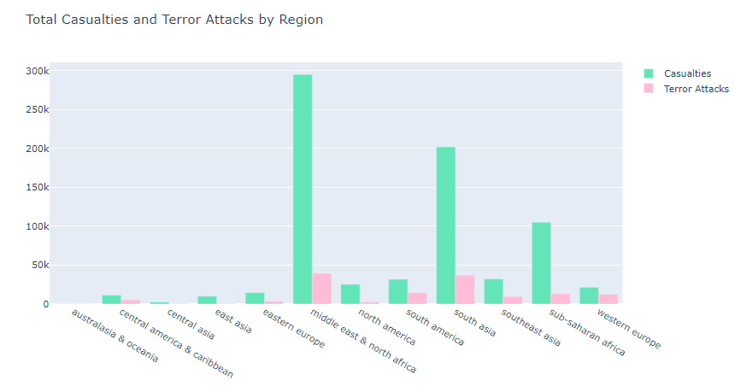
Exploratory Analysis
Actually the number of attacks are lesser than the number of casualties in Muslim countries compared to others.
The terrorist attacks generally happen in densely populated areas thus they eventually claim many lives.
"The Human Freedom Index" – another open source data. Compare Personal Freedom (score) and count of terrorist attacks.
We can see by plots that number of attacks is related to freedom schedules.

Slide 6
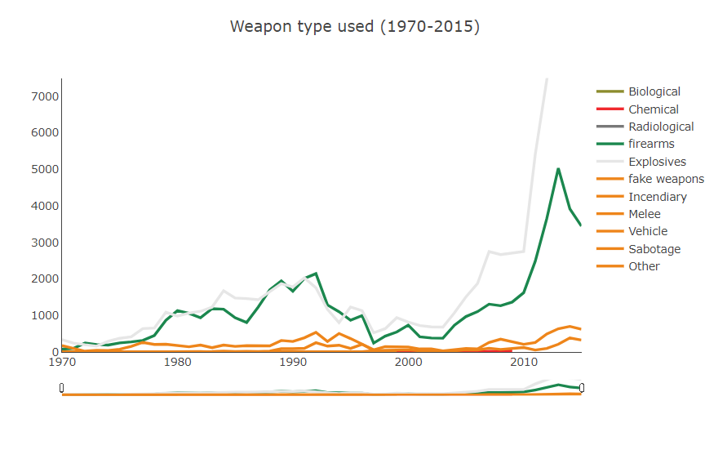
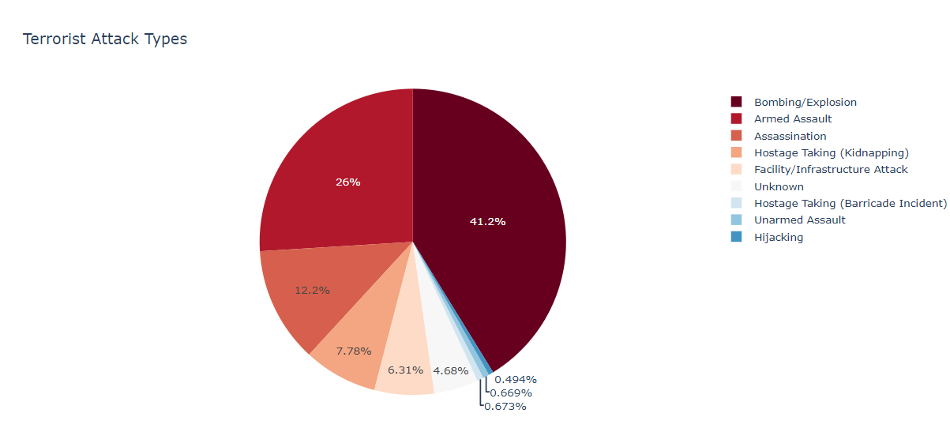
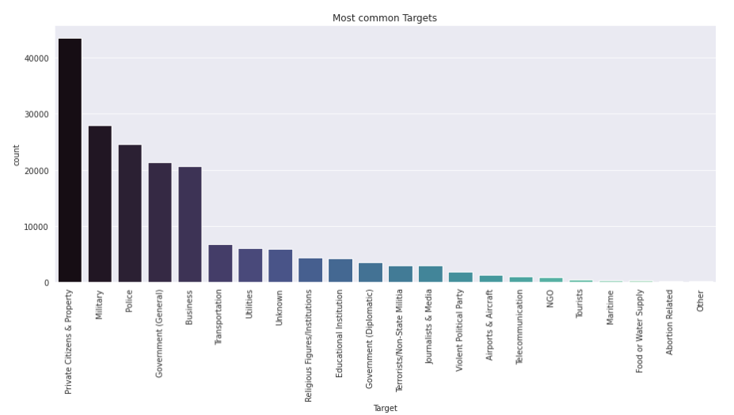
Exploratory Analysis
Explosives and firearms have always been the most popular weapon type (85%). Most effective weapons for maximizing the amount of casualties (biggest share in number of wounded and the total amount of property damage).
Bombing/Explosion is the most popular attacktype by far. Total attacks’ 3.7% were suicide attacks.
The main targets of terrorists were Private Citizens & Property totalling at 23.9% , while the second was Military at 15.4%. Defence organizations suffer more property damage then private citizens. The public sector does suffer more than the private sector.
Most active terrorist groups; Taliban, Islamic State, Boko Haram

Slide 7
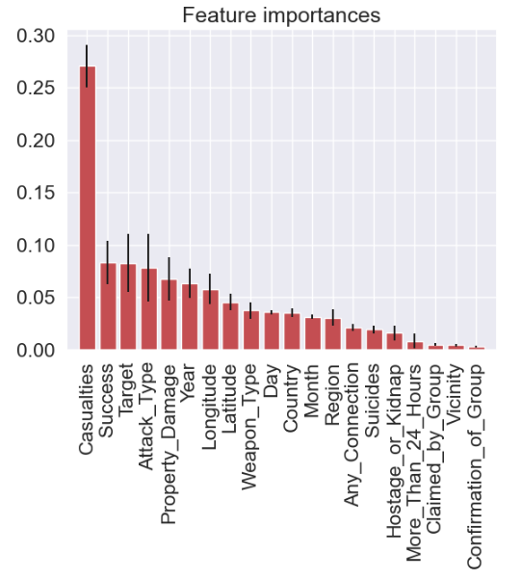
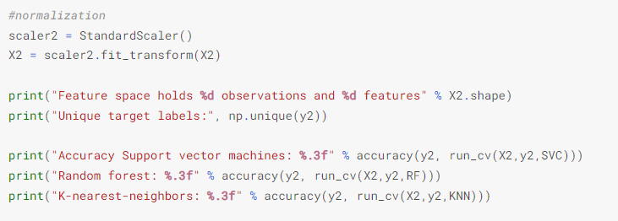
Predictive Analysis
Can casualties be predicted from GTD-exclusive features (our dataset)? – Random Forest?
Target, train and test. To continue the predictive part of the research, the importance of each column of the terrorism database was estimated using the Random Forest classifier (significance of each feature on predicting wether there will be casualties or not). The results were plotted in a bar graph, ordered by accuracy. Features with an accuracy score of 0.05 and higher are kept (to prevent overfitting), RandomForestClassifier, 78% accuracy. Time variables such as day, month and year were excluded from features, despite proving to possess high predictive power.
Whether a terrorist attack is expected to succeed or fail?
Predict successfulness of terrorism by using Decision Trees and Random Forests
Valuable because it can be used by intelligence groups to predict the impact of possible future terrorist attacks, and thus make them able to determine the risky situations in advance and allocate the necessary resources better.
This analysis aims to find a model, using the available variables, for predicting the successfulness of terrorist attacks. The methods used are Decision Trees and Random Forests.
The steps are the following
- Downloading and shaping the data and viewing it from various angles
- Creating a Train and Test set
- Presenting the Performance Measures for the models
- Creating two Decision Trees models; a simple and a more complex one
- Creating a Random Forest model
- Checking for Feature Importance
- Implementing the model

