Slide 1

GitHub Copilot Hackathon
Team Name- Access Denied
Members: Ishita Suchdeva, Selina Varshney, Vanshika Mittal, Shatakshi Saxena, Rimjhim Mittal

Slide 2

Brief Summary of Project:
The web-based personal finance tracker is a JavaScript, HTML, and CSS application that empowers users to manage their finances effectively. It enables users to add, edit, and delete income and expense transactions, providing them with a comprehensive overview of their financial activities. The application calculates and displays the current balance in real-time, ensuring users are always aware of their financial standing. With a user-friendly interface and intuitive functionalities, users can easily input and manage their financial data. The project leverages JavaScript for data manipulation and interaction, HTML for structuring the web pages, and CSS for designing an appealing and responsive layout. By offering these features, the finance tracker assists users in making informed financial decisions and maintaining control over their personal finances.

Slide 3
Business Challenge /Use Cases
The following are some business proposals that can be integrated in our project:
Free Offers: The basic version of the finance tracker would be available to users for free. This version would include essential features such as income and expense tracking, balance calculation, and basic reporting.
Premium Features: Additional advanced features would be offered as part of a premium subscription. These features could include enhanced reporting and analytics, goal tracking, customized budgeting tools, integration with financial institutions for automatic transaction syncing, and priority customer support.
Subscription Pricing: Users interested in accessing the premium features would have the option to subscribe to a monthly or annual plan. The pricing would be based on the value provided by the premium features and the level of convenience they offer.

Slide 4
4.Marketing and Promotion: To attract users, the project could adopt marketing strategies such as content marketing, social media campaigns, partnerships with personal finance influencers or bloggers, and targeted online advertising.
5.User Data Security: Since the application deals with sensitive financial information, ensuring strong data security measures would be crucial. Highlighting the security measures and privacy protection in the marketing and communication materials would help build trust with users.
6.Partnership Opportunities: Collaborating with financial institutions or other relevant businesses could provide opportunities for cross-promotion, integration, or offering exclusive benefits to users.

Slide 5
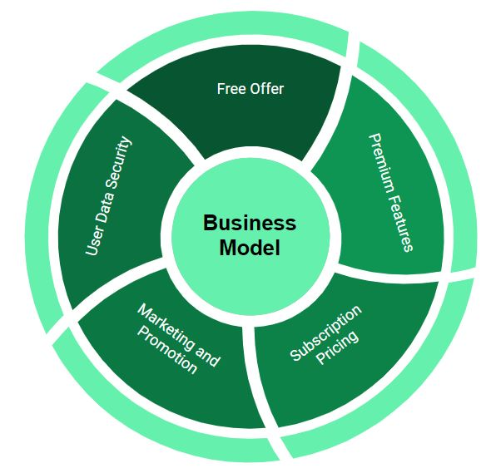

Slide 6
Proposed Solution
Here are some solution ideas which can be successfully implemented into our model:
Transaction Management: The platform will provide functionality for users to add, edit, and delete income and expense transactions. They can categorize transactions, assign labels, and add additional details as needed.
Real-time Balance Calculation: The finance tracker will automatically calculate and display the current balance based on the income and expense transactions entered by the user. This ensures users have an up-to-date understanding of their financial status.
Reporting and Analysis: Users will have access to comprehensive reports and visualizations to analyze their financial data. This may include graphical representations of spending patterns, income sources, budget tracking, and savings goals progress.

Slide 7
4.Budgeting and Goal Setting: The platform will enable users to set financial goals, create budgets, and track their progress. Alerts or notifications can be implemented to keep users informed about their budget limits or progress towards their goals.
5.Data Security and Privacy: Strong security measures, including encryption, secure authentication, and regular data backups, will be implemented to protect user data. Compliance with data protection regulations will be ensured.
6.Customer Support: Dedicated customer support channels, such as email or chat, will be provided to assist users with any issues or questions they may have.

Slide 8
Technology/Tool Stack Used:
The Technology and the tool stack used are as follows:
Frontend Development-
HTML: Used for structuring the web pages.
CSS: Used for styling and layout of the user interface.
JavaScript: Used for interactivity, data manipulation, and calculations.
Bootstrap or other CSS frameworks: To enhance responsiveness and design consistency.
Version Control-
Git: For version control and managing codebase.
GitHub: Platforms for hosting the code repository and enabling collaboration among team members.
Development Tools-
Visual Studio Code: For writing and editing code.

Slide 9
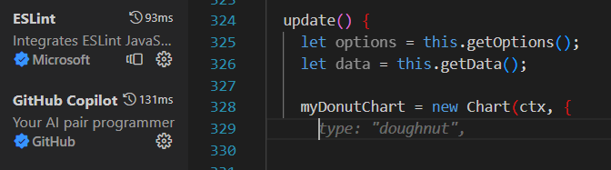
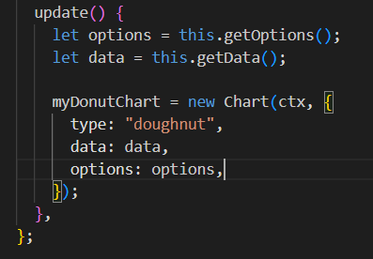

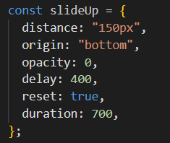
Mention of usage of Github Copilot

Slide 10
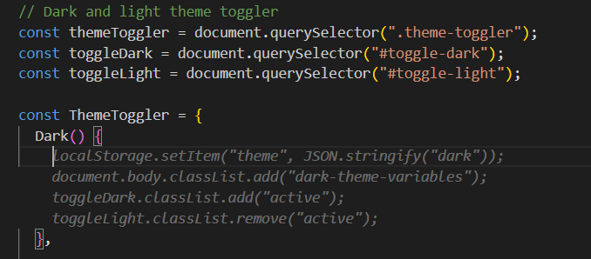
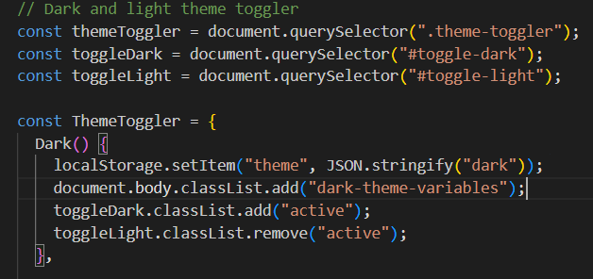
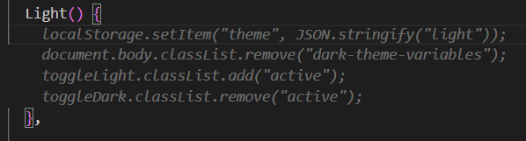
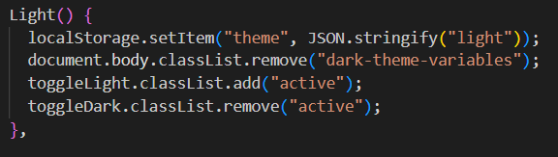
We have used github copilot for autocompletion of our code in a multitude of places as well as to understand adding new functions especially in our dark/light theme toggle switch

Slide 11
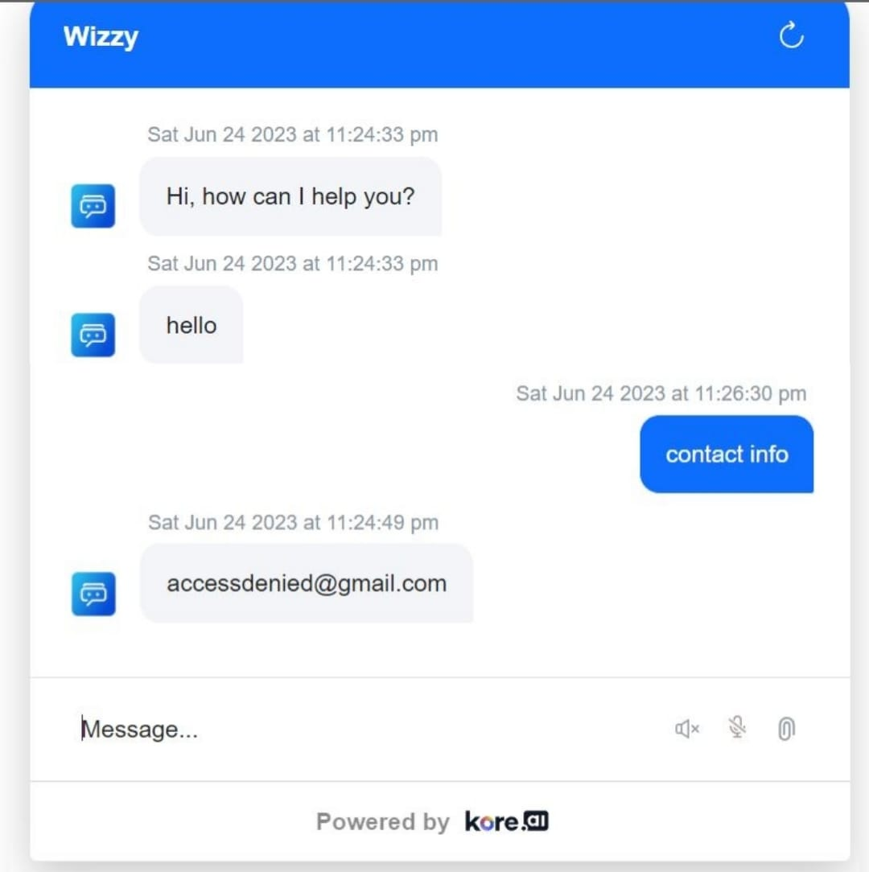
Execution Demo(Video/Screenshots) showing usage of the Kore AI Platform :
During this hackathon we also explored the Kore ai platform and
Came up with our own chatbot, ‘Wizzie’, to make the platform more interactive. We added utterances, greetings and plan to connect it soon to the website. Demo is as follows:

Slide 12
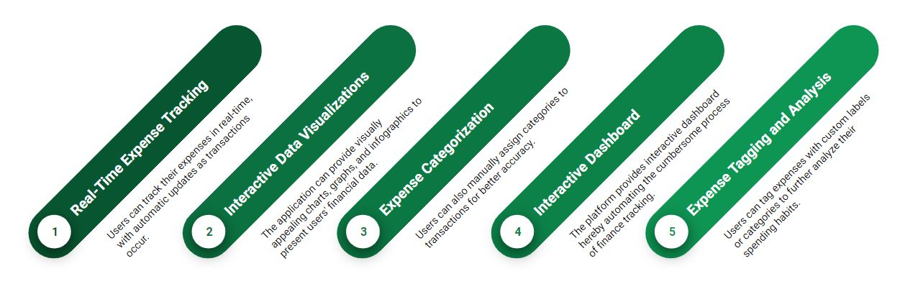
What makes us different:

Slide 13
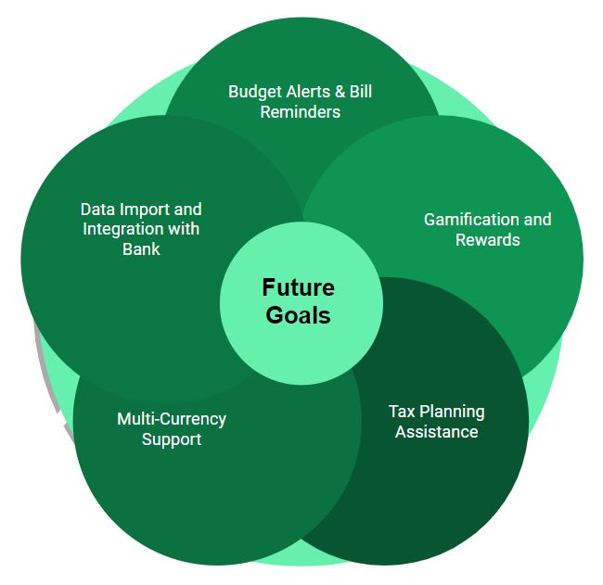

Slide 14
THANK YOU

