Slide 1
Progress Report
22.10.2026

Slide 2
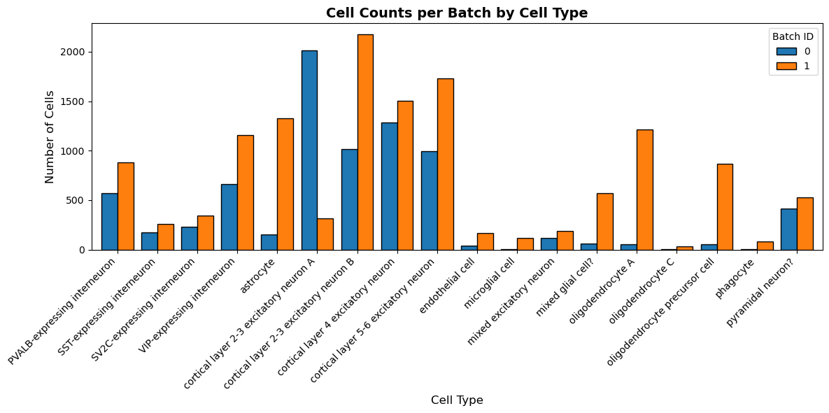
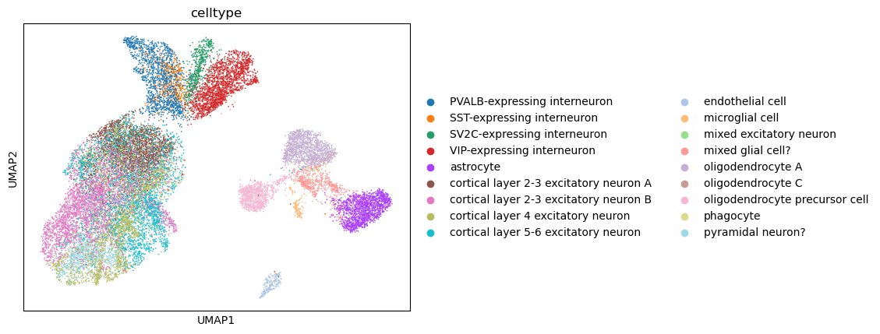
Cell types of MS Dataset
number of cells
0: 7844, 1: 13468
 | 0 | 1
oligodendrocyte C | 3 | 34
phagocyte | 3 | 82
microglial cell | 4 | 118
endothelial cell | 38 | 170
oligodendrocyte A | 53 | 1216
oligodendrocyte precursor cell | 55 | 866
mixed glial cell? | 60 | 573
mixed excitatory neuron | 114 | 185
astrocyte | 154 | 1330
SST-expressing interneuron | 172 | 258
SV2C-expressing interneuron | 234 | 344
pyramidal neuron? | 413 | 528
PVALB-expressing interneuron | 569 | 878
VIP-expressing interneuron | 662 | 1158
cortical layer 5-6 excitatory neuron | 997 | 1732
cortical layer 2-3 excitatory neuron B | 1019 | 2178
cortical layer 4 excitatory neuron | 1284 | 1504
cortical layer 2-3 excitatory neuron A | 2010 | 314

Slide 3
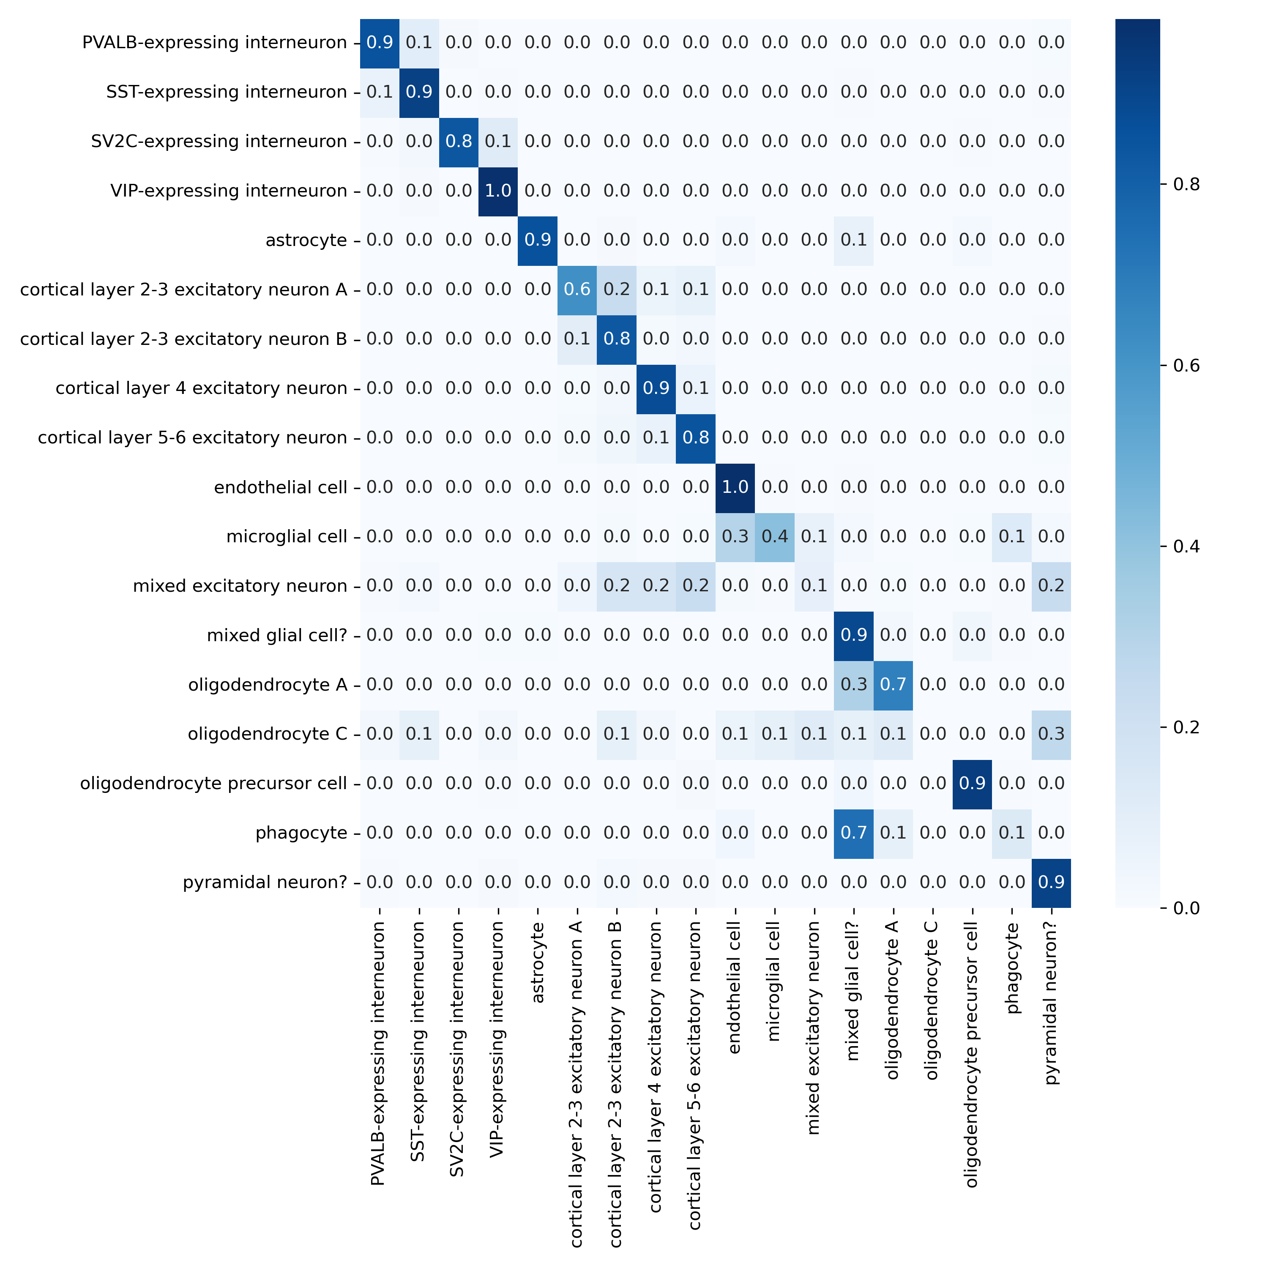
Cell type predictions for MS Dataset: confusion matrix

Slide 4
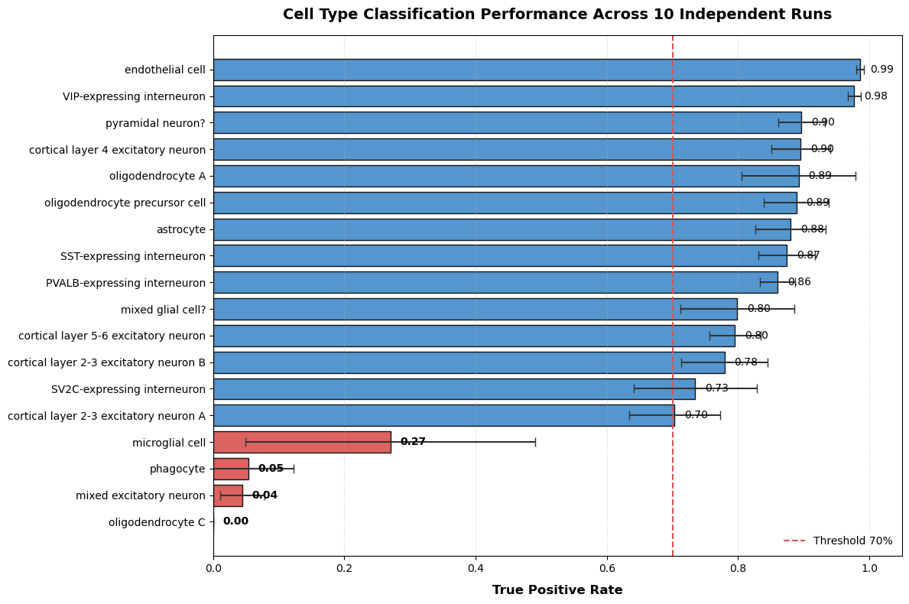
Cell type predictions for MS Dataset: mean true positive rate

Slide 5
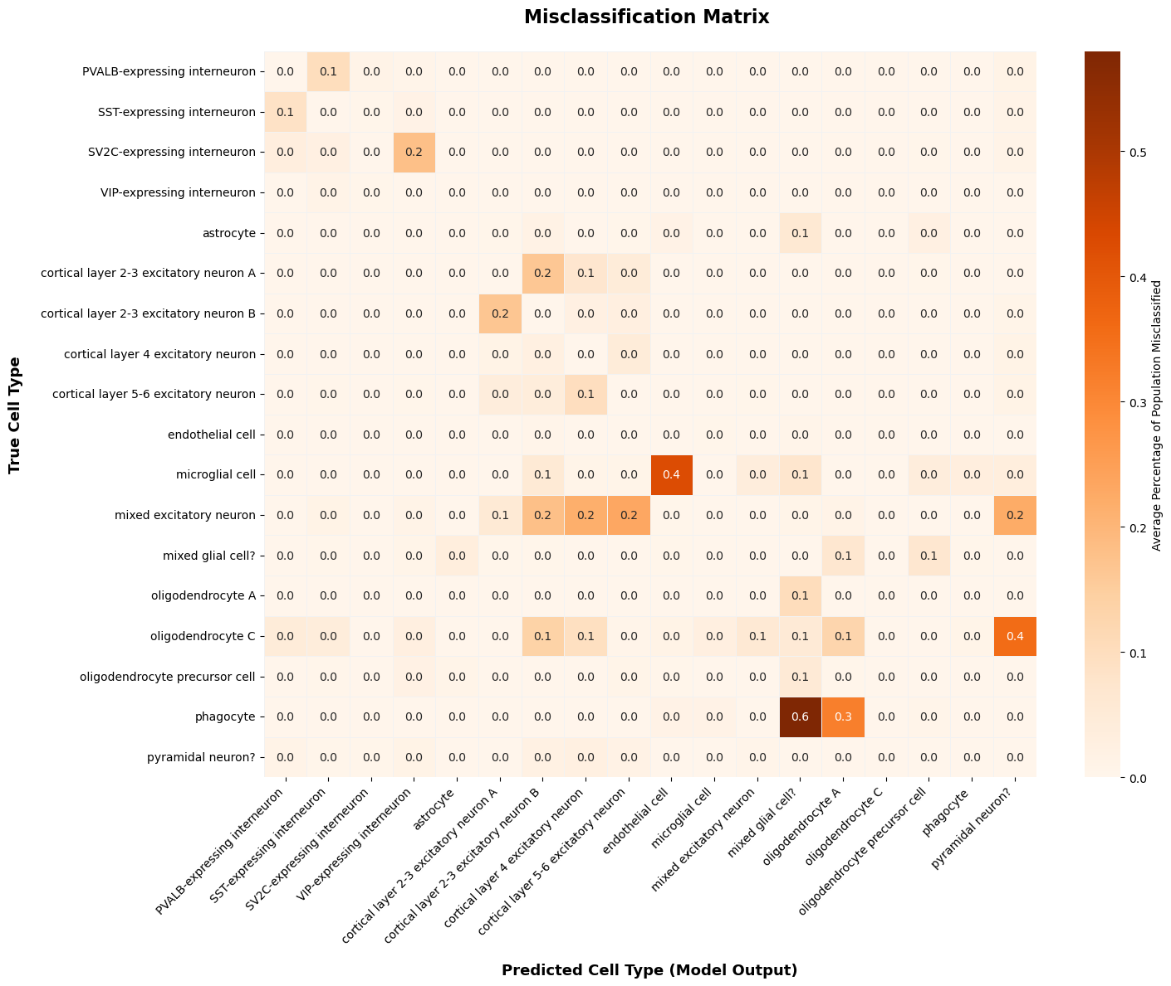
Misclassification matrix: mean false positive for each cell type

Slide 6
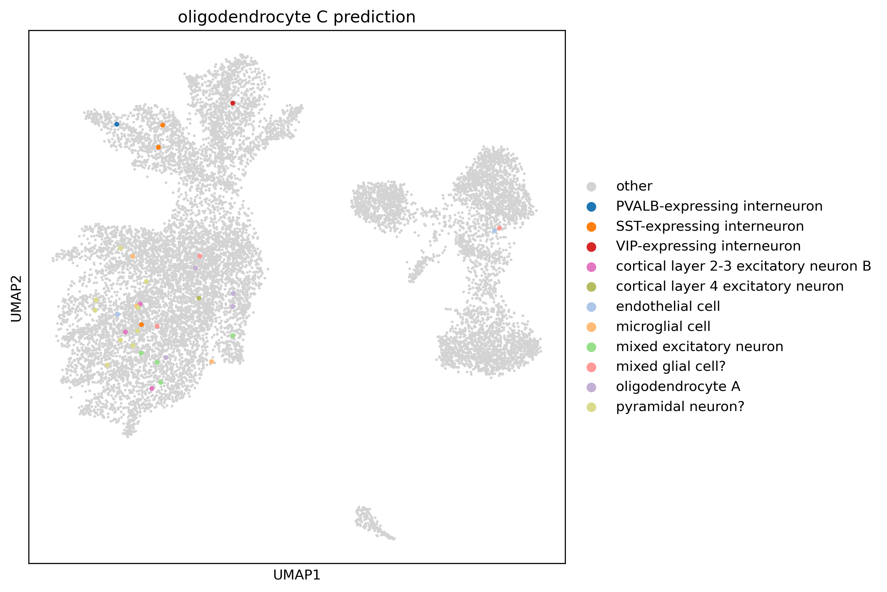
Predicted cell types for oligodendrocyte C

Slide 7
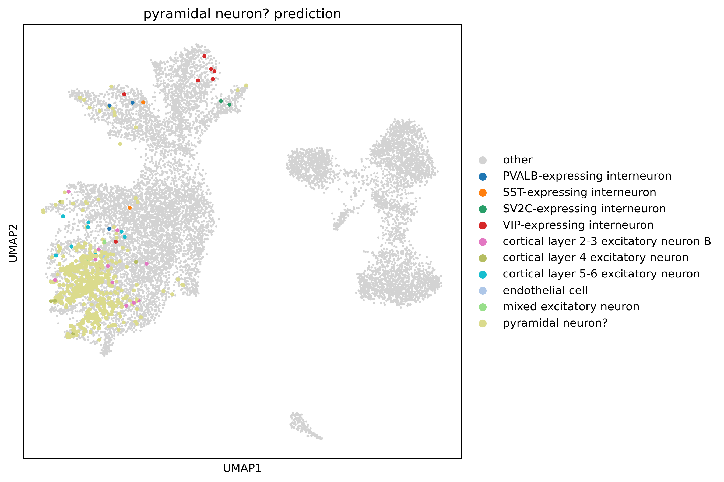
Predicted cell types for pyramidal neuron

Slide 8
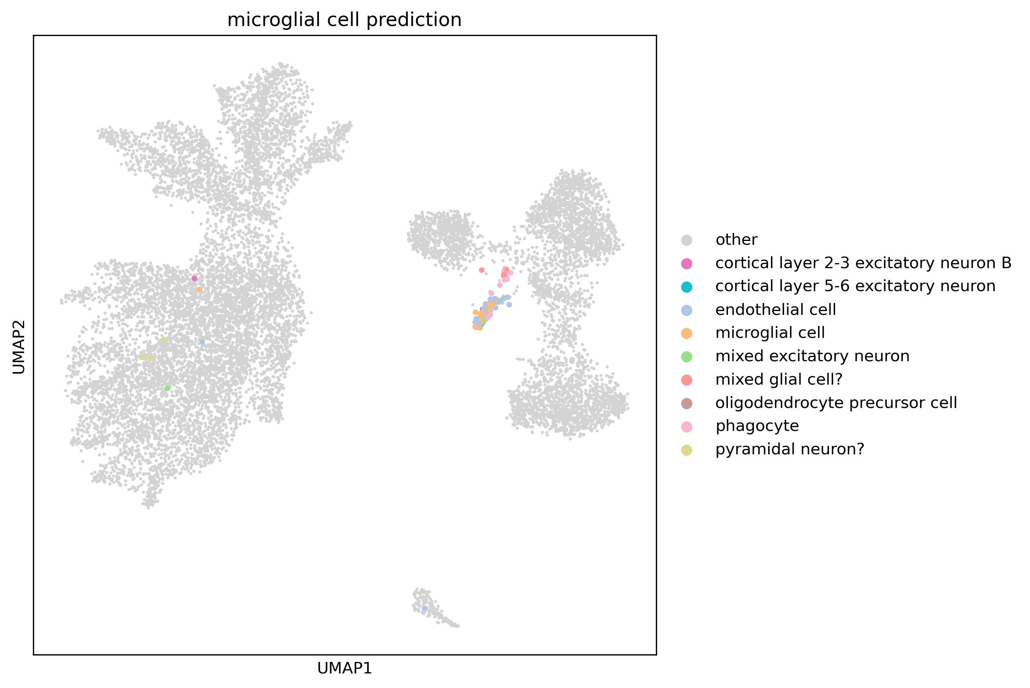
Predicted cell types for microglial cell

Slide 9
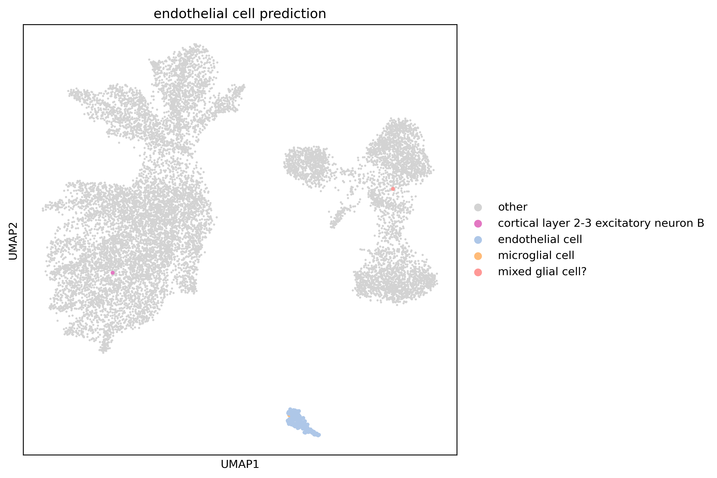
Predicted cell types for endothelial cell

Slide 10
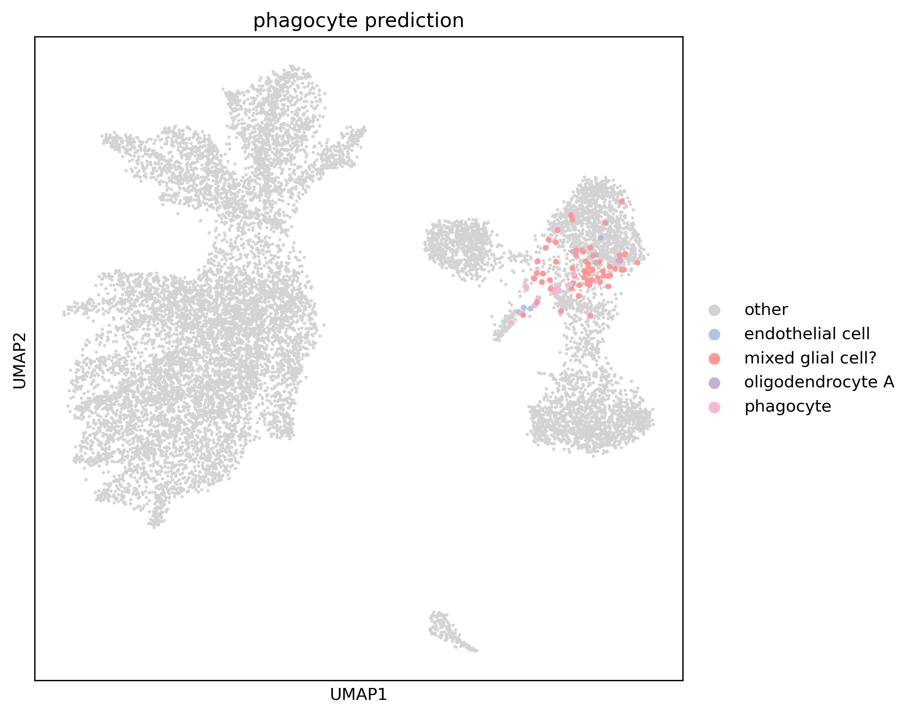
Predicted cell types for phagocyte

Slide 11
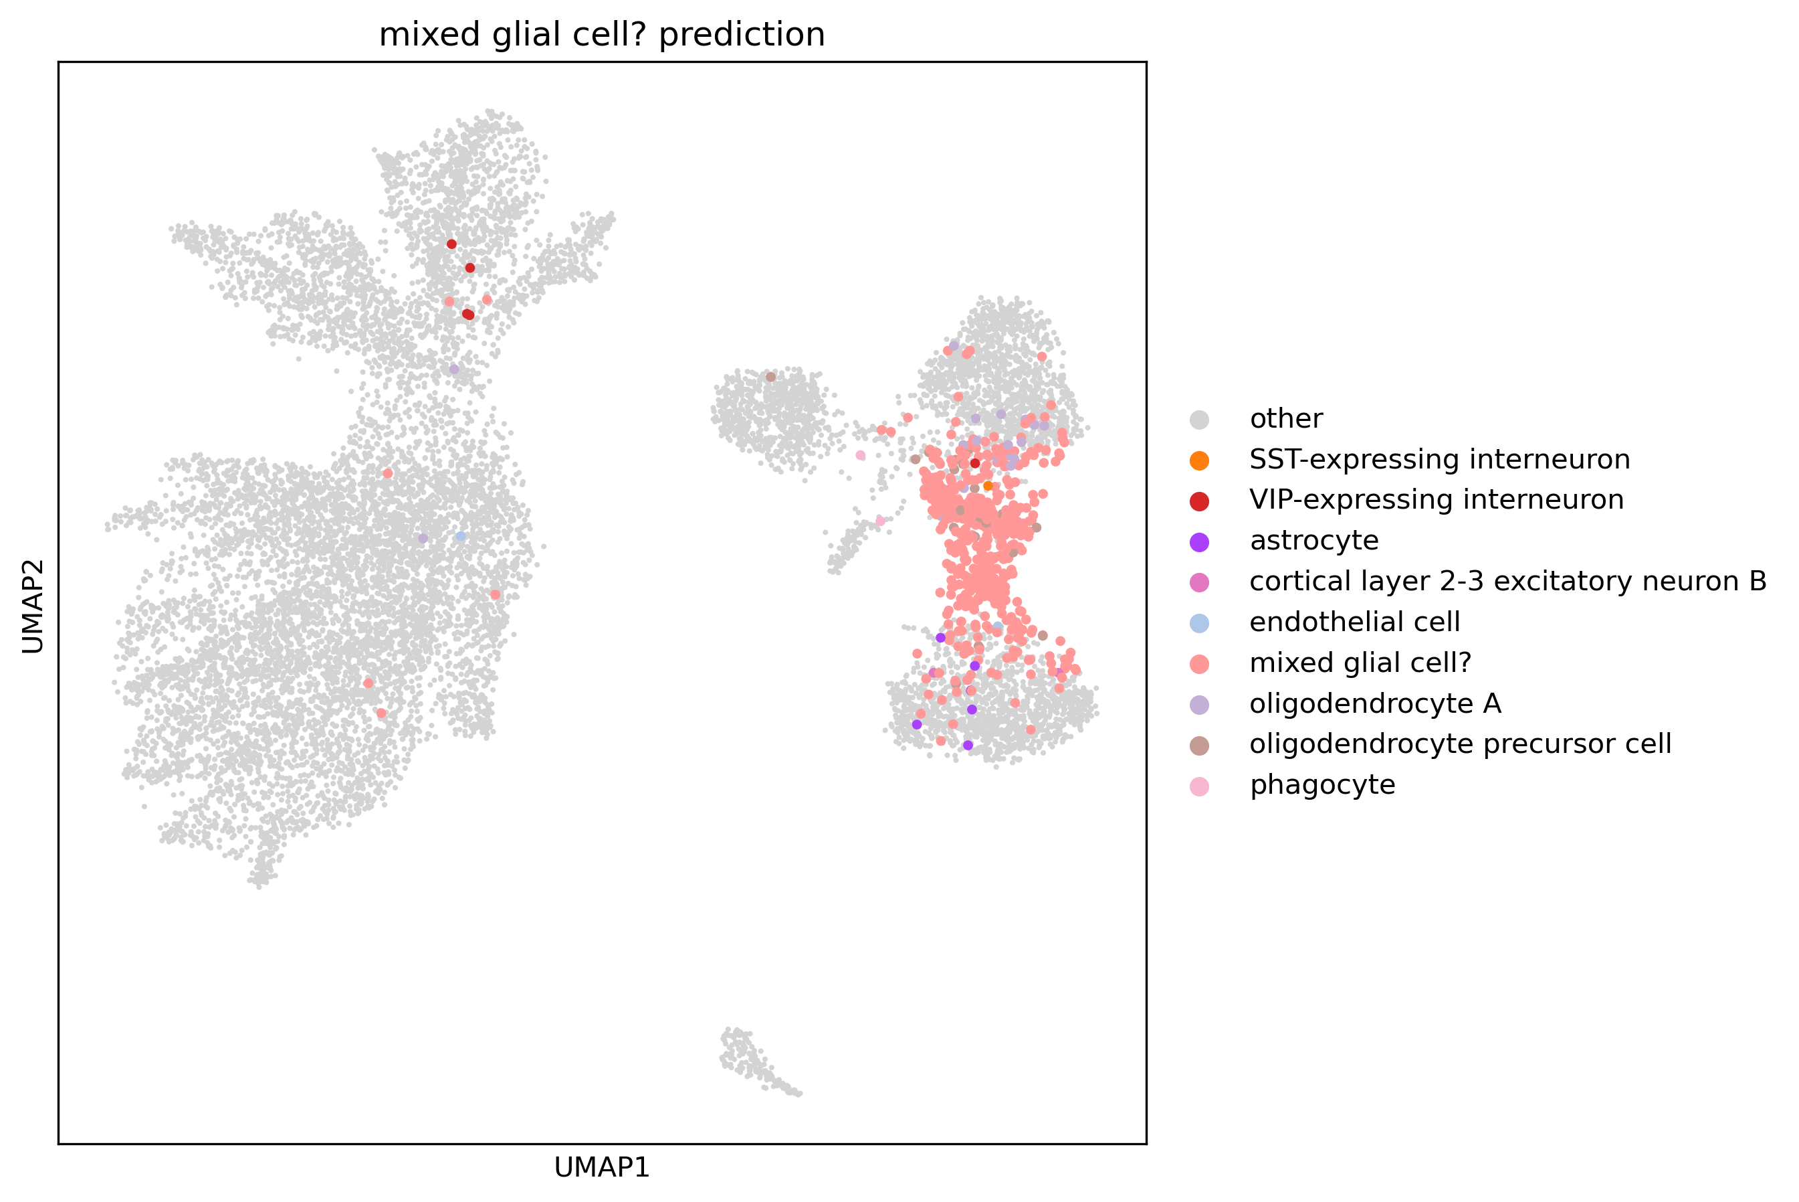
Predicted cell types for mixed glial cell?

Slide 12
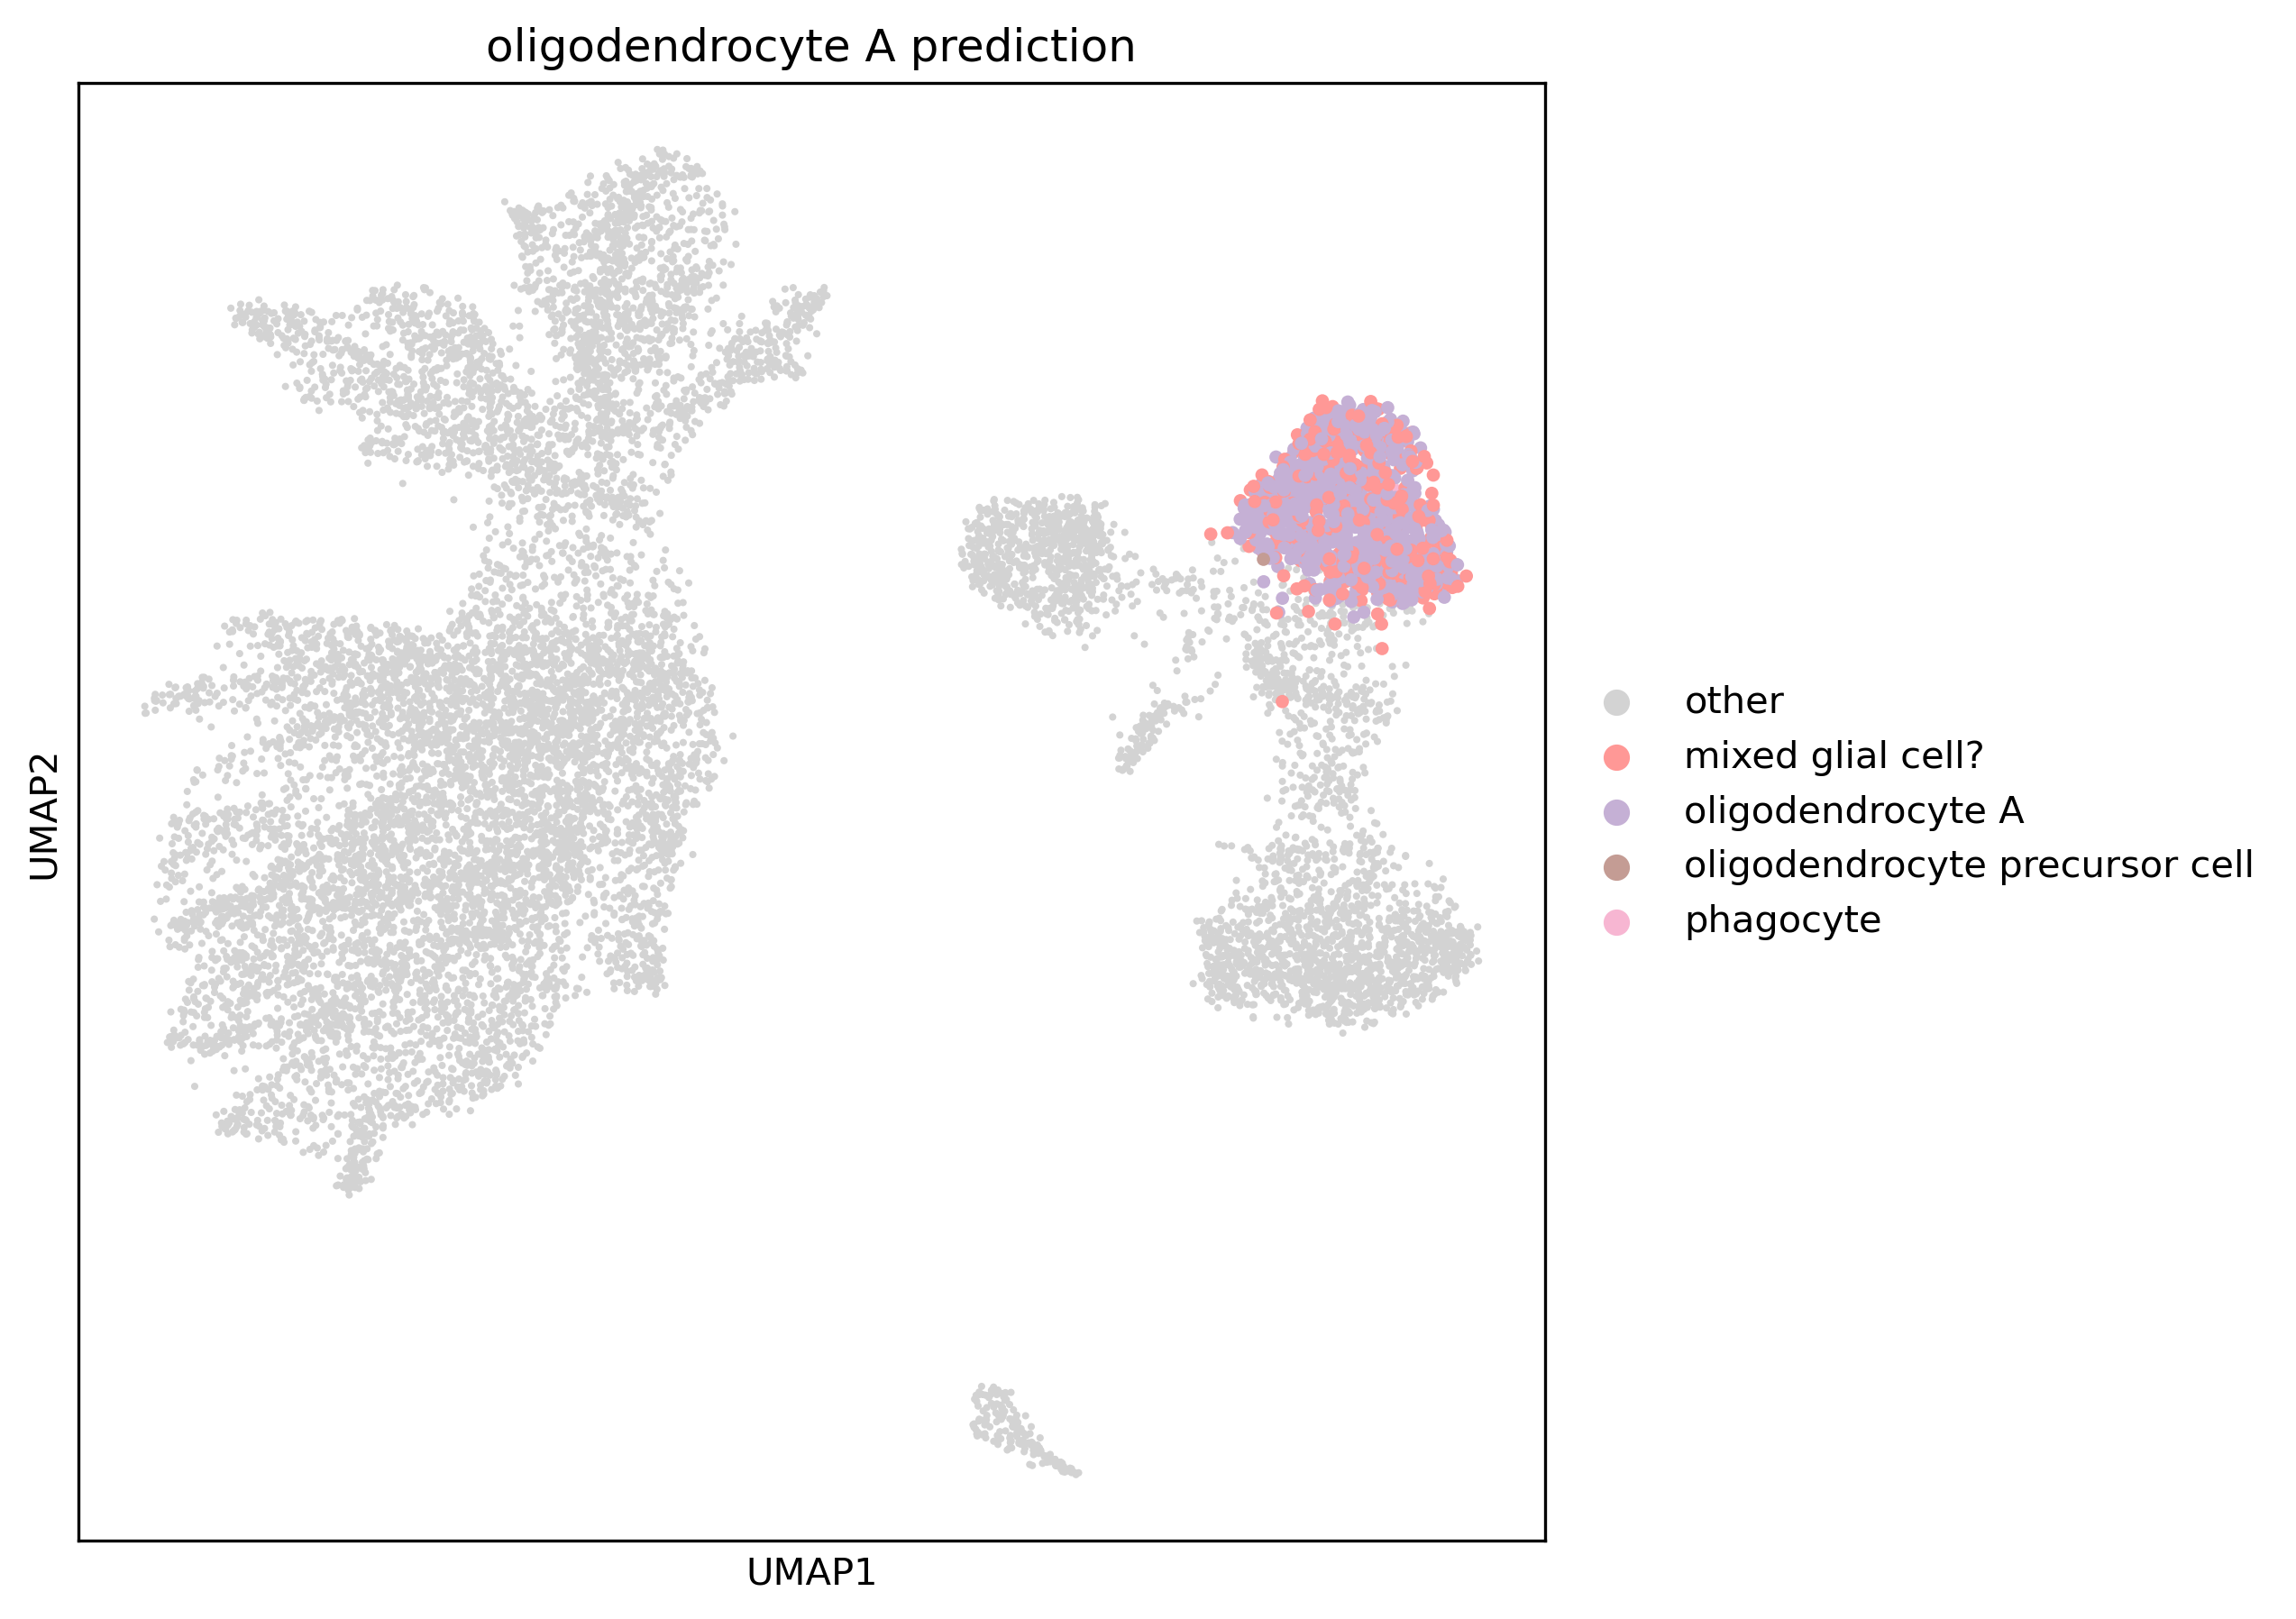
Predicted cell types for mixed glial cell?

Slide 13
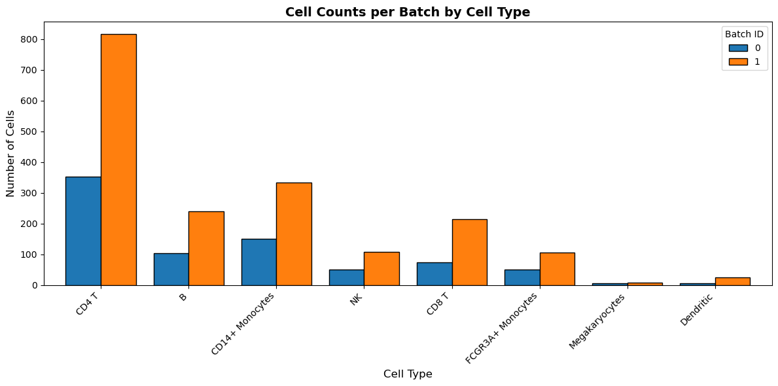
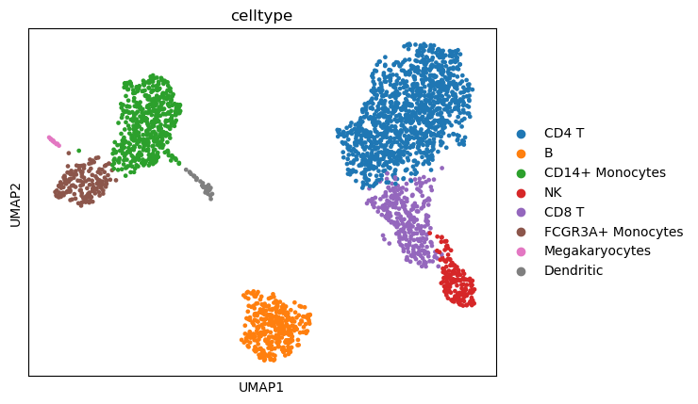
Cell types of PBMC3k Dataset
number of cells
0: 791, 1: 1847
 | 0 | 1
Megakaryocytes | 5 | 8
Dendritic | 6 | 25
NK | 50 | 107
FCGR3A+ Monocytes | 51 | 106
CD8 T | 73 | 214
B | 104 | 240
CD14+ Monocytes | 150 | 332
CD4 T | 352 | 815

Slide 14
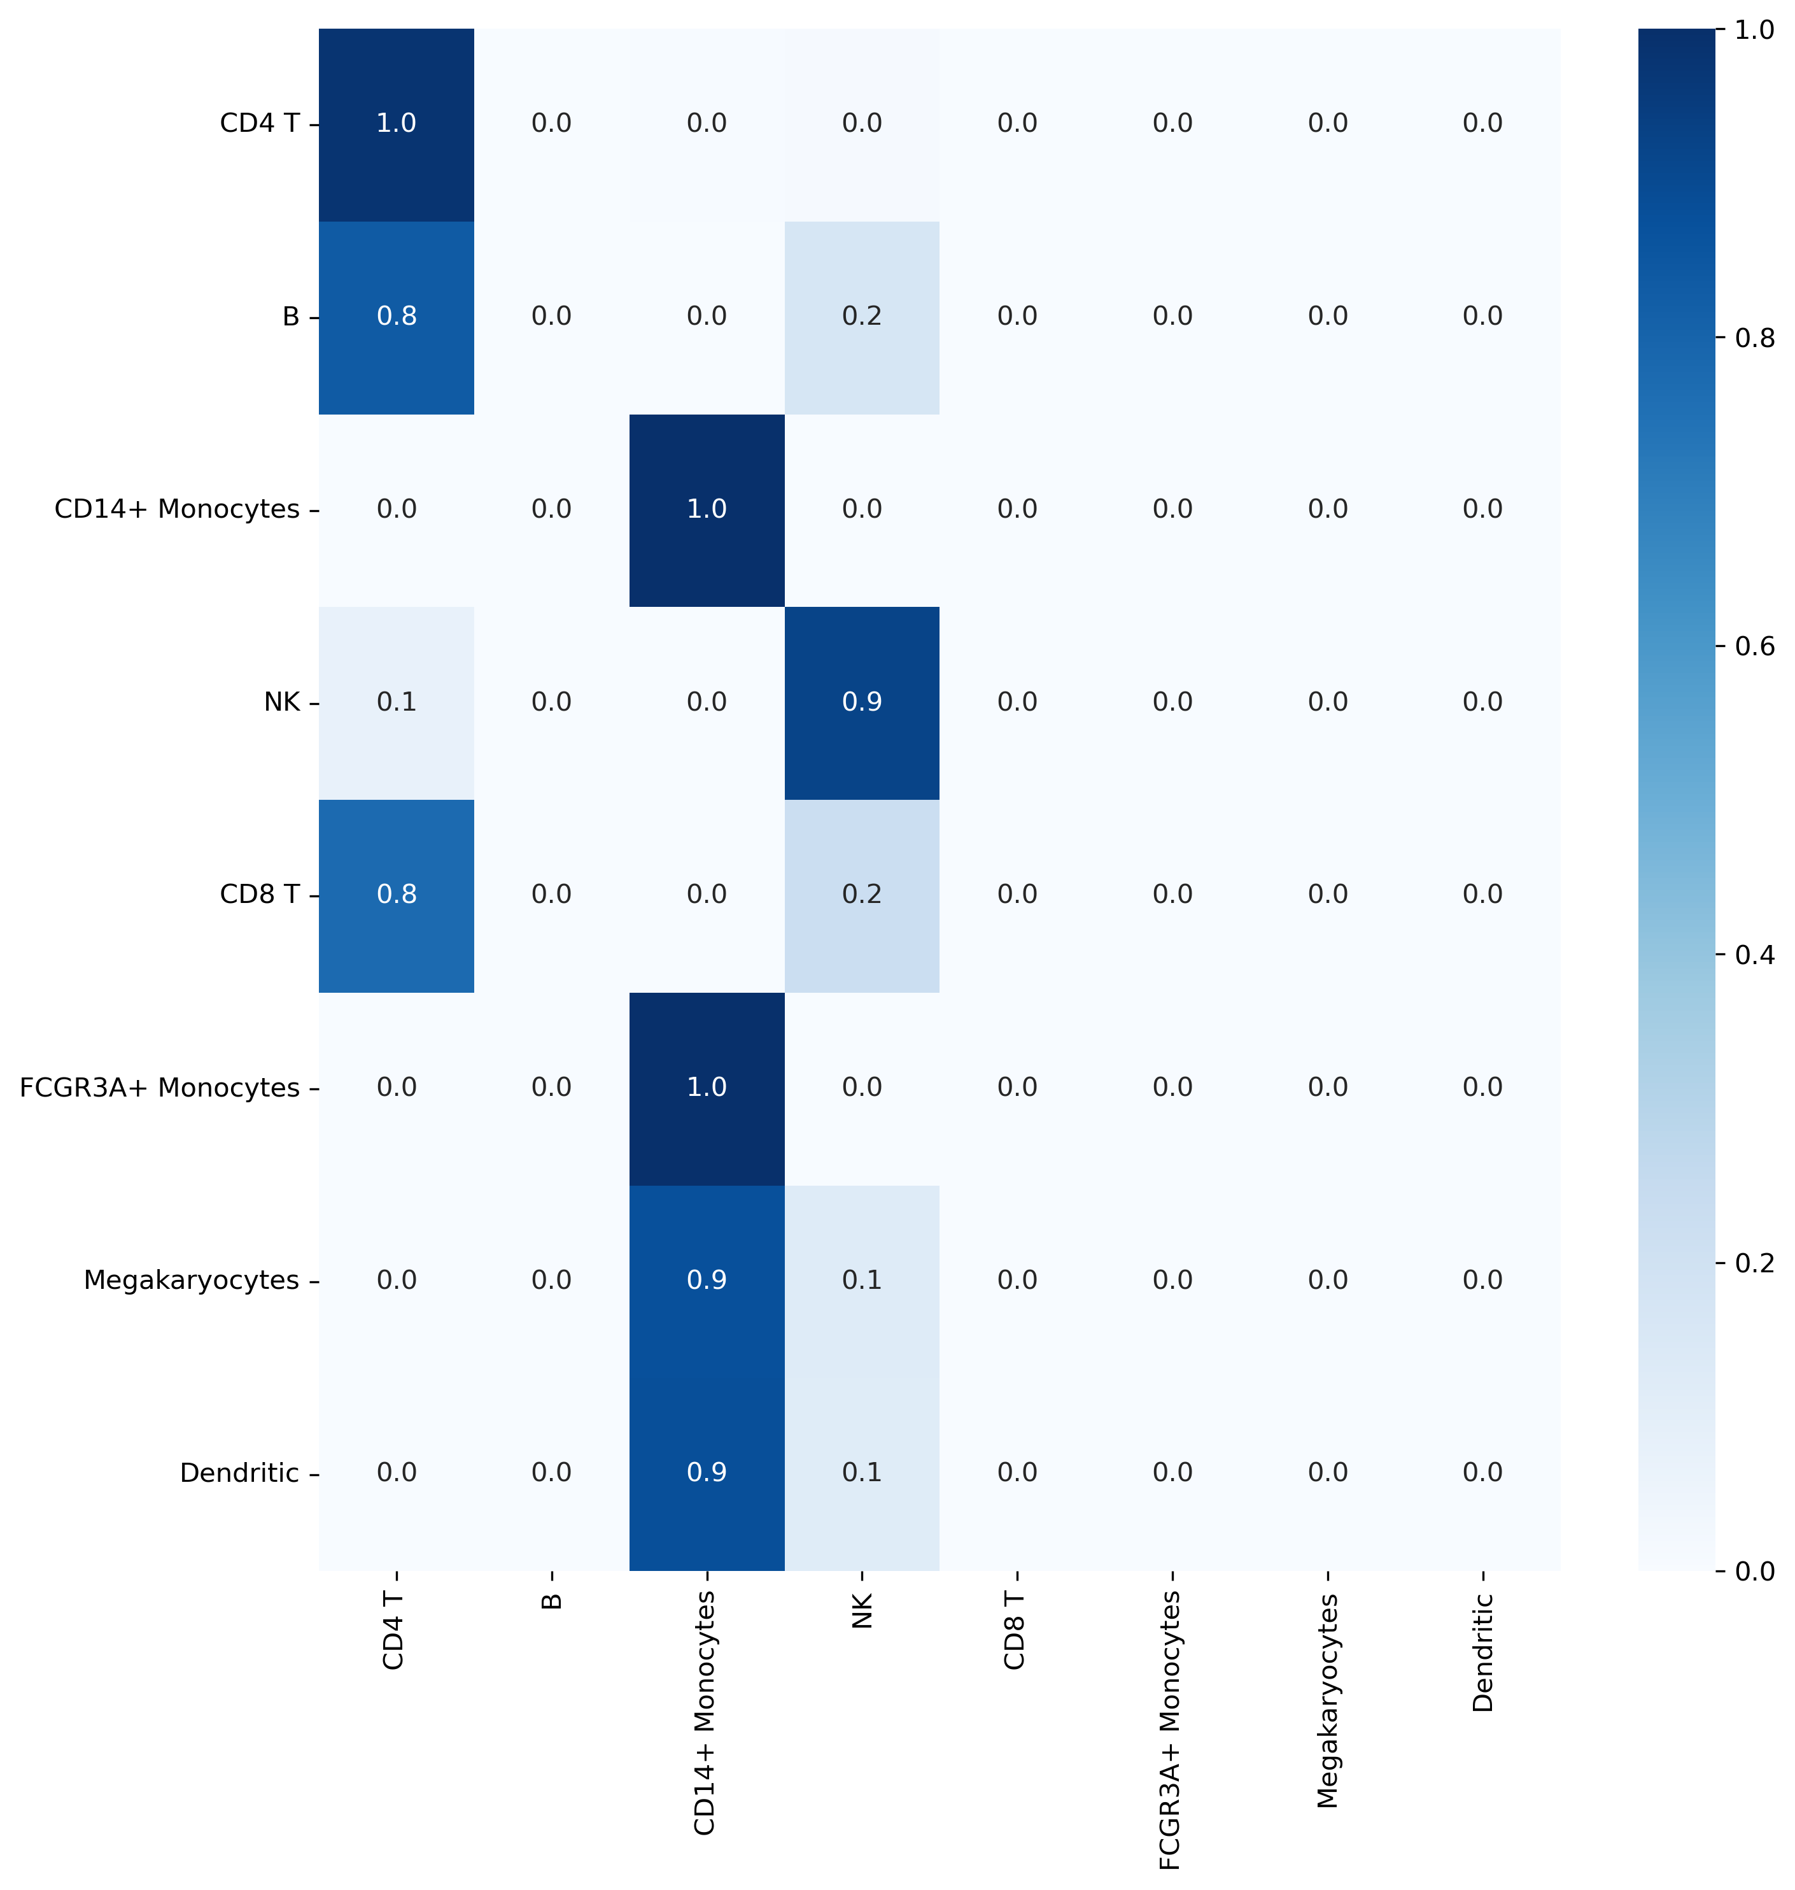
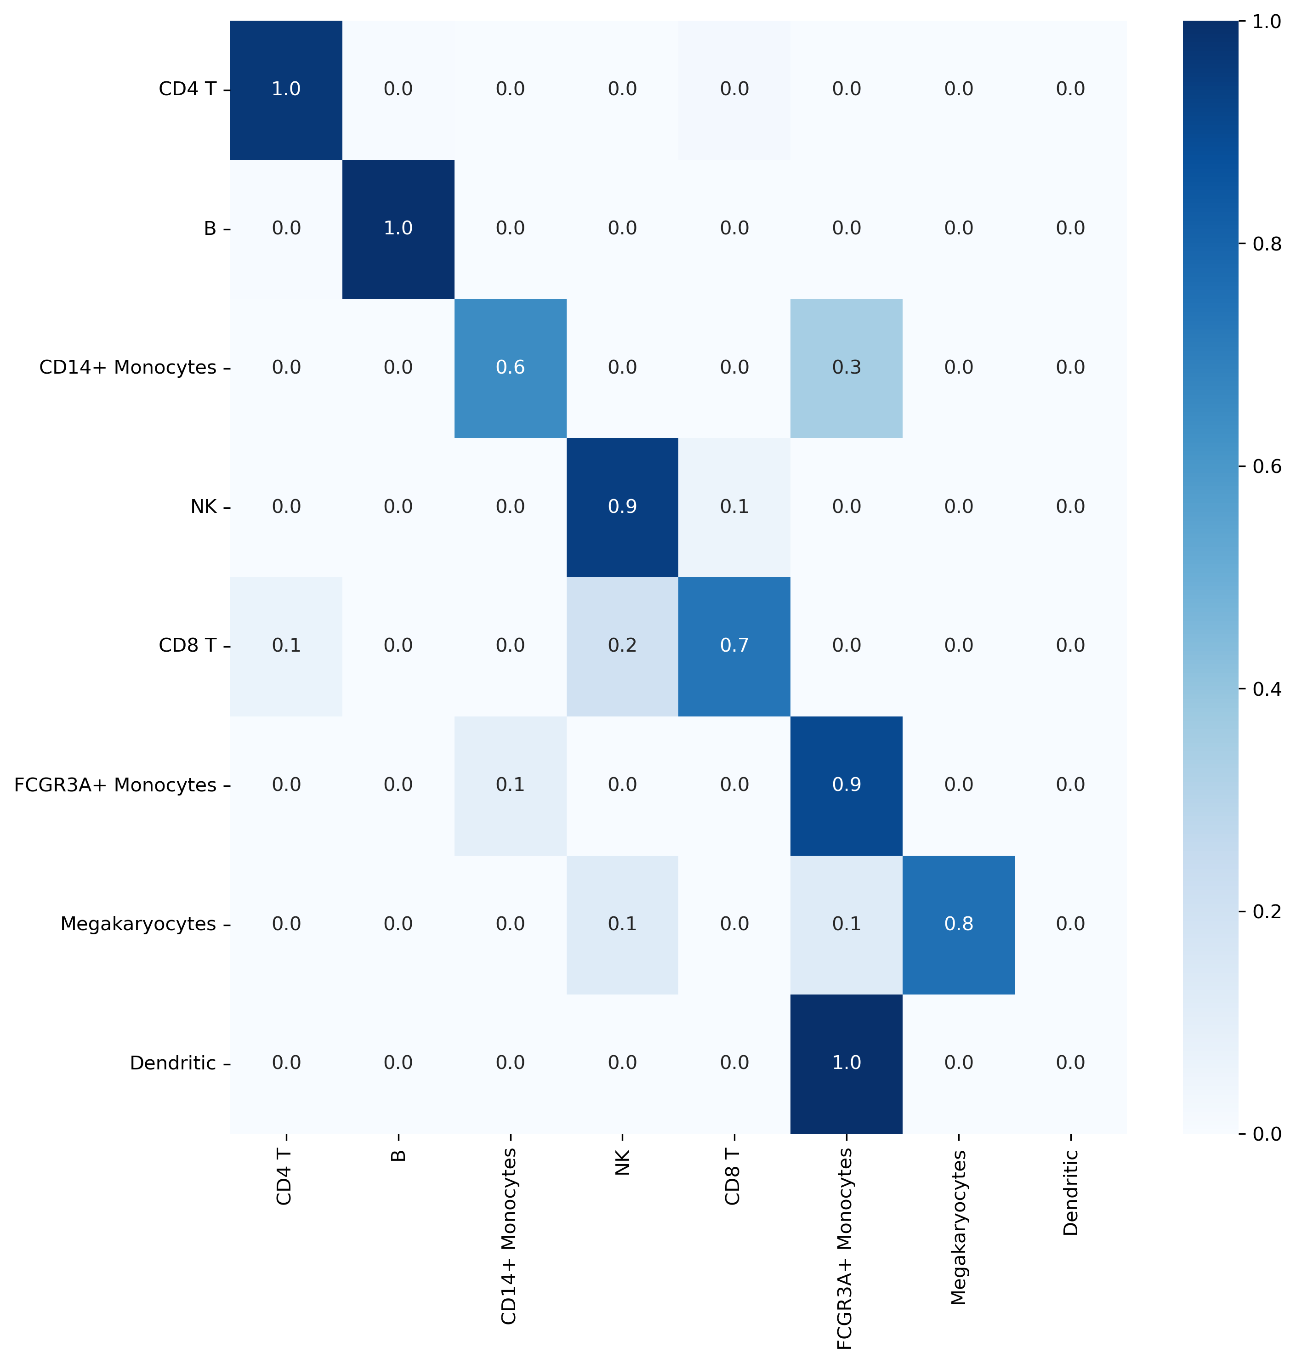
Choice of pre-trained model matters!
scGPT_human: 33 million normal human cells
scGPT_bc: 10.3 million blood and bone marrow cells

Slide 15
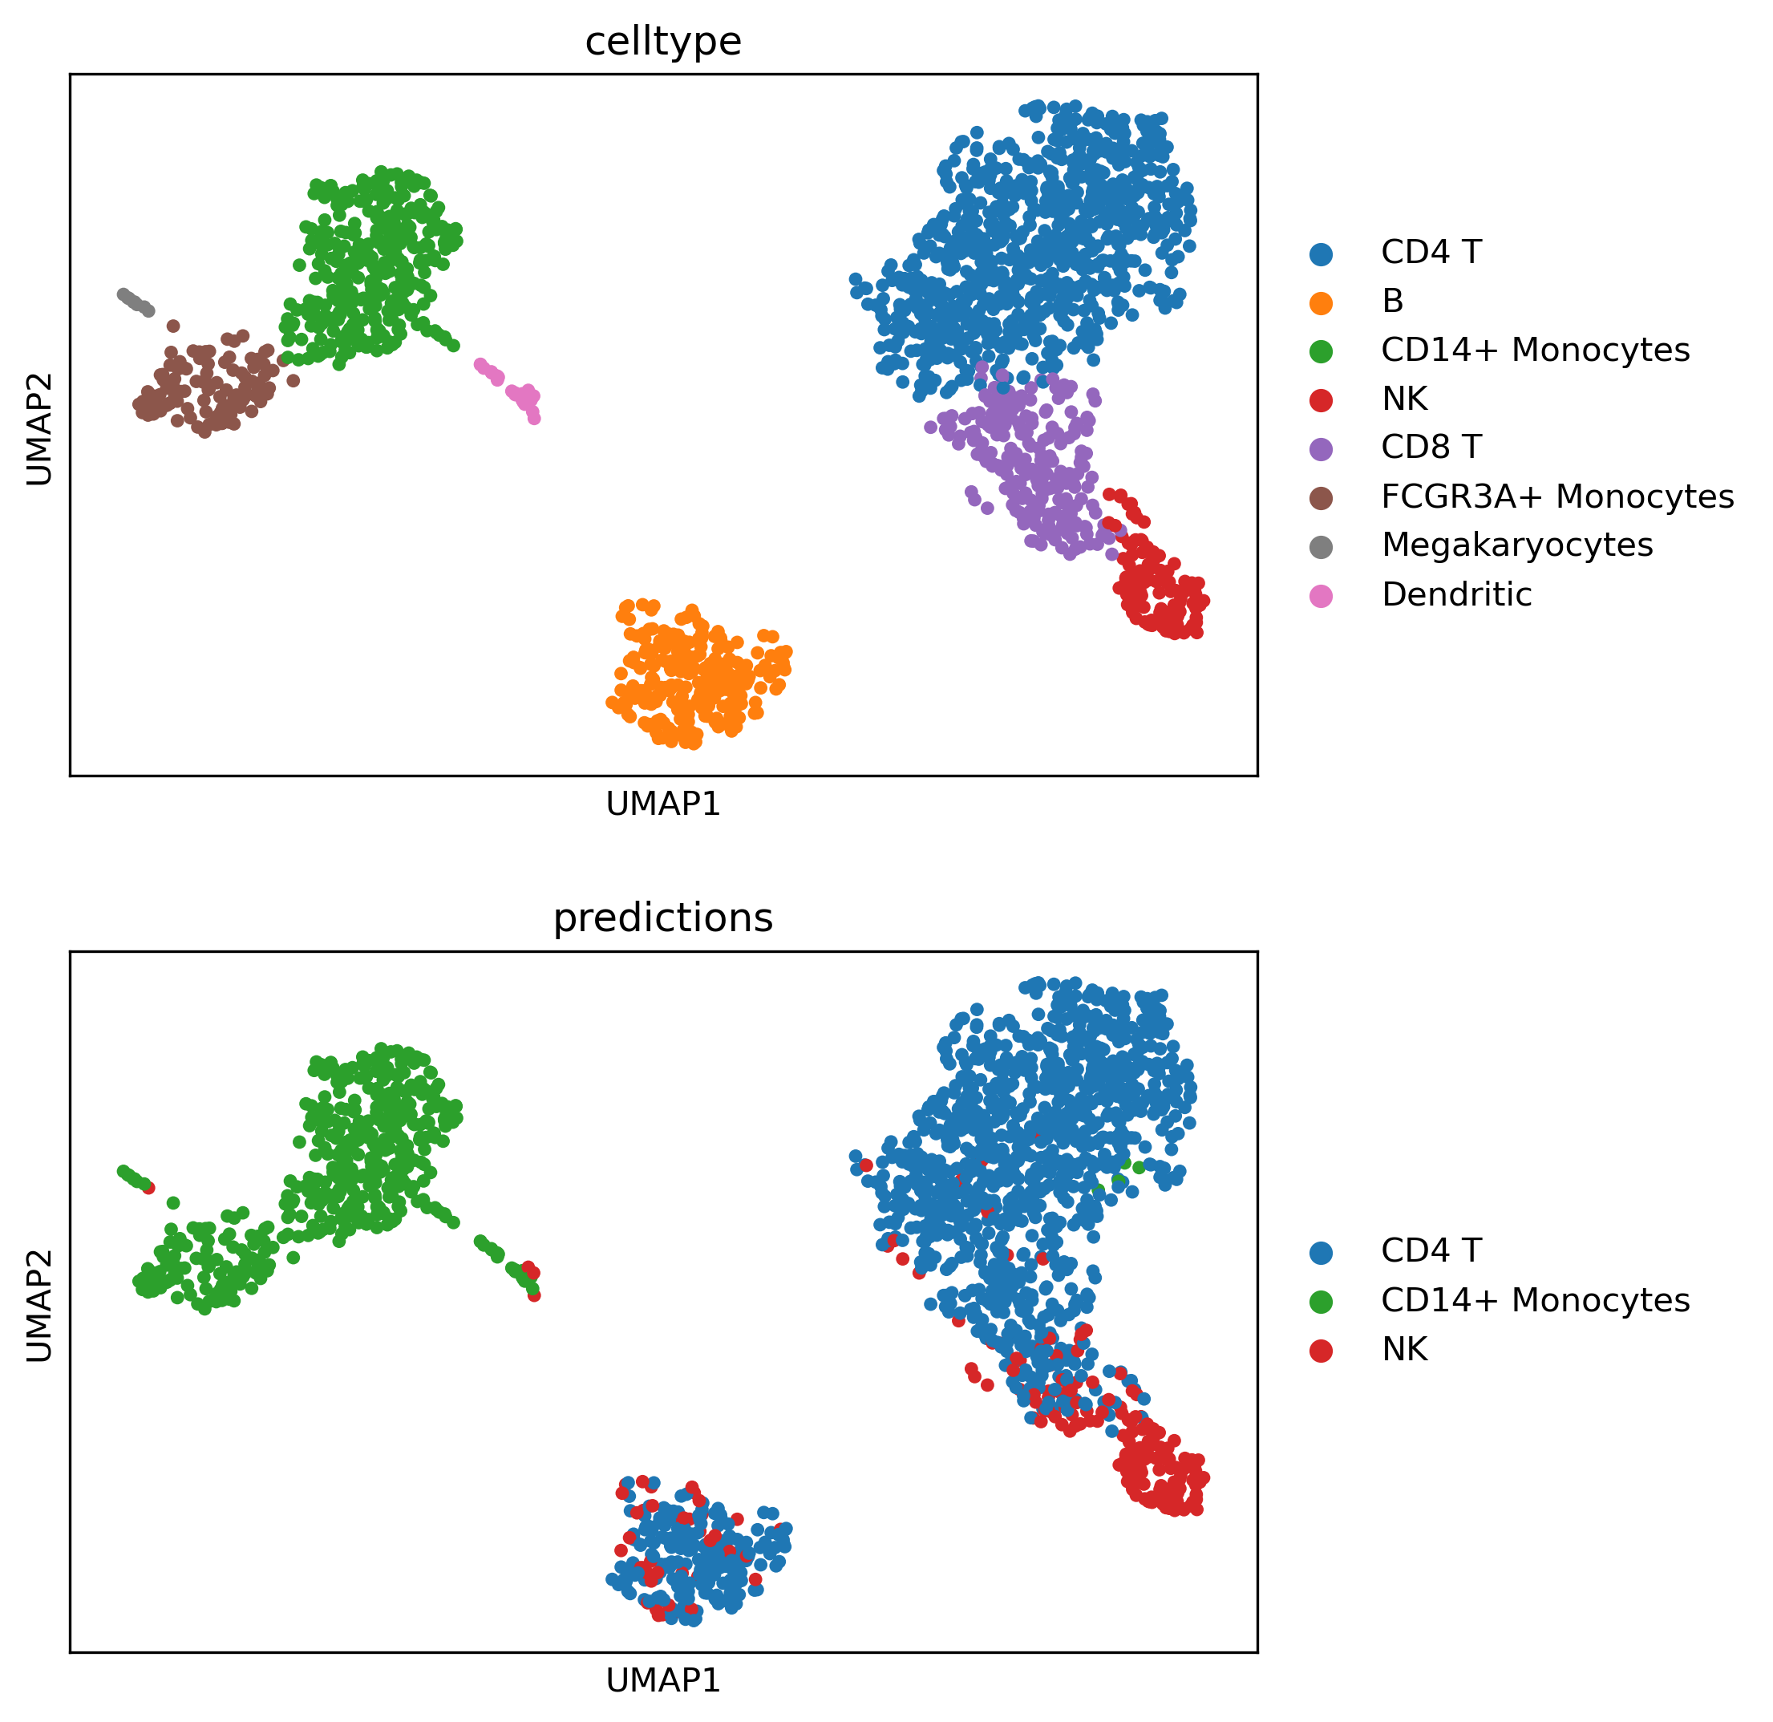
Choice of pre-trained model matters!
scGPT_human: 33 million normal human cells
scGPT_bc: 10.3 million blood and bone marrow cells

Slide 16
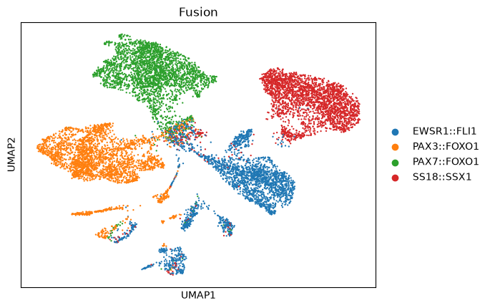
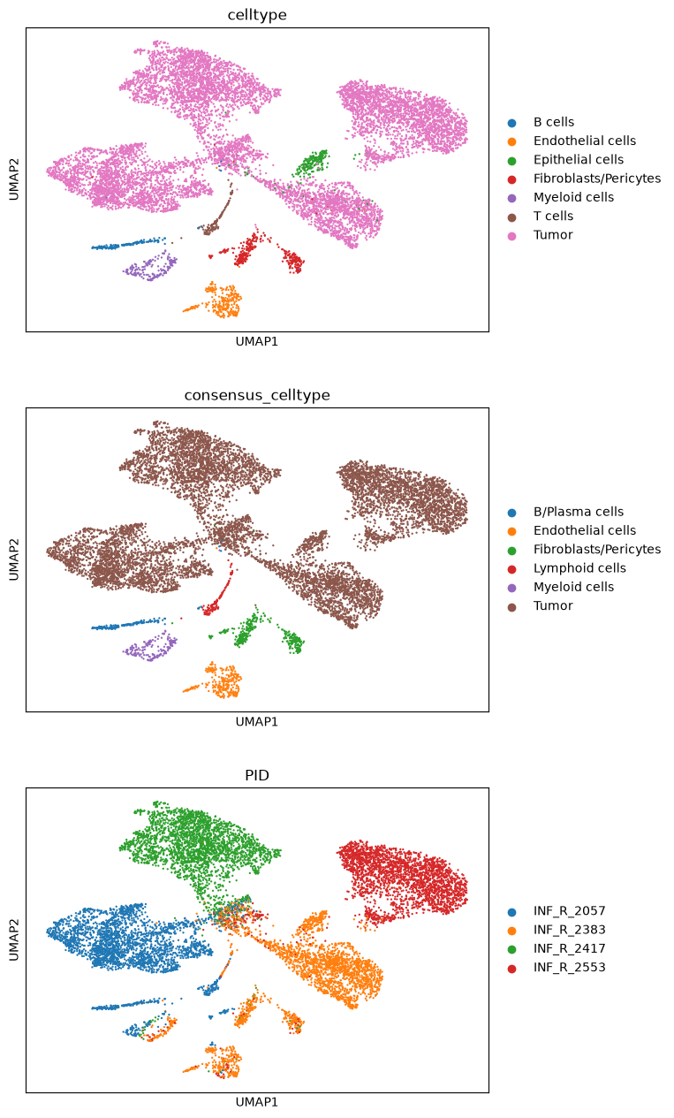
Sarcoma Dataset

Slide 17
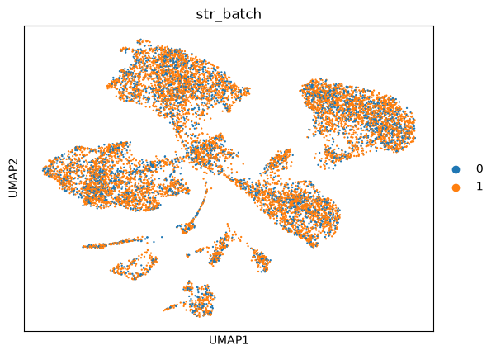
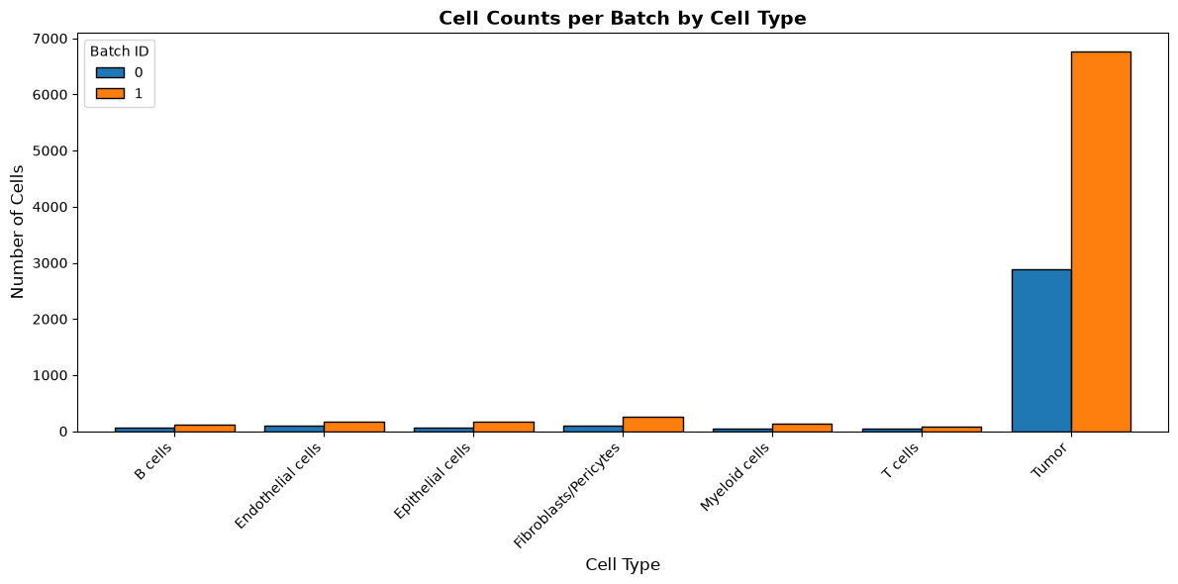
Sarcoma Dataset
0: train (3296 cells)
1: test (7691 cells)
 | 0 | 1
T cells | 40 | 75
Myeloid cells | 48 | 139
B cells | 56 | 112
Epithelial cells | 65 | 165
Endothelial cells | 91 | 178
Fibroblasts/Pericytes | 102 | 262
Tumor | 2894 | 6760

Slide 18
Some issues that came up
Processing step requires positive values (raw or log1p normalized)
Job with heroes (sarcoma) dataset requires highmem queue (at least 300GB)
Regarding the fine-tuning: train classifier -> any cell type label you want the model to be able to predict has to be included in the training data set

