Slide 1
Cell type annotation using a single-cell foundation model
Research Internship KiTZ 27.07 – 30.10.2026
Selina Ernst

Slide 2
Foundation Models
Large & Diverse Data
Tasks
Foundation
Model
Structured Data
Text
Images
Audio
Videos
Information extraction
Instruction following
Object Recognition
Image captioning
Q&A
Sentiment analysis
Training
Adaptation

Slide 3
Foundation Models in cell biology
Instead of words forming sentences, we have genes and cells
Idea:
  Learn gene-gene interactions, cell characteristics, network dynamics
  Perform well even in areas with limited data available
Main characteristics:
  Large-scale: trained with vast amount of diverse data
  Multipurpose: serve as foundation for variety of downstream tasks
  Fine-Tuning / Adaptation
    General-purpose model is adapted to perform specific tasks
    Trained on much smaller task-specific data
Examples
  Geneformer (Theodoris et al., Nature, 2023)
  scFoundation (Hao et al., Nature Methods, 2024)
  scGPT (Cui et al., Nature Methods, 2024)
  UCE: Universal cell embedding foundation model (Rosen et al., Nature, 2026)

Slide 4
scGPT - single-cell foundation model based on GPT architecture
Large & Diverse Data
Tasks
scGPT
Pre-trained model
cell type annotation
multi-batch integration
multiomic integration
perturbation response prediction
gene network inference
Non-spatial RNA sequencing data from CZ CELLxGENE Discover Census
Training
Adaptation

Slide 5
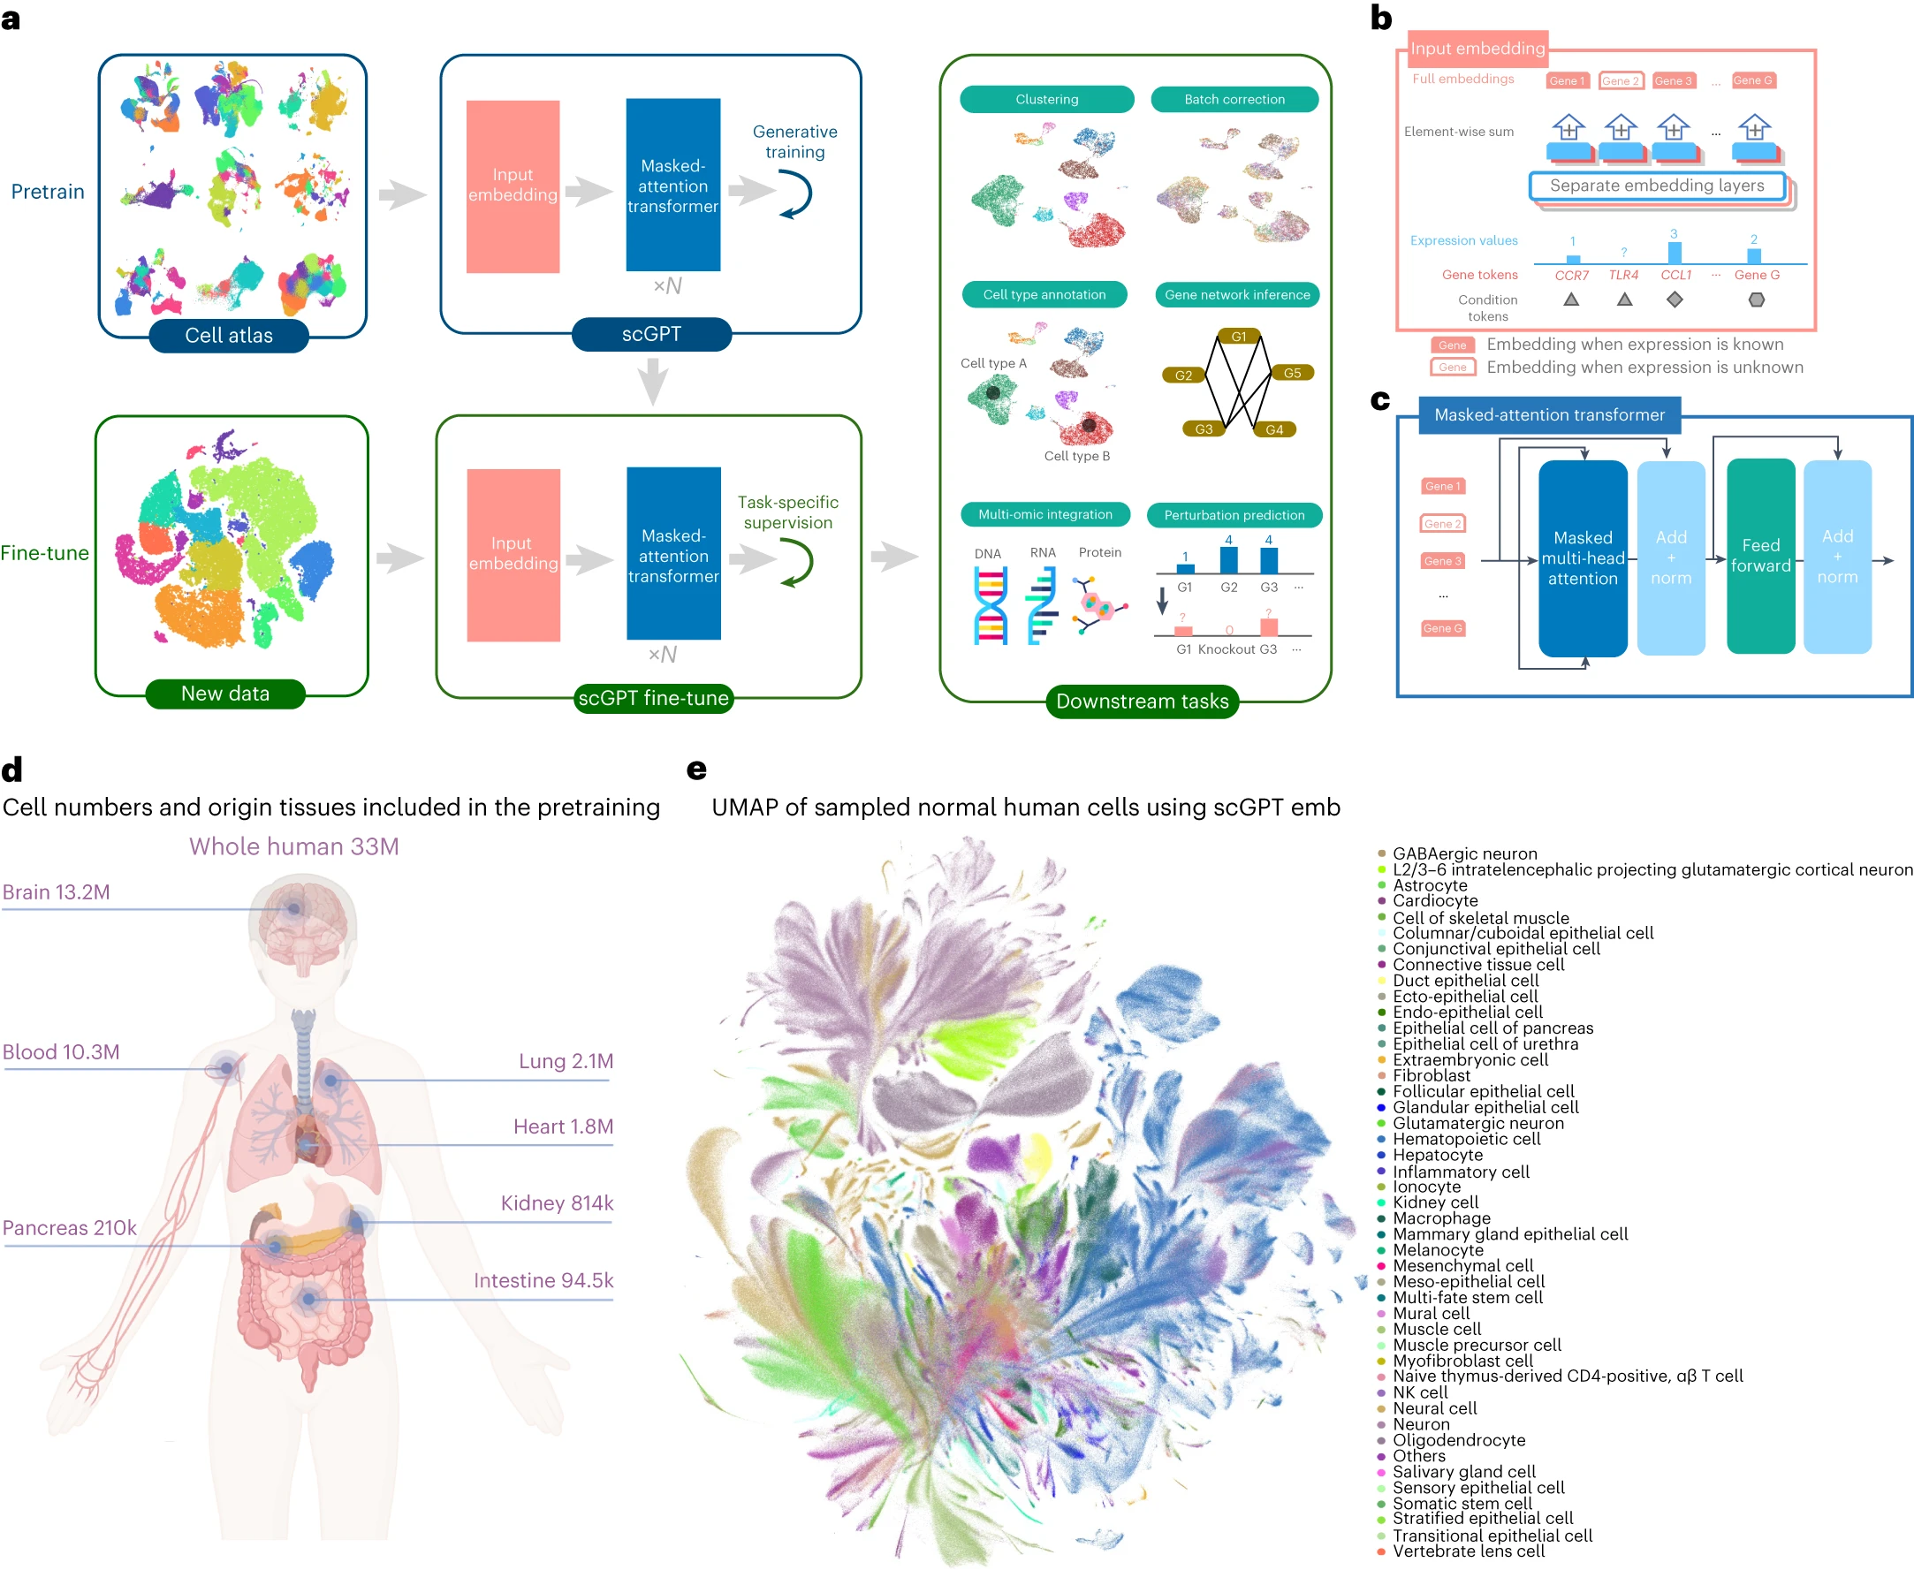
scGPT - Applications

Slide 6
Masked-attention transformer
learned gene-level Representation
GPT - generative pre-trained transformer
Model learns gene and cell embeddings simultaneously
  Learns gene–gene interactions at the single-cell level
Model Size
  53 million parameters
  Embedding size: 512
  Transformer blocks: 12
  Attention heads per block: 8
Layer Norm
Feed Forward
Nx
Layer Norm
Masked multi-head attention
Input Embedding

Slide 7
Input embedding
Gene tokens
  Gene name = token
  Gene has to be part of model vocabulary
  Special token <cls> used to obtain the cell representation
Binning
  Requires positive input values
  Convert expression counts to relative values
  take those continuous expression values and assign each to a discrete bin
  Fixed number of bins (e.g. 51),
  Bin boundaries are determined for each cell
  Each bin contains equal fraction of expressed genes
Condition tokens
  Encode contextual information about the cell
  Relevant for fine-tuning
  Multiple options:
    Perturbation
    Cell type
Gene
tokens
Expression
value
Condition
Token
Binned
value
Separate Embedding Layers
Full Input Embedding
…
Gene 1
Gene 2
Gene G

Slide 8
Training
Single-cell sequencing data
Initial general-purpose training
  Training data: large cell atlases
    Non-spatial RNA sequencing data from CZ CELLxGENE Discover Census
    Over 33 million human cells
  Model learns biological patterns
  Self-supervised
    Data sets are don’t have to be labeled
Fine-tuning: adaptation of pre-trained model
  Training data: smaller datasets
  Model learns to align its responses with desired output
  For specific application
  E.g. Annotation: supervised learning on reference dataset with expert annotations
General-purpose training
scGPT
Pre-trained model
Fine-tuning
scGPT
Fine-tuned model
Specific Task

Slide 9
Multiple options for pre-trained models
Single-cell sequencing data
Model Name | Training data
Whole-human | 33 million normal human cells
Brain | 13.2 million brain cells
Blood | 10.3 million blood and bone marrow cells
Heart | 1.8 million heart cells
Lung | 2.1 million lung cells
Kidney | 814 thousand kidney cells
Pan-cancer | 5.7 million cells of various cancer types
General-purpose training
scGPT
Pre-trained model
Fine-tuning
scGPT
Fine-tuned model
Specific Task

Slide 10
Cell Type Annotation Task
Single-cell sequencing data
General-purpose training
scGPT
Pre-trained model
Reference
Fine-tuning
scGPT
Fine-tuned model
scRNA-seq dataset
Query
Annotation

Slide 11
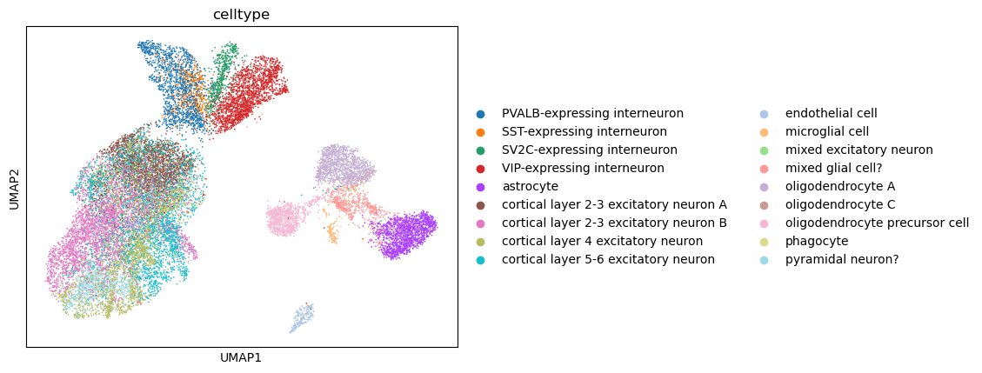
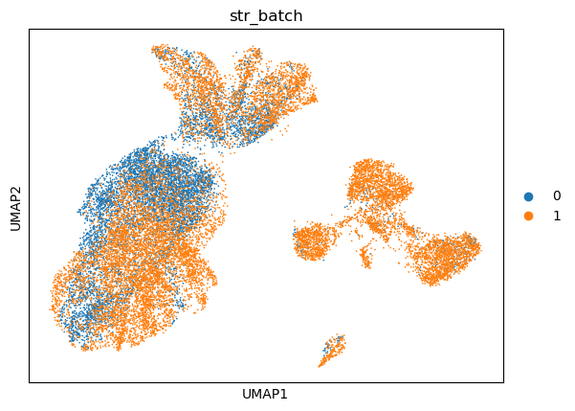
Datasets used for fine-tuning
Multiple sclerosis (MS) dataset
  Reference: 7844 cells (control), query: 13468 cells (MS)
  Genes: 3000 HVGs (2808 match vocabulary of size 60697)
Reference
Query

Slide 12
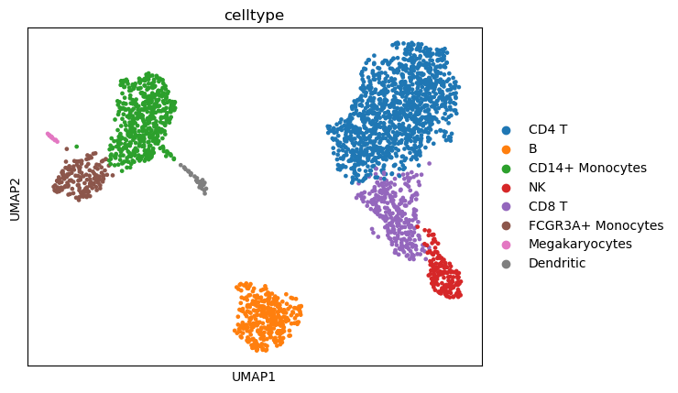
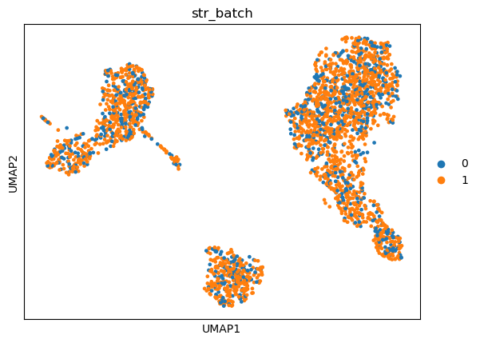
Datasets used for fine-tuning
Multiple sclerosis (MS) dataset
  Reference: 7844 cells (control), query: 13468 cells (MS)
PBMC3k dataset
  Reference: 791 cells, query: 1847 cells
  Genes: 13714 (12300 match vocabular)
Reference
Query

Slide 13
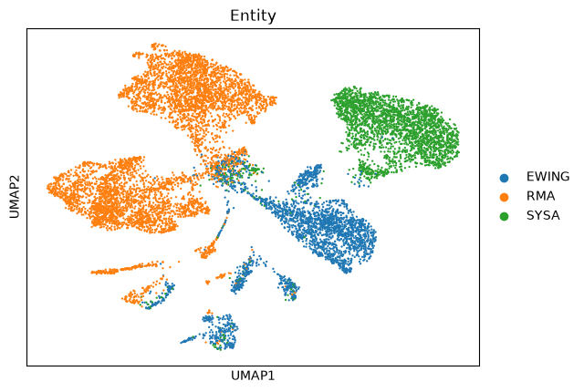
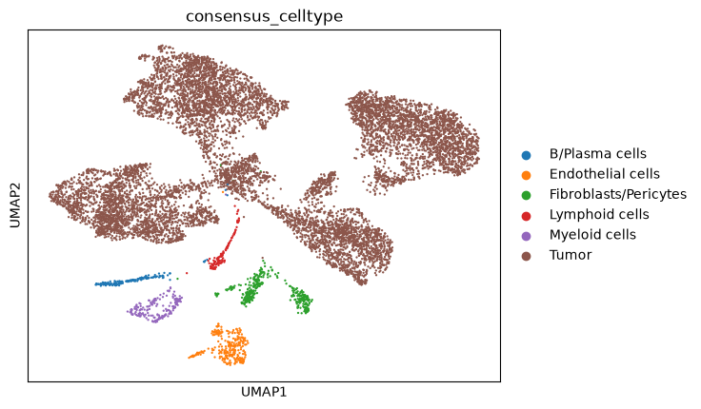
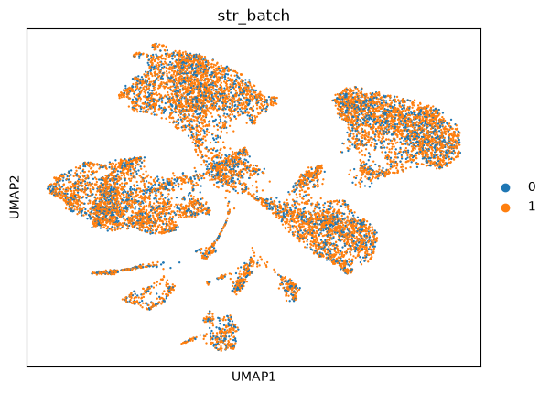
Datasets used for fine-tuning
Multiple sclerosis (MS) dataset
  Reference: 7844 cells (control), query: 13468 cells (MS)
PBMC3k dataset
  Reference: 791 cells, query: 1847 cells
Subset of Sarcoma dataset
  Reference: 3296 cells, query: 7691 cells
  Genes: 35929 -> 3000 HVGs (2075 match vocabulary)
Reference
Query

Slide 14
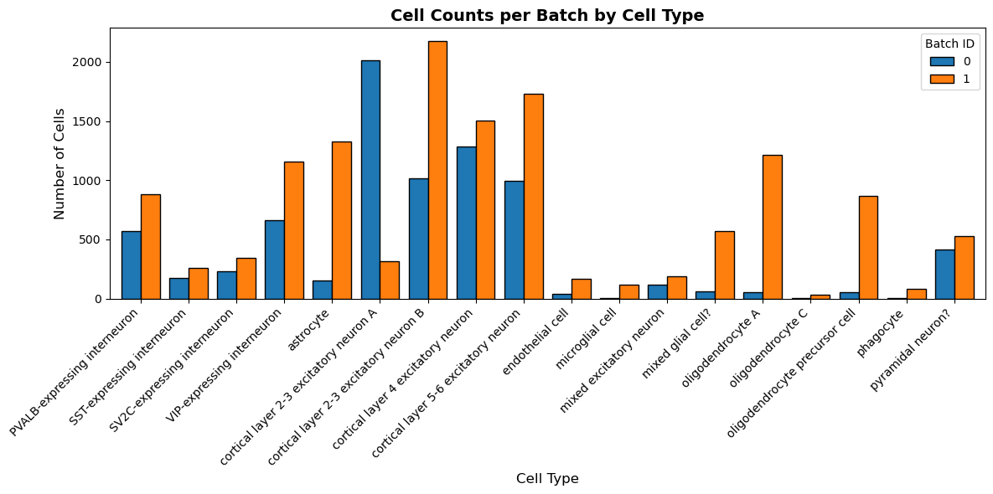
Reference – Query split for MS dataset

Slide 15
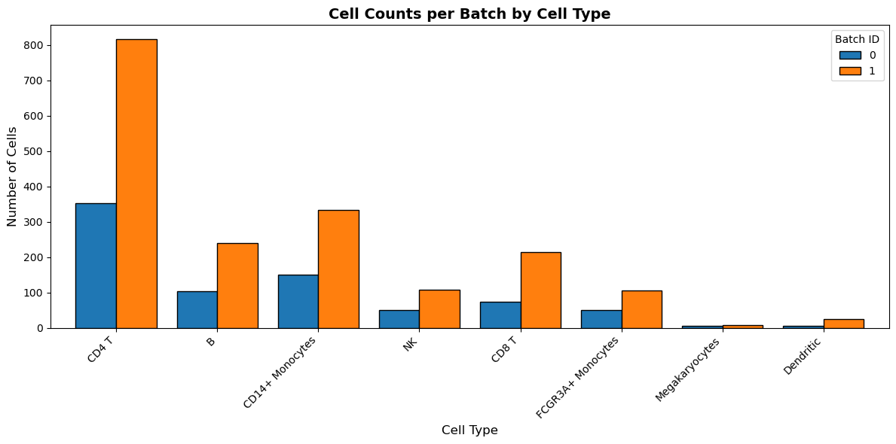
Reference – Query split for PBMC dataset

Slide 16
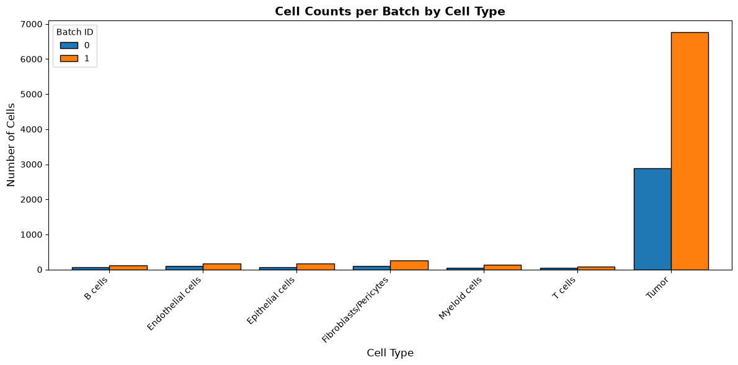
Reference – Query split for Sarcoma dataset

Slide 17
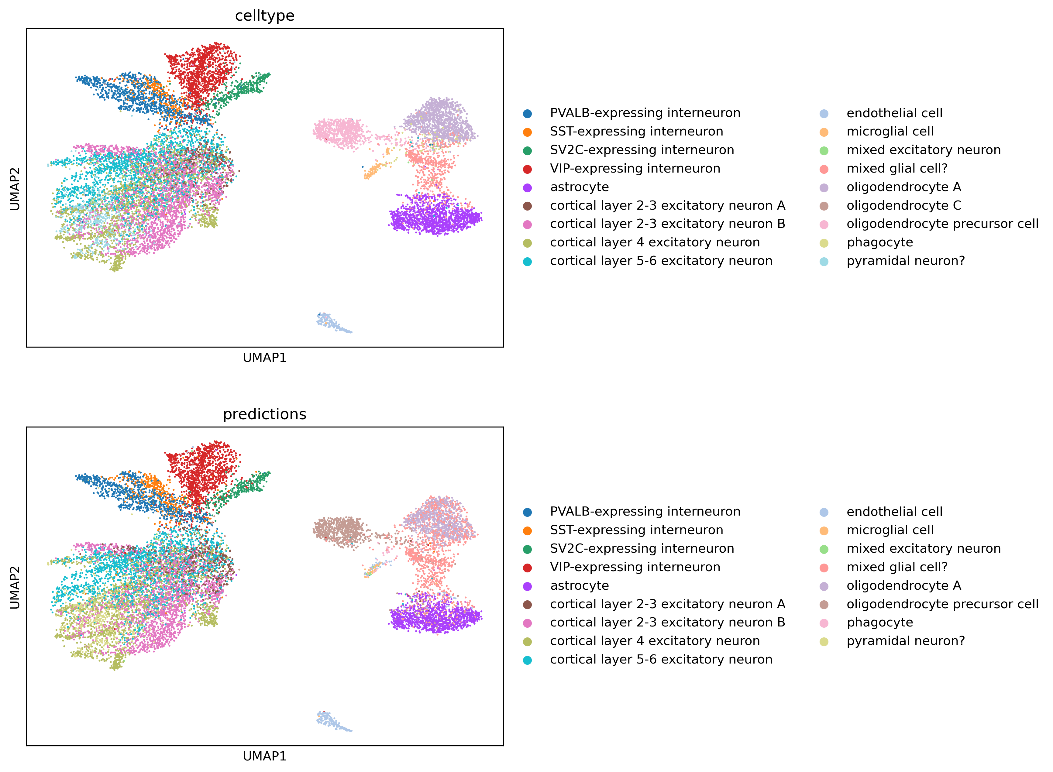
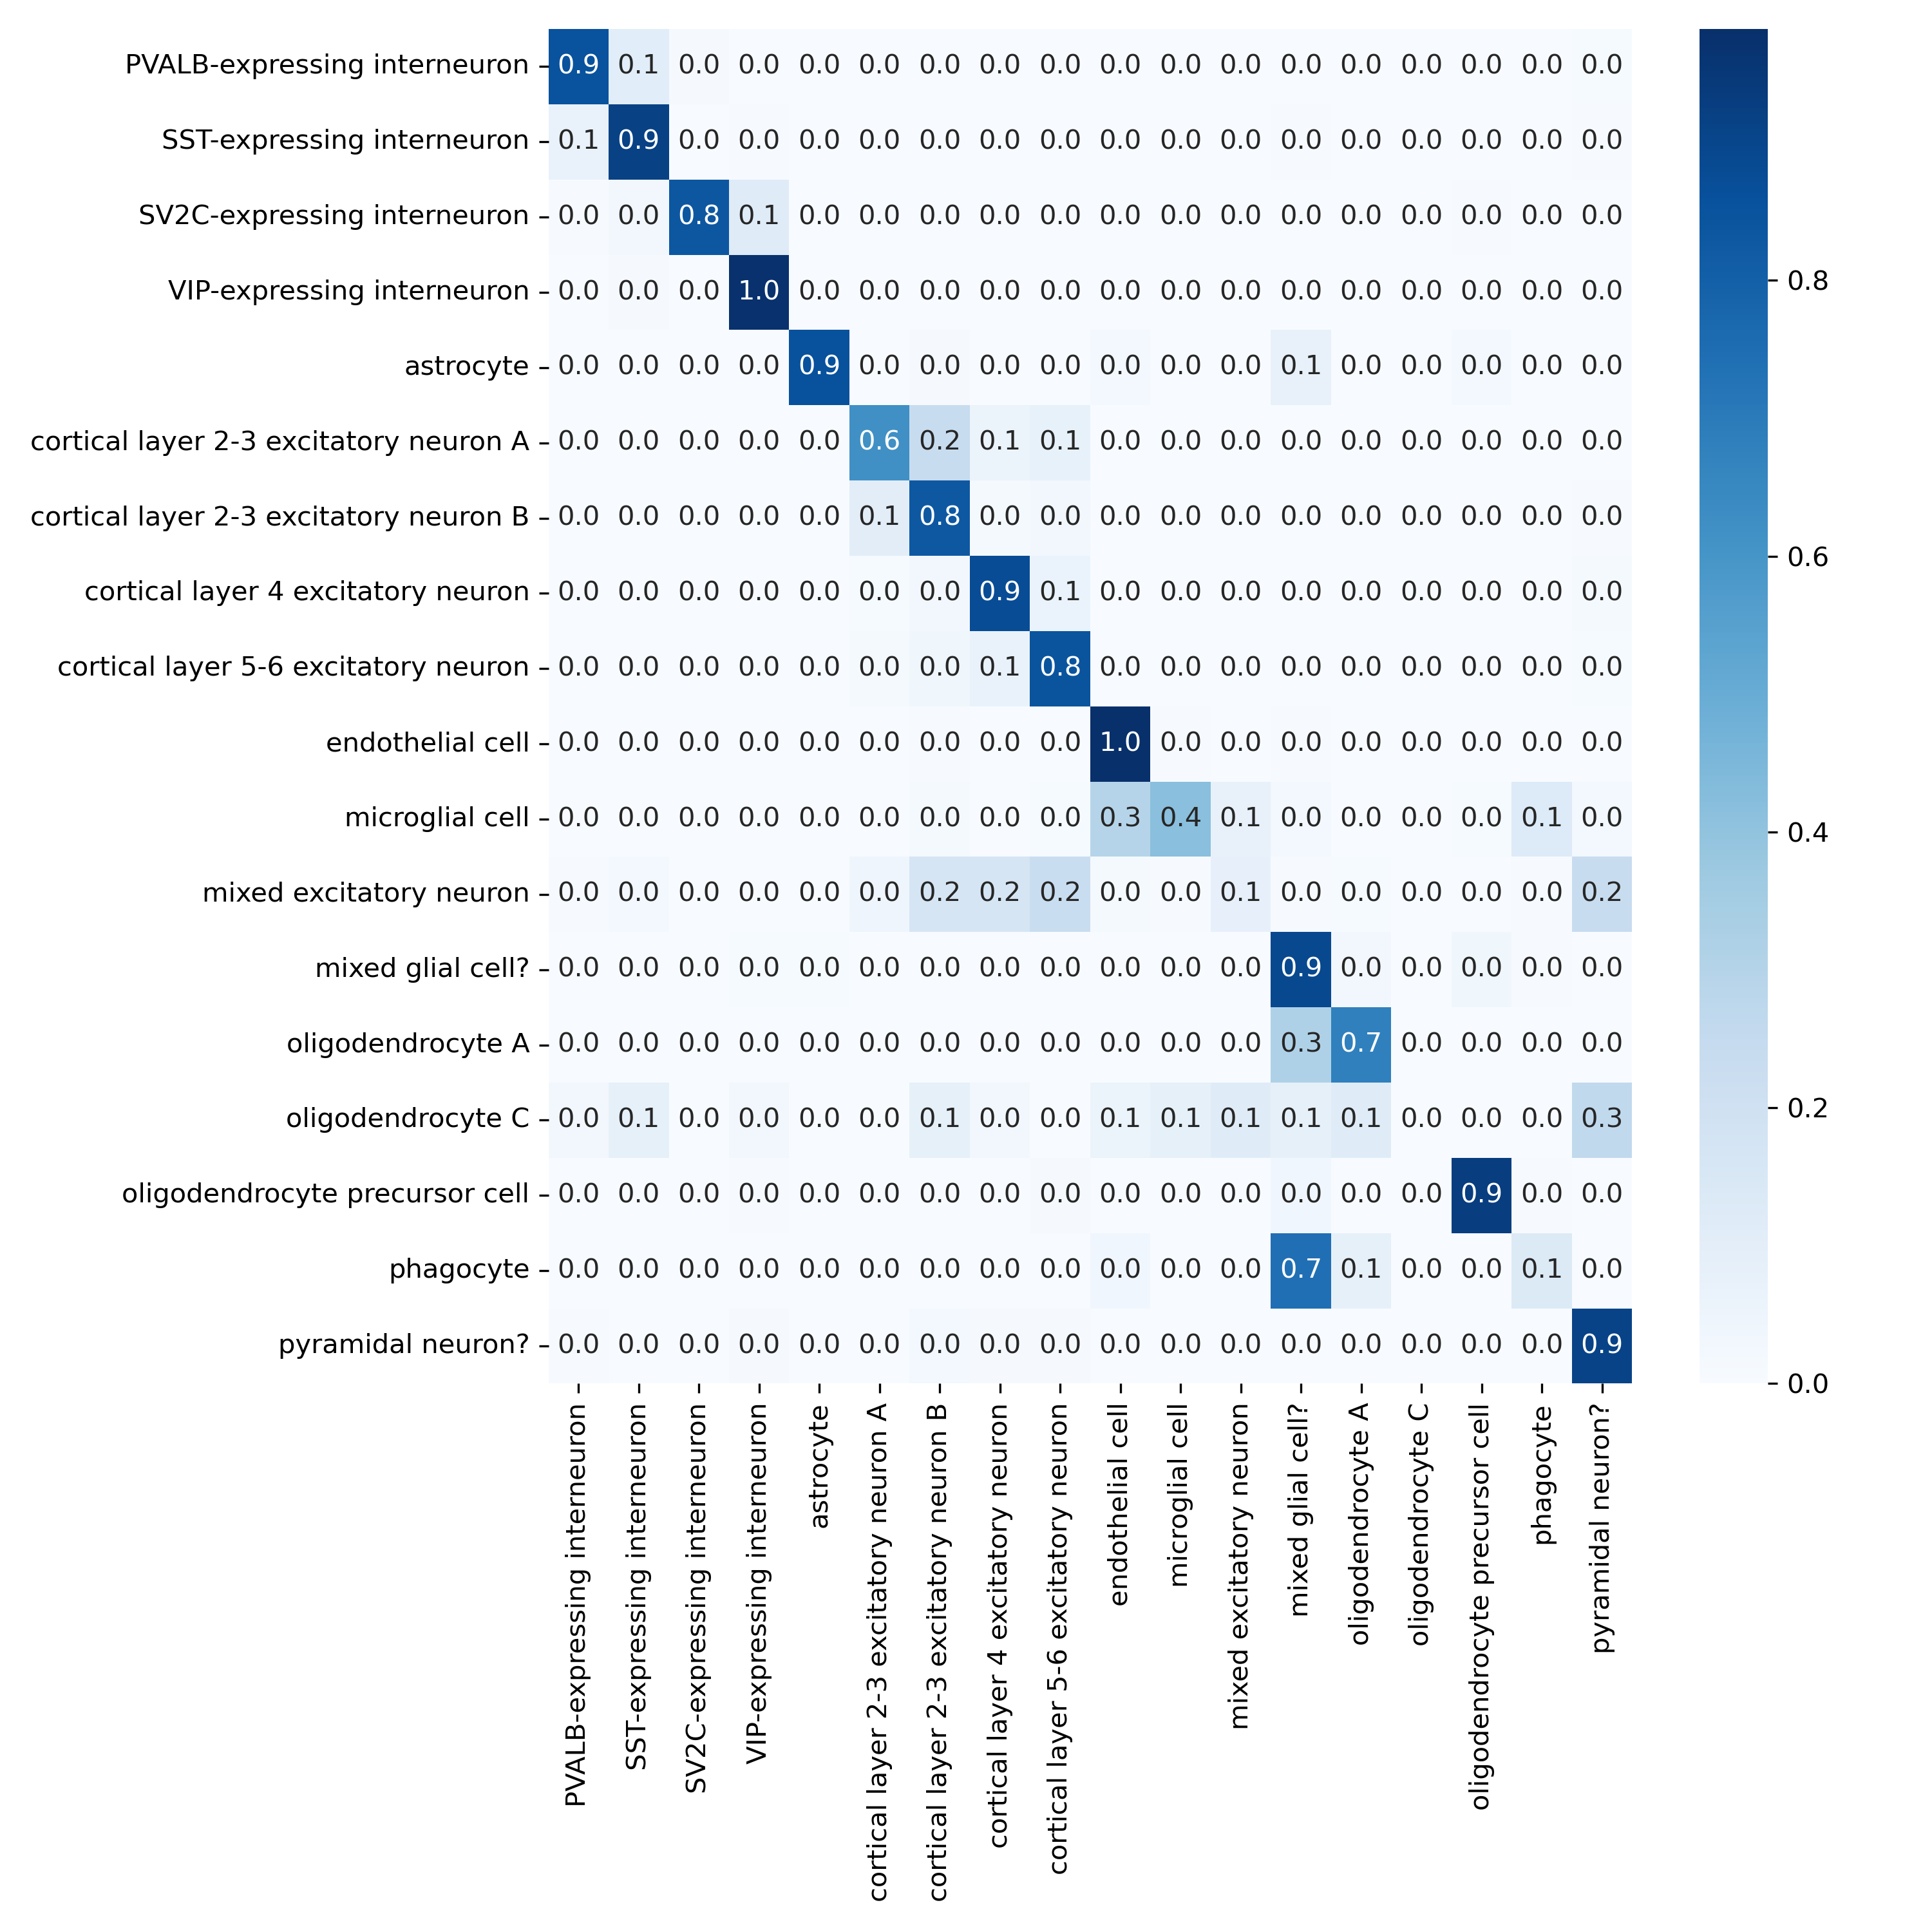
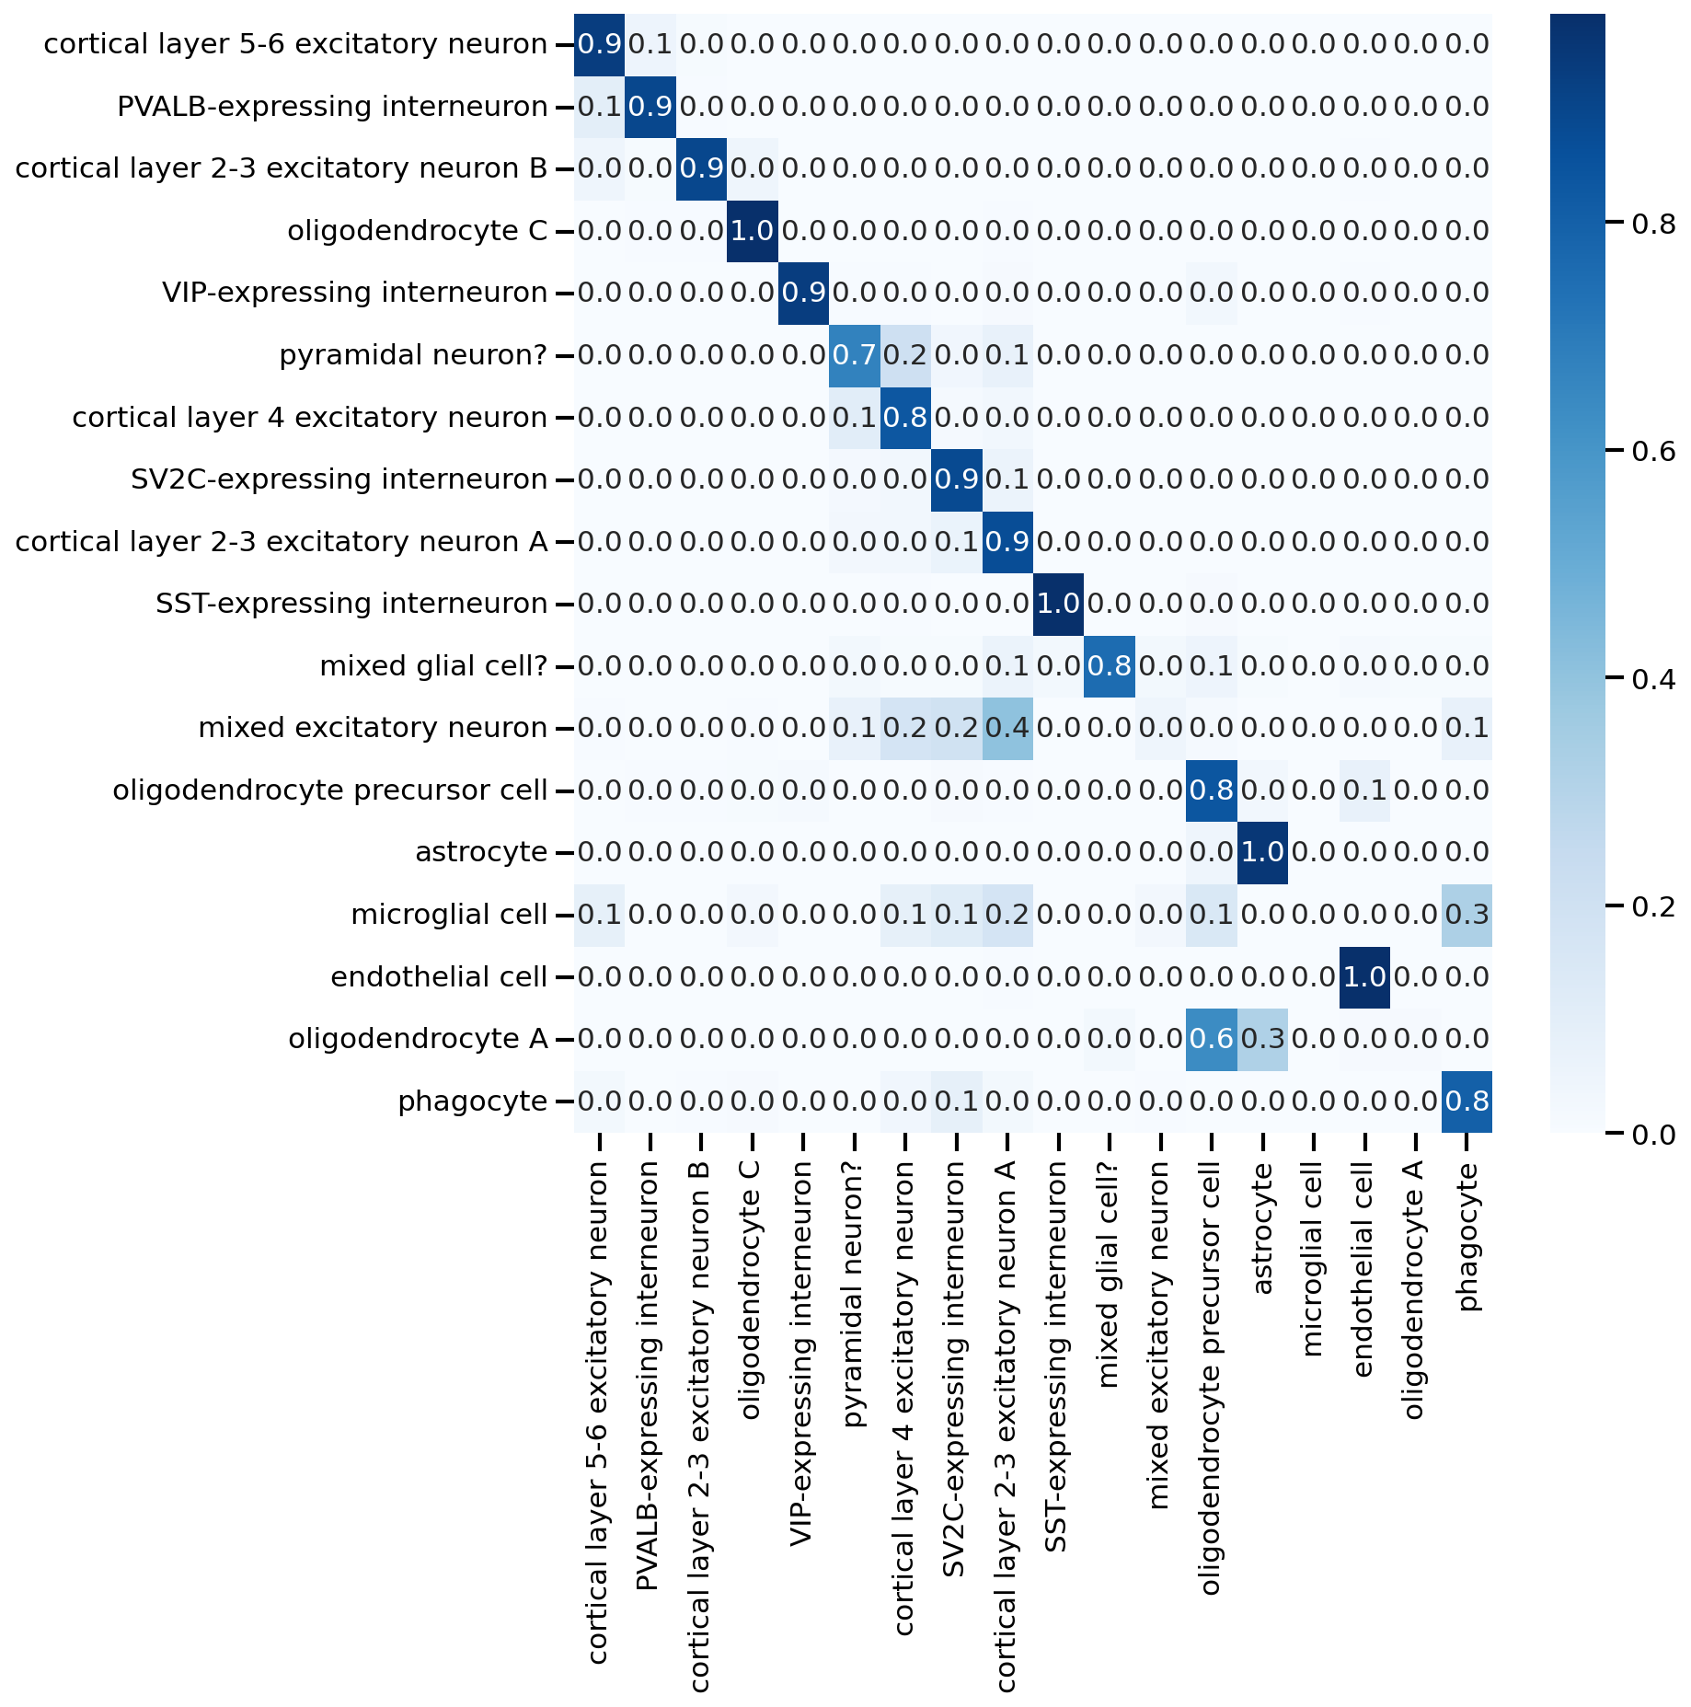
Reproducing scGPT Annotation Results on Query Dataset
MS dataset +
scGPT_human
Confusion matrix
scGPT tutorial

Slide 18
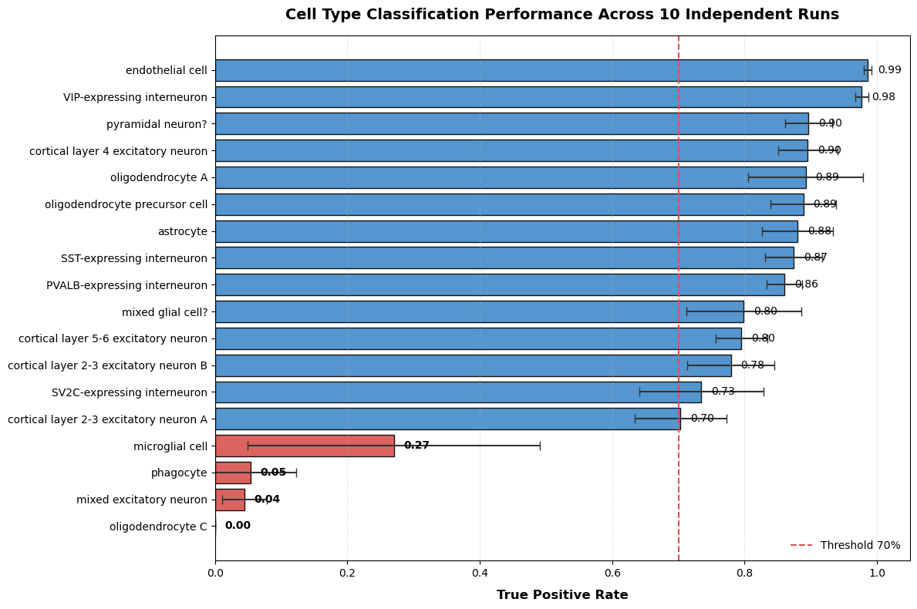
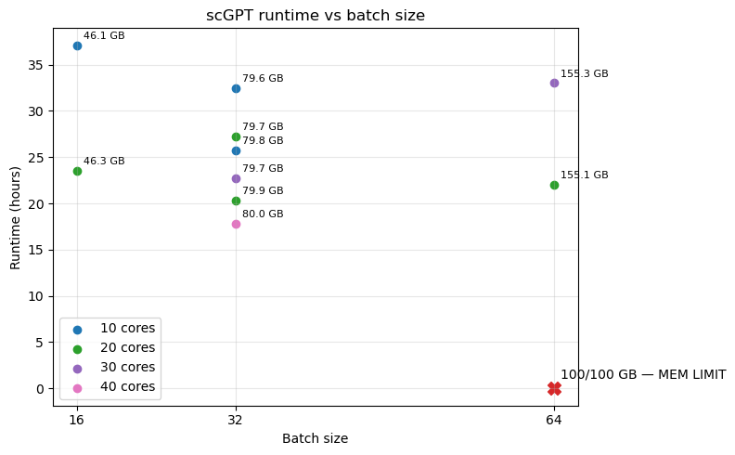
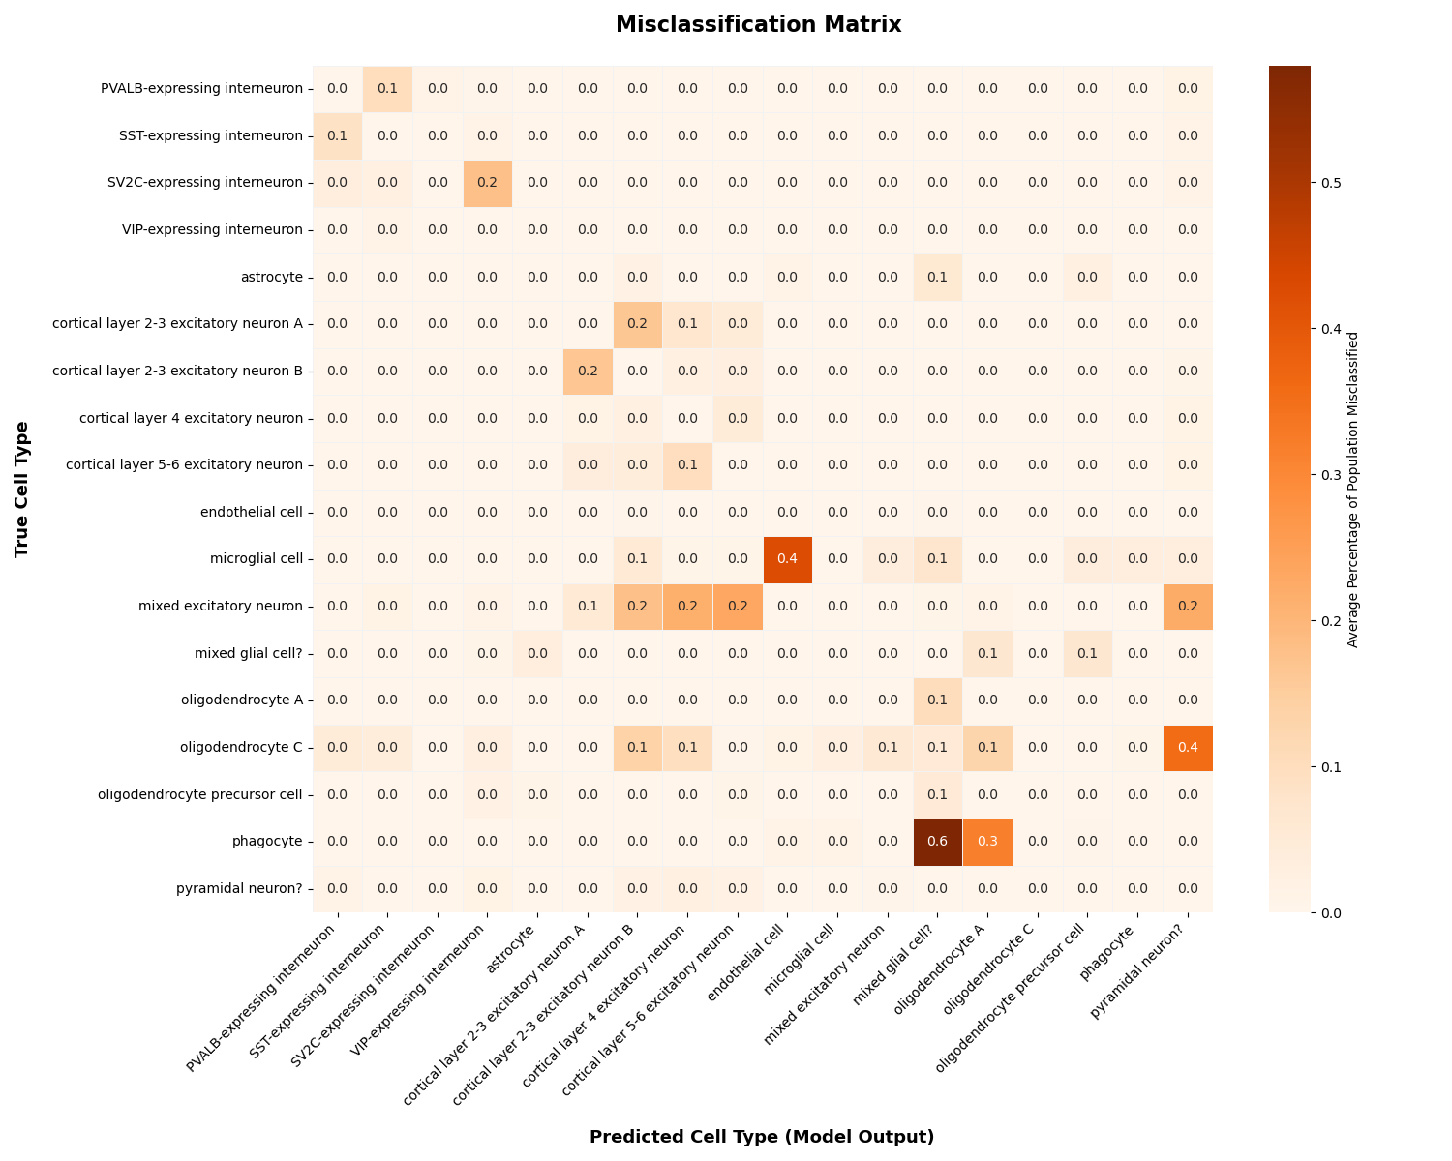
The results were consistent through multiple runs
MS dataset +
scGPT_human
Total number of cells per cell type:
 | Reference | Query
oligodendrocyte C | 3 | 34
phagocyte | 3 | 82
microglial cell | 4 | 118
endothelial cell | 38 | 170
oligodendrocyte A | 53 | 1216
oligodendrocyte precursor cell | 55 | 866
mixed glial cell? | 60 | 573
mixed excitatory neuron | 114 | 185
astrocyte | 154 | 1330
SST-expressing interneuron | 172 | 258
SV2C-expressing interneuron | 234 | 344
pyramidal neuron? | 413 | 528
PVALB-expressing interneuron | 569 | 878
VIP-expressing interneuron | 662 | 1158
cortical layer 5-6 excitatory neuron | 997 | 1732
cortical layer 2-3 excitatory neuron B | 1019 | 2178
cortical layer 4 excitatory neuron | 1284 | 1504
cortical layer 2-3 excitatory neuron A | 2010 | 314

Slide 19
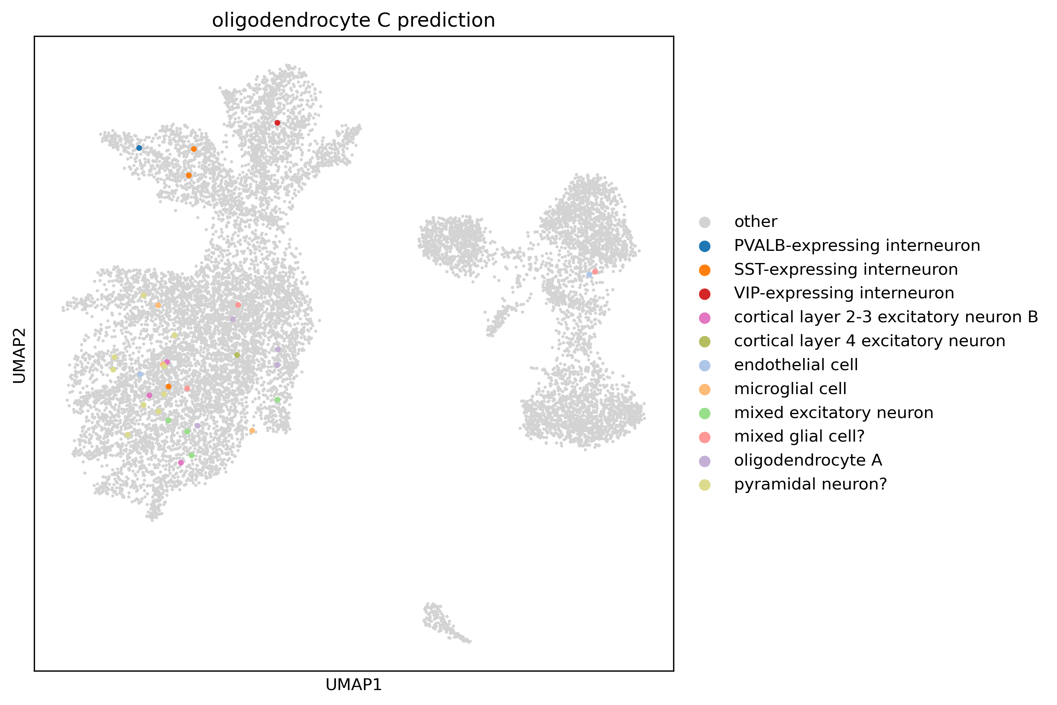
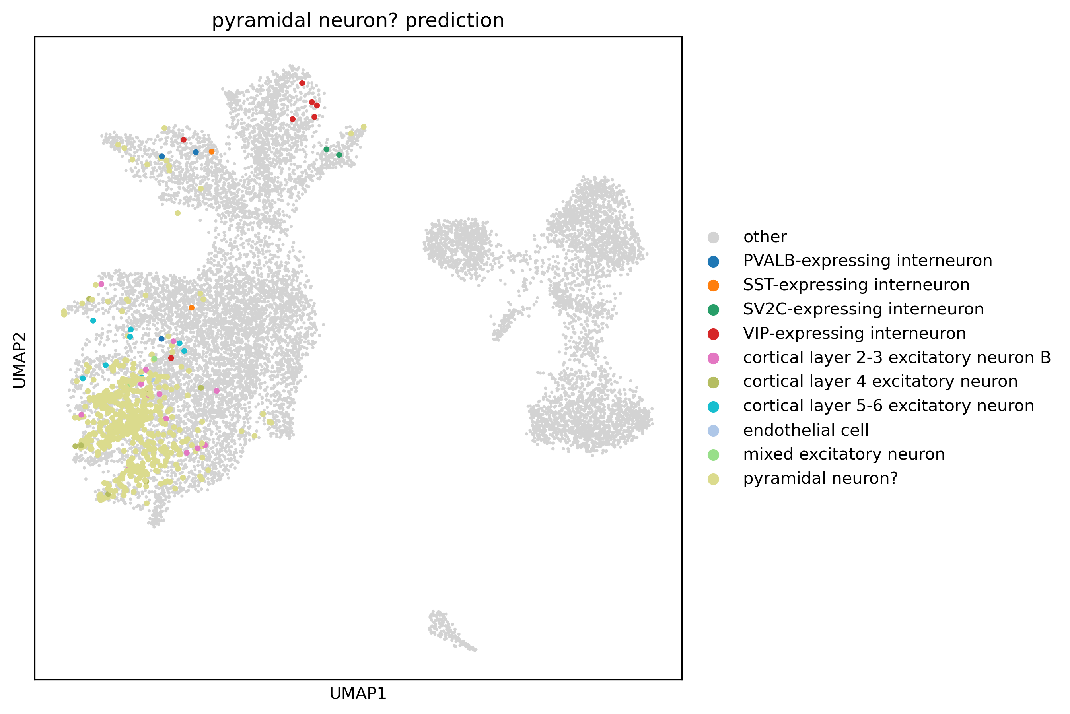
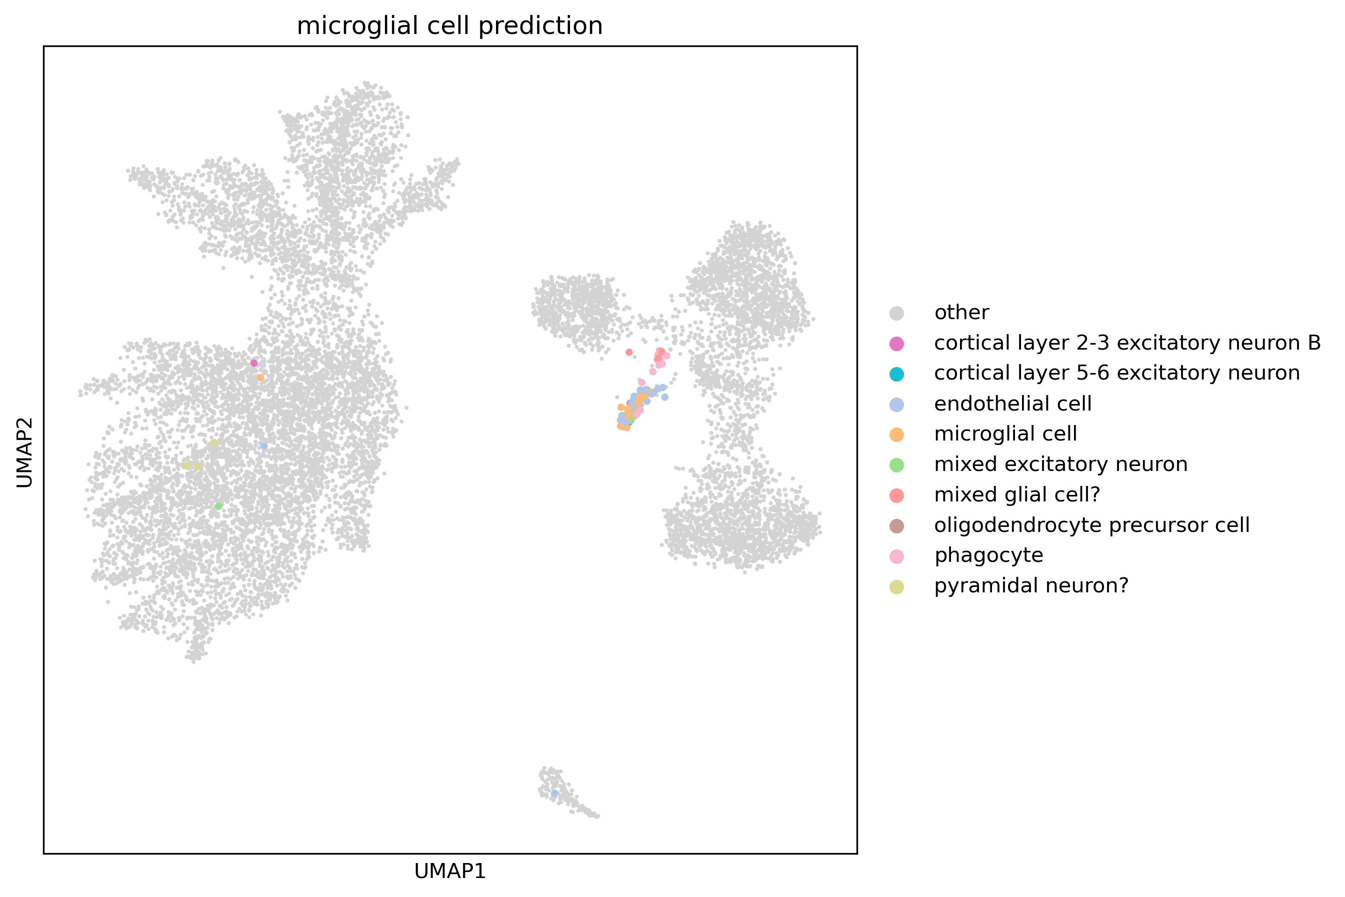
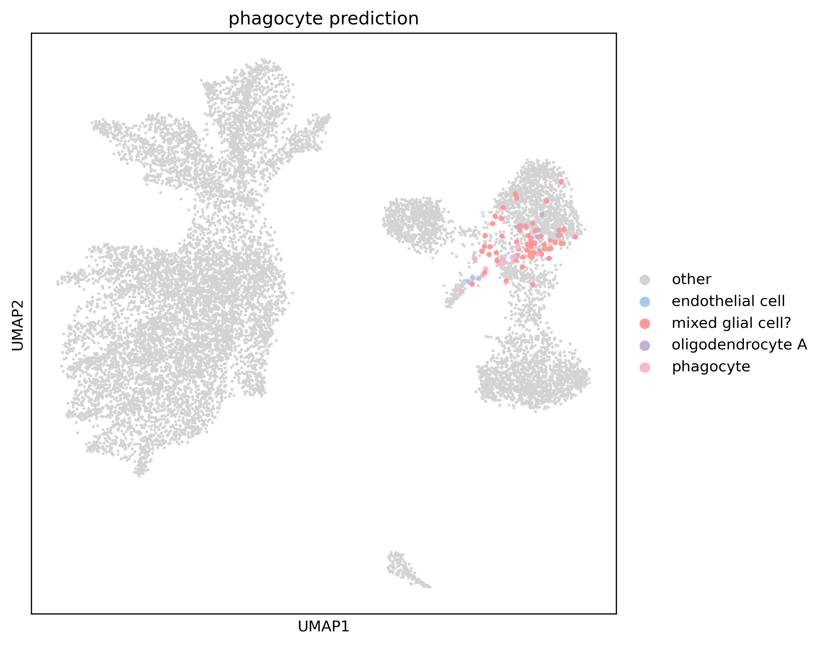
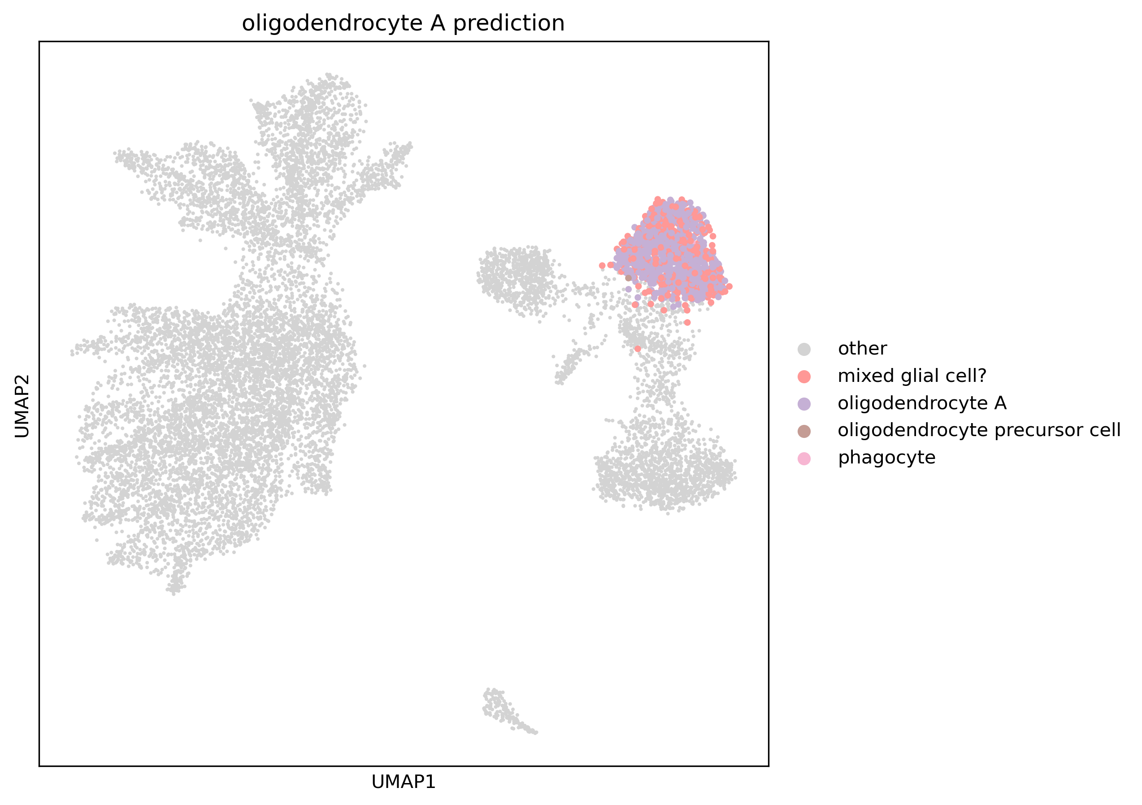
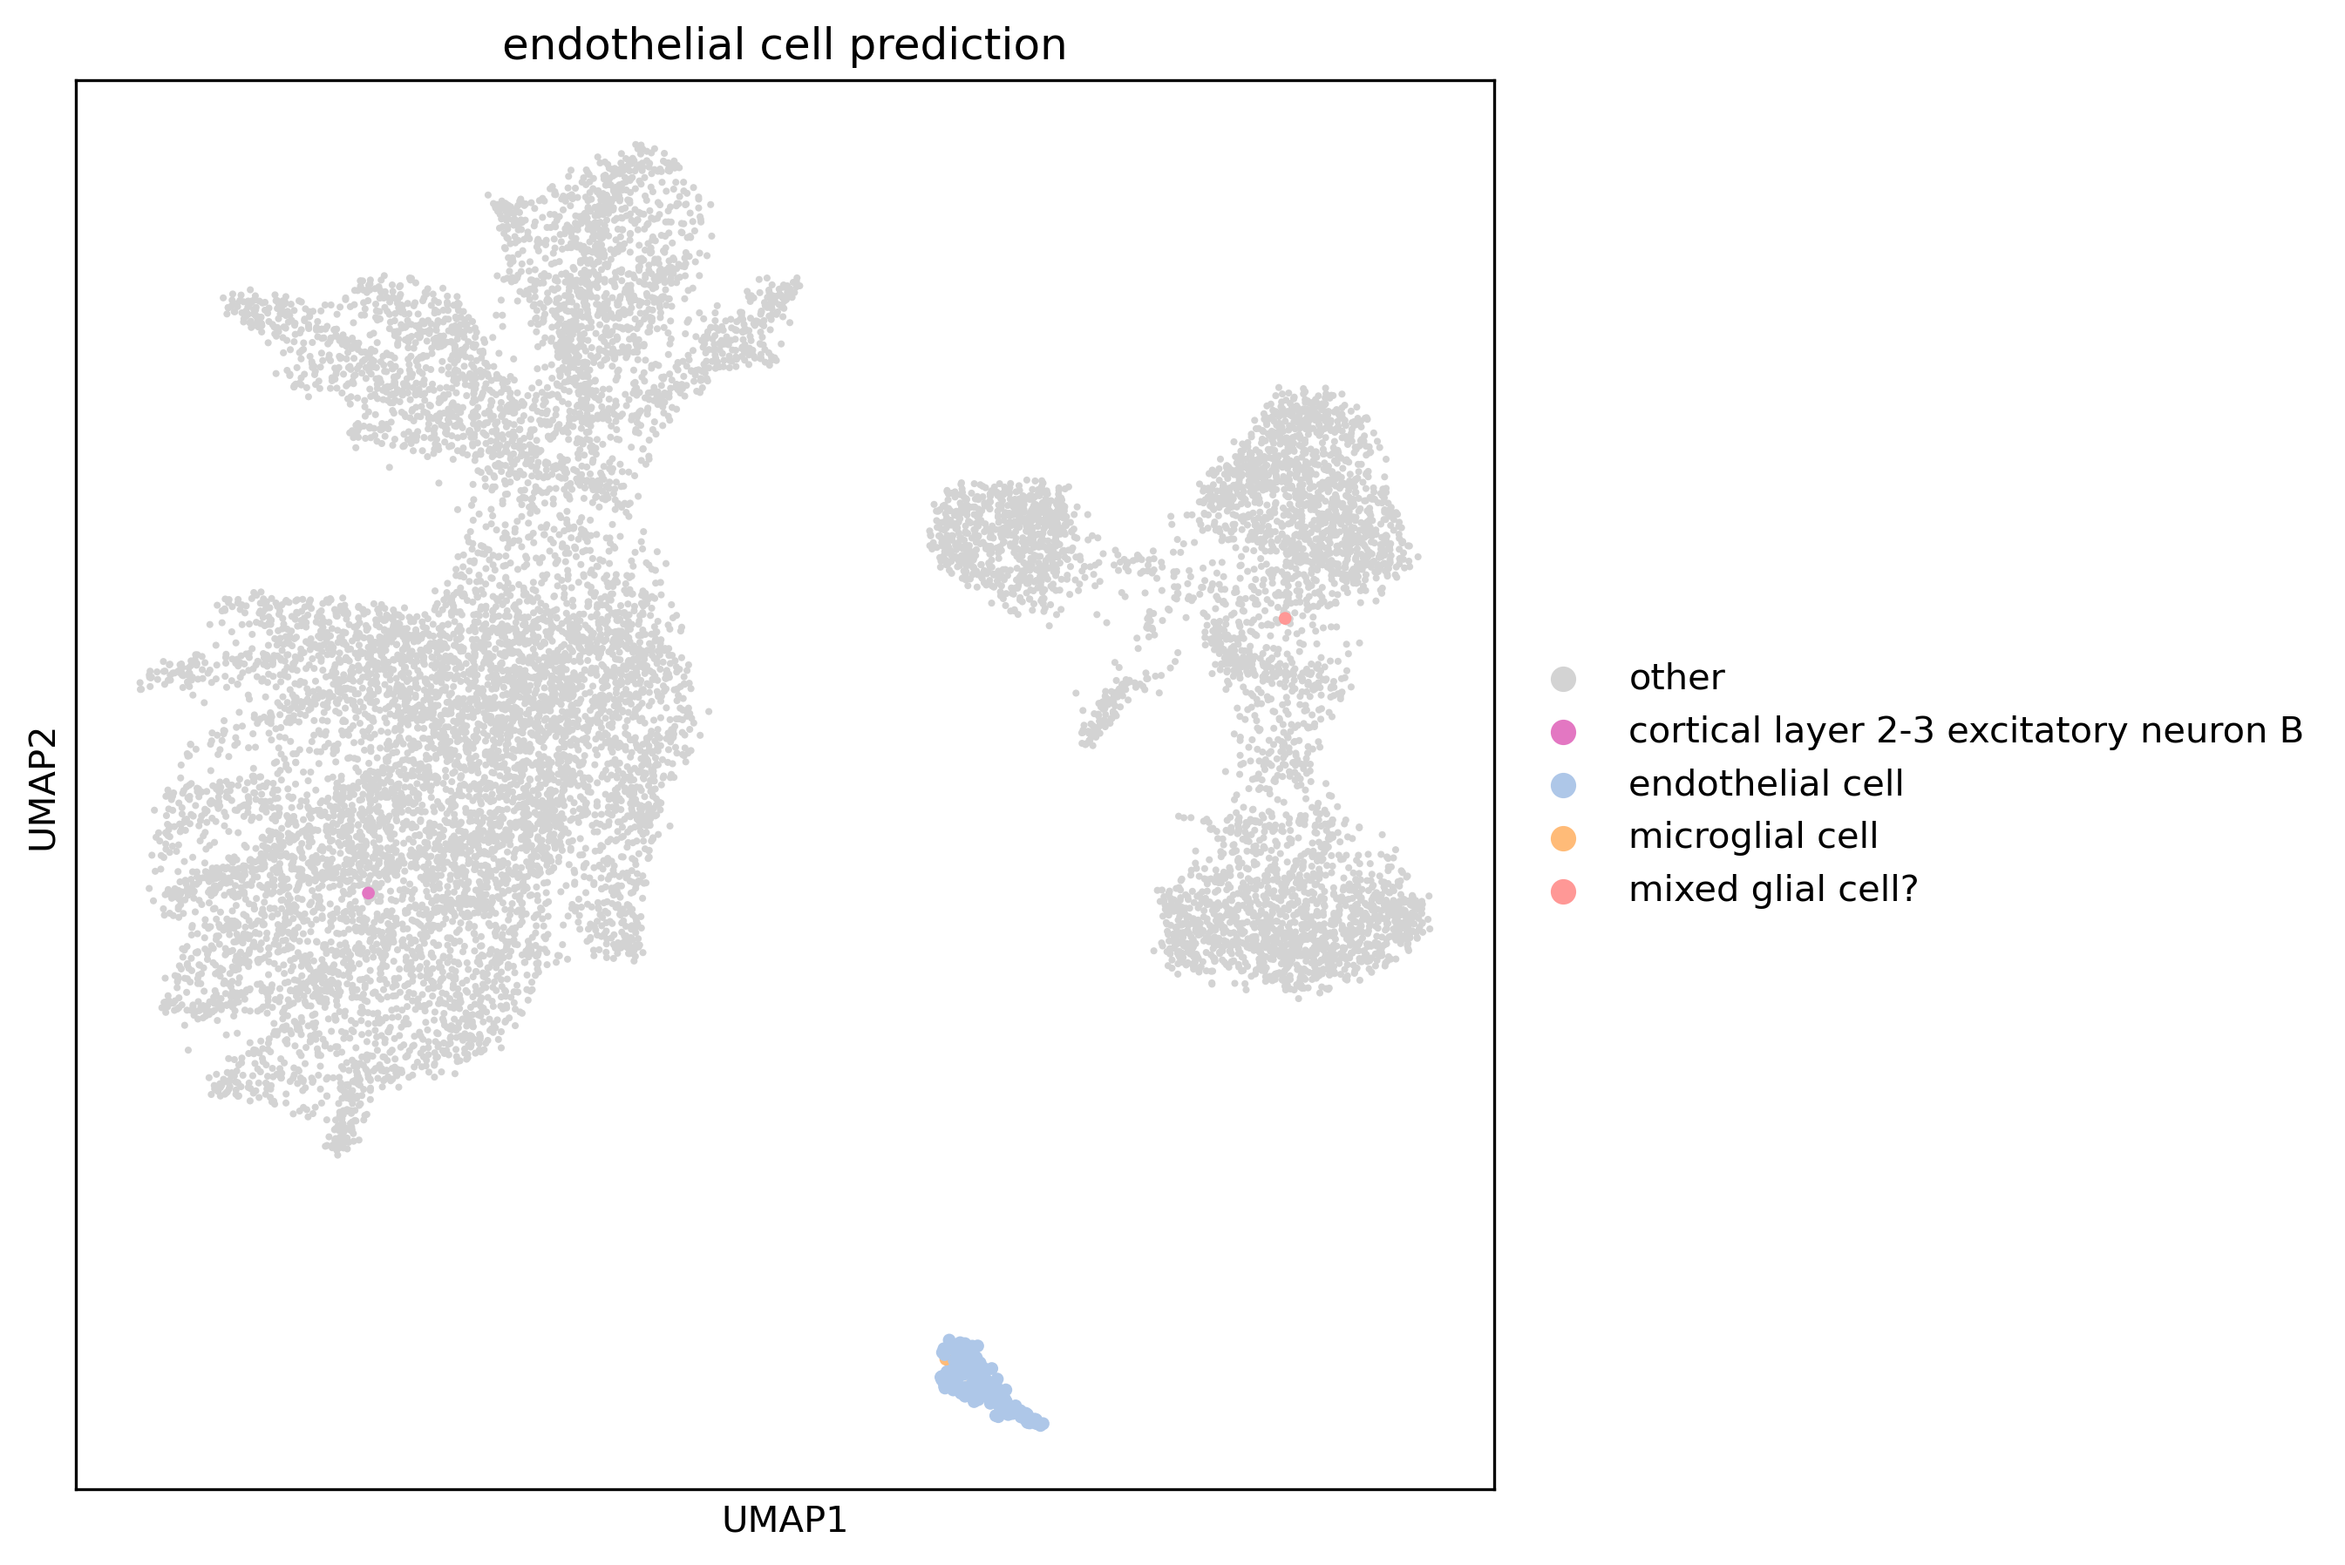
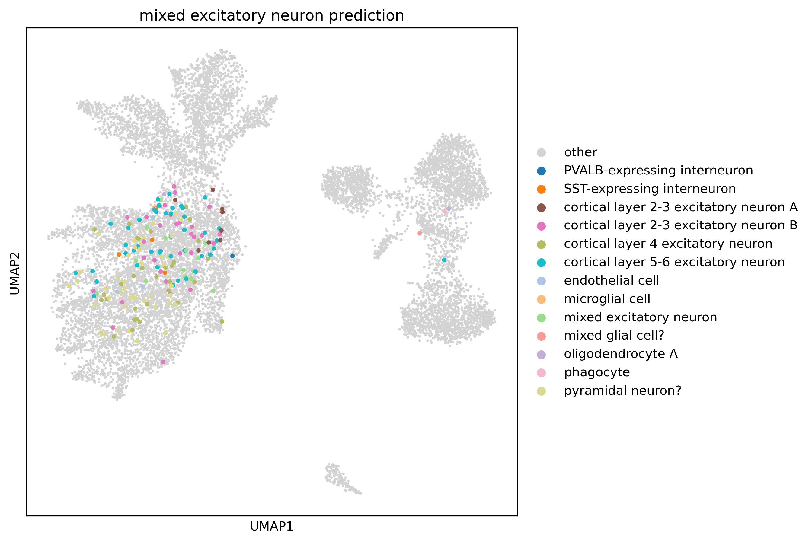
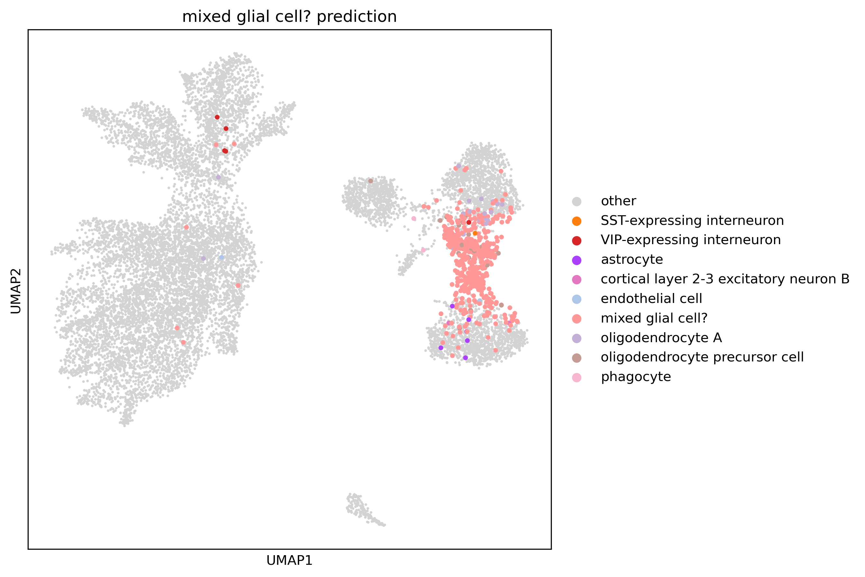
Predictions and Misclassifications of certain cell types
MS dataset +
scGPT_human

Slide 20
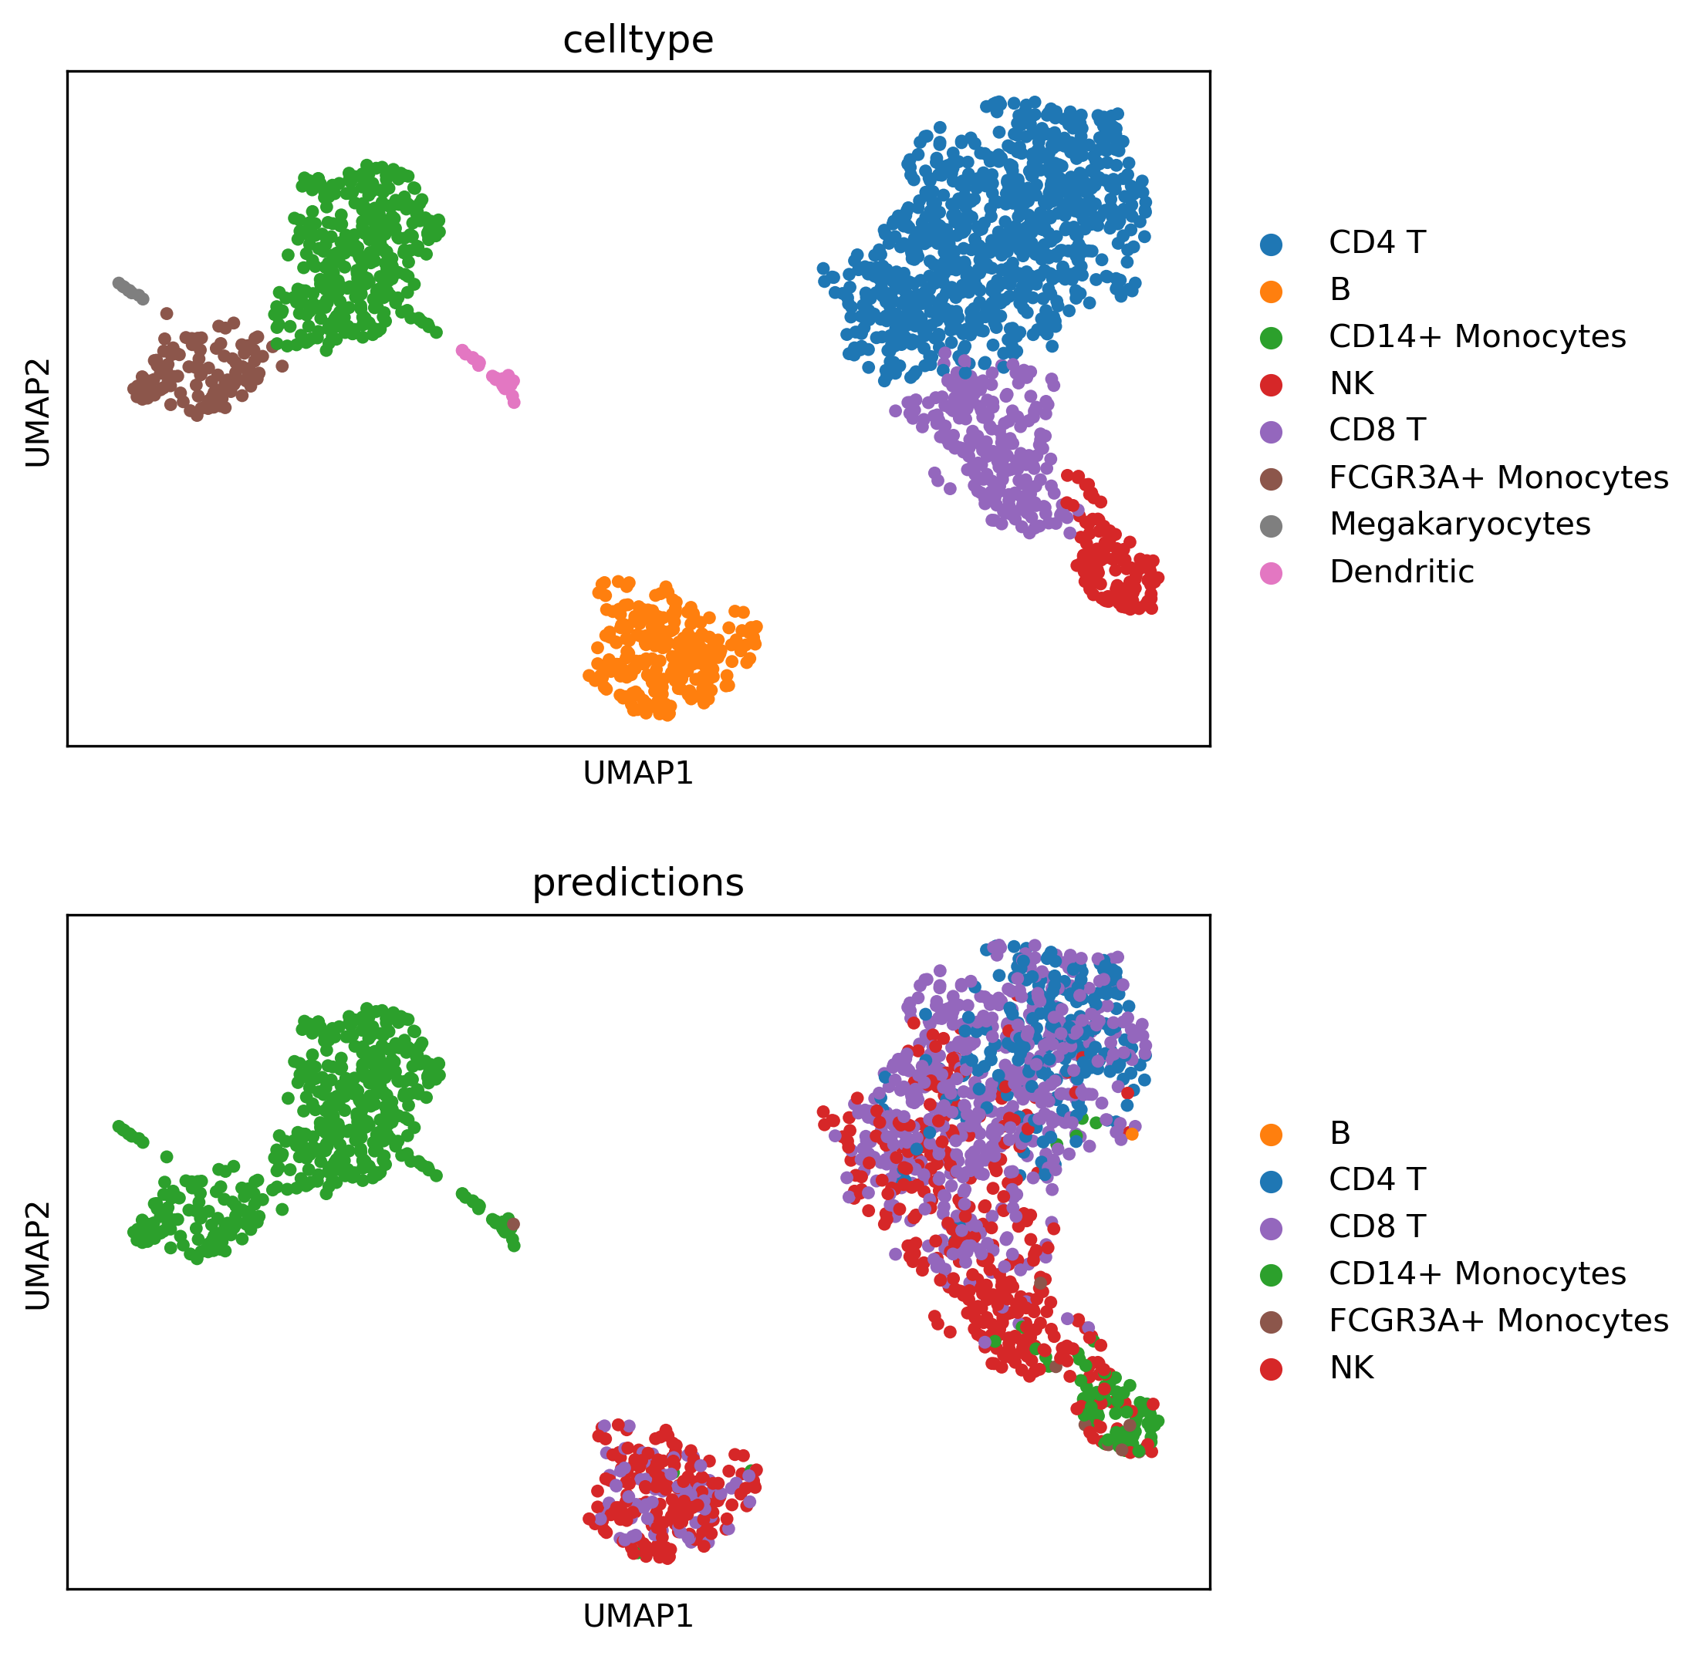
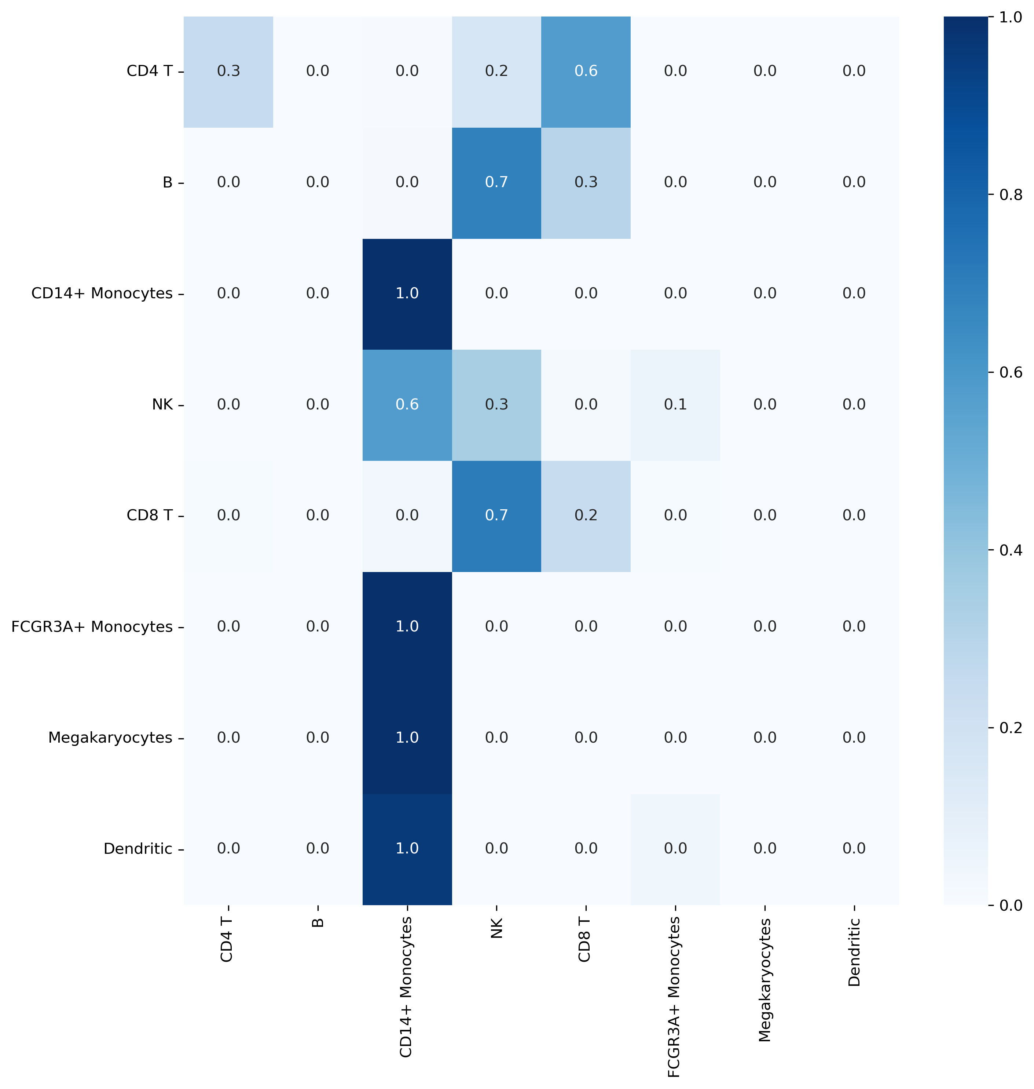
Annotation of PBMC3k query dataset
PBMC3k dataset +
scGPT_human

Slide 21
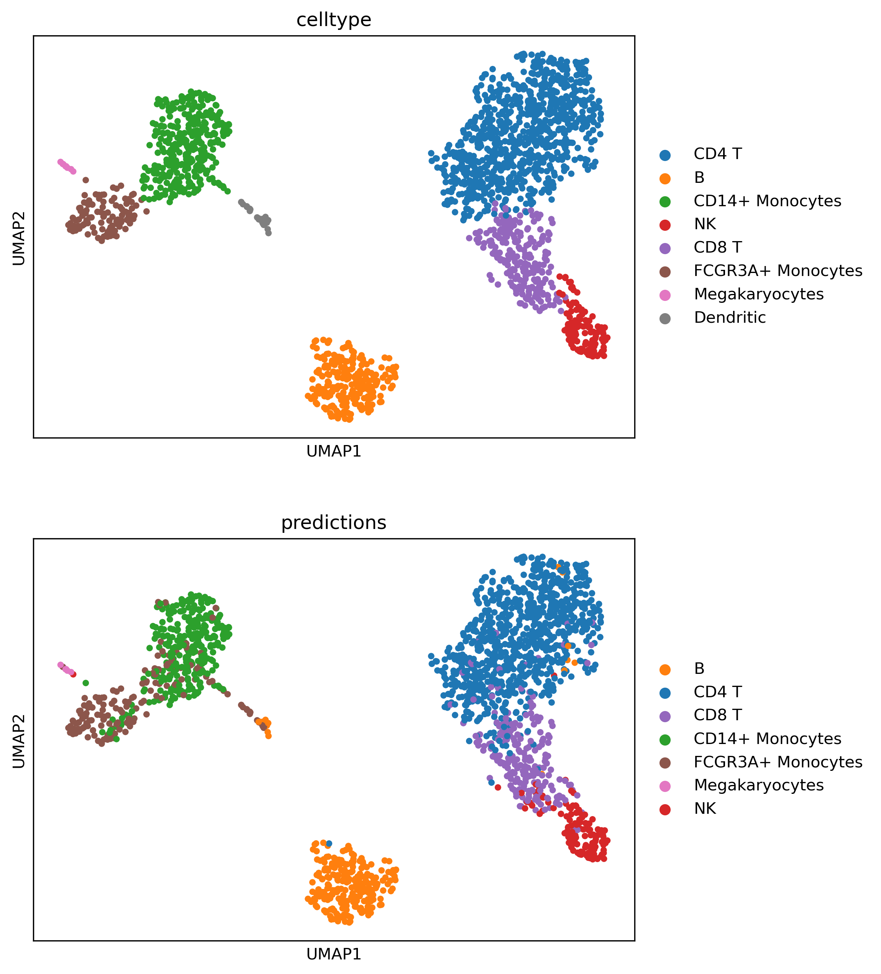
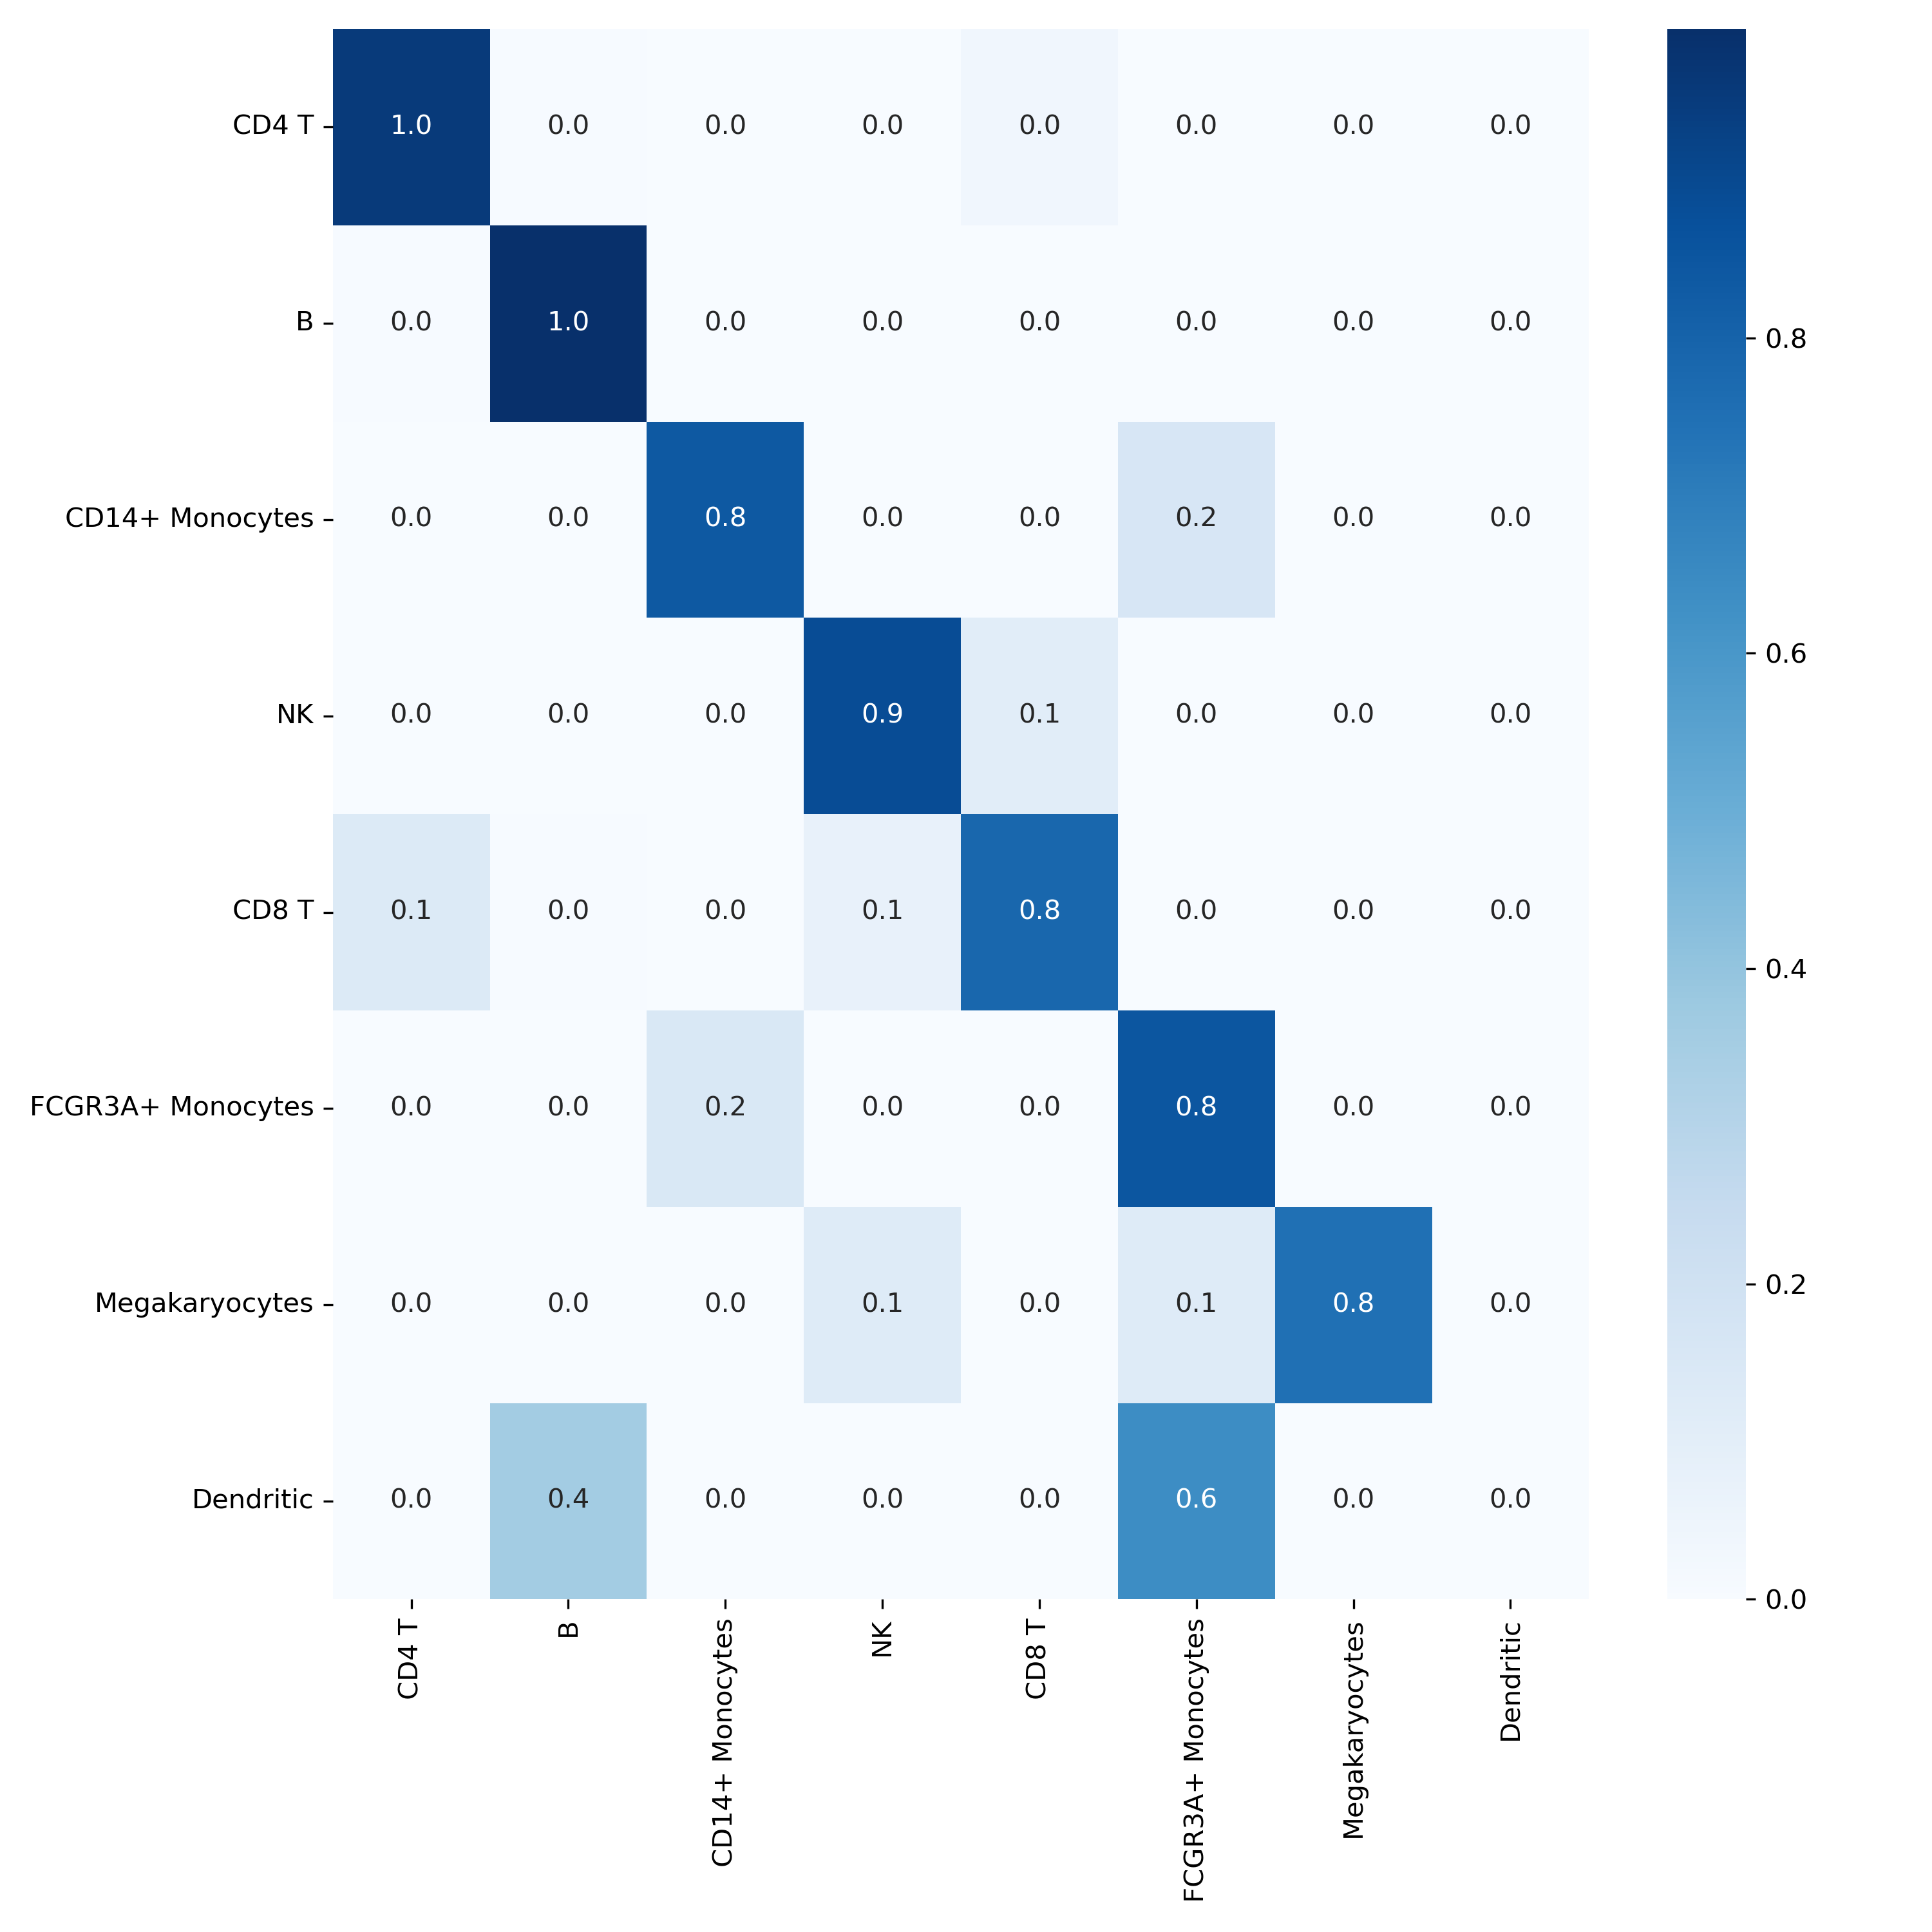
Annotation of PBMC3k query dataset
PBMC3k dataset +
scGPT_bc

Slide 22
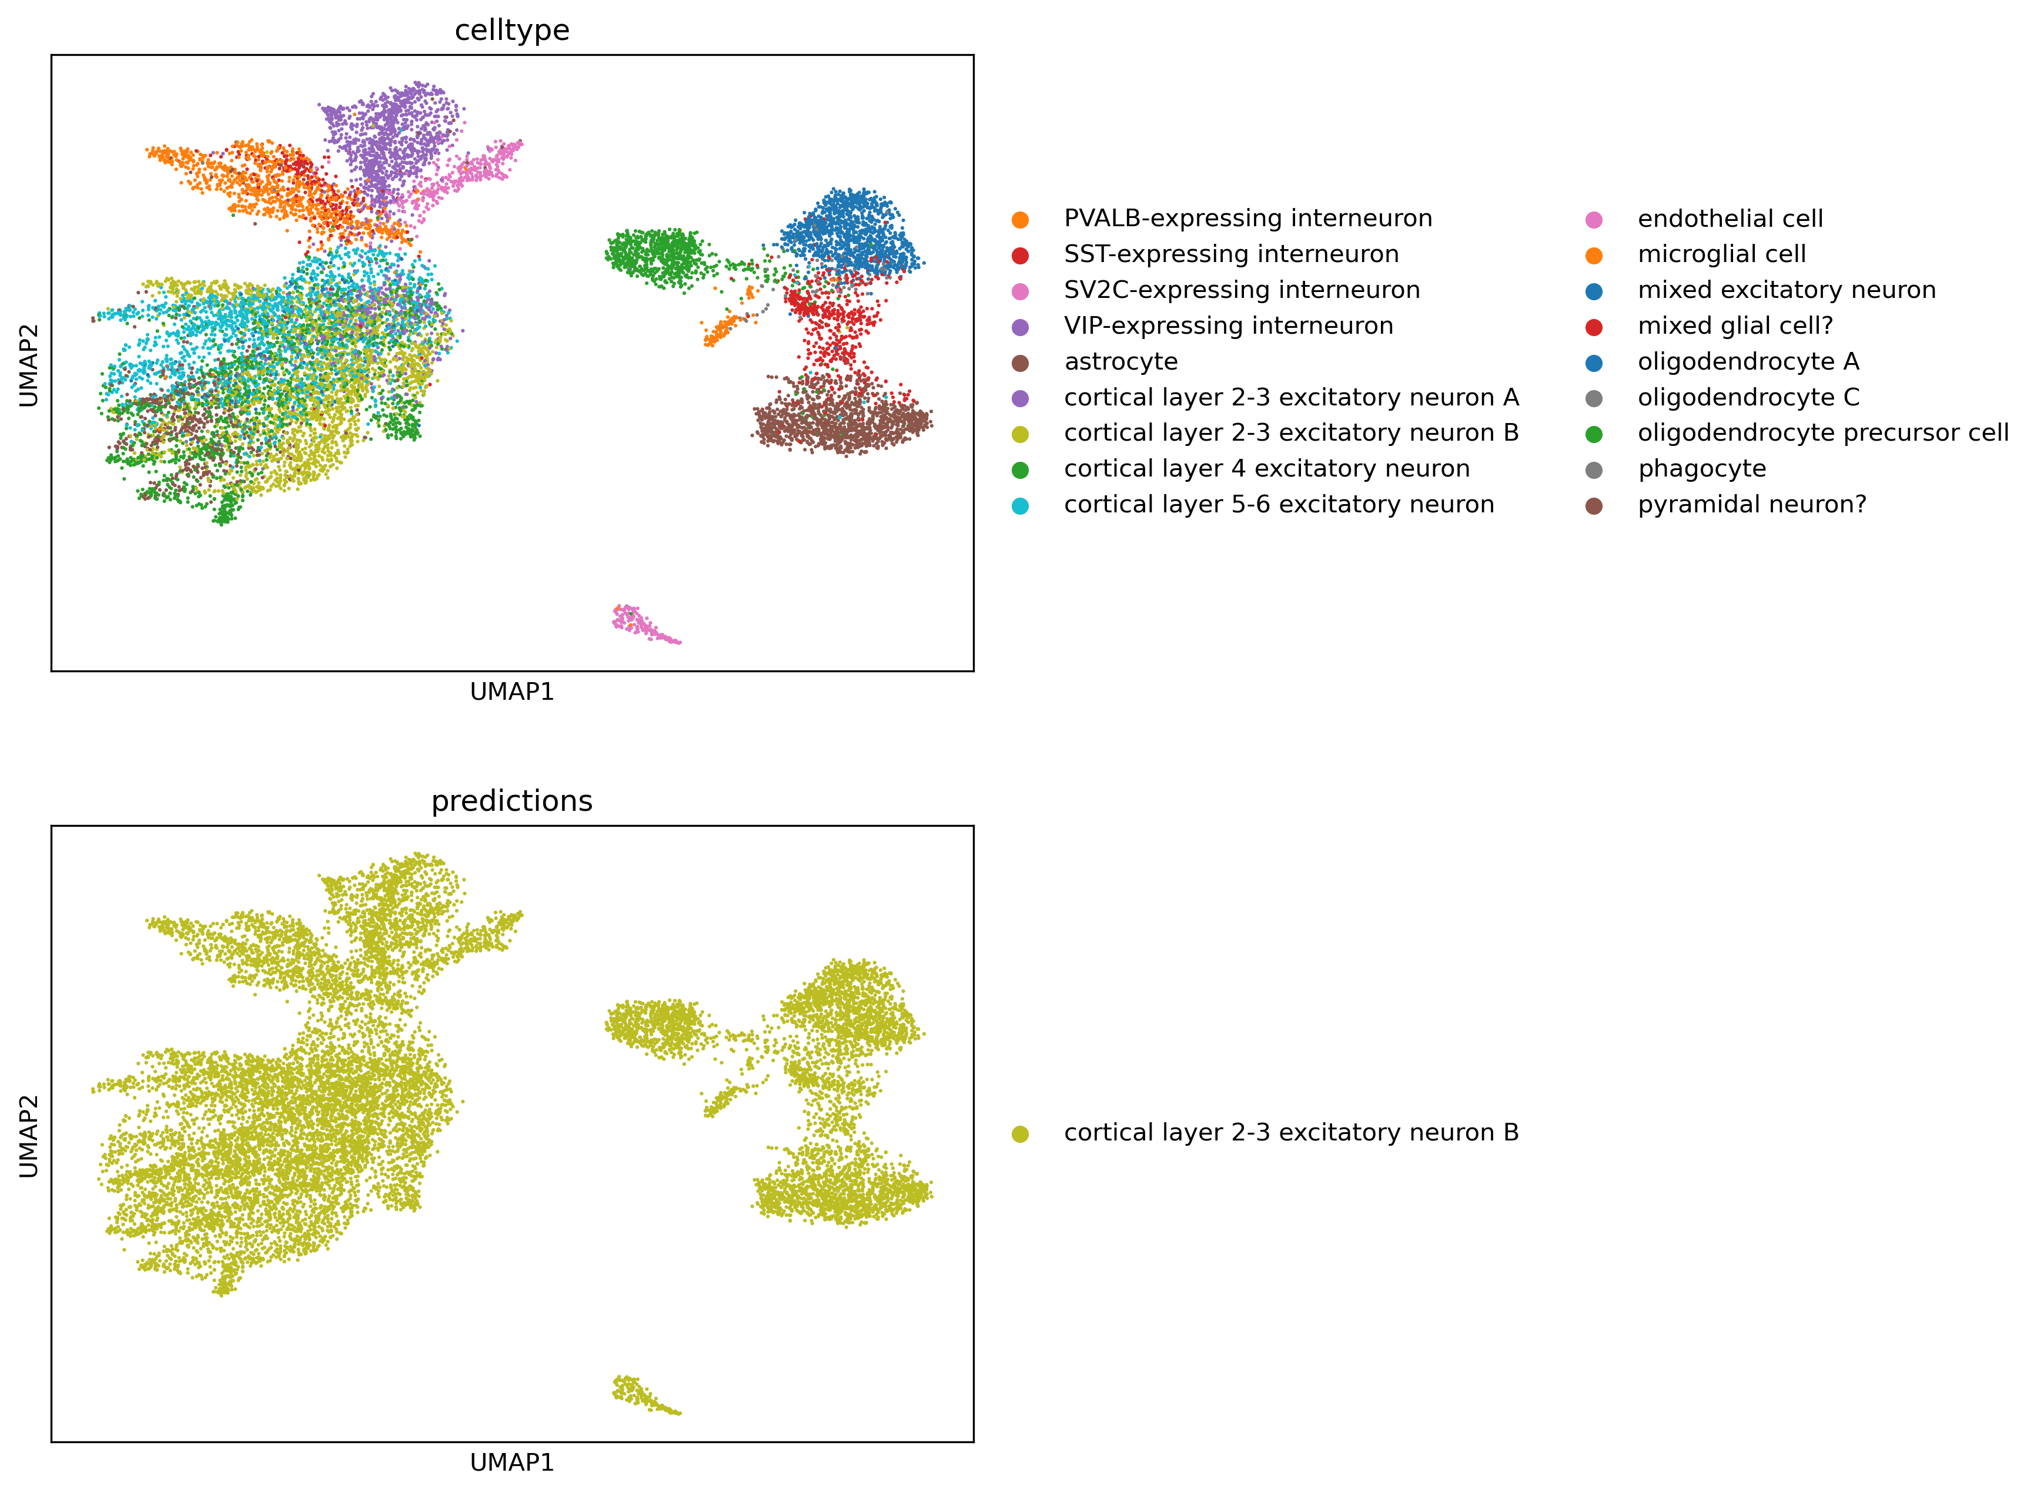
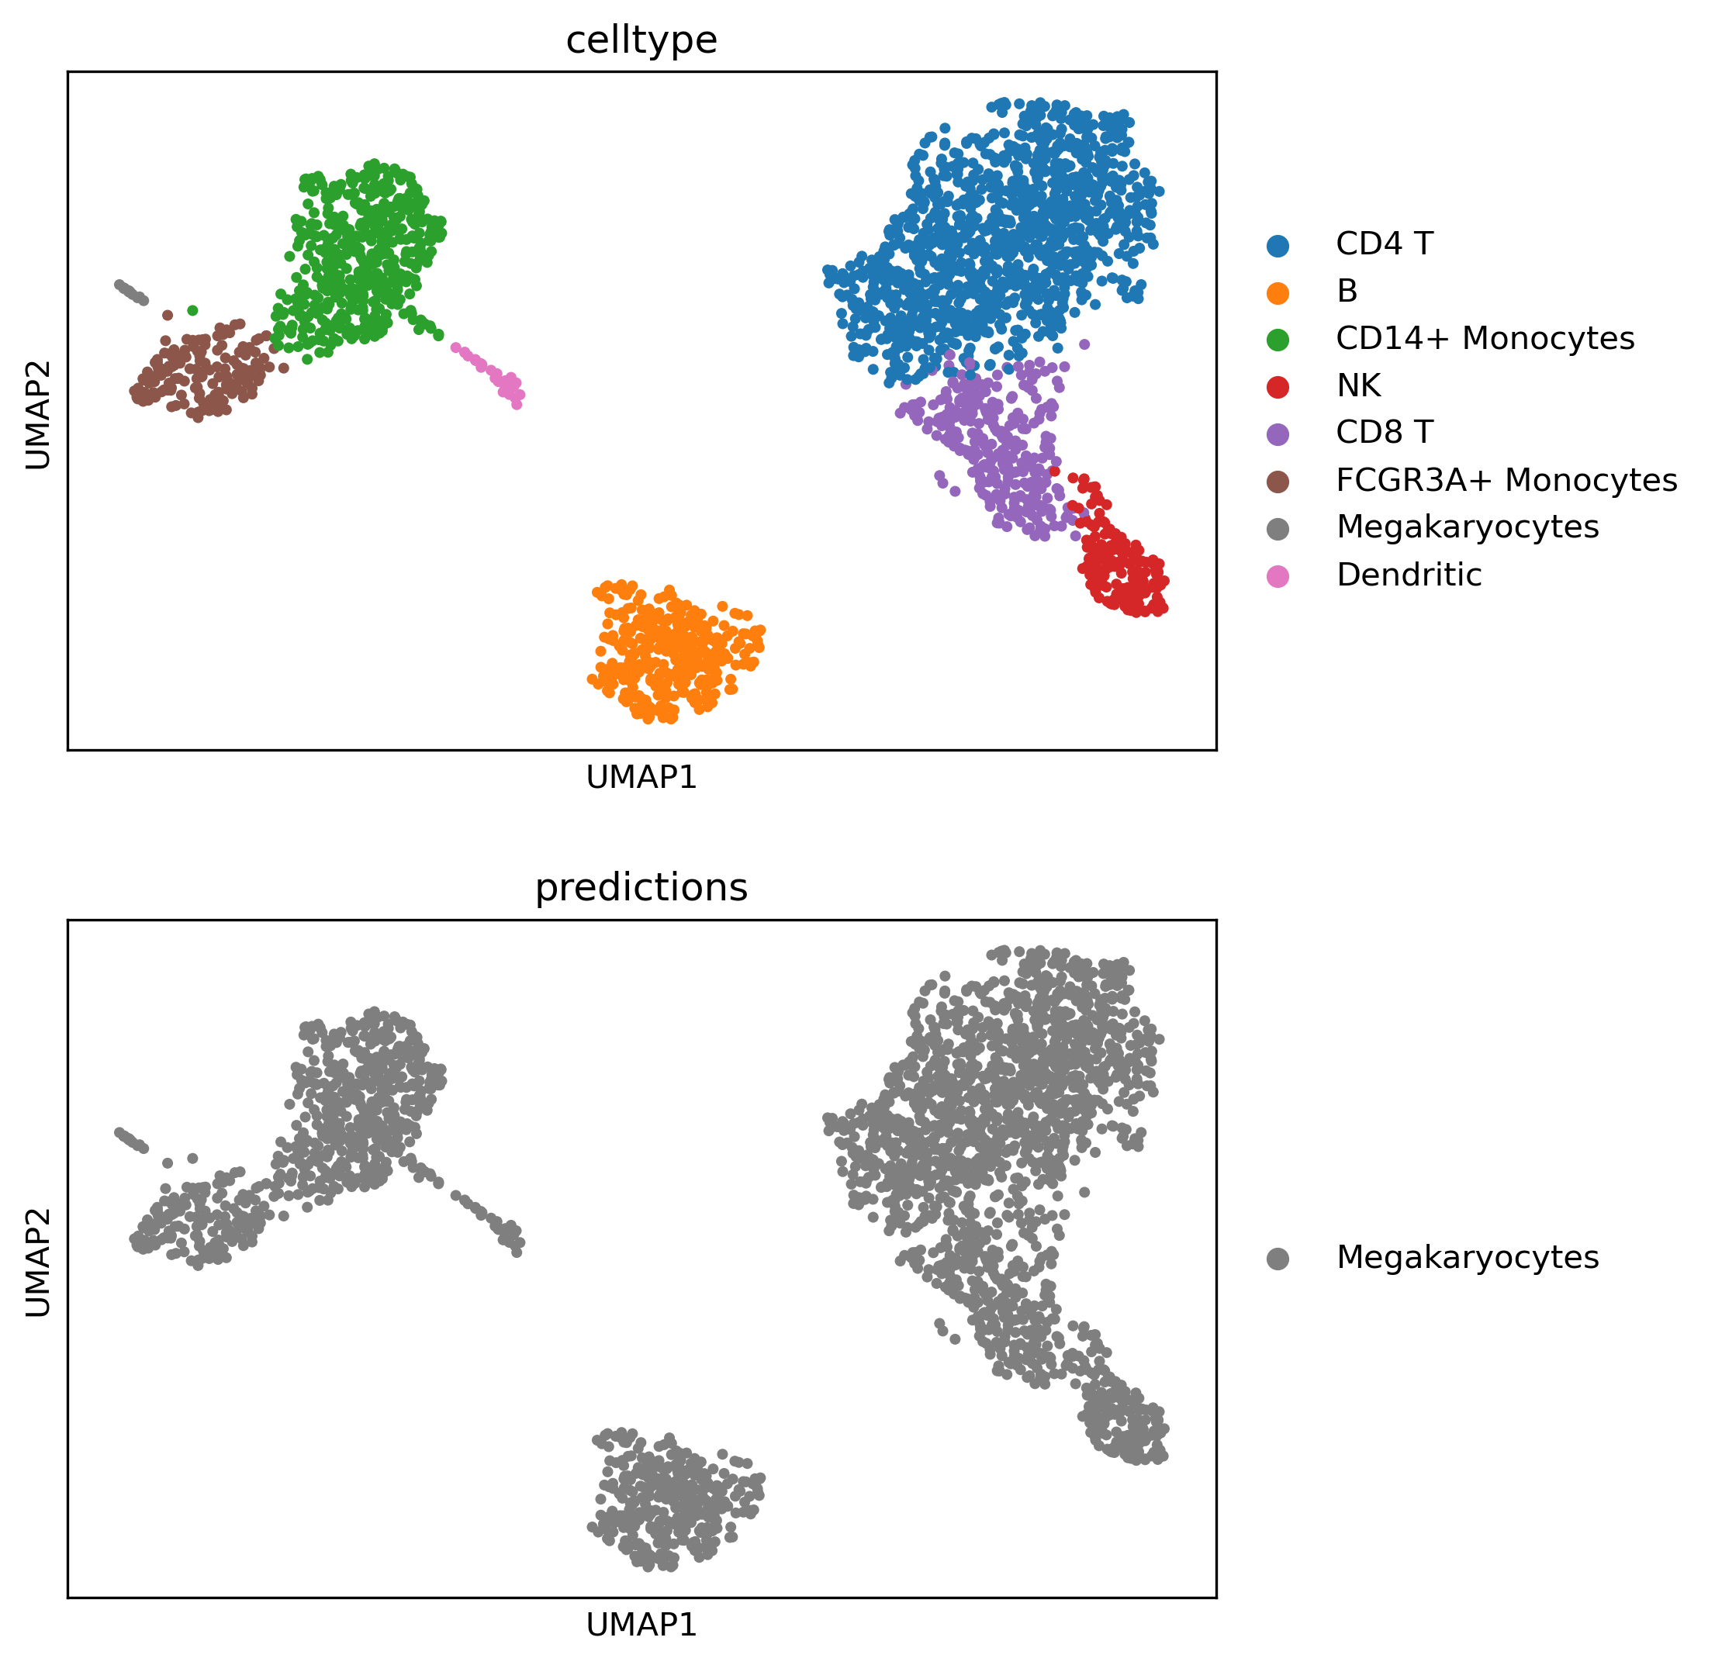
What happens when you do not fine-tune?

Slide 23
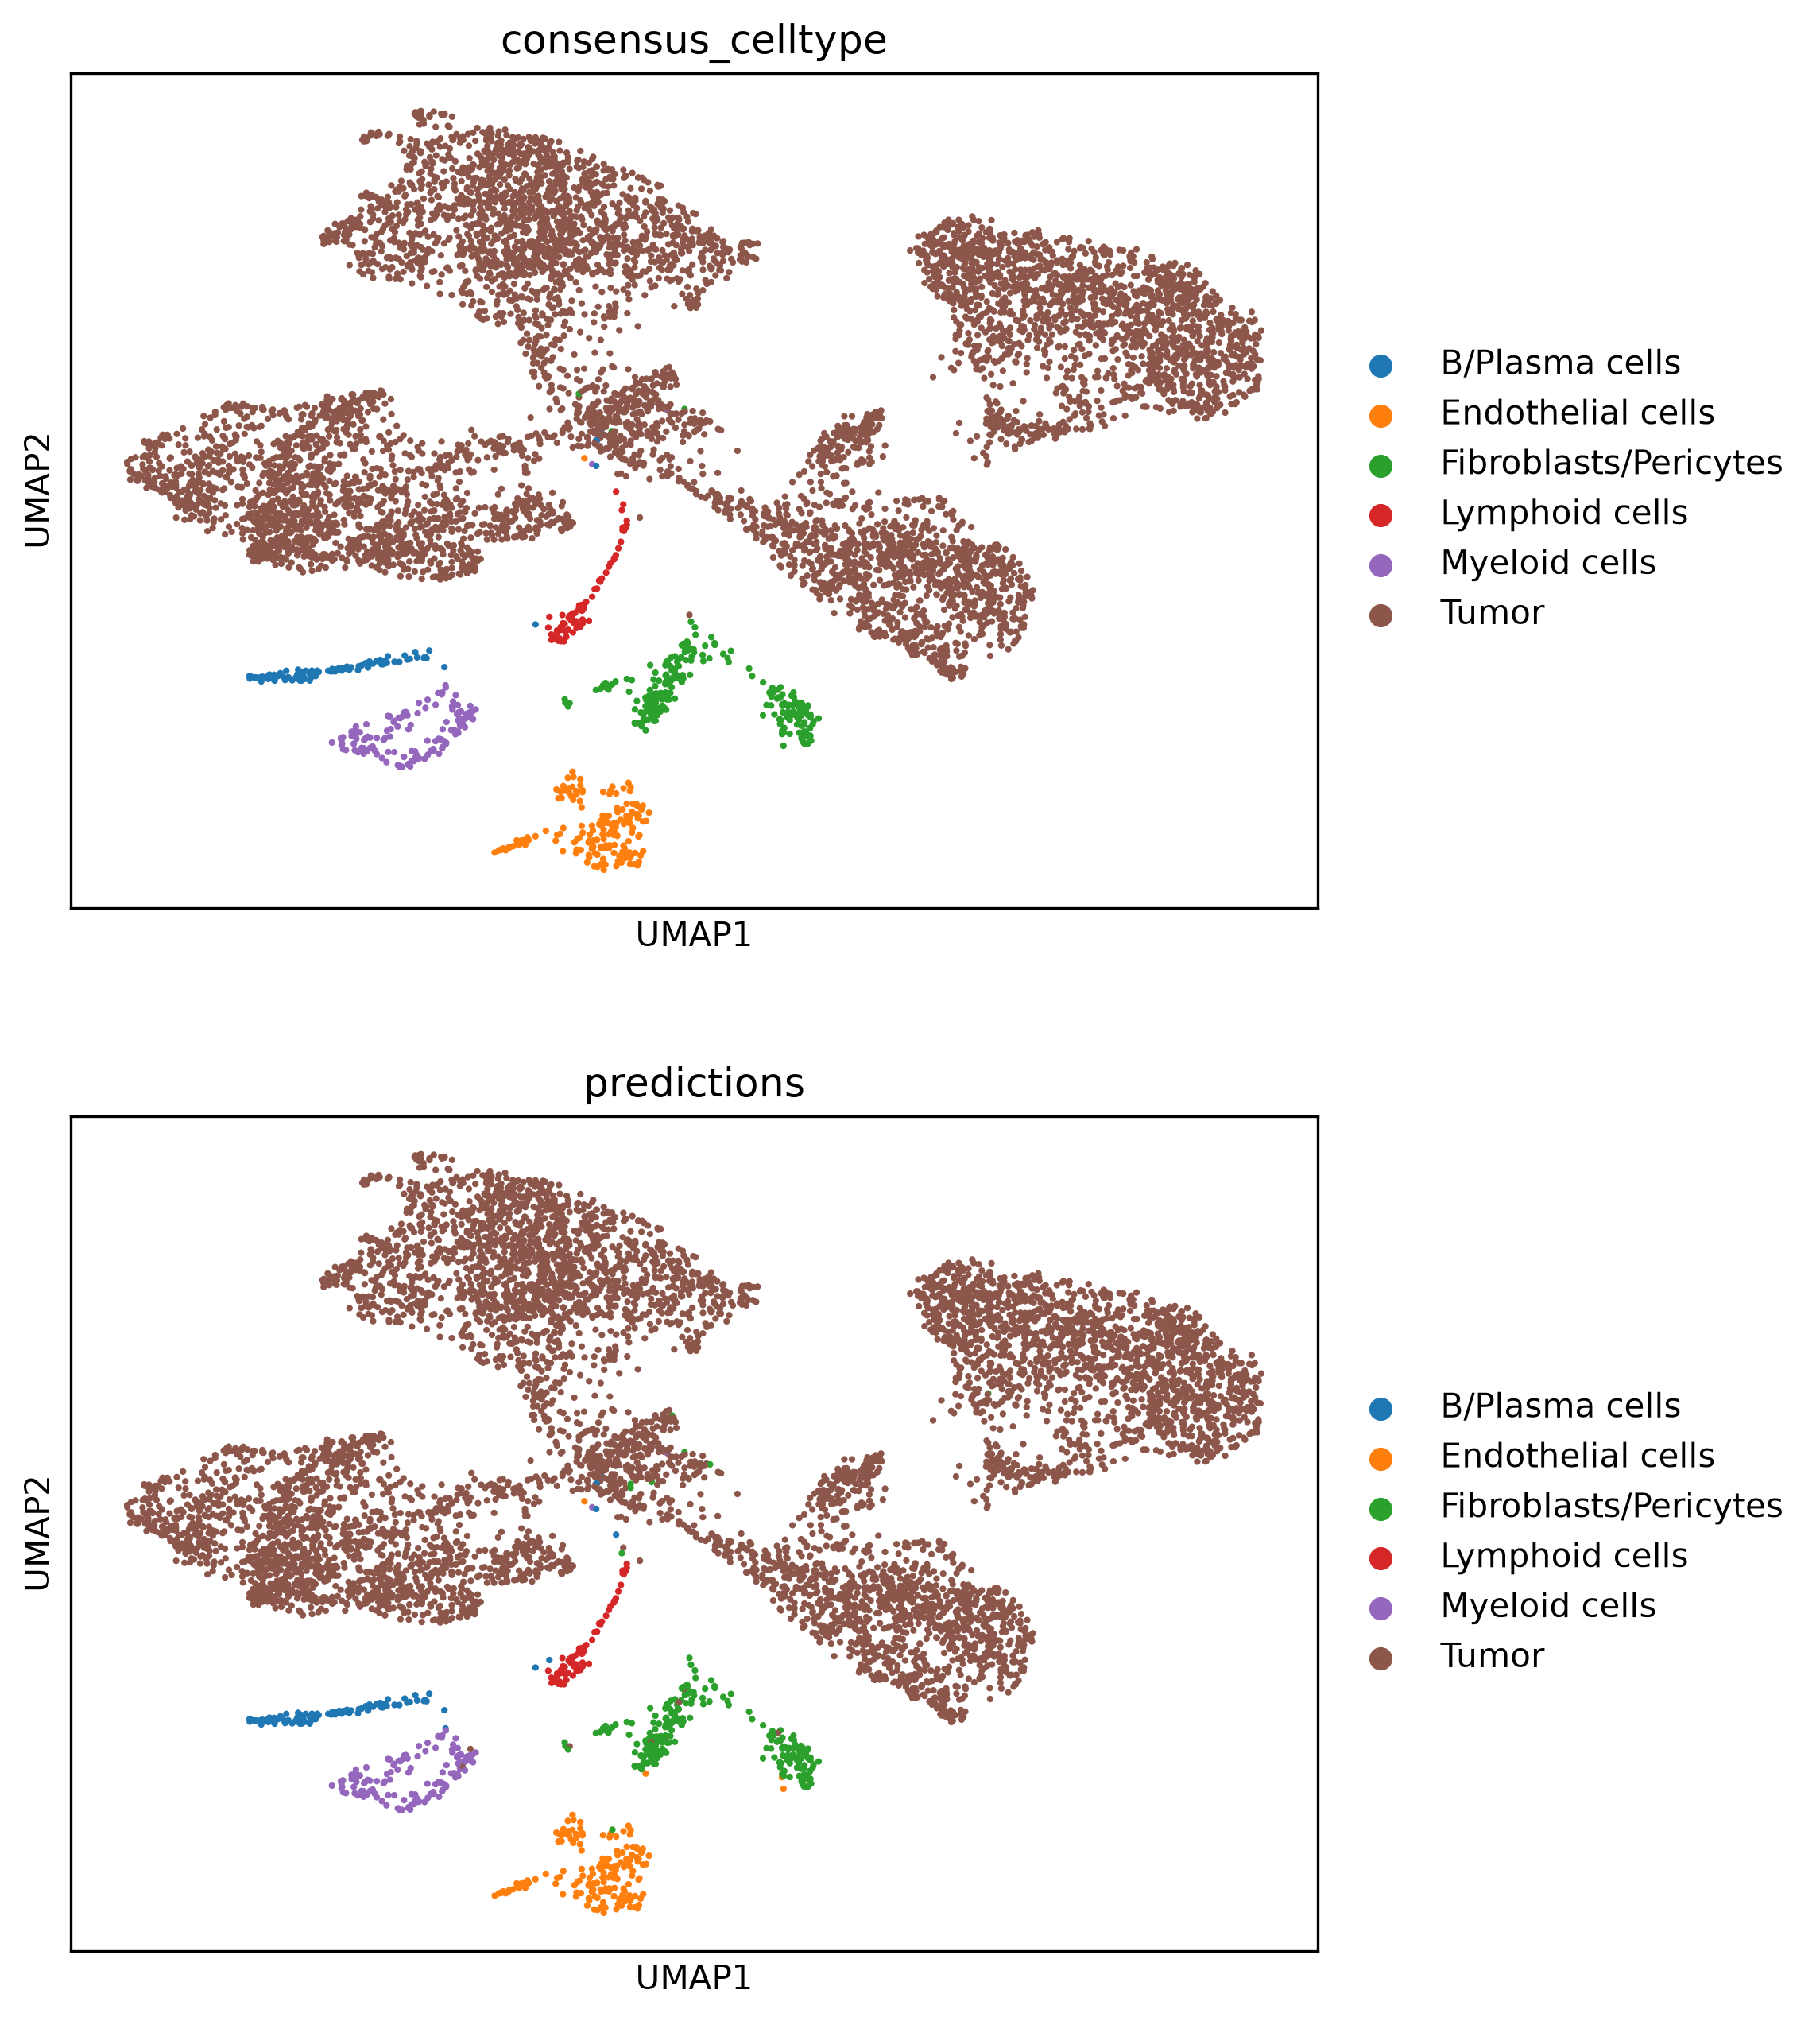
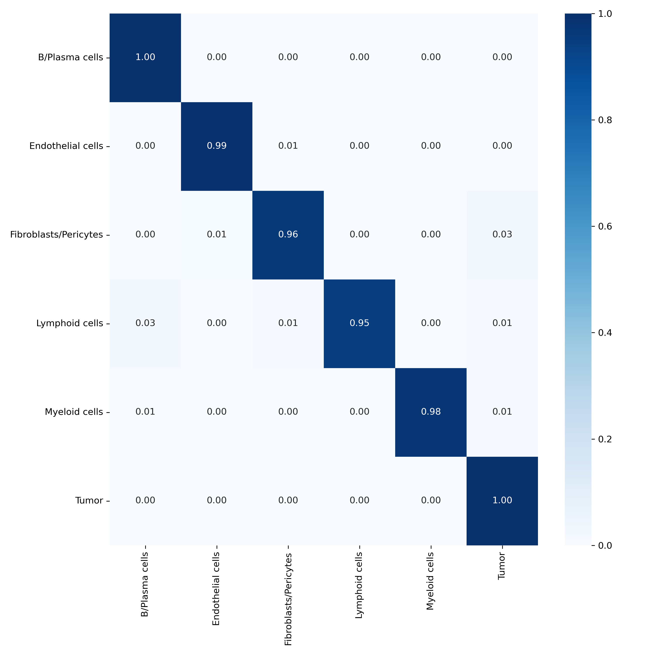
Annotation of sarcoma query dataset
Sarcoma dataset +
scGPT_pancancer

Slide 24
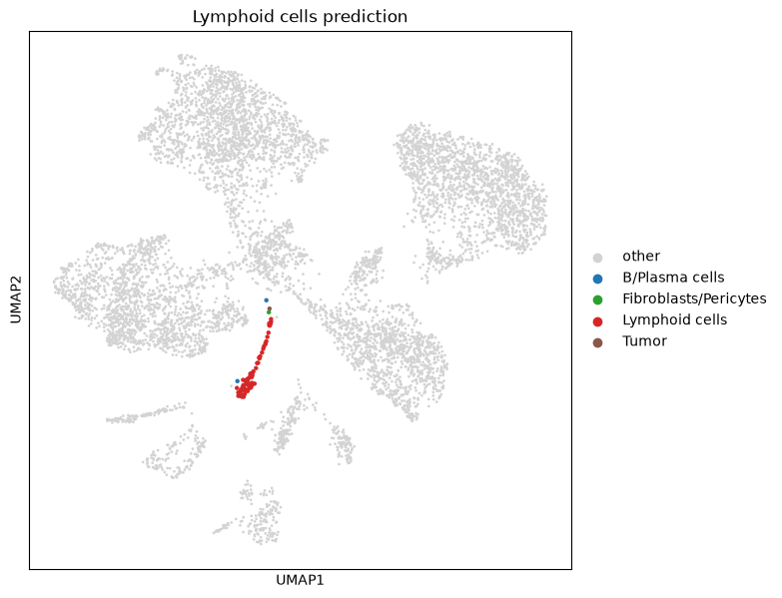
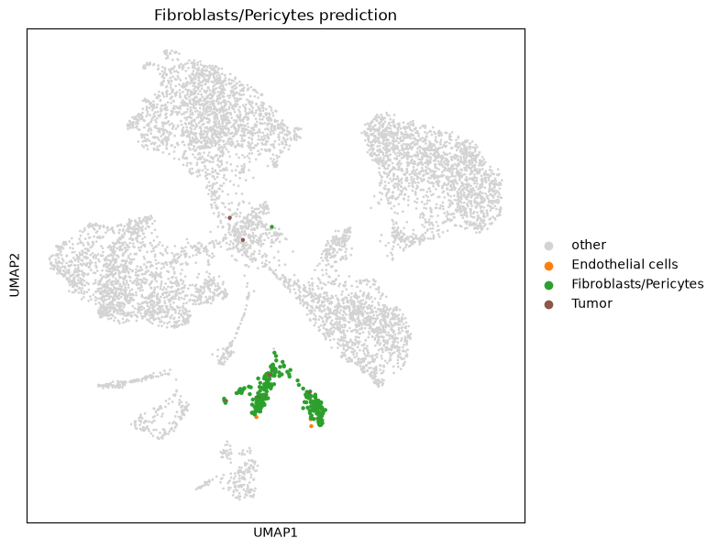
Predictions and Misclassifications of certain cell types
Sarcoma dataset +
scGPT_pancancer

Slide 25
Issues and possible future challenges
Run time / Memory usage depends on number of cells and genes
CPU vs GPU
Positive input values required for training dataset
Rare cells have bad prediction results
Choice of pre-trained model
Similarity of training and test dataset
  Cell types
  Genes
Potential of zero-shot applications
  Reference mapping
  Batch integration

Slide 26
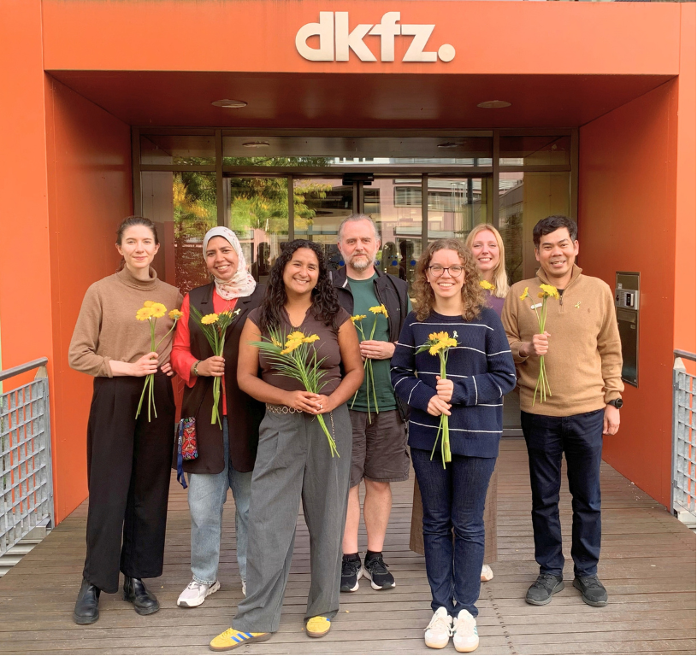
Thank You!

Slide 27
Geneformer Applications
Fine-tuning:
  transcription factor dosage sensitivity
  chromatin dynamics (bivalently marked promoters)
  transcription factor regulatory range
  gene network centrality
  transcription factor targets
  cell type annotation
  batch integration
  cell state classification across differentiation
  disease classification
  in silico perturbation to determine disease-driving genes
  in silico treatment to determine candidate therapeutic targets
Zero-shot learning:
  batch integration
  gene context specificity
  in silico reprogramming
  in silico differentiation
  in silico perturbation to determine impact on cell state
  in silico perturbation to determine transcription factor targets
  in silico perturbation to determine transcription factor cooperativity

Slide 28
scFoundation Applications
Cell clustering
Cell-type annotation
Drug response prediction on bulk data
Single-cell drug response classification
Single-cell perturbation prediction
Gene module and gene regulation inference

Slide 29
scGPT Applications
Fine-tuning:
  Cell type annotation
  Batch integration
  Multiomic integration
  GRN inference
  Perturbation prediction
Zero-shot learning:
  Reference mapping
  Batch integration

Slide 30

UMAP visualization of the pretrained scGPT cell embeddings

Slide 31
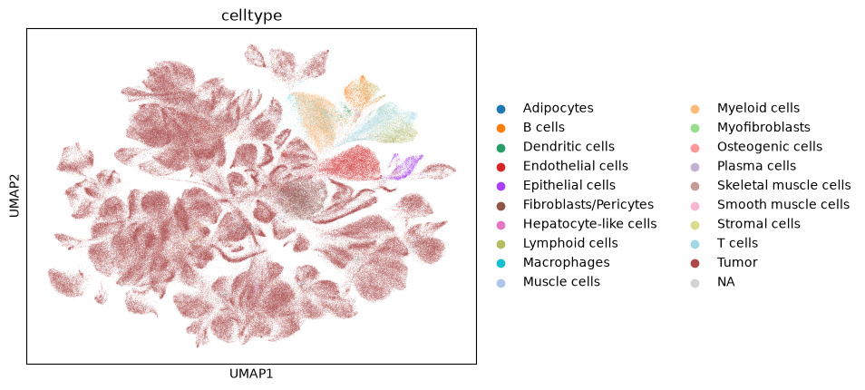
Sarcoma dataset cell types

