Slide 1
Progress Report
02.10.2026

Slide 2
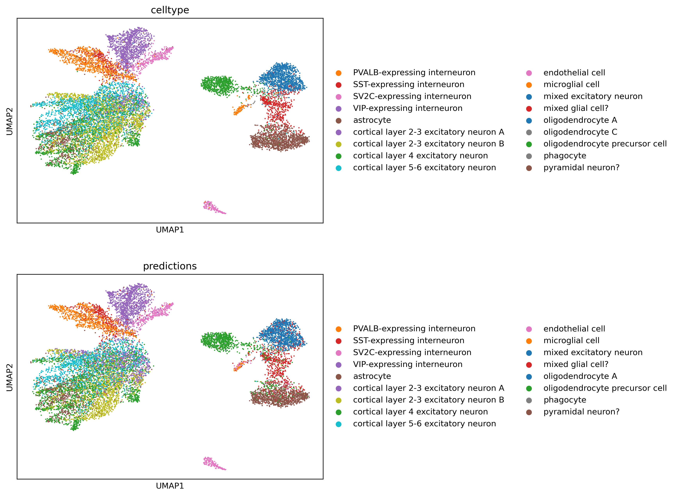
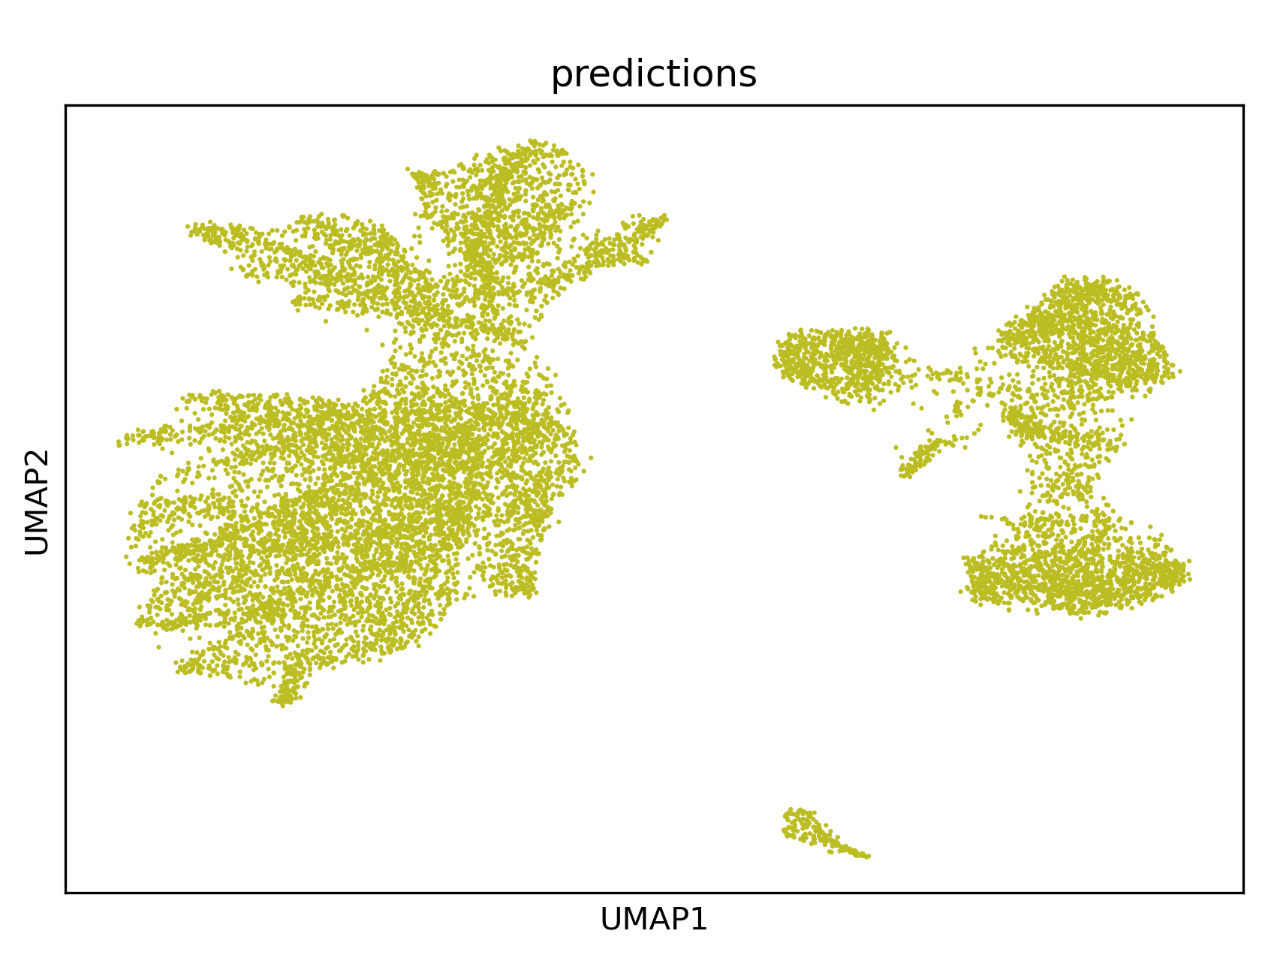
MS Dataset
With fine-tuning
Without fine-tuning

Slide 3
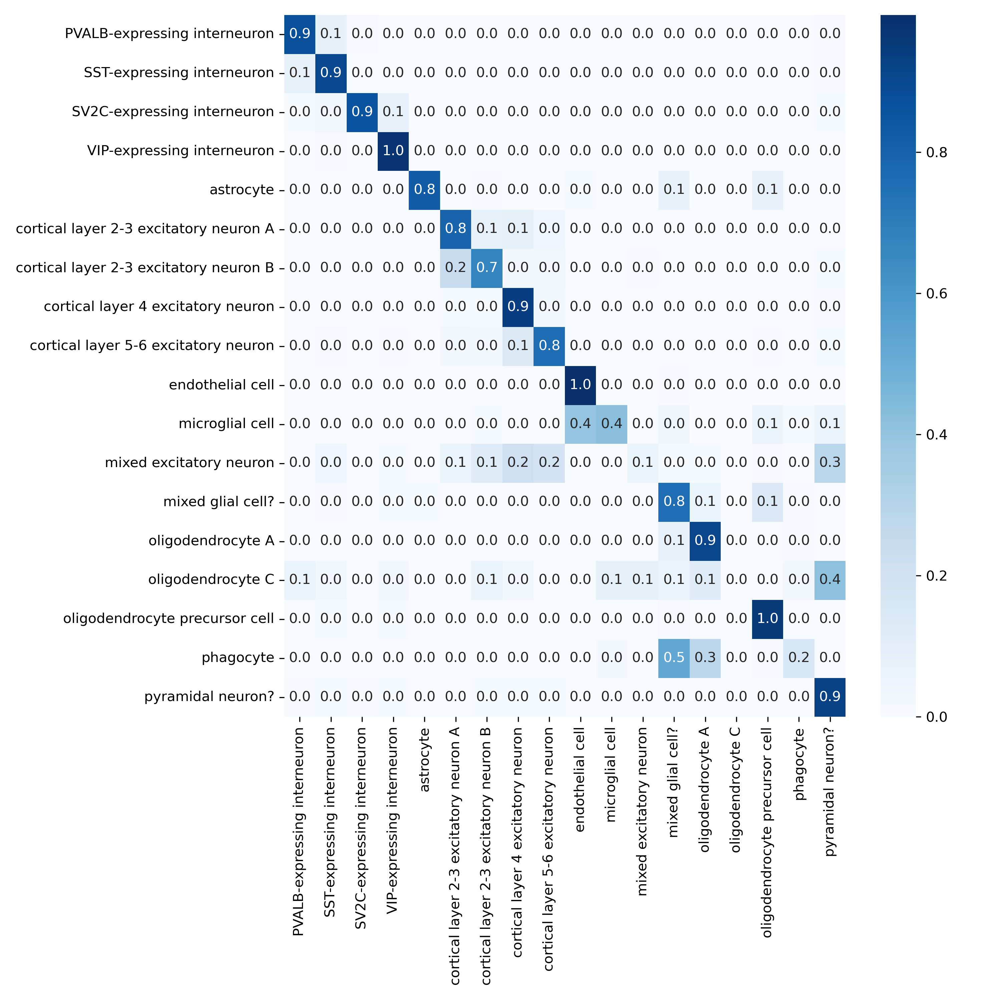
MS Dataset
Celltypes that do not get good predictions:
Oligodendrocyte C
Phagocyte
Mixed excitatory neuron
Microglial cell

Slide 4
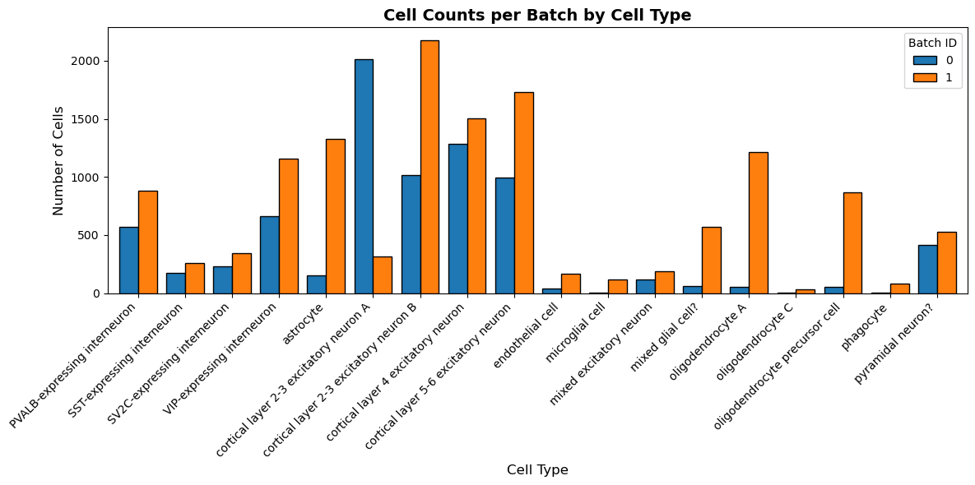
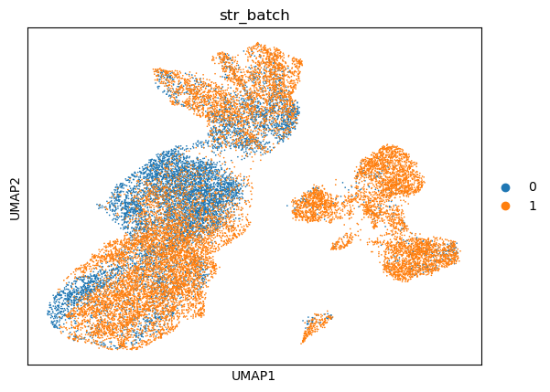
MS Dataset – train & test split
Trained on batch 0 (7844 cells)
Tested on batch 1 (13468 cells)

Slide 5
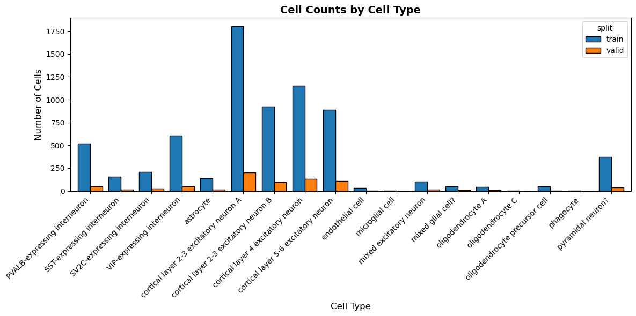
MS Dataset – train & valid split (during training)

Slide 6
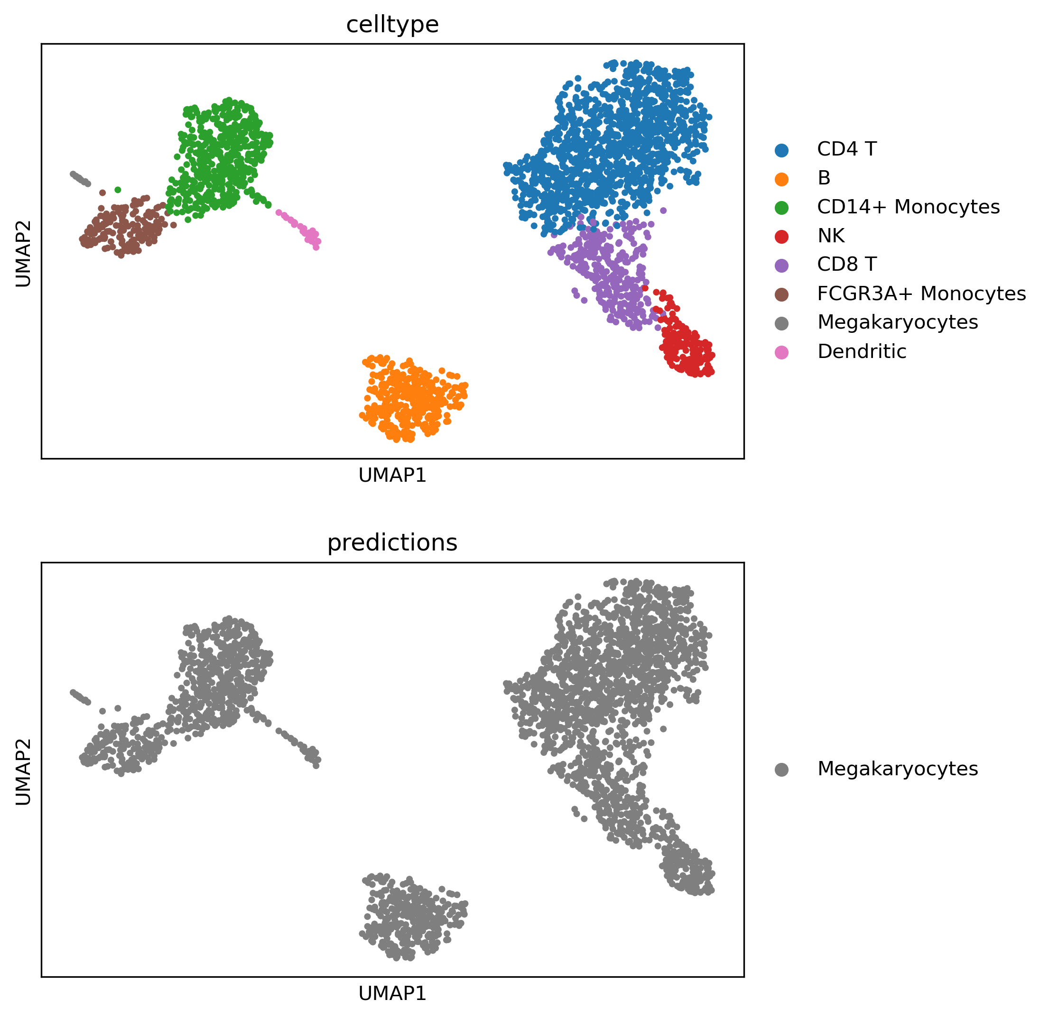
PBMC3k Dataset
Without fine-tuning

Slide 7
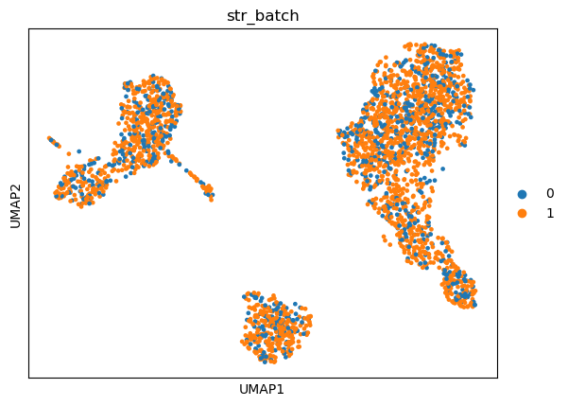
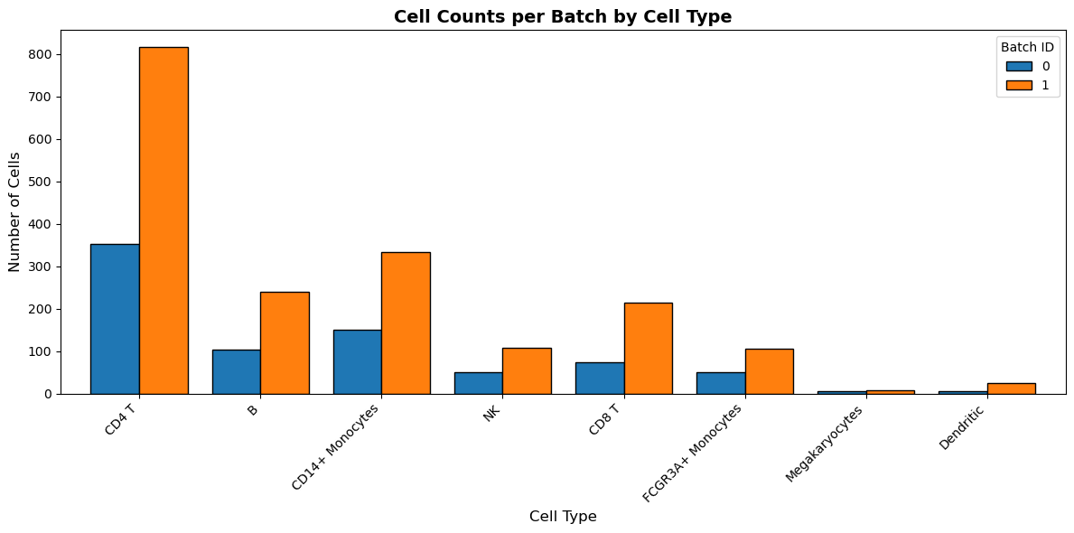
MS Dataset – train & test split
Total: 2638 cells
train (0): 791 cells
test (1): 1847 cells

Slide 8
Settings
Load & pre-process data
Load Pre-trained model
Finetune scGPT
Evaluation

Slide 9
Settings
hyper-parameter setup
for input and preprocessing: n_bins
for optimizer: batch_size, epochs,
for the model: layer_size, nlayers, dropout
for training: MVC,
…
Load & pre-process data
model configurations
Gene Vocabulary
Pre-trained Model
  TransformerEncoder : nlayers
  TransformerEncoderLayer :
    embsize / d_model, nhead, d_hid / dim_feedforward
Load Pre-trained model
Finetune scGPT
In-script parameters
for input and preprocessing
for training
for optimizer
for the model
…
Evaluation

Slide 10
Settings
adata file
Is data raw? → Normalization necessary
Gene names as index!
Are the genes part of the gene vocabulary?
Batch ids (train vs test)
Load & pre-process data
Load Pre-trained model
adata
  filter_gene_by_counts
  filter_cell_by_counts
  normalize_total
  Log1p
  hvg_flavor
  subset_hvg
Finetune scGPT
Preprocessor
config
adata
+ new metadata
Evaluation

Slide 11
Settings
adata file
Is data raw? → Normalization necessary
Gene names as index!
Are the genes part of the gene vocabulary?
Batch ids (train vs test)
Load & pre-process data
Load Pre-trained model
adata
prepare data into training, valid and test split
Optional steps:
  Filter genes
  Filter cells
  Normalize total
  Log1p transformation
  Subset hvg
  binning
Finetune scGPT
Preprocessor
adata
+ new metadata
Evaluation

Slide 12
Settings
scGPT_human
model file
scGPT_human
already fine-tuned
map_location = CPU !
Load & pre-process data
state dict
Load Pre-trained model
GeneEncoder: ntoken, embsize
TransformerEncode: embsize, nheads, d_hid, nlayers
…
Finetune scGPT
TransformerModel
config
model
Evaluation
! Some configurations absolutely have to fit the model file

Slide 13
Settings
scGPT_human
model file
scGPT_human
already fine-tuned
map_location = CPU !
Load & pre-process data
state dict
GeneEncoder: ntoken, embsize
TransformerEncode: embsize, nheads, d_hid, nlayers
…
Load Pre-trained model
TransformerModel
config
Finetune scGPT
model
! Some configurations absolutely have to fit the model file
Evaluation

Slide 14
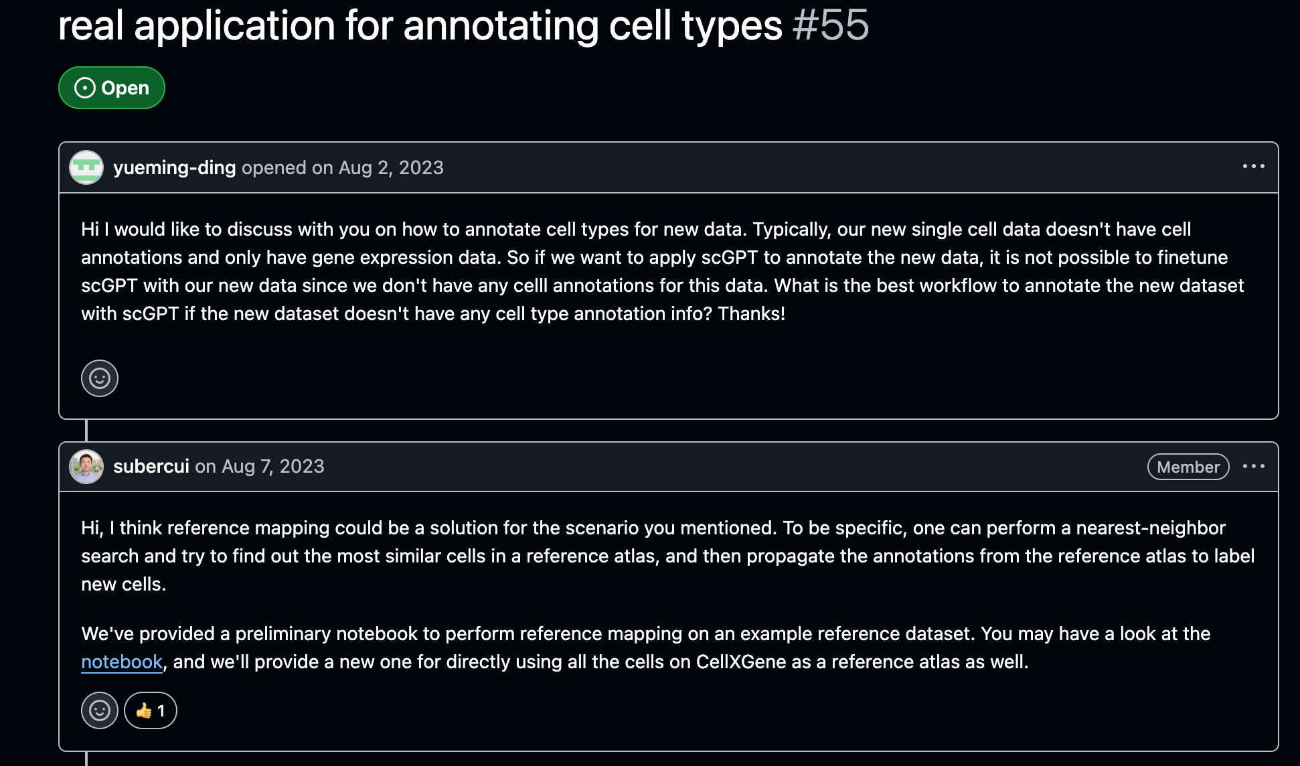
Reference mapping
Mapping unkown cells in a query set to reference atlas
Reference: 33 million cells from CellXGene
https://github.com/bowang-lab/scGPT/blob/main/tutorials/Tutorial_Reference_Mapping.ipynb

