Slide 1
Progress Report
04.09.2026

Slide 2
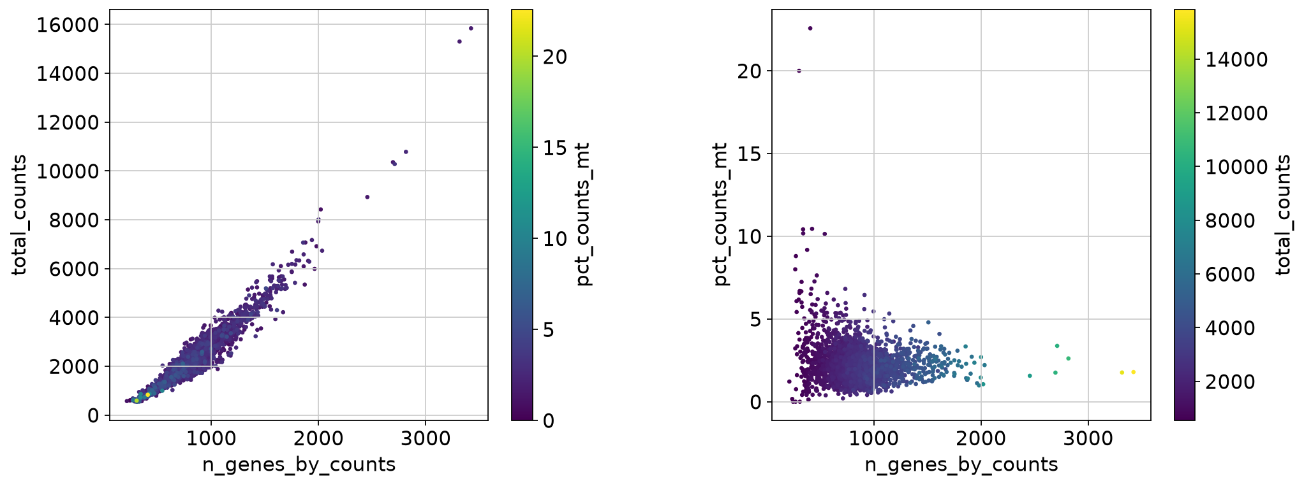
PBMC3k data: QC metrics

Slide 3
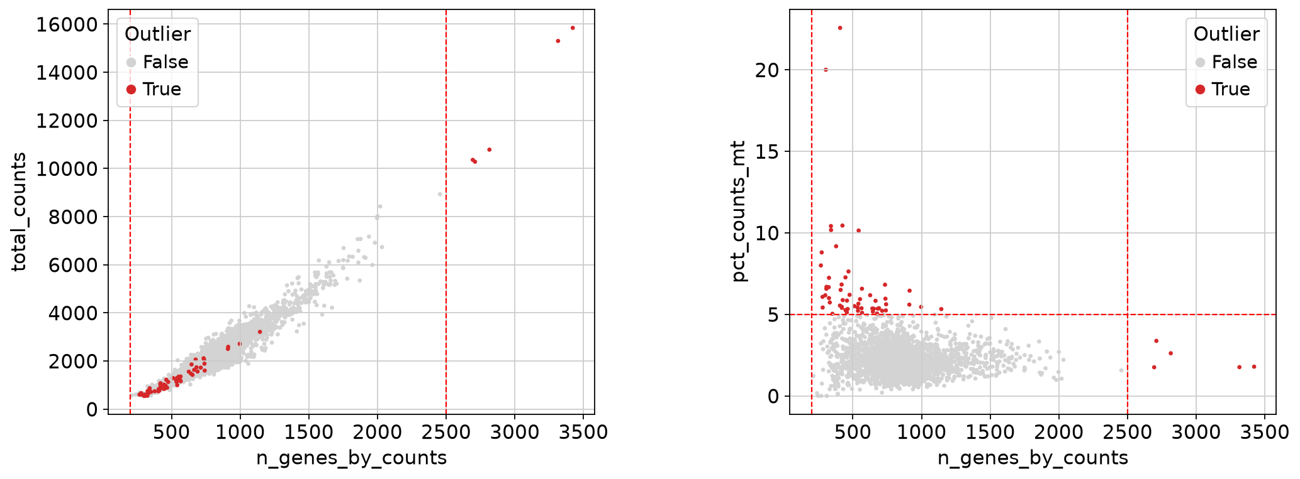
Outliers (Scanpy workflow)

Slide 4
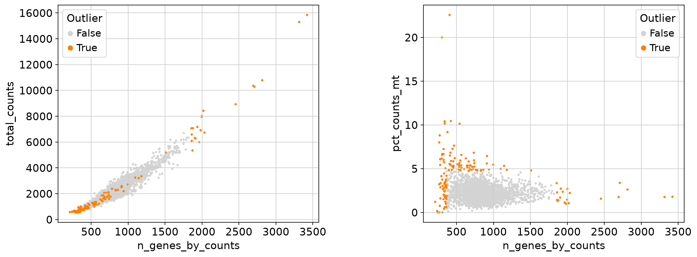
Outliers (MAD approach)

Slide 5
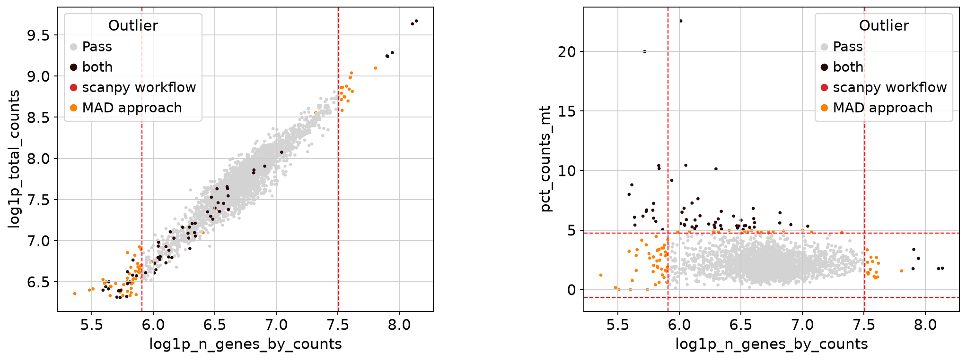
Outliers (MAD approach)

Slide 6
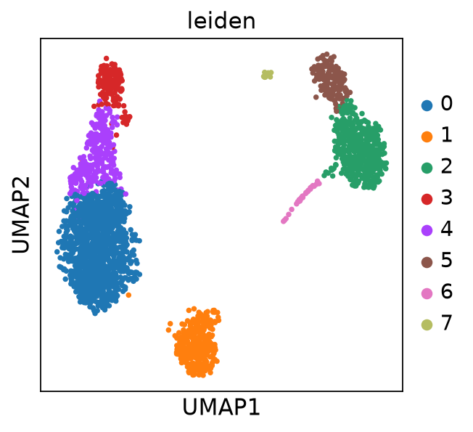
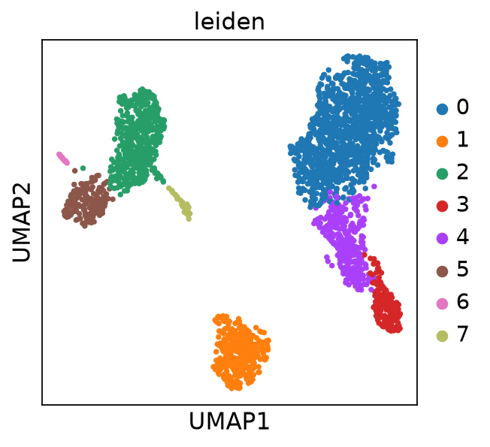
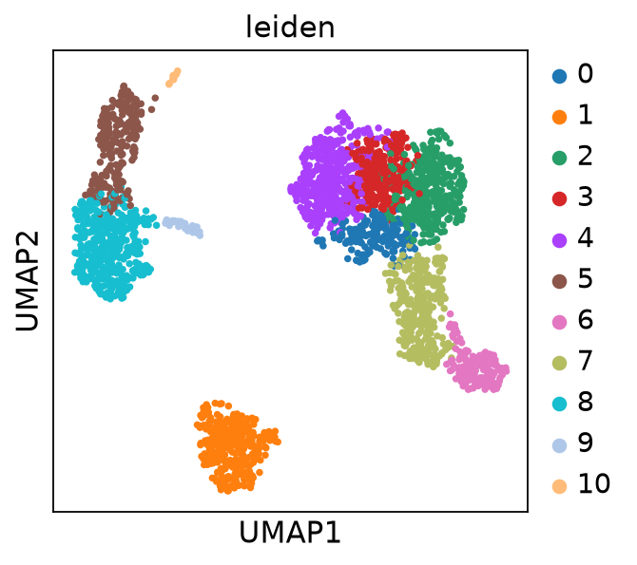
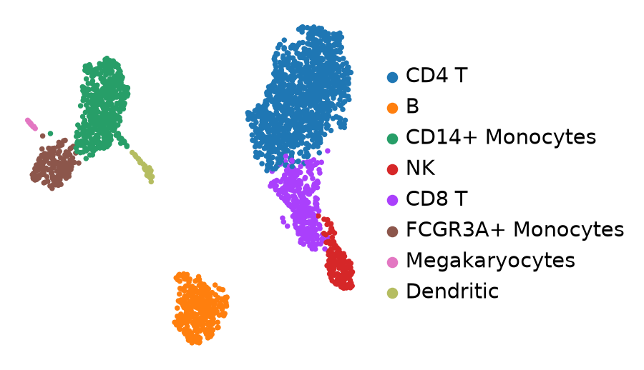
Playing around with PCA Parameters (sc)
PCA: 40, RES: 0.7 - 8 clusters
PCA: 10, RES: 0.7 – 11 clusters
PCA: 10, RES: 0.3 – 8 clusters

Slide 7
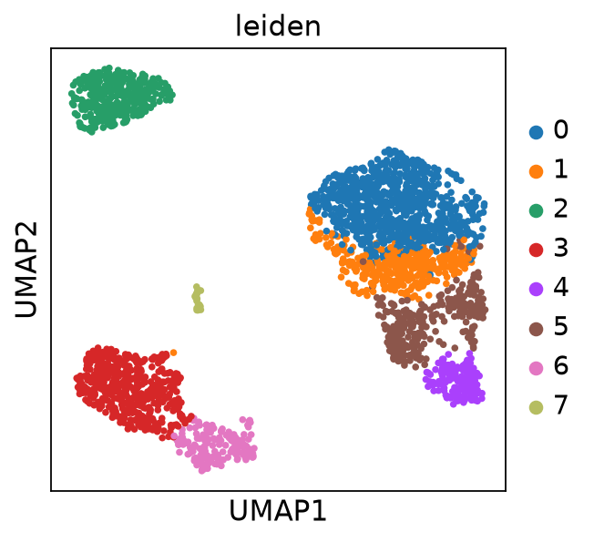
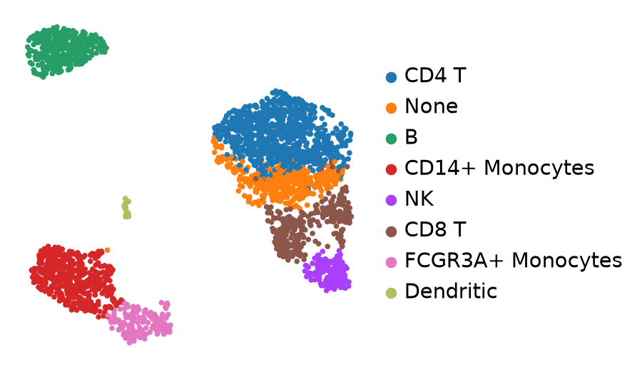
Clustering with MAD approach
PCAs: 10, RES: 0.35 – 8 clusters
Megakaryocytes?

Slide 8
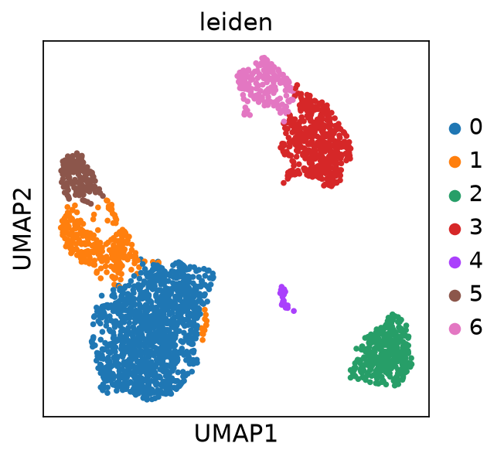
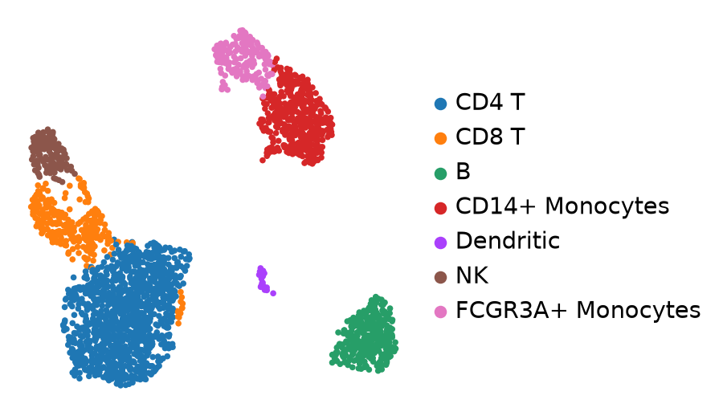
Clustering with MAD approach
PCAs: 10, RES: 0.3 – 7 clusters
Megakaryocytes?

Slide 9
scGPT – Annotation tutorial
#BSUB -J scGPT_annotation_tutorial
#BSUB -q verylong
#BSUB -n 10
#BSUB -R "rusage[mem=200GB] span[hosts=1]"
#BSUB -W 48:00
#BSUB -o
#BSUB -e
current status: running 48h job
  Start: yesterday 14:22
Next: Should I set up GPU?
  https://wiki.odcf.dkfz.de/pub/cluster/lsf/gpu/start
  Again ask for access to the GPU queue: cluster-support@dkfz-heidelberg.de
  See if scGPT can work with GPU
  Transfer data: /dkfz/cluster/gpu/data ?
  Output of scripts at: /dkfz/cluster/gpu/checkpoints/

Slide 10
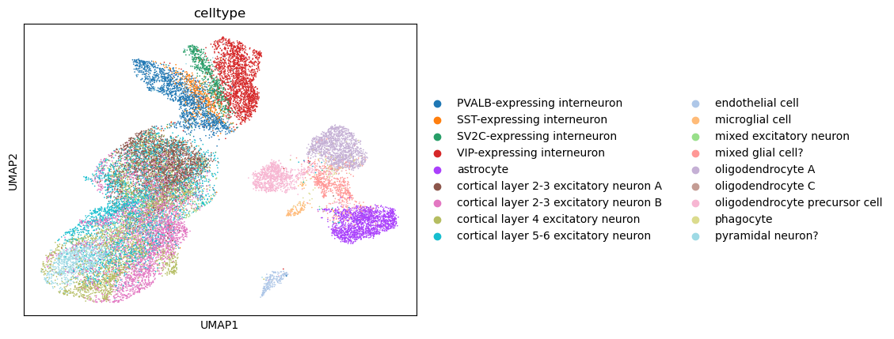
scGPT – Annotation tutorial
Data: Multiple Sclerosis (M.S.) dataset

Slide 11
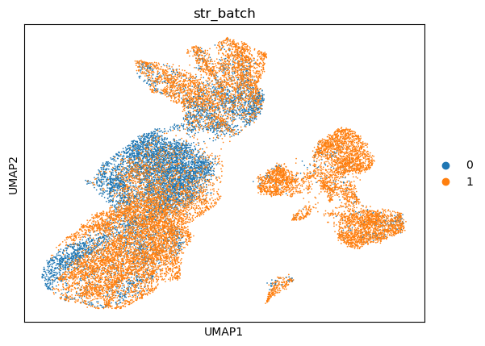
scGPT – Annotation tutorial
Data: Multiple Sclerosis (M.S.) dataset
Data set size: 21 312 x 3000
Fine tuning model with 37%: 7844 cells (Batch 0)
Test with 63%: 13468 cells (Batch 1)

Slide 12
Internship Objectives
Prepare example data set for analysis
  PBMC3k (from scanpy legacy workflow)
Install scGPT package (CPU-only)
Get example script running
  Example: Annotation Tutorial with MS dataset
  Compare results
Run with GPU ?
Focus: Learning how scGPT handles cell annotation
  Other workflows: Batch Integration, Perturbation Prediction, Multiomic Integration
  More: Reference Mapping, GRN (Gene regulatory network) Inference
Goal: Test workflow with example data set / Katherines' data set
  Compare predicted cell type annotations to existing ones

Slide 13
MAD approach
Median absolut deviation (MAD)
Thresholds
  Top: Mean + n * MAD
  Bottom: Mean – n * MAD
Outliers are above top threshold / below bottom threshold

