Slide 1
Progress Report
18.09.2026

Slide 2
Cell type annotation with scGPT
Specify parameters
Load and pre-process data
Load pre-trained model
Finetune scGPT with task-specific objectives
Evaluate fine-tuned scGPT

Slide 3
Cell type annotation with scGPT
Specify parameters
Load and pre-process data
Load pre-trained model
Finetune scGPT with task-specific objectives
Evaluate fine-tuned scGPT
Load fine-tuned model
or
Load pre-trained model
Time intensive

Slide 4
Specifying parameters
40 – 50 parameters / settings in the script
Types
  settings for input and preprocessing
  settings for training
  settings for optimizer
  settings for the model
Should be saved to .json file!

Slide 5
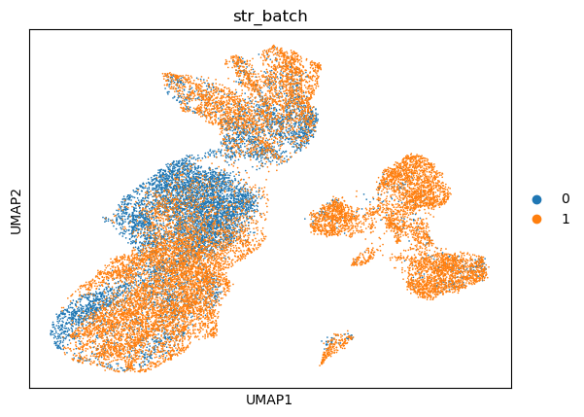
Load and pre-process data
Multiple Sclerosis (M.S.) dataset (21312 × 3000)
  For fine tuning (37%)
  For testing (63%)
Processing (can be changed via settings)
  Filter genes by counts: False
  Filter cells by counts: False
  Normalization (log1p): False (only when data is raw)
  Use only HVGs: False

Slide 6
Load pre-trained model
whole-human model
Pretrained on scRNA-seq data of 33 million normal human cells
Changed script so that it works on CPU
Involves some parameters (use given by args.json file and parameters at start of script)
  ntoken, d_model, nheads, d_hid, nlayers
  do_mvc (masked value prediction for cell embedding): False
  do_dab (domain adaptation by reverse backpropagation): False
  num_batch_labels, input_emb_style, dropout, mvc_decoder_style, …

Slide 7
Fine-tuning
Train pre-trained model on labelled data set
  Batch 0 : train
  Batch 1 : test
For other datasets:
  Should I choose random cells?
Is it possible to skip this step?

Slide 8
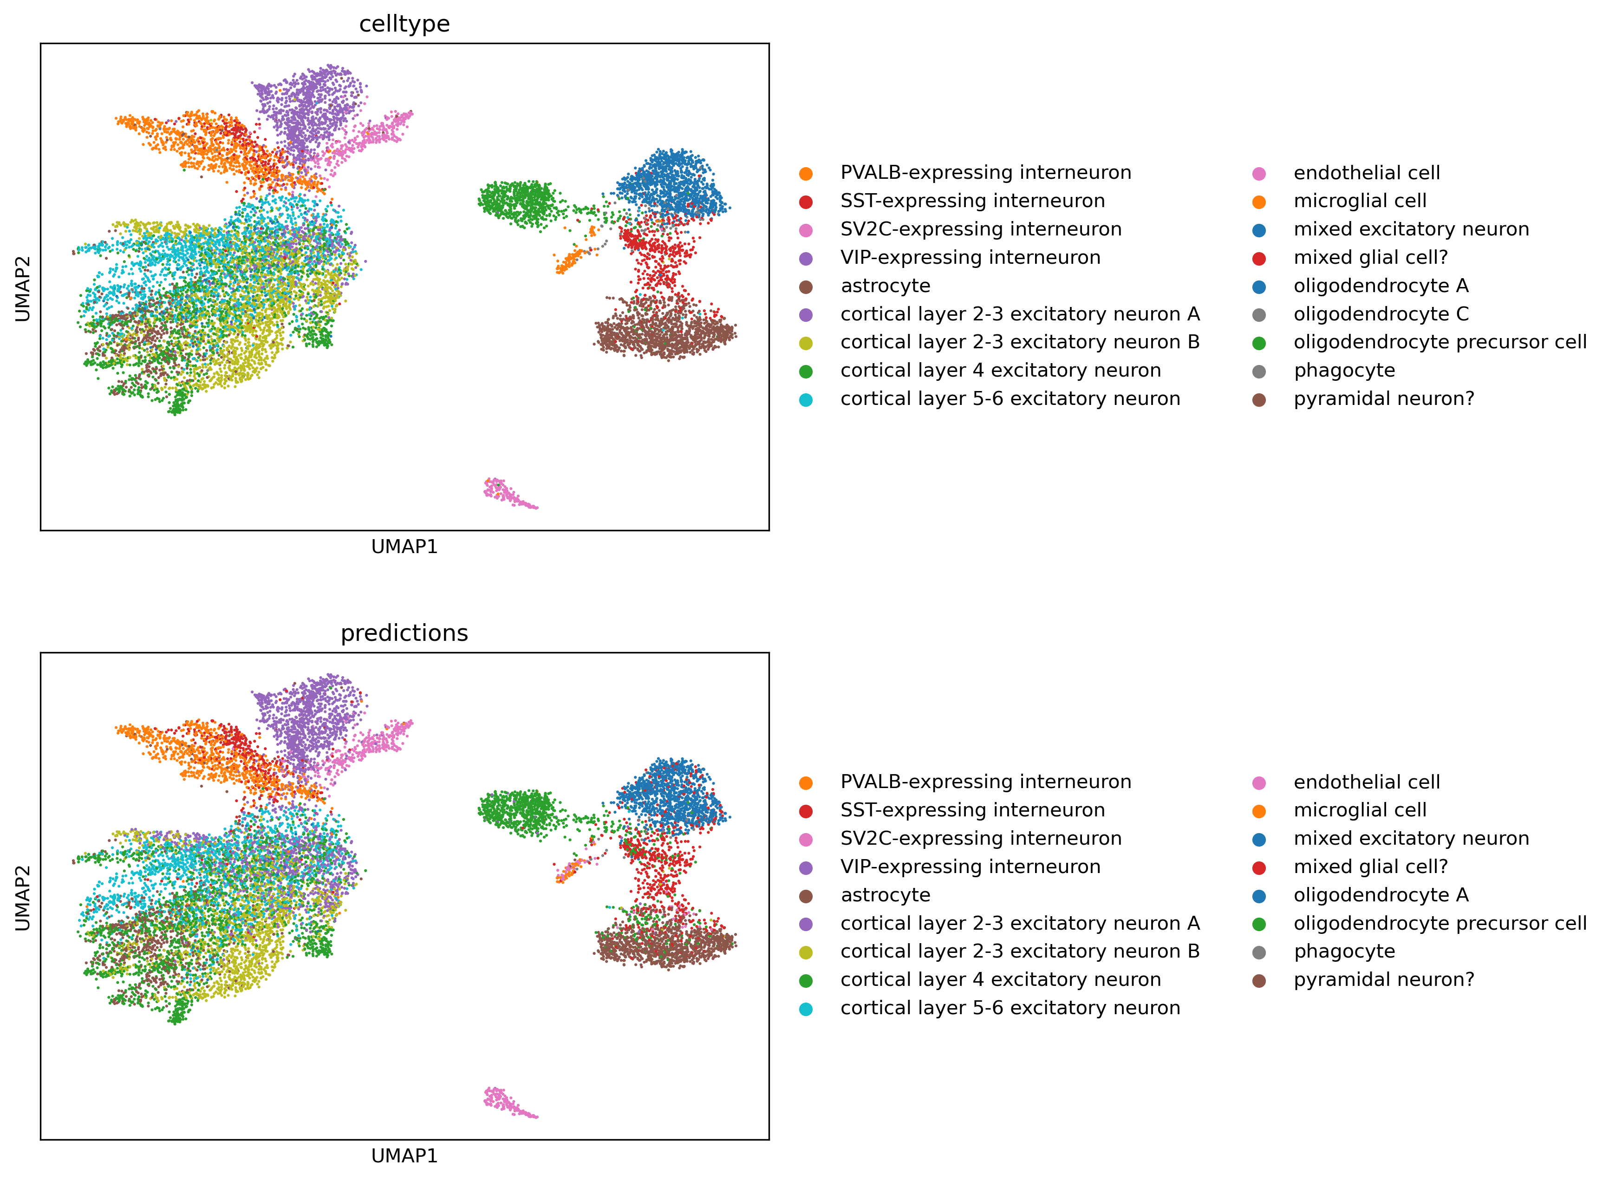
Prediction of Multiple Sclerosis (M.S.) dataset
Cores: 10
Batch_size: 32

Slide 9
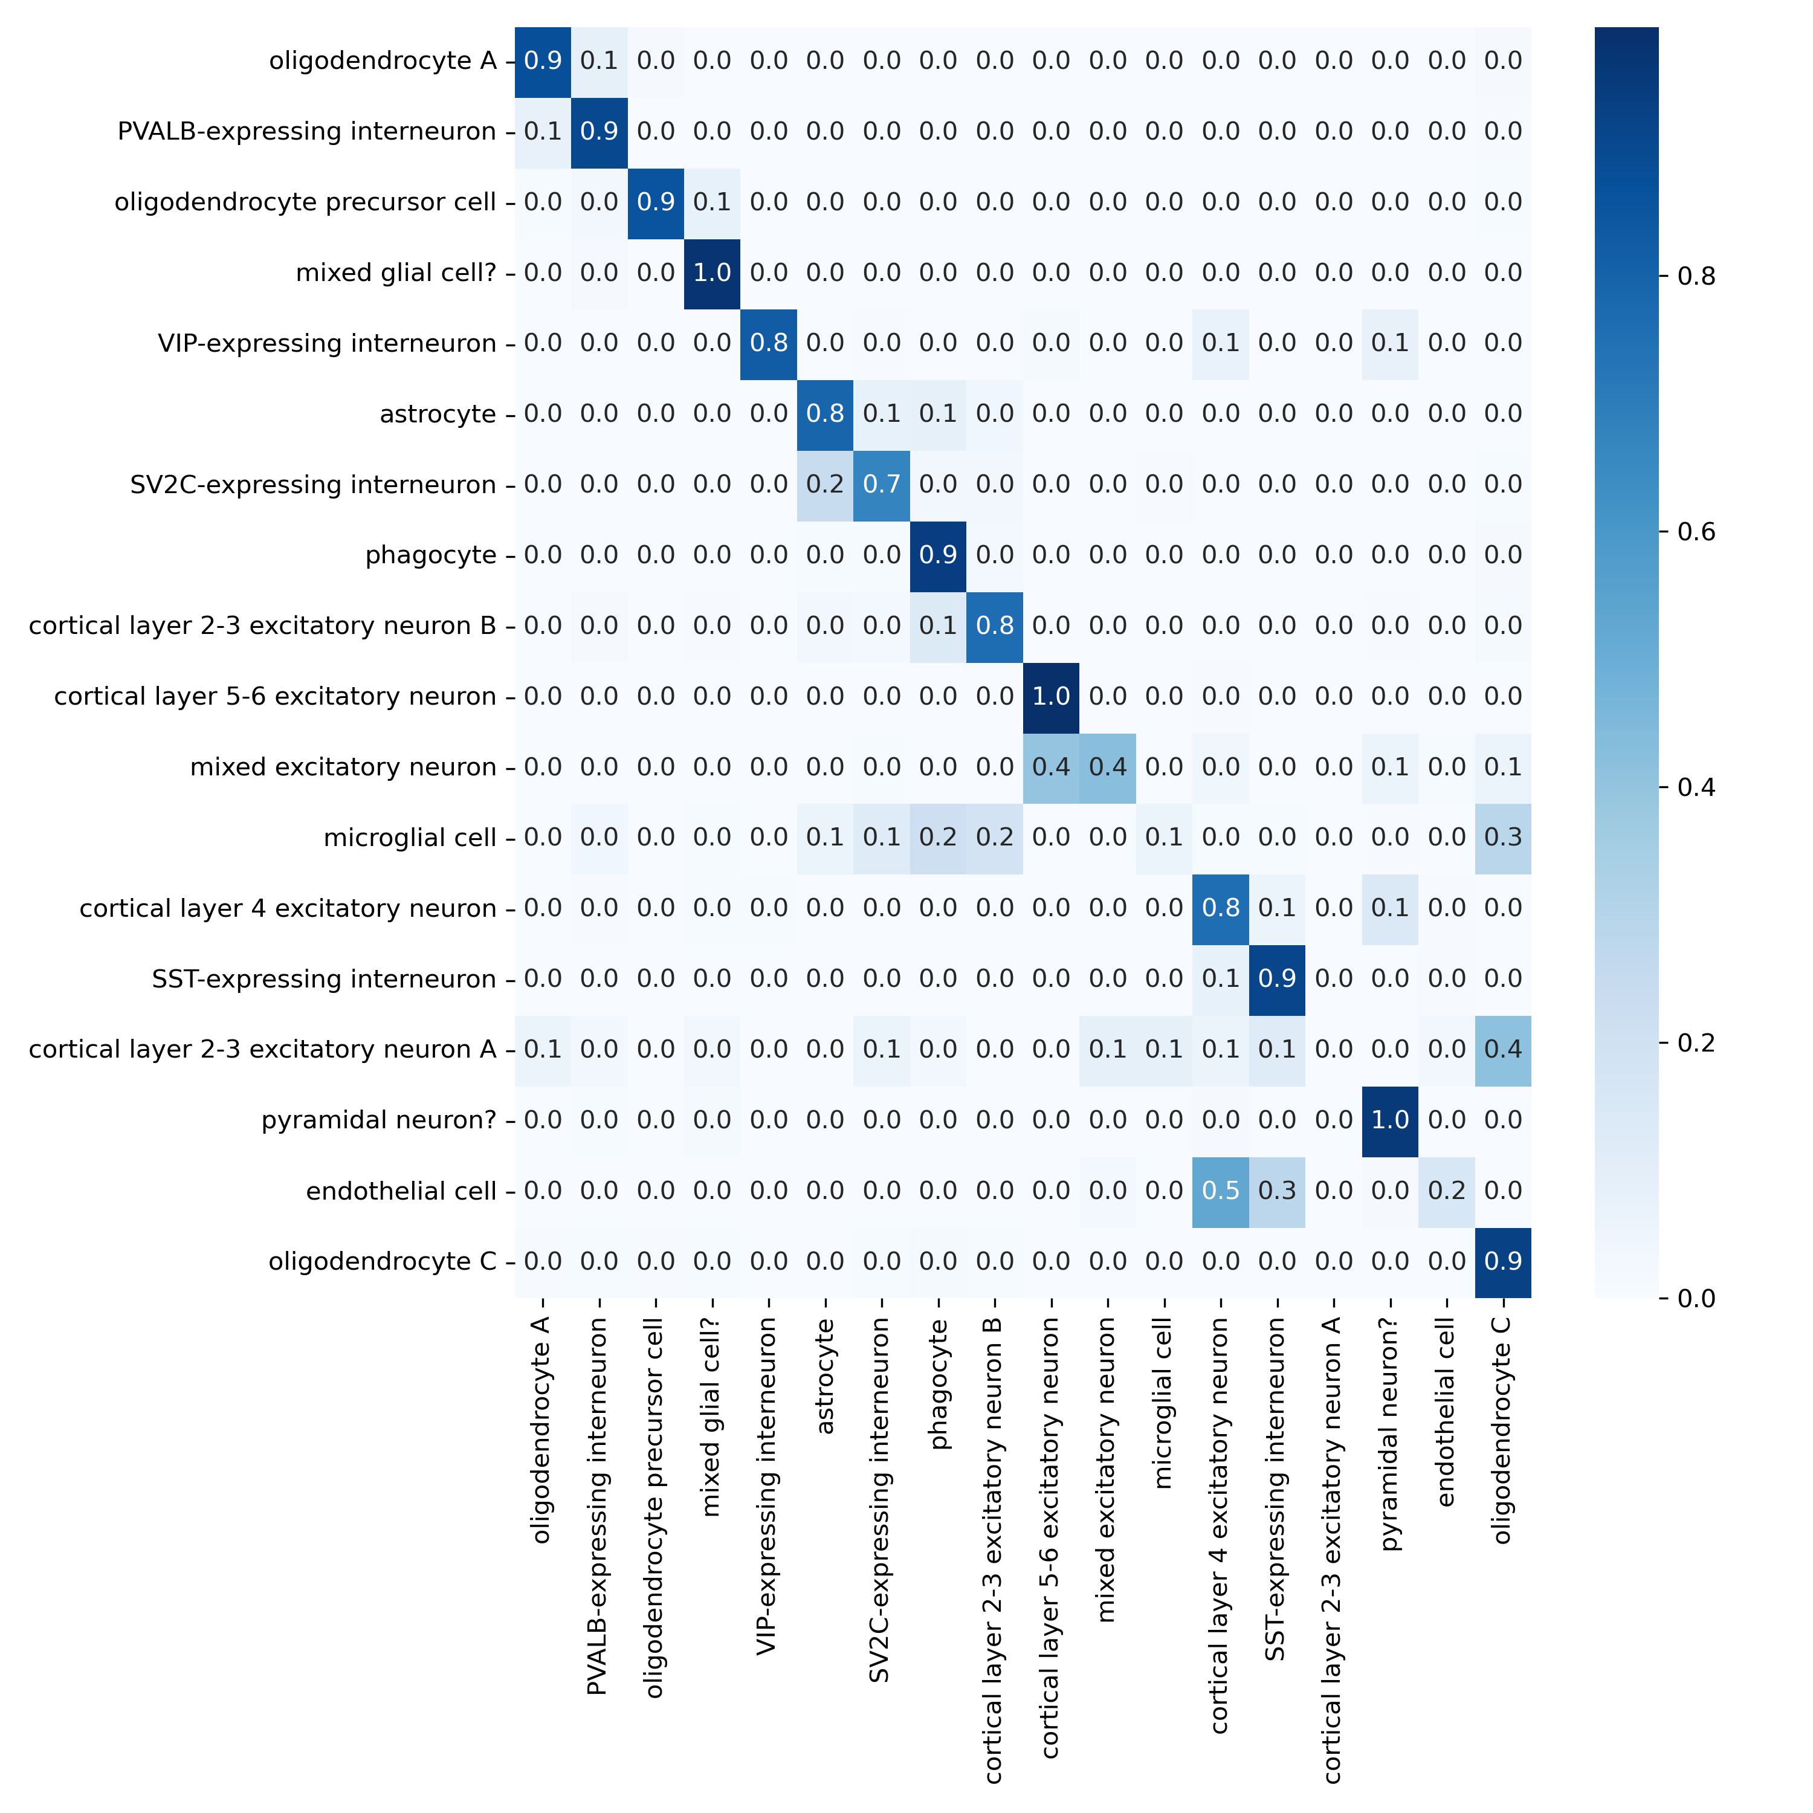
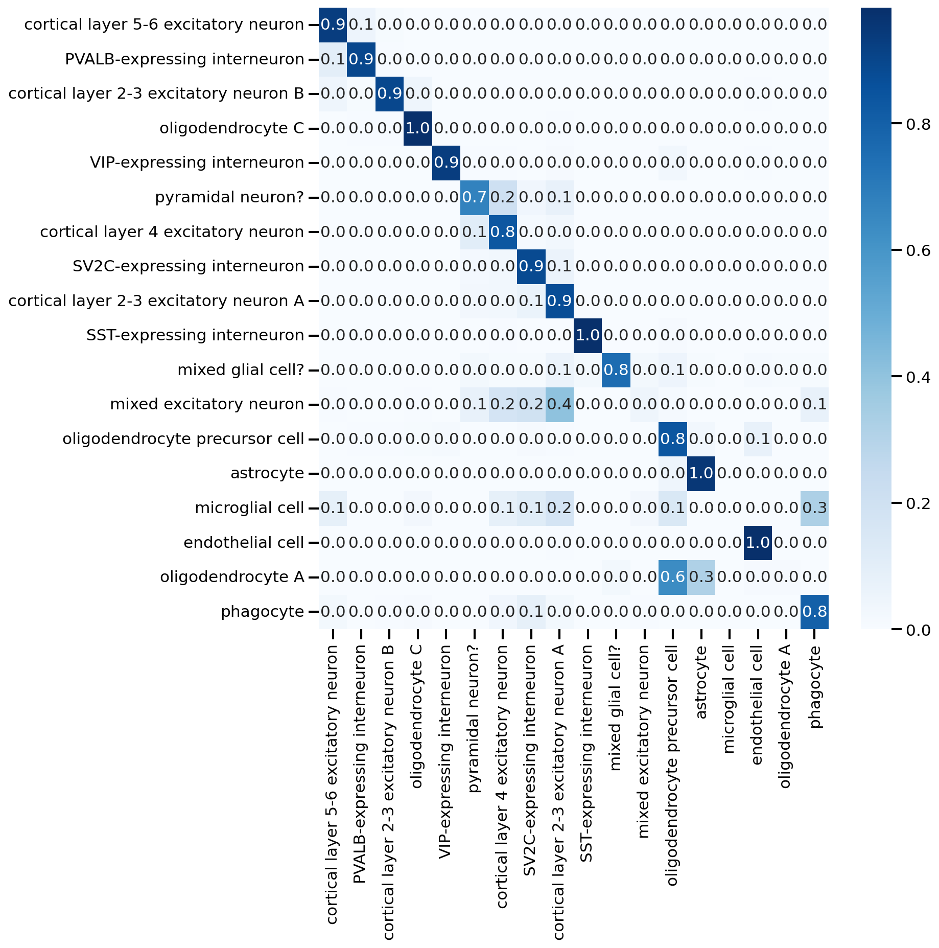
Prediction of Multiple Sclerosis (M.S.) dataset
scGPT GitHub tutorial result:
Cores: 10
Batch_size: 32

Slide 10
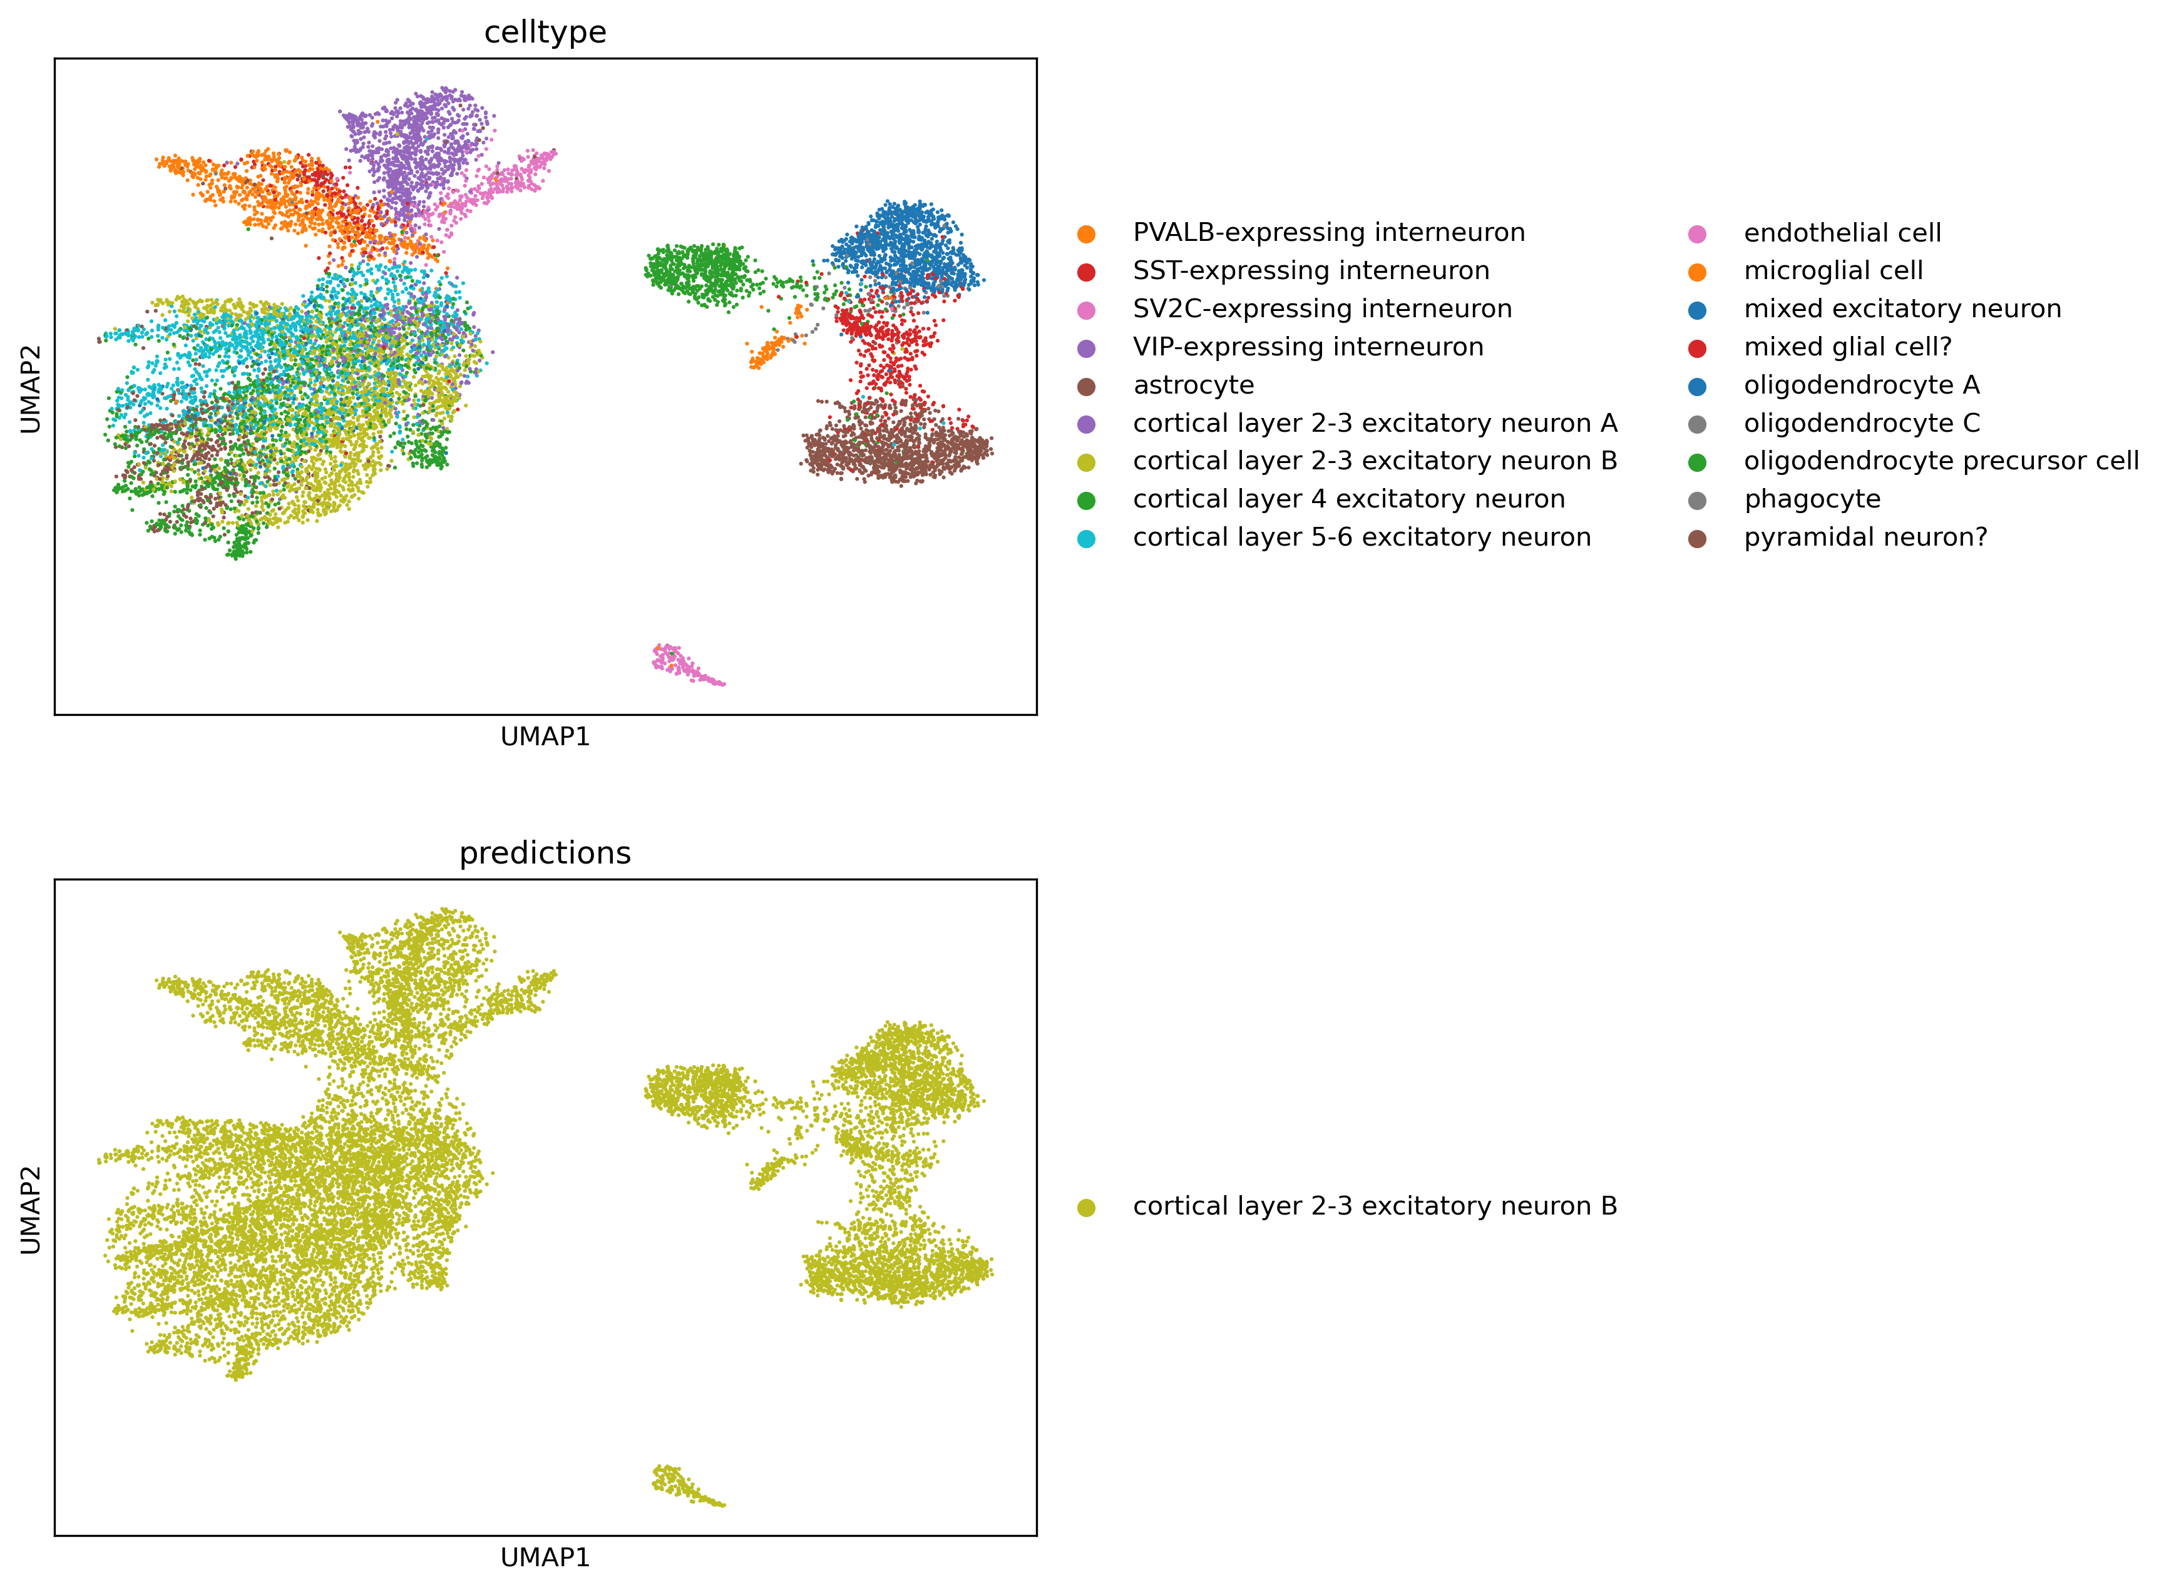
Prediction of Multiple Sclerosis (M.S.) dataset without fine-tuning
Without

Slide 11
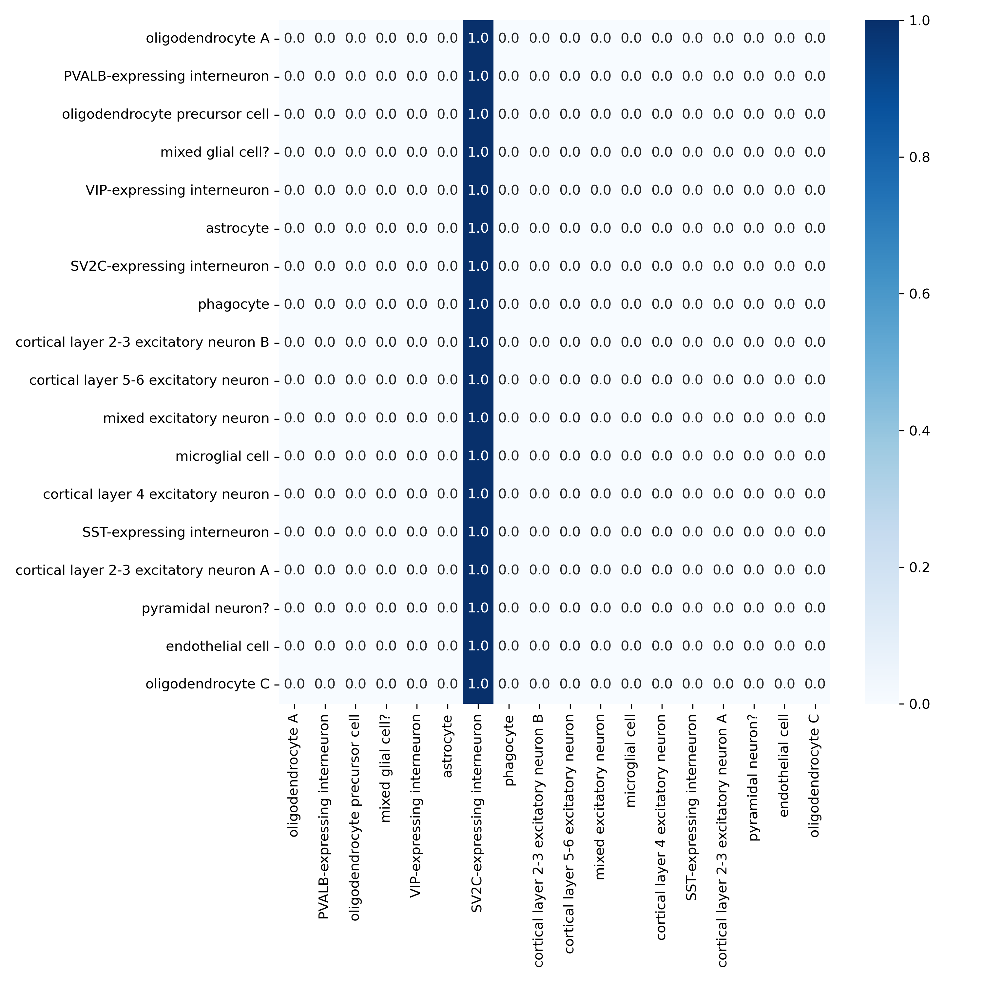
Prediction of Multiple Sclerosis (M.S.) dataset without fine-tuning

Slide 12
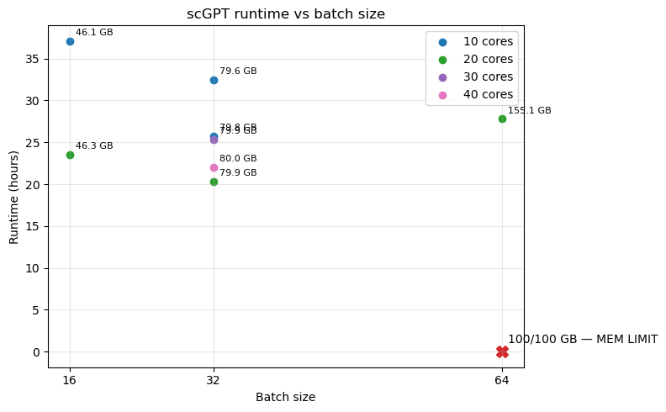
Runtime of jobs

