Slide 1
Progress Reoport
20.08.2026

Slide 2
PBMC3k
Create h3ad file
  Requried files: 10x-genomics-formatted mtx directory
    matrix.mtx : core data file, contains UMI counts (for cell and gene)
    barcodes.tsv : list of all barcodes (cell annotation)
    genes.tsv : list of all genes (gene symbols, gene ids)
      Gene ids = ENSEMBL ID
      Gene symbols are not unique
  Read
    Method: sc.read_10x_mtx
      Makes gene symbols unique by appending ”-1”
      Example: U1 -> U1, U1-1
    Result: 2700 x 32738 count matrix

Slide 3
Basic filtering
Minimum detected genes in cell = 200
  Reason
    Filter cells that are dead
    Filter out empty droplets
  Result: 0 cells
Minimum cells expressing gene = 3
  Reason
    Filter out genes that are too rare
    Make matrix more compact
  Result: 19024 genes

Slide 4
QC metrics
Some basic metrics
  For cells
    number of genes with (positive) counts in a cell
    total number of counts for a cell (library size, count depth)
  For genes
    sum of counts for a gene
    mean expression over all cells
  Mitochondrial genes
    Gene symbols start with “MT-”
    High percentage of mitochondrial RNA indicates dead / ruptured cells
      after cells outer membrane ruptures, cytoplasmic RNA is washed away but mitochondrial RNA will remain

Slide 5
QC metrics
More metrics
  Ribosomal genes
    Low percentage of ribosomal RNA indicates no protein synthesis
  Hemoglobin genes
    High percentage of hemoglobin RNA indicates red blood cell contamination

Slide 6
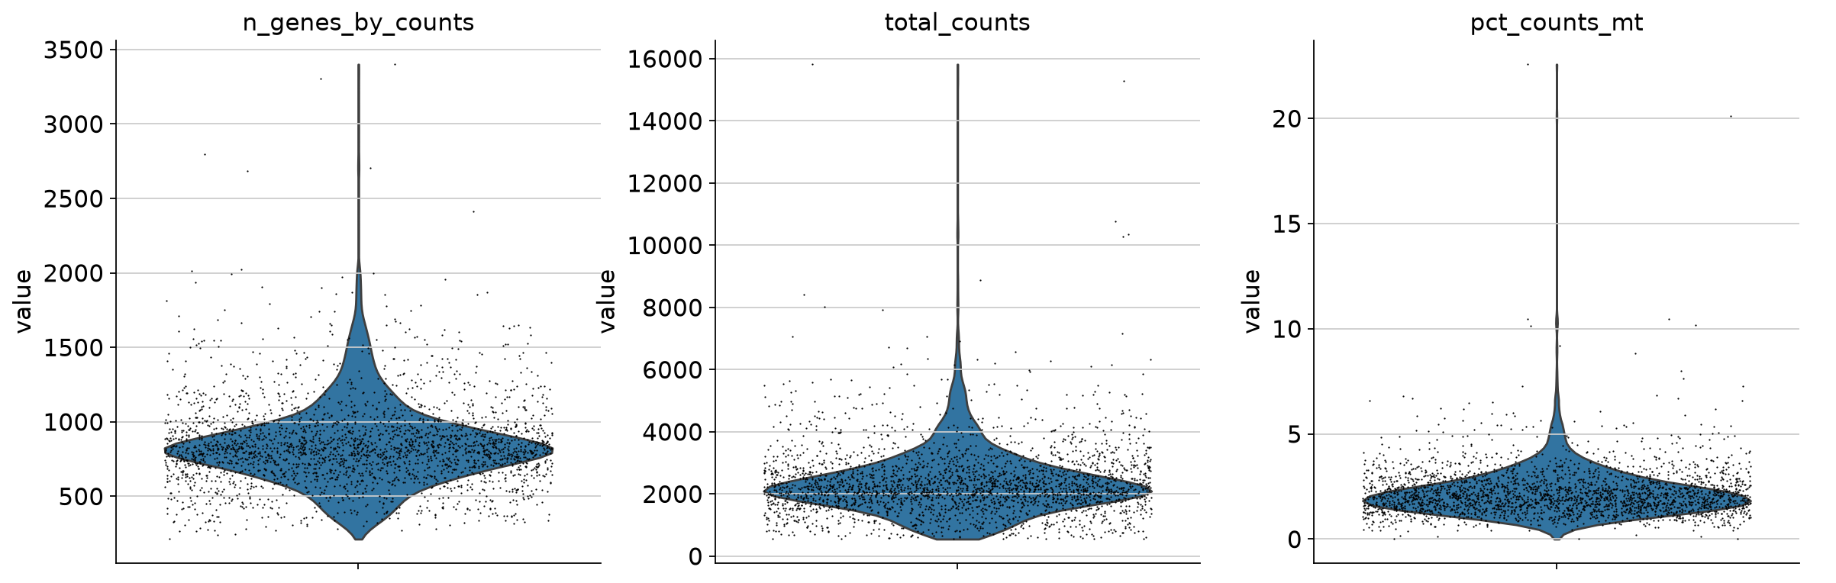
Basic metrics
Workflow only used these two

Slide 7
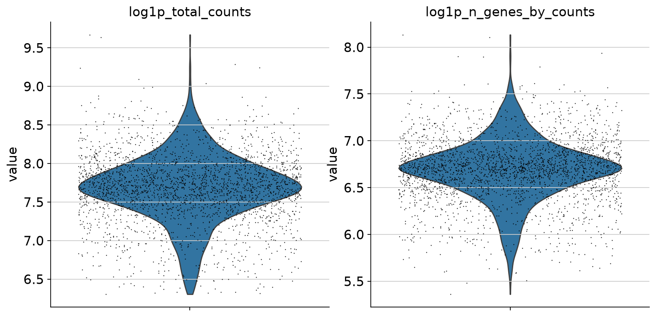
Basic metrics
Is log1p better?

Slide 8
Thresholds
Example workflow
  Metrics: detected genes, percentage of mitochondrial genes
  Hard coded
    n_genes_by_counts >= 2500 or n_genes_by_counts <= 200
    pct_counts_mt > 5
  Issue: might not be applicable to other data sets with different count distributions
  Question: Using “OR” might mean loss of information (cells can have high mitochondrial read count because of other reasons)
Idea
  Use Median Absolut Deviation (MAD)
    Bottom threshold = median - 5 MAD
    Top threshold = median + 5 MAD
  Use log1p values

Slide 9
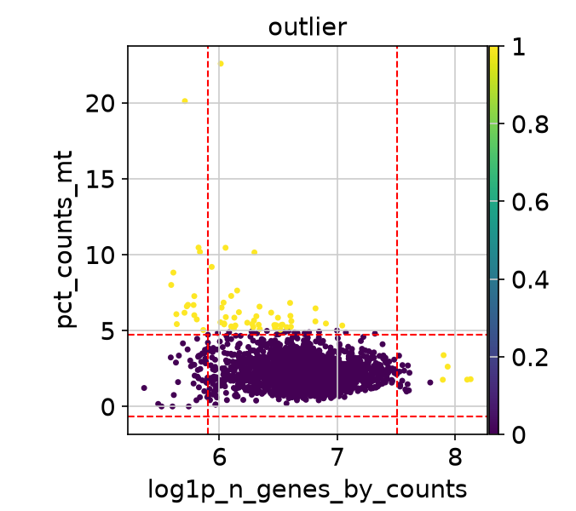
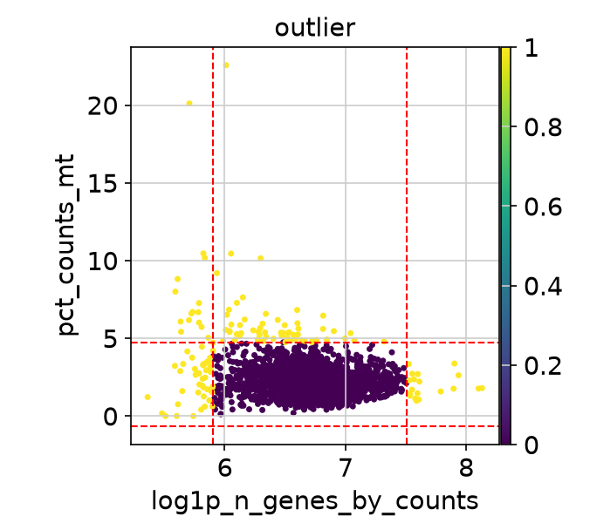
Outliers: pct_counts_mt, n_genes_by_count
PBMC workflow: 62 cells
MAD thresholds (red): 141 cells

Slide 10
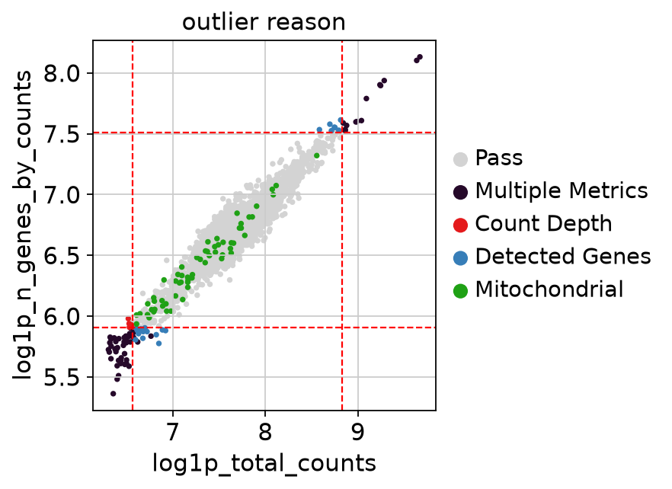
Outliers: MAD approach + Count Depth
MAD with 3 different metrics: 146 cells

Slide 11
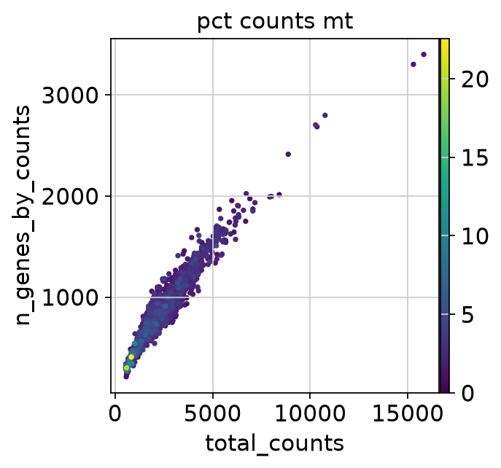
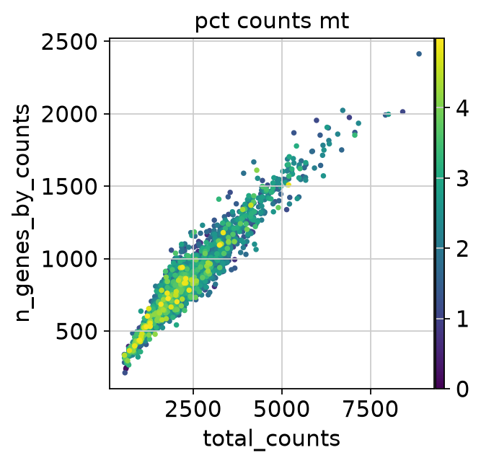
QC result (PBMC workflow)
Before:
After:

Slide 12
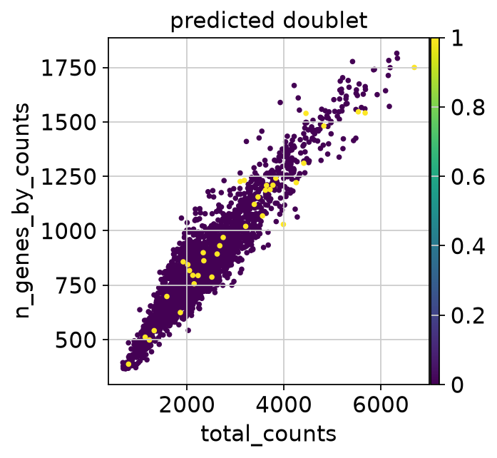
Doublet Detection
In PBMC workflow: did prediction, but did not remove
Result: 32 cells
I have not decided what to do with them

Slide 13
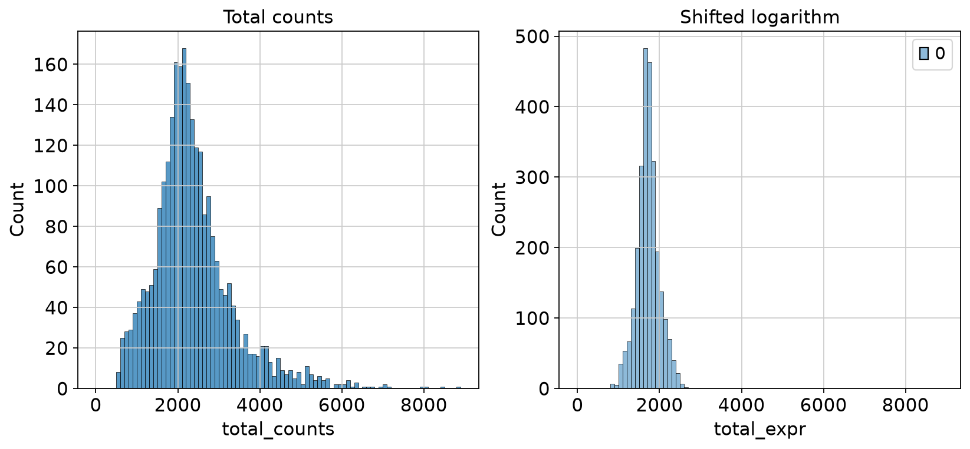
Normalization result

Slide 14
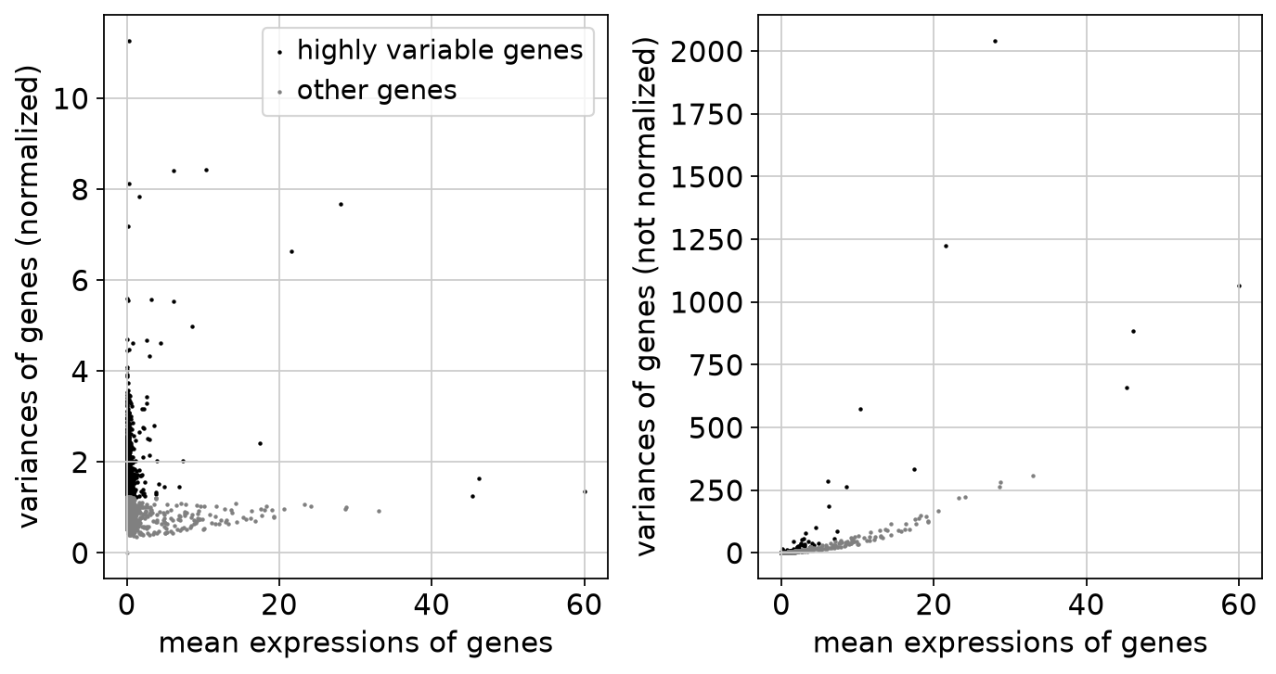
HVGs: Seurat
highly variable: dispersion of gene expression among cells is greater than in other cells (high positive Z-score)
min_disp = 0.5
n_top_genes=2000

Slide 15
PCA
Preparation
  Use normalized expressions
  Regress out unwanted variation by using linear regression
    prevents cells from clustering by read depth or mitochondrial content instead of actual cell types
    don't treat dying vs healthy as dominant axes of variance
  Scaling
    shifts the expression of each gene so the mean is (0) and scales it so the variance is (1) (Z-score calculation)
    clips extreme outliers at (10) standard deviations
    don't let PCA prioritize genes with higher variance

Slide 16
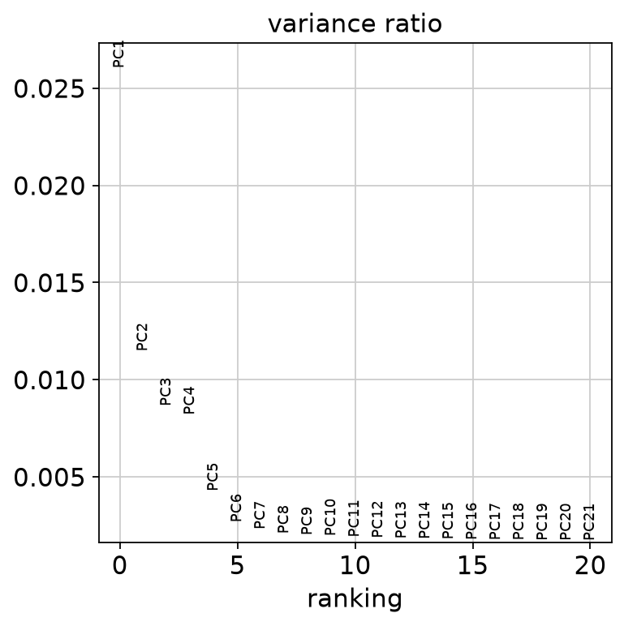
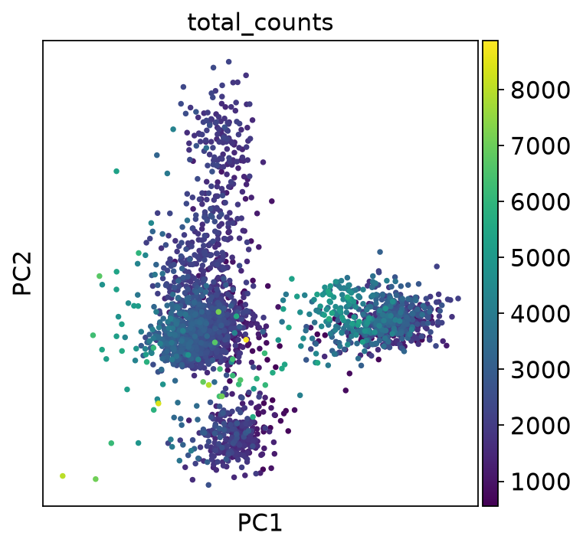
PCA
Configuration
  Compute 50 principal components
  Only use highly variable genes

Slide 17
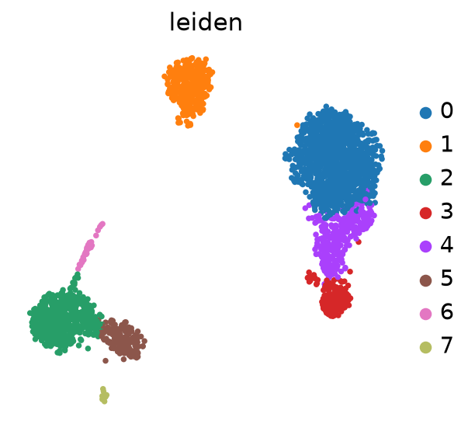
Clustering with leiden
Configuration
  Issue: based on resolution etc. the number of clusters can change. How do I decide?
  Workflow: 8 clusters (resolution=0.7)
  Tests: 9 clusters (resolution=1), 7 clusters (resolution=0.5)
PAGA: partition-based graph abstraction
  spatial layout should mean something biologically (incorporate connection amongst clusters)

Slide 18
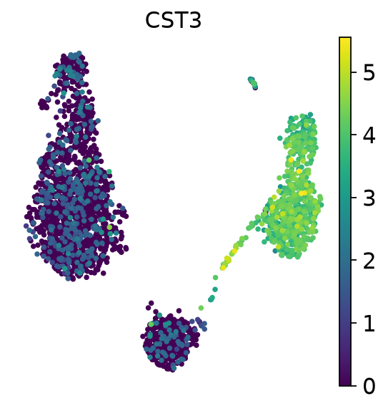
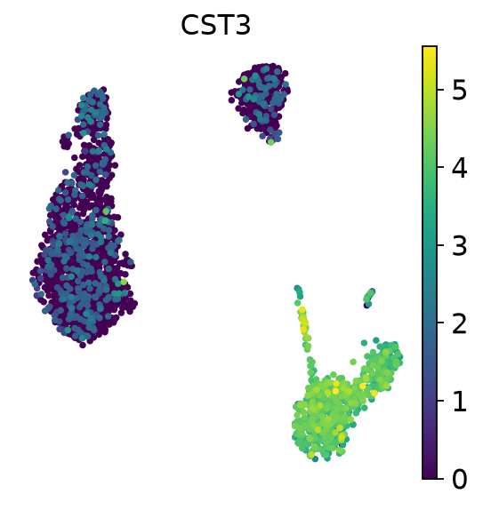
Clustering with leiden (normal vs PAGA)
normal
PAGA

Slide 19
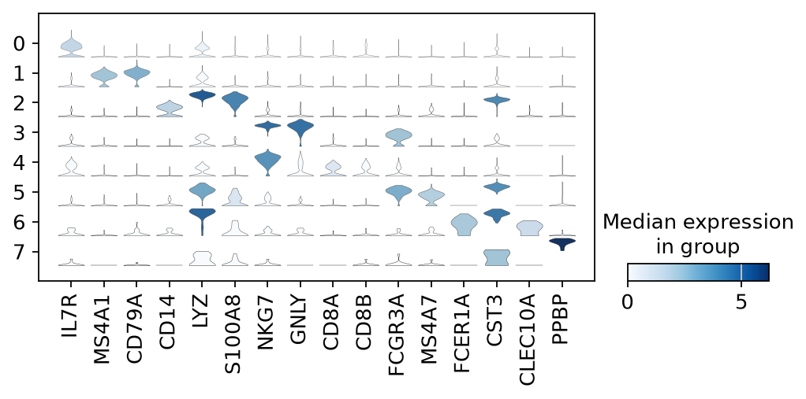
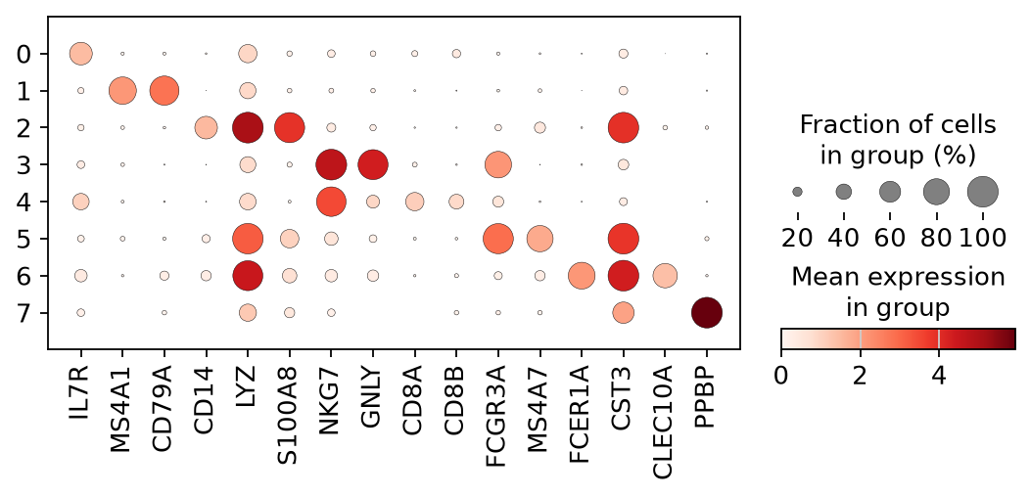
Annotation
Marker genes
  IL7R - CD4 T cells
  MS4A1, CD79A - B cells
  CD14, LYZ, S100A8 - CD14+ Monocytes
  CD8A, CD8B - CD8 T cells
  GNLY, NKG7 - NK cells
  FCGR3A, MS4A7 - FCGR3A+ Monocytes
  FCER1A, CST3, CLEC10A - Dendritic Cells
  PPBP - Megakaryocytes
PBMC workflow: just assigned cell types
Idea: Compare
  for each cell : Compute scores for a set of marker genes (compare to random set of genes)
  Mean score over all cells in a cluster determines which set of genes is highly expressed

Slide 20
scGPT
Installation
  Could not do Recommended: requires GPU
    pip install scgpt "flash-attn<1.0.5”
  Is CPU-only fine?
Next Steps
  Make example scripts and tutorial run
    Import packages (scvi-tools etc)
    Download necessary files
  Follow tutorials (eg. Annotation) and understand
  Understand implementation of methods (look at source code)

