Slide 1
文档地址：
https://docs.google.com/presentation/d/1tNkivCZZwa7SYB3_AEfQYI-GtRscceyARsQDcNglQ78/edit?usp=sharing

Slide 2
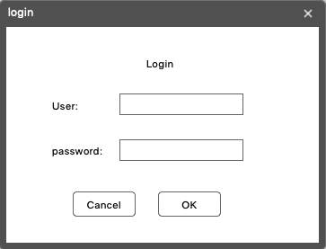
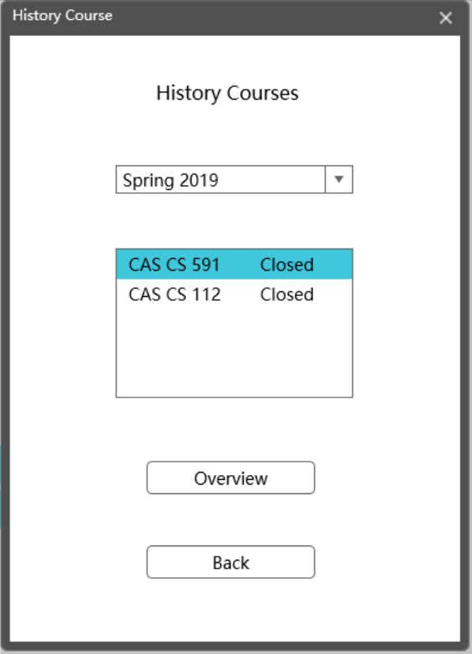
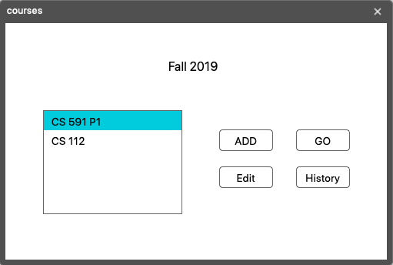
Login.fxml
CourseHistory.fxml
CourseHome.fxml

Slide 3
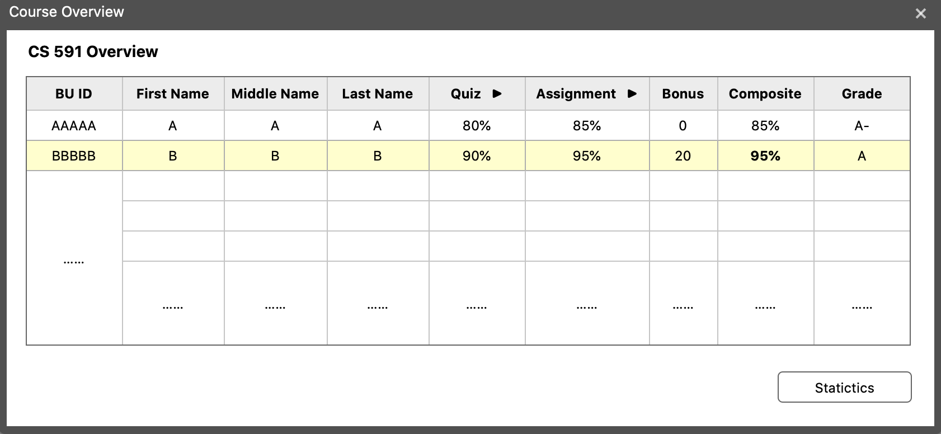
CourseOverview.fxml

Slide 4
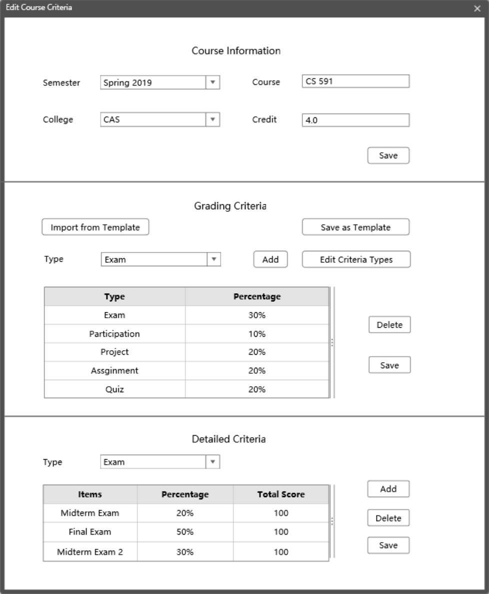
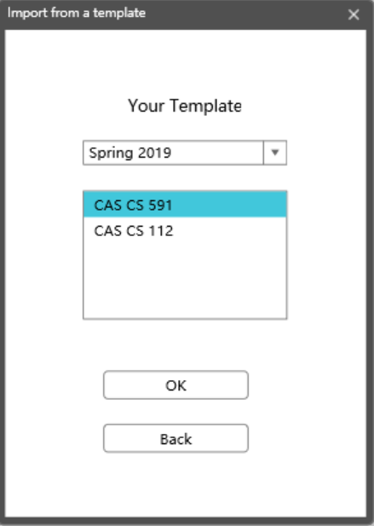
ImportTemplate.fxml
CourseInformation.fxml
view
Feature 1: Create your own criteria type
(eg. bonus)
Feature 2 : Save as / Import from a template

Slide 5
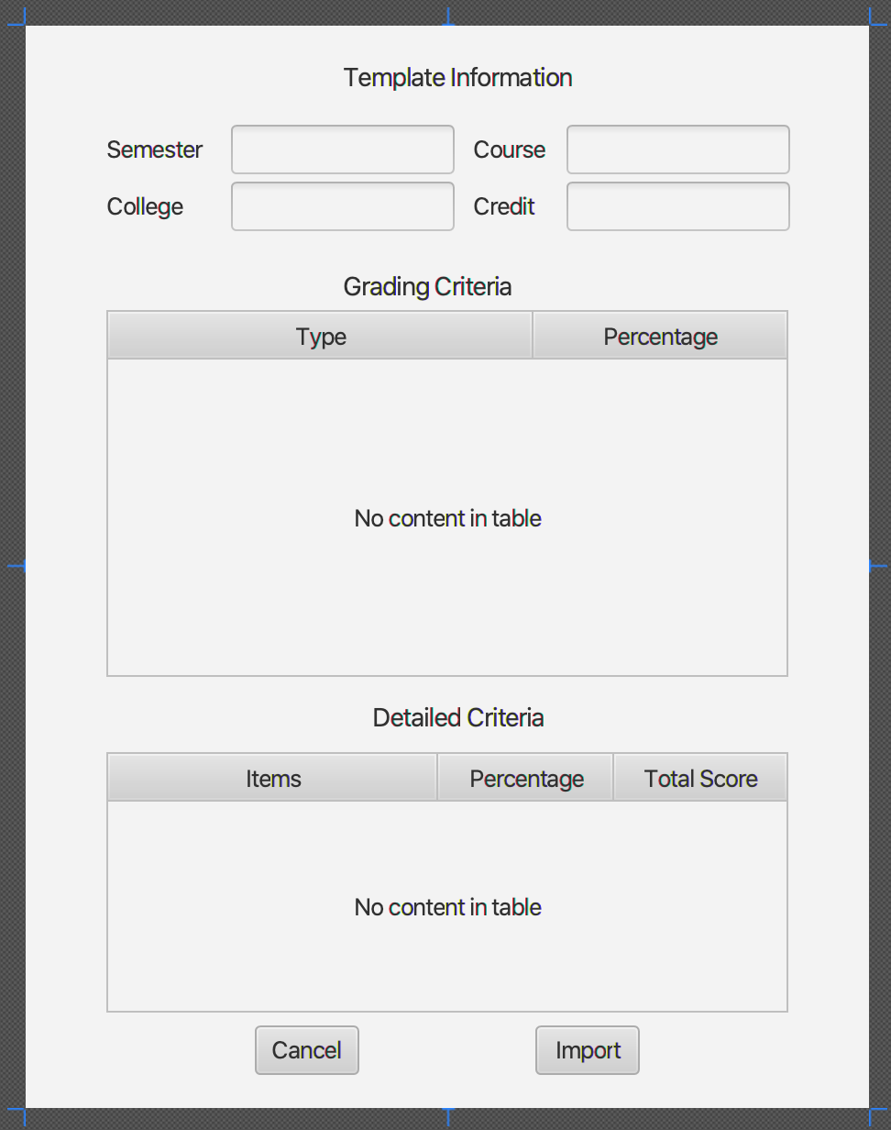
上一页的ok改成view。跳转到这一页
TemplateInformation.fxml

Slide 6
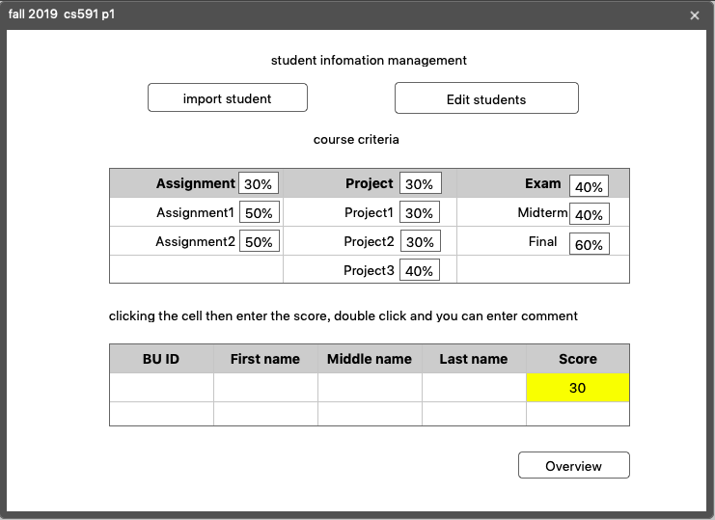
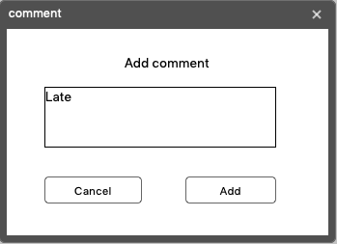
Grading.fxml
AddComments.fxml
Student Information Management
Course Criteria
By click an item, you can give students their grade as below
Add Grades
Feature 1: Two inputs: Nagetive Grades / Percentage
Feature 2: Comments and Highlight
Score and percentage and total score
上面显示总分和百分比？
表格里需要有负分项和百分比
Save

Slide 7
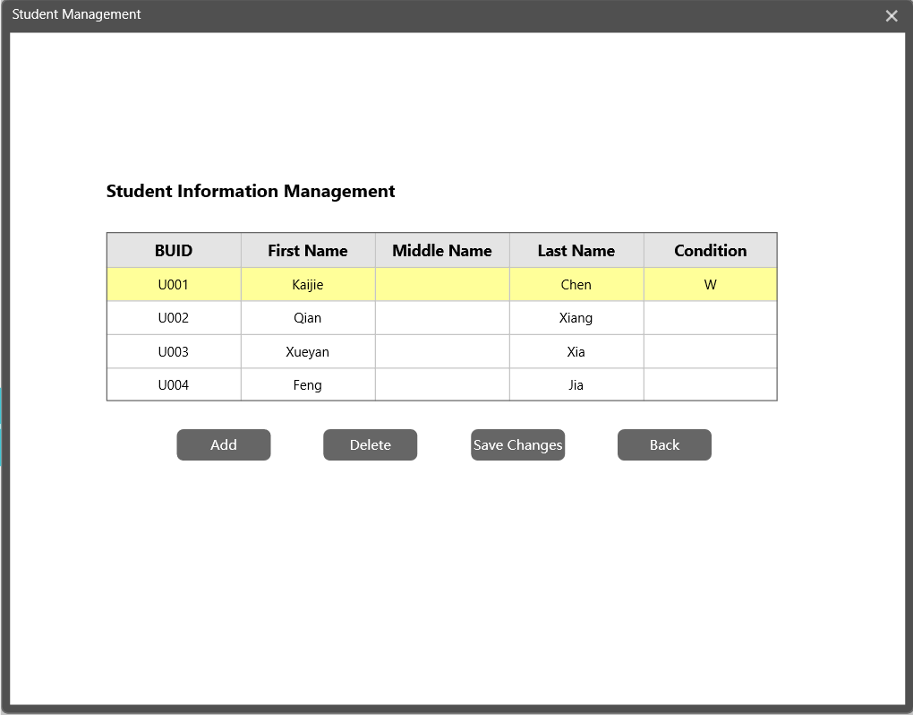
StudentManagement.fxml
By adding student information, you could edit the table directly

Slide 8
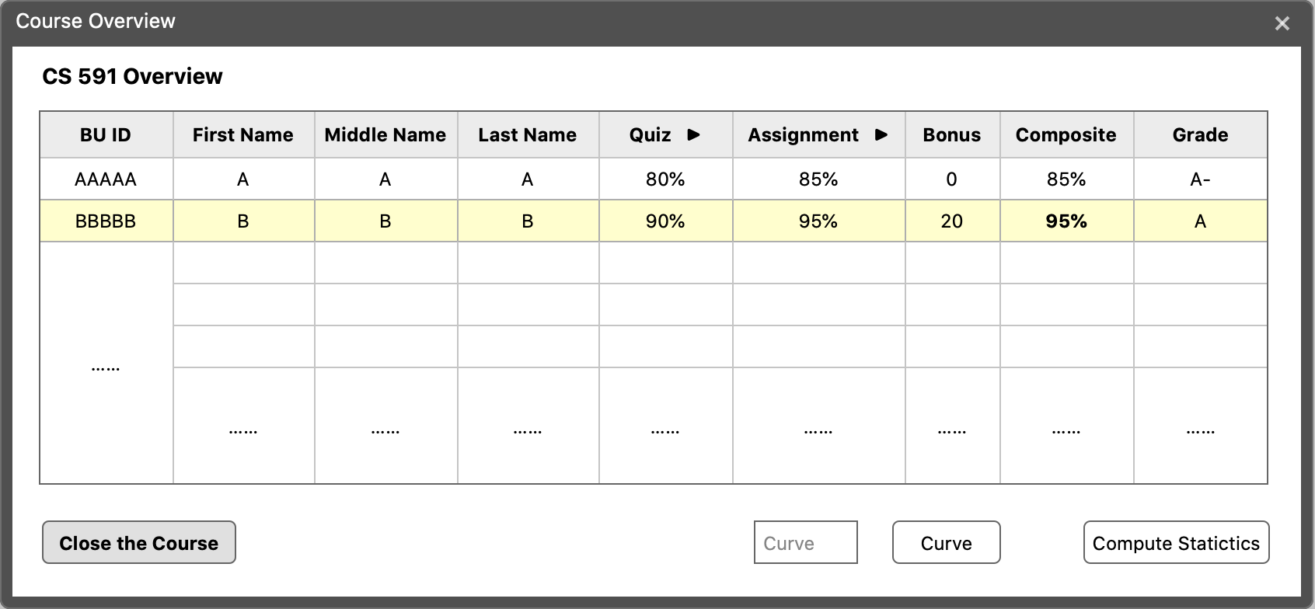
Feature: Fold certain columns (eg. quiz = quiz1 + quiz2)

Slide 9
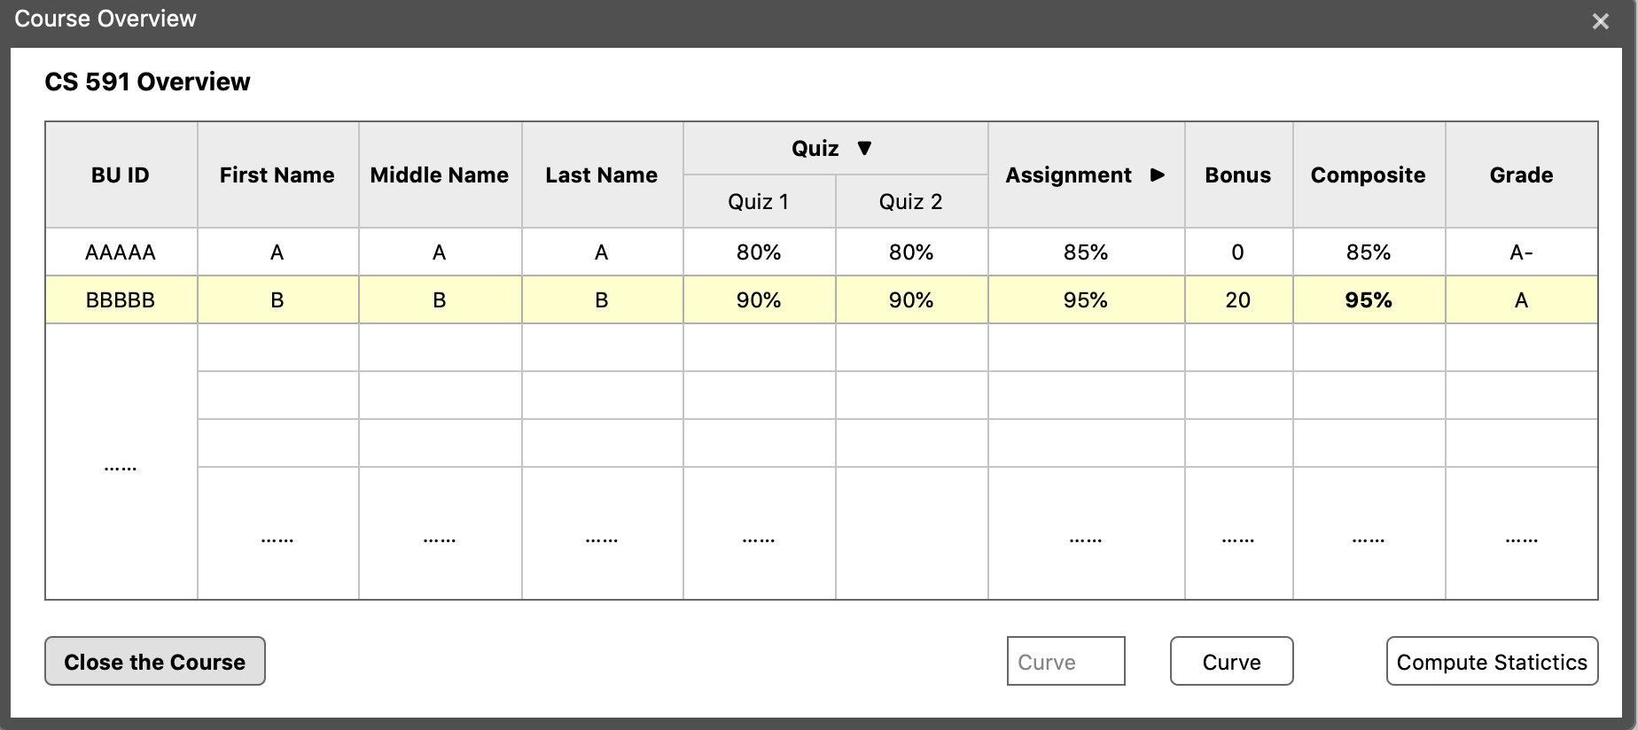

Slide 10
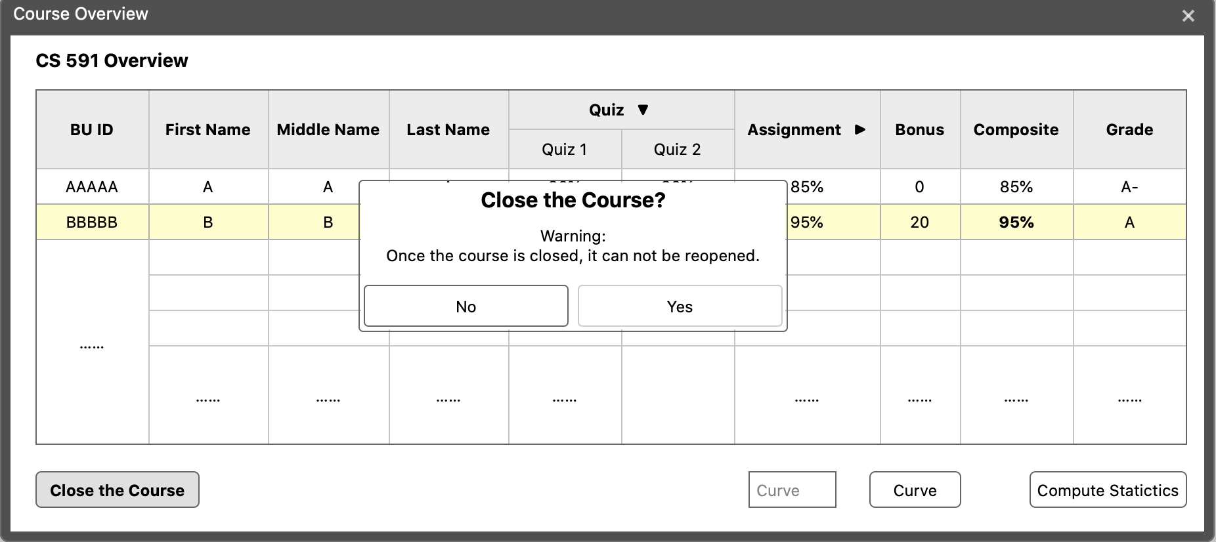
CloseCourse.fxml

Slide 11
