Slide 1
CIFAR 100
Training CNN with PyTorch on CIFAR100 dataset

Slide 2
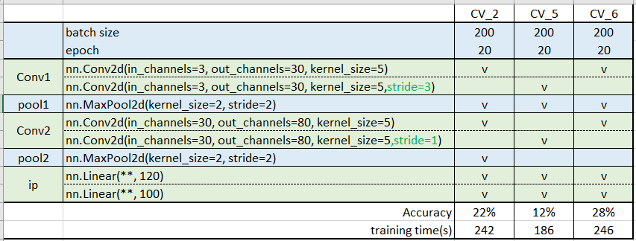
CNN in Pytorch
Changing the number of stride at convolution layer decreases with accuracy because FM did not sufficiently extract the feature of the picture.
  The size of outputs of Conv2 down to 80x1x1
  Suggest to increase the size of outputs of Conv2 layer by removing pool2 layer
Model CV_6 without pool2 layer has a better performance at accuracy

Slide 3
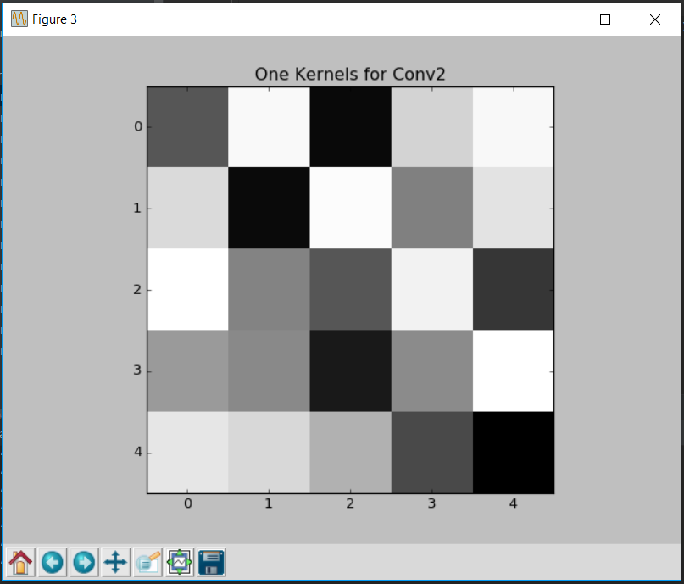
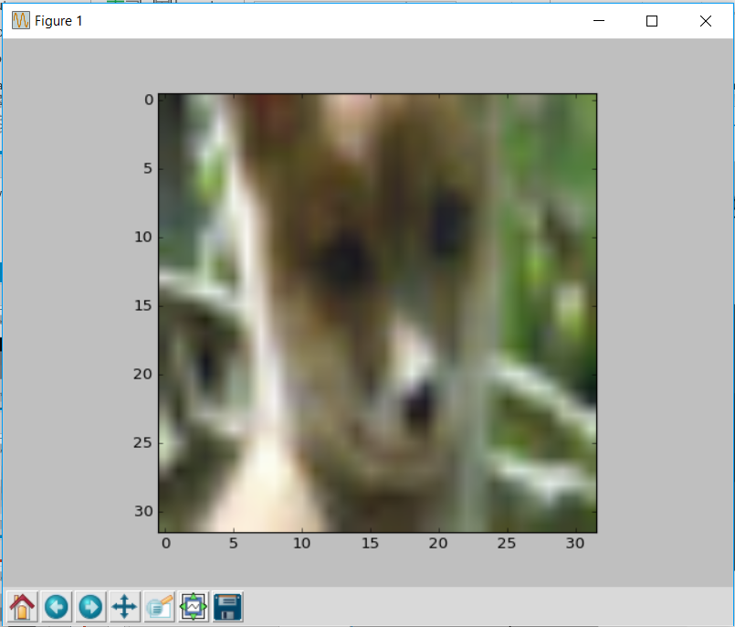
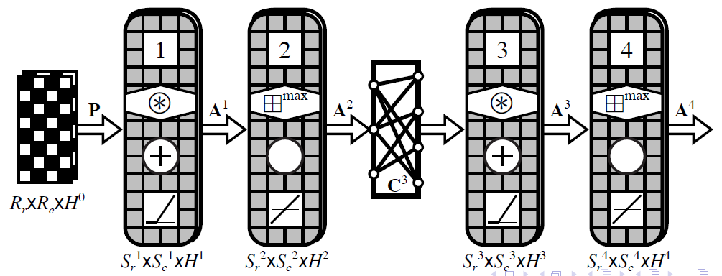
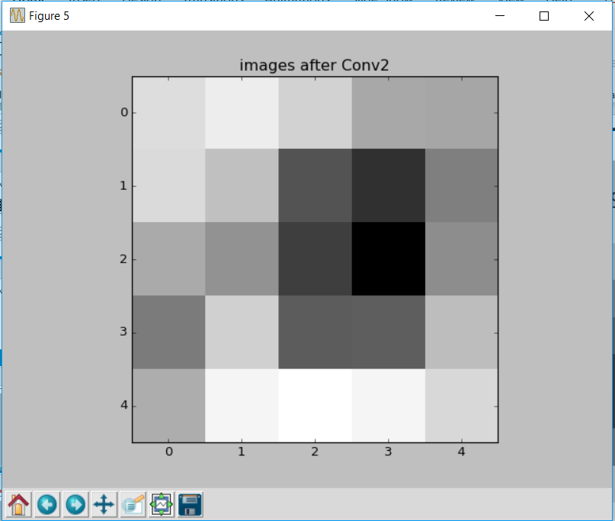
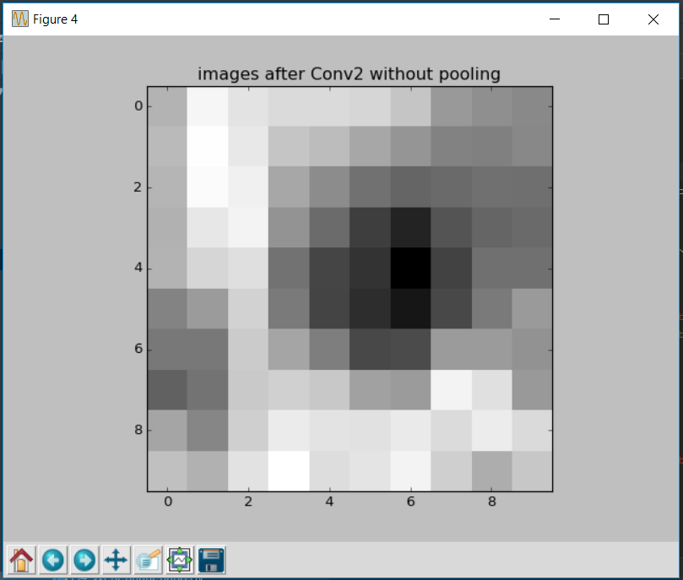
CNN in Pytorch
One kernel
Without pooling
Output after convolution2 without pooling has more information extracted from the original picture

Slide 4
CIFAR100 Dataset
The CIFAR-100 dataset consists of 60000 32x32 colour images in 100 classes, with 600 images per class. There are 500 training images and 100 test images.

