Slide 1
Credit card fraud Detection
By Selina Abraham

Slide 2

Contents
Project Description
Technology Used
Data Visualization
Demo

Slide 3

Project Description
Fraud Cases related to credit card have risen exponentially over the past few years. Unfortunately, fraud is one of the main challenges consumers have to deal with every day. There are different categories of scams with credit card transactions, and big data allows financial institutions to approach fraud differently. Big data can help by identifying suspicious activities, possible fraud attempts and study the historical data to predict anomalies.

Slide 4




Technology Used

Slide 5
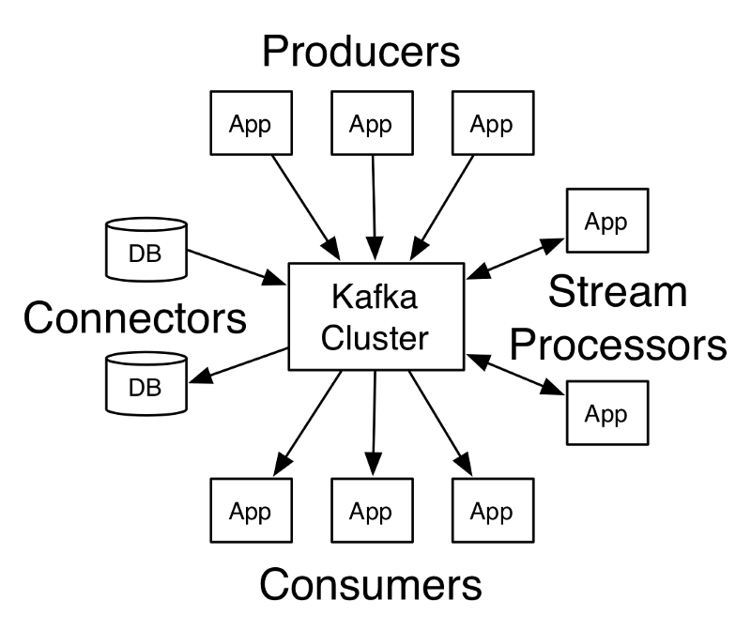
Apache Kafka Kafka supports parallelism and is a distributed message bus; its primary use is reliable message delivery architecture. Kafka uses a system of producer and consumer messaging.

Slide 6
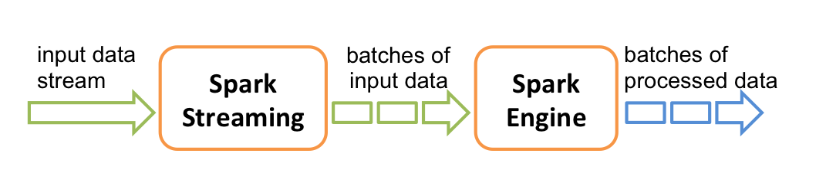
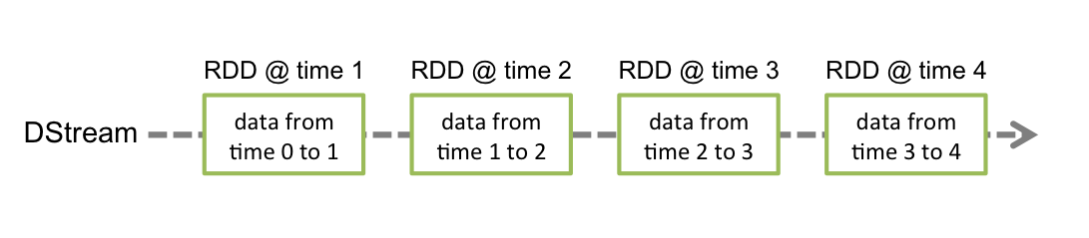
Apache Spark is a framework for batch-processing, like data analytics on distributed computing clusters like Hadoop. Spark Streaming can process structured and unstructured data in Hive, HDFS, Flume, Kafka, HTTP, Twitter,

Slide 7
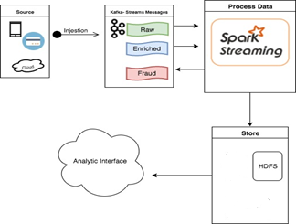
Simple work flow

Slide 8
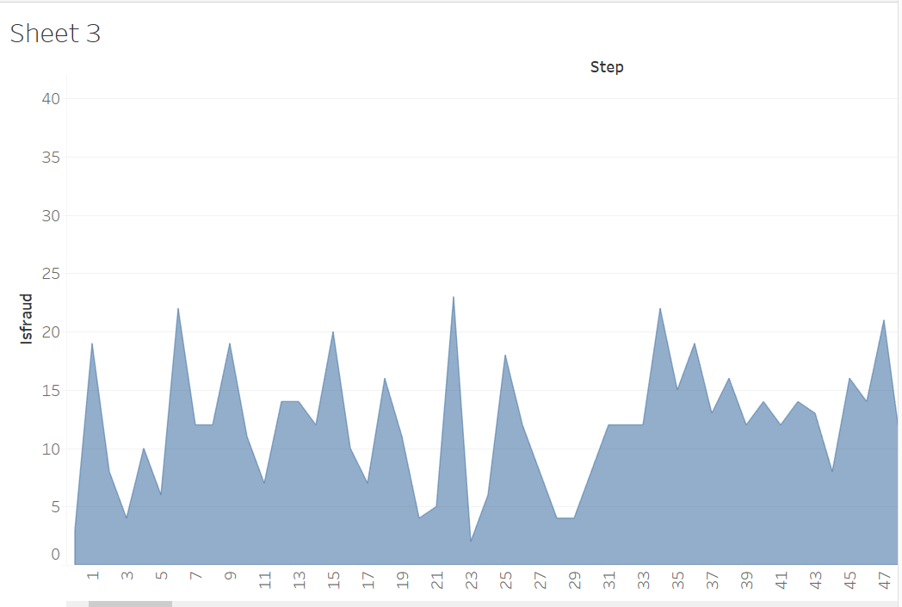
Tableau output

