Slide 1
longview / THE POLICY QUESTION
Three countries.
Different trajectories.
A health ministry analyst needs to know
what was proposed, what was funded,
and which assumptions deserve testing.
Observed life expectancy, 1995–2024
Sweden
United States
Singapore
86
Sweden
84.1
years
82
United States
78.9
years
78
Singapore
83.3
years
74
Life expectancy at birth · 2024
1995
2005
2015
2024
World Bank, WDI SP.DYN.LE00.IN. CC BY 4.0. Retrieved 11 Sep 2026. Period life expectancy; differences do not identify policy effects.
01
Notes:
Audience: health ministry analyst. Team: Selja, Max, Jan. We compare Sweden, the United States and Singapore. The plotted values are official aggregate observations from the same WDI vintage. These differences motivate investigation; they do not show that a policy caused a longer life. The prototype joins a dated policy record to numerical context and explicit what-if assumptions. Source: https://data.worldbank.org/indicator/SP.DYN.LE00.IN . Research snapshot: 11 September 2026.

Slide 2
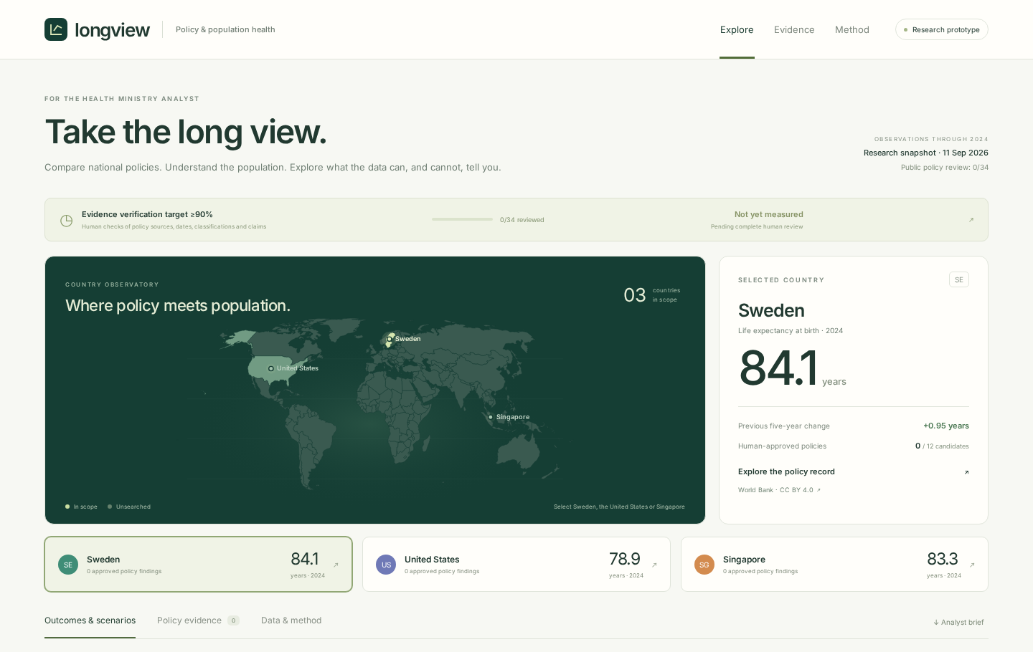
longview / THE WORKING DEMO
From a country to an analyst brief.
01
Choose a country
Observed outcomes and population
context, with dates and sources.
02
Inspect the policy record
Separate proposals, adopted rules
and funding commitments.
03
Change one assumption
Five-year forecast; ten-year scenario.
Share the link and print the brief.
36 candidates · 0 human-approved
React + TypeScript · Python + SQLite · You.com / Tavily discovery · World Bank indicators · Static browser inference; no public research endpoint.
02
Notes:
Demo cue: select Singapore, open Policy evidence, show a source and the distinction between publication and effective dates once human review is complete. Until then, show the explicit review-pending state and the private team review page without marking anything approved. Return to outcomes, adjust PM2.5, switch to ten years, reset, then print the analyst brief. Policy records are not predictive inputs; sliders are user assumptions. The screenshot is the actual running app. Human verification is still pending in this release.

Slide 3
longview / EVIDENCE & THE NEXT TEST
Make the uncertainty part of the decision.
FIVE-YEAR HISTORICAL FORECASTS
HUMAN EVIDENCE VERIFICATION
1.10
≥90%
years mean
absolute error
required initial
sample pass rate
Regression
1.10
0 / 34 reviewed · Not measured
No change
1.23
Source, date, classification and claim.
The initial sample is frozen before correction.
Unapproved claims stay out of the public release.
Previous trend
1.28
1,098 tests · 183 training countries / economies
Known failure: US error 1.95 years vs 0.91 for no change. Wider interval coverage: 74.9% (90% target).
Next pilot: test analyst interpretation and review comparable fundamental-ageing research funding. Team: Selja · Max · Jan.
Measured from release b89b9bf93a80 / d9261b592fe1, 11 Sep 2026. Current revised data; non-causal model. No clinical claims.
03
Notes:
The ridge model beats both baselines on the wider historical test, using model selection fixed on a pre-test validation period. Sweden, the US and Singapore were withheld from every fitting, tuning and calibration set. The US regression fails against both baselines. The displayed interval is an empirical error band: nominal 90% coverage achieved only 74.9% in the wider test. There are six overlapping historical origins per held-out country, so these are small dependent samples. The evidence requirement is different: at least 90% of the frozen initial findings must pass four human checks. At generation time no human reviews have been imported. Two supplemental funding leads are outside the initial 34-record benchmark and also require approval. The proposed adoption pilot measures source-checking time and whether analysts correctly understand conditional scenarios; no adoption benefit has been measured yet. Sources: public/release/quantitative.json; public/release/evidence.json; docs/model-evaluation.json.

