Slide 1

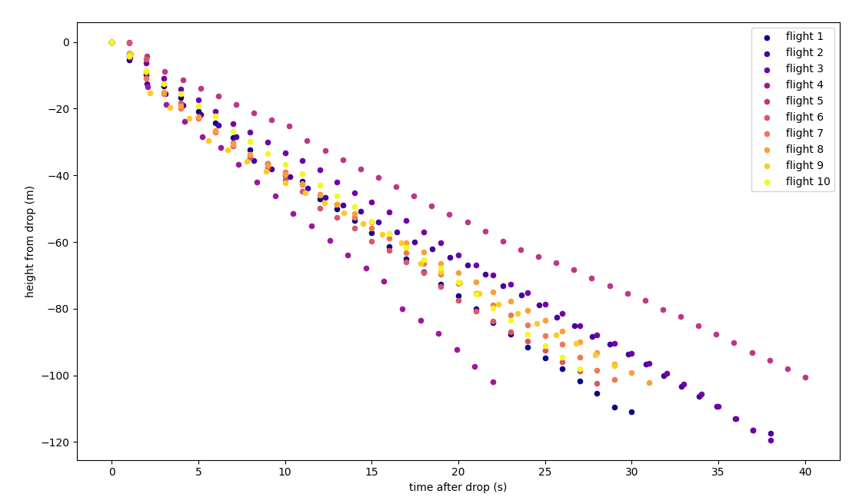
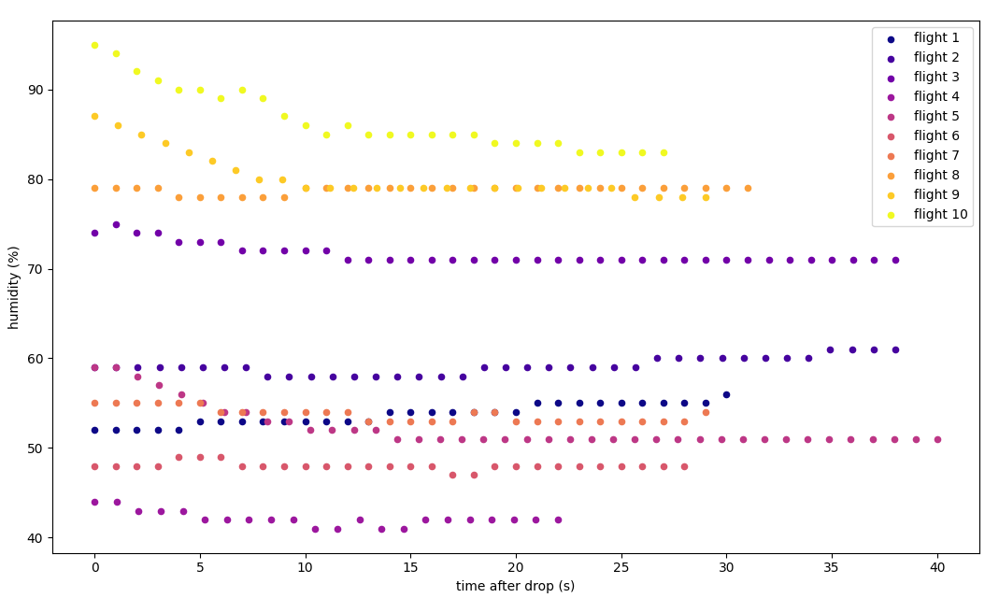
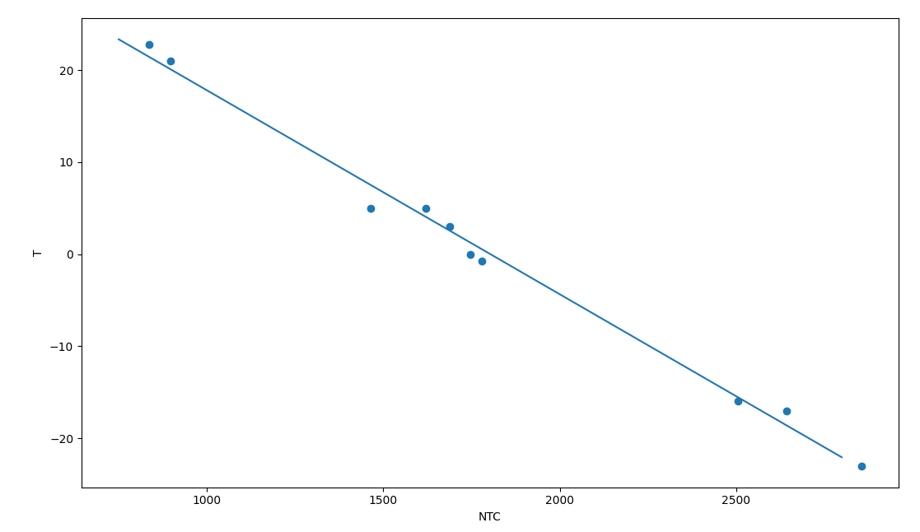
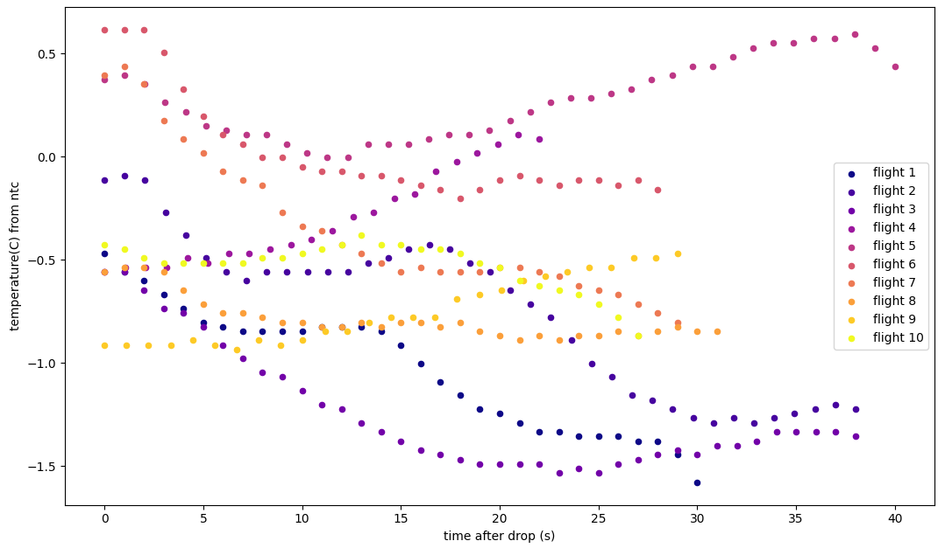
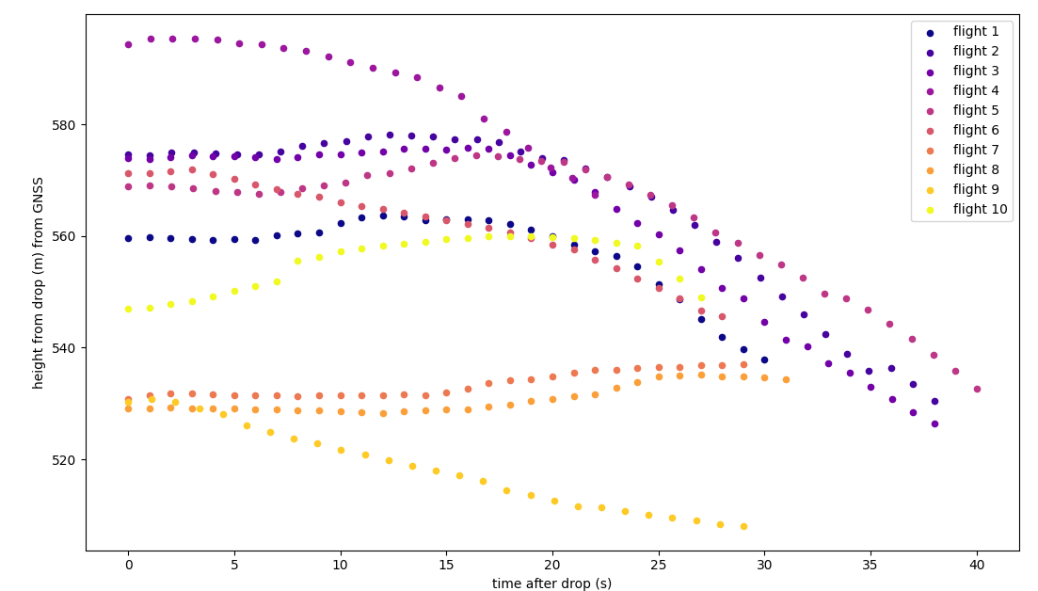
AGF 223 Flight Campaign: CuteSat
Selma Kiefersauer
Objective:
Measuring the atmosphere with a CanSat. Creating a heightprofile of the atmosphere, comparing to standard atmosphere model. The Sat gets flown up with a drone to 120m and then dropped with a (hopefully) deployed parachute. We did 10 flights at KHO observatory which is at 520m above sealevel, and 2 flights in Adventdalen at … m above sealevel. Just one flight in Adventdalen gave reasonable data though, as we had huge data gaps in the second flight. (Include the one Adventdalen flight? Does it give any new insights?)
Calibration of sensors:
Humidity and temperature have a ridiculously long time constant, several minutes. Part of the problem is the sensors being inside the can. In addition the electronics of the Sat produce warmth which leads to a 2-3 degree difference compared to reference sensors. The NTC has a time-constant of 9s, so too long for the flights but otherwise helpful if it stays in a place for some time.
Pressure: quite useful, can be used to calculate the height. The drop of the Sat is clearly visible, therfore I used this to define the point of the drop in all the data!
- Formula to calculate height from pressure: … assumptions!
Humidity:
As mentioned too slow, here are the plots
which are basically constant
NTC calibration: get the temperature from the NTC value by taking many reference measurements and fit a curve (linear):
Formula to calculate the temperature from the NTC value:
T = -0.02217*NTC+39.9886
Uncertainty:
The temperature range for the flights makes sense (between -1.5 and 1 degree Celsius), even though it is not very usefull during the flight bc of the time constant
Also temperature doesnt change a lot in 120m acording to standard atmosphere model (lapse rate of -6.5K/km or so?)
GNSS data:
Tracks of flight
std: lat 6.3m, lon 5.3m
Not useful for height as it clearly doesn`t give the 120m height difference during the flight
Can derive wind direction and speed
Pitch, yaw and roll:
- Our flights were quite stable, even though the plots of the above are more chaotic. This is due to the position of the can during flight and the definition of the zero points – it`s jumping a lot when its upright!
Improvements:
Try to correct for the time delay in NTC,
could For example have waited 10s up before drop
Have GNSS callibration at KHO Breinosa before the flights,
then we would have a better std for that day and that location instead of using the one from the measurement at UNIS

