Slide 1
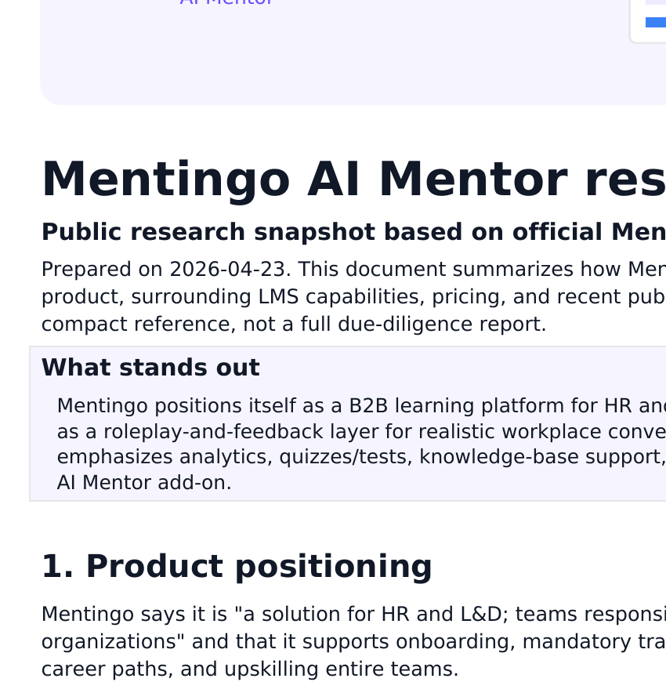
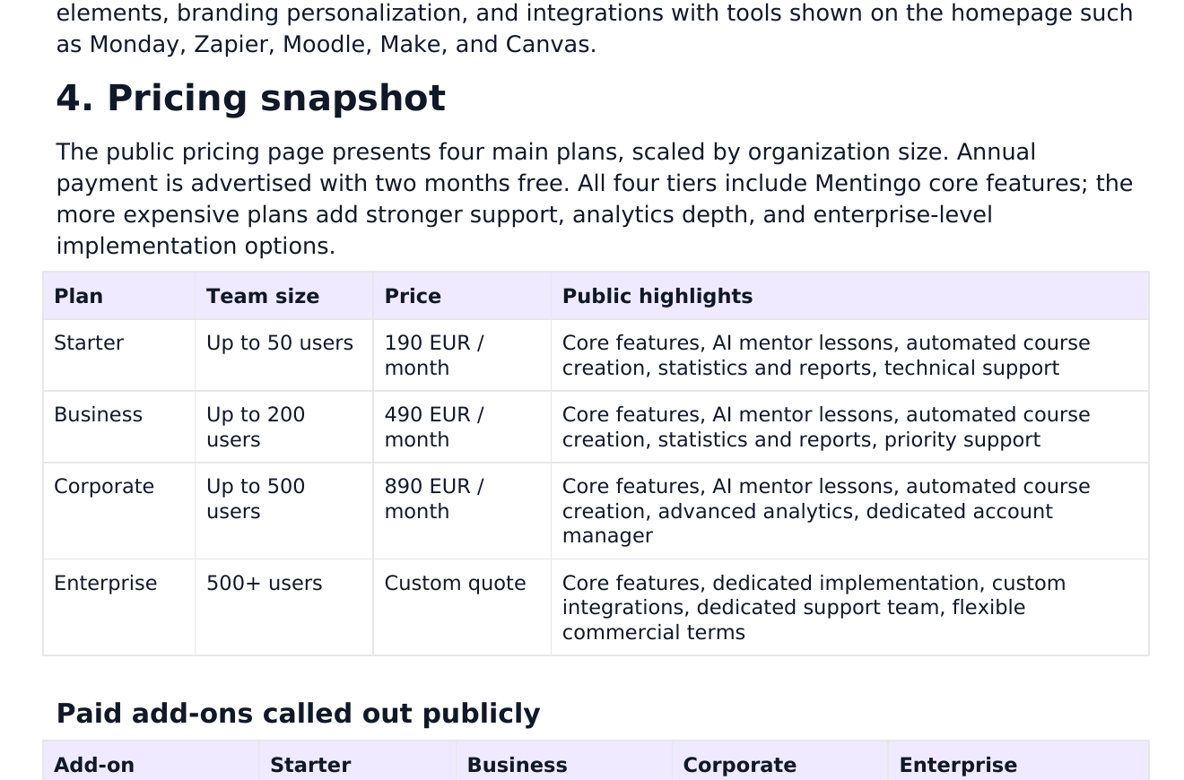
Mentingo
Content presentation preview
A public-site snapshot of product positioning, AI Mentor capabilities, pricing, and recent product momentum.
HR & L&D
AI practice layer
Pricing view
Based on Mentingo public pages

Slide 2
How Mentingo positions itself
Public snapshot
Mentingo presents itself as an AI-enabled learning platform for HR and L&D teams.
Targets onboarding, mandatory training, development programs, career paths, and upskilling.
Promises faster course creation with AI and simulations based on real workplace challenges.
Frames the platform as one place to plan, run, and measure people development.
Public site emphasizes practical learning, not just passive content delivery.
Site messaging leans toward team capability-building rather than a generic LMS pitch.

Slide 3
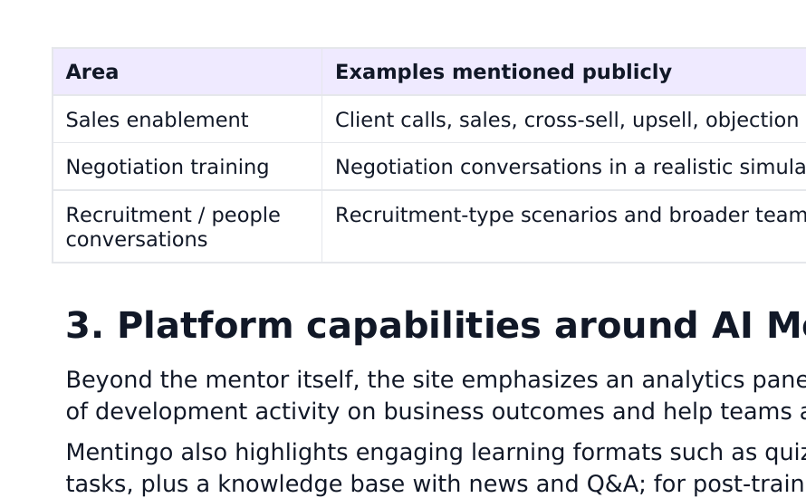

Where AI Mentor fits in the product
Mentingo combines AI practice, content generation, analytics, and broader LMS workflows.
Interactive AI lessons
Practice scenarios with an AI mentor instead of only reading or watching.
Courses from documents
Upload company docs and turn them into training content more quickly.
Stats and reports
Track progress, engagement, and learning effectiveness in real time.
White-label + integrations
Brand the experience and connect tools like Monday, Zapier, Moodle, Make, and Canvas.
Public benefits highlighted on pricing and homepage

Slide 4
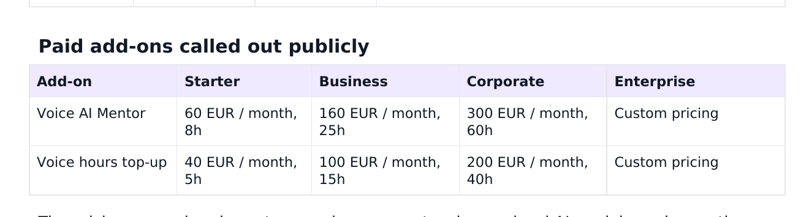
Pricing snapshot
Public pricing shows four main tiers plus optional voice add-ons.
Starter 190 € / month
Business 490 € / month
Corporate 890 € / month
Enterprise Custom quote
Voice AI Mentor add-on: 60 / 160 / 300 € monthly for Starter / Business / Corporate, with enterprise pricing custom.
Annual upfront payment is advertised with two months free.

Slide 5
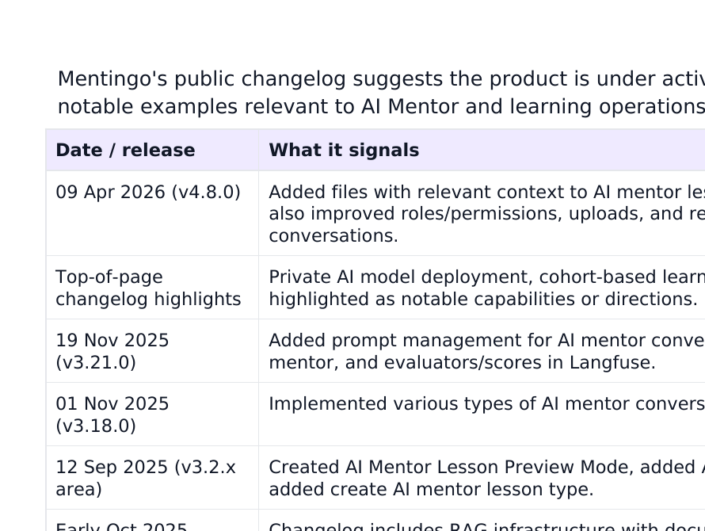
Signals from the public changelog
Release activity
The changelog makes Mentingo look like an actively evolving AI learning product.
2026: magic-link login, AI Mentor task descriptions, modern course list, and reliability improvements.
Late 2025: multilingual course UI, customizable AI Mentor appearance, group/user unenrollment, and admin previews of student conversations.
Nov 2025: prompt management, emoji picker, evaluators/scores, and richer AI Mentor workflows.
Oct 2025: multiple AI Mentor conversation types, preview mode, student interaction, and broader learning analytics.
Takeaway: Mentingo appears to be pushing beyond a basic LMS toward configurable AI-guided practice and enterprise readiness.

Slide 6
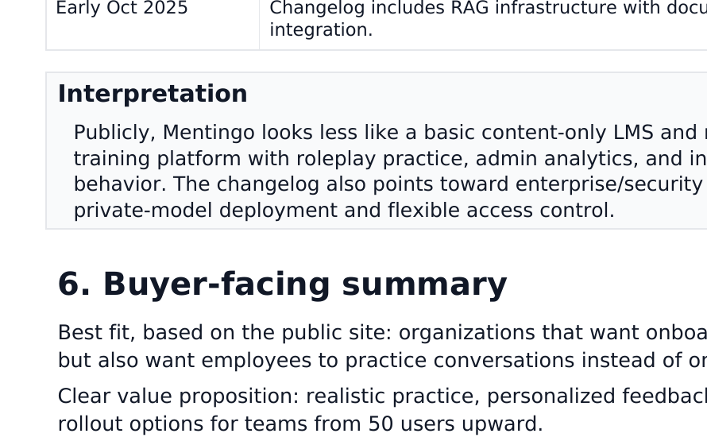
Bottom line
Best public-facing fit: organizations that want training content and realistic skill practice in the same platform.
Best for
Why it stands out
Questions buyers will ask
HR/L&D teams building onboarding, compliance, and upskilling programs for 50+ users.
AI Mentor roleplay, document-to-course workflows, analytics, and white-label options.
Integration depth, security posture, implementation effort, and true ROI after rollout.
Overall impression from public materials: Mentingo is selling a modern, AI-enabled training platform with practical conversation practice as a differentiator.
Sources used: Mentingo public homepage, pricing, changelog, learning hub, and case-study pages.

