Slide 1
Intractable Problems
We mentioned that Global Alignment and Parsimony were NP Complete
We said that this meant that solving them would take an exponential amount of time
Now we want to give you some background on why this is so
If we could guess the best parsimony tree we could check it in a short period of time, so shouldn’t we just come up with better algorithms for guessing?

Slide 2
Building Bridges
Standard algorithms exist to build bridges over arbitrary rivers
Even though it may be possible, it is not reasonable to build a bridge across the Pacific Ocean
Traveling salesman with 80 cities would take millions of years with the fastest processors
It is computable, but not tractable

Slide 3
Classifying Complexity

Slide 4
Order Notation
n²+3n+7=O(n²)
f(n)=O(g(n)) if
  There are constants C and n₀ so that for every n>n₀ f(n) < Cg(n)

Slide 5
Example
f(n)=n²+3n+7 g(n)=n²
C=2, n₀=5

Slide 6
Towers of Hanoi
The Legend. In an ancient city in India, so the legend goes, monks in a temple have to move a pile of 64 sacred disks from one location to another. The disks are fragile; only one can be carried at a time. A disk may not be placed on top of a smaller, less valuable disk. And, there is only one other location in the temple (besides the original and destination locations) sacred enough that a pile of disks can be placed there.
So, the monks start moving disks back and forth, between the original pile, the pile at the new location, and the intermediate location, always keeping the piles in order (largest on the bottom, smallest on the top). The legend is that, before the monks make the final move to complete the new pile in the new location, the temple will turn to dust and the world will end. Is there any truth to this legend?

Slide 7

Towers of Hanoi

Slide 8
Complexity
Is it in NP
  No, even if you could guess the answer, the answer is exponential in length and it takes an exponential number of steps to check it.
Is it in P?
  No, since NP includes P.

Slide 9
Pairwise Alignment
Given k characters
We have at most a k x k matrix (k² elements)
We have to make 2 passes, one to score the matrix, and one to find a path back
The path back could be at most 2k in length
So the total complexity is 2k + k² =O(k²)

Slide 10
Perspective
Halt
Computable
Towers
of
Hanoi
NP
Parsimony
2-align
P

Slide 11
Open Problem
is P=NP?
We have never proved a exponential time for NP problems.
If one was ever performed, the question would be answered.
Nobody has ever found a problem in NP that is provably not in P

Slide 12
Hamiltonian Path
Given a graph, is there a path that passes through all points exactly once

Slide 13
Complexity
Is it in NP?
  Yes, if we guess the correct solution, we can check it in polynomial time
Is it in P?
  No polynomial solution has ever been found to this problem
It is extremely useful in fault tolerant networks etc..

Slide 14
Eulerian Path
Is there a path which passes through each edge exactly once?
No Eulerian Path
Eulerian Path

Slide 15
Complexity
Is it in NP
  Yes, if you can guess the answer, you can check it in polynomial time
Is it in P?
  Yes, Leonhard Euler, there is a path if
    It is connected
    The number of edges emanating from any point (with the possible exception of two points) is even

Slide 16
Polynomial Time Reductions
If we can find a polynomial time algorithm for converting problem X into problem Y, then we can use an algorithm for problem Y to solve problem X
This means that Y is harder to solve than X
If we can solve Y in a polynomial amount of time, then we can also solve X in poly time

Slide 17
Example
Reduce Hamiltonian Path to Traveling salesman. This shows that Traveling Salesman is at least as hard
Given a graph G with N nodes, construct a traveling salesman network G’ in polynomial time
The nodes of G’ are the nodes of G
Edges are drawn between each pair of nodes, assigning cost 1 if the edge is present in G, cost 2 if it isn't

Slide 18
Example
1
2
1
1
1
1
2
2
1
2
G
G’
Does G have a Hamiltonian
path?
Does G’ have a tour that
is no longer than N+1?

Slide 19
NP-hard Problems
A problem is NP-hard if every other problem L_{I} in NP can be reduced to it
NP-Hard problems may not be in NP
NP-Hard problems are as hard, or harder than anything in NP
NP-Hard problems have never been shown to admit poly time solutions
They are all exponential or worse

Slide 20
NP-Complete Problems
A language or problem is NP-Complete if it is in NP-Hard and is an element of NP
These are the hardest problems in NP
None of them have ever been shown to admit poly time solutions
If one of them ever did admit a poly time solution, all problems in NP could be solved in poly time (P=NP).

Slide 21
Global Alignment is NPC!
What does this mean
Just showing that your algorithm takes an exponential amount of time could mean that you just have a bad algorithm
Showing it is NPC causes you to give up hope
Because it is unlikely that all NPC problems have polynomial algorithms

Slide 22
Overview
Towers of Hanoi
Halt
NP-Hard
Global Alignment
Parsimony
NP-Complete
Primality
NP
P
Pairwise Alignment Linear Programming
Log
Time
Telephone Book
Search

Slide 23
Don’t give up yet!
Linear Programming is used extensively in scheduling assembly lines, routing in computer networks etc..
It is easy to show that the problem is in NP
Until 1979 the best known algorithms were exponential
There was no reduction from a NP-complete problem
Finally, the Simplex algorithm was found which is poly
The Exponential algorithm is still used for small values of N

Slide 24
Other Problems
SAT
3SAT Exact Cover Independent Set Inequivalence
Hamiltonian Cycle Knapsack Clique Node Cover
Undirected Hamiltonian Partition Two Machine Schedule
Traveling Salesman
colorability
Steiner Tree
Parsimony

Slide 25
Phylogeny Search
O(1) work per node per character
Approximately n-1 internal nodes to evaluate
n nodes, k characters, so O(nk) time total
So if you guess the correct tree, you can check it in polynomial time
Parsimony is in NP
Now we reduce another NP-Complete problem to Parsimony to show it is NPC
Reduce Steiner tree to Parsimony - now NPC

Slide 26
Coping with NP-Completeness
Once a problem has been shown to be NP-Complete, then you have to take a different approach
  Special Cases may be solvable for NP-Complete problems
  For the graph problems, if the graph is a tree, then use dynamic programming to find a solution
  Is there a Hamiltonian path in a graph?

Slide 27
Approximation Algorithms
Some Heuristics have been developed for NP-Complete problems which come close to optimal performance
  MAX SAT: Given a Satisfiability expression, is there an assignment that satisfies at least K of the clauses

Slide 28
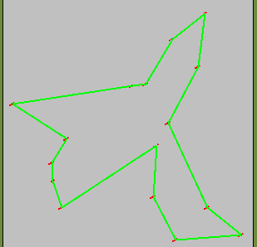
TSP

Slide 29
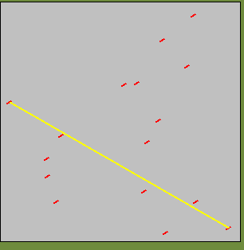
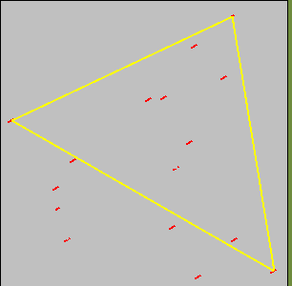
Initial Cities

Slide 30
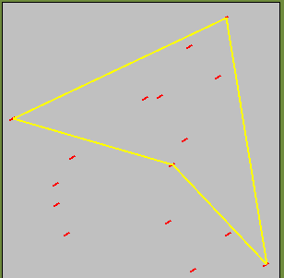
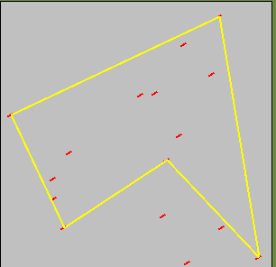
Strategy
Add Farthest city from tour between cities where it increases the tour length the least

Slide 31
Classifications
Fully Approximable: problems where there is an ε-approximate polynomial time algorithm for all ε >0
Partly Approximable: problems for which there are ε-approximate polynomial time algorithms but ε does not go all the way to zero, or P=NP
Innaproximable: problems for which there is no bound on the error for any poly algorithm

Slide 32
Two processor scheduling
Only fully approximable NP-Complete problem
Can get within any ε>0 in poly time
We can’t always use the same heuristic for every problem
The NP-Complete reduction only works if we can get an exact result.

Slide 33
Partially Approximable
Vertex Cover, Max SAT
The ε does not get arbitrarily close to zero, but there are ranges of values

Slide 34
Inapproximable
TSP and most others
There are no bounds that can be set on how close the heuristic will get.
The heuristic will probably be tuned to the data set that is most common for an application

Slide 35
How do we prove that problems are inapproximable
Show that if we could come up with any guaranteed approximation, then we could solve other NP-Complete problems totally
If we could come up with any ε-approximate polynomial time algorithm for traveling salesman, then we could solve Hamiltonian path completely (if ε<1)
Farthest insertion first often comes within a factor of 2 for TSP, but is not guaranteed.

Slide 36
Approximation Algorithms
Center Star Alignment Algorithm: Finds a MSA whose sum-of-pairs score is within a factor of 2 of optimal.
  Due to Gusfield, Bulletin of Math. Bio. 55:141-154, 1993.
  Requires pairwise alignment distance satisfy triangle inequality
  Based on finding the “center” of S1,…,Sk and progressively adding sequences to the center alignment.

Slide 37
Unsolvable Problems
this thing is too heavy for thee (Exodus 18:18)
though a man labour to seek it out, yet he shall not find it
(Ecclesiastes 8:17)

Slide 38
Common Belief
“Put the right kind of software into a computer and it will do whatever you want it to. There may be limits on what you can do with the machines themselves, but there are no limits on what you can do with software” April 1984 TIME

Slide 39
David Hilbert
1920s Asked for proofs that
  1) Mathematics is consistent (we cannot prove both a statement and its opposite)
  2) Mathematics is complete (Every mathematical assertion can be proved or disproved)
  3) Mathematics is decidable (For every mathematical problem there is an algorithm that can be mechanically followed to give a solution)

Slide 40
Kurt Godel
In 1930 proved that points one and two cannot both be true, we hope that this means that point two is false
“This statement is false”
All consistent axiomatic formulations of number theory include undecidable propositions
Derived Godel numbers for statements in lambda calculus

Slide 41
Church’s Thesis
Any machine that can perform a certain set of operations (Turing Complete) will be able to perform all conceivable algorithms
Worked with Lambda calculus before turing machines were formalized
To show that something is computable, you just have to describe the algorithm. Any algorithm can be coded in a turing machine

Slide 42
The Halting Problem
Given a Turing machine T and input w, does T halt on w?
From a language acceptance perspective
  Halting={e(T)e(w) | T halts on w}
May seem easy
  look at TM for infinite loops
  run it for a while to see its behavior

Slide 43
A simple Example
int f(x)
{
while (x > 1) {
if(x is even)
x=x/2
else
x=3x+1
}
}
Does it halt with x=7
7,22,11,34,17,52,26,13,
40,20,10,5,16,8,4,2,1 yes
Some inputs will go through
thousands or millions of intermediate
values
We dont know if it halts on a given
input

Slide 44
Halt is not recursive and is unsolvable
Assume that Halt is solvable, then there must exist a Turing machine T_{h}

Slide 45
What about encoding cont?

Slide 46
Another View
Halt(e(T)e(w))
e(T)
e(w)
Does T halt on w?
yes
no

Slide 47
Cont
Cont(e(x))
e(x)
e(T)
e(w)
Does T halt on w?
yes
no
no

Slide 48
Contradiction
e(Cont)
e(Cont)
e(Cont)
Does T halt on w?
Cont(Cont) doesnt halt
yes
no
Cont(Cont) halts
Cont(Cont) halts
no

Slide 49
Reductions
Reduction of the halting problem to another problem shows that the other problem is unsolvable
if P₁ and P₂ are decision problems and P₁<=P₂ then if P₂ is solvable, so is P₁
Must reduce unsolvable problem to problem in question, not the other way around

Slide 50

Monster Trucks
Truck B
Truck A

Slide 51
Bioinformatics
Unfortunately, the halting problem says that you really cant figure out what any program is going to do from looking at the source code.
  Bug Finding
  Virus checking
Many Bioinformatics problems are trying to figure out what the DNA will do and most are probably also unsolvable.

