Slide 1
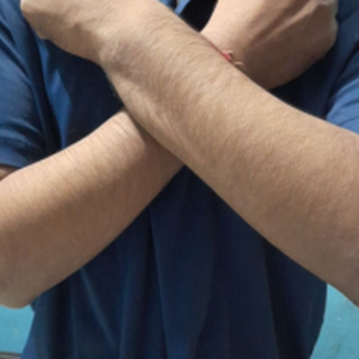
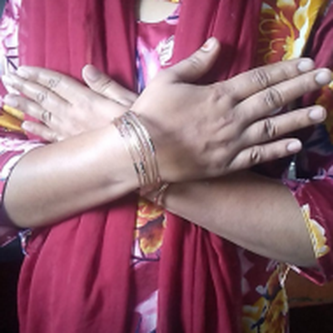
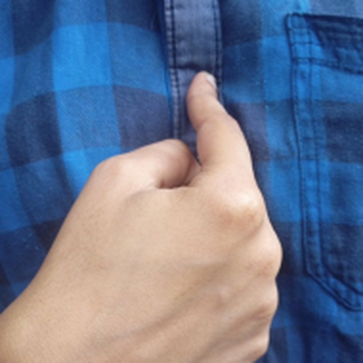
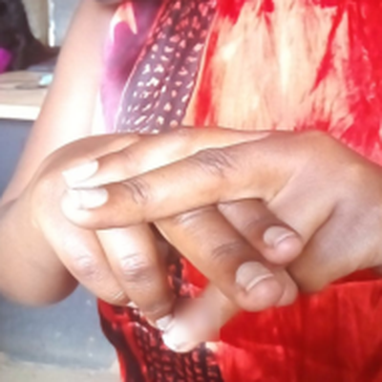
Recognising Kenyan Sign Language with Deep Learning
Deep learning vs classic machine learning on everyday phone photos
Selmah Tzindori
Student ID 669602 · DSA 4050-XA Deep Learning
Lecturer: Dr. Alex Wambua · USIU-Africa · November 2026
Love · Friend · Me · Seat
Notes:
Good morning. My term paper asks a simple question: can a computer recognise Kenyan Sign Language from an ordinary phone photo, and does deep learning actually do better than classic machine learning on this task? The four photos are real images from the dataset: the signs for Love, Friend, Me and Seat.

Slide 2
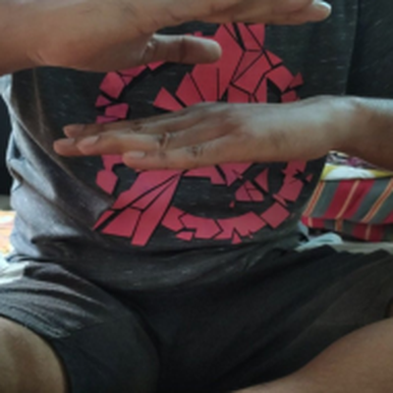
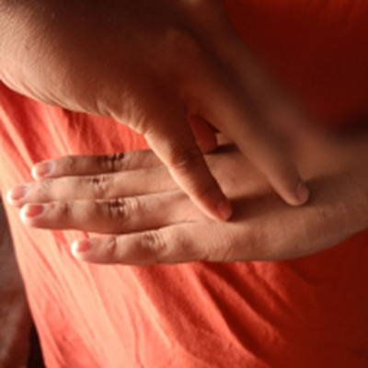

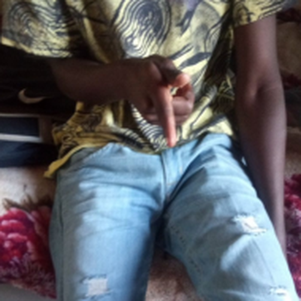


The problem: a communication gap
Kenyan Sign Language (KSL) is the language of Kenya’s Deaf community. The Constitution (2010, Art. 7(3)(b)) commits the State to promoting its use, yet few hearing Kenyans understand it.
Everyday services
Clinics, schools and offices still depend on scarce interpreters.
Phones are everywhere
A model that reads signs from a phone photo could power learning apps and assistive tools.
This project’s goal
Recognise 9 everyday KSL signs from photos, and test whether deep learning beats classic ML.
Enough/Satisfied · Mosque · You · Friend: real photos from the dataset
Notes:
KSL is recognised in our Constitution, but hearing people rarely learn it, so Deaf Kenyans depend on interpreters who are scarce. Phones are everywhere, so a model that can read signs from a phone photo is a realistic first step towards learning apps or assistive tools. My goal was to recognise nine everyday signs, shown on the right, and to test whether deep learning really beats classic machine learning on the same data.

Slide 3



Why deep learning? (part a)
Huge variation, tiny differences
Transfer learning
Decisions we can inspect
Signer, skin tone, clothing, background and lighting change completely, while two signs may differ only in open vs closed hands.
Networks pretrained on 1.3 million ImageNet photos already detect edges, skin and finger shapes, so ~4,400 training photos are enough.
Grad-CAM heatmaps show where a CNN looks, so we can check it reads the hands, not the background.
Hypothesis: on identical data, deep learning will clearly outperform classic machine learning that relies on hand-crafted features.
Notes:
Why is deep learning the right tool here, and not just a fashionable one? First, the photos vary enormously, different people, clothes and rooms, while the difference between two signs can be as small as an open hand versus a fist. Hand-crafted features respond to every edge, including patterned shirts; a CNN learns which patterns matter. Second, transfer learning: networks pretrained on ImageNet already know edges, skin and fingers, so a few thousand photos are enough. Third, with Grad-CAM we can check what the model looks at. So my hypothesis was that deep learning would clearly beat classic ML on the same data.

Slide 4







How the project was done
Mine data
Explore
Prepare
Classic ML
Deep learning
Evaluate
Dashboard
Zindi → Kaggle API → Drive
Balance, quality, duplicates
Clean, crop, group-aware split
HOG / pixels + 4 classifiers
CNN, MobileNetV2, EfficientNetB0
CIs, Grad-CAM, robustness
Interactive Streamlit app
Part (b)
Part (b)
Part (b)
Part (c)
Part (c)
Part (c)
Part (d)
Tools: Google Colab (T4 GPU) · Google Drive for data and models · TensorFlow/Keras 2.21 · scikit-learn · OpenCV · Streamlit. Seven documented notebooks (00–06); every figure, table and metric saved automatically for the report.
Notes:
This is the pipeline. I mined the data, explored it, cleaned and prepared it, then trained classic models and deep models on exactly the same split, evaluated them in depth, and built a dashboard. Everything ran in Google Colab on a free GPU, with data and models stored on Google Drive, across seven documented notebooks.

Slide 5
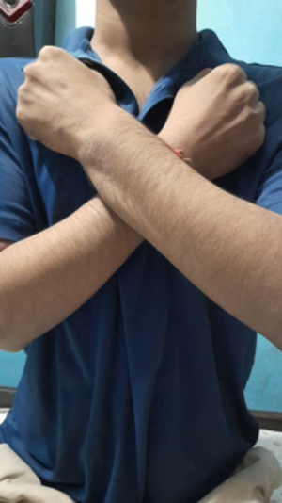
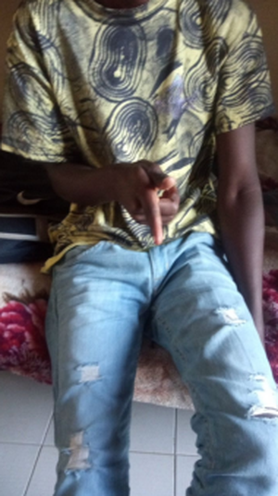
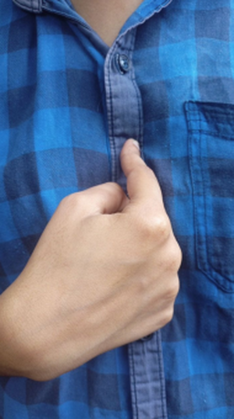
1 · The data
Mining, exploring and preparing 6,249 photos (part b)
Notes:
Part b: the data.

Slide 6
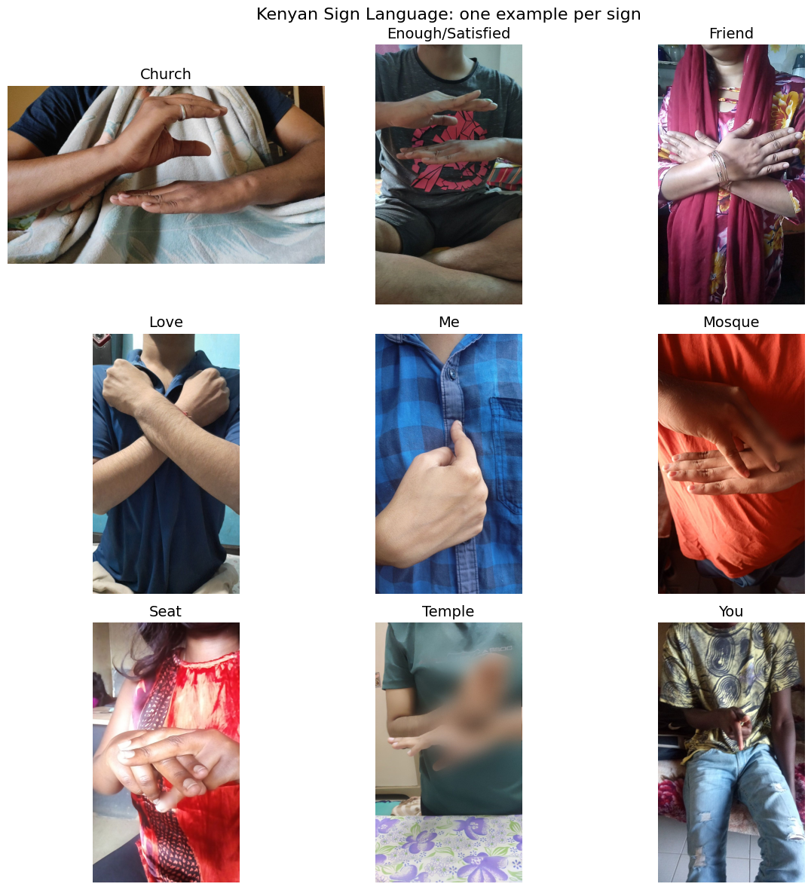
Where the data came from
6,249
9
labelled phone photos
everyday signs
694–695
11.1%
photos per sign (balanced)
random-guess baseline
Mining the data
Source: Zindi KSL Classification Challenge. Downloads were closed, so I found a Kaggle re-upload, pulled it with the Kaggle API into Colab and kept a 1.19 GB backup on Drive. All 8,931 files checked: 0 missing, 0 corrupt.
Notes:
The data comes from the Zindi KSL Classification Challenge. The competition no longer allows downloads, so I found a public Kaggle re-upload and downloaded it with the Kaggle API straight into Colab, then saved a backup on Drive. There are 6,249 labelled photos, perfectly balanced across nine signs, so random guessing would score 11 percent: that is the floor every model must beat. The 2,679 competition test images have no labels, so I couldn't use them.

Slide 7
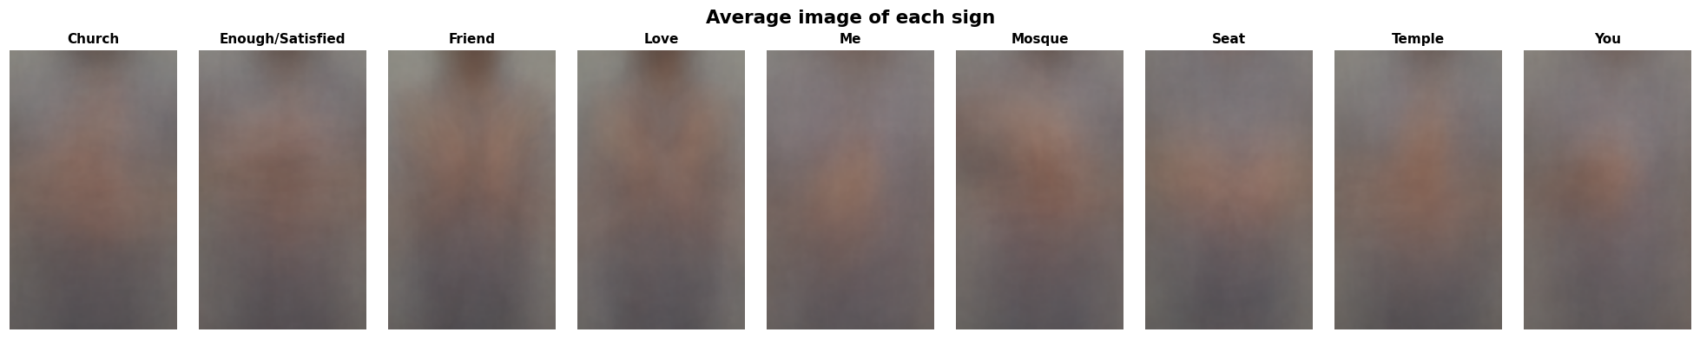




What exploring the data revealed
The “average” photo of each sign: backgrounds blur away, only the typical hand position remains
Orientation shortcut
No quality shortcut
Same signers repeat
Look-alike signs
15% (Church) to 28% (Love) of photos are landscape: a model could guess from image shape.
Brightness, contrast and sharpness are almost identical across signs.
Near-duplicate checks showed the same person performing several signs.
Friend vs Love (crossed arms); Church, Enough and Mosque (flat stacked hands).
Notes:
Exploring the data gave four findings that shaped everything after. The strip on top is every photo of a sign averaged together: backgrounds blur away and only the hand position remains, and you can see how subtle the differences are. First, some signs had more landscape photos than others, a shortcut a model could cheat with. Second, image quality was the same for every sign, so no shortcut there. Third, the same people appear performing several signs. Fourth, there are look-alike groups, which later turned out to be exactly where models make mistakes.

Slide 8
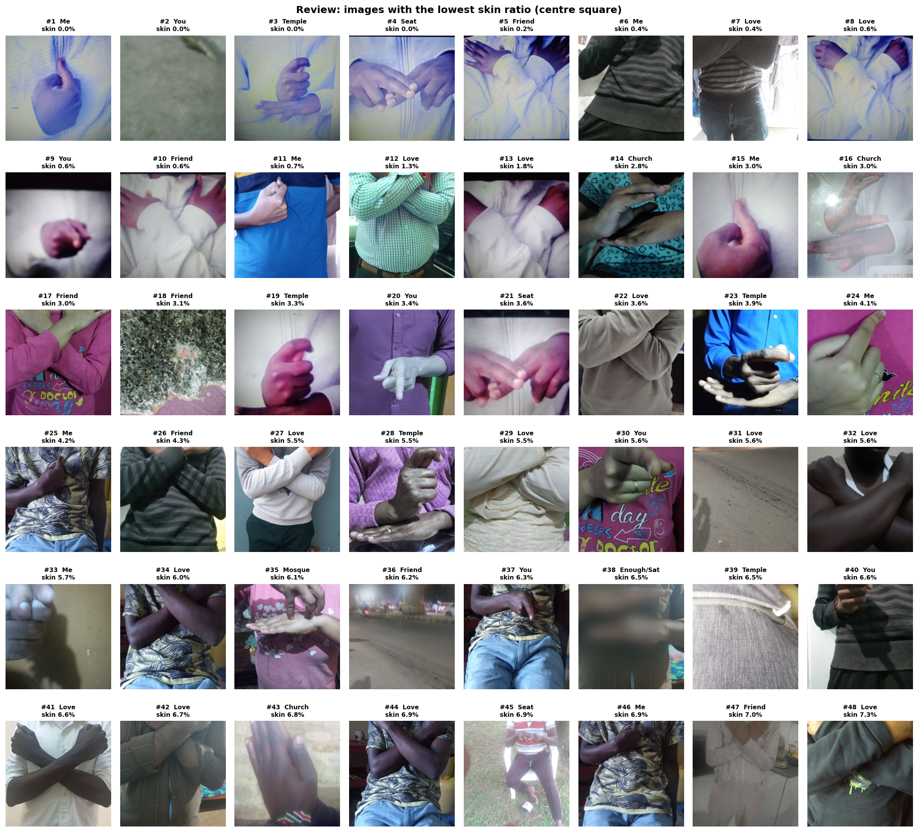

Cleaning: removing photos with no sign
Screen, then review by eye
A skin-colour score ranked every photo; the 48 most suspicious were checked by hand.
11
6,238
photos removed: blank surfaces, floors, fabric, a street scene
clean photos kept
A bias lesson
The fixed skin-colour rule missed the hands of darker-skinned signers. Hand-written rules can be biased, so a person made every final decision, and learned features are preferable.
Notes:
Some photos showed no sign at all: a blank wall, the floor, fabric, even a street at night. Checking 6,000 photos by eye isn't practical, so I scored every photo by how much skin colour it contains and reviewed the 48 most suspicious ones, shown here. Eleven were removed. An important lesson: the skin rule failed on darker-skinned signers. Several of these photos clearly show hands but scored as no skin. That's a known bias of fixed colour rules, so a human made the final call. It's also a good argument for learning features from data instead of writing rules by hand.

Slide 9
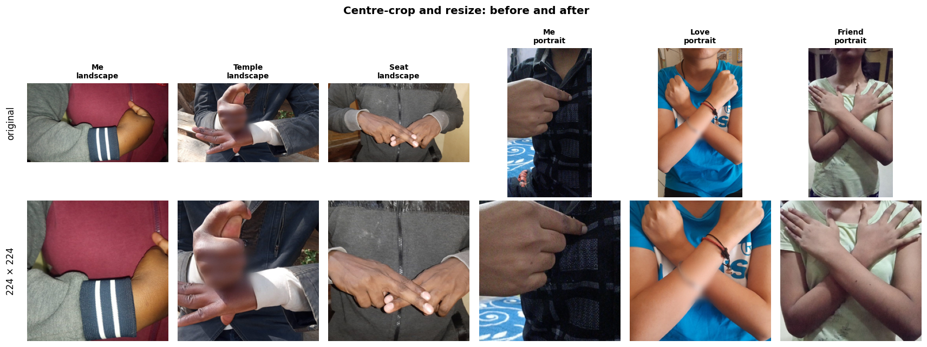

Preparing the photos for modelling
70 / 15 / 15 split
Stratified: every sign has the same share in each set. Group-aware: near-duplicates never cross sets.
4,362
935
941
Every photo is centre-cropped to a square and resized to 224 × 224, which removes the orientation shortcut
train
validation
test
Fair comparison: all 12 models use the same split. Settings were chosen on the validation set only; each model saw the test set exactly once.
Notes:
To remove the orientation shortcut, every photo is cropped to a centred square and resized to 224 by 224 pixels, the size pretrained networks expect. Portrait photos lose the head and legs, which carry no sign. I then split the data 70, 15, 15. It's stratified, so each sign has the same share everywhere, and group-aware, so near-duplicate photos never sit on both sides. Every model uses this same split, and the test set was used only once per model, so the comparison is fair.

Slide 10

2 · Models and results
8 classic models vs 4 deep networks on identical data (part c)
Notes:
Part c: the models and results.

Slide 11
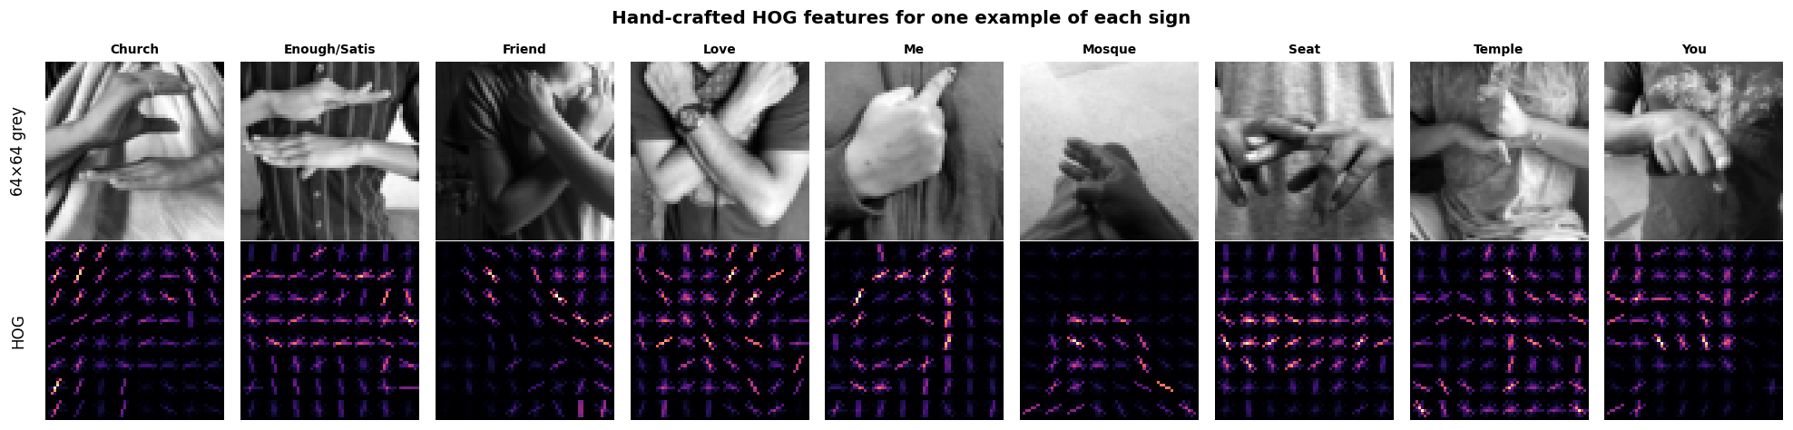
Classic ML: hand-crafted features
HOG (Histogram of Oriented Gradients) records the direction of edges in small cells: it captures arm outlines, but also every clothing edge
Best: HOG + SVM = 60.0%
Features matter more than the algorithm: HOG beats raw pixels by 20–32 points.
SVM and Random Forest score 100% on training photos but 52–60% on new ones: they memorise.
Notes:
Classic models can't read photos directly; they need features. I tried raw pixels, and HOG, which records edge directions and was a standard gesture feature before deep learning. You can see HOG picks up the arms, but also every fold and pattern in the clothing. I trained four classifiers on each. The best, HOG with an SVM, reached 60 percent, five times the baseline. HOG beat raw pixels with every algorithm. But notice the SVM and Random Forest score 100 percent on training photos and only about 55 percent on new ones: they memorise rather than learn the sign.

Slide 12


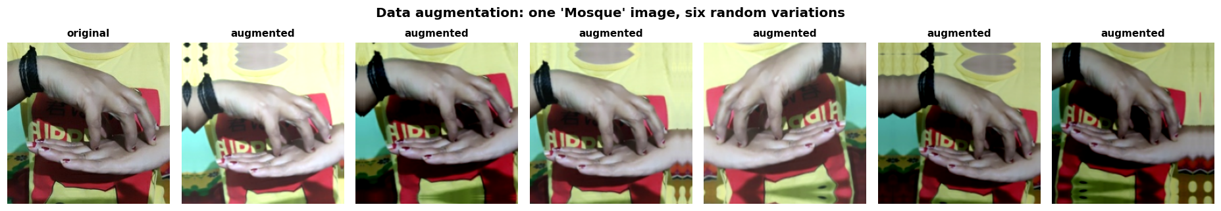
Deep learning: three CNNs
CNN from scratch
MobileNetV2
EfficientNetB0
4 convolution blocks, 1.18M weights, learns everything from our 4,362 photos (60 epochs).
Pretrained on ImageNet, built for phones. Train a new head, then fine-tune the top 40 layers.
Pretrained, more accurate design. Same two stages plus a third unfreezing 100 layers.
Data augmentation: every training photo is randomly flipped, rotated, zoomed, shifted and re-lit each epoch, imitating new signers and cameras
Notes:
For deep learning I trained three convolutional networks. One from scratch, which has to learn everything from our 4,400 photos. Then two pretrained networks using transfer learning: MobileNetV2, which is designed for phones, and EfficientNetB0. For those I first trained only a new final layer, then gently fine-tuned the top layers with a tiny learning rate. All three used data augmentation, shown at the bottom: every photo is randomly flipped, rotated, zoomed and re-lit each time, so the model never sees exactly the same picture twice. That's what fights the memorising we saw with the classic models.

Slide 13
Deep learning wins clearly
86.0%
EfficientNetB0 (95% CI 82.7–87.2%)
60.0%
best classic, HOG + SVM (95% CI 57.1–63.2%)
+25.9 points
The confidence intervals don’t overlap, so the gap is not luck. Every deep model beats every classic model.
Notes:
Here's the main result. All four deep models, in green, beat all eight classic models, in grey. The best, EfficientNetB0 with extended fine-tuning, reached 86 percent on 941 photos it had never seen, against 60 percent for HOG plus SVM: almost 26 points better. I bootstrapped the test set 2,000 times to get 95 percent confidence intervals, and they don't overlap, so this is not luck. The scratch CNN came close at 84 percent, but took 42 minutes to train against about 10 for transfer learning. So the hypothesis holds.

Slide 14



Every sign improved
Biggest gains
Temple, Enough/Satisfied, Seat and You: +0.30 F1, signs defined by finger positions HOG could not capture.
Easiest now
Seat (0.91), Me (0.91), Mosque (0.89)
Still hardest
Church (0.77), Friend (0.78), Love (0.78): the look-alike pairs.
Notes:
Deep learning improved every single sign. The biggest gains, about 0.3 in F1, were for Temple, Enough, Seat and You, signs defined by finger positions that hand-crafted HOG features simply could not capture. The hardest signs are still Church, Friend and Love: the look-alike pairs from the exploration stage.

Slide 15
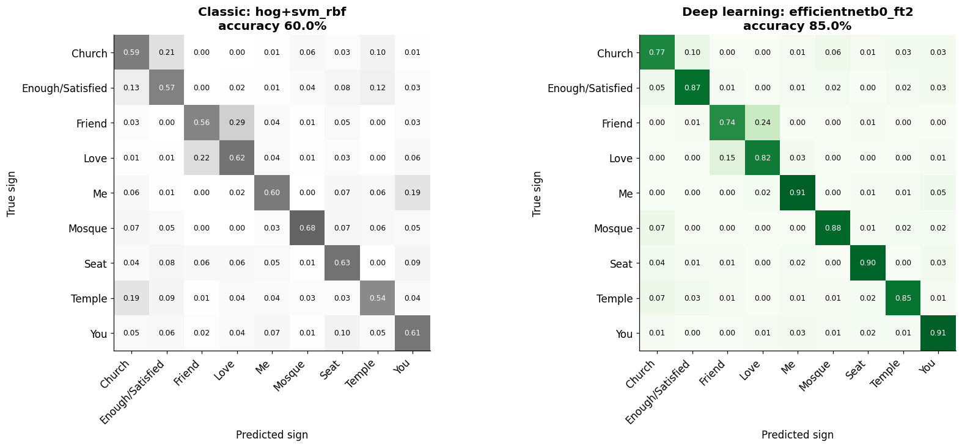
Where the mistakes are
Friend → Love
28.6% → 23.8% still the hardest pair
Church → Enough
21.2% → 9.6% largely fixed
Temple → Church
19.0% → 6.7% largely fixed
Confusion matrices: rows = true sign, columns = predicted. A brighter diagonal means fewer mistakes.
Surprise: some of the model’s most confident “mistakes” look like mislabelled photos (e.g. labelled Church but showing the Mosque sign), so the true accuracy may be slightly higher.
Notes:
These confusion matrices show where each model goes wrong: classic on the left, deep on the right. The deep diagonal is much brighter. Church being called Enough dropped from 21 to under 10 percent, and Temple being called Church from 19 to under 7. Friend versus Love is still the hardest pair, because they differ only in open hands versus fists. And a surprise: some of the model's most confident mistakes actually look like wrong labels in the dataset, photos labelled Church that show the Mosque sign. So the real accuracy may be a little higher than I report.

Slide 16
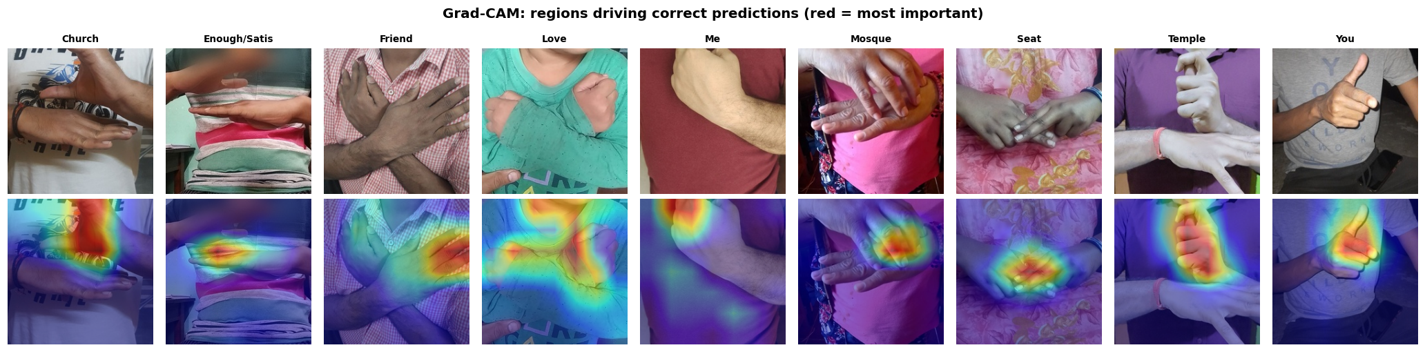



What the model looks at: Grad-CAM
Top: test photos · Bottom: Grad-CAM overlay (red = regions that drove the prediction)
Hands and fingers
Not shortcuts
Even when wrong
Heat sits on stacked palms (Church), interlocked fingers (Seat), the raised thumb (You).
Backgrounds, clothing patterns and faces are mostly ignored.
On mistakes it still looks at the hands but reads a similar sign: fine-detail confusion, not distraction.
Notes:
A high score is only convincing if the model is looking at the right thing. Grad-CAM traces each prediction back to the image: red marks the regions that drove the decision. For every sign, the heat sits on the hands and fingers: the stacked palms for Church, the interlocked fingers for Seat, the thumb for You. Backgrounds and clothing are mostly ignored. Even on its mistakes, the model looks at the hands; it just reads them as a similar sign. So it has learned the signs themselves, not shortcuts.

Slide 17
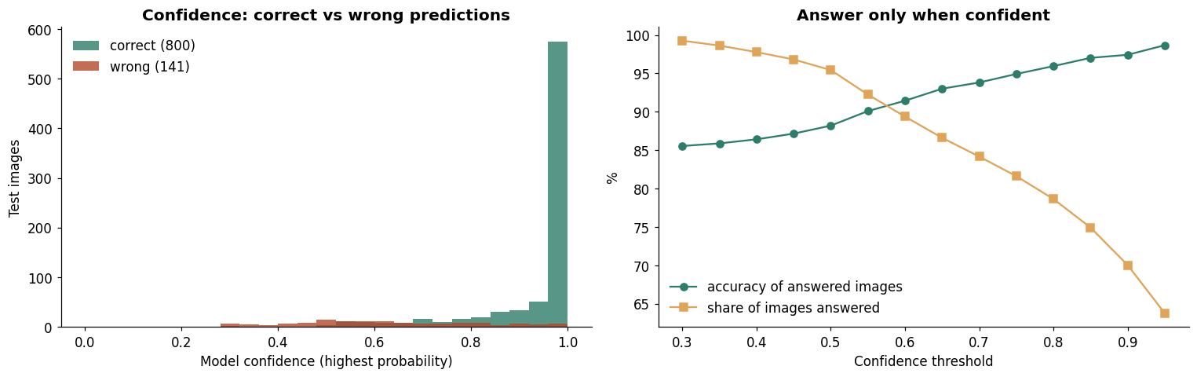
Knowing when it doesn’t know
0.99
0.62
median confidence when right
median confidence when wrong
95.9%
94.7%
accuracy when confidence ≥ 0.80
true sign in its top 2 guesses
Left: confidence of correct vs wrong predictions · Right: accuracy vs share answered for each threshold
In the dashboard: below 80% confidence the app says “Not sure, please try again” instead of guessing. It still answers 79% of photos, with 95.9% accuracy.
Notes:
A useful model should know when it's unsure. When it's right, its median confidence is 0.99; when it's wrong, only 0.62. So if we only accept answers above 80 percent confidence, it still answers almost 80 percent of photos, and is right 96 percent of the time. And when it's wrong, the correct sign is usually its second guess: top-2 accuracy is almost 95 percent. The dashboard uses this threshold to say 'not sure' instead of guessing.

Slide 18


Robustness: imitating real-world photos
Darkness: no problem
≤ 1.4-point drop for the deep model.
Rotation: deep learning shines
At 30° classic collapses to 17% (near random); deep keeps 74%.
Heavy blur: weak spot
−17.6 points. The model relies on fine finger detail: hold the phone steady.
Notes:
I didn't collect photos from new signers, so to imitate real-world conditions I altered the test photos: blur, darkness, rotation and noise. Darkness barely matters. Rotation is where deep learning shines: tilt the photo 30 degrees and the classic model collapses to 17 percent, close to random, while the deep model keeps 74. Its weak spot is heavy blur, which costs about 18 points, because it relies on fine finger detail. So in practice: hold the phone steady.

Slide 19

3 · The dashboard
Exploring the data and models interactively (part d)
Notes:
Part d: the interactive dashboard.

Slide 20

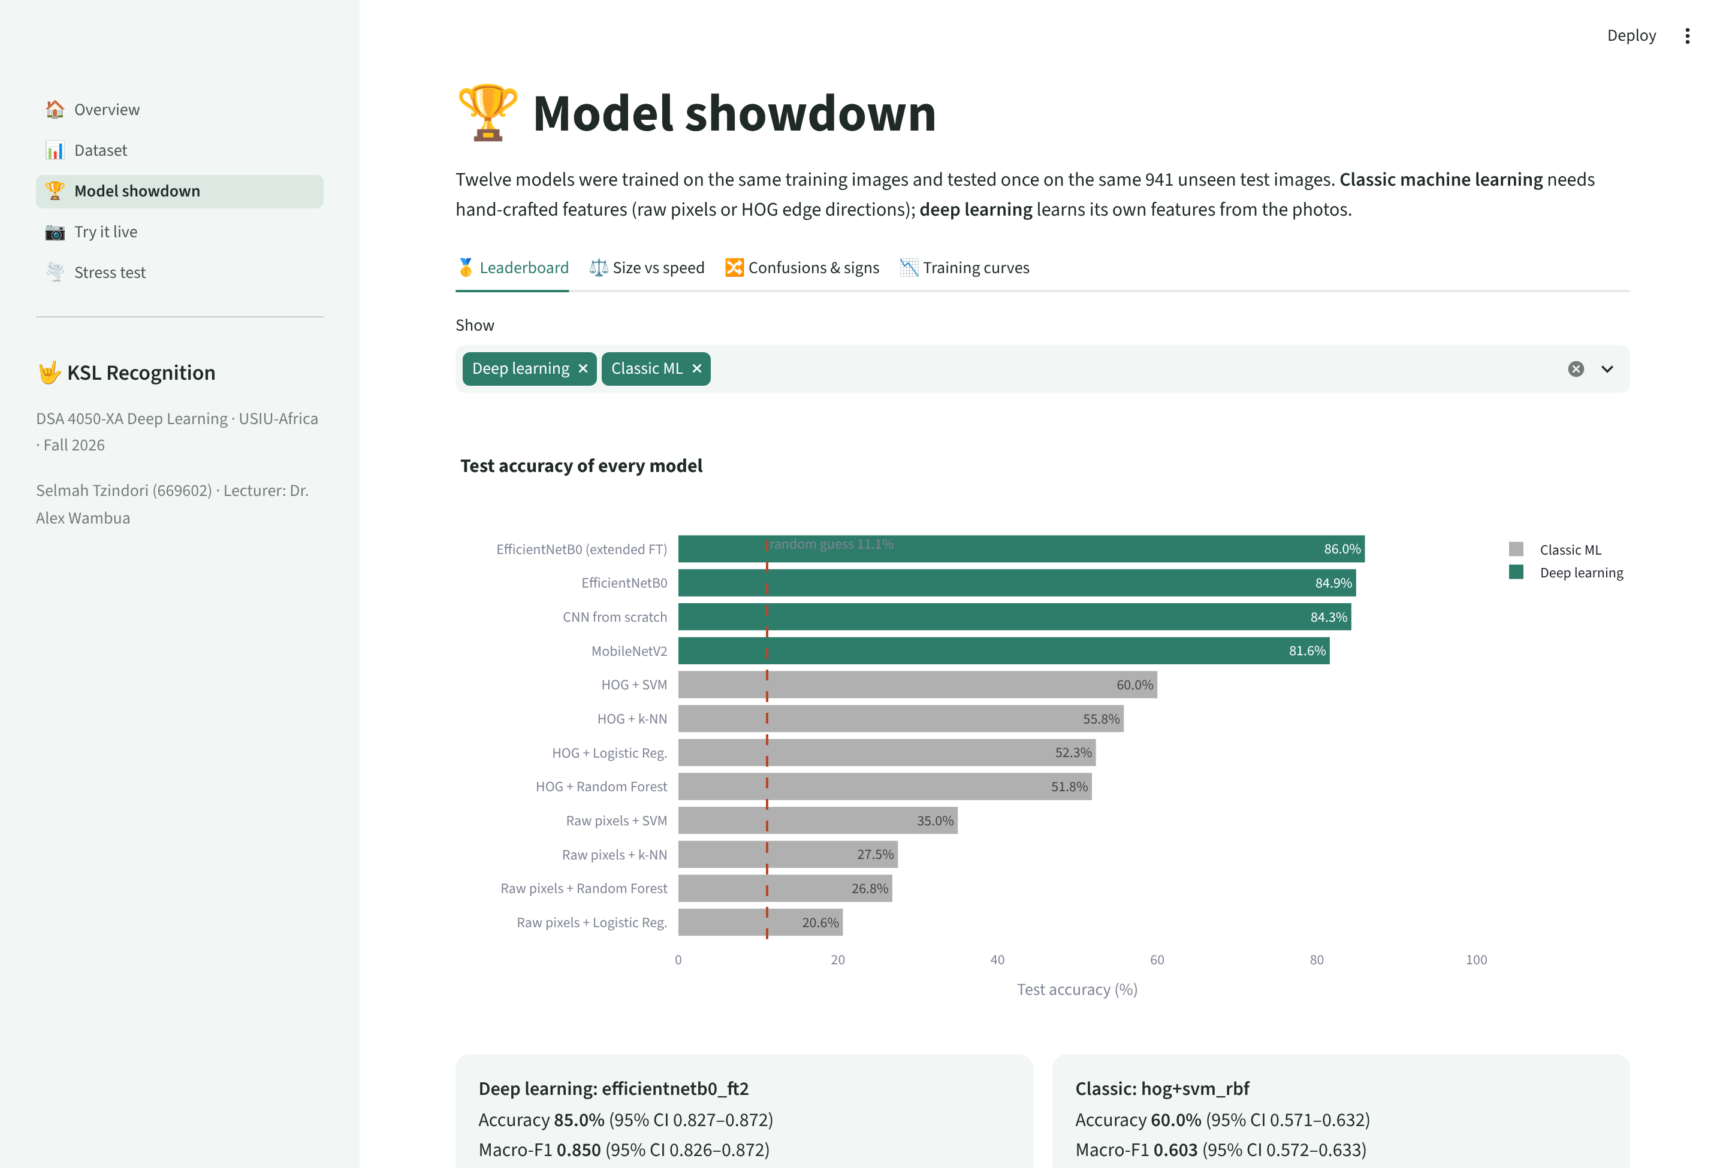




An interactive Streamlit dashboard
Overview
Problem, key numbers, pipeline
Dataset
Browse signs, balance, quality, cleaning
Model showdown
Leaderboard, confusions, training curves
Try it live
Photo, upload or webcam + Grad-CAM
Stress test
Sliders: blur, darken, rotate, noise
Notes:
To make the work explorable I built a Streamlit dashboard with five pages: an overview; a dataset explorer; the model showdown shown here, an interactive version of the results; and two live pages. 'Try it live' predicts the sign in a photo, an upload or a webcam shot, with a Grad-CAM heatmap. 'Stress test' lets you blur, darken or rotate a photo with sliders and watch both models react.

Slide 21



Live demo
1 · Try it live
2 · Stress test
3 · Model showdown
A volunteer makes a sign on the webcam: prediction, confidence and Grad-CAM.
Blur and rotate a photo live: watch deep learning hold up where classic ML fails.
Hover through the leaderboard and training curves.
Link: [dashboard link, added after deployment]
Frame your chest and hands in the centre, in good light, and keep still.
Notes:
Now the live demo. [Switch to the dashboard.] Could I have a volunteer? Please make one of the nine signs in front of the camera; the Dataset page shows how each sign looks. If the model is unsure it will say so, which is the confidence threshold doing its job. Then I'll show the stress test: blurring and rotating a photo and watching both models. BACKUP: if the camera or internet fails, use the example photos or photos taken beforehand on the Upload tab.

Slide 22



Limitations and next steps
Limitation
Next step
Only 9 static signs
Video or hand-pose models over time
Real KSL is continuous, with movement and facial expression.
Signers may overlap
A signer-independent test set
No signer IDs, so the same people may be in training and test sets.
Label noise
Labels verified with the Deaf community
Some labels look wrong; none were checked by Deaf signers.
Blur sensitivity
Stronger blur and noise augmentation
Heavy blur costs about 18 points.
Notes:
There are honest limitations. These are nine static signs, while real signing is continuous, with movement and facial expression, so video or hand-pose models are the natural next step. The dataset has no signer IDs, so the same people may appear in training and test, which can flatter the score; a signer-independent test set would fix that. Some labels look wrong, and no Deaf signer verified them. And heavy blur hurts, which stronger augmentation can address.

Slide 23
Conclusion
86%
Hands
Data
deep learning (EfficientNetB0) vs 60% for the best classic model: a clear, statistically sound gain
Grad-CAM confirms the model reads the hands, not backgrounds or clothing
the next gains will come from more signs, motion and Deaf-verified labels, not bigger models
Thank you · Questions?
Selmah Tzindori · 669602 · github.com/SelmahT
Notes:
To conclude: on the same data, deep learning recognised nine KSL signs with 86 percent accuracy against 60 for the best classic approach, a clear and statistically sound gain. Grad-CAM shows it reads the hands. And the biggest improvements from here will come from better data: more signs, motion, and labels verified by Deaf signers. Thank you, I'm happy to take questions.

Slide 24
References
awsaf49. (n.d.). KSLC Dataset [Data set]. Kaggle.
Constitution of Kenya (2010), Article 7(3)(b).
Dalal, N., & Triggs, B. (2005). Histograms of oriented gradients for human detection. CVPR.
Deng, J., et al. (2009). ImageNet: A large-scale hierarchical image database. CVPR.
Efron, B., & Tibshirani, R. J. (1993). An introduction to the bootstrap. Chapman & Hall.
Sandler, M., et al. (2018). MobileNetV2: Inverted residuals and linear bottlenecks. CVPR.
Selvaraju, R. R., et al. (2017). Grad-CAM: Visual explanations from deep networks. ICCV.
Tan, M., & Le, Q. V. (2019). EfficientNet: Rethinking model scaling for CNNs. ICML.
Zindi Africa. (n.d.). Kenyan Sign Language Classification Challenge.
Notes:
References, for anyone who wants to follow up.

