Slide 1
Detecting Phishing Websites Using Machine Learning Techniques
SELMAN OLGUN
190709038

Slide 2
Fundamentals
Phishing: Phishing is a malicious attack method that mimics legitimate websites to steal users' personal and financial information. These attacks typically use fake emails, SMS, or web links to deceive users into sharing sensitive information.
Machine Learning: Machine learning extracts meaningful patterns from large datasets to effectively differentiate between phishing and legitimate websites. Features such as URL length, presence of special characters, and use of IP addresses are crucial in identifying phishing websites.

Slide 3
Dataset Description
The dataset used in this study is from the UCI Machine Learning Repository and is focused on detecting phishing websites. It includes features extracted from URLs, such as URL length, presence of special characters, and domain age. The dataset was preprocessed to remove outdated features like web traffic and page ranking data. It was then split into training and test sets for model evaluation using metrics like F1 score and accuracy. This dataset enables effective training and evaluation of machine learning models for phishing detection.

Slide 4
Machine Learning Models Used
Logistic Regression
K-Nearest Neighbors (KNN)
Random Forest
Naive Bayes
Decision Tree

Slide 5
Stacking
Stacking is an ensemble learning technique that combines predictions from multiple machine learning models to make a final prediction. Unlike bagging and boosting, stacking uses predictions from diverse base models to train a meta-learner, improving overall performance by leveraging the strengths of different models.
We created a Stacking model by combining the top three performing models: Random Forest, Logistic Regression, and Decision Tree.

Slide 6
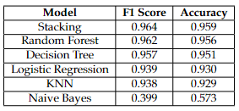
F1 and Accuracy Scores of the Models

Slide 7
Feature Extraction
Feature extraction involved transforming categorical feature values into meaningful representations for predictive modeling, enhancing the interpretability and effectiveness of our analysis.
We performed feature extraction to interpret and utilize the values of features in our data, which include -1, 0, and 1, for predictive modeling

Slide 8
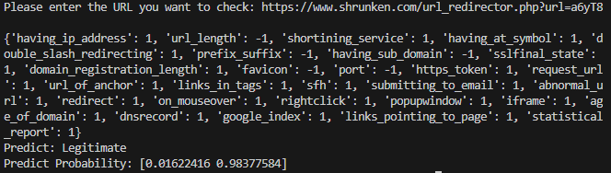
Predict
To predict using our model, we input the extracted features into the trained machine learning models, which then analyze the data to classify URLs as either phishing or legitimate based on learned patterns and feature importance.

Slide 9
Thanks for listening…

