Slide 1
Weld County Department of Public Health and Environment
Division of Public Health Services · Community Health · Environmental Health
Mobile Health Unit
Data Systems Assessment
Executive Leadership Briefing
Advancing health equity through mobile community-based services across Weld County
Prepared for discussion
20 minutes presentation
40 minutes leadership discussion
Selorm Buaka · Statistical Intern
Supervisor: Shaun May, MPH

Slide 2
Why this project matters
A practical assessment designed to support leadership decisions
The basic question
The leadership need
The practical goal
Can the Mobile Health Unit clearly show what it is doing, where it is working, who it is reaching, and what needs to improve?
Move from scattered spreadsheets and one-time reports toward repeatable dashboards that support planning, funding, and accountability.
Identify targeted fixes and dashboard views that help leaders decide what to prioritize, what to monitor, and what may eventually be shared publicly.
Selorm Buaka
Weld County DPHE · Mobile Health Unit Program
2 / 9

Slide 3
What Phase 2 tells us
The data system is usable, but it needs targeted improvements before broader reporting
1. We can describe activity
2. We still need to describe people
3. We need stronger systems
The program can show events, services, regions, staff effort, screenings, and engagement. That is a strong starting point.
The biggest gap is not counting services. It is describing who is being served and whether priority populations are being reached.
Definitions, file ownership, event IDs, and documentation need to be cleaned up so the dashboard can be trusted long term.
.
Selorm Buaka
Weld County DPHE · Mobile Health Unit Program
3 / 9

Slide 4
Recommended leadership priorities
Grouped for decision-making, not as a technical task list
Know who we serve
Trust what we measure
Build systems that last
Move forward with demographic data pathways such as Athena, EpiTrax, DPP data, and a simple event population category.
Why it matters: this strengthens equity reporting and grant justification.
Keep shared definitions consistent across divisions, update the Read Me tabs, and move key services out of notes into structured fields.
Why it matters: leadership needs to know that numbers mean the same thing everywhere.
Move files into shared county-controlled ownership, assign unique event IDs, and maintain a change log and quarterly review.
Why it matters: the dashboard should survive staff turnover and remain reliable.
Selorm Buaka
Weld County DPHE · Mobile Health Unit Program
4 / 9

Slide 5
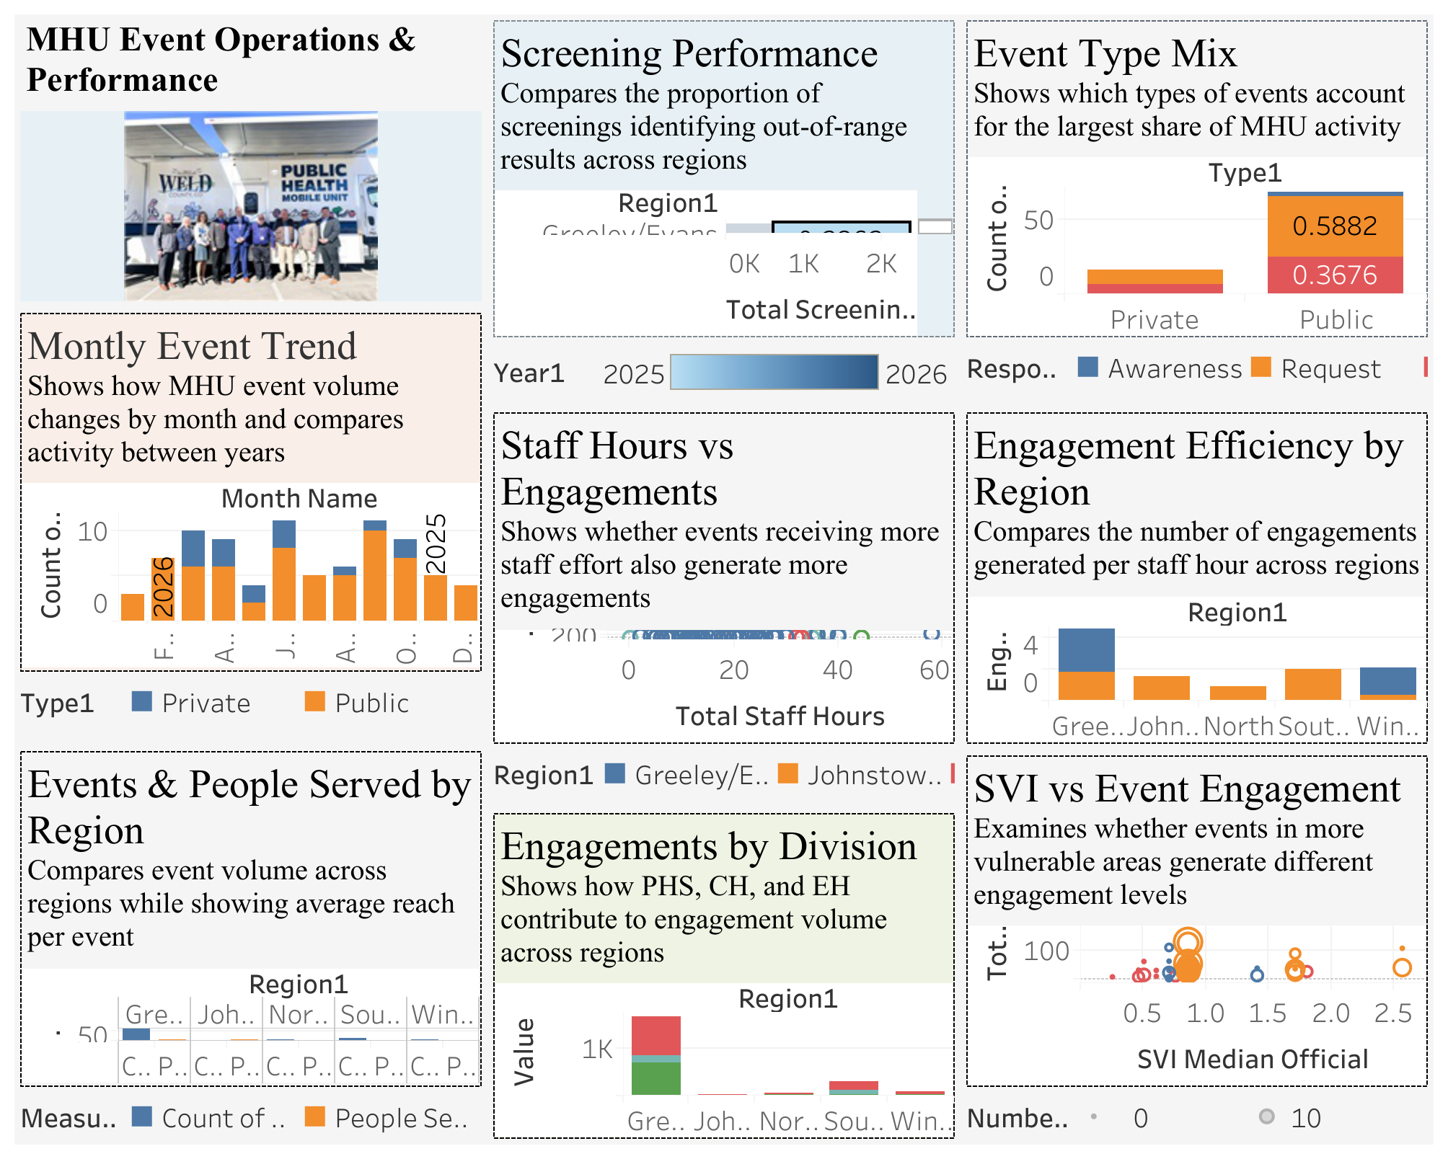
Operations dashboard
What the Mobile Health Unit is doing, where it is happening, and how resources are being used
Purpose
A single view of MHU operations and performance.
Useful for
Planning, staffing, regional coverage, service mix, and dashboard discussion.
Main message
Leadership can move from “What happened?” to “What should we do next?”
Selorm Buaka
Weld County DPHE · Mobile Health Unit Program
5 / 9

Slide 6
What the operations dashboard helps leadership understand
Trends
Reach
Staffing
Screening
Are events increasing or changing by month? Helps with seasonal planning.
Which regions are getting events, and how many people are reached per event?
Is staff time translating into actual engagement?
Where are screenings finding more out-of-range results?
Event mix
Division role
Efficiency
Equity
Are events public, private, requested, awareness-based, or strategic?
How do PHS, CH, and EH each contribute to engagement?
Which regions generate more engagement per staff hour?
Are we reaching areas with higher social vulnerability?
Use this slide to explain the smaller figures without showing each one separately.
Selorm Buaka
Weld County DPHE · Mobile Health Unit Program
6 / 9

Slide 7
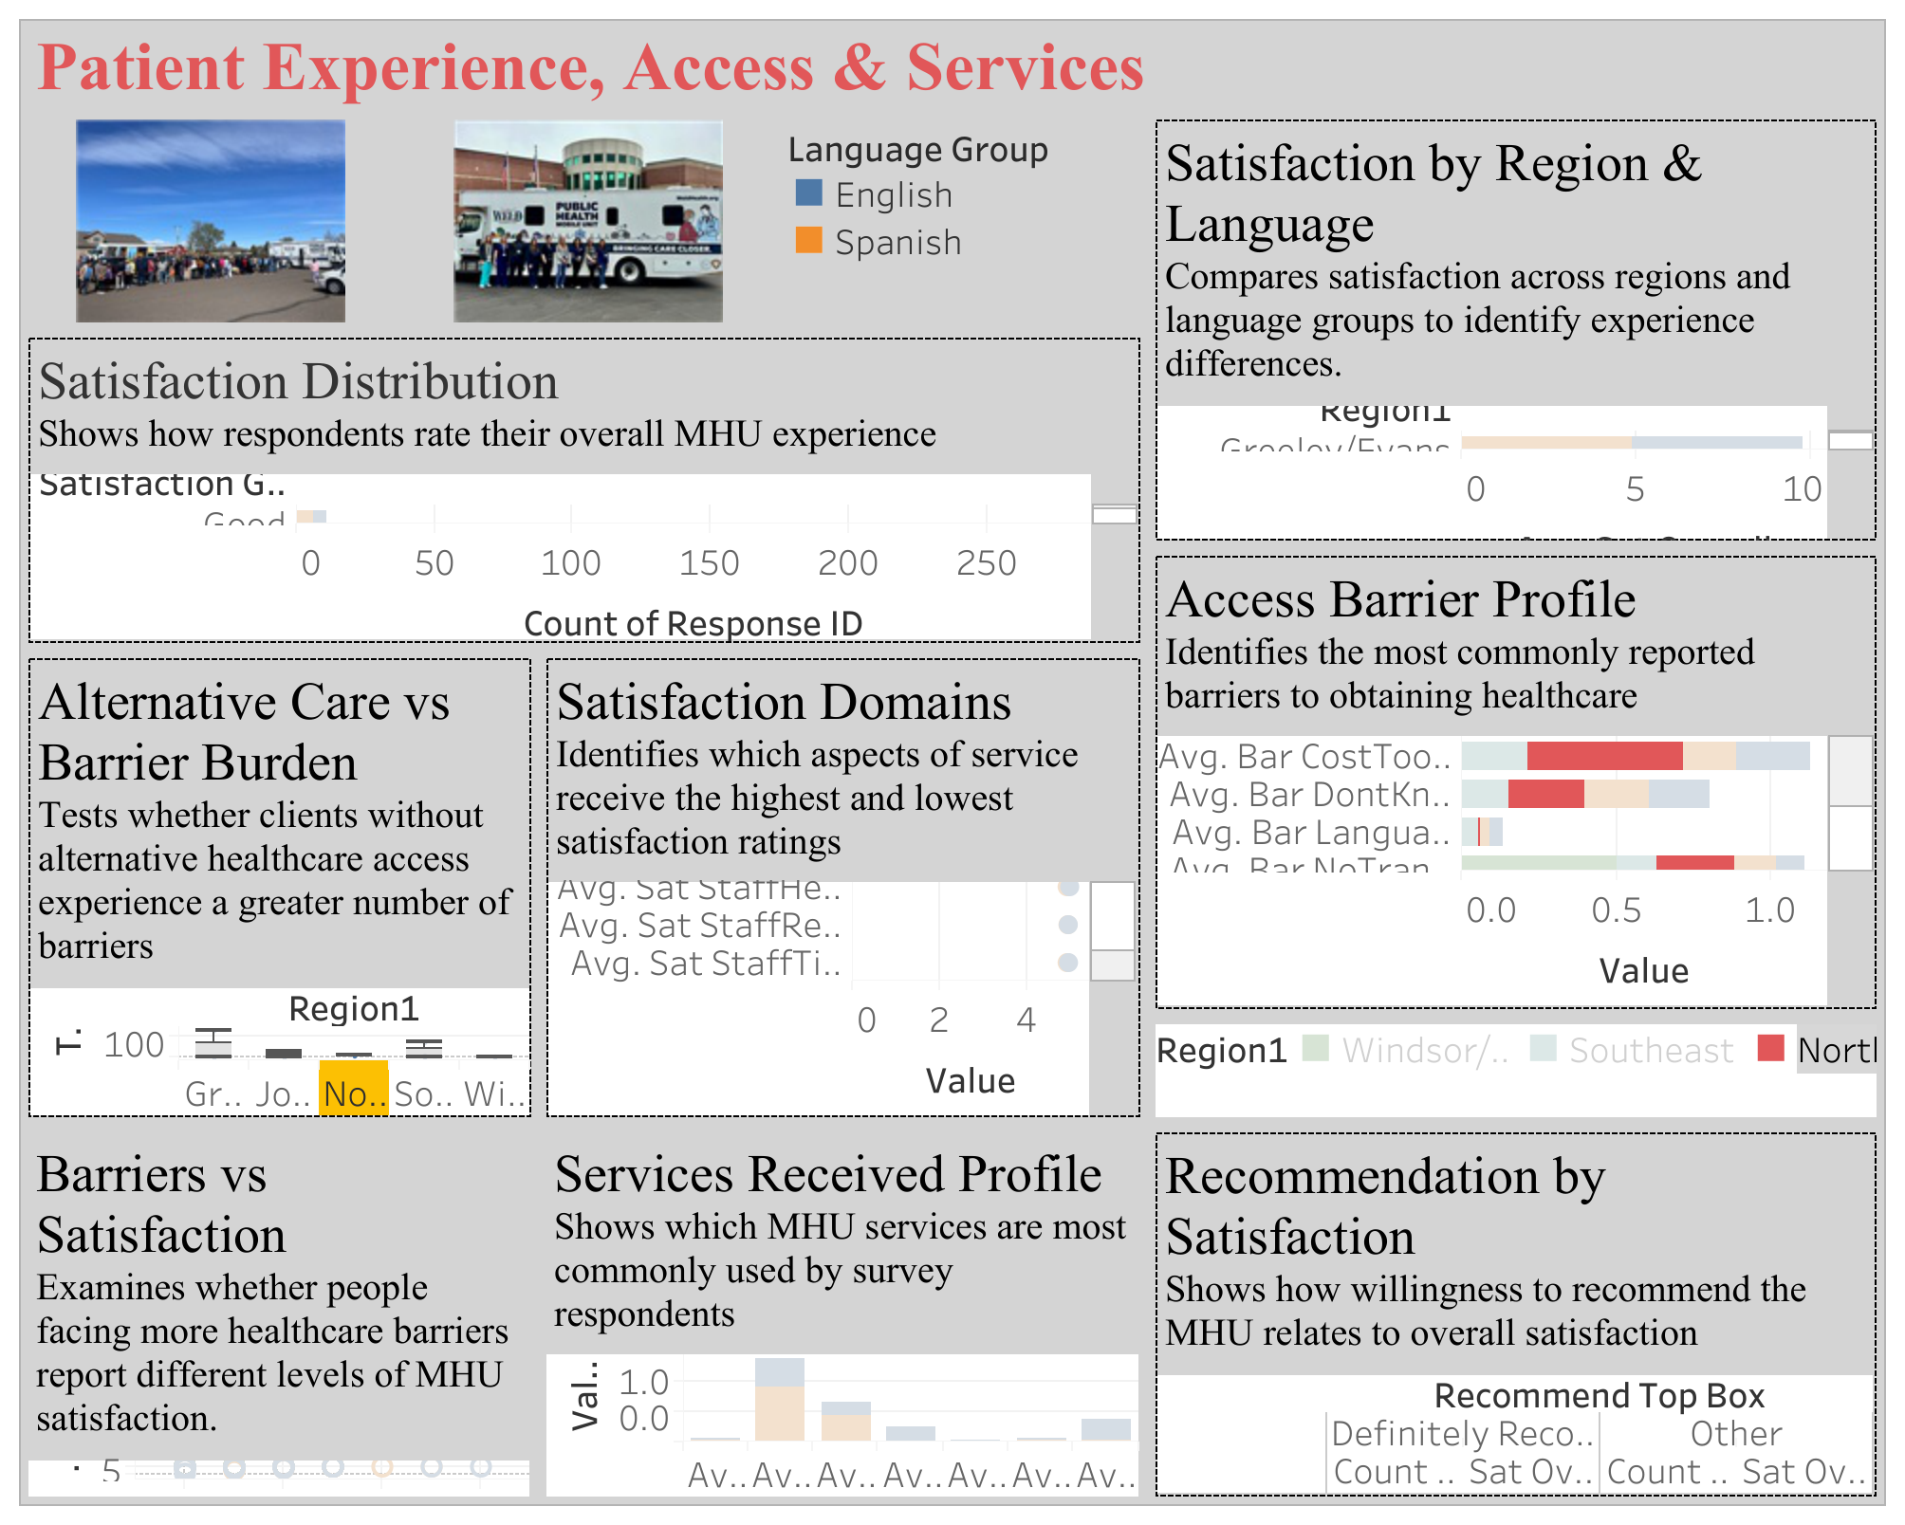
Patient experience dashboard
How clients experience services, what barriers they face, and what services they use
Purpose
Complements operations by showing the client perspective.
Useful for
Understanding satisfaction, barriers, service demand, language, and trust.
Main message
The dashboard shows not only what we delivered, but how people experienced it.
Selorm Buaka
Weld County DPHE · Mobile Health Unit Program
7 / 9

Slide 8
What the patient dashboard helps leadership understand
Relatable interpretation of the survey views
Satisfaction
Regional differences
Service quality
Barriers
How people rate their overall experience with the MHU.
Whether experience looks different across Weld County communities.
What people appreciate most: respect, helpfulness, time, communication, confidentiality.
Cost, transportation, language, distance, and hours.
Service use
Trust
High-need clients
Access
Which MHU services people report using most often.
Whether clients would recommend the MHU to others.
Whether people with more barriers still report positive experiences.
Who may rely on the MHU because other care is not available.
Selorm Buaka
Weld County DPHE · Mobile Health Unit Program
8 / 9

Slide 9
Decisions for executive discussion
What Jason can help move forward
1. Implementation priority
2. Dashboard use
Which recommendation group should move first: demographic data, measurement consistency, or data governance?
Which dashboard views should be used internally for routine leadership updates?
3. Public-facing reporting
4. Ownership
What information should eventually be shared publicly, and what needs to be fixed first?
Who should own implementation across PHS, CH, EH, and the data team?
Selorm Buaka
Weld County DPHE · Mobile Health Unit Program
9 / 9

