Slide 1
ECRIO INTERNSHIP · 2026
Wellhead Pressure
Monitoring Dashboard
A live view of tubing, casing and annulus pressure across every well — so nobody has to drive out and read a gauge to find out something's wrong.
Built during my Ecrio internship | Frontend: React.js + Tailwind CSS | Backend: Python + FastAPI
Presented by
Selvamani M

Slide 2
THE PROBLEM
Problem Statement
Why wellhead pressure monitoring needs to change
1
Manual Monitoring
5
Production Loss
Traditional wellhead pressure monitoring requires manual gauge readings and frequent field visits, which consume time and involve safety risks.
Issues such as blockage, sand-up, and hydrate formation can affect well performance and reduce production.
2
Lack of Real-Time Monitoring
6
Sensor Faults
There is no centralized dashboard to continuously monitor tubing, casing, and annulus pressures across multiple wells.
Faulty, drifting, or stuck sensors can produce unreliable readings and lead to incorrect alarms.
3
Delayed Fault Detection
7
Lack of Automated Alerts
Abnormal pressure conditions, unexpected shut-ins, and sudden pressure changes may not be detected promptly.
Manual monitoring may delay the notification of critical pressure conditions to field operators and well-integrity engineers.
4
Well Integrity Risks
8
Need for a Centralized Solution
Sustained casing pressure and abnormal annulus pressure buildup beyond MAASP can indicate potential well integrity problems.
A real-time monitoring dashboard is required to validate sensor data, detect abnormal conditions using rule-based logic, display pressure trends, and generate severity-based alerts for faster and safer decision-making.

Slide 3
THE SOLUTION
Problem Solution
How the Wellhead Pressure Monitoring Dashboard answers each problem
1
Centralized dashboard
5
Early production-loss signals
Replaces manual gauge readings and field visits with one continuously live view — safer, faster, no site drives.
Drawdown and trend analysis surfaces blockage, sand-up, and hydrate-formation patterns before output visibly drops.
2
Field-wide live monitoring
6
Sensor validation
A single dashboard continuously tracks tubing, casing, and annulus pressure across every well in the stock.
Built-in checks distinguish faulty, drifting, or stuck sensors from genuine alarms, filtering out unreliable readings.
3
Instant fault detection
7
Automated, severity-based alerts
Continuous data acquisition with rule-based logic flags abnormal conditions, shut-ins, and sudden changes the moment they occur.
Alerts route automatically to field operators and well-integrity engineers by severity — no one has to notice first.
4
Integrity alarms against MAASP
8
One integrated workflow
Automatically tracks casing pressure and annulus build-up against MAASP, raising integrity alerts before they escalate.
Validates sensor data, applies rule-based detection, visualizes pressure trends, and drives faster, safer decisions — end to end.

Slide 4
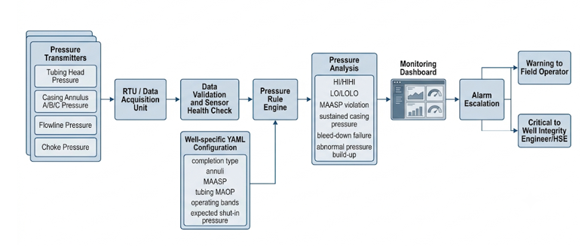
System Archietecture

Slide 5



WHY I BUILT THIS
Somebody was driving to every wellhead just to read a gauge
Manual rounds, real risk
Only a snapshot in time
The risky stuff is silent
Field operators were physically driving from well to well to check tubing, casing and annulus pressure — slow, and it puts people on-site more than it needs to.
Readings happened whenever someone visited. Anything that changed between visits was simply invisible until the next round.
Sustained casing pressure and annulus build-up against MAASP — the early warning signs of a leak — don't announce themselves. They just sit there until someone checks.
02

Slide 6



WHAT I SET OUT TO DO
Catch leaks before they're a problem
One screen.
Every well.
Every warning sign.
Watch for sustained casing pressure and annulus build-up against MAASP — the earliest signal of a containment issue — instead of finding out after the fact.
Notice production loss early
Pick up on blockage, sand-up and hydrate formation through drawdown patterns, rather than waiting for output to visibly drop.
My goal was simple: give operations and integrity engineers one live place to watch pressure across the whole well stock, with alarms that fire on their own when something's actually wrong.
Cut out the gauge walk entirely
Replace the hazardous site-to-site visits with one dashboard anyone on the team can pull up from their desk.
03

Slide 7




HOW THE DATA MOVES
From a sensor on the wellhead
to a reading I can trust
Tubing head, each accessible casing annulus (A / B / C), the flowline and the choke are all read every 1–10 seconds from wellhead RTUs.
01
02
03
04
SENSORS ON SITE
RTU PICKS IT UP
I VALIDATE IT
CLEAN, TAGGED DATA
Pressure transmitters on the tubing head, casing annuli A/B/C, flowline and choke.
Every 1–10 seconds, readings are sampled and published from the wellhead RTU.
Range checks, drift checks, stuck-sensor checks — a bad instrument becomes its own alarm, not a false reading.
What's left is a normalised, well-tagged reading the rule engine and dashboard can actually use.
04

Slide 8





HOW THE ALARMS DECIDE
A YAML file per well tells the rules what "normal" looks like
Completion type, which annuli exist, MAASP per annulus, tubing MAOP, the normal operating band, expected shut-in pressure — one register per well drives every rule below.
Tubing HI/HIHI · LO/LOLO
Annulus over MAASP
Casing pressure that won't bleed down
The standard threshold alarms, checked against that well's own operating band.
Any accessible annulus — A, B or C — crossing its Maximum Allowable Annulus Surface Pressure.
This is the one I care about most — it's the clearest early sign of a containment problem.
Fast pressure swings (dP/dt)
Build-up rate after bleed-down
Ignoring alarms I caused myself
A sudden rate-of-change spike that usually means a leak or a slug moving through.
Compares what happens right after a bleed-down against what's actually acceptable for that well.
If an operator changes the choke on purpose, the resulting alarm gets suppressed instead of paging someone for nothing.
05

Slide 9





HOW IT'S BUILT
A pretty lean, real-time web stack
Wellhead RTUs
FastAPI backend
Well register (YAML)
React + Tailwind UI
1–10s sensor reads
Ingestion · validation · rule engine
MAASP · MAOP · bands
Live dashboard · alarms
Frontend — React.js + Tailwind CSS
Backend — Python + FastAPI
The colour-coded well tiles, the drill-down trend views, the integrity watch-list — all built as fast, reusable components so adding a new panel doesn't mean starting over.
Handles ingestion from the RTUs, runs the validation and the YAML-driven rule engine, classifies well-state changes, and routes alarms by severity.
06

Slide 10




WHAT IT LOOKS LIKE TO USE
What ops and integrity actually see
Colour-coded well tiles
Drill-down trend views
Integrity watch-list
The whole field at a glance — tile colour follows the live alarm state, nothing to dig for.
Click a well and you're straight into its tubing, casing and annulus history.
Wells with active or building MAASP / bleed-down risk, sorted by how urgent they are.
WHO GETS PAGED, AND WHEN
WARNING
CRITICAL — INTEGRITY
CRITICAL — HSE
Field operator
Well-integrity engineer
HSE team
Early-stage stuff — operating-band excursions, minor drift. Worth a look, not a scramble.
MAASP breach, sustained casing pressure, a bleed-down that didn't work.
Anything that looks like a containment risk — this one can't wait.
07

Slide 11
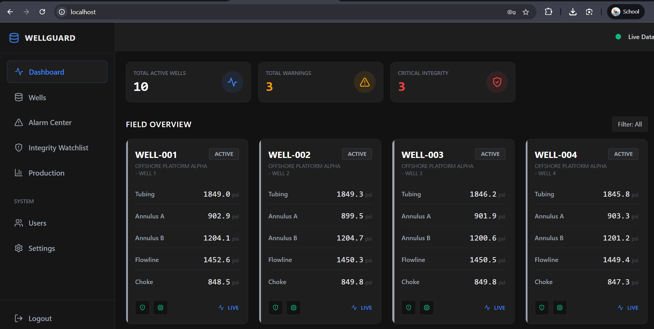

WHAT'S ACTUALLY RUNNING
Here it is, running in Docker
This isn't a mockup — it's a screenshot off my own machine, tracking the full well stock Dashboard.
10 active wells
Full field overview, one tile per well.
3 warnings, 3 critical
Clean at the moment I took this — the thresholds come straight from the YAML register.
Live sensor feed
Tubing, Annulus A/B, flowline and choke, updating per well.
08

Slide 12
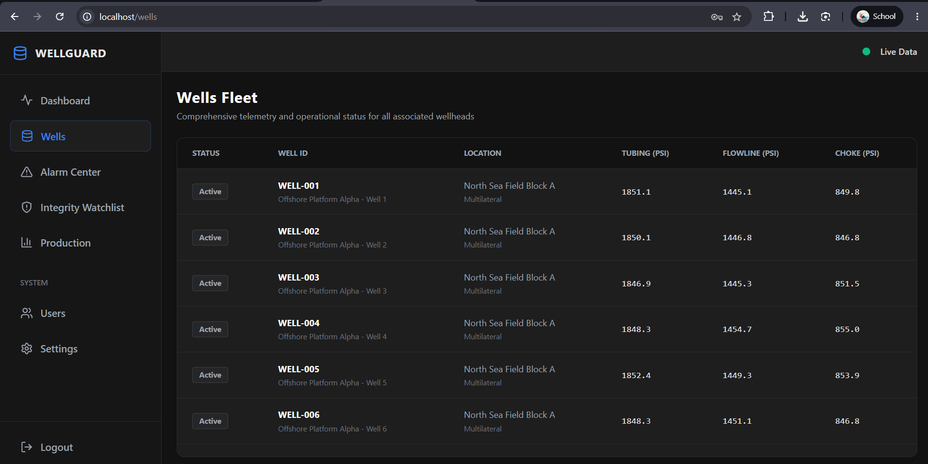
Wells

Slide 13
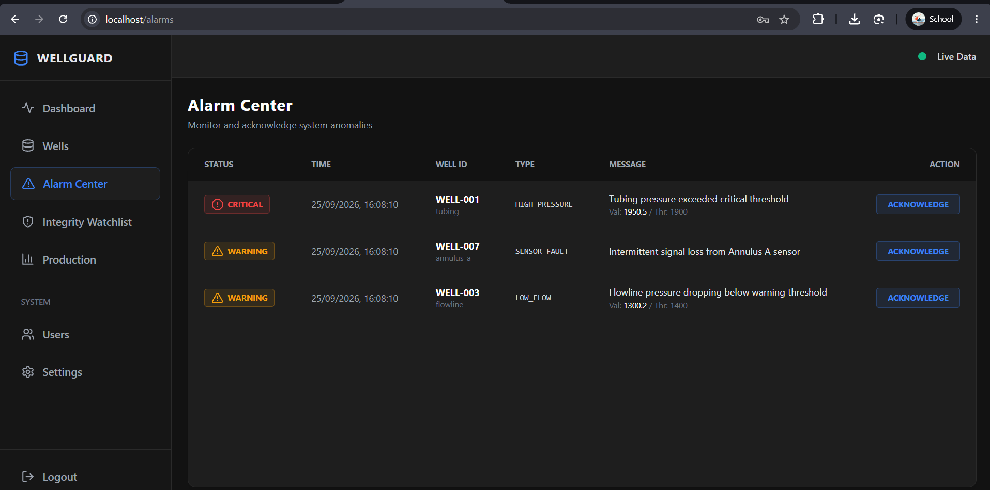
Alarm Center

Slide 14
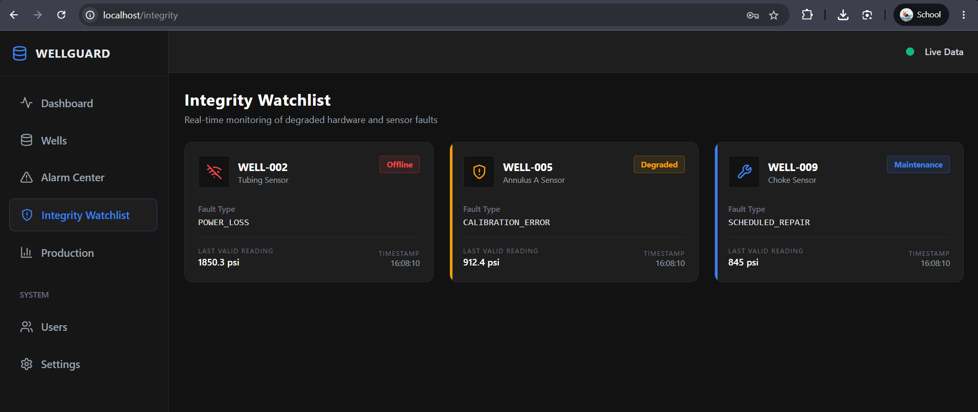
Integrity Watchlist

Slide 15
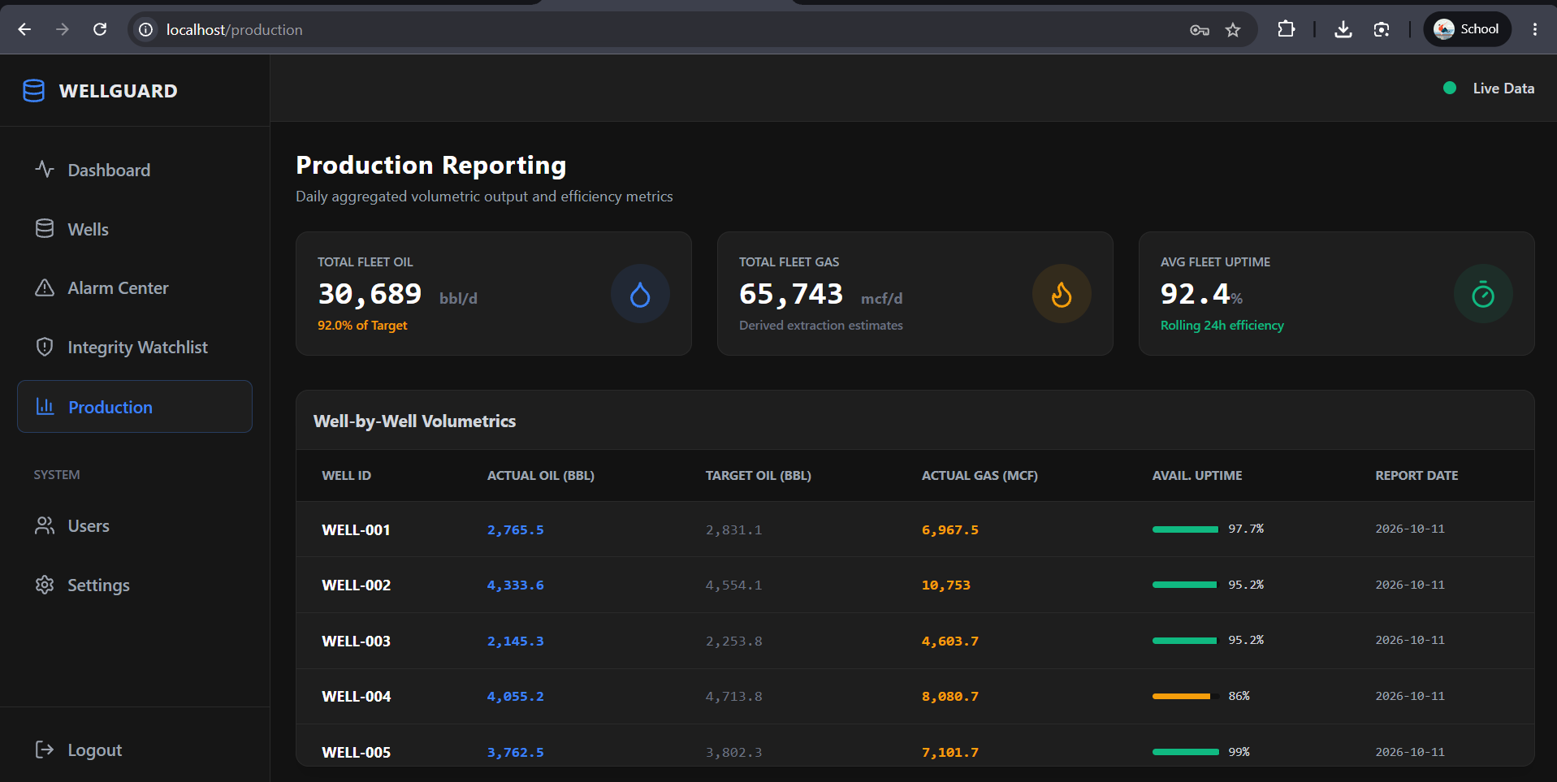
Production

Slide 16
WHAT CHANGES
From driving out to just... checking a screen
24 / 7
1–10s
3
0
Continuous automated watching, instead of periodic manual reads
How often each sensor tag refreshes across the well stock
Pressure zones tracked per well — tubing, casing, annulus A/B/C
Site drives needed just to check a pressure gauge
Warnings go to the field operator, integrity alarms go to the integrity engineer, and anything HSE-level goes straight to the safety team — automatically, based on severity, not on who happens to notice first.
09

Slide 17
Thanks for listening
Happy to answer questions on any part of the build.
Ecrio Internship | React.js + Tailwind CSS | Python + FastAPI

