Slide 1
Creating and deploying an open standard SPI on an FPGA, involving C based test case development for emulation
By Selva Kumar (2022HT80170)
Under the Guidance of
SIVA Selvamani from Qualcomm Pvt. LTD
&
Dr. PAWAN SHARMA from BITS PILANI

Slide 2
OUTLINE:
OUTLINE of this dissertation is to design a simple SoC with a Custom IP (SPI) and required ecosystem to validate the IP and portrait the IP qualification KPIs. It also includes the C based testcases to measure the KPIs and test specifications and testcase development.
to verify the Digital logic, SOC Design will be synthesized for FPGA platform where the gate logics are implemented as close as desired SoC.
The advantage of FPGA based EMUlation is, Execution of testcases will be faster as silicon when compared to DV platform. The only constraint is, it needs some modifications in RTL to meet the timings in the FPGA. these modifications will not affect the functionality of the RTL in the Silicon.

Slide 3
OBJECTIVE:
The objectives of my project are as follows:
Creating a custom SPI IP from Xilinx IP Integrator
Creating an ecosystem to validate this IP
Understanding the hardware specification of IP
Writing a test spec from the Hardware Specification
Creating the testcases to qualify the IP
Collecting the Output waveforms from the Xilinx ILA

Slide 4
Use case of the IP

Slide 5
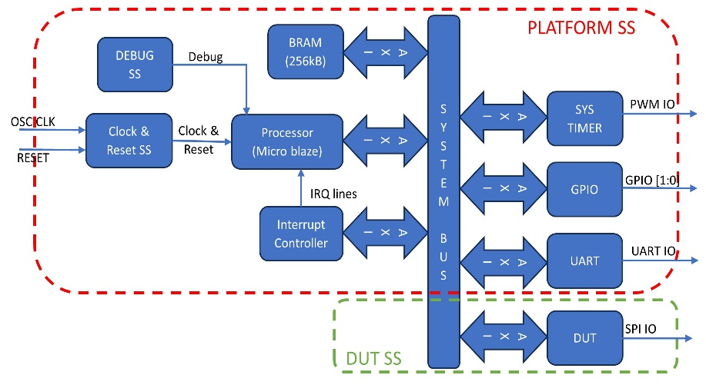
Block Diagram:
Xilinx IP Used | Address map | Size
clk_wiz:6.0\ | NA
microblaze:11.0\ | NA
mdm:3.2\ | NA
proc_sys_reset:5.0\ | NA
axi_gpio:2.0\ | 0x40000000 | 1kB
axi_bram_ctrl:4.1\ | NA
blk_mem_gen:8.4\ | 0xC0000000 | 512kB
xlconcat:2.1\ | NA
axi_intc:4.1\ | 0x41200000 | 1kB
axi_uartlite:2.0\ | 0x40600000 | 1kB
system_ila:1.1\ | NA
axi_timer:2.0\ | 0x41C00000 | 1kB
lmb_v10:3.0\ | 0x00000000 | 16kB
axi_quad_spi:3.2\ | 0x44A00000 | 4kB

Slide 6
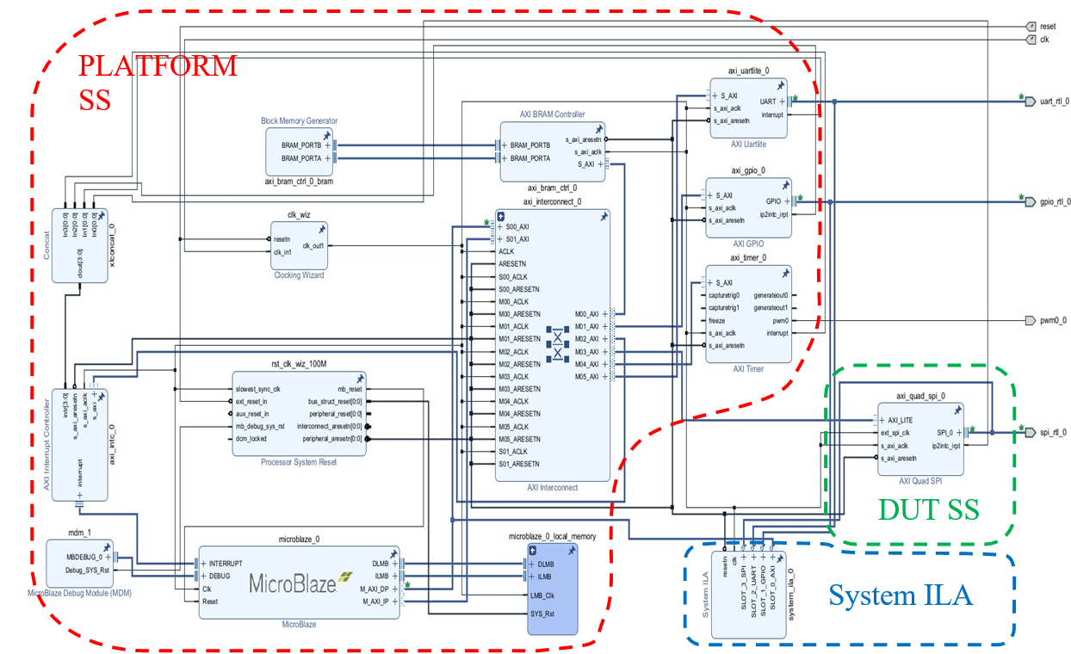
Block Design Implemented in VIVADO

Slide 7
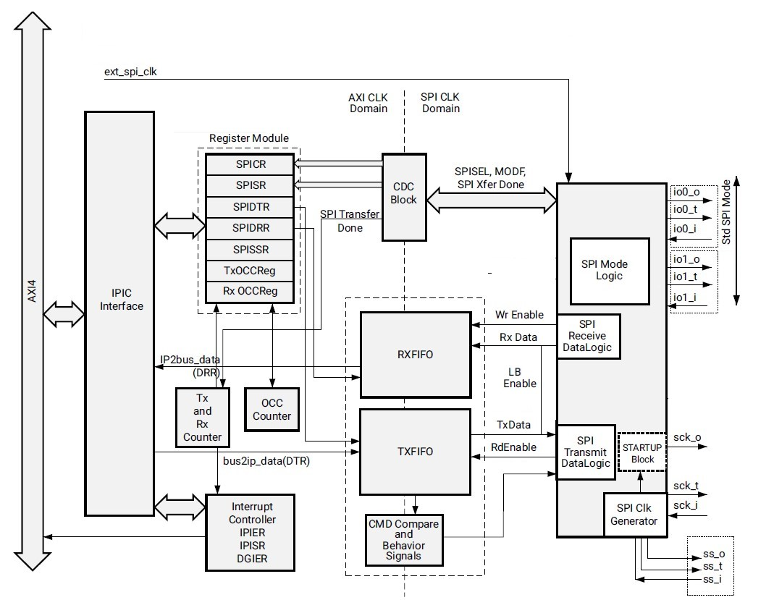
Block Diagram of SPI
DATA FLOW DIAGRAM:
AXI
CSR
FIFO
SPI TRANSIVER
IO LOGIC

Slide 8
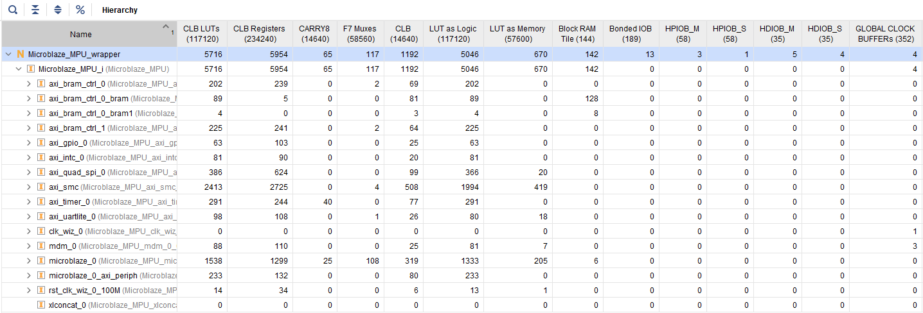
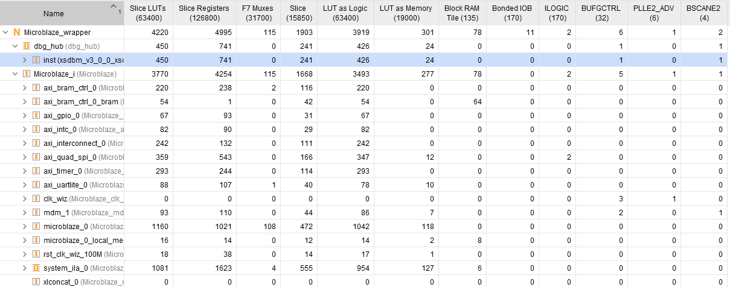
Utilization REPORT
Live board
Demo board

Slide 9
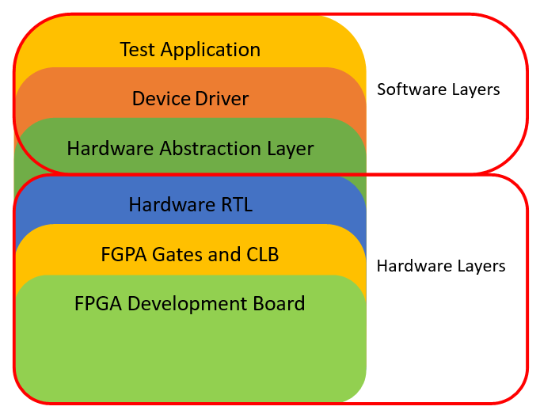
Layers of implementation
Test Application
Sip Loopback and FLASH Testcase
DEVICE DRIVER
SPI IP and FLASH Driver and PLATFORM Drivers
Hardware Abstraction layer
All Register Definition C macros of all IP
RTL
This is the block design generated and Synthesized from VIVADO
FPGA HARWARE:
Real hardware where the bitstream file is flashed
FPGA BOARD
The Board where the FPGA iC is soldered and Connected to Peripherals

Slide 10
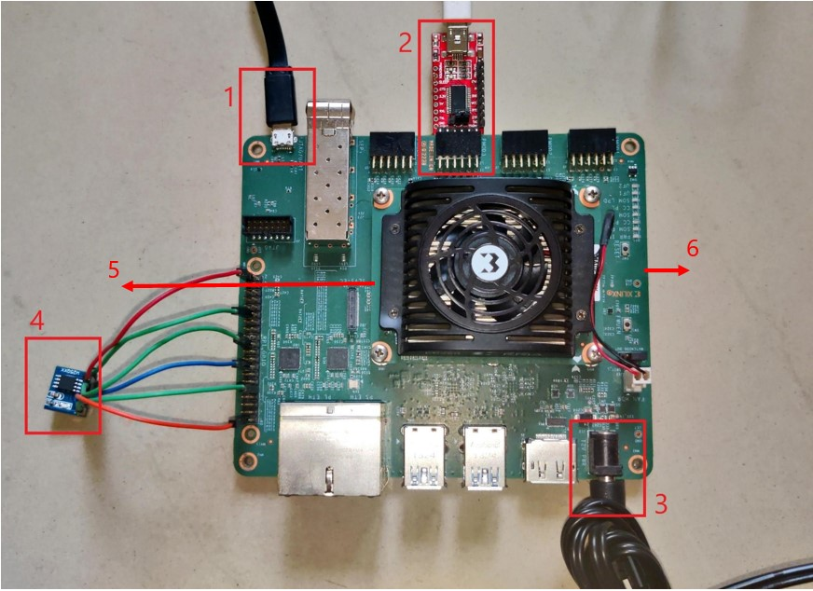
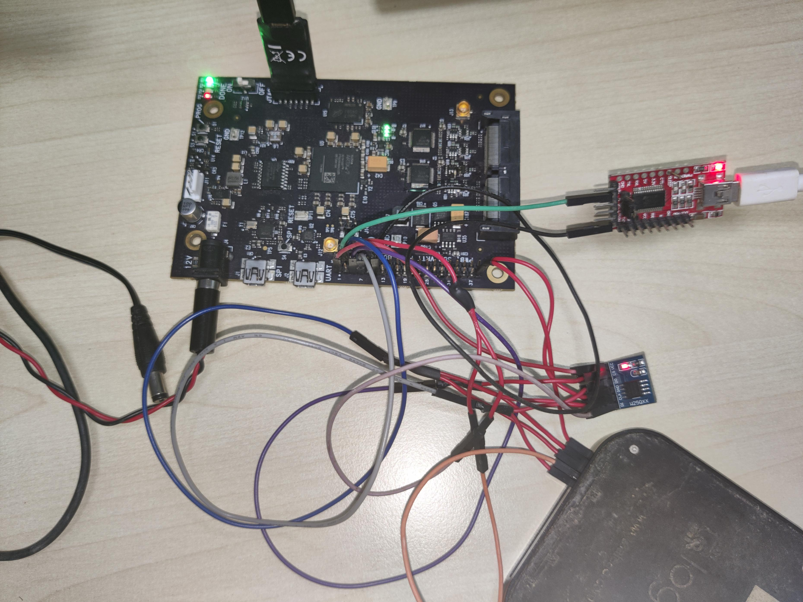
HARDWARE Setups:
Live board
Demo board

Slide 11
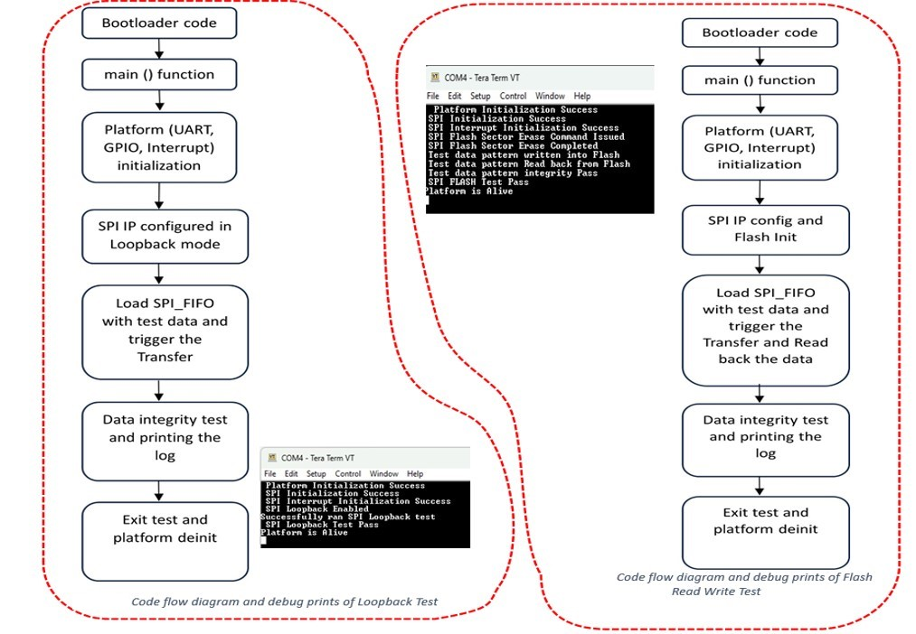
CODEFLOW CHART

Slide 12
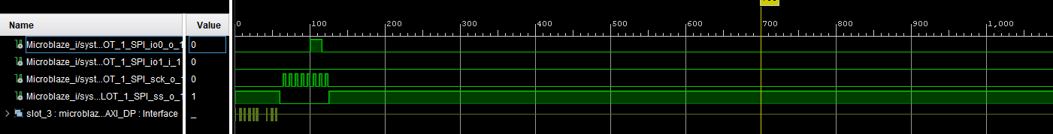
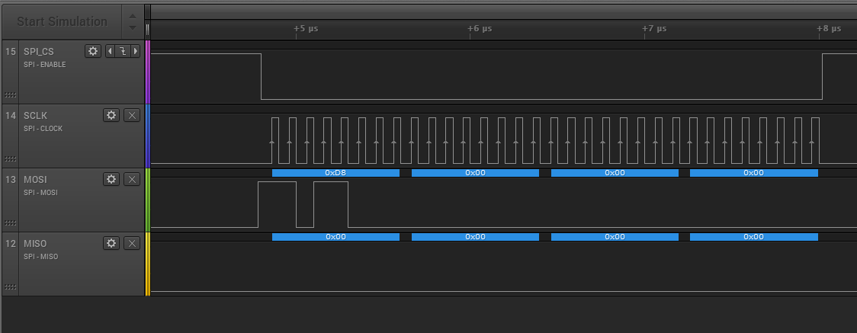
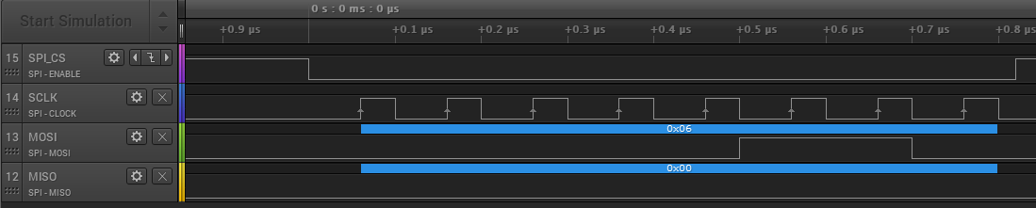
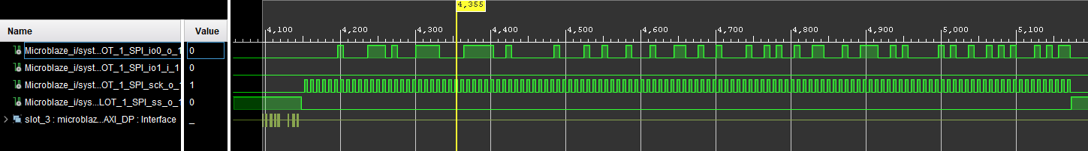
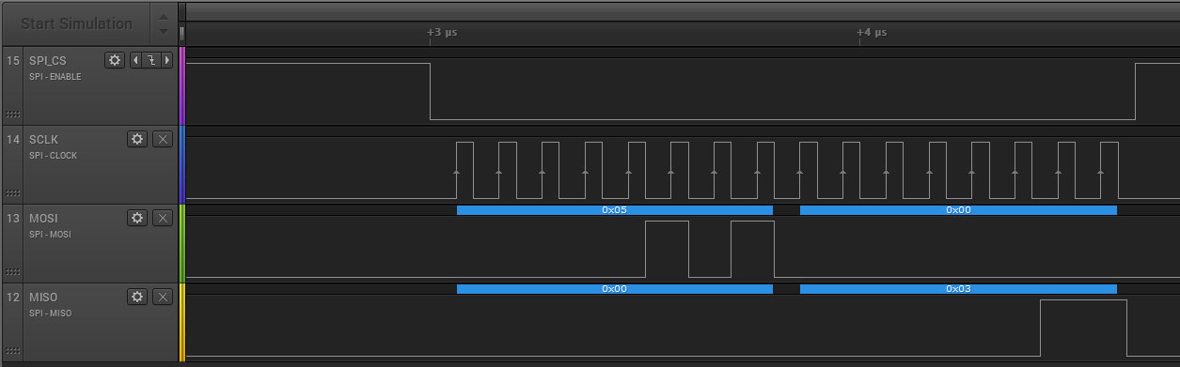
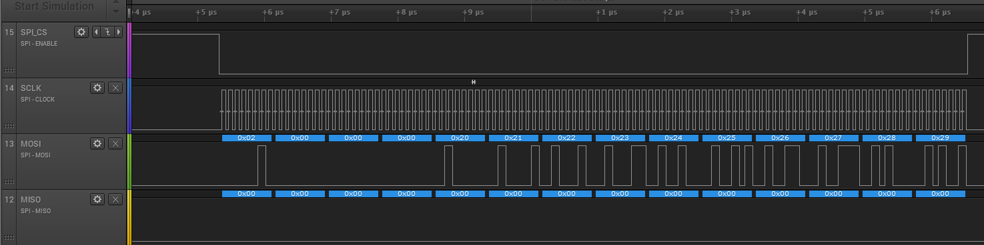
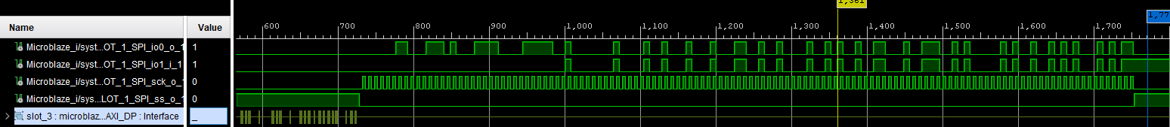
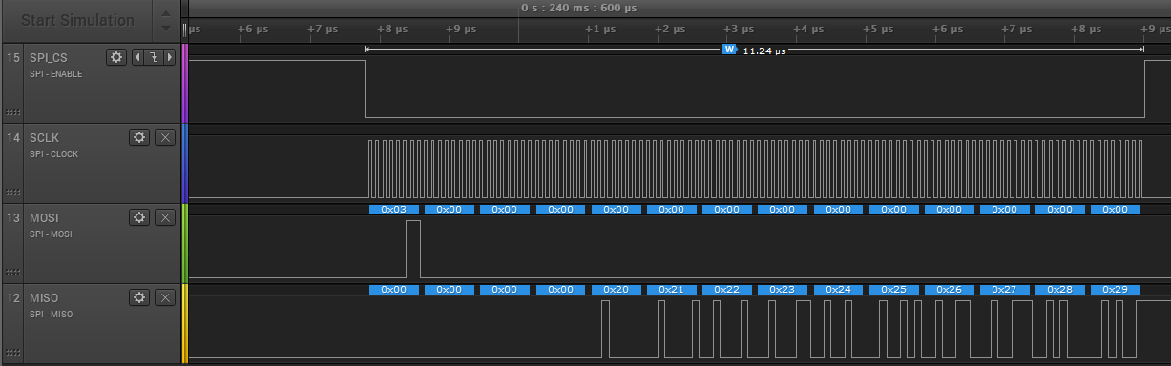
Time [s] | Protocol | Decoded Protocol Result
6E-08 | SPI | MOSI 0x06; MISO 0x00
2.49E-05 | SPI | MOSI 0xD8; MISO: 0x00
2.57E-05 | SPI | MOSI: 0x00; MISO: 0x00
2.65E-05 | SPI | MOSI: 0x00; MISO: 0x00
2.73E-05 | SPI | MOSI: 0x00; MISO: 0x00
5.31E-05 | SPI | MOSI: 0x05; MISO: 0x00
5.39E-05 | SPI | MOSI: 0x00; MISO: 0x03
0.240207 | SPI | MOSI: 0x05; MISO: 0x00
0.240207 | SPI | MOSI: 0x00; MISO: 0x00
0.240222 | SPI | MOSI: 0x06; MISO: 0x00
0.240535 | SPI | MOSI: 0x02; MISO: 0x00
0.240536 | SPI | MOSI: 0x00; MISO: 0x00
0.240537 | SPI | MOSI: 0x00; MISO: 0x00
0.240538 | SPI | MOSI: 0x00; MISO: 0x00
0.240539 | SPI | MOSI: 0x20; MISO: 0x00
0.240539 | SPI | MOSI: 0x21; MISO: 0x00
0.24054 | SPI | MOSI: 0x22; MISO: 0x00
0.240541 | SPI | MOSI: 0x23; MISO: 0x00
0.240542 | SPI | MOSI: 0x24; MISO: 0x00
0.240543 | SPI | MOSI: 0x25; MISO: 0x00
0.240543 | SPI | MOSI: 0x26; MISO: 0x00
0.240544 | SPI | MOSI: 0x27; MISO: 0x00
0.240545 | SPI | MOSI: 0x28; MISO: 0x00
0.240546 | SPI | MOSI: 0x29; MISO: 0x00
0.240598 | SPI | MOSI: 0x03; MISO: 0x00
0.240599 | SPI | MOSI: 0x00; MISO: 0x00
0.240599 | SPI | MOSI: 0x00; MISO: 0x00
0.2406 | SPI | MOSI: 0x00; MISO: 0x00
0.240601 | SPI | MOSI: 0x00; MISO: 0x20
0.240602 | SPI | MOSI: 0x00; MISO: 0x21
0.240603 | SPI | MOSI: 0x00; MISO: 0x22
0.240603 | SPI | MOSI: 0x00; MISO: 0x23
0.240604 | SPI | MOSI: 0x00; MISO: 0x24
0.240605 | SPI | MOSI: 0x00; MISO: 0x25
0.240606 | SPI | MOSI: 0x00; MISO: 0x26
0.240607 | SPI | MOSI: 0x00; MISO: 0x27
0.240607 | SPI | MOSI: 0x00; MISO: 0x28
0.240608 | SPI | MOSI: 0x00; MISO: 0x29

Slide 13
Conclusion:
This project successfully implemented a SPI IP in FPGA platform and developed standalone non-OS C based testcase to test the interface with the SPI Flash.
This Qualifies the IP is suitable for the targeted application of controlling an Industrial grade EtherCAT PHY chip via this SPI master IP.
In Real time application this SPI master is going to control a High speed EtherCAT bus via SPI slave interface provided to it.
As part of this project, tested the code developed and presented the result in different sections.
For demo and results presentation, a different development boards (based on XC7A100T) are used due to resource constraints.

