Slide 1

Puducherry Technological University
Department of Information Technolgy
IT225-SOFTWARE ENGINEERING LABORATORY
RESTAURANT SEAT BOOKING SYSTEM
WITH PRE-FOOD ORDERING,
MESSAGING & PREMIUM FEATURES
Project By
SELVAGANAPATHI S - (2201112039)
SHARMA R – (2201112041)
Date :15-05-2025

Slide 2
Agenda
Abstract
Motivation
Project Objectives
Literature Survey
Inference from Literature Survey
Proposed High Level Architecture
Description of RSBS-PFO-MPF Mini-Project
Decomposition of RSBS-PFO-MPF
Module–I: Seat Booking Module
Module– II: Messaging and Monitoring Module
Module– III: Pre-Food Ordering Module
Results and Discussion
Conclusion with Future Enhancement
References

Slide 3
Abstract
In today’s fast-paced world, Most systems lack smart features like
food pre-ordering,
live booking updates, and
intelligent user engagement.
To overcome these issues, this project introduces a Smart Restaurant Seat Booking System that integrates
live location-based restaurant discovery,
real-time seat selection with premium and non-premium options,
pre ordering of food prior to arrival.
Additionally, it offers automated email and messaging confirmations to enhance communication and reduce manual errors.

Slide 4
Motivation
Efficient restaurant seat booking improves both user satisfaction and restaurant revenue. Traditional booking systems lack real-time updates, pre-ordering food capabilities, and do not offer incentives for booking during low-demand periods.
This system bridges these gaps by offering:
Live nearby restaurant discovery
Dynamic, time-slot based seat booking
Premium seat reservation options during peak hours
Incentives and perks for non-peak hour bookings
Integrated food pre-ordering
Immediate email/message booking confirmations

Slide 5
Literature Survey
Title of Paper | Journal Title with Year of Publication & Author | Technical Description (Base Concept) | Issues/Gaps
Table Booking and Food Ordering System | IJERT, 2021 Priya Sharma et al. | Developed a system for both table booking and food ordering with basic integration between modules. | It do not offer incentives for booking during low-demand periods.
A Real-Time Booking and Food Ordering System Based on Web Services | IJCA, 2020 Rahul Singh, Neha Verma | Emphasized real-time communication and modular API-based ordering. | It lacks of monitoring seat booking status at real time.
A Digital System for Table Booking and Food Ordering in Restaurants | IJIREEICE, 2019 Sushmita Jain et al. | Proposed a unified digital interface for managing restaurant table booking with linked orders. | Inefficiency in tracking of bookings.

Slide 6
Inference From Literature Survey
Literature shows that existing restaurant booking systems suffer from static reservation methods, lack of real-time seat availability updates, absence of location based restaurant discovery, no integration of pre-food ordering options, and delayed booking confirmation.
Research on AI-driven seat optimization demonstrated improvements in allocation efficiency, but lacked real-time location integration. Studies on digital reservation systems confirm enhancements in customer satisfaction, although they did not address dynamic seat visualization or live slot availability.
Based on these inferences, this Restaurant Seat Booking System with Pre-Food Ordering, Messaging & Premium features (RSBS-PFO-MPF) System

Slide 7
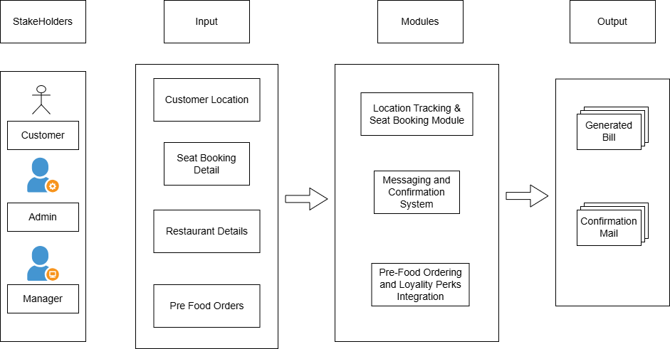
Proposed High Level Architecture

Slide 8
Description of RSBS-PFO-MPF Mini-Project
This project aims to transform traditional restaurant seat reservation into a dynamic, digital system that seamlessly manages seat bookings, displays nearby restaurants based on live user location.
Integrates pre-food ordering, offers premium fast-pass booking during peak hours, and provides instant booking confirmations via messaging or email.
By integrating real-time data management, premium booking options, and automated seat availability tracking.
The system will enable customers to effortlessly find, reserve seats, and pre-order food, while providing restaurants with better operational control and revenue optimization.
The Smart Restaurant Seat Booking System will ensure accurate seat status updates, streamline restaurant operations—benefiting both diners and restaurant administrators.

Slide 9
Module - I
Location Tracking and Seat Booking Module

Slide 10
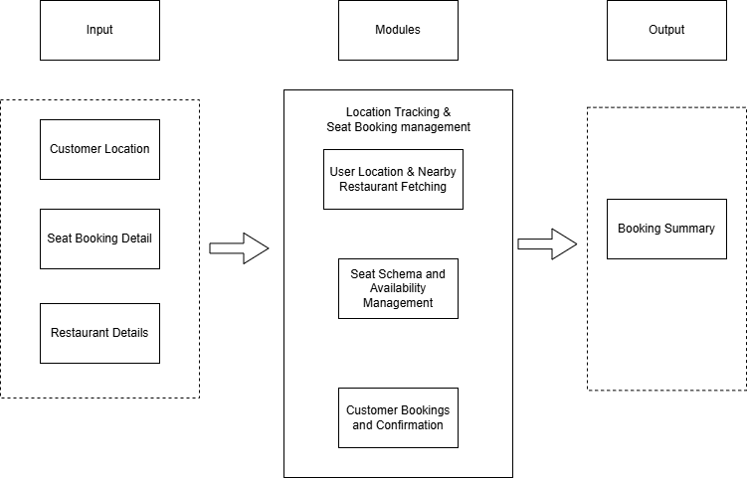
Location Tracking and Seat Booking Module
TASK 1: User Location & Nearby Restaurant Fetching: In this task, the system captures the user's live location and fetches nearby restaurants using the Foursquare API. Restaurants are dynamically displayed on the map with interactive markers and route drawing functionality.
TASK 2: Seat Schema & Availability Management: This task defines the seat schema in MongoDB and initializes default time slots during restaurant data creation. It dynamically updates available seats to prevent overbooking and offers premium fast-pass seat booking options during peak hours.
TASK 3: Customer Booking and Confirmation: Here, the system collects customer booking details, validates inputs, and stores them securely in MongoDB and OracleDB. It provides a booking summary view for users to confirm or modify before finalizing the seat reservation.

Slide 11
Module - II
Messaging and Confirmation System

Slide 12
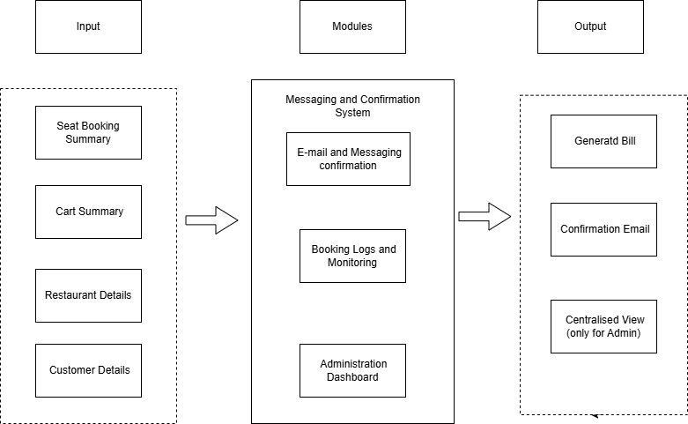
Messaging and Confirmation System
TASK 1: Email and SMS Confirmation: This task involves setting up Nodemailer for sending booking confirmation emails and optionally integrating Twilio to send real-time booking confirmations via SMS for better communication.
TASK 2: Booking Logs and Monitoring: The system stores all booking histories and messaging logs separately. It provides admin access to monitor booking statuses, retry failed notifications, and ensure messaging reliability during critical operations.
TASK 3: Administration Dashboard: The administration dashboard will provide restaurant owners and managers a centralized view of all bookings, food orders, and seat availability. It will allow admins to manage time slots, update seat capacity, monitor booking trends, handle premium bookings, and review messaging status in real-time.
5/15/2025

Slide 13
Module - III
Pre-Food Ordering and Loyalty Perks Integration

Slide 14
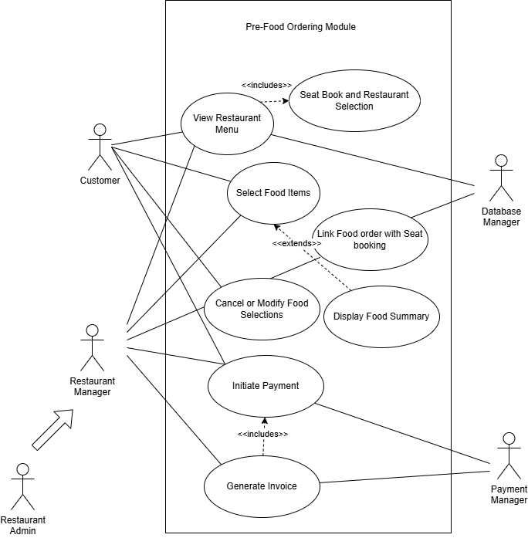
Pre-Food Ordering and Loyalty Perks Integration
TASK 1: Menu Listing and Selection: This task fetches the restaurant menu, displays food items for customers to browse, and allows users to select multiple items to add to their cart, dynamically updating the total price.
TASK 2: Food Order Linking with Seat Booking: The selected food orders are linked with the seat booking records in MongoDB. Food order summaries are displayed along with the seat booking details for user review before final confirmation.
TASK 3: Pre-Food Payment Integration : The system plans to integrate payment gateways like Stripe or Razorpay to allow full online payment. It will also auto-generate invoice receipts and handle cancellation or refund processes in future enhancements.
5/15/2025

Slide 15
INPUT AND OUTPUT SCREENSHOTS

Slide 16
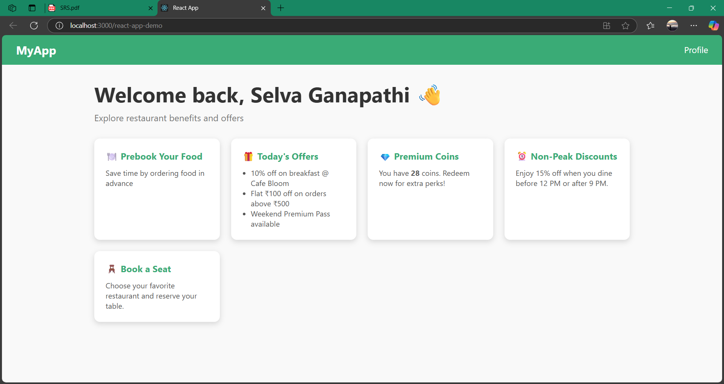
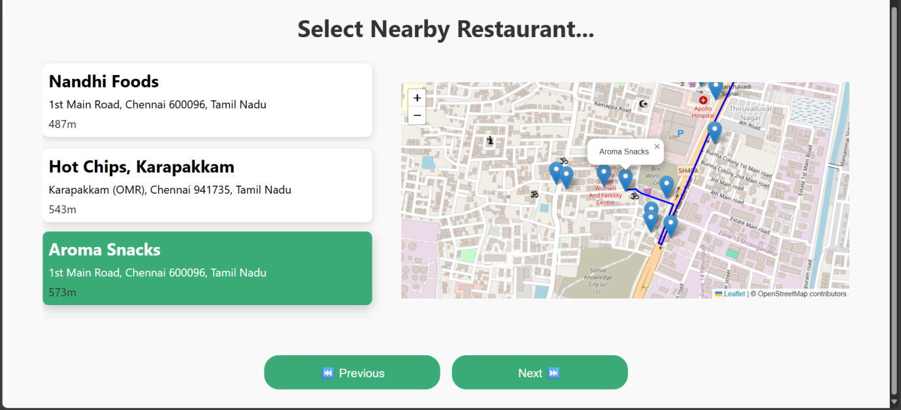
Module - I Location Tracking and Seat Booking Module

Slide 17
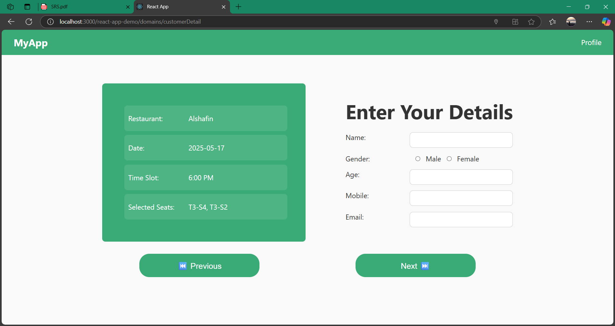
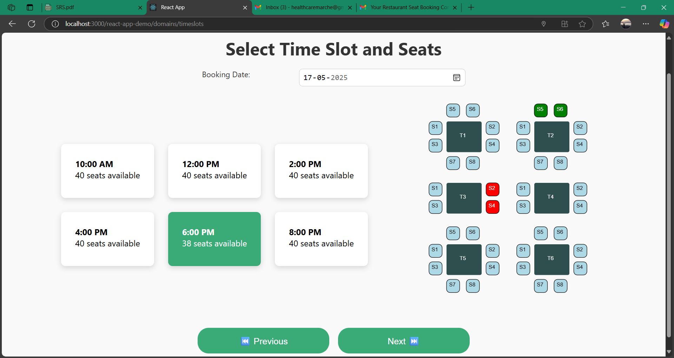
Module - I Location Tracking and Seat Booking Module

Slide 18
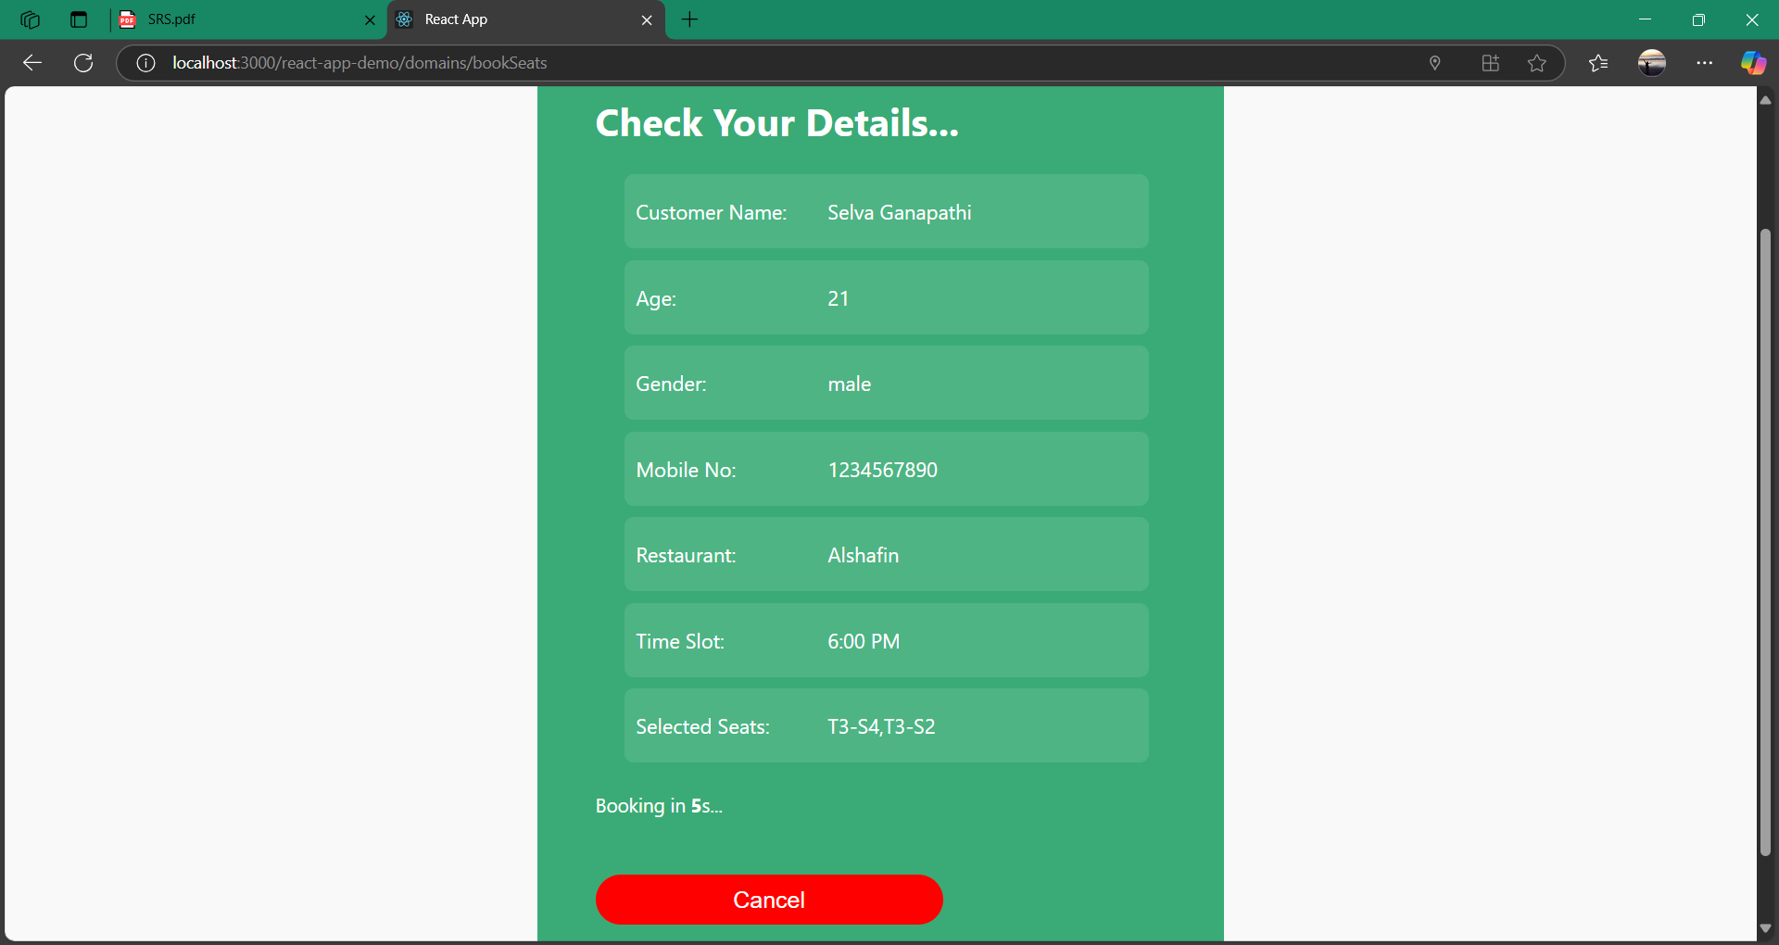
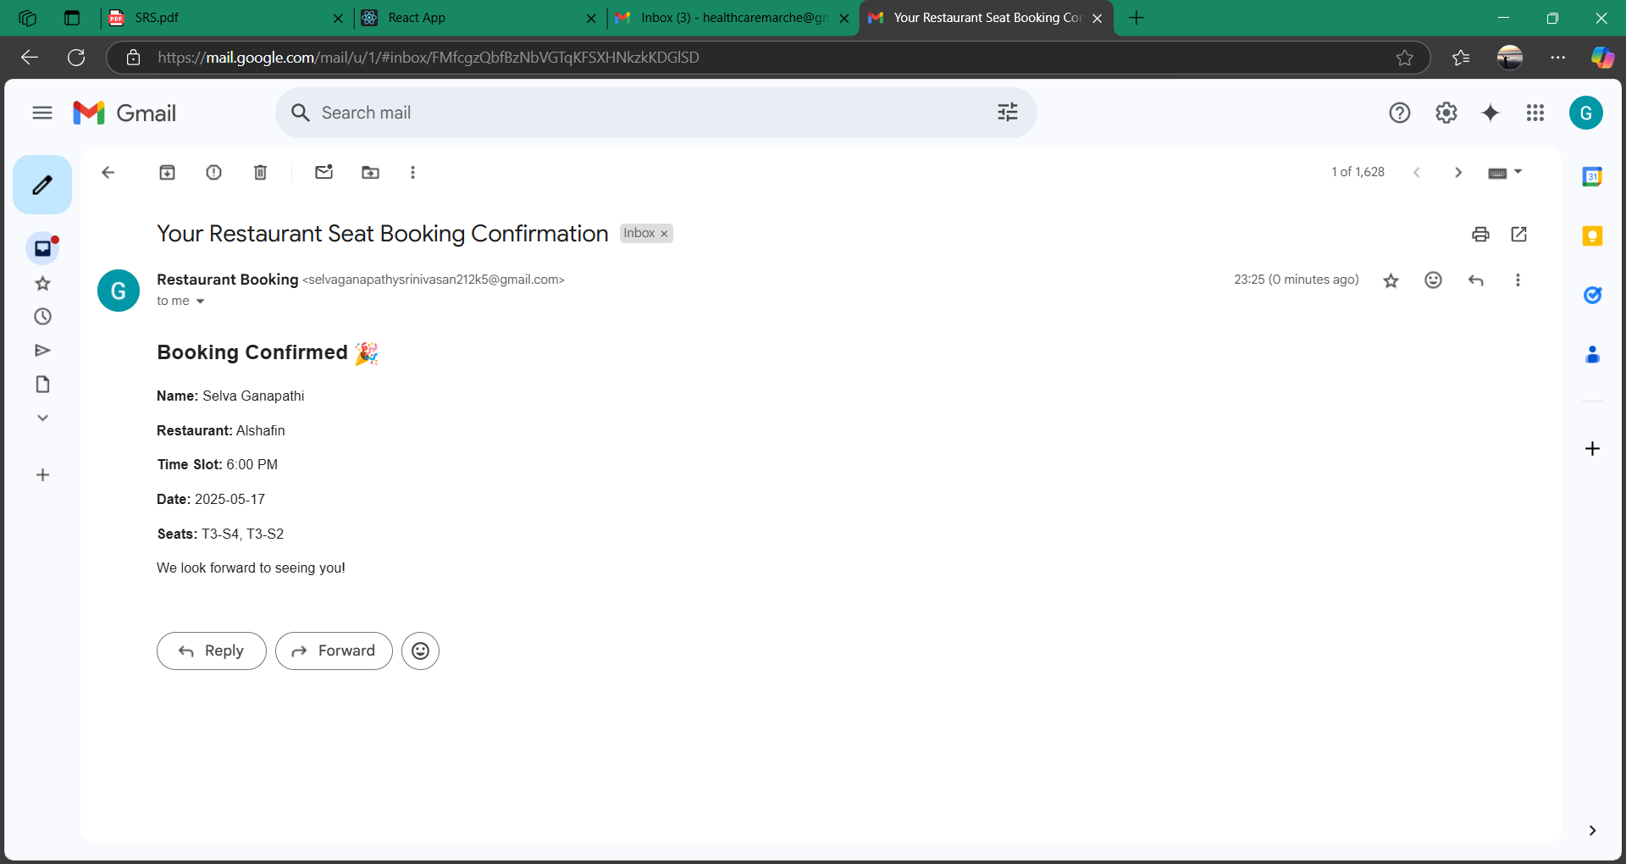
Module - II Messaging and Confirmation System

Slide 19
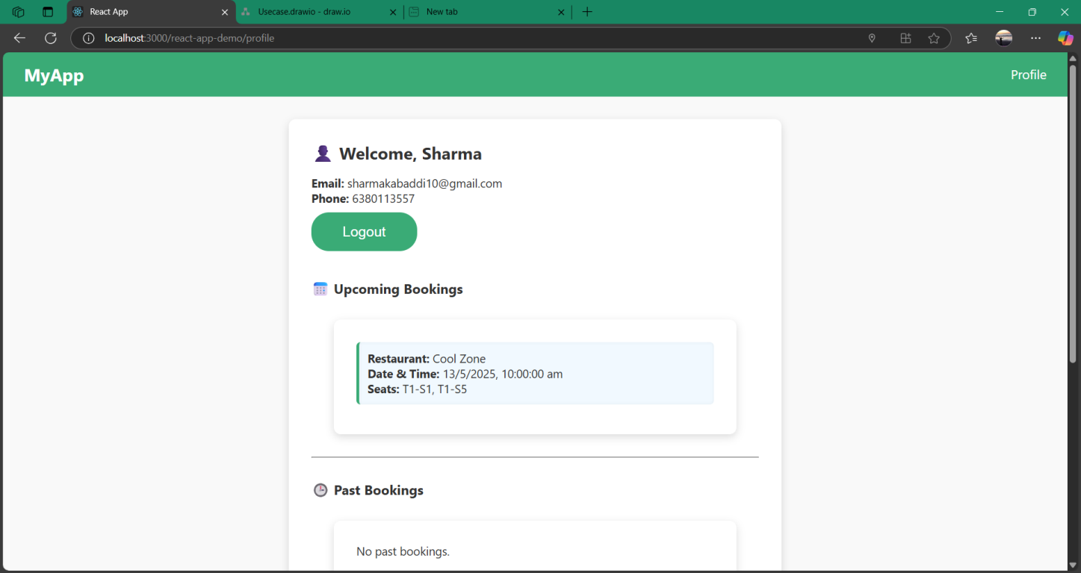
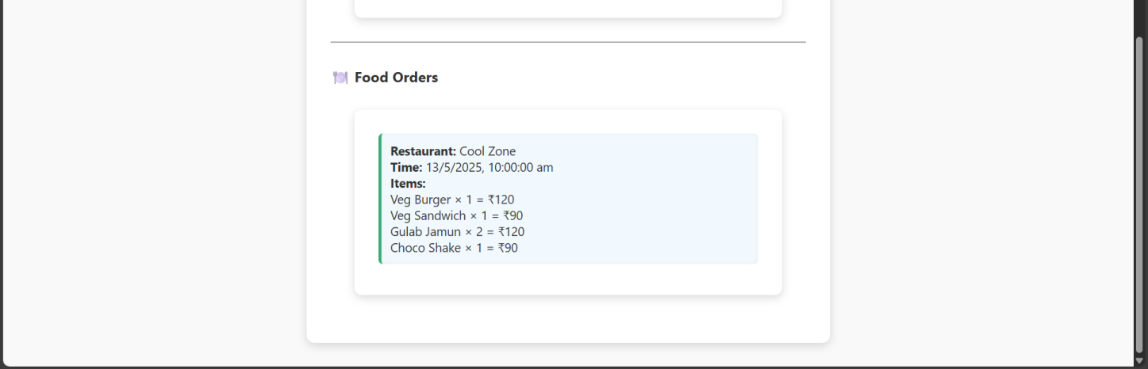
Module - II Messaging and Confirmation System

Slide 20
Results and Discussions
The implementation of the "Restaurant Seat Booking System with Pre-Food Ordering, Messaging & Premium Features" project successfully demonstrated robust performance in managing dynamic reservations and enhancing the customer experience. The core booking engine accurately processed real-time seat availability, prevented overbooking, and supported time-slot-based reservations, improving operational efficiency for restaurant owners. Pre-food ordering allowed users to plan meals in advance, reducing wait times and enabling better kitchen preparation workflows. Additionally, the system’s integration with email and SMS messaging ensured timely confirmations, enhancing user trust and engagement. Premium features such as fast-pass booking and loyalty perks during non-peak hours incentivized user retention and added business value. Testing showed seamless module interaction—from location-based restaurant discovery to final booking confirmation. Feedback from mock users highlighted ease of use, a modern interface, and the convenience of booking and ordering in one platform. Overall, the project met its goal of offering a unified, intelligent, and scalable solution for modern restaurant operations.
5/15/2025

Slide 21
Conclusion with Future Enhancement
The Restaurant Seat Booking System with Pre-Food Ordering, Messaging & Premium Features provides a complete digital solution for streamlining reservations, enhancing dining experiences, and modernizing restaurant management. With integrated modules for seat booking, advanced food pre ordering, and real-time messaging, the system effectively bridges customer expectations with backend efficiency. By offering premium features like fast pass reservations and dynamic loyalty perks, the platform goes beyond basic booking systems to support user satisfaction and business growth. Looking forward, several enhancements could elevate the system further. Integrating AI-based recommendation engines for seat and food suggestions could personalize the experience. Real-time analytics dashboards for restaurant owners could aid in demand forecasting and trend analysis. Expanding messaging to include push notifications via a mobile app would improve accessibility. Additionally, payment gateway integration would allow end-to-end booking and payment flow. Future modules may also include table service feedback, voice assistant ordering, and integration with third-party food delivery APIs, making the platform even more competitive in the evolving restaurant tech landscape.
5/15/2025

Slide 22
REFERENCES
1. A. Alamin, A. A. Alghamdi and F. A. Alabdulqader, "Smart Restaurant Reservation System using Internet of Things (IoT)," International Journal of Advanced Computer Science and Applications (IJACSA), vol. 11, no. 2, pp. 528–533, 2020. doi: 10.14569/IJACSA.2020.0110265.
2. A. Nasser, S. El-Haggar and H. Nassar, "Optimizing Restaurant Table Reservations Using Genetic Algorithms," International Conference on Advanced Intelligent Systems and Informatics, Springer, pp. 134–142, 2019. doi: 10.1007/978-3-030-31129-2_12.
3. A. S. Al-Jabri, "Customer Preferences in Online Restaurant Reservations: A Data Mining Approach," Procedia Computer Science, vol. 164, pp. 604–610, 2019. doi: 10.1016/j.procs.2019.12.225.
4. B. M. Lamba and D. N. Patel, "Table Booking and Food Ordering System," International Journal of Innovative Research in Computer and Communication Engineering (IJIRCCE), vol. 5, no. 4, pp. 7293–7296, 2017.
5. C. Li and D. Liu, "A Real-Time Booking and Food Ordering System Based on Web Services," IEEE International Conference on Computer and Communications (ICCC), Chengdu, China, pp. 973–978, 2018. doi: 10.1109/CompComm.2018.8781035.
6. H. C. Lin, Y. T. Lee and C. Y. Wu, "A Smart Restaurant System Using Mobile and Wireless Networks," International Journal of Computer and Communication Engineering, vol. 2, no. 3, pp. 324–328, 2013. doi: 10.7763/IJCCE.2013.V2.203. 7. K. H. Ho and C. H. Lin, "Design a

Slide 23
REFERENCES(cont..)
7. K. H. Ho and C. H. Lin, "Design and Implementation of an Online Restaurant Booking System Using Cloud Computing," International Journal of Engineering and Technology, vol. 7, no. 3, pp. 123–127, 2018. doi: 10.14419/ijet.v7i3.34.20068.
8. M. A. Khan, S. Alam and A. Imran, "A Digital System for Table Booking and Food Ordering in Restaurants," International Journal of Scientific & Engineering Research, vol. 9, no. 5, pp. 547–550, 2018.
9. M. Hossain and S. R. Ahmed, "Food Ordering and Reservation System Using Mobile Application," International Journal of Computer Applications, vol. 180, no. 34, pp. 9–13, 2018. doi: 10.5120/ijca2018917114.
10. M. Mahmud and N. F. Haider, "A Study on the Development of an Intelligent Restaurant Management System," International Conference on Computing, Communication and Automation (ICCCA), pp. 192–197, 2017. doi: 10.1109/CCAA.2017.8229852.

Slide 24
REFERENCES(cont..)
11. N. H. Nguyen and D. H. Nguyen, "Development of an Online Restaurant Booking and Food Ordering System," IEEE Conference on Information Technology, Electronics and Mobile Communication (IEMCON), pp. 1–6, 2016. doi: 10.1109/IEMCON.2016.7746311.
12. R. Jadhav and A. Joshi, "Mobile Based Food Ordering System with Real Time Restaurant Menu and Customer Feedback," International Journal of Advanced Research in Computer Science, vol. 8, no. 5, pp. 100–105, 2017.
13. R. U. Khan and M. Khan, "IoT-Based Smart Restaurant Management System," IEEE 4th World Forum on Internet of Things (WF-IoT), pp. 457462, 2018. doi: 10.1109/WF-IoT.2018.8355218.
14. S. Jain, R. Dubey and A. Mehra, "Smart E-Restaurant Using Android System," International Journal of Computer Applications, vol. 133, no. 7, pp. 6–10, 2016. doi: 10.5120/ijca2016908474.
15. V. Gupta and P. Singh, "A Review on Digital Restaurant Management Systems," International Journal of Engineering Research & Technology (IJERT), vol. 6, no. 6, pp. 233–236, 2017.

Slide 25
THANK YOU

