Slide 1
Use Your Opportunities wisely
Selvamurugan S B
2014239022
M.Sc. Computer Science

Slide 2
Objective
The theme of the project is to show how one should use their opportunities wisely.
The story will make us realize even a small opportunities are so valuable in our life and how we must make use of it and we must make use of with what we have rather than complaining about that we don’t have enough.

Slide 3
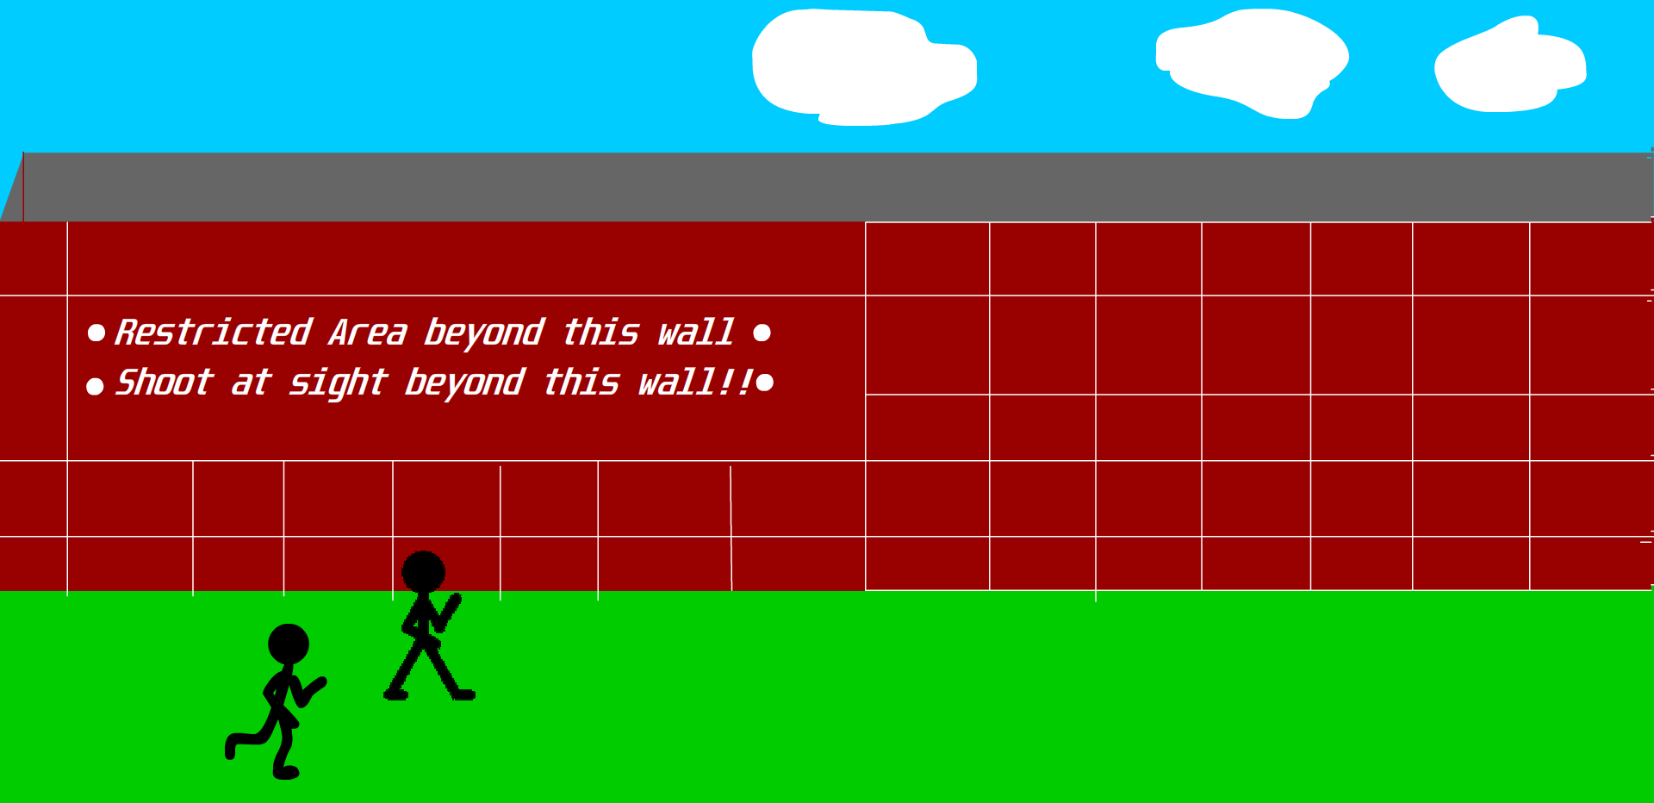
Motion created using series of symbols of stickman character.

Slide 4
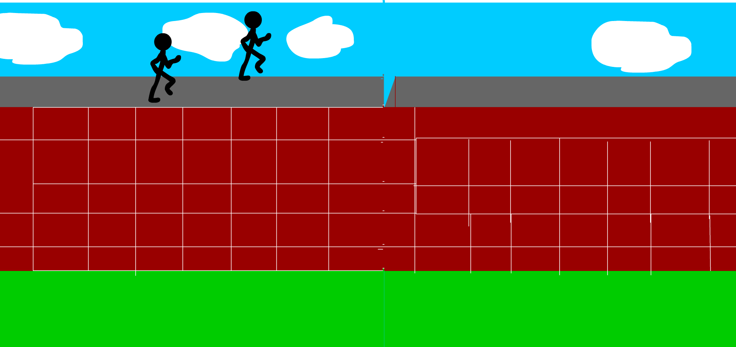
Motion tween of the background gives the animation feel of moving characters.

Slide 5
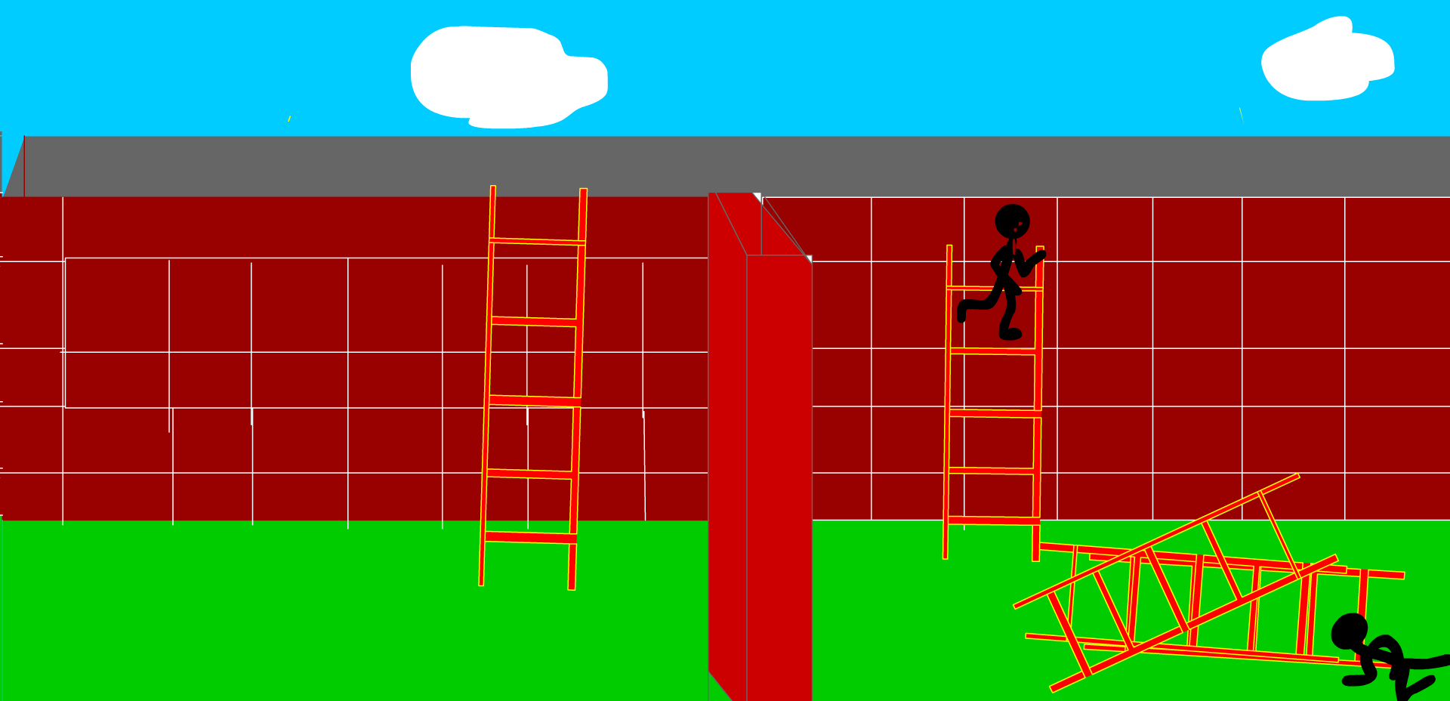
Escape Scene

Slide 6
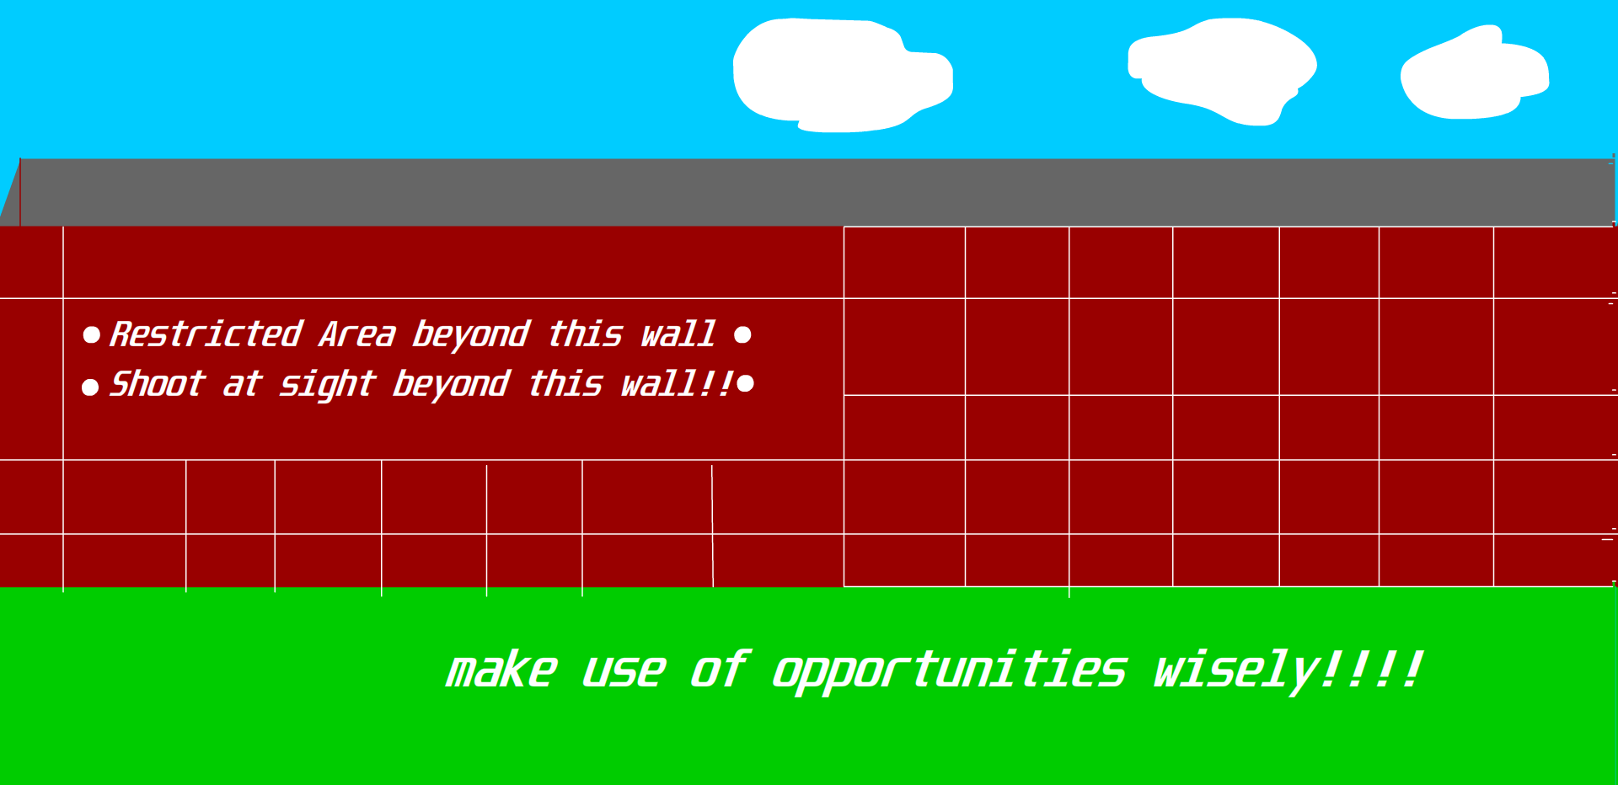
“Make use of opportunities wisely”

Slide 7
Tools and Technologies Used
In the first frame the title card is displayed and then in the next frame background wall is displayed.
The running of character is done by creating a motion tween for the background images and then changing the series of images for the character which results the motion of the character.
The symbols are used for characters and ladders in the story.
Dialogues are shown using the text and certain other features also used for animation purpose.

Slide 8
Story Of The Project.
The is a huge wall, beyond this wall is restricted area and those who trespass the wall will shoot at sight.
Two boys looking at the wall decided to play a dare of running on the wall but they unfortunately fell beyond the wall.
Both of them praying to god for one last opportunity to save their lives.
For one boy god provides one ladder alone and for another one he gives 5-6 ladders.
The boy with many ladders don’t know how to use it and he started crying and meanwhile the boys with one ladder thinking calmly he used the ladder in right way and he escaped.

Slide 9
Story (Contd):
A enemy started shooting at him and then suddenly the boy throws a ladder at him and the he uses ladder and he escaped and finally he realized it does matter how many opportunities we have if we did not use it wisely the consequence will be bad.
MORAL: “ONE MUST MAKE USE OF THEIR OPPORTUNITIES WISELY”

